Slide 1
Polar coordinates
Lecture (1)
Lecture by Rabab A.Hameed

Slide 2
1- Definition of Polar Coordinates
The coordinate of any point can be representing by polar form or in terms of pair (r, θ). Fix an origin O (called the pole) and an initial ray (x-axis) from O. Then each point P can be located by assigning to it a polar coordinate pair (r, θ) as shown in figure1 below in which r gives the directed distance from origin O to P and θ gives the directed angle from the initial ray (x-axis) to ray OP.

Slide 3
- θ is (+ve ) if it is measured counter clock wise.
- θ is (-ve ) if it is measured clock wise

Slide 4
Representation of any point by polar coordinates starts by drawing ray of the angle (θ), then specify the point on the ray according to value of r.
The negative value of r means that the distance (OP) is in opposite direction of angle ray. Fig.2

Slide 5
In the Cartesian coordinate system (x,y) every point has only one representation, but in the polar coordinate system each point has infinitely many pairs of polar coordinates due to multi cycles of this angle, therefore:-
θ= θ ± 2nπ
Also (r, θ) = (-r, θ ± π)

Slide 7
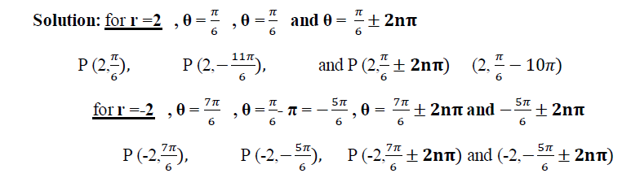
Example: Find all the polar coordinates of the point P (2,𝜋/6)

Slide 8
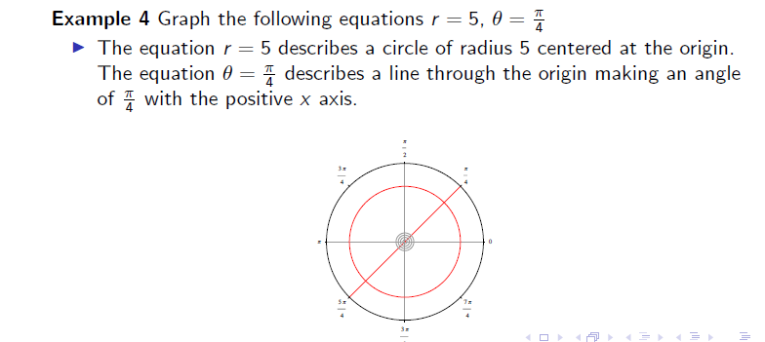

Slide 9
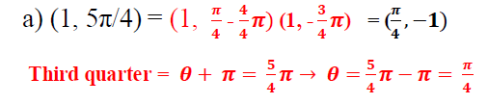
Example 6: Plot the points for the following polar coordinates:
(a) (1, 5π/4) (b) (2, 3 π)

Slide 10
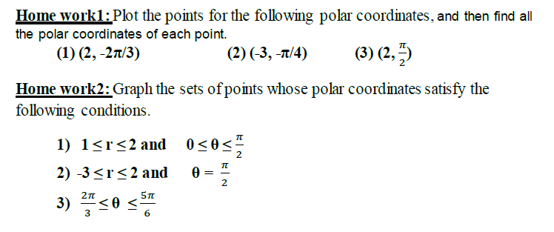

Slide 11
2- Relating Polar and Cartesian Coordinates

Slide 12
Example3: Convert the point (2; π/3) from polar to Cartesian coordinates.
Therefore, the point is (1,√3) in Cartesian coordinates.

Slide 13

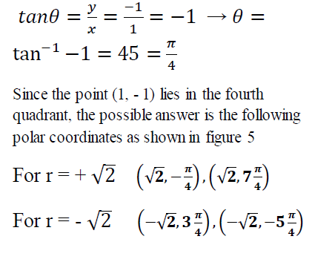
Example 4: Represent the point with Cartesian coordinates (1, - 1) in terms of polar coordinates.

Slide 14
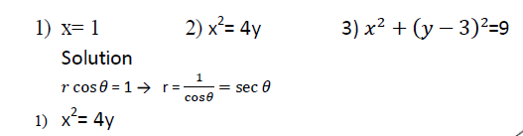
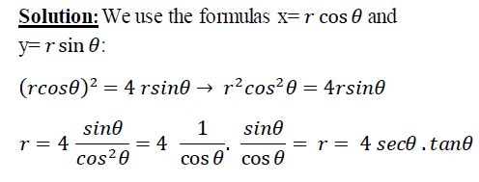
Example 5: Replace the following Cartesian equations by equivalent polar equations.

Slide 15
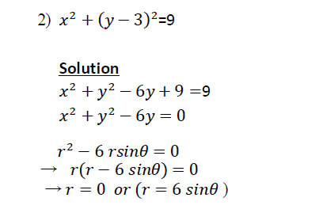

Slide 16
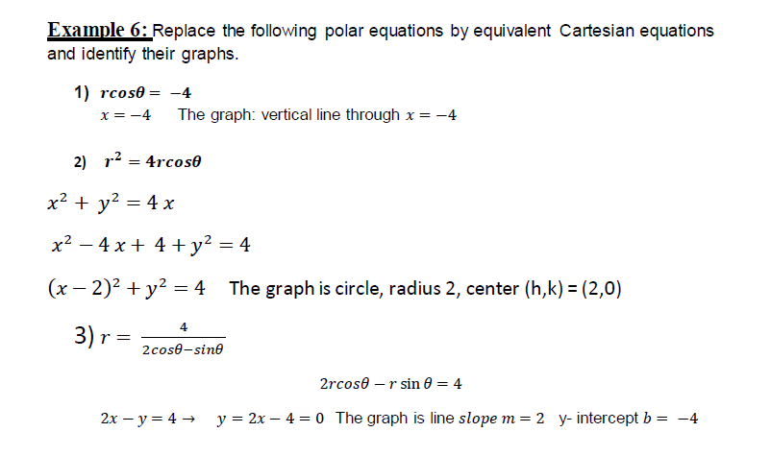

Slide 17
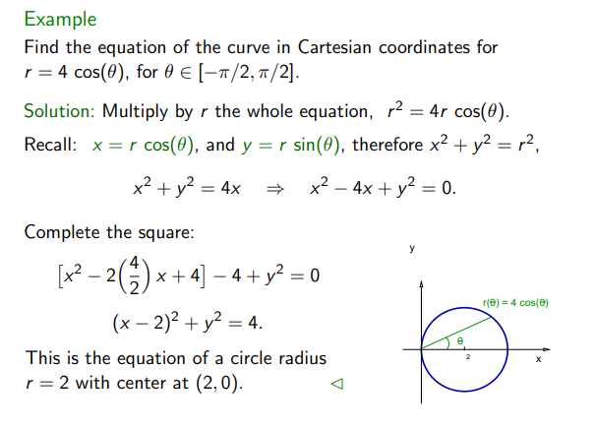

Slide 18
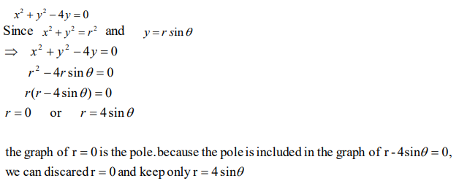
Example :- Converting an equation from Cartesian form to polar form

Slide 19
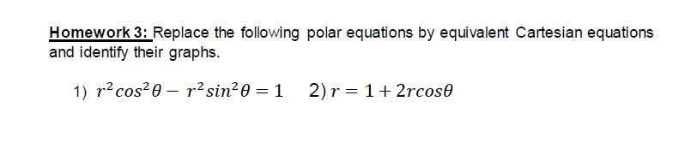

Slide 20
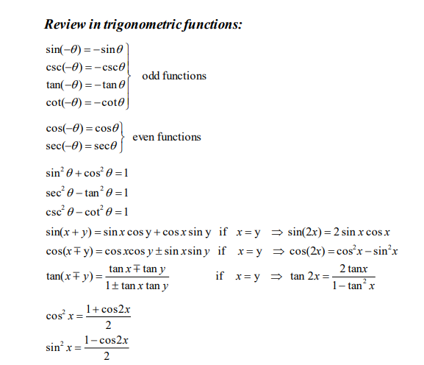

Slide 21
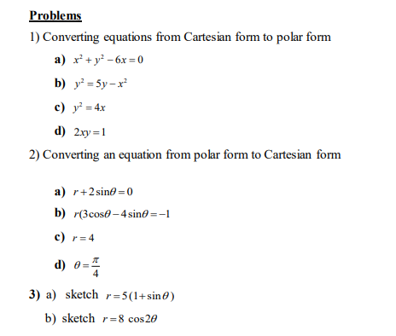

Slide 22





Slide 23
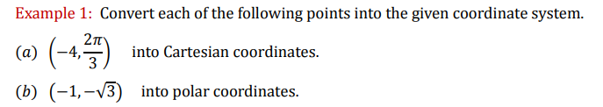

Slide 24
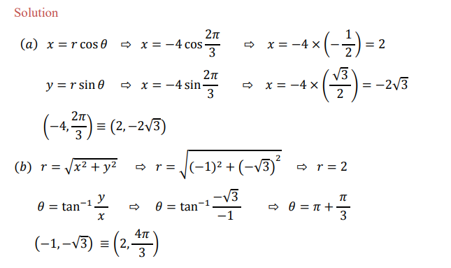

Slide 25
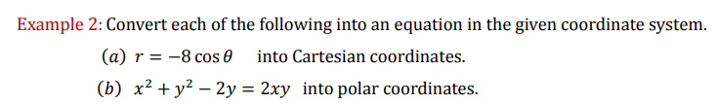

Slide 26
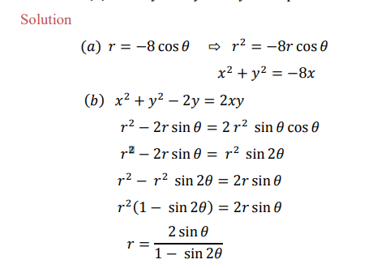

Slide 27
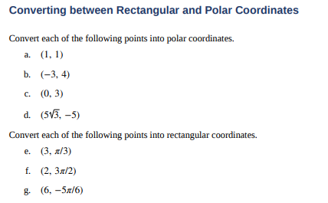

Slide 28
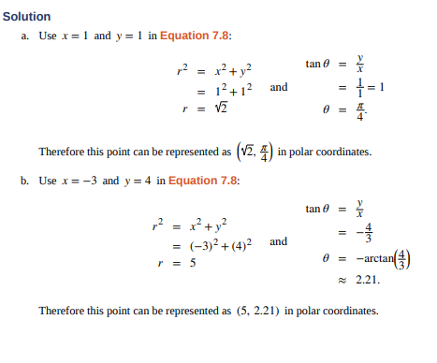

Slide 29
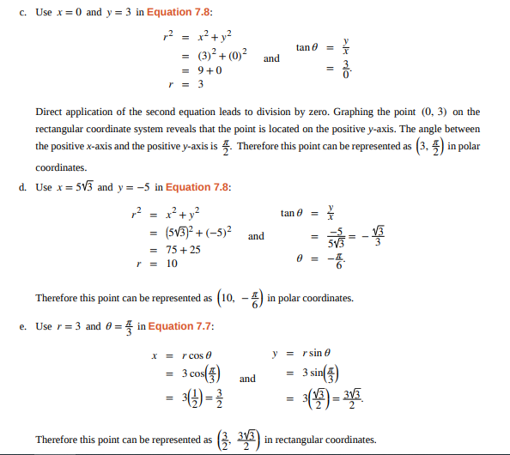

Slide 30
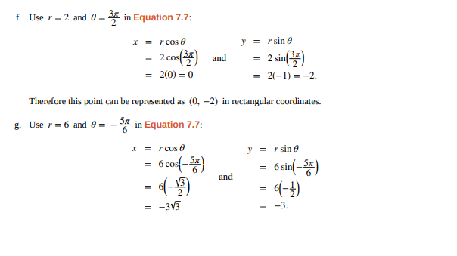

Slide 31
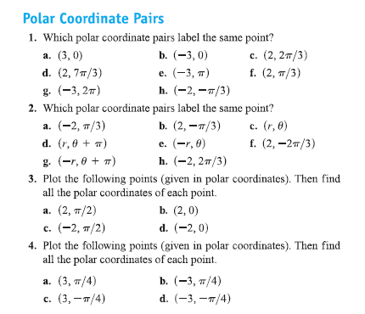
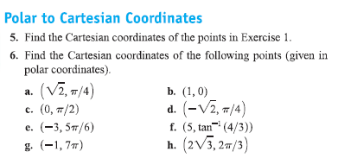
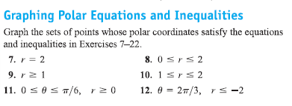

Slide 32
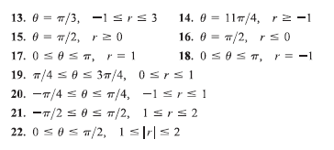
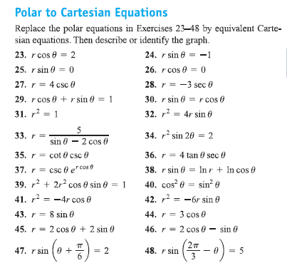

Slide 33
