Slide 1
Toxoplasma gondii (Tissue Sporozoa)
Dr. Maysoon A.Merdaw

Slide 2
Phylum: Apicomplexa Class: Coccidea
Has a worldwide distribution, infecting a wide range of animals and birds. Members of the cat family (Felidae) are the definitive hosts; many mammals and birds serve as intermediate hosts.

Slide 3
Transmission
T. gondii is transmitted by three known modes: congenitally, through the consumption of undercooked infected meat, and ingestion of food or drinks contaminated with cat’s feces, ---------?
Cats acquire Toxoplasma infection by ingesting any of three infectious stages of the organism: the rapidly multiplying forms called tachyzoites, the quiescent bradyzoites from tissue cysts in the flesh of other animals (mostly rodents), and sporozoites from oocysts shed in cat feces.
Successful infection of the cat is revealed by the shedding of oocysts in the feces.

Slide 4
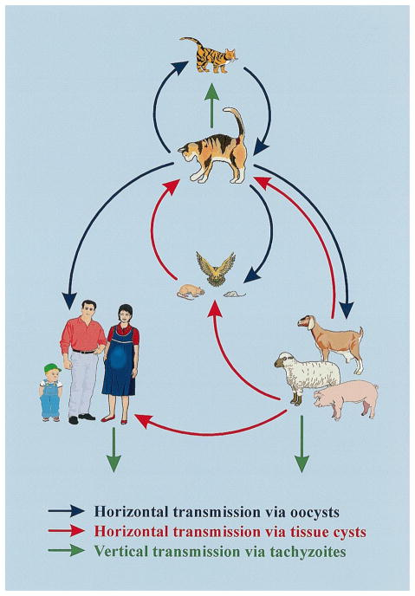
Major routes of transmission of T. gondii.

Slide 5
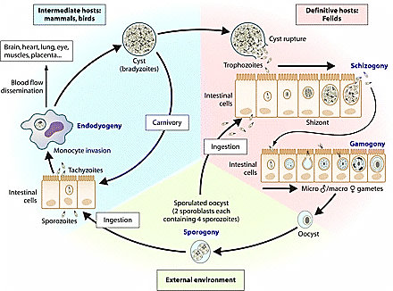
Life cycle of Toxoplasma gondii

Slide 6
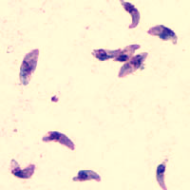
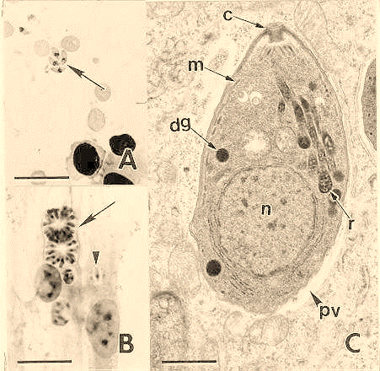
Tachyzoites of T gondii

Slide 7
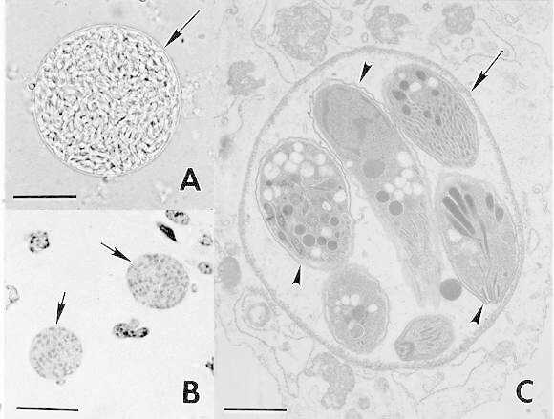
The tissue cysts (formerly called pseudocysts) are infective when ingested by cats (resulting in the intestinal sexual stage and oocyst production); when they are eaten by other animals, more tissue cysts are produced (asexually).
tissue cysts in section of brain

Slide 8
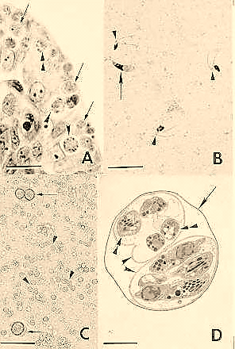
sporulated oocyst

Slide 9
Pathogenesis
The organism in humans produces either congenital or postnatal toxoplasmosis.
Congenital infection, which develops only when nonimmune mothers are infected during pregnancy, is usually of great severity.
postnatal toxoplasmosis is usually much less severe. Most human infections are asymptomatic.
Varying degrees of disease may occur in immunosuppressed individuals, resulting in retinitis or chorioretinitis, encephalitis, pneumonitis, or various other conditions.

Slide 10
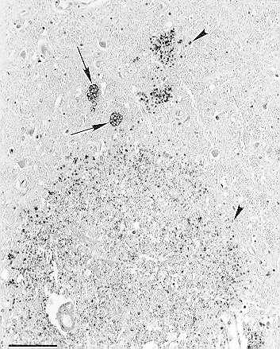
large focus of necrosis, 2 tissue cysts (arrows) and numerous tachyzoites
Section of brain with fatal toxoplasmosis

Slide 11
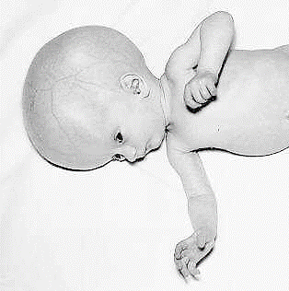
-The tachyzoite directly destroys cells and has a preference for parenchymal cells and those of the reticuloendothelial system.
- When a tissue cyst ruptures, releasing numerous bradyzoites, a local hypersensitivity reaction may cause inflammation, blockage of blood vessels, and cell death near the damaged cyst.
- Congenital infection leads to stillbirths, chorioretinitis, intracerebral calcifications, and hydrocephaly or microcephaly.

Slide 12
Diagnosis
serologic testing, amniocentesis (prenatal diagnosis of chromosomal abnormalities and fetal infections), PCR, or by the presence of abnormal ultrasound findings.
Treatment
Toxoplasma infection in healthy immunocompetent individuals is hardly detected and or treated.
The related symptoms are usually resolved in a few weeks or months. However, treatments are required in unresolved (after 2 to 4 weeks) or severe cases as well as, in immunosuppressed and HIV/AID and congenital toxoplasmosis.
The commonly used Pyrimethamine (Daraprim), Sulfonamides, Spiramycin and may use combination drugs. No killed vaccine is currently available

Slide 13
Epidemiology
-Avoidance of human contact with cat feces is clearly important in control.
-Pregnant women should avoid all contact with cats.
-An equally important source of human exposure is raw or undercooked meat, in which infective tissue cysts are frequently found. Freezing meat at –20°C for 48 hours or heating to 50°C for 4–6 minutes will provide sterilization.
-Periodic serologic screening for IgG and IgM antibodies to Toxoplasma is recommended.

Slide 14
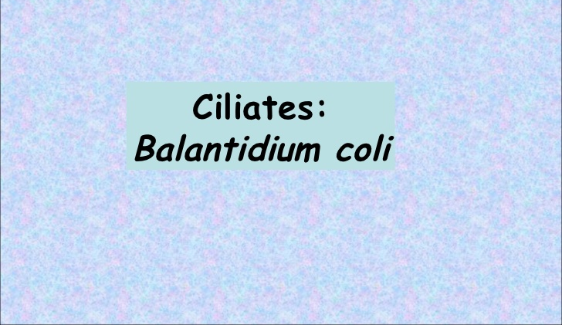

Slide 15
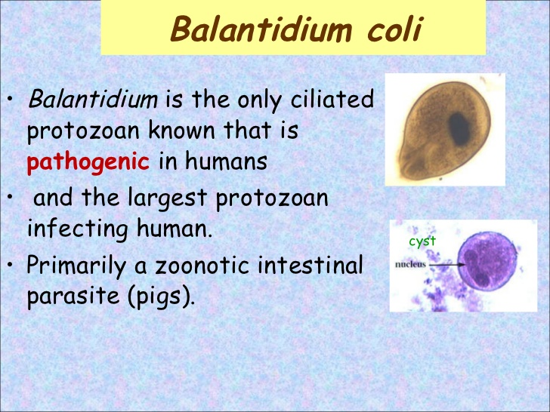

Slide 16
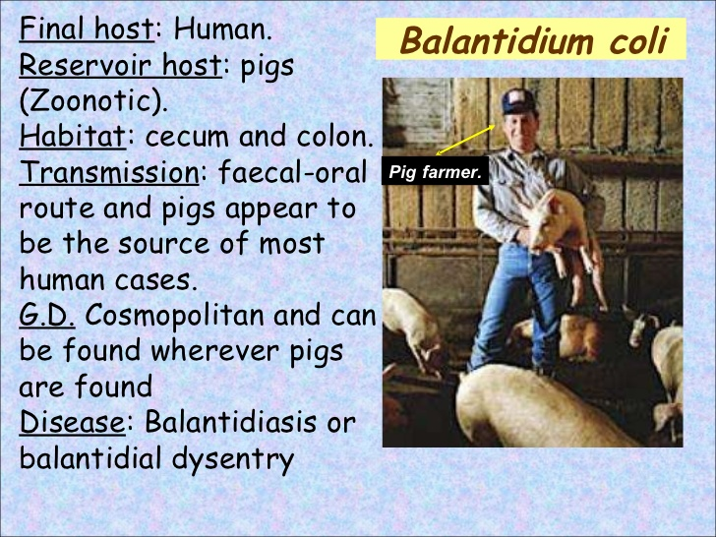

Slide 17
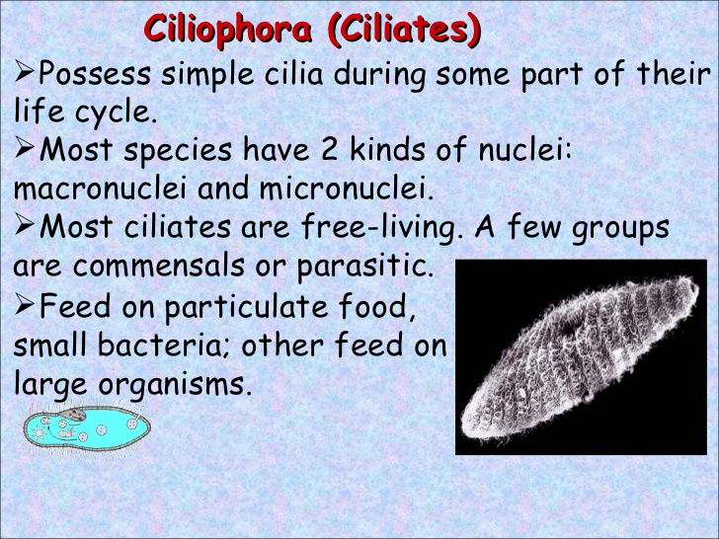

Slide 18
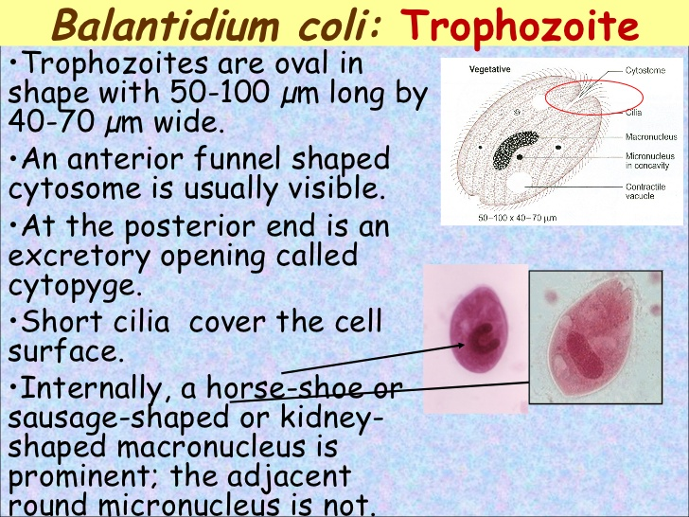

Slide 19
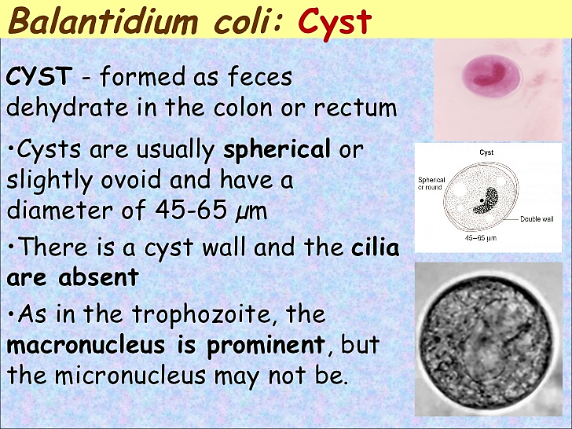

Slide 20
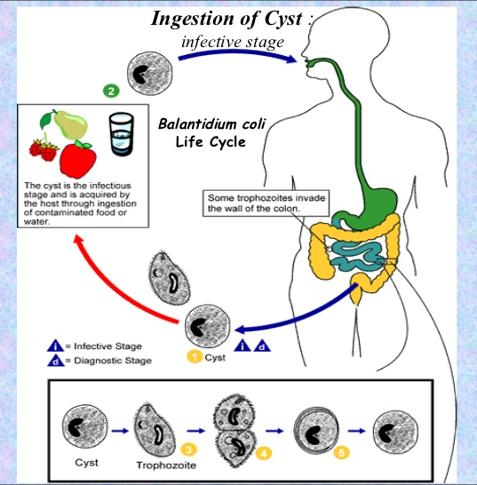

Slide 21
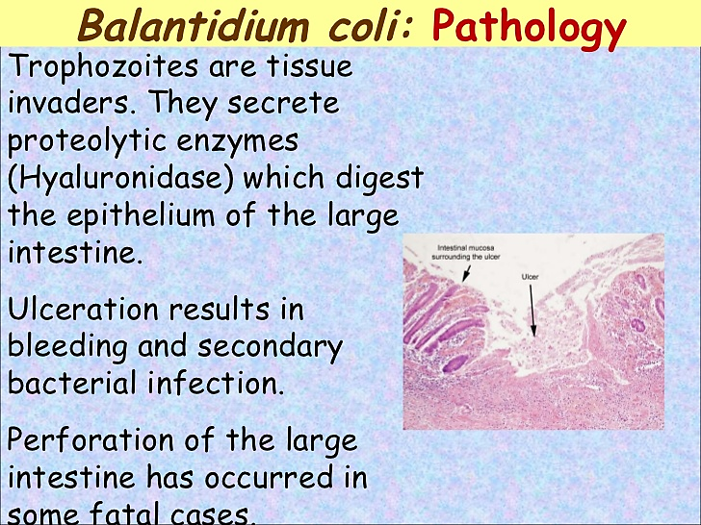

Slide 22
Pathogenesis:
Most infections with B.coli apparently harmless. However, the trophozoites invade the mucosa and submucosa of large intestine and produce ulcers.
If left untreated, Balantidiasis can become chronic. Persistent diarrhea can lead to high fluid loss and dehydration. Chronic recurrent diarrhea, alternating with constipation, is the most common clinical manifestation. Abdominal bleeding can lead to death. Extraintestinal involvement such as liver, peritonea and lung may occur.

Slide 23
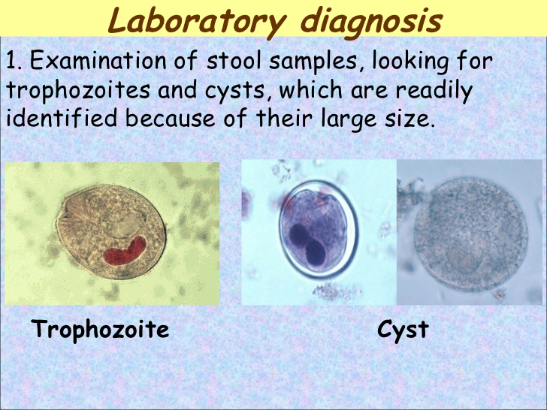

Slide 24
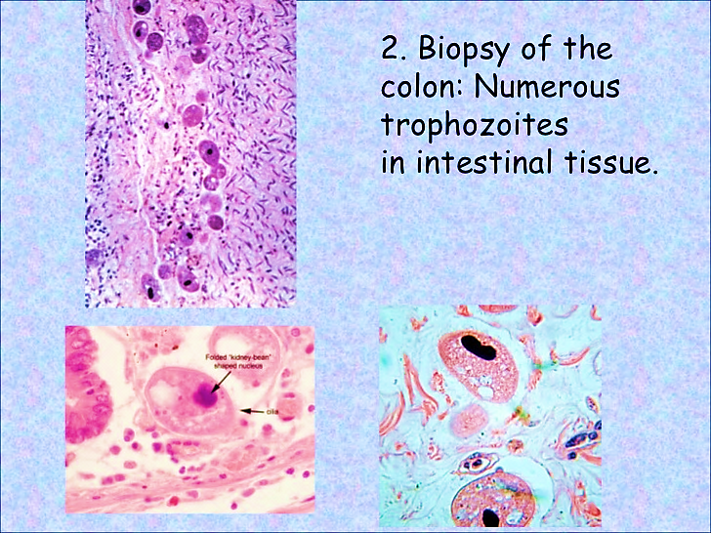

Slide 25
Treatment:
Balantidium coli infection can be treated effectively with antibiotics. Tetracyclines, Metronidazole, Iodoquinol

