Slide 1
Clinical Laboratory Training Microbiology (Bacteriology) 5th. stage
Dr. Maysoon A.Merdaw

Slide 2
Concepts of Infectious Diseases
Infection: refers to the ability of microorganisms to invade tissue and find conditions that are suitable for growth and replication. Infections may cause either clinical or subclinical illness. Many individuals develop an immune response to a pathogen without manifesting any signs of illness.
Intoxication: Some pathogens can cause disease by the elaboration of a toxin. This can occur in the absence of viable bacteria (e.g., food poisoning).
Carrier: An individual with asymptomatic colonization or infection who is capable of transmitting infection to others. They may or may not be ill themselves (e.g., Corona v.).
Latency: The pathogen remains viable but is dormant within the host. It however remains capable of causing disease at a later date (e.g., Mycobacterium tuberculosis or herpes viruses).

Slide 3
The Infectious Disease Cycle:
Reservoirs: are generally divided into the following: humans (the most common animate reservoir), animals, soil and water. Knowing the reservoir and the exposure history of the patient is often helpful in establishing the likely pathogen.
Patterns of transmission: Infections can be acquired from within the host (endogenous infection) or from without (exogenous infection).
Portals of Entry: There are numerous means of inoculation, including through breaks in the skin, inhalation, ingestion, etc.
Response to infection: There is a varied response to infection ranging from subclinical illness to full-blown, life-threatening disease.

Slide 4
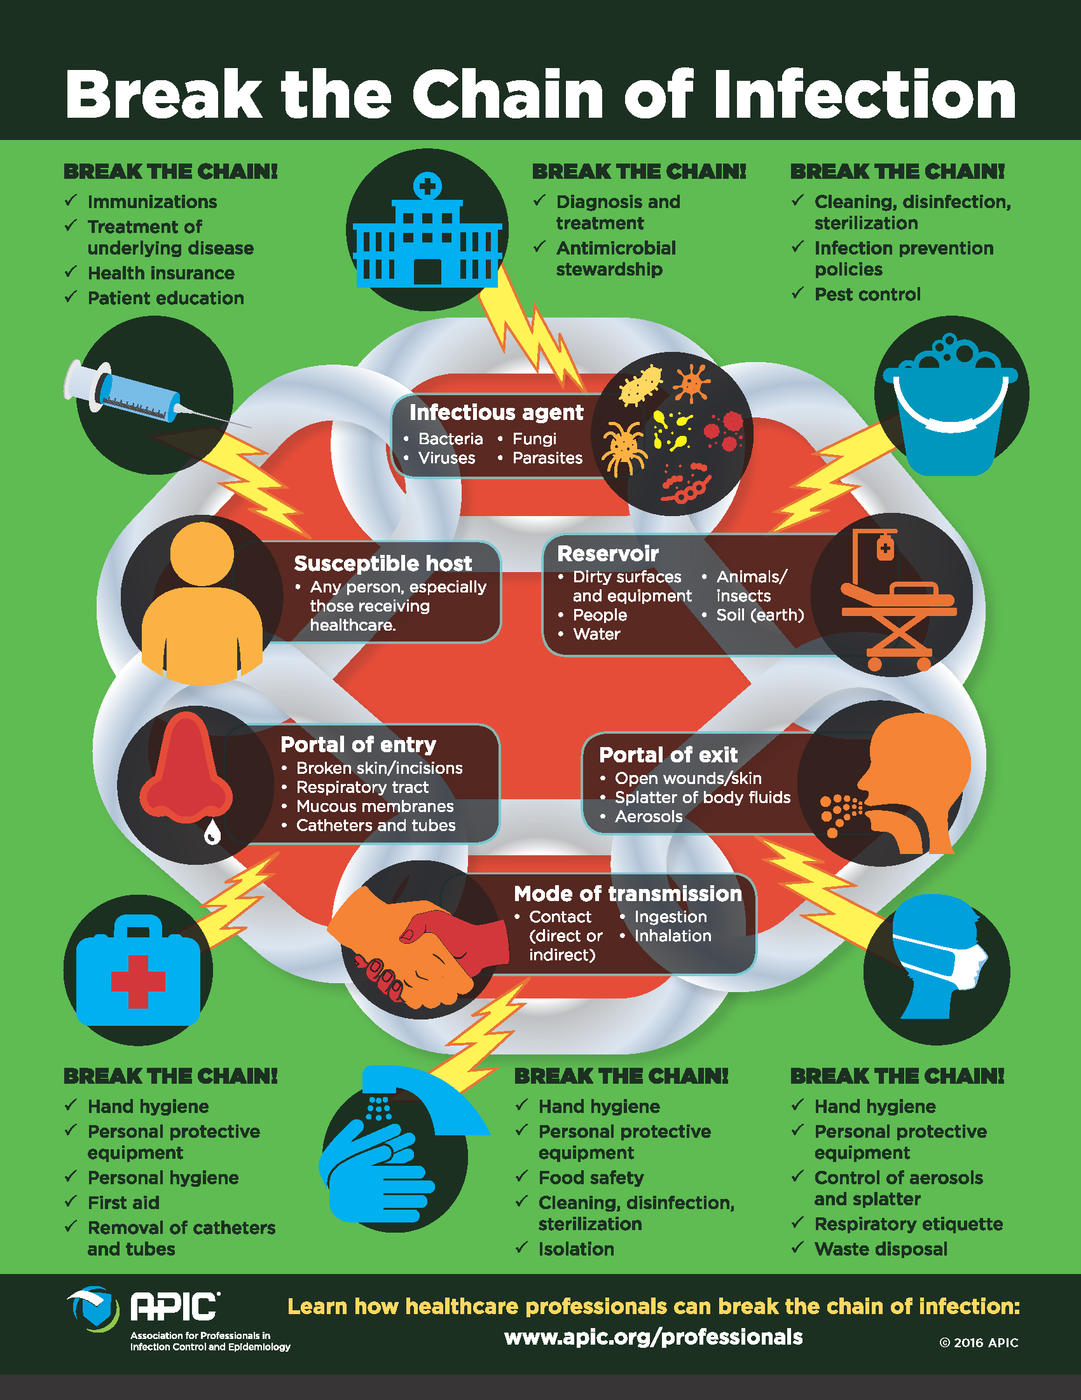

Slide 5
The Nature of Infections
Infectious disease syndromes: It is important to keep in mind that many different bacterial species may cause the same syndrome. For example both Gram positive and negative bacteria can cause the sepsis syndrome characterized by fever, disorientation and shock. In addition, the same bacterial species is capable of causing multiple different syndromes. For example Streptococcus pyogenes causes impetigo as well as toxic shock.

Slide 6
Pathogenesis of host damage: Pathogens cause damage in a number of different ways. They may: by the elaboration of proteolytic enzymes that destroy or damage tissue, by induce an excessive immune response, by cause a hypersensitivity reaction and may cause malignant transformation of host cells.
Host susceptibility to infection: There are a number of host factors that increase susceptibility to infection such as the extremes of age, malnutrition, congenital or acquired defects in immunity and various forms of medical treatment.

Slide 7
Sequence of Steps Necessary for Infection:
Adherence may be the result of specific (adhesin-receptor) or nonspecific (e.g. hydrophobic) interactions.
Evasion of host defense
Invasion
Interference with the host response
Host tissue damage

Slide 8
Samples Collection and Transport
There are many sources of specimens which should be collected in appropriate way to ensure an accurate examination results.
Information derived from the results has impact on:
-Diagnosis of infectious diseases
-Antibiotic prescribing
-Formulation of local antibiotic policy
-Infection control measures e.g. MRSA

Slide 9
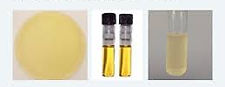
Types of culture media
Media are of different types on consistency and chemical composition.
A. On Consistency:
1. Solid Media. 2. Liquid Media 3. Semisolid media
B. On Chemical Composition:
Routine Laboratory Media 2. Synthetic Media.
Routine laboratory media
These are classified into six types: (1) Basal media, (2) Enriched media, (3) Selective media, (4) Indicator media, (5) Transport media, and (6) Storage media.

Slide 10
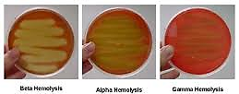

Slide 11
Antibiotic sensitivity
or antibiotic susceptibility is the susceptibility of bacteria to antibiotics. Because susceptibility can vary even within a species (with some strains being more resistant than others), antibiotic susceptibility testing (AST) is usually carried out to determine which antibiotic will be most successful in treating a bacterial infection in vivo.
Testing for antibiotic sensitivity is often done by the Kirby-Bauer method (semi-quantitative way). Another method is Agar or Broth dilution method (quantitative way) for minimum inhibitory concentration (MIC) determination.

Slide 12
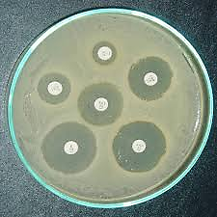
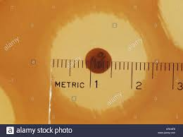
Some antibiotics actually kill the bacteria (bactericidal) as aminoglycosides, cephalosporin, metronidazole and penicillins, whereas others merely prevent the bacteria from multiplying (bacteriostatic) as chloramphenicol, erythromycin and tetracycline.
Kirby-Bauer method

Slide 14
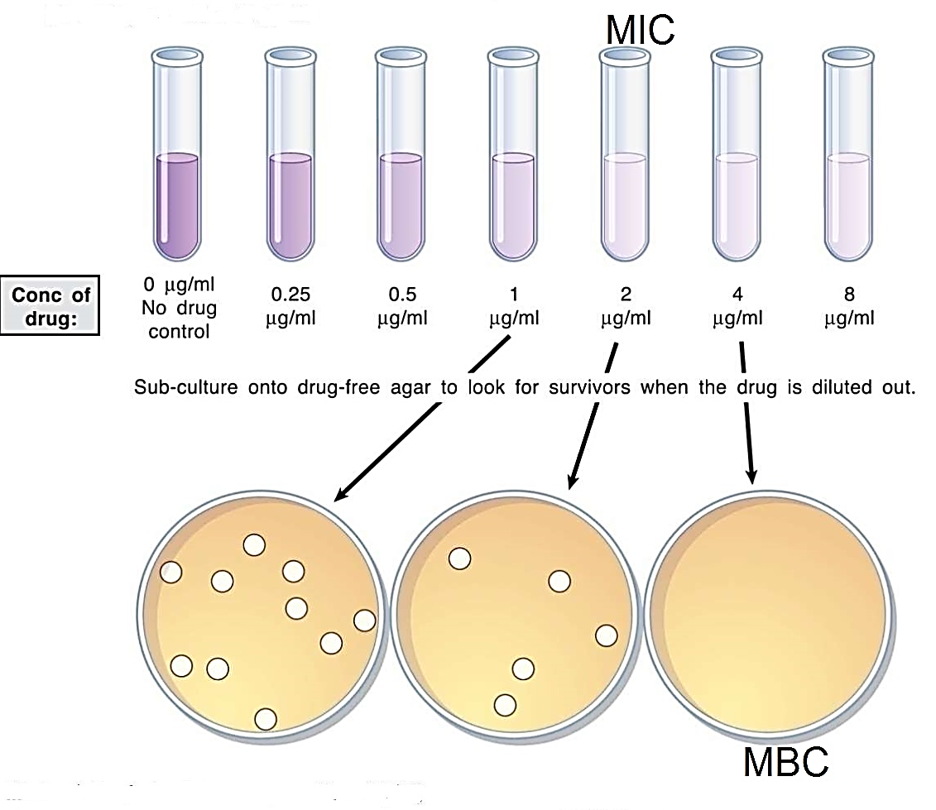
Broth dilution method

Slide 15
STAINING:
The main use of the microscope in bacteriology is in the study of stained preparations of the organisms. Staining makes bacteria opaque and hence more easily seen than the transparent unstained forms.

Slide 16
Bacterial diseases and their laboratory diagnosis
Disease | Specimen | Common Causative Agents | Usual Microscopic Findings | Culture Media
Cellulitis of skin | Punch biopsy | Group A -hemolytic streptococci, S aureus | Occasionally gram-positive cocci | Blood agar
Impetigo | Swab | As for cellulitis (above) | As for cellulitis (above) and pharyngitis (below)
Skin ulcers | Punch biopsy; deep; tissue aspirate or biopsy | Mixed flora | Mixed flora | Blood, MacConkey, or EMB agar; anaerobe media
Meningitis | CSF | Neisseria meningitidis | Gram-negative intracellular diplococci | Chocolate agarª and blood agar for CSF cultures
 |  | Haemophilus influenzae | Small gram-negative coccobacilli | Chocolate agarª
 |  | Streptococcus pneumoniae | Gram-positive cocci in pairs | Blood agar
 |  | Group B streptococci | Gram-positive cocci in pairs and chains | Blood agar
 |  | Escherichia coli and other Enterobacteriaceae | Gram-negative rods | Blood agar
 |  | Listeria monocytogenes | Gram-positive rods | Blood agar
Brain abscess | Pus | Mixed infection; anaerobic gram-positive and gram-negative cocci and rods, aerobic gram-positive cocci | Gram-positive cocci or mixed flora | Blood agar, chocolate agar,ª anaerobe media

