Slide 1
Protozoa
Sporozoa
Malaria
Dr. Maysoon A. Merdaw

Slide 2
Sporozoa belong to the kingdom Protozoa, phylum Sporozoa, class Coccidia, and orders Eimeriida, Piroplasmida and Haemosporida. Sporozoa organisms have a system of organelles at their apical end that produces substances to help the organism to penetrate host cells and thus become intracellular parasites.
Plasmodium Species (Blood Sporozoa)
Five species are known to infect humans– P. falciparum, P. vivax, P. malariae, P. ovale, and P. knowlesi, a species of monkeys, can also infect humans.
Malaria continues to be an important vector-borne disease.

Slide 3
The incidence of malaria is increasing due to resistance of vectors to insecticides and drug-resistant parasites. P. vivax and P. falciparum account for 95% of infections. P. vivax has widest distribution, P. ovale is rare in much of the world.
Life cycle
Malaria parasites exhibit a complex life cycle involving alternating cycles of asexual division (schizogony) occurring in man (intermediate host) and sexual development (sporogony) occurring in female Anopheles mosquito (definitive host).
Therefore, malaria parasites exhibit alternation of generations and alternation of hosts.

Slide 4
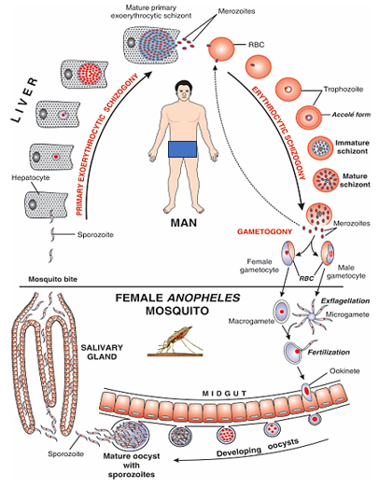
Human cycle
The sporozoites are the infective form, present in the salivary glands of female Anopheles mosquito. Man gets infection by the bite of infected mosquito.
The cycle comprises of following stages:
1• Primary exo-erythrocytic or pre-erythrocytic schizogony
2• Erythrocytic schizogony
3• Gametogony
4• Secondary exo-erythrocytic or dormant schizogony.

Slide 5
1- Primary exo-erythrocytic or pre-erythrocytic schizogony:
Within one hour all the sporozoites leave the blood stream and enter into liver parenchyma cells. The sporozoites become rounded inside the liver cells. They undergo a process of multiple nuclear division, followed by cytoplasmic division and develop into primary exo erythrocytic schizont.

Slide 6
In different species it contains 2,000–30,000 merozoites. This stage consists of only one generation. The duration of this cycle of P. falciparum, P. vivax, P. ovale and P. malariae is 6, 8, 9 and 13–16 days, respectively.
When this stage is complete, the liver cell ruptures and releases several thousands of merozoites into blood stream.

Slide 7
2- Erythrocytic schizogony
The merozoites attach to specific receptors on the surface of erythrocytes and enter the cells where they multiply. Here they pass through the stages of trophozoites, schizonts and merozoites. Depending on the species, 6–32 nuclei are produced followed by cytoplasmic division, and the red cell ruptures to release merozoites, which then infect fresh RBCs. The parasitic multiplication during the erythrocytic phase is responsible for bringing on a clinical attack of malaria. .
*P. falciparum differs from the other malaria parasites in that developing erythro cytic schizonts aggregate in the capillaries.

Slide 8
3- Gametogony:
After malaria parasites have undergone erythrocytic schizogony for certain period, some merozoites develop within red cells into male and female gametocytes known as microgametocytes and macrogametocytes respectively, in process of gametocytogenesis.
Only mature gametocytes are found in the peripheral blood. They do not cause any febrile condition (fever) in human host. The host carrying gametocytes is known as carrier.

Slide 9
4- Secondary exo-erythrocytic or dormant schizogony:
In case of P. vivax and P. ovale, some sporozoites on entering into hepatocytes enter into a resting (dormant) stage before undergoing asexual multiplication, is known as hypnozoite or sleeping form.
After a period of weeks, months or years (usually up to 2 years) hypnozoites are reactivated to become secondary exo-erythrocytic schizonts and release merozoites which infect RBCs producing relapse of malaria.
Recrudescence occurs when RBC infection is not eliminated by the immune system or by therapy and the numbers in the RBCs begin to increase again with subsequent clinical symptoms.

Slide 10
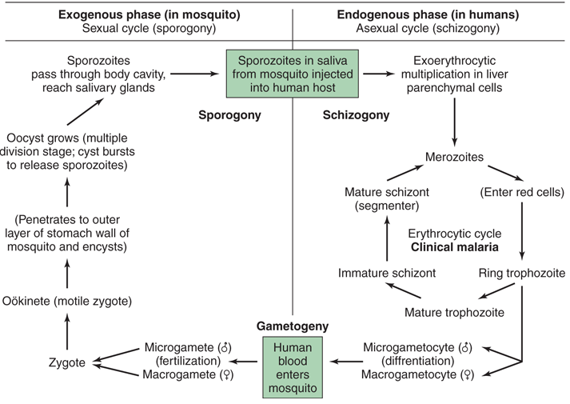
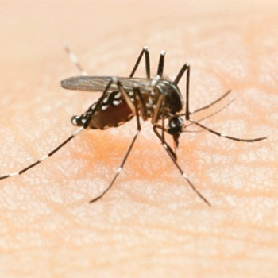

Slide 11
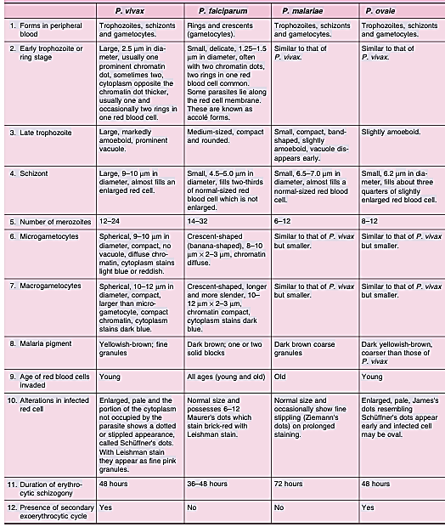

Slide 12
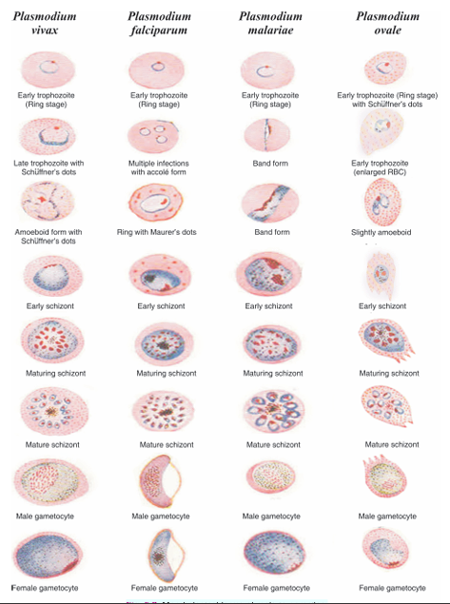
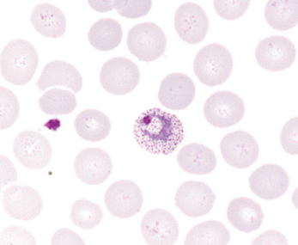
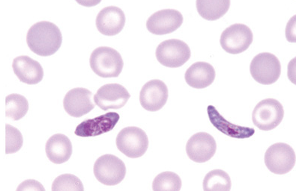
P. vivax trophozoite with Schüffner dots.
banana-shaped gametocytes are seen in P. falciparum infections.

Slide 13
Mosquito cycle
Sexual cycle actually starts in the human by the formation of gametocytes in blood. In the stomach of the mosquito from one microgametocyte 8 thread-like filamentous structures called microgametes are formed by the process of exflagellation. The fertilized macrogamete is known as zygote, matures into ookinete then penetrates the stomach of the mosquito and develops into oocyst. Inside this develop sporozoites.

Slide 14
*Only the sporozoite, merozoite and ookinete, which are designed for invasion.
Other stages of the life cycle, which are designed for growth and development.
Pathogenicity
Infection caused by the bite of infected mosquito, may also be transmitted by:
• Transfusion of blood (transfusion malaria). Plasmodia can remain viable in refriged blood for up to 10 days.
• Transmission of infection to foetus (congenital malaria).
• By the use of contaminated syringes particularly in drug addicts ( “mainline” malaria.
In these conditions (trophozoite-induced malaria) there is no primary and secondary exoerythrocytic schizogony, incubation period is short and there is no relapse.

Slide 15
Typical picture of malaria consists of febrile paroxysm, anaemia and splenomegaly.
Febrile paroxysm
It begins in the early afternoon and comprises of 3 successive stages – cold stage (15–60 min.), hot stage (40°–40.6°C lasting for 26 hr.) and sweating stage.
The periodicity of the attack varies with the species. 48 hours in P. vivax (benign tertian) and P. ovale (ovale tertian), and 72 hours in P. malariae (quartan).
However, with P. falciparum, the cycles of different broods of parasite do not become synchronized as they do in other species. Therefore, typical tertian fever is not usual in falciparum (malignant tertian) malaria. The periodicity of paroxysms in P. knowlesi is 24 hrs.

Slide 16
Anaemia
After a few paroxysms, anaemia of a microcytic or a normocytic hypochromic type develops as a result of:
• Direct RBC lysis as a result of life cycle of the parasite.
• Splenic removal of both infected and uninfected RBCs (coated with immune complexes).
• Autoimmune lysis of coated infected and uninfected RBCs.
• Decreased incorporation of iron into heme.
• Increased fragility of RBCs.
• Decreased RBC production from bone marrow suppression.

Slide 17
Pernicious malaria
Is a complex of life-threatening complications that sometimes appear in acute falciparum malaria. It is due to heavy parasitization and is of 3 types:
1. Cerebral malaria 2. Algid malaria 3. Septicemic malaria.
Cerebral malaria: frequently leads to death, even when appropriate therapy has been given. It is characterized by hyperpyrexia, coma and paralysis. Capillaries of the brain are plugged with parasitized RBCs, each cell containing malaria pigment, most commonly in children aged 3–4 years.
Algid malaria: It resembles surgical shock with cold clammy skin, peripheral circulatory failure and intense shock. Patient may also develop vomiting and diarrhoea or dysentery.

Slide 18
Septicemic malaria: It is characterized by a high degree of prostration; there is high continuous fever with involvement of various organs.
Blackwater fever: It is a manifestation of repeated infections with P. falciparum which were inadequately treated with quinine. Sometimes resumption of quinine therapy for new attack is followed by massive destruction of RBCs, fever, haemoglobinuria and renal failure.
The exact mechanism of haemolysis in blackwater fever is not known. An autoimmune mechanism has been suggested.

Slide 19
Host immunity
Immunity in malaria is of two types: 1. Innate immunity 2. Acquired immunity Innate immunity: This refers to inherent, non-immune mechanisms of host defence against malaria. This is due to:
Age of RBCs- Mentioned above
Nature of haemoglobin- Presence of abnormal haemoglobin like thalassemia haemoglobin and foetal haemoglobin confers resistance against all Plasmodium spp., while sickle cell anaemia trait and haemoglobin E protect against P. falciparum and P. vivax respectively.

Slide 20
Enzyme content of RBCs- A genetic deficiency known as glucose-6-phosphate dehydrogenase (G6PD) trait confers some protection against P. falciparum infection. This enzyme is essential for respiratory process of the parasite.
Presence or absence of certain factors: The Duffy factor increases the susceptibility to malaria (as receptor for attachment of malaria parasite to RBCs).
Acquired immunity: in malaria involves both humoral and cellular immunity. Antibodies against sporozoites and all stages develop in malaria patients. Antibodies (IgM, IgG and IgA) against asexual blood stages may protect by inhibiting red cell invasion and antibodies against sexual stages are believed to reduce malaria transmission.

Slide 21
Immunity produced following infection with malaria parasites is species-specific, stage-specific and strain-specific and the immunity lasts only till original infection remains active. This is known as concomitant immunity.
Malaria parasites are capable of periodically changing the expression of their antigens, this provides the evading host immunity.

Slide 22
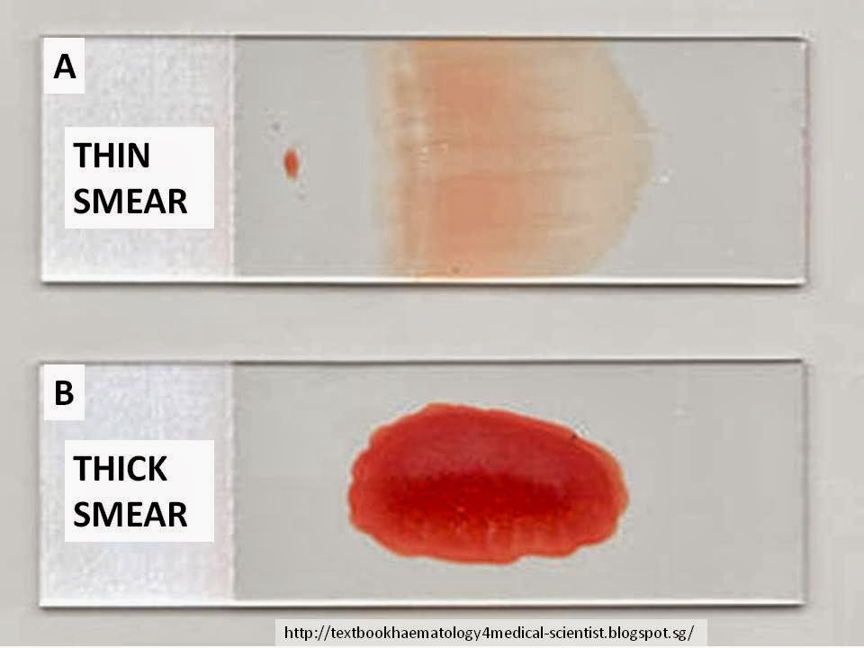
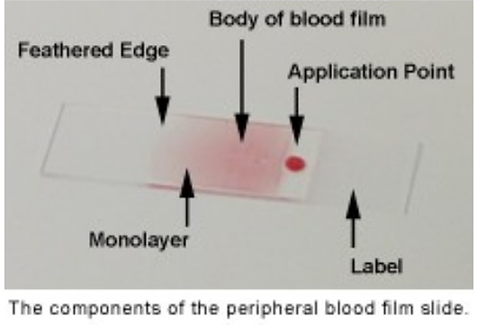
Laboratory Diagnosis
Microscopy Diagnosis by demonstration of parasites in the blood. Thick and thin smears of the blood stained with Leishman stain, then examined under oil-immersion lens. Blood is taken by pricking a finger or ear lobule before starting treatment with antimalarials.

Slide 23
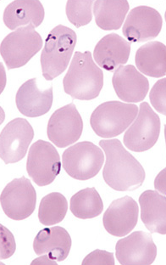
The parasites are most abundant in peripheral blood late in the febrile paroxysm (a few hours after the height of paroxysm). All asexual erythrocytic stages, as well as gametocytes can be seen in P. vivax, P. malariae and P. ovale, but in P. falciparum infection, only the ring forms and crescent-shaped gametocytes can be seen.
The occurrence of multiple rings in an individual RBC with accolé forms (young, ring-stage trophozoites appear fixed to the edge of RBC) is diagnostic of P. falciparum infection. The presence of malaria pigment only, in the absence of malaria parasites, suggests P. falciparum infection.

Slide 24
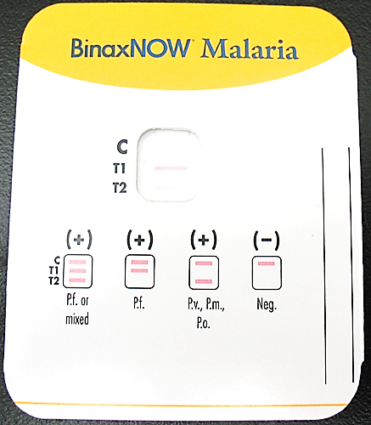
OTHER TECHNIQUES: include
Molecular methods (polymerase chain reaction PCR) - Antibody detection by serology (immune assay).
However, serology only measures prior exposure and not specifically current infection.

Slide 25
Treatment:
Chloroquine was the standard treatment. Quinine is the most reliable alternative to chloroquine for the chloroquine-resistant strains. Chloroquine and quinine do not eliminate exo erythrocytic parasites in the liver. For this primaquine should be used. However, this drug may precipitate haemolysis in individuals who are deficient in the enzyme G6PD.
Drug resistance in malaria parasites
Most resistant strains of P. falciparum have developed due to: 1. Inadequate drug doses mainly as a result of unregulated drug distribution and prescribing. 2. Lack of adequate drugs. 3. Poor quality of drugs. 4. Incorrect taking of drugs by patients. 5. When insufficient drug is taken to kill the malaria parasites, the mutants survive and multiply.

Slide 26
WHO definition and classification of drug resistance as {the ability of a parasite to multiply or to survive in the presence of concentrations of a drug that normally destroy parasites of the same species or prevent their multiplication}.
Three levels of resistance (R) following treatment are defined by WHO: RI:, parasitaemia clears but a recrudescence occurs. RII: there is a reduction but not a clearance of parasitaemia. RIII: there is no reduction of parasitaemia.
The above method of classifying resistance, based on counting trophozoites in blood films for up to 7 days after treatment and monitoring the patient for any subsequent recrudescence is referred to as in vivo testing.
Vaccine: No effective malaria vaccine is yet available.

Slide 27
Plasmodium knowlesi
A fifth species, which normally infects macaques, is a significant cause of human malaria in Southeast Asia. Similar to P. falciparum, the erythrocyte invasion is not restricted to young or old RBCs. It has a short life cycle of 24 hours (quotidian).
P. knowlesi infection is usually misidentified as P. falciparum or P. malariae because its early trophozoites resemble the ring forms of P. falciparum and the later stages mimic those of P. malariae. In contrast to P. falciparum, P. knowlesi does not appear to sequester in the microvasculature, and the neurologic complications have not been described.
P. knowlesi, similar to P. falciparum and P. malariae, does not produce hypnozoites.

