Slide 1
Protozoa
Phylum: Apicomplexa Class: Sporozoa
Plasmodium Species
Dr. Maysoon A. Merdaw

Slide 2
Phylum: Apicomplexa
Class: sporozoa
Sporozoa undergo a complex life cycle with alternating sexual and asexual reproductive phases. The human parasites Cryptosporidium, Cyclospora, and Toxoplasma and the malarial parasites (Plasmodium species) are all intracellular parasites.
Plasmodium Species (Blood Sporozoa)
Four species of Plasmodium cause malaria in humans: Plasmodium vivax, P falciparum, P malariae, and P ovale. The two most common species are P vivax and P falciparum

Slide 4
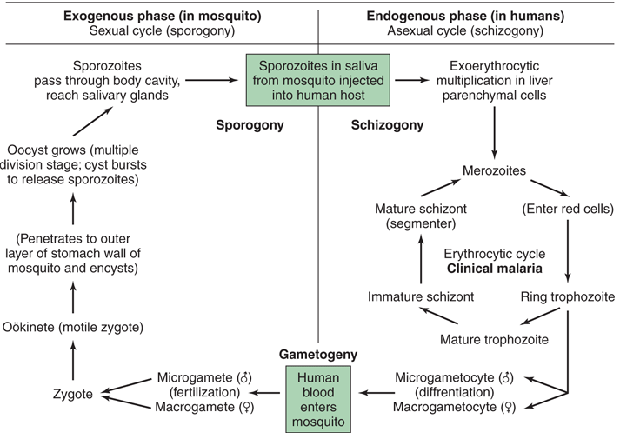
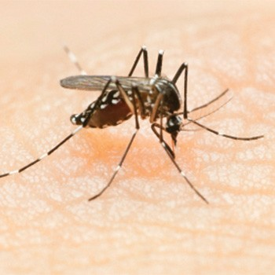

Slide 5
P vivax and P ovale may persist as dormant forms, or hypnozoites, after the parasites have disappeared from the peripheral blood.
Resurgence of an erythrocytic infection (relapse) occurs when merozoites from hypnozoites in the liver break out, are not phagocytosed in the bloodstream, and succeed in reestablishing a red cell infection (clinical malaria).

Slide 7
Names of malarial diseases
Plasmodium vivax (Benign Tertian Malaria)
P falciparum (Malignant Tertian Malaria)
P malariae (Quartan Malaria)
P ovale (Ovale Malaria)
Plasmodium vivax: 43% of total malarial cases in Iraq.

Slide 8
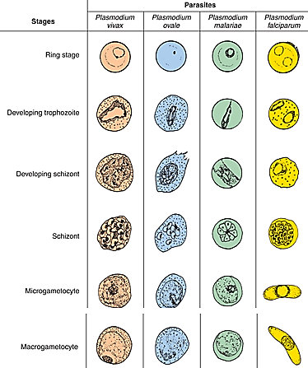

Slide 9
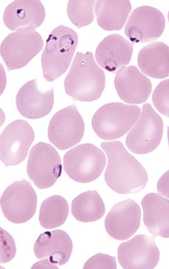
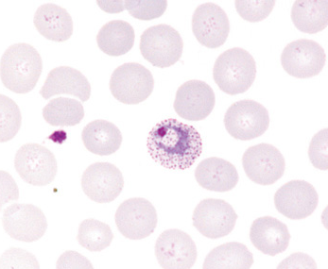
Plasmodium vivax trophozoite inside a RBC with Schüffner dots.
Double rings

Slide 10
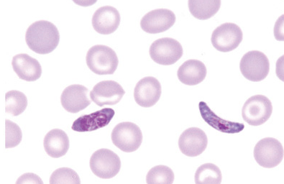
banana-shaped gametocytes are typically seen in Plasmodium falciparum infections.

Slide 11
Pathogenicity and symptoms:
Signs and symptoms are due to erythrocytic infection, not due to the Exo-erythrocytic.
Destruction of RBCs due to rupture method by parasite and lysis of non-parasitized cells due to debris and toxins metabolic byproducts of ruptured cells cause anemia.
Erythrocytes containing P. falciparum adhere to one another and to lining of blood vessels causing blockage of blood capillaries in vital area such as brain, lung, and kidney.
Spleen is typically enlarged and congested (splenomegaly), its color get darkened as amount of pigment increase and hard in chronic stage and soft and hemorrhagic in acute stage.
The liver hypertrophic and congested in acute malaria and contains deposits of pigments.

Slide 12
Malarial paroxysm:
P. vivax, P. ovale or quarter malaria characterized by sudden develops with shaking chill followed by a fever of 40-40.6˚C with headache, muscular pain, malaise, nausea, vomiting, and increase in pulse and respiration rates.
After several hours, the fever terminates and followed by drenching sweat and patient will be exhausted. The series of paroxysm constitute the primary attack complication and pernicious symptoms: coma, convulsion, and cardiac failure.

Slide 13
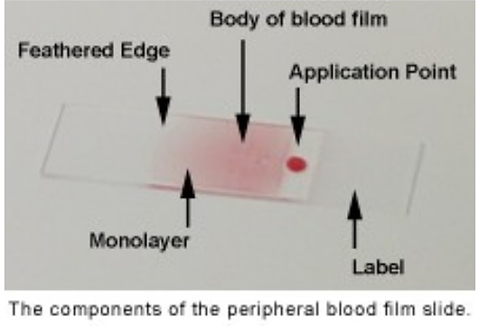
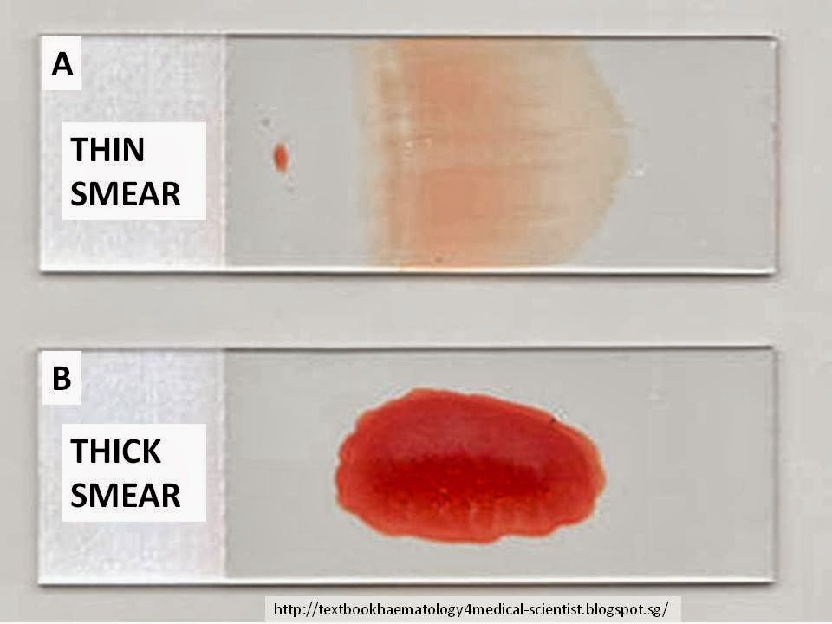
Diagnosis:
-Microscopy: Thin and thick blood films taken just before or at the height of malarial paroxysm will detect number of parasites.

Slide 14
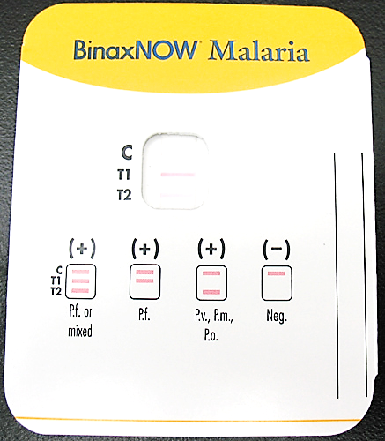
-immunochromatographic methods: to detect the antigens in blood.
-other methods: as serology (detect antibodies) by ELISA or IFA.
Molecular methods (PCR).

Slide 15
Challenges in diagnosis:
There are some issues with the various stages of the P. vivax lifecycle that complicate diagnosis.
Low parasite density
Ex. P. vivax merozoites only invade immature red blood cells (reticulocytes). As these occur most often in the bone marrow, rather than in the blood circulation, parasite densities in blood are often low, making the parasite detection more challenging.
Complex life cycle
Gametocytes appear at approximately the same time as asexual parasites, usually before the onset of symptoms. Thus, individuals may be infectious before diagnosis. P. vivax hypnozoites, which lie dormant in the liver, are undetectable with any currently available diagnostic methods.

Slide 16
Treatment:
Treatment of malarial attacks: chloroquine and amodiaquine. Resistant malaria P. falciparum showing drug resistant, and treated with quinine alone or with combination with other drugs.
Control:
requires community rather than individual reports.
Antimosquito chemicals: like DDT (Dichloro Diphenyl Trichloroethane) and Malathion are found to be effective to control by preventing the breeding of Anopheles mosquito.
2. Avoiding exposure to mosquito bites.
3. Taking chemoprophylaxis: Chloroquine and the antifolate drugs.

