Slide 1
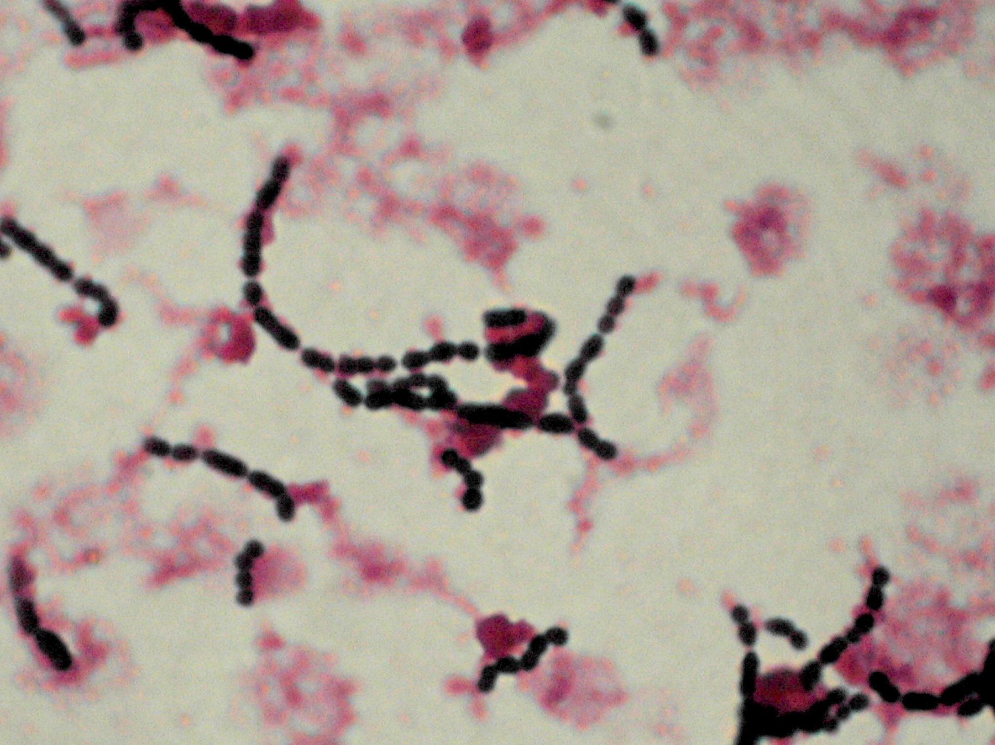
Genus Streptococcus
By
Dr. Maysoon A.Merdaw

Slide 2
-gram-positive spherical bacteria that characteristically form pairs or chains during growth.
-widely distributed in nature. Some are members of the normal human flora; others are associated with important human diseases.
-elaborate a variety of extracellular substances and enzymes.
-Most pathogenic hemolytic streptococci grow best at 37°C. Most streptococci are facultative anaerobes (Peptostreptococci are obligate anaerobes).
-no one system suffices to classify them.

Slide 3
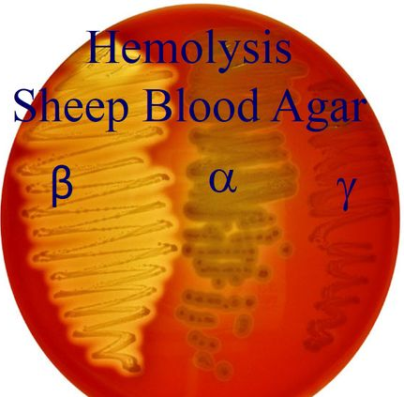
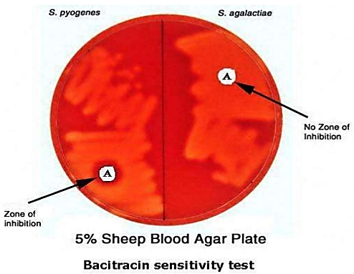
Classification of Streptococci
The classification has been based on a series of observations over years:
1-Hemolysis
Many streptococci are able to hemolyze RBCs in vitro in varying degrees.
Bacitracin test is usually performed for differentiation of beta-hemolytic Strep. pyogenes (susceptible) from other beta-hemolytic streptococci.
the organism is sensitive to the bacitracin in the disk whereas if organism grows up to the edge of the disk, it is resistant to bacitracin infusing the disk.

Slide 4
2-Group-Specific Substance (Lancefield Classification)
Based on the carbohydrate composition of bacterial antigens found on their cell walls and forms the basis of serologic grouping into Lancefield groups. The serologic specificity is determined by an amino sugar, e.g. group A streptococci, this is rhamnose-N-acetylglucosamine; group B, it is rhamnose-glucosamine polysaccharide. Two groups lack the Lancefield carbohydrate antigen: Strep.pneumoniae and Viridans streptococci.

Slide 5
3-Capsular Polysaccharides
The antigenic specificity of the capsular polysaccharides is used to classify S. pneumoniae into over 90 types and to type S. agalactiae.
4-Biochemical Reactions
include sugar fermentation reactions, tests for the presence of enzymes, and tests for susceptibility or resistance to certain chemical agents.
Because biochemical reactions are often unreliable, molecular genetic capabilities, such as gene sequencing, are used with these methods when identification of streptococci is required.

Slide 6
Streptococcus pyogenes
group A antigen. It is a typical human pathogen. produces large zones of β hemolysis and produce capsules and plays a greater role in virulence.
Capsules of other streptococci (e. g, S agalactiae and S pneumoniae) are different.
The S pyogenes cell wall contains proteins (M, T, R antigens), carbohydrates (group-specific), and peptidoglycans.
The pili project through the capsule consist partly of M protein which induces antibodies that react with cardiac muscle tissue (cross-reactive antigens), and are covered with lipoteichoic acid which is important in the attachment of streptococci to epithelial cells.

Slide 7
Toxins & Enzymes
More than 20 extracellular products that are antigenic, including the following:
1-Streptokinase (Fibrinolysin)
It transforms the plasminogen of human plasma into plasmin, an active proteolytic enzyme that digests fibrin and other proteins.
2-Streptodornase (streptococcal deoxyribonuclease)
It depolymerizes DNA, an antibody to DNAse develops after streptococcal infections, especially after skin infections.
3-Hyaluronidase (spreading factor).
4-Pyrogenic Exotoxins (Erythrogenic Toxin)
Act as superantigens, associated with streptococcal toxic shock syndrome and scarlet fever.

Slide 8
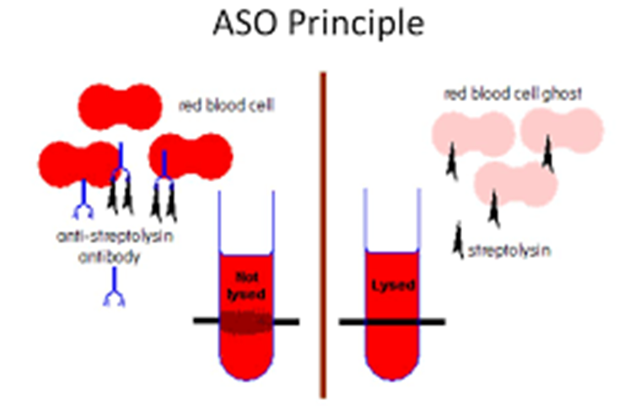
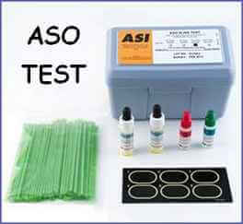
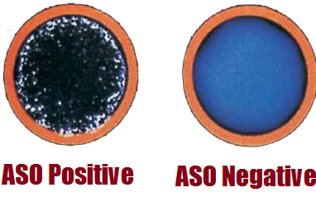
5-Hemolysins
S. pyogenes elaborates two hemolysins (streptolysins). Streptolysin O is a protein that is hemolytically active in the reduced state, but rapidly inactivated in the presence of O2. It combines quantitatively with antistreptolysin O (ASO), an antibody that appears after infection with any streptococci that produce streptolysin O. This antibody blocks hemolysis.

Slide 9
This phenomenon forms the basis of a quantitative test for the antibody. An ASO serum titer in excess of 160–200 units is considered abnormally high and suggests either recent infection or persistently high antibody levels in a hyper sensitive person.
Streptolysin S responsible for the hemolytic zones on blood agar plates. It is not antigenic, but it may be inhibited in the sera of humans and animals.

Slide 10
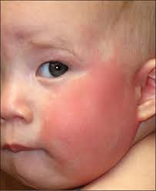
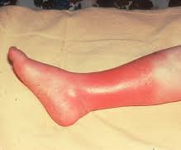
Pathogenesis & Clinical Findings
A variety of distinct disease processes are associated with S. pyogenes infections.
Diseases Attributable to Invasion by S. pyogenes.
Erysipelas—If the portal of entry is the skin.
2. Cellulitis- acute, rapidly spreading infection of the skin and subcutaneous tissues.
3. Necrotizing fasciitis (streptococcal gangrene)—There is extensive spreading necrosis of the skin and subcutaneous tissues.
4. Puerperal fever—If the streptococci enter the uterus after delivery.
5. Bacteremia/sepsis— Infection of traumatic or surgical wounds with streptococci results in bacteremia, which rapidly can be fatal.

Slide 11
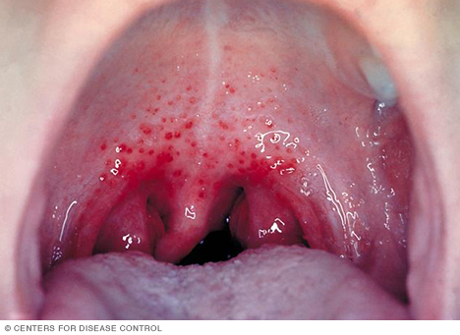
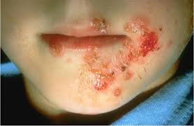
Diseases Attributable to Local Infection with S pyogenes
1. Streptococcal sore throat- or pharyngitis, the most common infection of S pyogenes adhere to the pharyngeal epithelium.
2. Streptococcal pyoderma—Local infection of superficial layers of skin, especially in children, is called impetigo. A clinically identical infection can be caused by S aureus and sometimes both S pyogenes and S aureus are present.

Slide 12
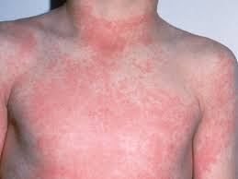
Overlapping diseases (Streptococcal Toxic Shock Syndrome, and Scarlet Fever)
Fulminant, invasive S pyogenes infections with streptococcal toxic shock syndrome are characterized by shock, bacteremia, respiratory failure, and multiorgan failure.
Pyrogenic exotoxins A–C cause scarlet fever in association with S. pyogenes pharyngitis or with skin or soft tissue infection. The pharyngitis may be severe. The rash appears on the trunk after 24 hours of illness and spreads to involve the extremities.

Slide 13
Poststreptococcal Diseases (Rheumatic Fever, Glomerulonephritis)
Following an acute S pyogenes infection, there is a latent period of 1–4 weeks, nephritogenic M types will associate with throat infections and glomerulonephritis.
Rheumatic fever occasionally develops in patients with more severe streptococcal sore throats. The first attack of rheumatic fever usually produces only slight cardiac damage, which, however, increases with each subsequent attack. It is therefore important to protect such patients from recurrent S pyogenes infections by prophylactic penicillin administration.

Slide 14
Diagnostic Laboratory Tests
Specimens: Depend upon the nature of the streptococcal infection.
1-Smears
If smears of pus show streptococci but cultures fail to grow, anaerobic organisms must be suspected.
2-Culture
Specimens are cultured on blood agar plates. If anaerobes are suspected, suitable media must also be inoculated. Incubation in 10% CO₂ often speeds hemolysis.
3-Serologic Tests
A rise in the titer of antibodies (as ASO) to many group A streptococcal antigens can be estimated, particularly in respiratory disease; anti-DNase and antihyaluronidase, particularly in skin infections; and others.

Slide 15
Treatment
-All S pyogenes are susceptible to penicillin G, and most are susceptible to erythromycin.
-Some are resistant to tetracyclines.
-Antimicrobial drugs have no effect on established glomerulonephritis and rheumatic fever.

Slide 16
Streptococcus agalactiae (group B streptococci)
They are part of the normal vaginal flora and lower gastrointestinal tract in 5–25% of women. They typically are β-hemolytic.
Group B streptococcal infection during the first month of life may present as fulminant sepsis, meningitis, or respiratory distress syndrome. I.V. ampicillin given to mothers, who carry group B streptococci and are in labor, prevents colonization of their infants and group B streptococcal disease.
Two expanding populations, namely the elderly and immunocompromised hosts, are most at risk for invasive disease.
Bacteremia, skin and soft tissue infections, respiratory infections, and genitourinary infections are the major clinical manifestations.

Slide 17
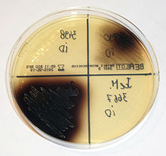
Group D Streptococci
All Group D streptococci are nonhemolytic, grow in the presence of bile and hydrolyze esculin (bile-esculin positive). They are part of the normal enteric flora.
Enterococcus colonies (black) growing on Bile Esculin Agar BEA

Slide 18
Viridans Streptococci
The viridans streptococci are the most prevalent members of the normal flora of the upper respiratory tract and are important for the healthy state of the mucous membranes there.
They may reach the bloodstream as a result of trauma and are a principal cause of endocarditis on abnormal heart valves.
Some viridans streptococci (eg, S mutans) synthesize large polysaccharides such as dextrans or levans from sucrose and contribute importantly to the genesis of dental caries.

Slide 19
In the course of bacteremia, viridans streptococci, pneumococci, or enterococci may settle on normal or previously deformed heart valves, producing acute endocarditis.
Subacute endocarditis is most frequently due to members of the normal flora of the respiratory or intestinal tract that have accidentally reached the blood. After dental extraction, at least 30% of patients have viridans streptococcal bacteremia.

Slide 20
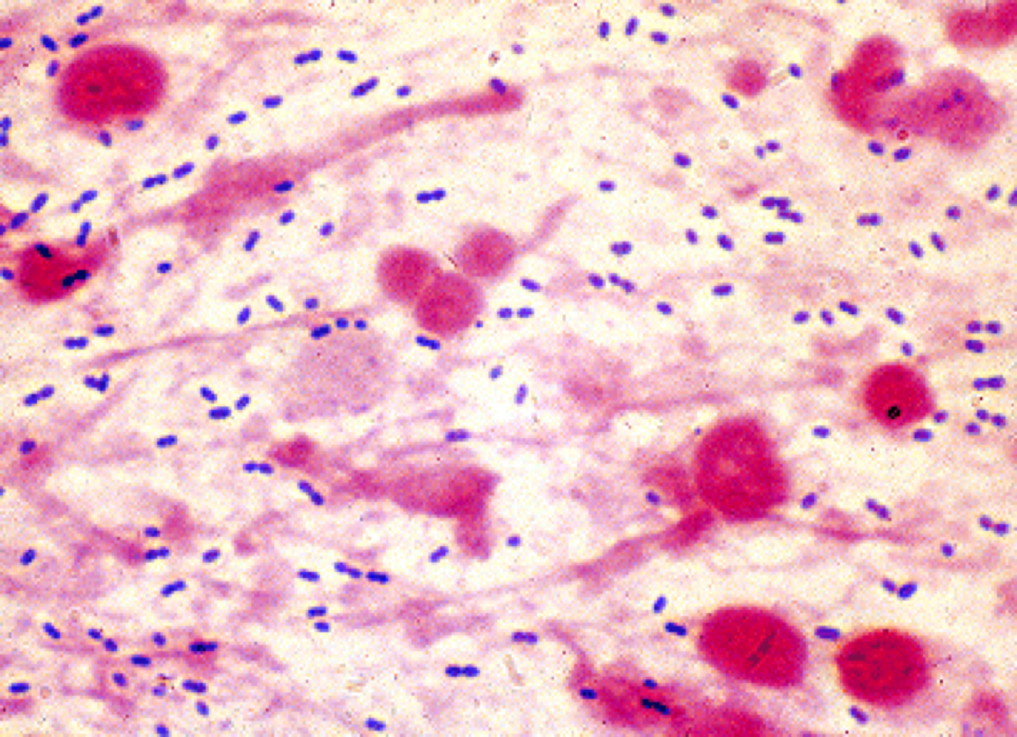
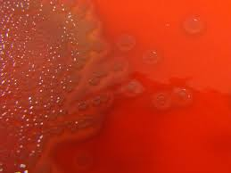
Streptococcus pneumoniae
The pneumococci are diplococci, often lancet-shaped or arranged in chains. Pneumococci form small round colonies, α-hemolytic on blood agar. Growth is enhanced by 5–10% CO₂, possessing a capsule of polysaccharide that permits typing with specific antisera.

Slide 21
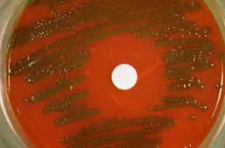
Pneumococci are normal inhabitants of the upper respiratory tract of 5–40% of humans and can cause pneumonia, sinusitis, otitis, bronchitis, bacteremia, meningitis, and other infectious processes.
With age, the organisms rapidly become gram-negative and tend to lyse spontaneously. On solid media, the growth of pneumococci is inhibited around a disk of Optochin; viridans streptococci are not inhibited by Optochin.

Slide 22
Antigenic Structure: isolates that produce large amounts of capsules produce large mucoid colonies.
Quellung Reaction: is a biochemical reaction in which antipolysaccharide serum bind to the bacterial capsule of Strep. pneumoniae, Kleb. pneumoniae, N.meningitidis, Haemophilus influenzae, E. coli, and Salmonella. The antibody reaction allows these species to be visualized under a microscope. If the reaction is positive, the capsule becomes opaque and appears to enlarge.
This reaction is useful for rapid identification. The polyvalent antiserum, which contains antibody to all of the types ("omniserum"), is a good reagent for rapid microscopic determination.

Slide 23
Pathogenesis
Types of Pneumococci: In adults, types 1–8 are responsible for about 75% of cases of pneumococcal pneumonia; in children, types 6, 14, 19, and 23 are frequent causes.
Production of Disease: through their ability to multiply in the tissues. They produce no toxins of significance. The virulence of the organism is a function of its capsule, which prevents or delays ingestion by phagocytes. A serum that contains antibodies against the type-specific polysaccharide protects against infection.
Animals or humans immunized with a given type of pneumococcal polysaccharide are subsequently immune to that type of pneumococcus and possess precipitating and opsonizing antibodies for that type of polysaccharide.

Slide 24
Clinical Findings
The onset of pneumococcal pneumonia is usually sudden, with fever, chills, and sharp pleural pain. The sputum is similar to the alveolar exudate, being characteristically bloody or rusty colored. Early in the disease, when the fever is high, bacteremia is present in 10–20% of cases. With antimicrobial therapy, the illness is usually terminated quickly.
From the respiratory tract, pneumococci may reach other sites. The sinuses and middle ear are most frequently involved.
Infection sometimes extends from the mastoid to the meninges. Bacteremia from pneumonia has a triad of severe complications: meningitis, endocarditis, and septic arthritis. With the early use of chemotherapy, acute pneumococcal endocarditis and arthritis have become rare.

Slide 25
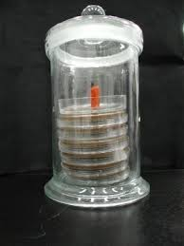
Diagnostic Laboratory Tests
Blood for culture; CSF and sputum are collected for demonstration of pneumococci by smear and culture. Serum antibody tests are impractical.
Sputum may be examined by Gram-stained film and capsule swelling (the quellung reaction). The culture is created by sputum cultured on blood agar and incubated in CO₂ or a candle jar. A blood culture is also taken.

Slide 26
Treatment
Since pneumococci are sensitive to many antimicrobial drugs, early treatment usually results in rapid recovery, and antibody response seems to play a much diminished role.
Penicillin G is the drug of choice. High-dose penicillin G appears to be effective in treating pneumonia caused by pneumococci but would not be effective in treatment of meningitis due to the same strains.
Resistance to tetracycline and erythromycin may occurs. Pneumococci remain susceptible to vancomycin.

