Slide 1
Analgesics Acetaminophen & Salicylates

Slide 2
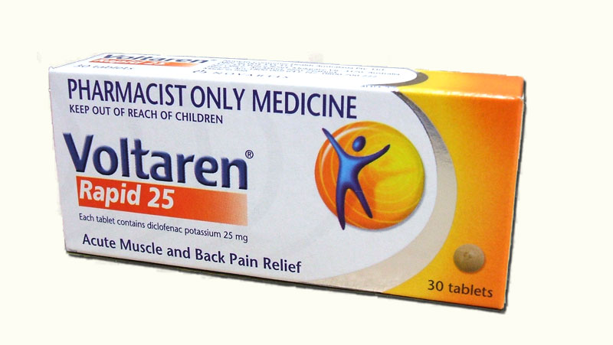
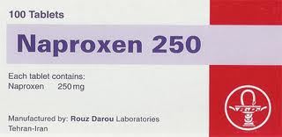
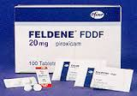
Non-steroidal anti-inflammatory drugs (NSAIDs)
Non-steroidal anti-inflammatory drugs (NSAIDs)
Analgesic, anti-inflammatory, and antipyretic
OTC drugs
The most widely used of all drugs
Used to relieve mild to moderate pain
Gastrointestinal toxicity including bleeding ulcer
Risk of cardiovascular events
Kidney damage

Slide 3
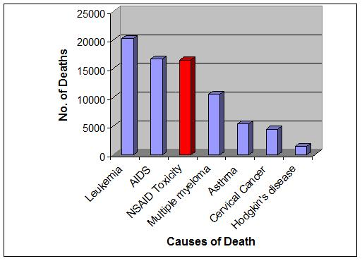
NSAID overdose
Symptoms of NSAID overdose are usually mild
Gastrointestinal upset, abdominal pain, vomiting and diarrhea
5% to 10% of patients experience convulsions. Metabolic acidosis is uncommon
Rarely, coma, prolonged seizures, apnea, bradycardia, renal failure and death may occur

Slide 4
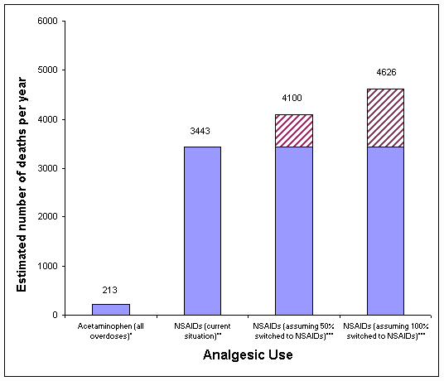
NSAID overdose

Slide 5
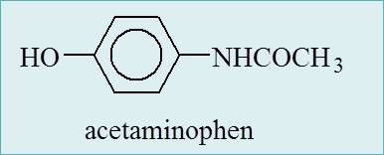
Acetaminophen
Acetaminophen (paracetamol) is not a NSAID, but a distinct analgesic and fever reducing drug with a similarly broad usage
Most commonly used OTC analgesic & also most common over dose leading to hospital
Overdose is the leading cause of acute liver failure in the developed world
56,000 emergency room visits, 26,000 hospitalizations, and 458 deaths due to acute liver failure
Kidney toxicity
FDA: combination prescription pain relievers that contain more than 325 mg of acetaminophen per tablet, capsule, or other dosage unit should no longer be prescribed because of a risk of liver damage

Slide 6
Acetaminophen
Toxicokinetics
Relatively safe
Rapid oral abs with peak levels at 1-2hrs for tablets (30mins for elixir)
20% is metabolized by gut wall, rest by the liver
Elimination T½=~2hrs, ≥4hrs in over dose where
LETHAL DOSE 15-25g
Liver damage severe with >10g doses; Children: 150 mg/kg

Slide 7
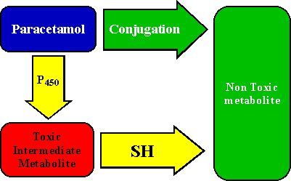
Acetaminophen
Metabolism
60% glucuronide conjugates
30% to sulfate conjugates
4% is metabolized by the cytochrome P450 mixed-function oxidase system (3A4 at low doses; 2E1 predominantly at high doses) to the potentially toxic reactive intermediate N-acetyl-p-benzoquinoneimine (NAPQI).
LIVER
conjugated with glutathione to form nontoxic cysteine and mercapturic acid conjugates

Slide 8
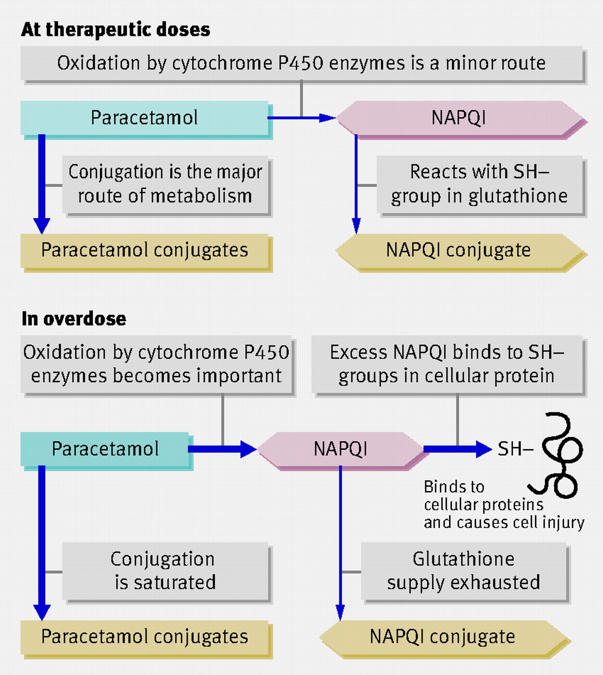
Acetaminophen
Toxicity
NAPQI induces oxidation of enzymes which alter normal cell functions and impairs cell defenses against endogenous reactive oxygen species
Hepatic toxicity becomes evident only when hepatic GSH falls to 30% of baseline
Therapeutic Dose: 10 to 15mg/kg
Toxic Dose: 150 mg/kg

Slide 9
Acetaminophen
Factors that may predispose patients to hepatotoxicity
Increased frequency and duration of acetaminophen dosing
Increased capacity for CYP2E1 activation to NAPQI
Decreased GSH availability
Decreased capacity for glucuronidation and sulfation
Alcohol
Acetaminophen Level | Result Interpretation
10-20 mcg/mL | Therapeutic levels
Less than 150 mcg/mL 4 hours after ingestion | Low risk of liver damage
Greater than 200 mcg/mL 4 hours after ingestion Or Greater than 50 mcg/mL 12 hours after ingestion | Associated with toxicity and liver damage

Slide 10
Clinical Manifestations
Stage I toxicity
With in 24 hours, No hepatic injury, asymptomatic, N/V/abdominal pain
Stage II toxicity
24 to 72hours, right upper quadrant abdominal pain, anorexia, N/V,
Tachycardia and hypotension , Raised liver function test
Stage III toxicity
72 to 96 hours, N/V/abdominal pain, Maximal liver injury (jaundice, coagulopathy,
hypoglycemia, and hepatic encephalopathy), Acute renal failure,
Death from multiorgan failure
Stage IV toxicity
The recovery phase, Patients who survive stage III

Slide 11
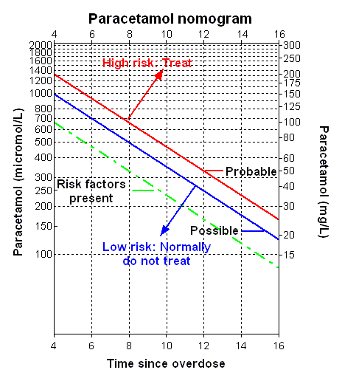
Monitoring and Testing
Laboratory tests
Serum acetaminophen levels
Management is dependent on the serum acetaminophen level and the time of ingestion
Rumack/Matthew nomogram
Paracetamol concentrations taken between 4 and 24 hours after ingestion

Slide 12
Monitoring and Testing
Laboratory tests
Liver function tests
alanine aminotransferase [ALT]
aspartate aminotransferase [AST]
bilirubin [total and fractionated]
alkaline phosphatase
Prothrombin time (PT) with international normalized ratio (INR)
Glucose
Renal function studies (electrolytes, BUN, creatinine)
ECG
Lipase and amylase (in patients with abdominal pain)
Other tests to consider
Serum salicylate level: in unconscious patients or those in whom there is a suspicion of co-ingestion of salicylates
Urine drug screen: may be used in patients who are unconscious to determine if other substances have been taken

Slide 13
Monitoring and Testing
Special clinical considerations
Glutathione deficiency
people with acute or chronic starvation
Eating disorders (e.g., anorexia or bulimia)
Patients with chronic debilitating illnesses (e.g., cystic fibrosis, AIDS, alcoholism, or hepatitis C)
Prior medications
Long-term treatment with CYP 450 inductors (e.g., carbamazepine, rifampicin)
Long standing alcohol
Children

Slide 14
Treatment of Acetaminophen Overdose
Out of hospital treatment
Activated charcoal, with in the first hour after overdose
Ipecac and Lavage might be used with in 2 hours of ingestion (not common)
Antiemetics are used to relieve nausea and vomiting, which can result from both acetaminophen toxicity and from Activated charcoal and oral N-acetylcysteine administration

Slide 15
Treatment of Acetaminophen Overdose
N-acetylcysteine
The mainstay of treatment for paracetamol toxicity
Antidote for paracetamol
As early as possible
Is a sulfhydryl donor, replenishes glutathione stores
Loading dose of 140 mg/kg then 70 mg/kg given every 4 hours
Total treatment duration of 72 hours
Should be given even if the history is unclear but a potentially toxic acetaminophen ingestion is suspected. NAC should be administered while awaiting a serum Acetaminophen level if the patient presents close to or later than 8 hours after an acute ingestion

Slide 16
Treatment of Acetaminophen Overdose
N-acetylcysteine
Sulphurous compound:
Causes vomiting when given by mouth or nausea when given intravenously
Asthma, family history of drug allergy, and women
Treated by interrupting the acetylcysteine infusion and providing symptomatic relief with an antihistamine such as chlorpheniramine and nebulized salbutamol
Liver transplantation, patients with severe hepatotoxicity and potential to progress to hepatic failure
Metabolic acidosis
Renal failure
Coagulopathy
Encephalopathy

Slide 17
ACETAMINOPHEN
Case study
A 21-year-old woman was brought to the emergency department (ED) by her friend when he learned that she ingested approximately 30 (325-mg) acetaminophen tablets in an attempted suicide. He was unaware of any previous significant medical or psychiatric illness but reported that she was seen in another ED several days earlier for persistent headaches. He said that she did not abuse alcohol or any other drugs.
The patient was able to provide a history and admitted to taking approximately 30 tablets approximately 3 hours before coming to the hospital because she wanted to kill herself. Shortly after taking the tablets she developed a bad stomach ache, felt extremely nauseated, and vomited once. She denied taking any other medications or alcohol in the suicide attempt.

Slide 18
SALICYLATES
Salicylate-containing medications have been widely used in the world
Aspirin
Topical products containing salicylates, such as Ben-Gay, salicylic acid, and oil of wintergreen or methyl salicylate
Continues to be responsible for a significant number of cases of morbidity and mortality every year
Salicylism, acute or chronic poisoning
OTC Analgesic Exposures
64% acetaminophen
19% ibuprofen
17% aspirin
OTC Analgesic Fatalities
62% aspirin
34% acetaminophen
04% ibuprofen

Slide 19
SALICYLATES
Toxic dose
Less than 150 mg/kg - no toxicity to mild toxicity
150-300 mg/kg – Mild to moderate toxicity
301-500 mg/kg - Serious toxicity
Greater than 500 mg/kg - Potentially lethal toxicity
Toxicokinetics
Aspirin is a weak acid (pKa = 3.5)
Rapidly absorbed (peak ~1hr or 4-6 if enteric coated)
~5-10% is excreted unchanged as salicylic acid
~90% oxidation, glycine conjugation, and glucoronide conjugation
Therapeutic T½=2-4.5hr, but in over dose T½~18-36hr

Slide 20
SALICYLATES
Toxic mechanisms
Acid-base, fluid, and electrolyte abnormalities
Phase 1
hyperventilation resulting from direct respiratory center stimulation, respiratory alkalosis and compensatory alkaluria
last as long as 12 hours
Phase 3
Dehydration, hypokalemia, and fever
4-6 hours after ingestion in a young infant or 24 hours or more in adults
phase 2
Metabolic acidosis, interrupts aerobic respiration, Krebs cycle and lactate accomulation
last 12-24 hours
Metabolic acidosis
Affect TCA (↑glucose utilization, ↑lactic acid) & Urea (↑ammonia) Cycles
Glucose metabolism
Hypoglycemia, ↑tissue glycolysis, ↓glucose synthesis
Other effects
Inhibit Vit K dependent factors II, VII, IX & X → ↑INR

Slide 21
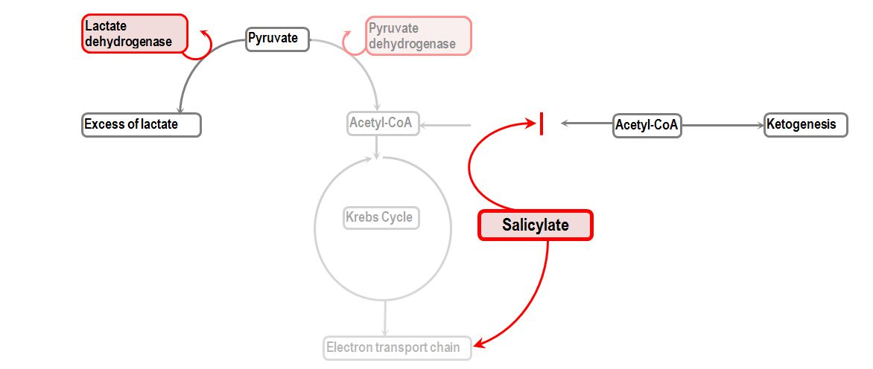
Toxic mechanisms

Slide 22
SALICYLATES
Clinical features
Hyperthermia is an indication of severe toxicity
Acute intoxication
Gastric effects: N & V, Gastritis
CNS effects: N & V, tinnitus, confusion, hallucinations, seizures
Metabolic effects: Hyperventilation, Acid-base disturbance (respiratory alkalosis, metabolic acidosis), dehydration, electrolyte disturbances, fever
Chronic intoxication
More common in elderly
Lower GI symptoms & higher non-specific neuro symptoms
Confusion, delirium, dehydration, metabolic acidosis, cerebral oedema

Slide 23
SALICYLATES
Lab tests
Salicylate level
If enteric coated preparations, serial salicylate levels (2 hourly)
15-30 mg/dL: therapeutic level
Higher than 40-50 mg/dL: symptomatic
Above 100 mg/dL: life-threatening toxicity
Arterial blood gas (ABG)
Respiratory alkalosis
Metabolic acidosis
Electrolytes, BUN/creatinine, glucose
Anion-gap metabolic acidosis
Hypokalemia
Baseline renal function
Imaging studies
Abdominal radiograph
Computed tomography (CT) scanning of the abdomen
Endoscopy

Slide 24
SALICYLATES
Management
Asymptomatic
Charcoal 1g/kg
I.V. bicarbonate infusion 1mmol/kg/hr to correct any acidosis (pH <7.3)
Symptomatic
Charcoal 1g/kg unless altered conscious state
Whole-bowel irrigation, hemodialysis
I.V. fluid resuscitation to correct dehydration (use N. Saline)
I.V. bicarbonate infusion 1mmol/kg/hr, after initial slow bolus of 2mmol/kg, (Alkalization, urine pH >7.5)
Potassium replacement (20–40 mEq KCl per liter)
Respiratory support ± haemodialysis in case of convulsion and coma
STABILIZATION THERAPY

Slide 25
SALICYLATES
Case study
A 22-years-old woman came to the emergency department complaining of abdominal pain, nausea, and vomiting. She had a history of depression but stated that she currently was not being treated by a psychiatrist or taking any psychiatric medications. Upon further questioning, the patient said that 6 hours earlier she had been severely depressed and had ingested at least half a bottle of aspirin tablets in a suicide attempt, after which she vomited once. She denied tinnitus but said that she was short of breath. She denied significant past medical or surgical problems.

Slide 26


Slide 27


