Slide 1
Laboratory Principles And Toxicological Screening

Slide 2
Introduction to Clinical Toxicology
Objectives
To learn applications of the principles of the drugs and chemicals-induced toxicity in humans, and gain experience in evaluation steps and treatment measures based on sample analyses and interpretation of toxicity sings and symptoms

Slide 3
Introduction to Clinical Toxicology
A 33 year old woman came to the ED
She found “down”
She took something, as reports from scene
No pill bottles on scene
No family with her
Person that found her are long gone
What should I do with her? How to treat her? Do I give her an antidote?.....?

Slide 4
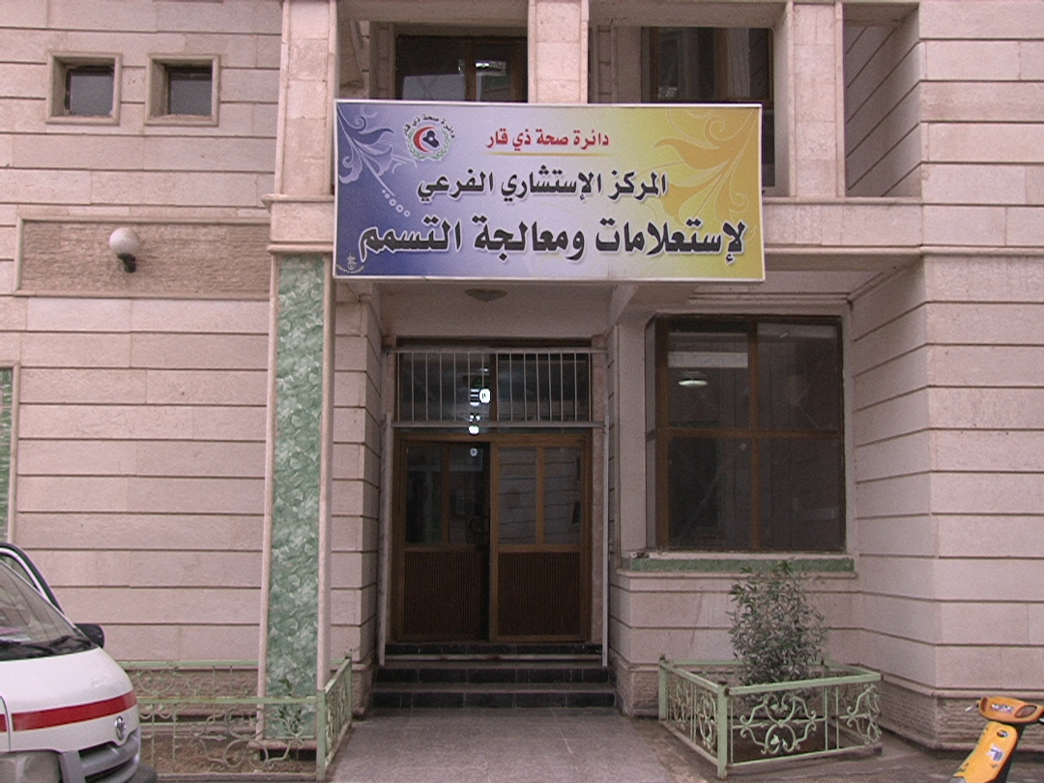
Introduction to Clinical Toxicology
The discipline within toxicology concerned with the toxic effect of
  Agents whose intent is to treat, ameliorate, modify, or prevent disease states, or the effect of drugs which, at one time, were intended to be used as such
  Agents used with non-therapeutic intent—for example, alcohol and drugs of misuse and chemical byproducts of industrial development
Clinical toxicology is focused on the diseases associated with short-term and long-term exposure to various toxic chemicals

Slide 5
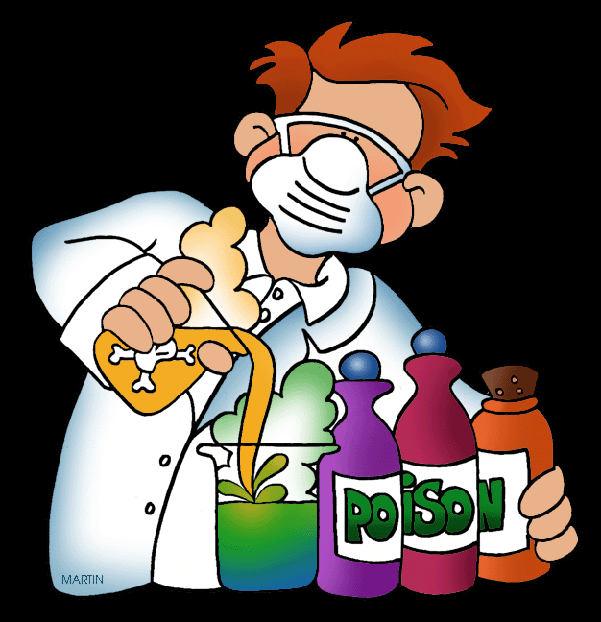

Introduction to Clinical Toxicology
Clinical toxicologists are Individuals who specialize in clinical toxicology
  Their work focuses around the identification, diagnosis, and treatment of conditions resulting from exposure to harmful agents
  They usually study the toxic effects of various drugs in the body, and are also concerned with the treatment and prevention of drug toxicity in the population

Slide 6
Introduction to Clinical Toxicology
Clinical toxicology is focused on the diseases associated with short-term and long-term exposure to various toxic chemicals. It typically coincides with other sciences such as biochemistry, pharmacology, and pathology
It focus on:
  Molecular responses to xenobiotics and the impact on the body
  Processes that determine the disposition of xenobiotics within the body
  Mechanisms responsible for the toxic effects of xenobiotics and their metabolites
Types of Toxicological testing include:
  Forensic toxicological analysis is conducted by laboratories for medical-legal purposes, which include death and criminal investigations
  Workplace drug testing is conducted by laboratories for administrative purposes, detecting misuses of drugs
  Diagnostic or hospital drug testing is conducted in laboratories to assist in medical treatment

Slide 7
Laboratory of Clinical Toxicology
A health care facilities have a systematic approach for the assessment of the poisoned or overdosed patient
Toxicological testing involves:
  History and physical examination
  Toxicological screening and lab. tests
Victim
Triage
History and physical exam.
Toxicology laboratory: Lab tests, Toxicological screening
Treatments: terminate exposure, prevent absorption,…etc.

Slide 8
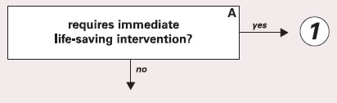
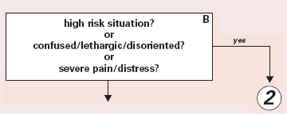
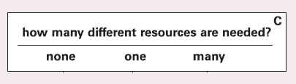
Triage, history and physical examination
Triage
A process for sorting injured people into groups based on their need for or likely benefit from immediate medical treatment
Is always the first step performed in the emergency department
immediate danger VS potential danger
Immediate danger, the goals of immediate treatment are patient stabilization and evaluation and management of airway, breathing, and circulation (ABCs)

Slide 9
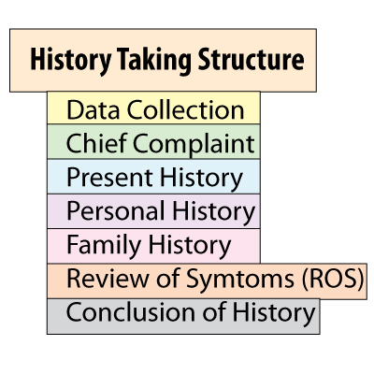
Triage, history and physical examination
History
Taking a good history is possibly more important for drug overdose than for other medical problems, it includes:
  Determine the mode of exposure (inhalation, ingestion, etc.)
  State of the toxin (solid, liquid, gas)
  Quantity
  Time of exposure, and other circumstances
  Age/weight, symptoms, reason for exposure, previous therapy

Slide 10
Triage, history and physical examination
Physical Examination
  A quick but thorough physical examination is essential
  Toxidrome, is a group of signs and symptoms associated with overdose or exposure to a particular category of drugs and toxins
  Focus on poison specific symptoms
  Rule out other medical conditions/trauma
  Are signs/symptoms consistent with history
    Vital signs: BP, HR, RR, T, O2 saturation
    Mouth: odors, mucous membranes
    Pupils
    Breath sounds
    Bowel sounds
    Skin
    Urination/defecation
    Neurologic exam

Slide 11
Triage, history and physical examination
Cholinergic Toxidrome
  SLUDGE
    Salivation, Lacrimation, Urination, Defecation, GI upset, Emesis
Opioids Toxidrome
  Respiratory depression
  Miosis
  Hypoactive bowel sounds
Sympathomimetics Toxidrome
  Hypertension
  Tachycardia
  Hyperpyrexia
  Mydriasis
  Anxiety, delirium

Slide 12
Toxicology Screen
  A toxicology screen refers to various tests to determine the type and approximate amount of legal and illegal drugs a person has taken
  This test is often done in emergency medical situations. It can be used to evaluate possible accidental or intentional overdose or poisoning
  Toxicology screening is most often done using a blood or urine sample. However, it may be done soon after swallowing the medication, using stomach contents that are obtained through gastric lavage or after vomiting
  If the test is used as a drug screen, it must be done during a certain time period after the drug has been taken or while forms of the drug can still be detected in the body. Examples: Amphetamines: 24 to 48 hour, and Barbiturates: up to 6 weeks

Slide 13
Toxicology Screen
Basic testing typically screens for the following, commonly-abused drugs
  Amphetamines
  Cannabinoids (marijuana, hashish)
  Cocaine
  Opiates (heroin, morphine, opium, codeine)
  Phencyclidine (PCP)
Extended testing might also screen for some or all of the following, but basic testing is the most common
  Barbiturates (phenobarbital, secobarbital)
  Benzodiazepines (tranquilizers like Valium, Librium, Xanax)
  Ethanol
  Hallucinogens (mushrooms, mescaline)
  Inhalants (paint, glue, hair spray)
  Anabolic Steroids (synthesized, muscle-building hormones)

Slide 14
Other Lab Tests
Other essential Lab tests may include:
  Routine labs Electrolytes
    Glucose
    BUN and creatinine
    Urinalysis, urine drug screen
    Serum osmolality
    Acetaminophen, salicylates
    Specific drug levels
    Pregnancy test
  Carboxyhemoglobin, Methemoglobin
  Radiographic Examination, for visualizing toxins like iron, lead

Slide 15
Other Lab Tests
Anion Gap
Na – (HCO3 + Cl)
Normal: 8-12 mEq/L (8-16)
Causes: Methanol, Uremia, Iron, isoniazid, ibuprofen, Lithium, lactic acidosis,…
Osmolar Gap
Measured osmolality – Calculated osmolality
Calculated osmolality = 2(Na) + glucose/18 + BUN/2.8 + Ethanol / 4.6
Normal = 285-290 mOsm/L
Gap > 10 mOsm/L suggests the presence of extra solutes:
  Alcohols: ethanol, mathanol
  Sugars, mannitol
  Lipids
  Proteins
Clinical Pearl: Anion gap acidosis with an osmolar gap should suggest methanol or ethylene glycol poisoning

Slide 16
General Treatments
Treatment begins with first aid at the scene and continues in the emergency department and often the intensive care unit (ICU)
  Terminate exposure
  Prevent absorption
  Enhance elimination
  Medications, antidotes

Slide 17
General Treatments
Terminate exposure
  Depends on route of exposure:
    Eye exposures – immediately flush eyes with water/saline for 15-20 minutes
    Dermal – Remove jewelry, clothing. Brush off powders. Immediately flush with water for 15 minutes (longer for caustics)
    Inhalation – Move to fresh air
    Injection/Bites and Stings – Remove clothing, jewelry that might constrict the extremity. Do not excise and apply suction to bites/stings
    Ingestion – Give a glass of water to dilute chemicals such as caustics

Slide 18
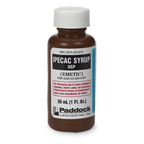
General Treatments
Prevent absorption:
  Indicated for recent ingestion, toxic substance, toxic amount.
  Syrup of Ipecac
    Ipecac may be used to induce emesis to treat unintentional ingestions
    Can be used at home if there are no contraindications
    Should be administered within 30-60 minutes of ingestion
    Use has declined markedly; limited role for management of poisonings in children
    Mechanism: direct irritant effect on GI mucosa and central emetic effect
    Emesis occurs in 95% of patients within 30 minutes.
    Contraindications: Lethargy, Seizures, Hydrocarbons, Caustics, foreign objects, and agents that produce rapid onset of CNS depression or seizures (e.g. cyclic antidepressants, camphor,..)
    Side effects include drowsiness , diarrhea, and aspiration pneumonitis

Slide 19
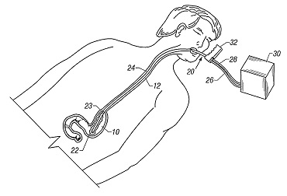
General Treatments
Prevent absorption:
  Orogastric Lavage
    Removes stomach contents through a large bore tube until the return is clear
    Little or no benefit over activated charcoal; consider for substances not adsorbed by activated charcoal
    Lumen size is a limitation, especially in children.
    Adverse effects: aspiration, cyanosis, epistaxis, esophageal perforation, hypothermia, fluid and electrolyte imbalances
    Activated charcoal is usually instilled following gastric lavage

Slide 20
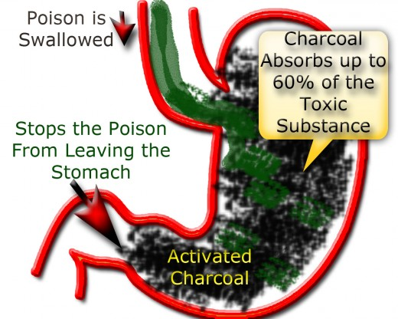
General Treatments
Prevent absorption:
  Activated Charcoal
    First line of therapy in the emergency department, the most commonly used method of gastric decontamination
    Adsorbs substances to prevent systemic absorption
    More effective than ipecac
    Prevents absorption of toxins beyond the stomach (unlike ipecac and lavage)

Slide 21
General Treatments
Prevent absorption:
  Activated Charcoal
    Dosage: 1 gram/kg administered orally or by nasogastric tube
    Adverse effects: aspiration pneumonitis, GI obstruction
    Cathartics: activated charcoal may be given with a cathartic (usually sorbitol or magnesium citrate) to hasten the elimination of the charcoal/toxin complex
    Second dose may be administered for single acute overdoses of drugs for which delayed or continued absorption occurs (e.g., carbamazepine, salicylates, valproic acid, sustained release or enteric coated preparations)
    Contraindicated if ileus is present or foreign bodies ingested
    Does not adsorb:
      Iron, lithium, sodium, lead, cyanide, Hydrocarbons, Caustics, and alcohols

Slide 22
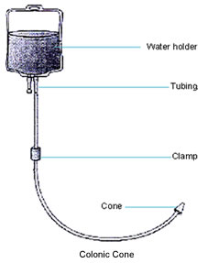
General Treatments
Prevent absorption:
  Whole Bowel Irrigation
    Flushes the GI tract
    Uses large volumes of isotonic polyethylene glycol electrolyte lavage solutions (Golytely, CoLyte)
    Reduces the absorption of iron, lead, and sustained-release drugs

Slide 23
General Treatments
Enhancing elimination
  Multiple dose activated charcoal
    Multiple-dose activated charcoal therapy involves the repeated administration (more than 2 doses) of oral activated charcoal to enhance the elimination of drugs already absorbed into the body
    Increases gastrointestinal clearance of substances
    Dosing: 20-50 g activated charcoal every 4 hours
    Indications: Consider for overdoses of dapsone (acute or chronic), phenobarbital (acute or chronic), phenytoin (acute only), theophylline (acute or chronic)
    Complications include aspiration and bowel obstruction

Slide 24
General Treatments
Enhancing elimination
  Hemodialysis/Hemoperfusion
    Indication: progressive deterioration despite intensive supportive care
    Examples:
      Hemodialysis: phenobarbital, salicylates, alcohols, lithium.
      Hemoperfusion: meprobamate, theophylline, phenobarbital
  Chelation
    Involves the use of binding agents to remove toxic levels of metals from the body, such as mercury, lead, iron, and arsenic
    Examples: dimercaprol (BAL in oil), calcium disodium edetate (EDTA), succimer (DMSA), and deferoxamine
    Concerns about the toxicity of the chelators; their tissue distribution characteristics; and the stability, distribution, and elimination of the chelator–metal complex make chelation a complicated procedure

Slide 25
General Treatments
Enhancing elimination
  Hyperbaric Oxygen Therapy (HOT)
    Oxygen is administered to a patient in an enclosed chamber at a pressure greater than the pressure at sea level (e.g., 1 atmosphere absolute)
    This therapy has been used in carbon monoxide and methylene chloride poisonings
    The small number of HBO chambers and lack of around-the-clock staffing limits the wide use of this therapy

Slide 26
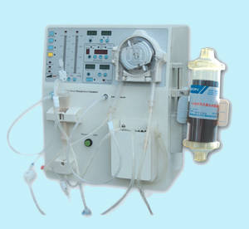
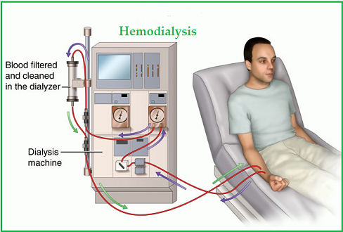
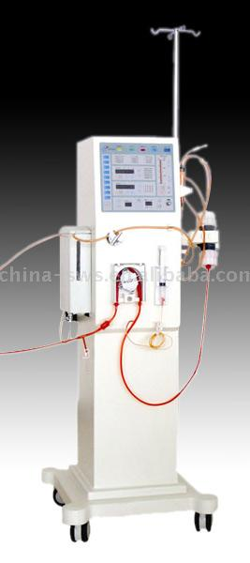
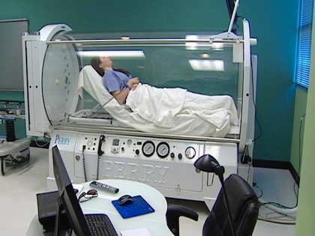

Slide 27
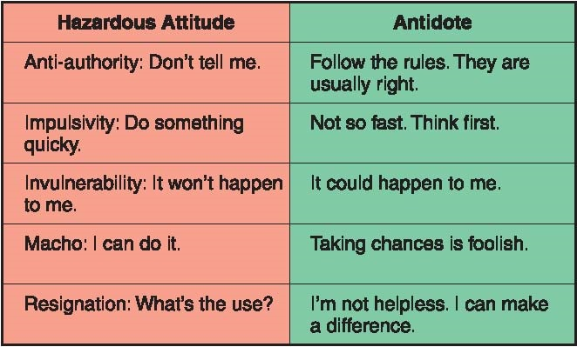
General Treatments
Antidotes
  Chemical agents, which attack or combine with the poison in such a way as to render it insoluble, and so inert
  Counter-poisons
  No one antidote is suited to all emergencies. The antidote is required to be adapted to the poison

Slide 28
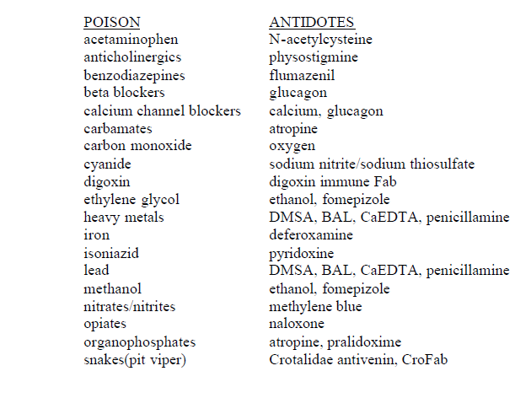
General Treatments
Antidotes

Slide 29
General Treatments
Continuous Patient Monitoring
  Seriously poisoned or overdosed patients may require continued monitoring for hours or days after exposure
Patient Teaching
  One of the interventions the nurse can perform in the emergency department or intensive care unit is preventive teaching
  All patients (and parents of pediatric patients) who have survived a toxic encounter should be taught how to prevent such an incident from recurring.

Slide 30
Practice
1. A dad calls about his 1-year-old, 8 kg child who was found with an open bottle of Extra strength Tylenol. The bottle looks almost as full as it did yesterday but dad isn’t sure if any are missing.
2. A 27-year-old man is in the ED following a suicide attempt with a methanol containing gas additive. His obtunded, responsive to pain with a respiratory rate of 28/min. Physical exam is normal. ECG, chest and abdominal x-rays are normal.
Serum chemistries: Na, 140 mEq/L, K, 3.0 mEq/L, Cl, 94 mEq/L, HCO3, 8
mEq/L, BUN, 12 mg/dL. ABGs: pH, 7.20, PCO2, 20 mmHg, PO2, 98 mmHg.
Serum methanol concentration = 67 mg/dL.
3. Mom calls to find out if amitriptyline is toxic. Her 12 year old is on amitriptyline and left the container out on the bathroom counter. The 2-year-old opened the safety closure and may have ingested some tablets.

Slide 31


