Slide 1
Digitalis toxicity

Slide 2
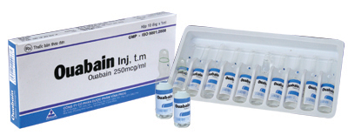

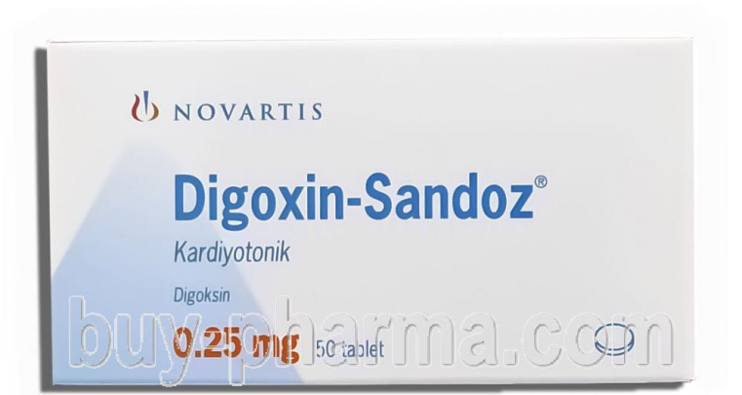
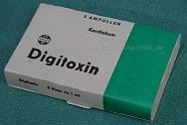
Cardiac glycosides
Digitalis is the oldest compound in cardiovascular medicine
Cardiac glycosides include digoxin, digitoxin, digitalis and ouabain
+ve inotropic, -ve chronotropic
Heart failure, Atrial fibrillation, Atrial flutter
Low TI

Slide 3
Mechanism Of Pharmacological Action
Potent inhibitors of cellular Na+/K+-ATPase
This ion transport system moves 3 sodium ions out of the cell and brings 2 potassium ions into the cell
Necessary for cell survival
Subsequent inhibit the Na+-Ca++ exchanger
Three sodium ions are exchanged for each calcium
An increase in intracellular sodium concentration competes for calcium through this exchange mechanism leading to an increase in intracellular calcium concentration, leading to increases contractility (inotropy)
Increase vagal efferent activity to the heart, reduces sinoatrial firing rate (decreases heart rate; negative chronotropy) and reduces conduction velocity of electrical impulses through the atrioventricular node (negative dromotropy)

Slide 4
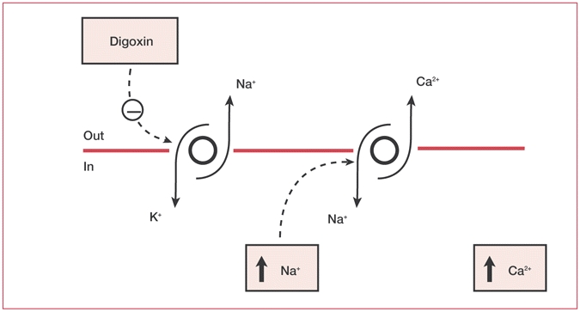
Mechanism Of Pharmacological Action

Slide 5
Kinetics
Volume of Distribution
Protein Binding
Half Life
Time to peak (serum)
5-7 L/kg
25%
Age, Renal, and cardiac function dependent
Approximately 38 Hours (parent drug)
Oral: 1-3 hours
Distribution phase: 6-8 hours
Steady state: 7-10 Days

Slide 6
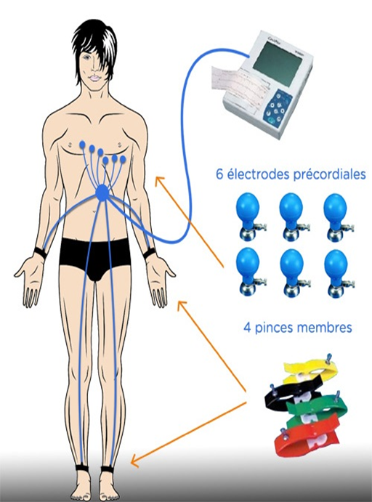
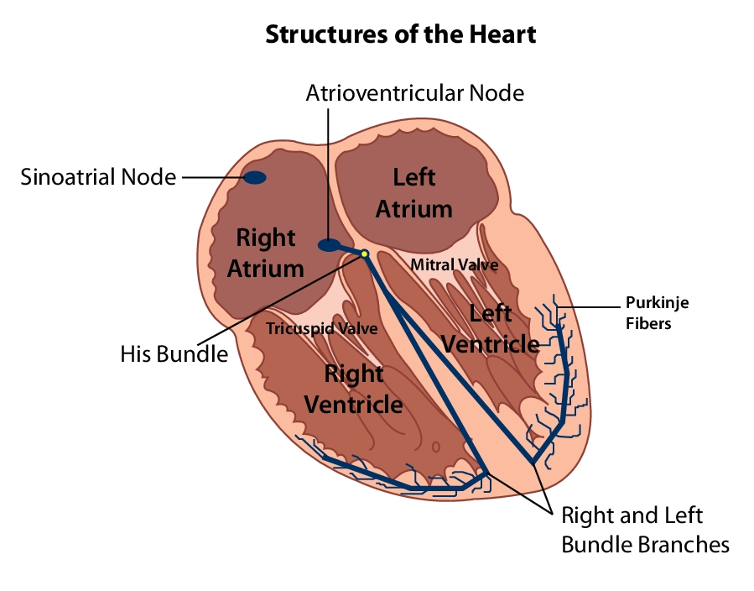
Electrocardiography (ECG)

Slide 7
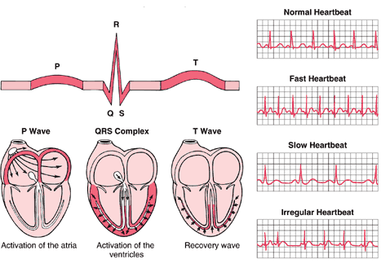
ECG

Slide 8
Digitalis toxicity
life-threatening condition, 1,500/year
In 2011, there were 2,513 cases involving cardiac glycosides reported to U.S. poison control centers. Of these, 90 experienced major effects (i.e, life threatening resulting in prolonged hospitalization) and 26 died
Low TI
Therapeutic levels are 0.6 to 2 ng/mL
levels of toxicity between therapeutic and toxic ranges
Acute toxicity
cardiac effects
nausea and vomiting
Chronic toxicity
cardiac effects
nonspecific symptoms include fatigue, malaise, and visual disturbances

Slide 9
Digitalis toxicity
Causes
High levels of digitalis in the body (over dose)
Accumulation during chronic treatment
Decreased tolerance to the drug, have normal levels of digitalis in blood
Risk factors
Electrolyte Imbalance
Potassium loss (thiazide)
Low levels of magnesium
Hypercalcemia
Quinidine, flecainide, verapamil, amiodarone.
Kidney failure and dehydration

Slide 10
Signs/symptoms of acute toxicity
Gastrointestinal
Neurological
nausea, vomiting, abdominal pain
weakness, confusion, Photophobia
Electrolyte
Cardiac
Hyperkalemia (> 5.5 mEq/L is a poor prognostic sign)
Palpitations, bradycardia, heart block, several types of arrhythmias, and Shortness of breath

Slide 11
Signs/symptoms of chronic toxicity
Gastrointestinal
Neurological
Less than that of acute digoxin toxicity (nausea, anorexia)
confusion, drowsiness, headache, hallucinations
Visual
sensitivity to light, yellow halos around lights, blurred vision

Slide 12
Diagnosis
Serum digoxin level
Electrolytes
Renal function studies
ECG

Slide 13
Diagnosis
Serum digoxin level
Toxicity begins >2.0 ng/mL
May be misleading in the acutely poisoned patient
False-negative assay results may occur with acute ingestion of non-digoxin cardiac glycosides (eg, foxglove or oleander)
Digoxin’s long distribution phase results in high serum levels for 6-10 hours prior to completed tissue distribution

Slide 14
Diagnosis
Electrolytes
Hyperkalemia
Chronic toxicity: hypokalemia and hypomagnesemia
Kidney function tests
BUN
Creatinine

Slide 15
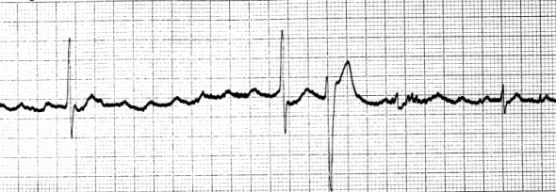
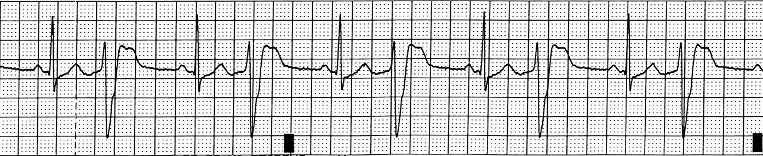
Diagnosis
ECG
May cause almost any dysrhythmia
atrial tachycardia with a 2:1 conduction
bidirectional ventricular tachycardia
atrial fibrillation with a slow ventricular response
atrial tachycardia with block
Sinus rhythm with frequent PVCs in a pattern of ventricular bigeminy

Slide 16
Treatments
Decontamination/enhanced elimination
For acute overdose: Activated charcoal, multiple dose activated charcoal, gastric lavage
Enhanced elimination (dialysis, hemoperfusion) does not effectively remove digoxin due to large volume of distribution and relatively high protein binding

Slide 17
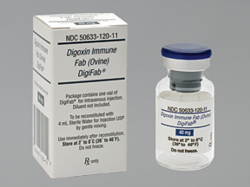
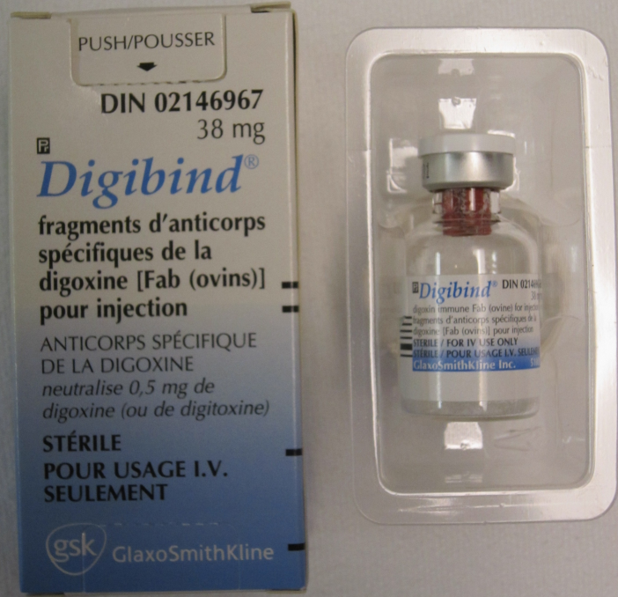
Treatments
Digoxin immune Fab (ovine)
Antidote, highly effective in treating life-threatening signs of digoxin toxicity such as hyperkalemia, hemodynamic instability, and arrhythmias
Primary treatment of digoxin toxicity
Indications:
Ingestion of 10 mg of digitalis (in children, 4 mg)
Serum digoxin level greater than 8 ng/mL in adults at steady state
Hyperkalemia (greater than 5 mEq/L)
Altered mental status
Rapidly progressive signs and symptoms of toxicity

Slide 18
Treatments
DigiFab (40 mg of Fab), binds 0.5 mg digoxin
30 minute slow IV infusion
Acute ingestion of unknown amounts and serum concentration of digoxin:
20 vials of Digoxin immune fab (ovine)
Can split dose into 10 vials followed by another 10 vials to avoid a febrile reaction
Chronic ingestion unknown serum digoxin concentration
6 Vials of Digoxin immune fab (ovine) in adults and Children > 20 Kg
1 Vial of Digoxin immune fab (ovine) in infants and Children < 20 Kg

Slide 19
Treatments
For known amounts of digoxin
Dose In Vials =
Digoxin ingested (mg) X 1.6
Round up to the nearest vial

Slide 20
Treatments
For known digoxin serum concentration
(Serum Digoxin ng/mL) x Weight (kg)
Dose In Vials =
100
Round up to the nearest vial

Slide 21
Treatments
Digoxin immune Fab
Adverse Effects
Digitalis withdrawal: exacerbation of HF, rapid ventricular response and postural hypotension
Hypokalemia
Phlebitis
Fever, May occur with doses above 10 vials
Warning
Patients who require digoxin’s inotropic action may deteriorate secondary to the withdrawal of digoxin
Additional inotropic support may be required for these patients (e.g, dopamine, dobutamine or vasodilators)

Slide 22
Treatments
Electrolyte imbalance
Hyperkalemia, use insulin plus glucose, and sodium bicarbonate if the patient is acidotic
Hemodialysis may be necessary for uncontrolled hyperkalemia
Correct hypokalemia (usually in chronic intoxication)
Concomitant hypomagnesemia may result in refractory hypokalemia
Dysrhythmias
Short-acting beta blockers (eg, esmolol) may be helpful for supraventricular tachyarrhythmias with rapid ventricular rates, but may precipitate advanced or complete AV block
Phenytoin and lidocaine are useful for ventricular tachycardia
Phenytoin can suppress digitalis-induced tachydysrhythmias
Atropine has proved helpful in reversing severe sinus bradycardia
Magnesium sulfate may terminate dysrhythmias

Slide 23
Digoxin Toxicity: Case Study
76 year old woman with history of atrial fibrillation, hypertension, renal impairment, breast cancer, osteoarthritis. Stroke 1 month prior to admission.
Medications: digoxin 250 mcg once daily, amlodipine, lisinopril, indapamide SR, simvastatin, clopidogrel, bisoprolol, omeprazole, erythromycin
Presents with nausea, vomiting, change in vision, lethargy
VS: BP “normal”; HR 35-38 bpm
Labs
Digoxin levels: prior to admission: 3.4 ng/mL (0.8-2 ng/mL normal range for this lab)
On admission: 2.9 ng/mL
Increased digoxin dose from 125 mcg/day to 250 mcg/day 28 days ago

Slide 24
Digoxin Toxicity: Case Study
Summary: elderly patient with renal impairment, signs/symptoms of (chronic) digoxin poisoning with elevated digoxin level
Potential drug interactions:
Amlodipine
Bisoprolol
Erythromycin
(Ca⁺² channel blocker) can increase digoxin level and enhance digoxin AV blocking effect
(ß blocker) can enhance digoxin’s bradycardic effect
(macrolide antibiotic) can increase digoxin level

Slide 25
Digoxin Toxicity: Case Study
Received digoxin-specific antibody fragments (Fab)
Weight 108 kg
Digoxin level: 2.9 ng/mL
(Serum Digoxin ng/mL) x (Weight in kg)
Fab Dose In Vials =
100
3 vials administered

Slide 26
Digoxin Toxicity: Case Study
6 hours post digoxin Fab infusion: digoxin 1.9 ng/mL
At discharge (91 hours post digoxin Fab infusion): digoxin 1 ng/mL, HR 65 bpm, digoxin toxicity signs/symptoms resolved
Monitoring
HR: improved (35-38 bpm to 65 bpm at discharge)
BP: remained stable
EKG: unchanged from baseline (atrial fibrillation)
K⁺ not provided in this report (although this was a chronic toxicity not acute)

Slide 27

Digoxin Toxicity: Case Study
Approaches to digoxin poisoning in the chronically poisoned patient will depend on the status of the patient (signs/symptoms, age, renal function, cardiac status)
This was an elderly patient with impaired renal function who clearly had digoxin toxicity and an elevated level.
The clinical decision was made to treat promptly with digoxin Fab rather than prolong her clinical course.

Slide 28


