Slide 1
Three Component (ternary) Systems Containing Liquid Phases
(part 1)
By:
Lena Murad Thomas
College of pharmacy/University of Baghdad

Slide 2
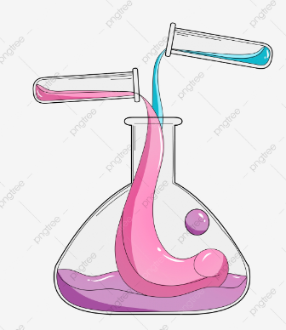
What happens when you add a third liquid to a system composed of 2 liquids (binary system) ?
For a binary system composed of two miscible liquids
the composition of the new
three component (ternary) system
depends on
the relative solubility of the added (third) liquid in the two liquids
If the added third liquid has similar miscibility in both liquids
If the added third liquid has different miscibility in both liquids
the complementary miscibility of the two liquids is increased
the miscibility of one liquid in the others will be lowered

Slide 3
THREE COMPONENT SYSTEM HAVING A PAIR OF MISCIBLE LIQUID
Example: Benzene , water and ethanol system
addition of
sufficient alcohol
to a
two phase system
would give a
single phase system composed of all the
three components
Benzene
Non polar
Ethanol
intermediate polar solvent
Miscible with both water and benzene
Water
Highly polar
Benzene + water = slightly miscible and produce a binary system.
Alcohol + water = completely miscible and produce a single phase system.
Alcohol + benzene = completely miscible and produce a single phase system.
Notes:
Benzene and water are slightly miscible and they produce a binary system.
Alcohol is completely miscible with both the solvents.
Thus, it is expected that additions of sufficient alcohol to a two phase system would give a single phase system composed all the three components.
Addition of alcohol leads to complete miscibility of two solvents which is achieved by solvent effect.
Water is highly polar whereas benzene is non polar, alcohol is as an intermediate polar solvent that provides the electronic equilibrium and provides solvation

Slide 4
Rules of a construction and interpretation of phase diagram for three component liquid systems

Slide 5
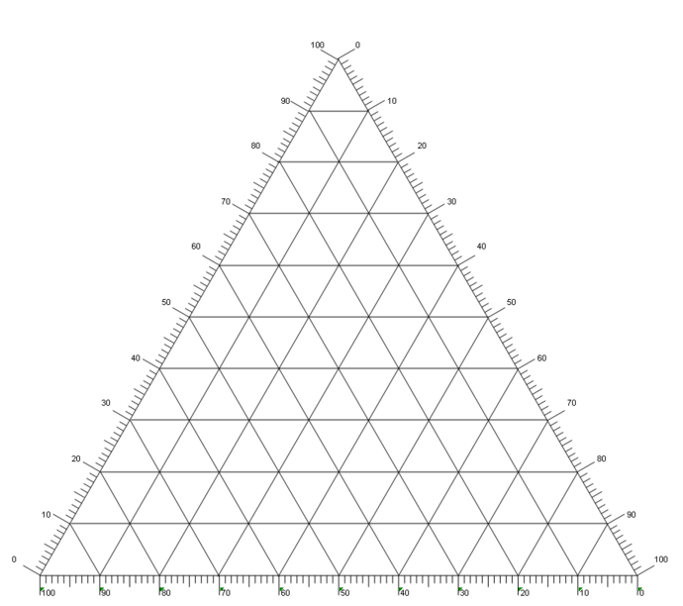
Construction of phase diagram for 3 component liquid system
You can not use:
ordinary graph paper
You need to use:
triangle (ternary) plot

Slide 6
What is a triangle plot ?
A liquid acting as a cosolvent for two partially miscible liquids is usually located on top of the triangle
An equilateral triangle also known as Gibbs phase triangle or composition triangle.
Each of the apexes of the equilateral triangle represents 100% of one component in terms of weight and 0% of the remaining two components.
100% A
Any point inside the triangle represents a three component system having all the possible combinations of the ternary system A, B, and C.
A point located on the three lines (AB, BC, CA) joining the apex points represent a two component (binary) systems of A/B, B/C and A/C.
100% C
100% B
The concentration of the components in ternary systems is expressed in terms of weight basis
Notes:
WHAT IS A TERNARY PLOT?
A ternary plot is a useful chart for vizualing three variables which (almost always) sum to a constant. This constant is usually 1.0 or 100%.
There are three axes, one for each component. In each "corner" of the triangle we're at 100% of one of the soil types. On the axis opposite to the corner, the soil type is at 0% — ie there's none of it in the sample.

Slide 7
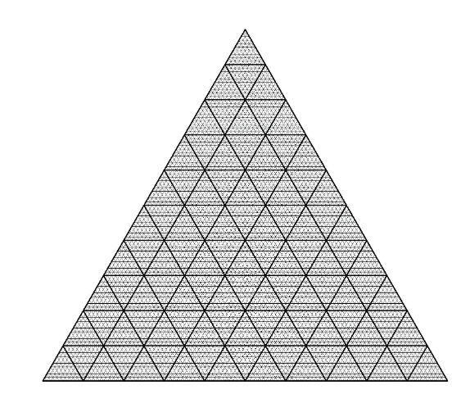
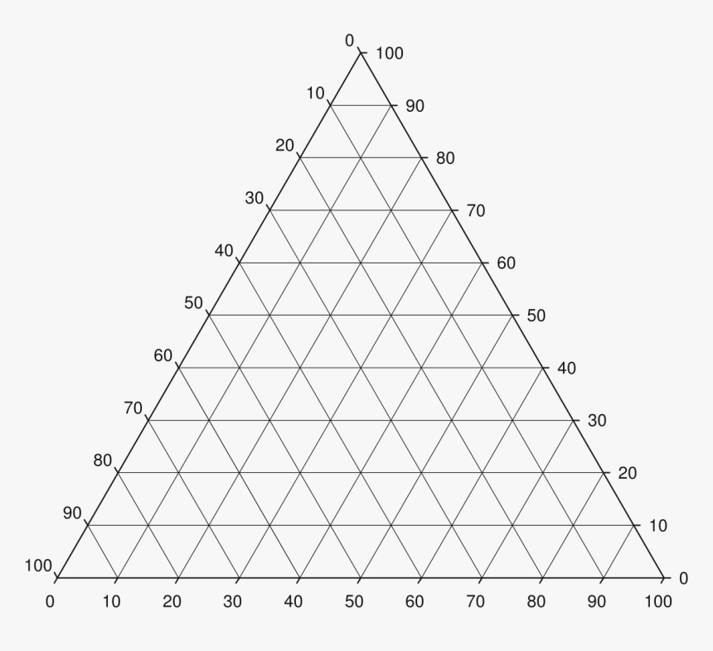
How to read compositions in Gibbs phase triangle ?
For convenience in reading composition, an equilateral triangle may be ruled with lines parallel to the sides, and each side of the triangle is divided into 100 equal parts.

Slide 8
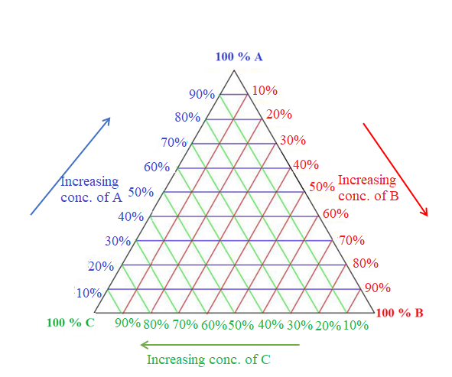
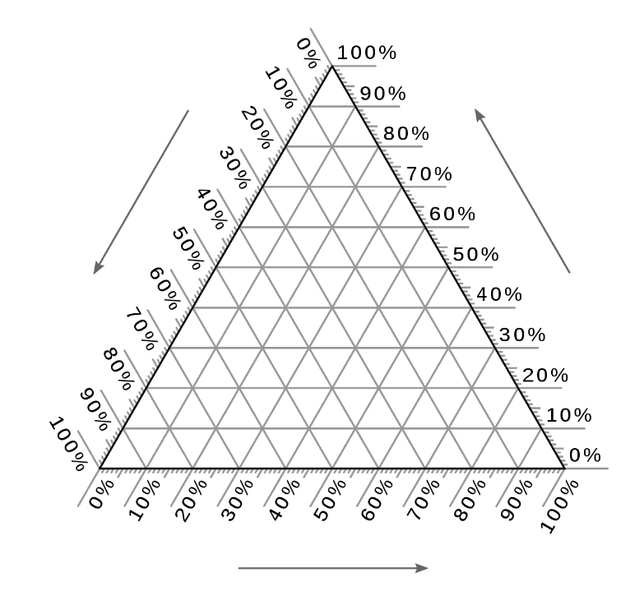
How to read compositions in Gibbs phase triangle ?
In going along a line bounding the triangle corners together, it doesn’t matter whether we proceed in a clock wise or counter clock wise direction around the triangle, provided that we are consistent as we move (for convenience, we will proceed clock wise direction)

Slide 9
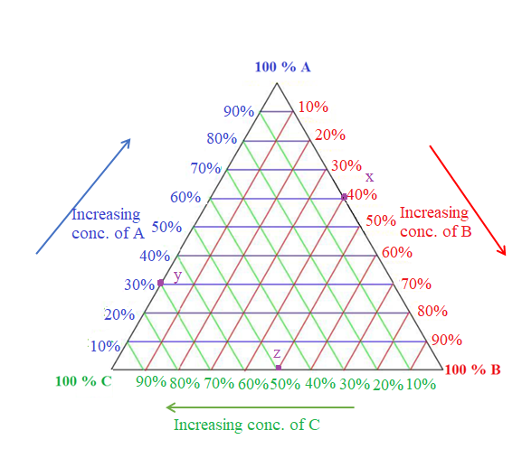
What are the compositions of systems represented by points x, y and z ?
System | % A (w/w) | % B (w/w) | % C (w/w)
X
Y
Z

Slide 11
What is the compositions of system represented by point w?
System | % A (w/w) | % B (w/w) | % C (w/w)
W
w

Slide 12
Where will be the position of system v having a composition of 10% (w/w) A, 20 % (w/w) B, 70 % (w/w) C ?

