Slide 1
Pharmaceutical measurements
Assist. Lecturer Noor Mohammed Dawood

Slide 2
# The pharmaceutical preparation, as the final form used for medication, should be: 1-Effective 2-Safe 3-Accurate quantitatively and qualitatively. . ------------------------------------- #The pharmacist should be aware of: 1-weighing of solids(weight measurement). 2-volume measurement of liquids. 3-Calculations .

Slide 3
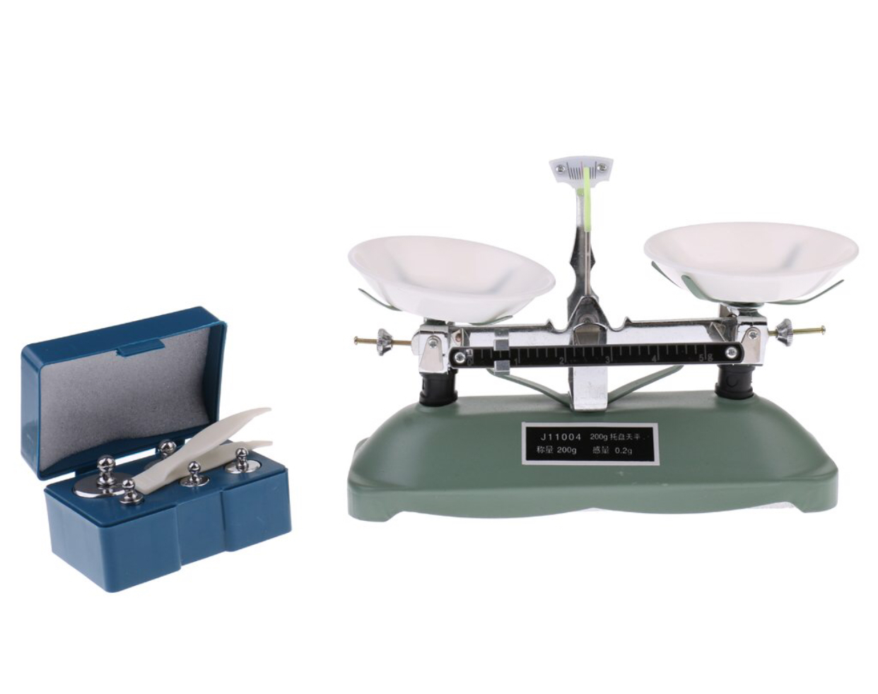
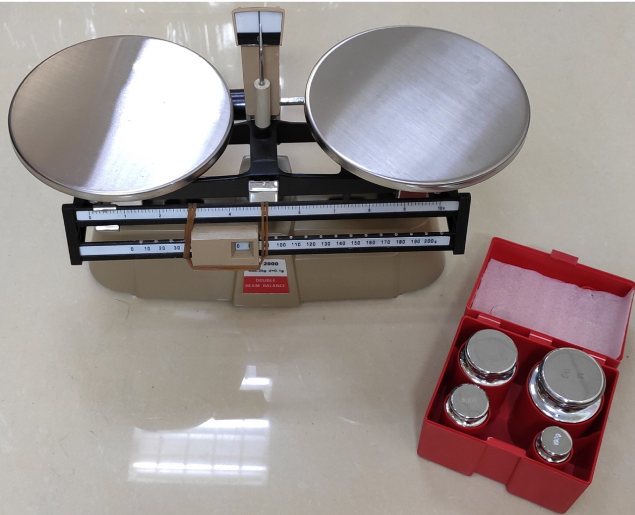
Weights
Weight is measured by means of balance ,there are different types of balance for rough weights( double beam balance) ,others for highly accurate and sensitive weights( electronic balance).

Slide 4
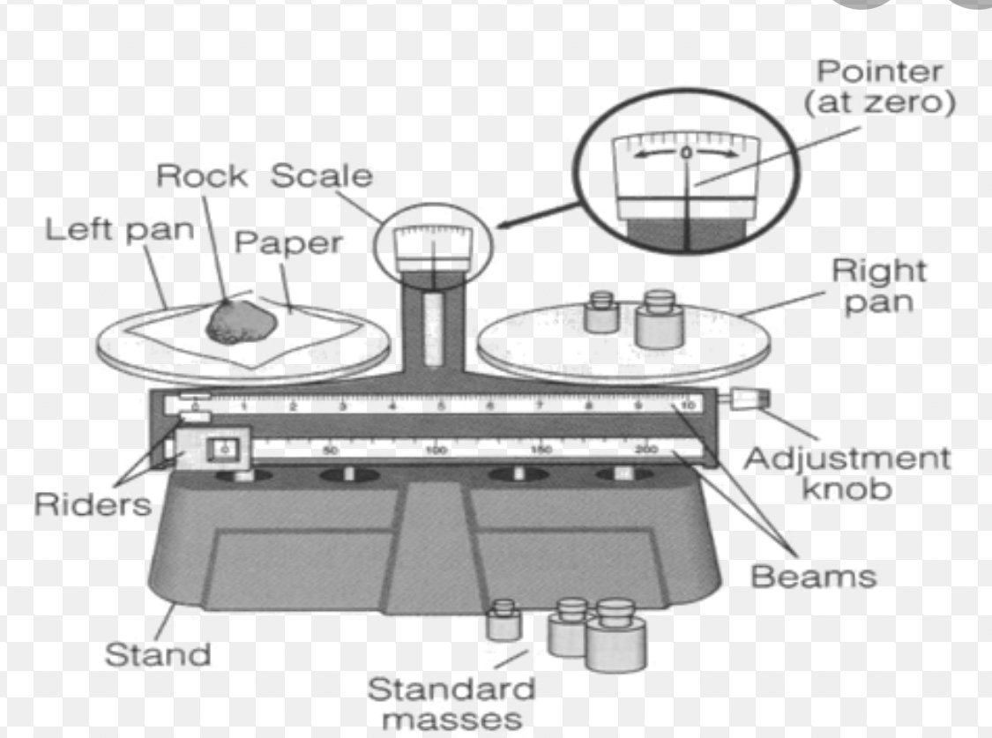
Dubble beam balance(mechanical balance)

Slide 5
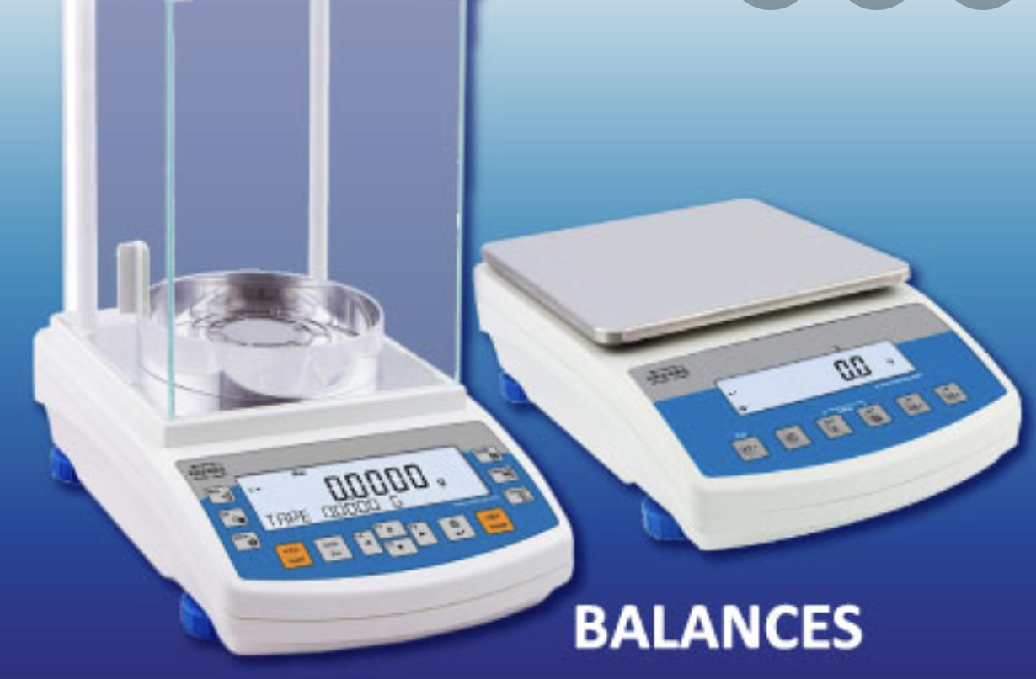
Electronic balances

Slide 6
Rules for use and care of balance
1-The balance should be located in a well –lightened place ,as free as possible from vibration ,dust, moisture and corrosive vapor . 2- The balance should be kept clean at all times .Any chemicals spilled on balance should be removed immediately with soft brush or clean dry towel. 3-watch glass should be used for weighing solids, stoppered bottle should be used for corrosive substance or liquids. 4-Never place materials to be weighted directly on the pan . 5-check to see if the balance is adjusted including zeroing of it ,also check the adjustment of the balance before each weighing.

Slide 7
Sources of errors in weight measurement
1-Current of air.
2-failure in zeroing of balance.
3-posture of the balance (should be put on smooth surface).

Slide 8
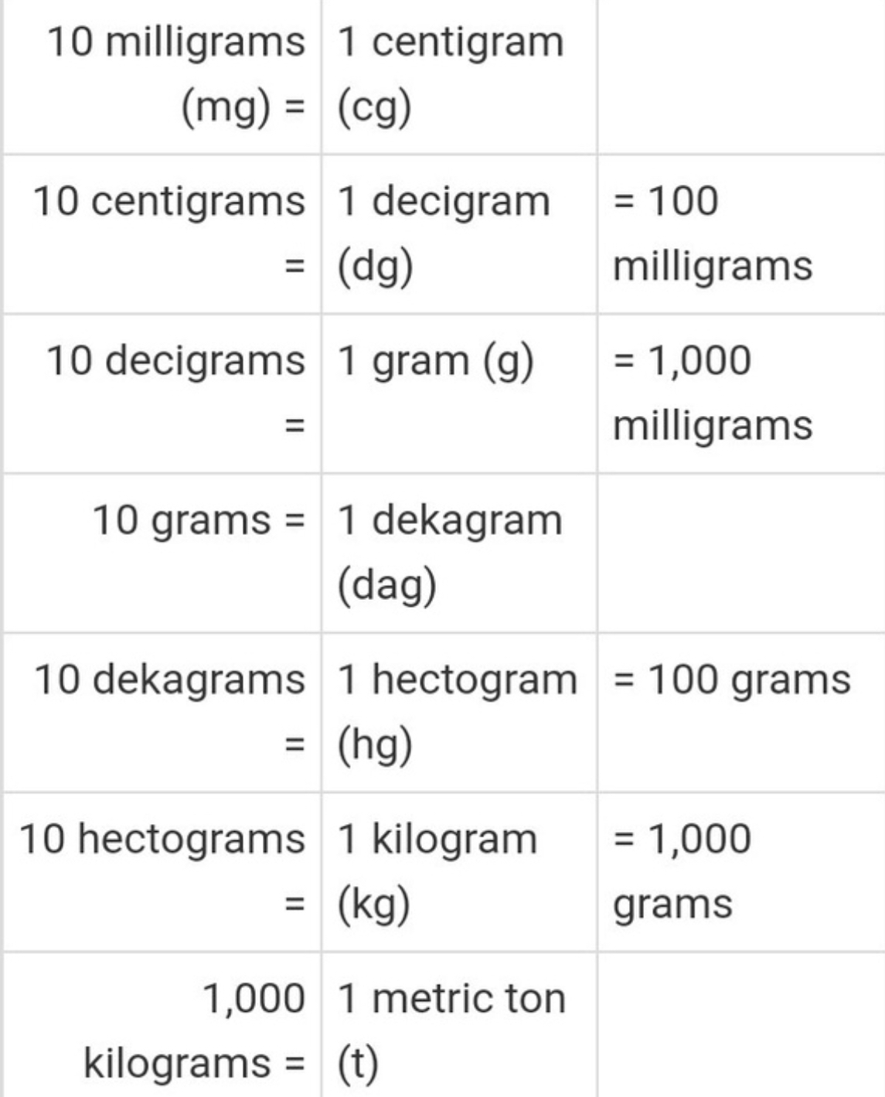
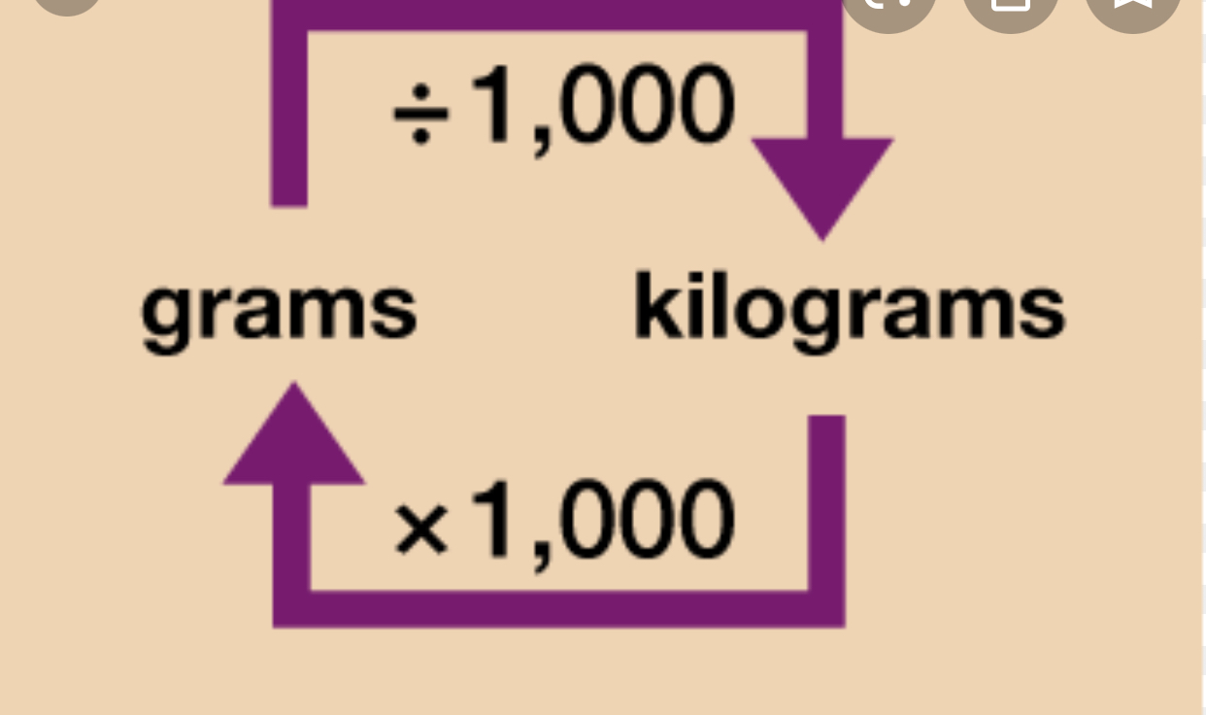
System of measuring weight
There are two systems:
1-Imperial system : units of weight in this system are: grain (gr.),drachm (ʒ),ounce
Pound(Ib).
2-Metric system : units of weight in this system are: gram( gm), kg, Mg ,mg.

Slide 9
Relationship between metric and imperial system for weight measurement
1 gr =65mg = 0.065 gm
1gm =15.432 gr
1ʒ =15 gm
1 ounce = 30 gm
1 ounce = 480 gr
1Kg = 2.2 Ib

Slide 10
Procedure for weight measurement
1-Conversion from Imperial to metric system.
2-Put the balance on smooth surface and clean it.
3-Zeroing the balance.
4-Moving the pointer to desiend weight .
5-Adding the chemical substances on left pans gradually until we get the desired weight (equilibrium).

Slide 11
Thank you for listening

