Slide 1
Industrial pharmacy lab Micrometrics

Slide 2
Micromeritics
Micrometrics: Science of small particles
Particle: the smallest unit of matter having defined physical dimension.

Slide 3
Micromeritics
Why study particles?
Most drug dosage forms are solids
Solids are not static systems →
physical state of particles can be changed by physical manipulation → alter the therapeutic effectiveness

Slide 4
Micromeritics
Particle size
Particle shape
Bulk volume
Flowability

Slide 5
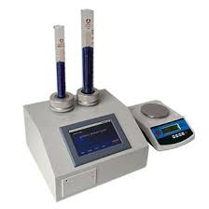
Micromeritics - Bulk volume
Used to calculate bulk density

Slide 6
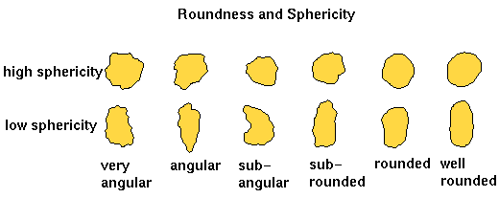
Micromeritics – particle shape

Slide 7
Micromeritics - Flowability
The ease with which a powder will flow under a specified set of conditions. Some of these conditions include:
The pressure on the powder,
The humidity of the air around the powder
The equipment the powder is flowing through or from

Slide 8
Particle Size Analysis
Why we do particle size analysis?
Bioavailability: particle size controls the dissolution rate
particle size ↑ dissolution rate ↓
Stability: especially for suspensions where the rate of settlement is directly related to the particle size.
Formulation: the particle size affects formulation behavior during processing, and ultimately the content uniformity of the formulation

Slide 9
Determination of Particle Size
Particles are not uniform in shape → complicate particle size determinations
The selection of suitable technique depends on:
Solubility
Ease of handling
Time restrictions

Slide 10
Methods for measuring particle size
Microscopic method
Sieving method
Coulter counter method
Sedimentation method

Slide 11
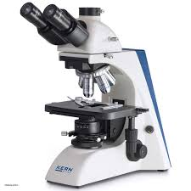
Microscopic Method
Use a calibrated ocular microscope to count a minimum of 200 particle in a single plane.
The particle size usually between 0.2 – 100 μm.

Slide 12
Microscopic Method
Advantage of microscopic method:
We can examine each particle individually
Disadvantages of microscopic method:
We measure two dimensions only
Time consuming and need an experienced staff.

Slide 13
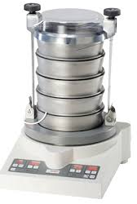
Sieving Method
Use set of standard sieves arranged in descending order:
The powder is placed in the top sieve and the sieves are shaken .
The quantity of powder remaining on each sieve are weighed.

Slide 14
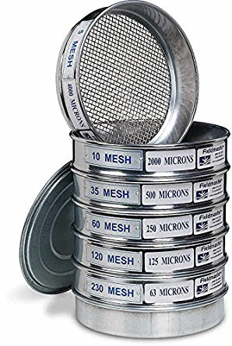
Sieving Method
Sieves can be referred by their size or by mesh size
Mesh number: number of square opening across 1 inch of screen
Typically 90% or more of the particles
will lie within the indicated range.

Slide 15
Sieving Method
Factors affecting sieving method
Sieve loading
Agitation duration
Agitation intensity

Slide 16
Sieving Method
Advantages of sieving method:
Easy to perform.
Wide range of sizes can be obtained.
Inexpensive
Disadvantage of sieving method:
Wear and damage to the sieve.
Weight loss.
Particles with irregular shape will be difficult to measure.

Slide 17
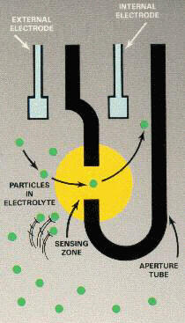
Coulter Counter Method
A particle is suspended in conducting liquid and passed through a small orifice.
This orifice has electrodes on either sides.
As particle passes, it displaces its own volume of electrolyte and a change in electric resistance occurs
This change is amplified and calibrated in term of particle size.

Slide 18
Coulter Counter Method
Advantages:
True volume of distribution.
Wide range measurement 0.5 – 400 μm.
Very fast, can count 4000 particle per second.

Slide 19
Sedimentation Method
Gravitational sedimentation (originally the pipette method) measures the settling rate of particles in liquid medium and relates this rate to the particle mass by use of the Stokes law.

Slide 20
Sedimentation Method
The settling rate during sedimentation analysis is determined by measuring x-ray transmission in the liquid at specific heights and time intervals
Particle size distribution based on difference in mass is calculated.
Allows high-resolution measurements within a relatively short time frame.

Slide 21
Experimental work
Measure particle size and size distribution of a powder using 2 methods
Submit a report with you results
Discuss your results with lab instructors

Slide 22
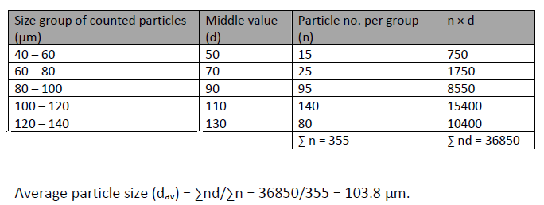
A) Microscopic method

Slide 23
B) Sieving method

Slide 24
Particle size distribution
When the number or weight of particles lying within a certain size range is plotted against range or mean particle size, the resulted curve called frequency distribution curve

Slide 25
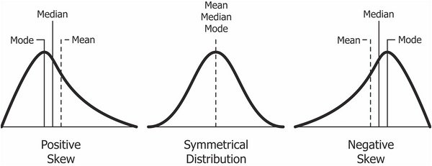
frequency distribution curve
Normal distribution curve is symmetrical about vertical axis but most pharmaceutical distribution are asymmetrical.

Slide 26
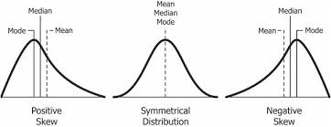
The plot gives a visible representation of particle distribution that an average diameter cannot achieve.
It is possible for two sample to have the same average diameter but different distribution. In addition.
By having a quick look on the curve, one can have an idea about which particle size occurs most frequently within the

