Slide 1






























Slide 2


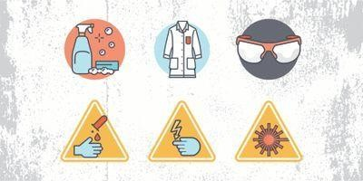




Occupational safety and health
Having a strong set of overall laboratory safety rules is essential to avoiding disasters in the lab.
Lab Manager recently scoured the safety policies of several laboratories to determine some of the most common lab safety rules out there to help you whether you’re developing or updating a set of policies for your lab.

Slide 3








Of course, safety rules are only effective when they are enforced, which is why strong lab management is so important to a safe laboratory as well.
Knowing the proper laboratory safety signs and symbols is also important. Here are the safety rules that most commonly came up in our look at several laboratories’ policies:

Slide 4








General lab safety rules
The following are rules that relate to almost every laboratory and should be included in most safety policies. They cover what you should know in the event of an emergency, proper signage, safety equipment, safely using laboratory equipment, and basic common- sense rules:
Be sure to read all fire alarm and safety signs and follow the instructions in the event of an accident or emergency.
Ensure you are fully aware of your facility's/building's evacuation procedures.
Ensure you know where your lab's safety equipment—including first aid kit(s), fire extinguishers, eye wash stations, and safety showers is located and how to properly use it.

Slide 5
4) Know emergency phone numbers to use to call for help in case of an emergency.
5) Lab areas containing carcinogens, radioisotopes, biohazards, and lasers should be properly marked with the appropriate warning
signs.
Asst. Prof. Wasan abdul Razzaq Asst. Prof. Ruaa Muhammed Dhedan
Open flames should never be used in the laboratory unless you have permission from a qualified supervisor.
Make sure you are aware of where your lab's exits and fire alarms are located.
An area of 36" diameter must be kept clear at all times around all fire sprinkler heads.
If there is a fire drill, be sure to turn off all electrical equipment and close all containers .

Slide 6








Always work in properly ventilated areas.
Do not chew gum, drink, or eat while working in the lab.
Laboratory glassware should never be utilized as food or beverage containers.
Each time you use glassware, be sure to check it for chips and cracks. Notify your lab supervisor of any damaged glassware so it can be properly disposed of.
Never use lab equipment you are not approved or trained by your supervisor to operate.
If an instrument or equipment fails during use or isn't operating properly, report the issue to a technician immediately. Never try to repair an equipment problem on your own.

Slide 7








If you are the last person to leave the lab, make sure to lock all the doors and turn off all ignition sources.
Do not work alone in the lab.
Never leave an ongoing experiment unattended.
Never lift any glassware, solutions, or other types of apparatus above eye level.
Never smell or taste chemicals.
Do not pipette by mouth.

Slide 8








Make sure you always follow the proper procedures for disposing of lab waste.
Report all injuries, accidents, and broken equipment or glass immediately, even if the incident seems small or unimportant.
If you have been injured, yell out immediately and as loud as possible to ensure you get help.
If a chemical splashes into your eye(s) or on your skin, immediately flush the affected area(s) with running water for at least 20 minutes.
If you notice any unsafe conditions in the lab, let your supervisor know as soon as possible.

Slide 9








Dress code safety rules
As you’d expect, laboratory dress codes set a clear policy for the clothing employees should avoid wearing in order to prevent accidents or injuries in the lab. For example, skirts and shorts might be nice for enjoying the warm weather outside but quickly become a liability in the lab, where skin can be exposed to heat or dangerous chemicals.
Always tie back hair that is chin-length or longer.
Make sure that loose clothing or dangling jewelry is secured, or avoid wearing it in the first place.
Never wear sandals or other open-toed shoes in the lab. Footwear should always cover the foot completely.
Never wear shorts or skirts in the lab.
When working with Bunsen burners, lighted splints, matches, etc., acrylic nails are not allowed.

Slide 10








Personal protection safety rules:
Unlike laboratory dress code policies, rules for personal protection cover what employees should be wearing in the lab to protect themselves from various hazards, as well as basic hygiene rules to follow to avoid any sort of contamination.
When working with equipment, hazardous materials, glassware, heat, and/or chemicals, always wear face shields or safety glasses.
When handling any toxic or hazardous agent, always wear the appropriate gloves.
When performing laboratory experiments, you should always wear a smock or lab coat.
Before leaving the lab or eating, always wash your hands.
After performing an experiment, you should always wash your hands with soap and water.
When using lab equipment and chemicals, keep your hands away from your body, mouth, eyes, and face.

Slide 11
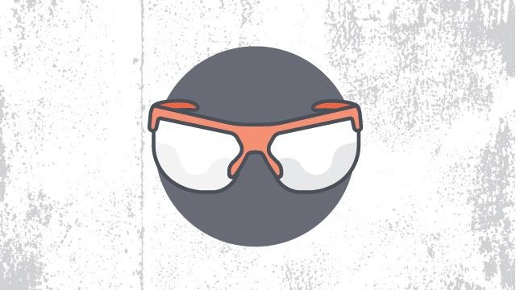
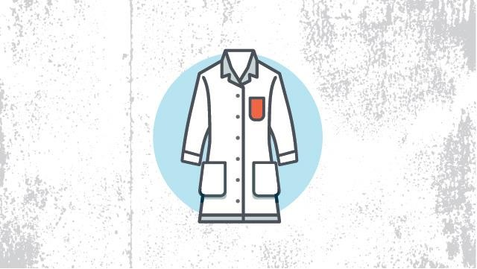
personal protection cover

Slide 12


Thank you

