Slide 1
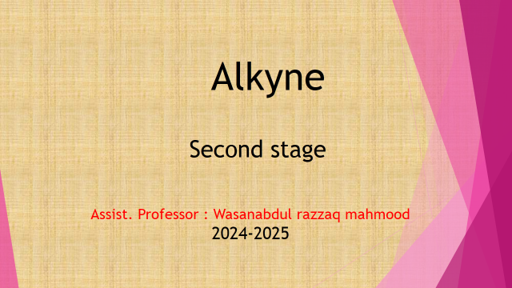

Slide 2
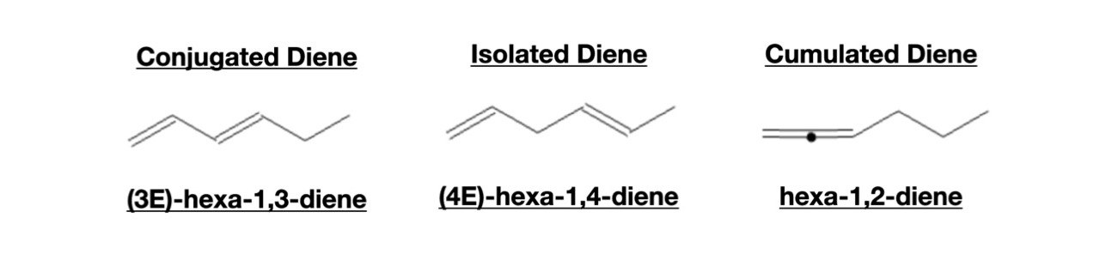
DIENES : Structure and properties
Diene is an unsaturated compound containing two double bonds between carbon atoms. Diene is used in industries as a monomer subunit of complex polymer. It is also used in Organic Synthesis

Slide 3
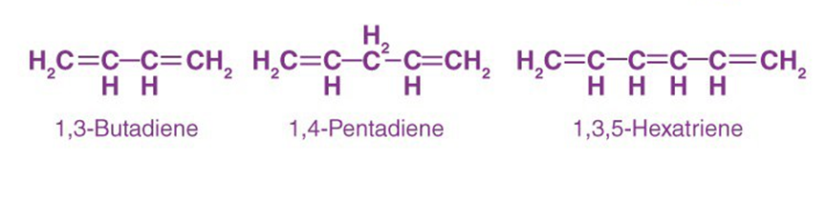
Nomenclature of Diene
IUPAC names Dienes in the same way as alkenes are named.
In the end, we use diene as a suffix.
In the beginning, we use two numbers to specify the position of two double bonds.
Example

Slide 4
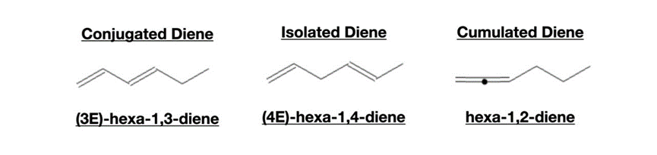
Classes of Diene:
Based on the relative position of the double bond in the overall molecule,
Dienes are classified into three classes:
1-Cumulated Diene: A cumulated diene has two successive double bonds on adjacent Carbon. They are also called Allene.
2-Conjugated Diene: A conjugated diene has two conjugated double bonds separated by a single bond.
3-Isolated Diene: An isolated diene has two double bonds separated by two or more double bonds.

Slide 5
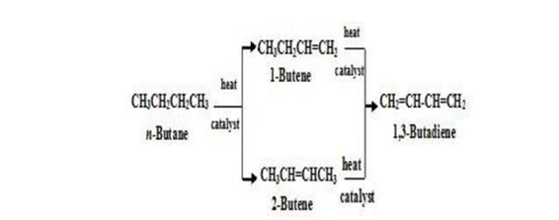
Synthesis of Dienes
Dienes are usually prepared by adaptations of the methods used to make simple alkenes. For example, the most important diene, 1,3-butadiene (used to make synthetic rubber), has been made by cracking process, or by dehydration of an alcohol containing two –OH groups:

Slide 6
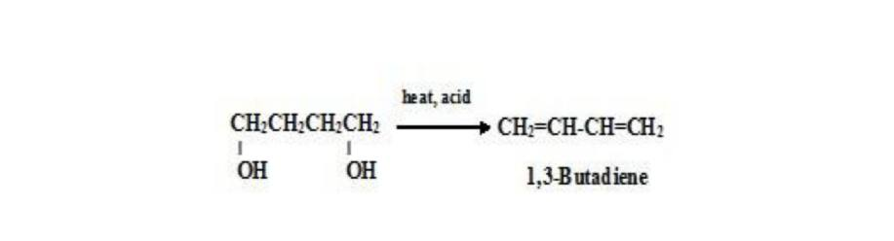
Dehydration of Diols
Dienes can be prepared by dehydration of diols by two successive elimination reactions

Slide 7
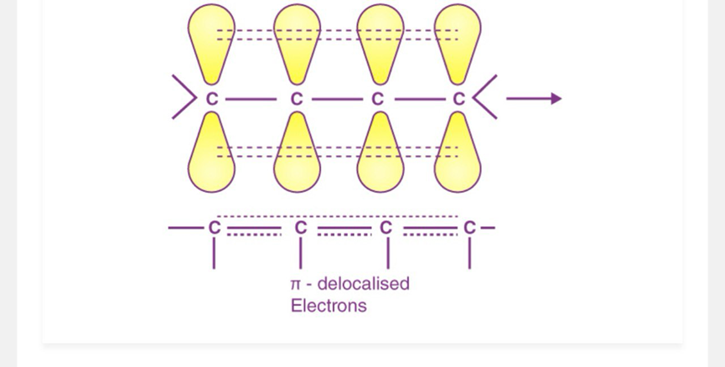
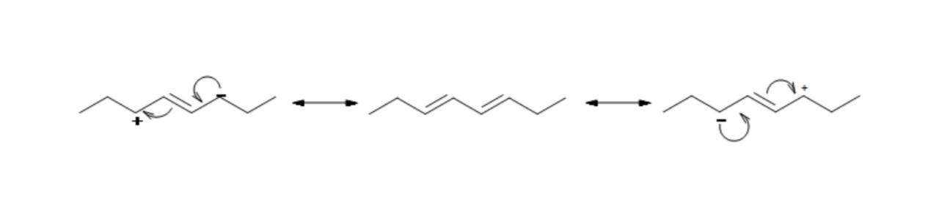
Physical Properties of Diene
Conjugated dienes are more stable than non conjugated dienes (both isolated and cumulated) due to factors such as delocalization of charge through resonance and hybridization energy. This can also explain why allylic radicals -Electron_Delocalization) are much more stable than secondary or even tertiary carbocations. This is all due to the positioning of the pi orbitals and ability for overlap to occur to strengthen the single bond between the two double bonds.
Conjugated dienes differ from simple alkenes in three ways:
(a) they are more stable,
(b) they undergo 1,4-addition, and toward free radical addition, they are more reactive.
( c) The resonance structure shown below gives a good understanding of how the charge is delocalized across the four carbons in this conjugated diene. This delocalization of charges stablizes the conjugated dien

Slide 8



