Slide 1





Slide 2
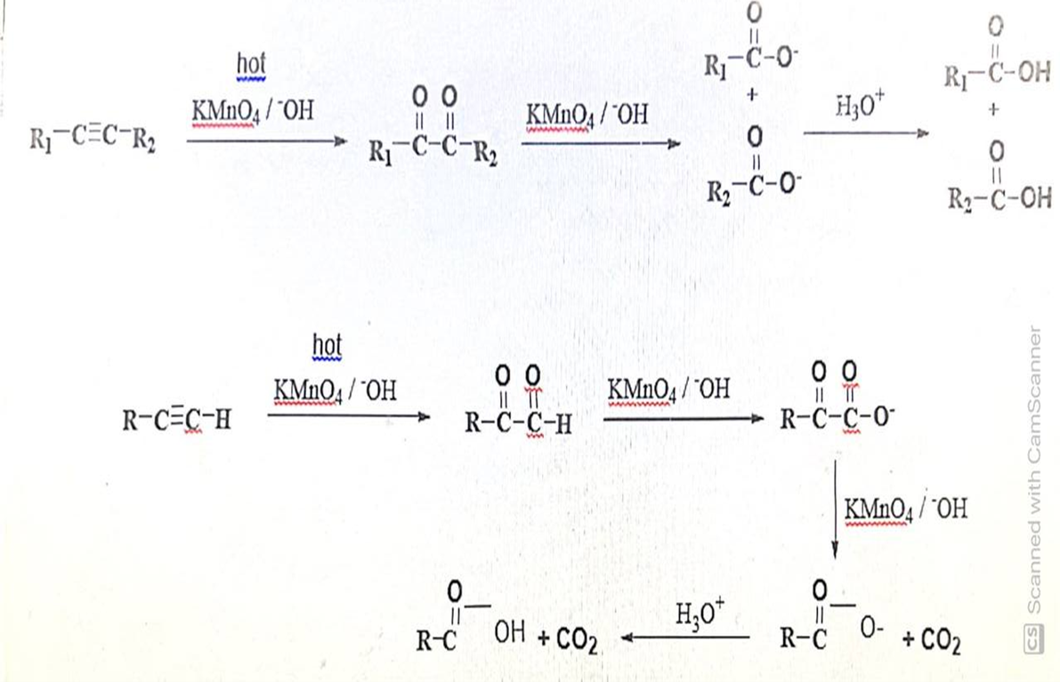
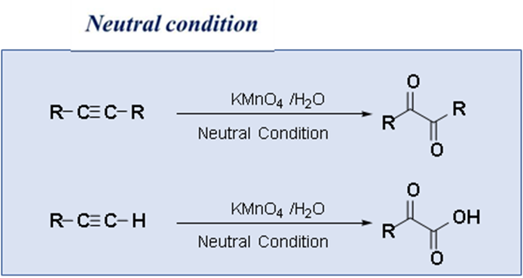
1.7.4 Oxidative Cleavage of Alkynes
Treating alkynes with hot basic potassium permanganate followed by acid, leads to cleavage at the carbon– carbon triple bond. The products are carboxylic acids. Whereas under neutral condition it gives 1,2-diketo compounds (in case of internal alkyne), b-keto acids (in case of terminal alkynes), respectively.
Alkaline condition

Slide 3

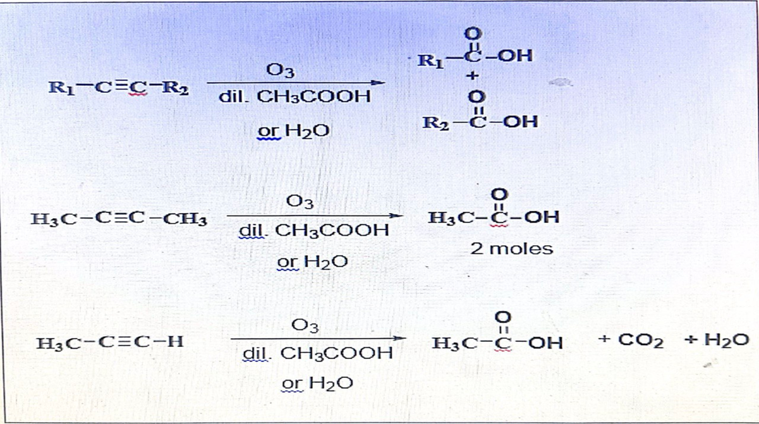

Slide 4

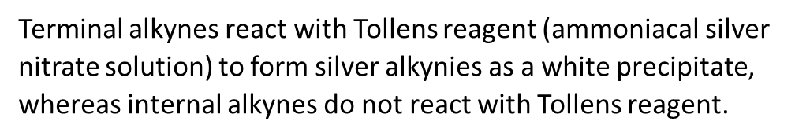
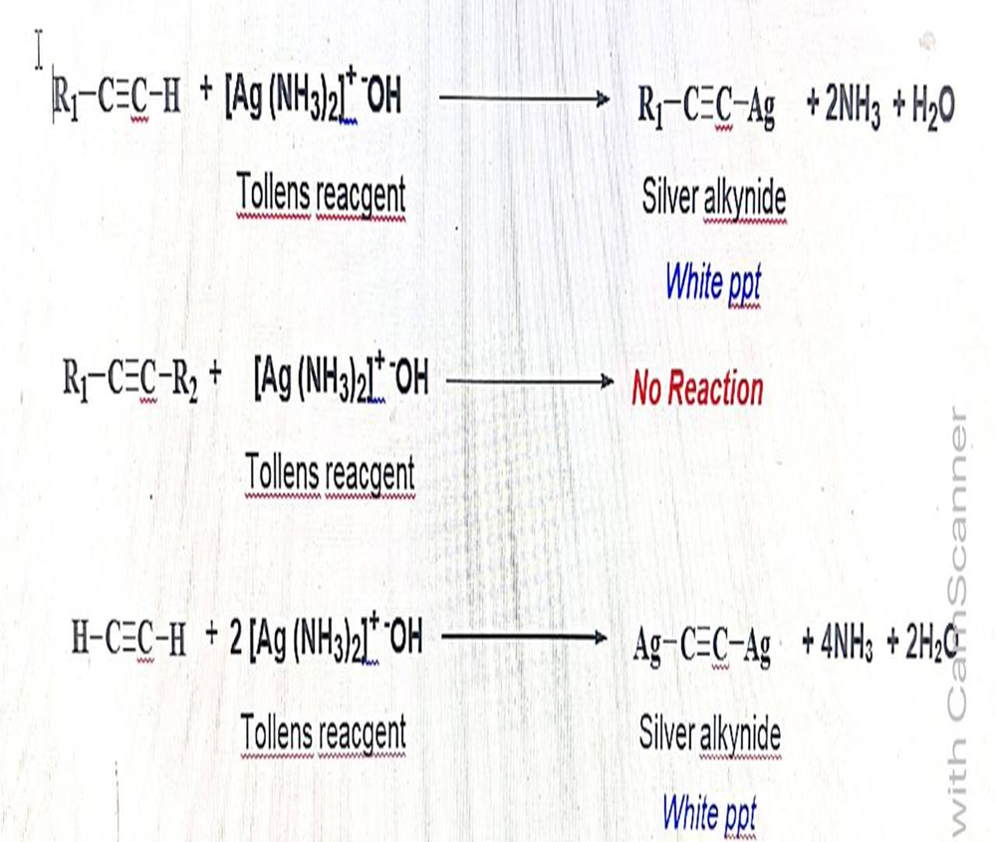
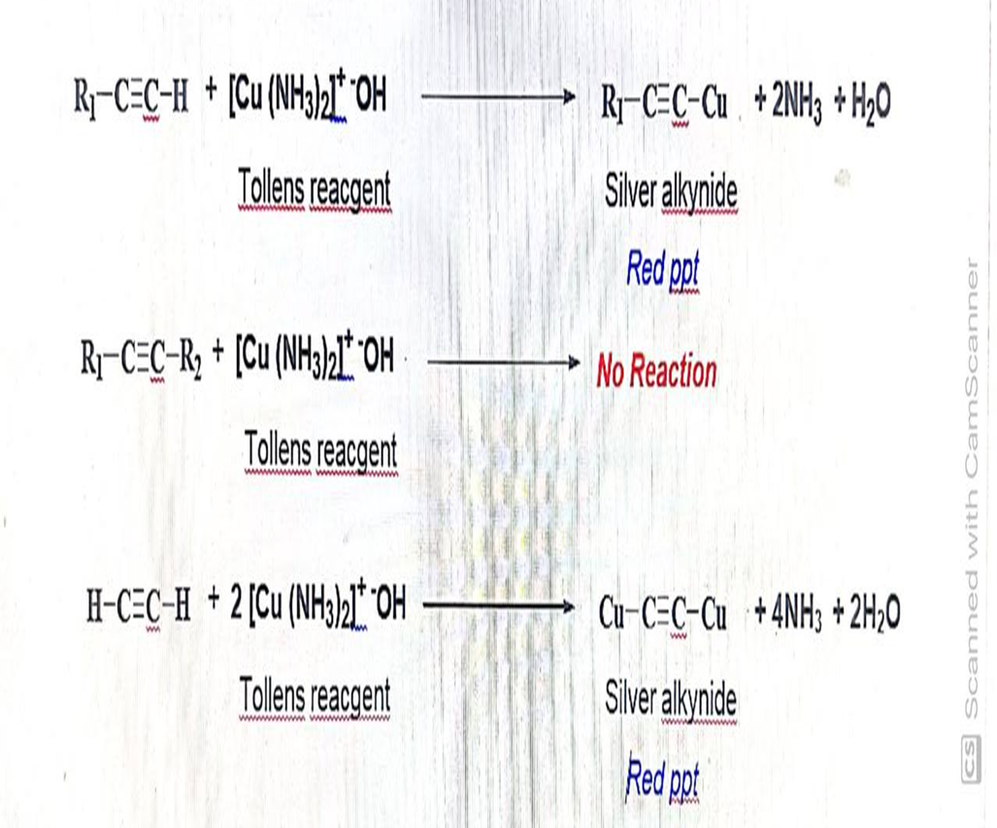

Slide 5
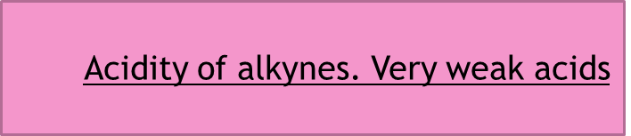




Slide 6
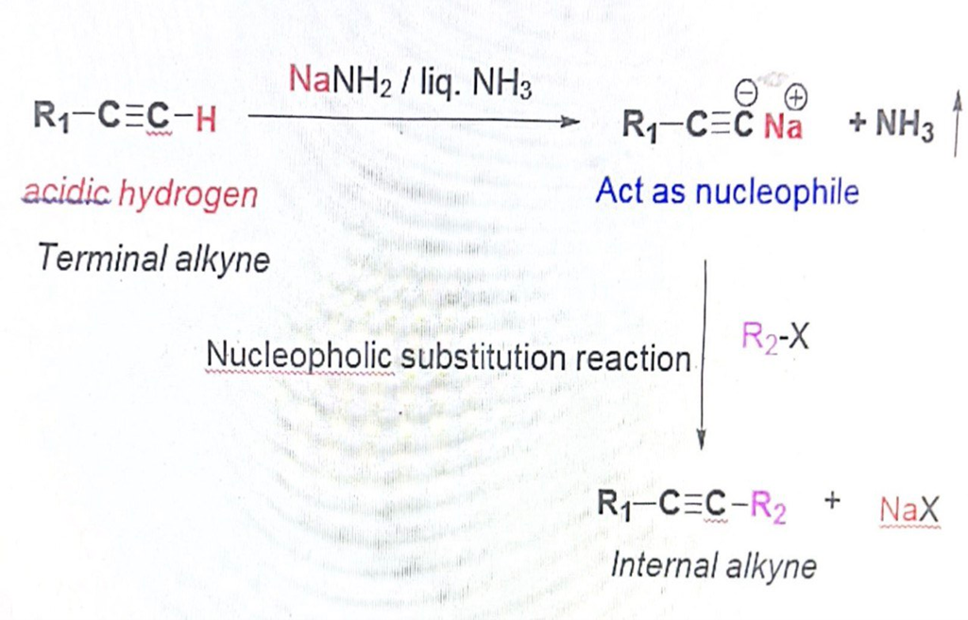
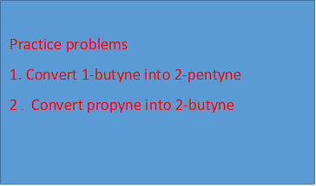
Conversion of terminal alkynes into internal alkynes

Slide 7



