Slide 1





























Fifth Lecture

Slide 2

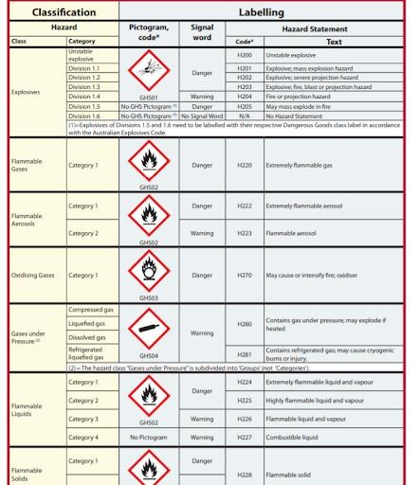


Review of the warning signs for the hazards of chemicals and classification of hazardous material:
Globally Harmonised System of Classification and Labelling of Chemicals
Asst. Prof. Wasan abdul Razzaq
Asst. Prof. Ruaa Muhammed Dhedan

Slide 3








Chemicals Classifying:
The Global Maritime System for Hazardous Substances (IMDGC) is one of the best ways to classify hazardous chemicals. This classification divides hazardous materials into nine levels of danger.
A- Explosive chemicals (ranked 1)
Explosion massive.
Explosion projection
Fire hazard
Explosive materials are completely insensitive to explosion, but when they explode, they have a great destructive effect.

Slide 4








B- Gases under Pressure Hazards (ranked 2)
-Gases Flammable.
- Nonflammable and Nontoxic Gas
- Toxic Gases

Slide 5








C- Liquids Flammable (ranked 3)
The flash point of a material is the "lowest liquid temperature at which, under certain standardized conditions, a liquid gives off vapors in a quantity such as to be capable of forming an ignitable vapor/air mixture
Point Flash Low: liquids where the flash point is less than -18°C.
Intermediate Flash: Medium Flash Point Liquids These are liquids with a flash point from -18°C to 23°C.
High Point Flash: High flash point liquids are liquids with a flash point of 23°C to 61°C.

Slide 6

D-Solids Flammable: (ranked 4)
-Solids Combustible Readily
-Substances Liable to Spontaneous Combustion
- Substances Emit Flammable Gases when they are In Contact with Water

Slide 7








E- Organic Peroxide (ranked 5)
It includes chemicals that produce oxygen when it is decomposed or interacted, and it includes two types:
Substances Oxidizing Agents
Organic Peroxide
F-Toxic and infectious Substances (ranked 6)
Substances that cause harm or death to humans when swallowed or inhaled

Slide 8








G-Substances Infectious (ranked 7)
They are materials that contain real living organisms such as bacteria, viruses, parasites, and hybrid and genetically modified microorganisms that cause diseases to humans or animals.
H- Corrosive substances (ranked 8)
They are the substances that are in this dangerous category because of their chemical activity, which causes severe damage when they come into contact with living tissues, or they become cloudy when they leak into the surrounding containers and other goods, and in many cases, this results in the escalation of gases, some of which are toxic and others that may cause a mixture with atmospheric air to explode and ignite.

Slide 9






I-Miscellaneous Dangerous (Substances) (ranked 9)
Substances that constitute a danger during transportation or a danger to the environment, such as mineral acids such as sulfuric acid, alkalis such as sodium hydroxide, and salts such as mercury chloride or hydrocyanic salts.
.

Slide 10
Thank you

