Slide 1

Alkyne
Second stage
Assist. Professor : Wasanabdul razzaq mahmood
2024-2025

Slide 2
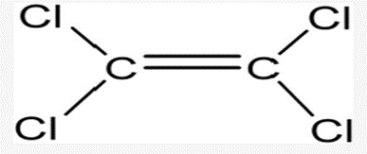
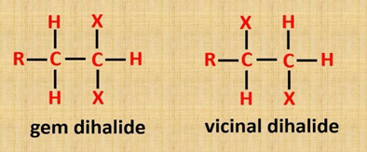
2.6.1 Dehydrohalogenation of vicinal di halide
They are three types of halide:
Tetra di halid
germinal di hlaid
vicinal di halid

Slide 3
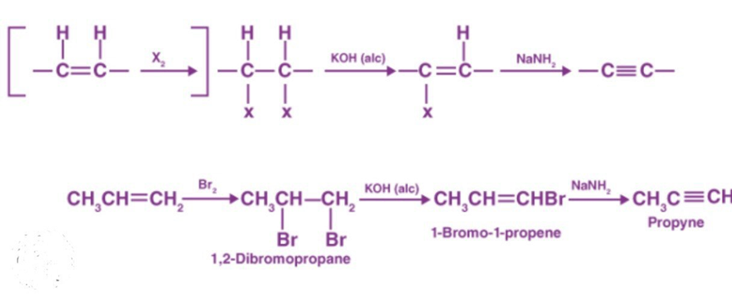
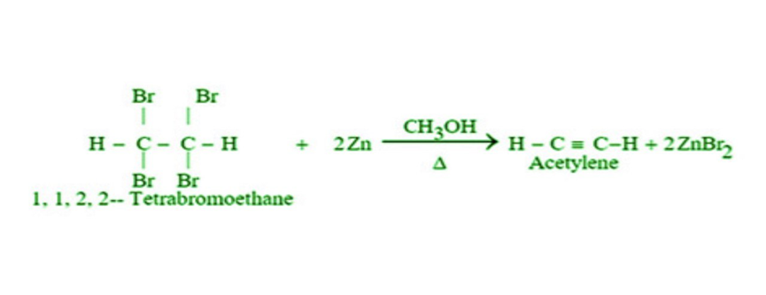
1. Dehydrohalogenation of alkyl dihalides
Dehydrohalogenation of vicinal dihalides is particulary useful since the dihalides themselves are readily obtained from the corresponding alkenes by addition of halogen .This amounts to conversion by several steps of adouble bond in to atriple bond .Dehydrohalogenation can generally be carried out in tow stages as shown.
Tatrahalid with metal

Slide 4
2-Reaction of metal acetylides with primary alkyl halides
A carbon- carbon triple bond is formed in the same way as a double bond: elimination of atoms or groups from two adjacent carbon.
RC≡C-R + LiX ⁻ RC≡C-Li + R –X
Alkyl halide
The alkyl group becomes attached to the triply bonded carbon, and a new, larger alkyne has been generated. For example
-
HC ≡ C: ⁻ Li⁺ + CH₃CH₂CH₂CH₂Br HC≡C-CH₂CH₂CH₂CH₃
Lithium acetylide n-Butyl bromide 1-Hexyne (n-Butyl acetylene)
-C≡CH ⁻ NaNH₂or Na metal -C≡C⁻ Na⁺ +RX -C≡C-R +NaX-

Slide 5
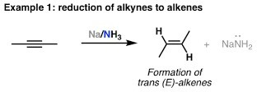
1.7 Reaction of alkynes
Q/ Comported between alkene and alkyne
lithium in liquid ammonia. Almost entirely cis alkene is obtained by hydrogenation of alkynes with several catalysts: a specially prepared palladium called the Lindlar catalyst ,For example.
1.7.1 Reduction using Na/ Liq. NH₃ (Birch Reduction)
Na / Liq. NH₃ or Li / Liq. NH₃ is used to carry out reduction of alkynes into alkenes.
Alkynes are selectively converted into trans-alkenes.
Na / liq NH₃ is the source of ammoniated electrons.
Na in ethanol can also be used.
2-Butyne
Anti-Addition

Slide 6
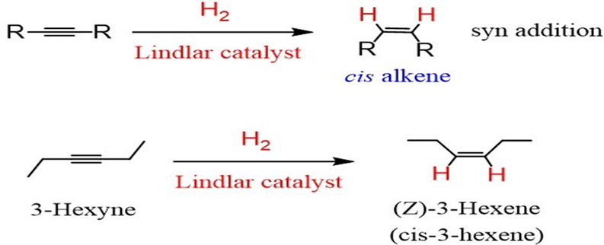
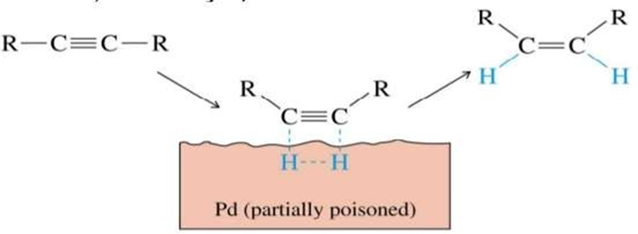
1.7.2 Reduction using Lindlar’s catalyst H₂/ Pd(BaSO₄)
H₂/ Pd(BaSO₄) partially deactivated (poisoned) by quinoline is used to carry out reduction of alkynes into cis-alkenes.
Alkynes are selectively converted into cis-alkenes.
syn-addition of H₂ takes place.
Mechanism

Slide 7
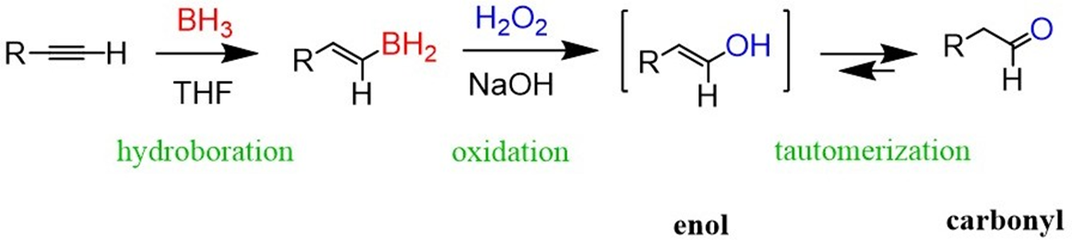
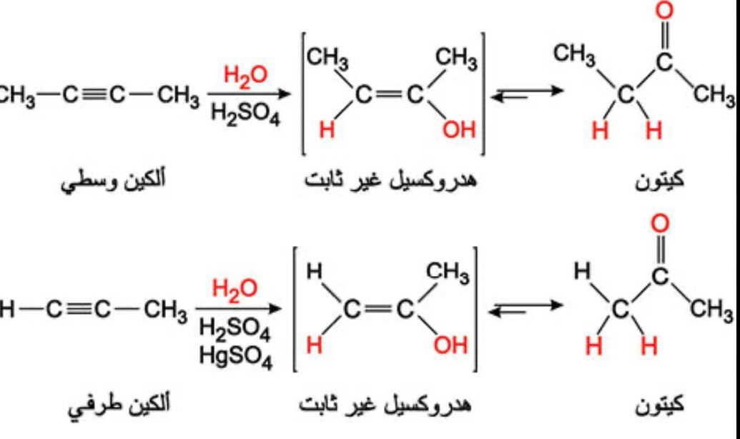
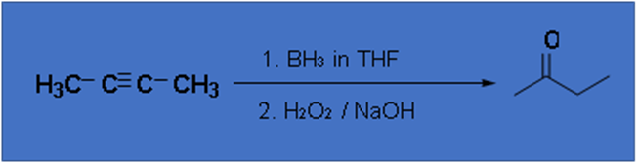
1.7.3 Hydroboration- Oxidation of alkynes. Tautomerization:
AND Addtion the water to alkyne
Hydroboration of internal alkynes is not a particularly useful procedure because a mixture of products will often be obtained, unless the triple-bond is symmetrically substituted
There is an equilibrium between the two structures, but it generally lies very much in favor of the keto form.
Toutomerism : is a phenomenon where a compounds structures differ markedly in arrangement of atoms , but which exist in easy and rapid equilibrium ,are called tautomers .

Slide 8

