Slide 1
ENT PATHOLOGY
PRACTICAL EXAM
FIFTH GRADE
DR. SAZAN ABDULWAHAB

Slide 2
A 26 year old male complains of persistent nasal blockage, runny nose, and headache. Multiple nasal masses are identified and resected . Histological examination of the lesions shown in the image .
Answer the following question by true or false:
These lesions are not true neoplasms.
They are associated with inflammation and allergy.
They are single and nearly always unilateral.
This lesion is a malignant tumor
Composed of loose mucoid stroma and mucous glands covered by respiratory epithelium

Slide 3
the answers:
True
True
False
False
True

Slide 4
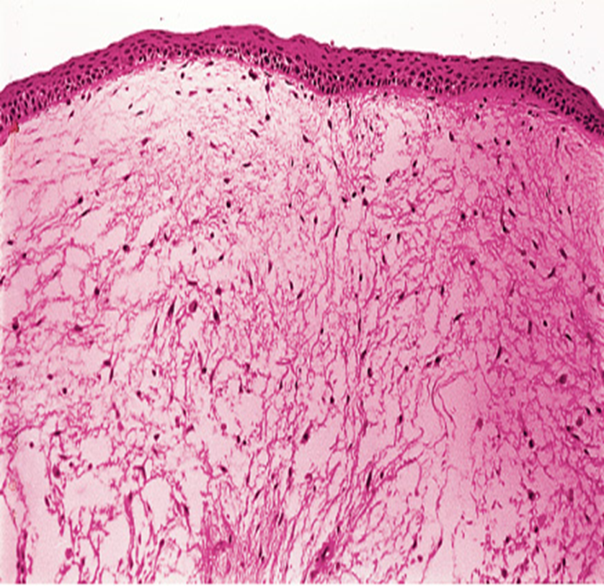
A vocal cord nodule is removed from a 45-year-old man who presented with chronic hoarseness. Histologically, it is composed of hyalinized stroma containing dilated blood vessels with perivascular fibrinous exudate. Answer the following questions by true or false
This is a non-inflammatory reaction to injury causing hoarseness,
Seen most commonly in voice overuse
The diagnosis is laryngeal papilloma
The diagnosis is laryngeal carcinoma
The diagnosis is Laryngeal nodule (singer’s nodule)

Slide 5
the answers:
True
True
False
False
True

