Slide 1
Chemical tests for urine
Sugar in urine
College of pharmacy /university of Baghdad Biochemistry
third stage - 2nd semester
Lab 3
Presented by
Lecturer Aminah Ali

Slide 2
Objective learning
Objective learning
Define glycosuria and explain its clinical importance.
Describe the renal threshold of glucose (≈180 mg/dL).
Identify different reducing sugars in urine.
Explain the principle of Benedict's test.
Interpret positive and negative test results.
Correlate laboratory findings with clinical conditions.
Recognize physiological vs pathological causes of reducing sugars in urine.

Slide 3
Sugar in urine
Sugar that may be present in the sample includes
Glucose, galactose, lactose, fructose, and pentose.
Normally, reducing sugars are found in urine, in very small amounts at 24 h <0.5 mg/dl or 2.18 mmol/day, which gives a negative result with benedicts test.
glycosuria: glucose appears in urine when the blood glucose level exceeds the renal threshold (180 mg/ dl), mainly occurs in DM patients or those who receive G / W IV fluids, or patients who have renal disease affect renal tubule or in physiological condition of Pregnancy (physiological lactosuria).
renal threshold: is the highest level at which the kidney can reabsorb glucose back to the blood.

Slide 4
Sugar in urine
Other reducing sugars appearing in the urine but are not associated with DM as:
Lactose (Lactosuria): Frequently seen in the late stages of pregnancy and during lactation. This is a physiological occurrence and not a sign of diabetes.
Fructose: Can appear after high fruit intake or in rare metabolic disorders.
Galactose: Important to detect in infants, as it may indicate galactosemia (an inability to process milk sugar).
Pentose: May appear after eating large amounts of fruits like cherries or plums

Slide 5
Methods of glycoseuria tests (by Benedict’s test)
Biochemical Reaction (Principle) of Benedict's Test
The Benedict's Test is a redox reaction used to detect reducing sugars (sugars with a free aldehyde or ketone group).
Alkaline Conditions: Sodium carbonate in the reagent provides an alkaline medium that converts the sugar into a powerful reducing agent called an enediol.
The Reduction: These enediols reduce blue cupric ions from copper(II) sulfate into cuprous ions.
Precipitation: The cuprous ions react with the solution to form cuprous(I) oxide, which is an insoluble brick-red precipitate.
Role of Sodium Citrate: It acts as a chelating agent to keep the
ions in solution during storage, preventing them from reacting prematurely.

Slide 6
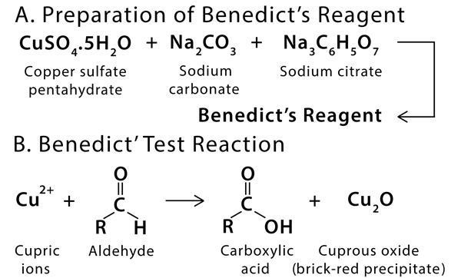

Slide 7
Glucose in urine (glycoseuria) tests
Urine is prepared by dissolving 0, 1.25, 5g of glucose in 100 ml DW

Slide 8
Glucose in urine (glycoseuria) tests procedure
Benedict’s test (-ve result)
2ml urine + 0.5ml benedict’s solution → 5min boiling → blue color (-ve result)
Benedict’s test (+ve result)
2ml urine + 0.5ml benedict’s solution → 5min boiling → Green ppt., Yellow ppt., Orange-red ppt., Brick-red ppt. (+ve result)

Slide 9
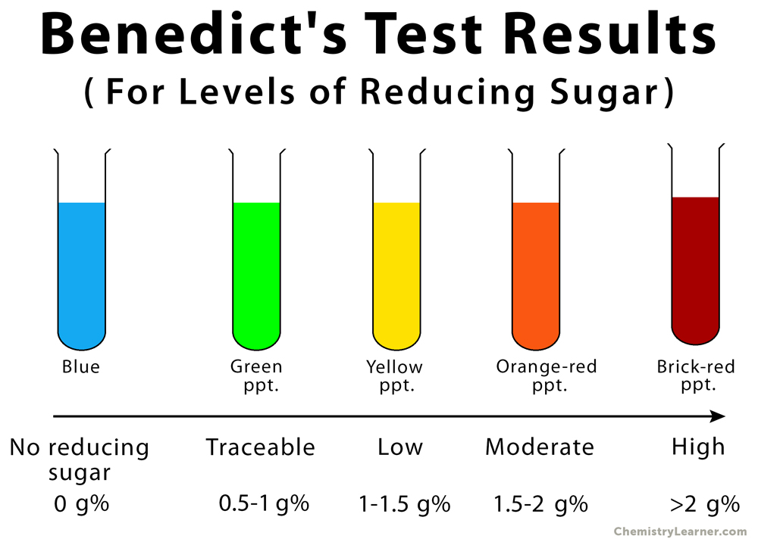

Slide 10
Acquired skills
Skills Gained from This Lab
Laboratory Skills
Proper urine sample handling
Accurate measurement of reagents
Safe heating techniques
Observing color changes
Analytical Skills
Interpreting results correctly
Correlating findings with patient condition
Distinguishing physiological vs pathological causes

Slide 11
Applications in the Medical Field
The sugar in urine lab has wide clinical importance, including:
Screening and monitoring of Diabetes mellitus
Early detection of Galactosemia in infants
Assessment of renal tubular function
Foundation for modern urine dipstick testing

Slide 12
Thanks for listening

