Slide 1
Chemical tests for urine
Ketone in urine (ketonuria)
College of pharmacy /university of Baghdad Biochemistry
third stage - 2nd semester
Lab 4
Presented by
Lecturer Aminah Ali

Slide 2
Learning Objectives
Define ketonuria and explain its biochemical basis.
Describe ketone body metabolism (acetoacetate, β-hydroxybutyrate, acetone).
Explain principles of Rothera’s test, Gerhardt’s test, and urine dipstick method.
Differentiate between detection of acetoacetate and β-hydroxybutyrate.
Interpret laboratory findings in diabetes mellitus and starvation.

Slide 3
Introduction to Ketonuria
Ketone in urine, or ketonuria, refers to the presence of ketone bodies in the urine, which happens when the body burns fat for energy instead of glucose.
So it is a normal response to fasting, starvation, or following a low-carbohydrate/ketogenic diet. However, in people with diabetes, high levels of ketones in the urine can be a warning sign of a life-threatening condition called diabetic ketoacidosis (DKA), which requires immediate medical attention.

Slide 4
Ketone Body Formation
In case of DM and starvation, the oxidation of fatty acids will lead to the accumulation of acetylcoA in the liver
Acetyl-CoA leads to the formation of acetoacetic acid, which is reduced to B- hydroxybutyric acid and decarboxylated to acetone

Slide 5
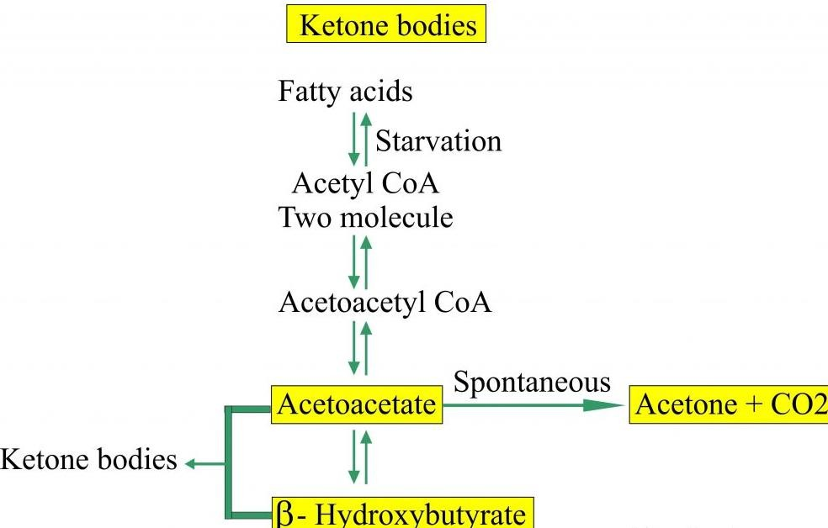
Diagram: Ketone Body Formation
β-Oxidation in Mitochondria

Slide 6
Causes of Ketonuria
Uncontrolled Diabetes Mellitus (especially Type 1)
Prolonged fasting or starvation
Low-carbohydrate diets
Pregnancy (especially hyperemesis gravidarum)
Severe illness or infection

Slide 7
Clinical Significance
Early indicator of Diabetic Ketoacidosis (DKA)
Monitoring uncontrolled diabetes mellitus
Assessment of metabolic status of Starvation, malnutrition, or a low-carbohydrate diet

Slide 8
Detection Methods
  Rothera’s Test
  Gerhardt’s Test
  Urine Dipstick (Ketostix)
Notes:
Blood ketone measurement is preferred in diabetic ketoacidosis as it detects β-hydroxybutyrate.

Slide 9
Rothera’s Test (Nitroprusside Reaction)
Principle of Rothera’s Test
Acetoacetic acid and acetone react with an alkaline solution (ammonium hydroxide) of sodium nitroprusside to form a purple colored complex. This method can detect above 1-5 mg/dl of acetoacetic acid and 10-20 mg/dl of acetone. Beta-hydroxybutyrate is not detected.

Slide 10
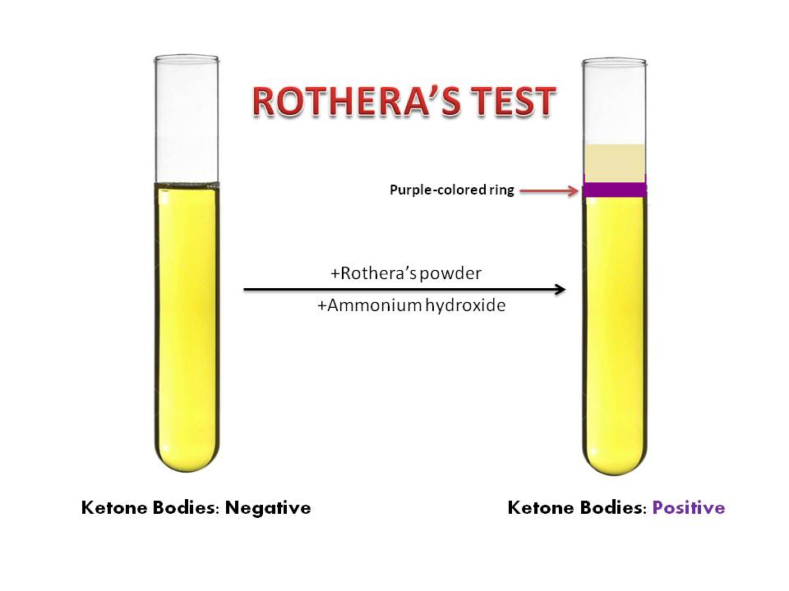

Slide 11
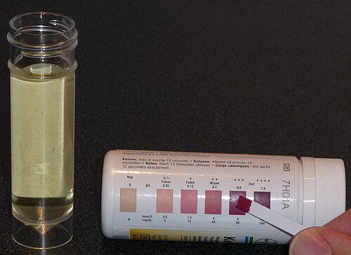
Urine Dipstick (Reagent Strip) Method
Based on nitroprusside reaction
  Color change: Beige → Pink → Purple
  Rapid and commonly used in clinical labs and at home using over-the-counter urine test strips.
  Does not detect β-hydroxybutyrate

Slide 12
Laboratory Interpretation Chart
Result | Color | Approximate Level
Negative | Beige | 0 mg/dL
Trace (+/-) | Light pink | 5 mg/dL
+ | Light purple | 15 mg/dL
++ | Purple | 40 mg/dL
+++ | Dark purple | 80–160 mg/dL
Notes:
Color intensity correlates with ketone concentration. Always interpret with clinical findings.

Slide 13
Comparison of Methods
Method | Detects | Common Use
Rothera’s | Acetoacetate and acetone | Laboratory
Gerhardt’s | Acetoacetate | Rarely used
Dipstick | Acetoacetate | Routine screening
All Ketonuria methods not detect β-hydroxybutyrate keton so to detect it we used the β-hydroxybutyrate dehydrogenase Enzymatic Blood Ketone test for accurate diagnosed the severe DKA

Slide 14
Gerhardt’s Test (Ferric Chloride Test)
Principle: Ferric chloride reacts with acetoacetate
  Produces burgundy/red color
  Less specific, possible false positives with salicylic acid

Slide 15
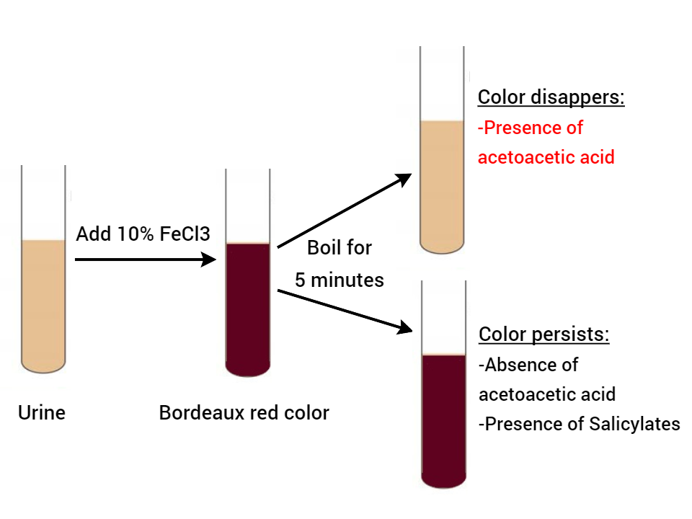

Slide 16
Keton in urine (Ketonuria) tests
5% Urine is prepared by dissolving
5ml acetoacetic acid in 100ml D.W for (+ve result)
5g salicylic acid in 100ml D.W for (-ve result)
10% ferric chloride is prepared by dissolving 10g in 100ml D.W

Slide 17
Keton in urine (Ketonuria) tests procedure
Gerhard’s test (-ve result)
2ml urine + few drops FeCl3 → Purple color → 5min boiling → Purple color salicylic acid (-ve result)
Gerhard’s test (+ve result)
2ml urine + few drops FeCl3 → Purple color → 5min boiling → disappear Purple color acetoacetic acid (+ve result)

Slide 18
Skills Acquired from This Laboratory
Proper sample handling and preparation.
Preparation of laboratory reagents (Ferric chloride, standards).
Performing Gerhardt’s tests accurately.
Observing and interpreting color reactions.
Correlating laboratory results with clinical conditions.

Slide 19
Application in the Medical Field
Early detection and monitoring of diabetic ketoacidosis (DKA).
Monitoring glycemic control in diabetes mellitus patients.
Assessment of starvation and malnutrition.
Evaluation of ketosis in pregnancy (hyperemesis gravidarum).
Clinical laboratory diagnosis in emergency settings.

Slide 20
Thanks for listening

