Slide 1
circulatory system
By
assist. Professor
Dr. Suhaib A.H.AL-TAAI

Slide 2
The circulatory system pumps and directs blood cells and substances carried in blood to all tissues of the body. It includes both the blood and lymphatic vascular systems, and in an adult the total length of its vessels is estimated at between 100,000 and 150,000 kilometers. The blood vascular system, or cardiovascular system
consists of the following structures:

Slide 3
■ The heart propels blood through the system.
■ Arteries, a series of vessels efferent from the heart that
become smaller as they branch into the various organs,
carry blood to the tissues.
■ Capillaries, the smallest vessels, are the sites of O2, CO2,
nutrient, and waste product exchange between blood and
tissues. Together with the smallest arterial and venous
branches carrying blood to and from them, capillaries
in almost every organ form a complex network of thin,
anastomosing tubules called the microvasculature or
microvascular bed.
■ Veins result from the convergence of venules into a system
of larger channels that continue enlarging as they
approach the heart, toward which they carry the blood to
be pumped again.

Slide 4
1- Heart: serve as the pumping unit
2-Arteries : carry the blood to the organs and tissues
3-Capillaries: exchange of materials
4-Veins : return the blood to the heart

Slide 5
Heart
Cardiac muscle in the four chambers of the heart wall contracts
rhythmically, pumping the blood through the circulatory
system (Figure 11–2). The right and left ventricles propel
blood to the pulmonary and systemic circulation, respectively;
right and left atria receive blood from the body and the pulmonary
veins, respectively. The walls of all four heart chambers
consist of three major layers: the internal endocardium;
the middle myocardium; and the external epicardium.
■ The endocardium consists of a thin inner layer of
endothelium and supporting connective tissue, a middle
myoelastic layer of smooth muscle fibers and connective
tissue, and a deep layer of connective tissue called
the subendocardial layer that merges with the myocardium.
Branches of the heart’s impulse-conducting
system, consisting of modified cardiac muscle fibers, are
also located in the subendocardial layer (Figure 11–3).
■ The thickest layer, the myocardium, consists mainly of
cardiac muscle with its fibers arranged spirally around
each heart chamber. Because strong force is required to

Slide 6
pump blood through the systemic and pulmonary circulations,
the myocardium is much thicker in the walls of
the ventricles, particularly the left, than in the atrial walls
.
The epicardium is a simple squamous mesothelium
supported by a layer of loose connective tissue containing
blood vessels and nerves. The epicardium corresponds to the visceral layer of the pericardium, the membrane surrounding the heart.
Where the large vessels enter and leave the heart, the
epicardium is reflected back as the parietal layer lining
the pericardium. During heart movements, underlying
structures are cushioned by deposits of adipose tissue in
the epicardium and friction within the pericardium is
prevented by lubricant fluid produced by both layers of
Serous mesothelial cells.

Slide 7
Within these major layers the heart contains other structures important for its overall function of moving blood.
Dense fibrous connective tissue of the cardiac skeleton forms part of the interventricular and interatrial septa, surrounds
all valves of the heart, and extends into the valve cusps and the chordae tendineae to which they are attached
. These regions of dense irregular connective tissue perform the following functions:
■ Anchoring and supporting the heart valves
■ Providing firm points of insertion for cardiac muscle
■ Helping coordinate the heartbeat by acting as electrical
insulation between atria and ventricles
Within the subendocardial layer and adjacent myocardium, modified cardiac muscle cells make up the impulse conducting
system of the heart, which generates and propagates waves of depolarization that spread through the myocardium
to stimulate rhythmic contractions. This system consists of two nodes of specialized myocardial tissue in the
right atrium: the sinoatrial (SA) node (or pacemaker) and the atrioventricular (AV) node, followed by the AV bundle
(of His) and the subendocardial conducting network.
Located in the right atrial wall near the superior vena
cava, the SA node is a 6- to 7-mm3 mass of cardiac muscle cells
with smaller size, fewer myofibrils, and fewer typical intercalated
disks than the neighboring muscle fibers. Impulses initiated
by these cells move along the myocardial fibers of both
atria, stimulating their contraction.

Slide 9
At the apex of the heart, these bundles subdivide further into a subendocardial conducting network of myofibers, usually called Purkinje fibers. These are pale-staining fibers, larger than the adjacent contractile muscle fibers, with parse,peripheral myofibrils and much glycogen. Purkinje fibers mingle distally with contractile fibers of both ventricles and trigger waves of contraction through both ventricles
simultaneously.

Slide 10
Epicardium or visceral pericardium

Slide 11
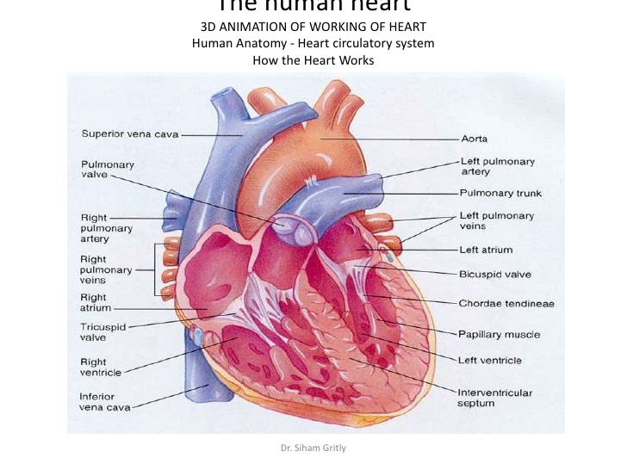

Slide 12
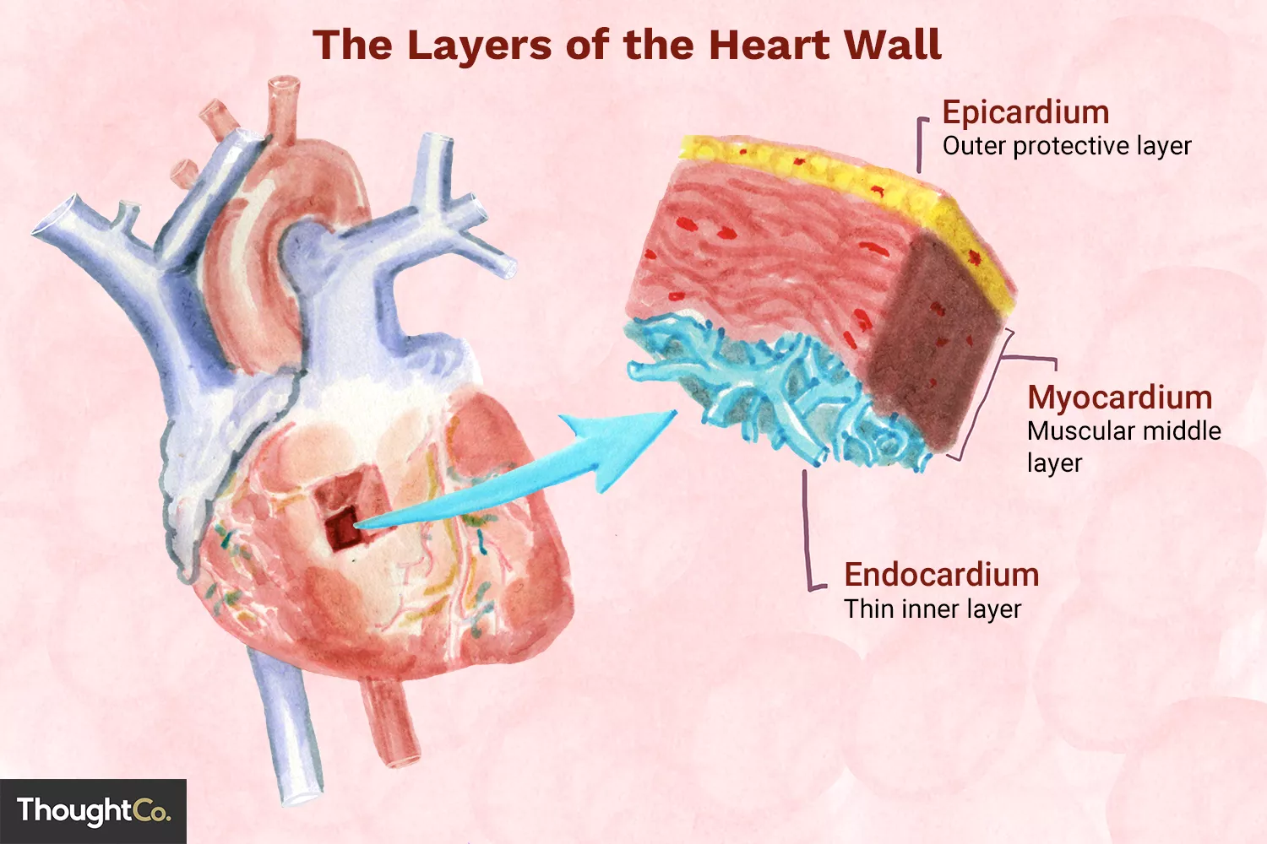
The heart wall consist of 3 main coats:
Endocardium (inner lining layer)
Myocardium (middle muscular layer)
epicardium (external connective tissue layer)

Slide 13
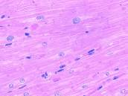
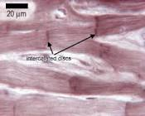
Endocardium
Consists of a single layer of polygonal squamous cells with oval or rounded nuclei
Subendothelial layer (basal lamina +collagen fibers)
(between the endocardium and the myocardium is a layer of connective tissue termed subendocardial layer consist of veins,nerves,branches of the impules–conducting system of the heart (purkinjie cells)
Myocardium
Special striated cardiac muscle
Compose of elongated ,branched individual cells that lie parallel to each other
Has cross – striations
At sites of end – to – end contact are intercalated disks

Slide 14
(pericardium)
Is the fibrous sac that surrounded the heart ,it can be divided into three layers , fibrous , parietal and visceral layers of epicardium. the parietal and visceral layer together form the serous epicardium.
General structure of blood vessels
Usually the blood vessels composed of the following
Tunica intima
Tunica media
Tunica adventitia

Slide 15
The epicardium is a simple squamous mesothelium
supported by a layer of loose connective tissue containing
blood vessels and nerves. The epicardium corresponds to the visceral layer of the pericardium, the membrane surrounding the heart.
Where the large vessels enter and leave the heart, the
epicardium is reflected back as the parietal layer lining
the pericardium. During heart movements, underlying
structures are cushioned by deposits of adipose tissue in
the epicardium and friction within the pericardium is
prevented by lubricant fluid produced by both layers of
serous mesothelial cells.

Slide 16
Tunica intima
Layer of endothelial cells rest on a basal lamina
Subendothelial layer(L.C.T +smooth muscles)
Tunica media
Concentric layers of smooth muscle cells
Interposed among the smooth muscle cells, elastic fibers ,collagen fibers and proteoglycans
In arteries , the tunica media is separated from the intima by an internal elastic lamina
External elastic lamina is often found separating the media from the outer tunica adventitia
Elastic lamina
Compose from elastin
Has gap (fenestrate) that allow substances to diffuse to and nourish cells deep in the vessels wall
Tunica adventitia
Longitudinally oriented collagen and elastic fibers
Vasovasorum (vessels of the vessels)
Branch profusely in the adventitia and the outer part of the T. media
Provide metabolites to the adventitia and the T. media
More frequent in veins than in arteries

Slide 17
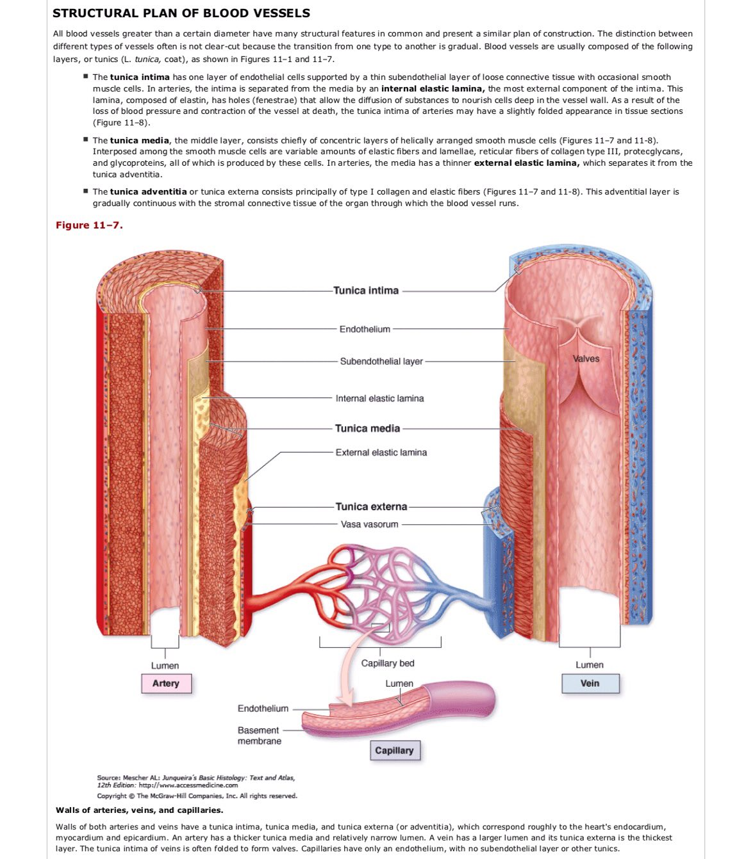

Slide 18
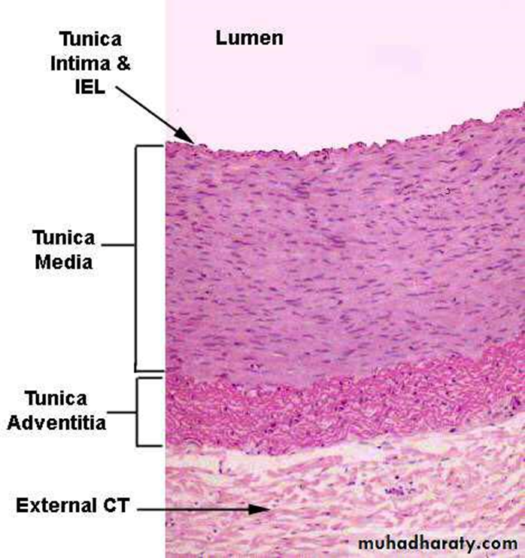

Slide 19
1- Arterioles 2- muscular artery 3- elastic arteries
Arteries (classified according to their size
Arterioles
Arterioles are generally less than
0.1 mm in diameter, with lumens approximately as wide as
the wall is thick
Have relatively narrow lumens
The lumen is lined by endothelial cells
Have one or two layers of muscle cells in tunica media
Subendothelial layer is lacking
T. media is muscular 1-5 circularly smooth muscle
T. adventitia is thin and have no external elastic lamina

Slide 20
arterioles
Muscular arteries branch repeatedly into smaller and smaller arteries, until reaching a size with three or four layers of medial smooth muscle. The smallest arteries branch as arterioles, which have only one or two smooth muscle layers; these indicate the beginning of an organ’s microvasculature
where exchanges between blood and tissue fluid occur. Arterioles are generally less than 0.1 mm in diameter, with lumens approximately as wide as the wall is thick . The subendothelial layer is very thin, elastic laminae are absent, and the media consists of the circularly arranged smooth muscle cells. In both small arteries and arterioles the adventitia is very thin and inconspicuous. Arterioles almost always branch to form anastomosing
networks of capillaries that surround the parenchymal cells of
the organ. At the ends of arterioles the smooth muscle fibers
act as sphincters and produce periodic blood flow into capillaries
. Muscle tone normally keeps arterioles
partially closed, resisting blood flow, which makes these vessels
the major determinants of systemic blood pressure

Slide 21
Elastic artery
Elastic arteries are the aorta, the pulmonary artery, and their
largest branches; these large vessels are also called conducting arteries because their major role is to carry blood to smaller arteries. As shown in Figure 11–7a, the most prominent feature of elastic arteries is the thick tunica media in which elastic lamellae alternate with layers of smooth muscle fibers. The adult aorta has about 50 elastic lamellae (more if the individual is hypertensive).
The tunica intima is well developed, with many smooth
muscle cells in the subendothelial connective tissue, and often shows folds in cross section as a result of the loss of bloodpressure and contraction of the vessel at death.
Between the intima and the media is the internal elastic lamina,
which is more well-defined than the elastic laminae of the media. The adventitia is much thinner than the media. The numerous elastic laminae of these arteries contribute to their important function of making the blood flow more uniform. During ventricular contraction (systole) blood is moved through the arteries forcefully and the elastin is stretched, distending the wall within the limit set by the wall’s collagen. When the ventricles relax (diastole) ventricular pressure drops to a low level, but the elastin rebounds passively, helping to maintain arterial pressure. The aortic and pulmonary valves prevent backflow of blood into the heart, so the rebound continues the blood flow away from the heart. Arterial
blood pressure and blood velocity decrease and become less variable as the distance from the heart increases.

Slide 22
Elastic or conducting arteries
Tunica intima
Thick, lined by a single layer of flattened polygonal cells that rest upon a complete basal lamina
Subendothelial layer (L.C.T)
Tunica media
Thick layer of elastic tissue which forms 50-70 concentric lamina +collagen fibers + smooth muscle cells
Tunica adventitia
Thin +bundles of collagen fibers and a few elastic fibers
Provided with vasa vasorum
Muscular or distributing arteries
Thick wall due to the large amount of smooth muscle fibers
T. intima
1- lining endothelium
Subendothelial layer
Internal elastic lamina
T. media
entirely of smooth muscle cells
External elastic lamina
T . adventitia
collagen and elastic fibers

Slide 23
Muscular artery
The muscular arteries, also called distributing arteries, distribute blood to the organs and help regulate blood pressureby contracting or relaxing the smooth muscle in the media. The intima has a thin subendothelial layer and a prominent internal elastic lamina . The media may contain up to 40 layers of large smooth muscle cells interspersed with a variable number of elastic lamellae (depending on the size of the vessel). An external elastic lamina is present only in the larger muscular arteries. The adventitial connective tissue contains lymphatic capillaries, vasa vasorum, and nerves, all of which may penetrate to the outer part of the media.

Slide 25
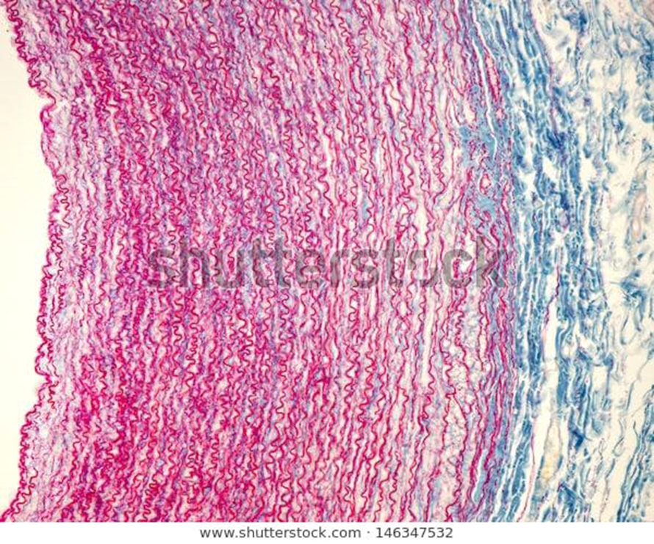

Slide 26
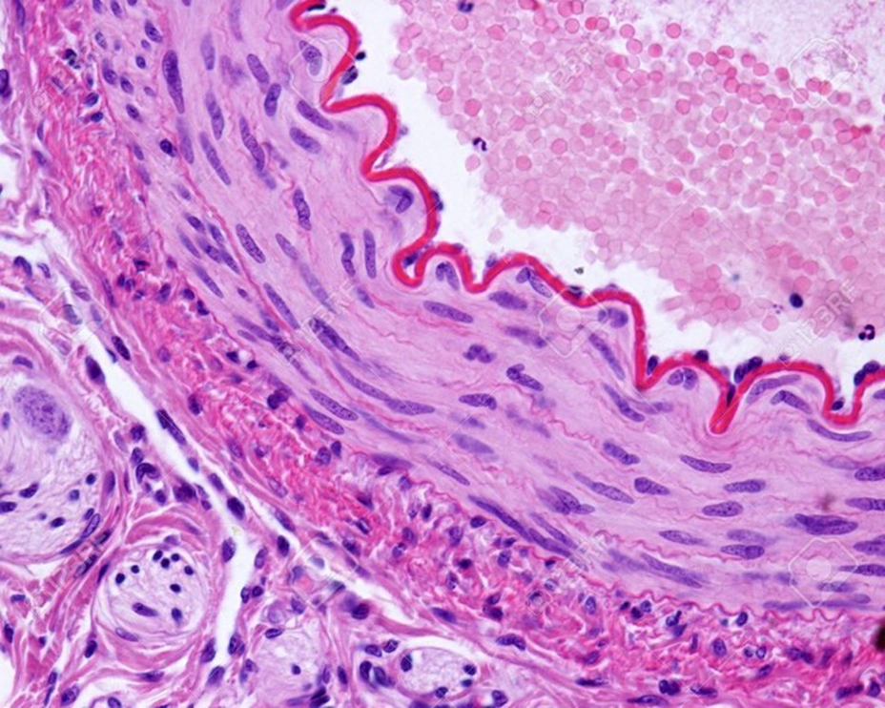

Slide 27
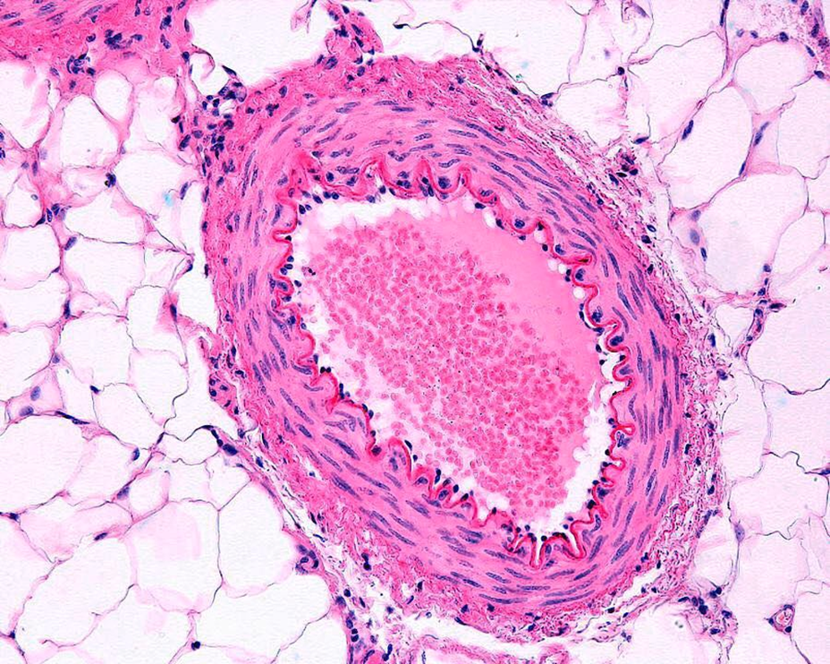

Slide 28
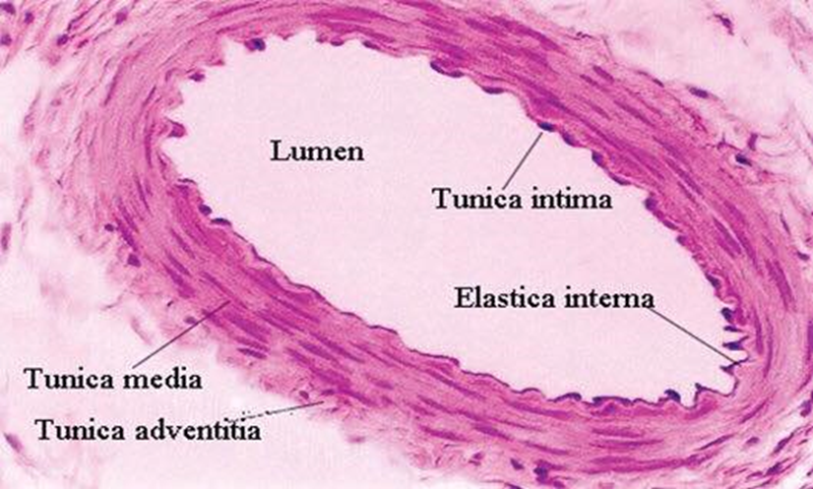

Slide 29
C
A
A

Slide 30
Continuous capillaries
have many tight, well-developed occluding junctions between slightly overlapping endothelial cells, which provide for
continuity along the endothelium and well-regulated metabolic exchange across the cells. This is the most common type of capillary and is found in muscle, connective tissue, lungs, exocrine glands, and nervous tissue. Ultrastructural studies show numerous vesicles indicating
transcytosis of macromolecules in both directions across the endothelial cell cytoplasm.

Slide 31
Fenestrated capillaries have a sieve like
structure that allows more extensive molecular
exchange across the endothelium. The endothelial cells are penetrated by numerous small circular openings or fenestrations (L. fenestra, perforation), approximately 80 nm in diameter. Some fenestrations are covered by very thin diaphragms of proteoglycans
others may represent membrane invaginations during
transcytosis that temporarily involve both sides of the
very thin cells. The basement membrane however is
continuous and covers the fenestrations. Fenestrated
capillaries are found in organs with rapid interchange
of substances between tissues and the blood, such as
the kidneys, intestine, choroid plexus, and endocrine
glands.

Slide 32
Discontinuous capillaries, commonly called sinusoids
permit maximal exchange of
macromolecules as well as allow easier movement of cells between tissues and blood. The endothelium here
has large perforations without diaphragms and irregular intercellular clefts, forming a discontinuous layer with spaces between and through the cells. Unlike other capillaries sinusoids also have highly discontinuous basement membranes and much larger diameters, often 30-40 μm,
which slows blood flow. Sinusoidal capillaries of this type are found in the liver, spleen, some endocrine organs, and bone marrow.

Slide 33
capillaries
A single layer of endothelial cells rest on basal lamina
The average diameter of capillaries varies from 4 to 10 μm,
pericytes with long cytoplasmic processes that partly surround the endothelial cells
A thin layer of collagen fibers
Function :well-regulated metabolic exchange across the cells.

Slide 34
Types of capillaries : depending on the structure of the endothelial cells , presence or absence of a basal lamina
Continuous capillaries
Fenestrated capillaries
Sinusoidal capillaries

Slide 35
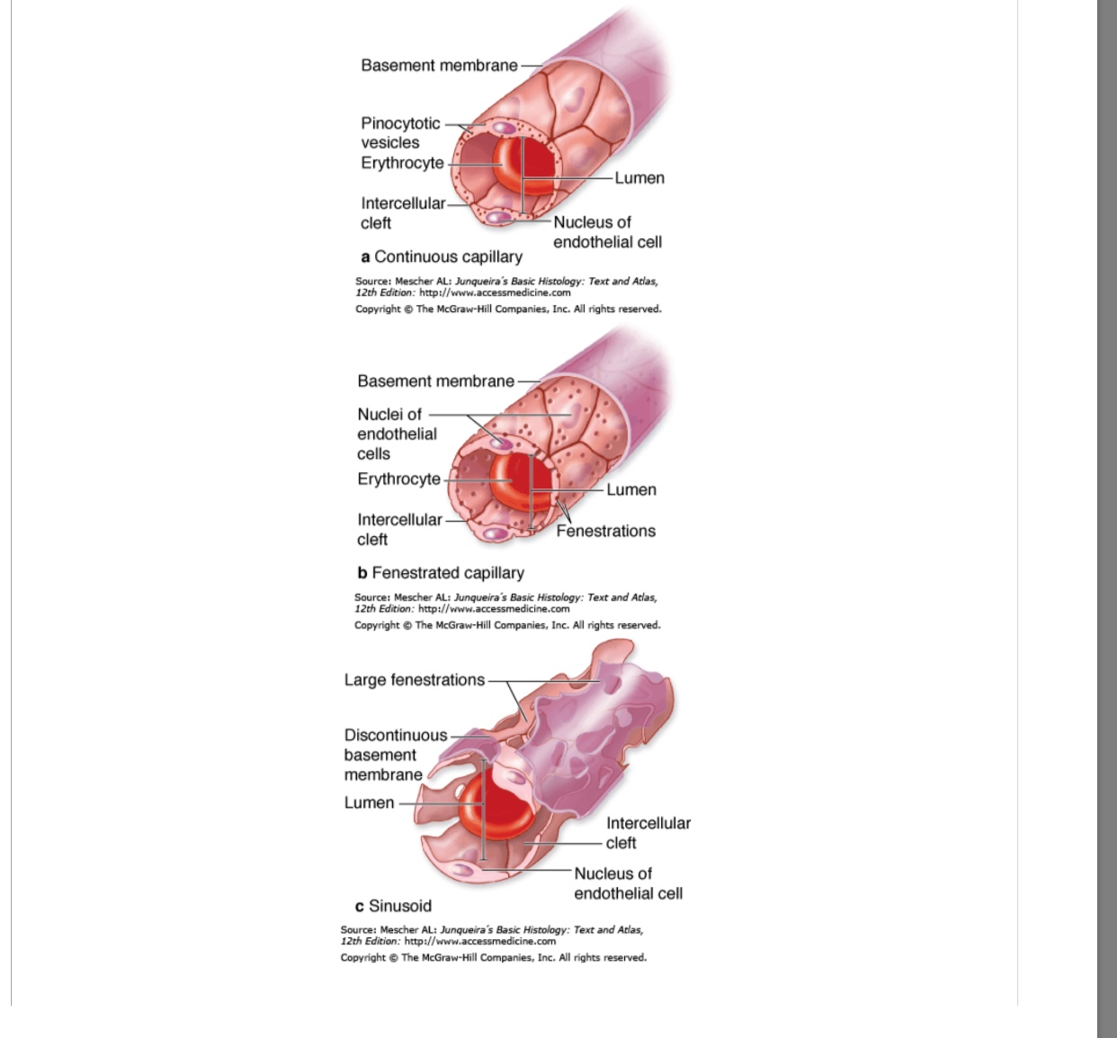

Slide 36
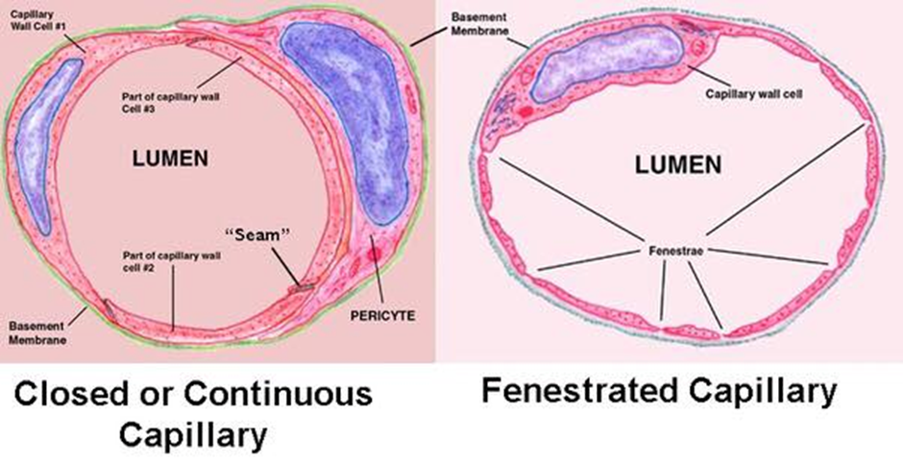
continuous capillaries
Lack of fenestrated in it’s wall
A continuous endothelium rest upon a basal lamina
Thin tunica adventitia
Pericytes are irregular, branched, isolated cells
This is the most common type of capillary and is found in muscle, connective
tissue, lungs, exocrine glands, and nervous tissue.
Fenestrated capillaries
Endothelial cells contain fenestrae (pores)
Fenestrae are closed by a thin diaphragm
A continuous basal lamina is present
Fenestrated capillaries are found in organs with rapid interchange
of substances between tissues and the blood, such as
the kidneys, intestine, choroid plexus, and endocrine
glands.
Sinusoidal capillaries (discontinuous capillaries)
A tortuous path and a greatly enlarged diameter
Presence of multiple fenestrations (no diaphragms
Presence around the wall of macrophages
Absence of a continuous basal lamina
Sinusoidal capillaries of this type
are found in the liver, spleen, some endocrine organs,
and bone marrow

Slide 37
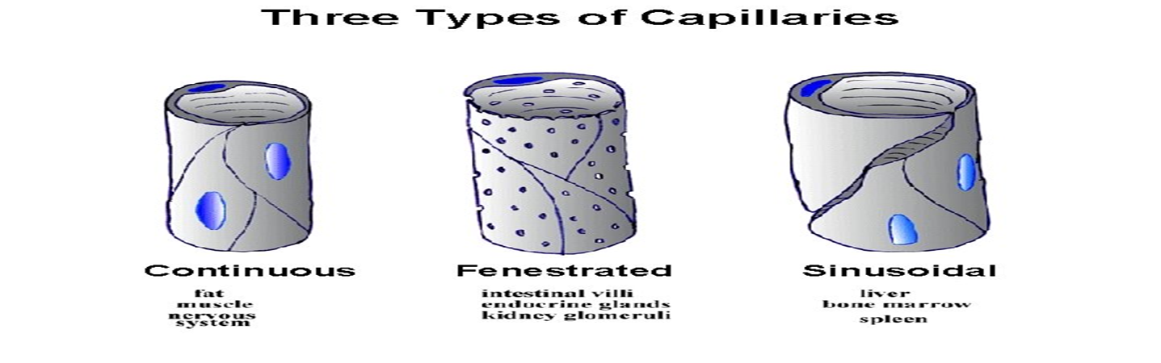

Slide 38
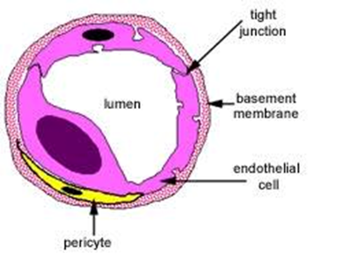

Slide 39
Veins
Veins are divided into
1- venules
, 2- small veins
3- medium veins
4- large veins
Venules
Venules are the smallest veins and receive blood from capillaries.
They also play a role in the exchange of oxygen and nutrients for water products. There are post-capillary sphincters located between the capillaries and venules
Small 0.2-1µm in a diameters
T. intima composed of endothelium
T. media from none to a few cell layer of smooth muscles
T. Adventitia is thick layer of C.T
Small or medium size veins
diameter of 1-9µm
T. intima has a thin subendothelial layers
T. media bundles of smooth m. cells
Well developed collagenous adventitia layer
Large veins
Well developed tunica intima
T. media which thinner, with few layers with S.M.Cs and abundant connective tissue
Best developed tunica adventitia in veins

Slide 40
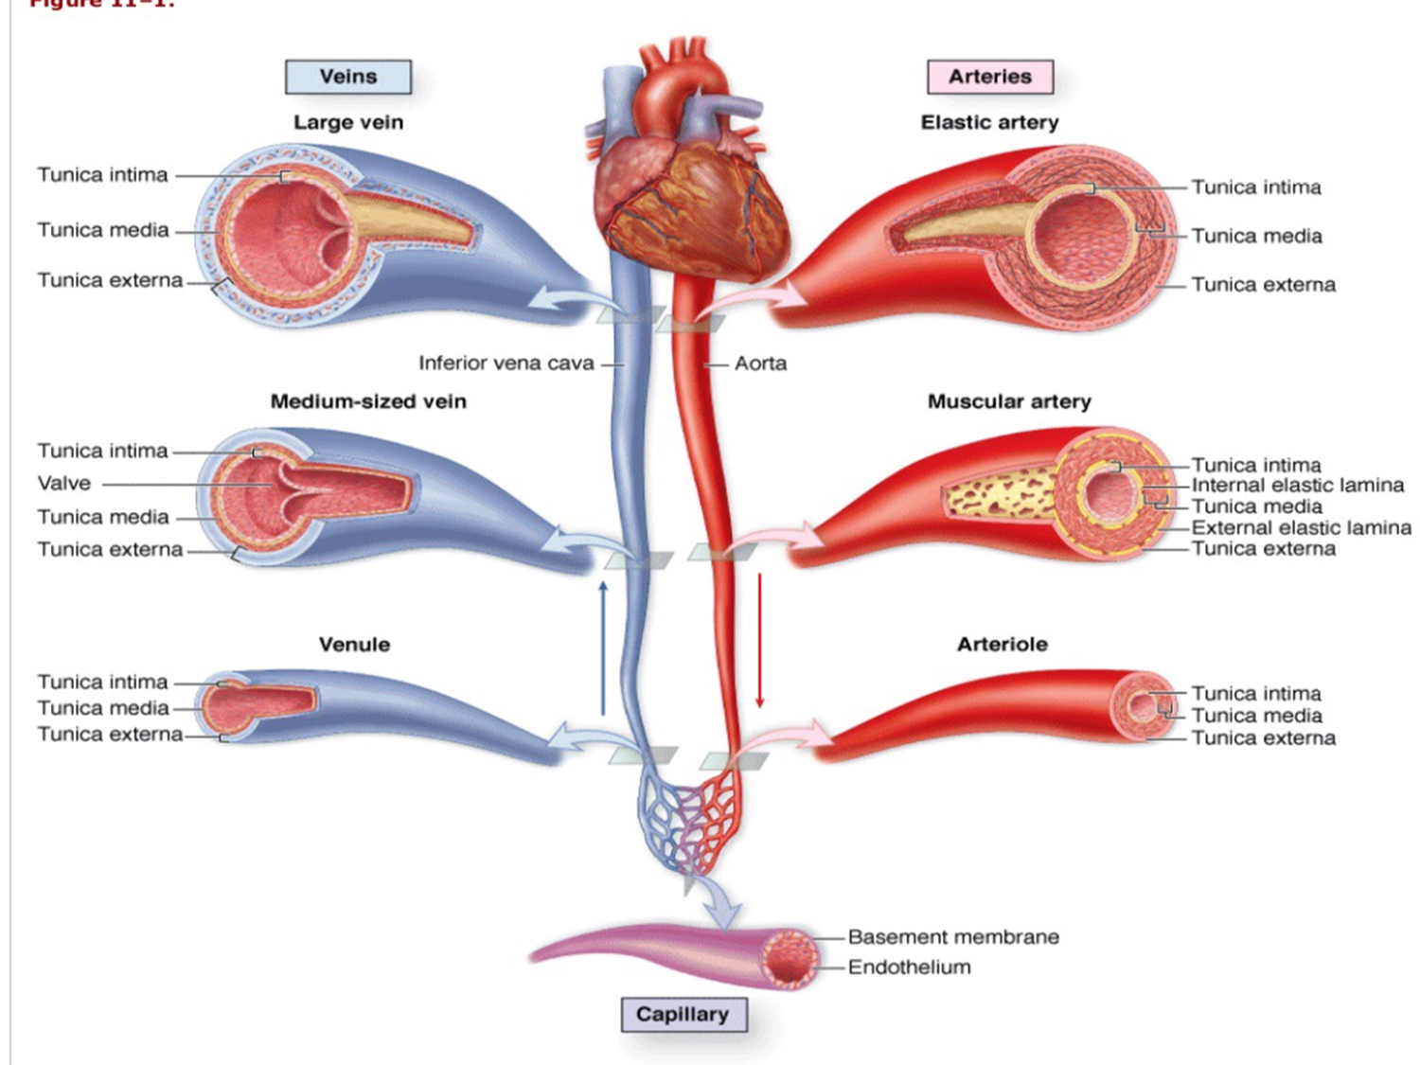

Slide 41
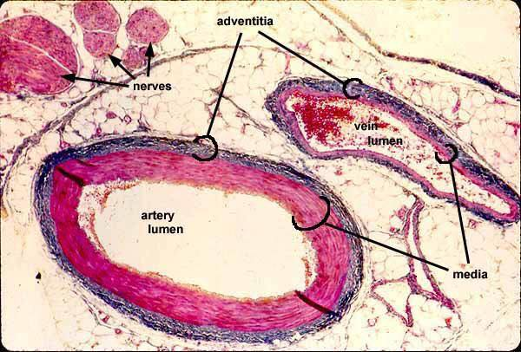

Slide 42
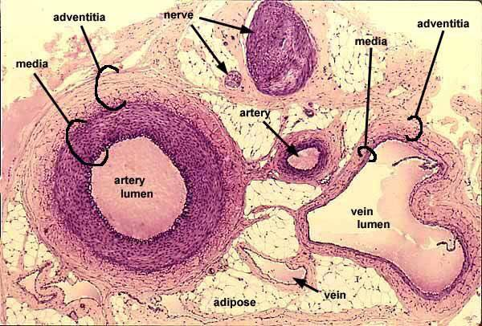

Slide 43
