Slide 1
المختبر الخامس
الطحالب الخضر Division :Chlorophyta

Slide 2
Chlorella

Slide 3
Cup shape chloroplast
Chlorella

Slide 4
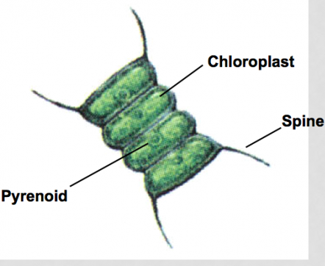
Parietal shape
Scenedesmus

Slide 5
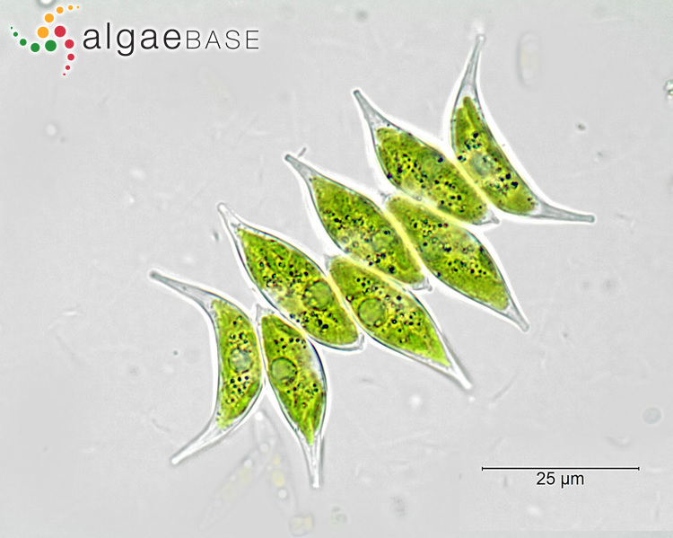
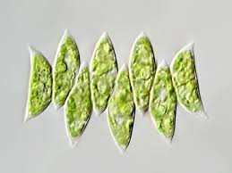
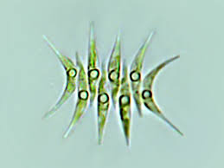
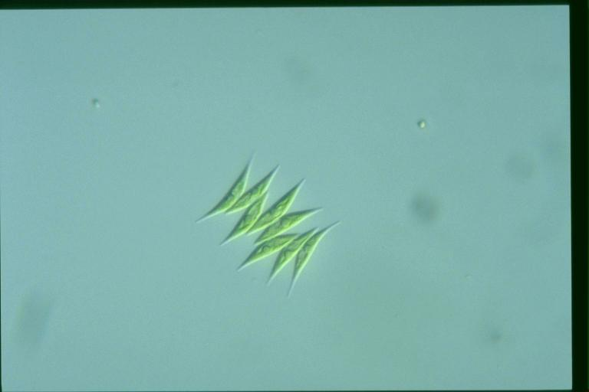

Slide 6
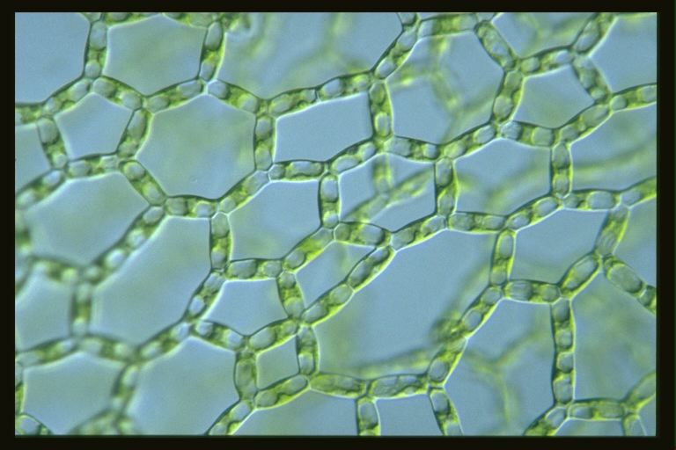
Hydrodictyon (Water net)

Slide 7
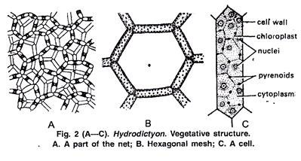

Slide 8
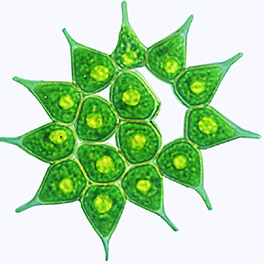
Parietal shape
Pyrenoied

Slide 9
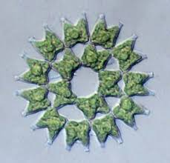
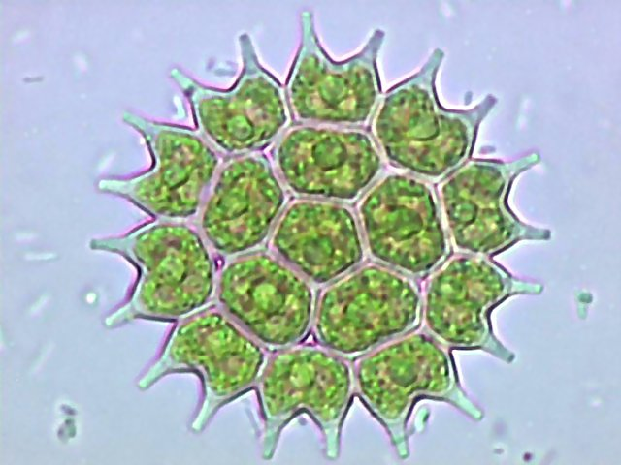
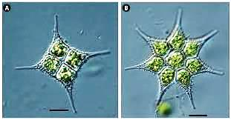
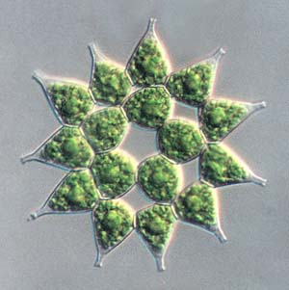
Pediastrum

Slide 10
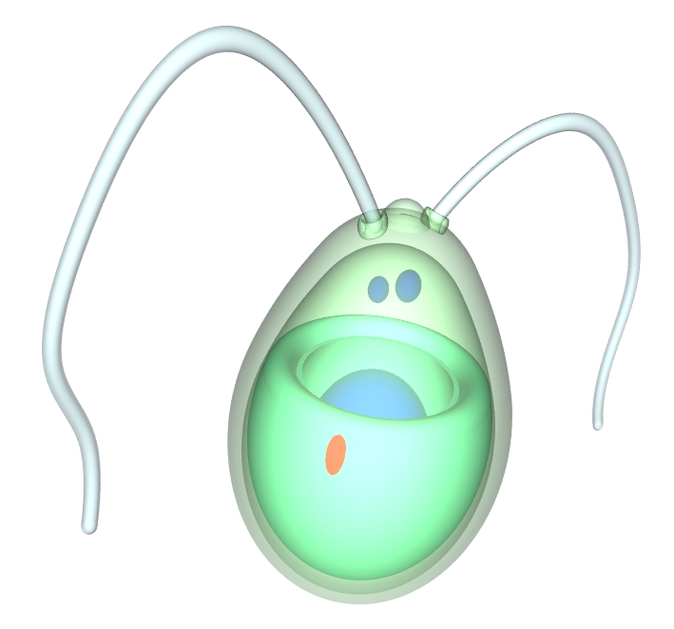
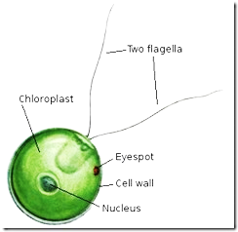
Cup shape
Chlamydomonas

Slide 11
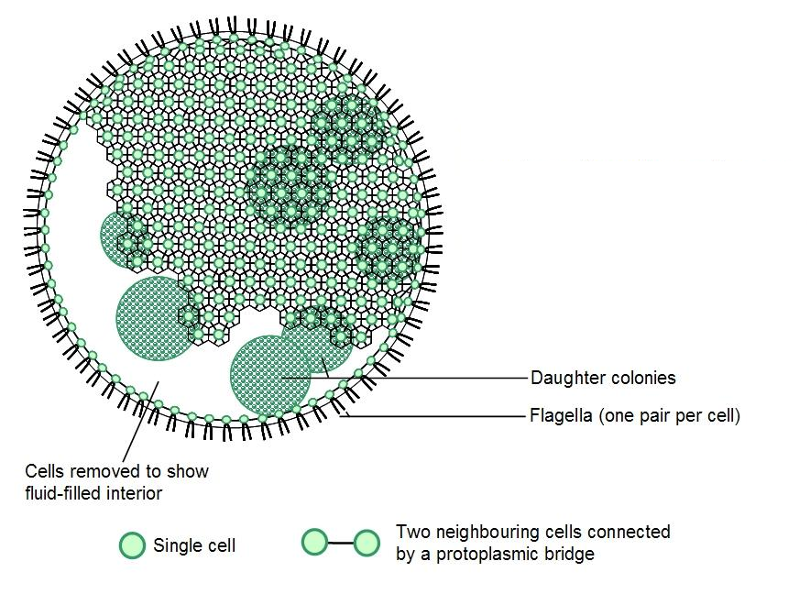
Volvox

Slide 12
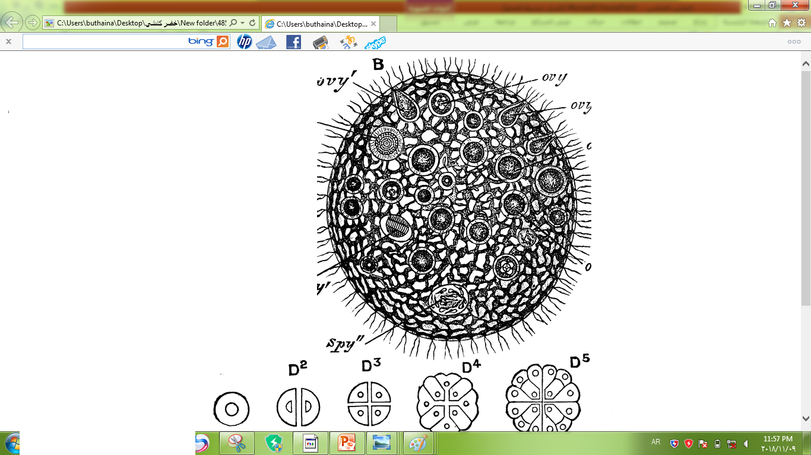
Gonidial cells
Oogonium
Oospore
Antheridium
Vegetative cells
Types of cell colony

Slide 13
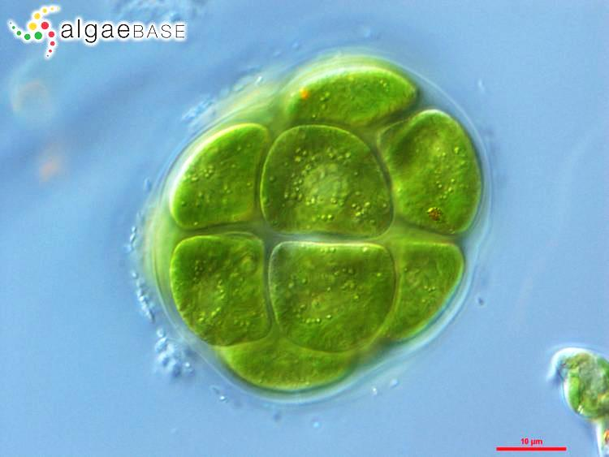
Eye spote
Pyrenoid
Mucilaginous envelop
Pandorina

Slide 14
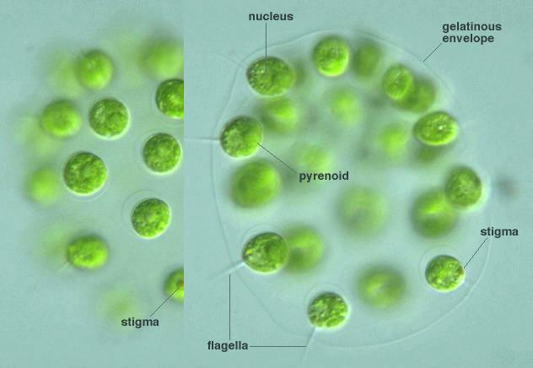
Eudorina
Eudorina

Slide 15
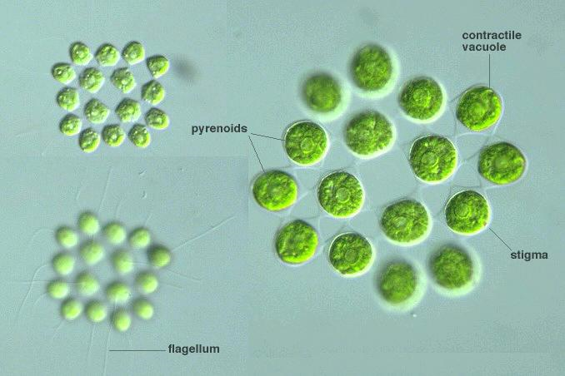
Gonium

