Slide 1
اشكال البلاستيدات
Shapes of plasteds

Slide 2
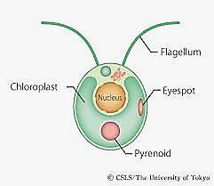
Cup Shape Chloroplast

Slide 3
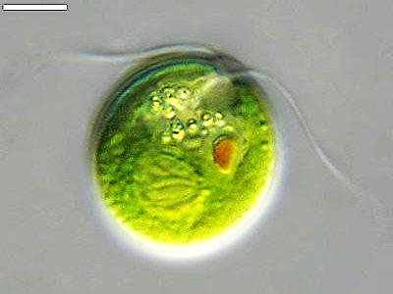
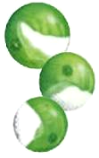
Cup Shape Chloroplast
Chlorella
Chlamydeomonas

Slide 4
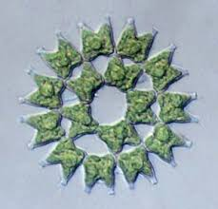
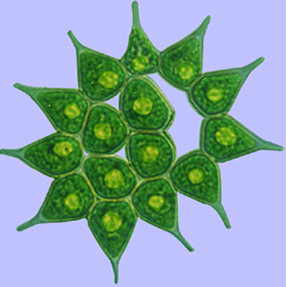
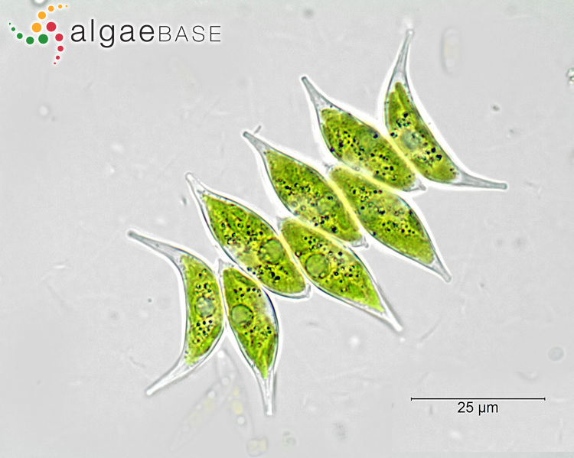
Parietal shape chloroplast
Pediastrum
Scendesmas

Slide 5
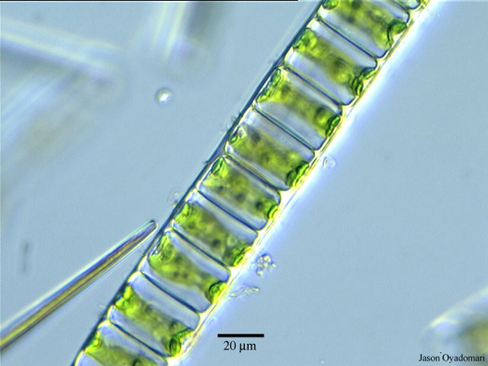
Girdle shape chloroplast
Ulothrix

Slide 6
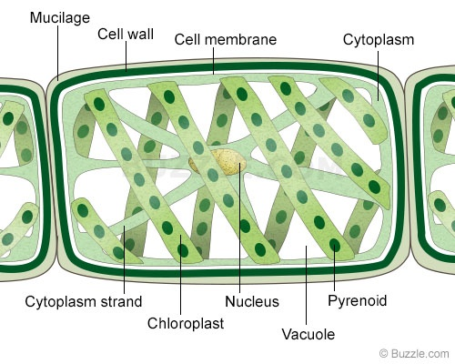
Spiral shape chloroplast
رسم تخطيطي يوضح البلاستيدة الحلزونية في طحلب Spirogyra

Slide 7
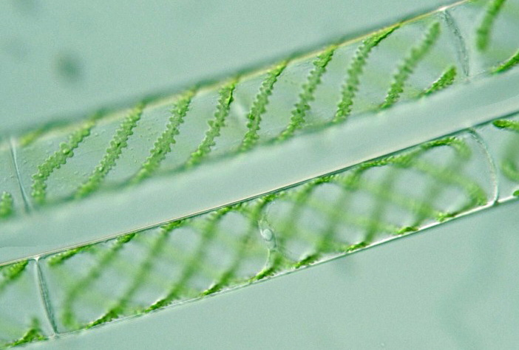
Spiral shape chloroplast
Spirogyra

Slide 8
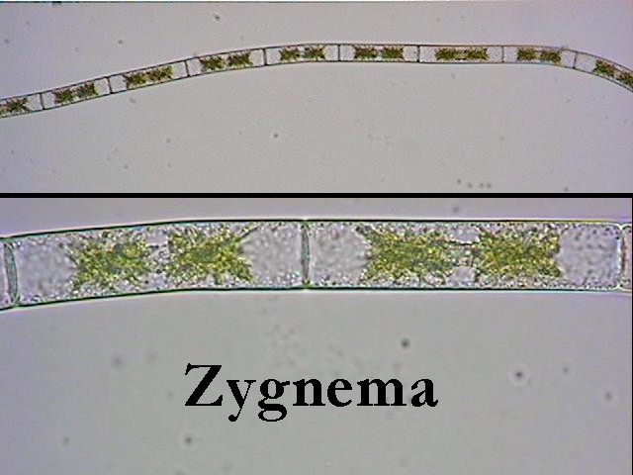
Stellate shape chloroplast

Slide 9
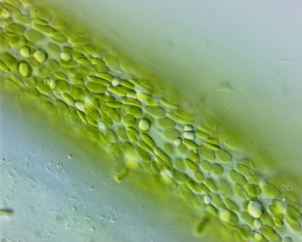
Discoid shape chromoplast
Vaucheria

Slide 10
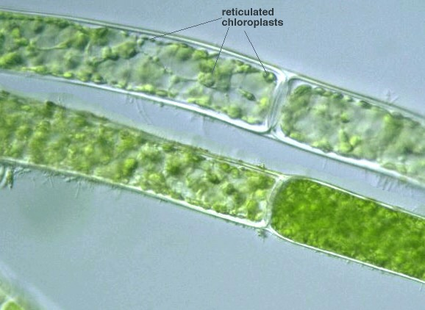
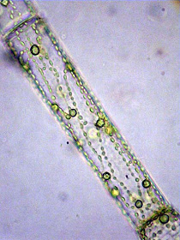
Reticulate shape chloroplast
Oedogonium

Slide 11
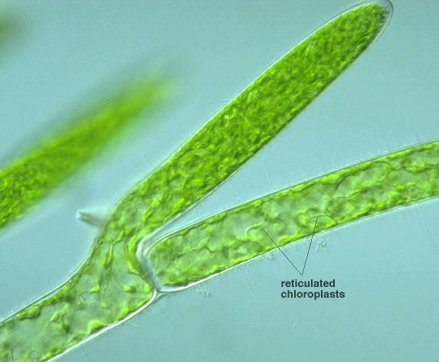
Reticulate shape chloroplast
Cladophora

Slide 12
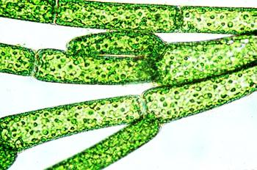
Granular shape chloroplast
Cladophora

