Slide 1
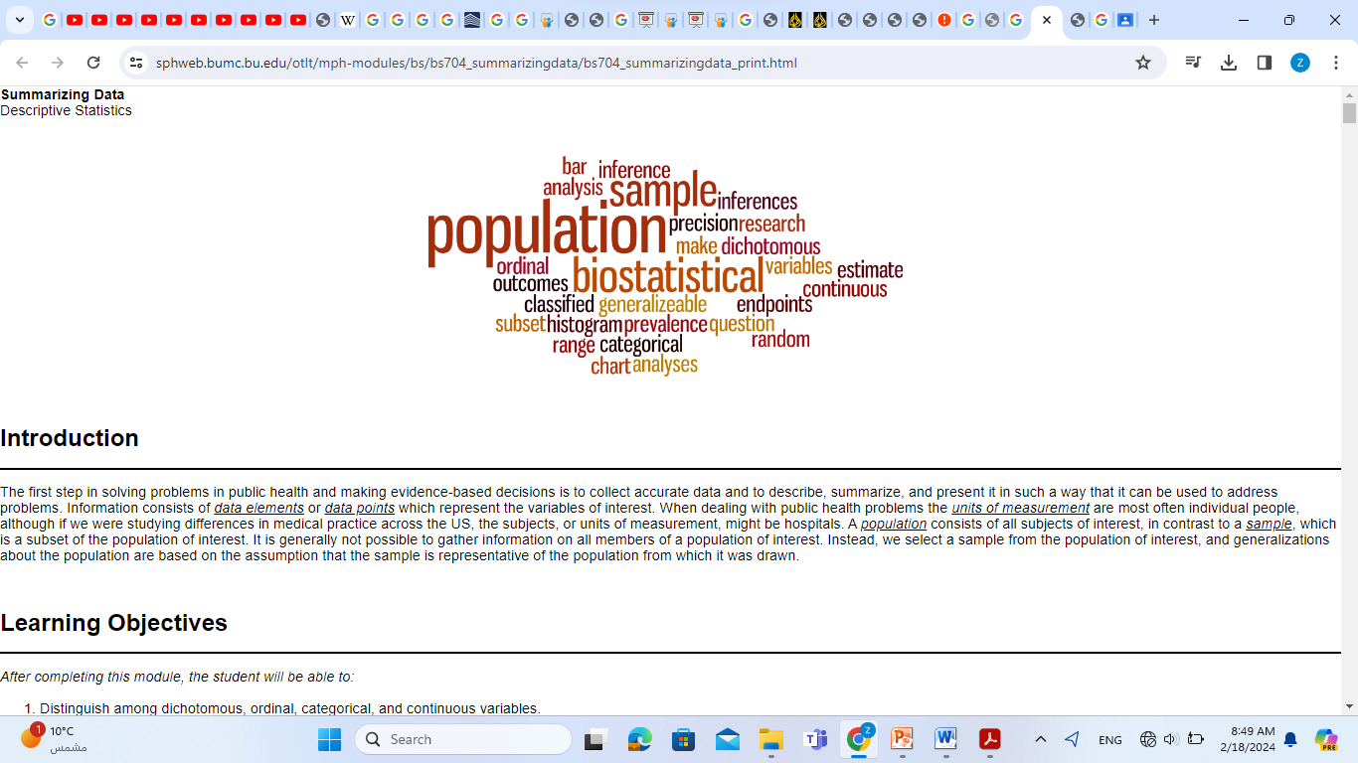
"وَكُلَّ شَيْءٍ أَحْصَيْنَاهُ كِتَابًا“
الآية (29) من سورة النبأ

Slide 2
Probability
and
Probability Distributions

Slide 3
CONTENTS
* Probability and Probability Distributions
- independent events
- conditional probability
* Discrete probability distributions
- Binomial Distributions
- Poisson Distributions
* Continuous Probability Distributions
- normal distribution
* Random Variables
- Discrete Random Variable
- Continuous Random Variable

Slide 4
Probability and Probability Distributions
•Usually we want to do more with data than just describing them!
•We might want to test certain specific inferences about the behavior of the data.

Slide 5
Example
One theory concerning the etiology of breast cancer states that:
•Women aged (over 30) who give birth to their first child are at greater risk for eventually developing breast cancer than are women who give birth to their first child early in life (before age 20)!
•To test this hypothesis, we might choose 2000 women who are currently ages 45–54 and have never had breast cancer, of whom 1000 had their first child before the age of 20 (call this group A) and 1000 after the age of 30 (group B)

Slide 6
Follow them for 5 years to assess whether they developed breast cancer during this period
Suppose there are 4 new cases of breast cancer in group A and 5 new cases in group B.
•Is this evidence enough to confirm a difference in risk between the two groups?!!
•Do we need to increase the sample size? Could this results be due to chance!!
•The problem is that we need a conceptual framework to make these decisions!
•This framework is provided by the underlying concept of probability.

Slide 7
Probability
• A probability is a measure of the likelihood that an event in the future will happen. It can only assume a value between 0 and 1.
•A value near zero means the event is not likely to happen.
A value near one means it is likely.

Slide 8
Definitions
•An experiment is the observation of some activity or the act of taking some measurement.
•An outcome is the particular result of an experiment.
•An event is the collection of one or more outcomes of an experiment.

Slide 9
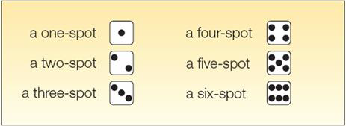
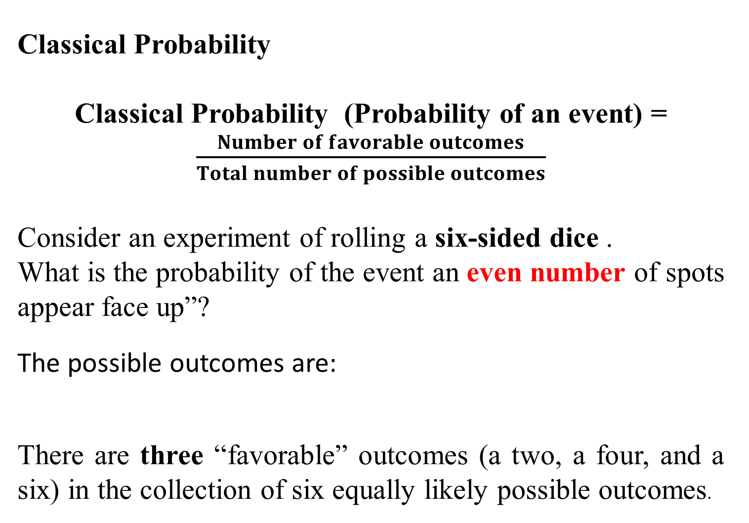
Classical Probability
Classical Probability (Probability of an event) = $\frac{Number of favorable outcomes}{Total number of possible outcomes}$
Consider an experiment of rolling a six-sided dice .
What is the probability of the event an even number of spots appear face up”?
The possible outcomes are:
There are three “favorable” outcomes (a two, a four, and a six) in the collection of six equally likely possible outcomes.

Slide 10

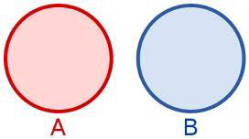
Mutually Exclusive Events
•Events are mutually exclusive if the occurrence of any one event means that none of the others can occur at the same time.
•Two events A and B are mutually exclusive if they cannot both happen at the same time.
A, B NOT mutually exclusive
A, B mutually exclusive

Slide 11
Example
•Let A be the event that a person has normotensive diastolic blood pressure (DBP) readings (DBP < 90), and let B be the event that a person has borderline DBP readings (90 ≤ DBP < 95).
•Suppose that Pr(A) = .7, and Pr(B) = .1.
•Let Z be the event that a person has a DBP < 95. Then
Pr (Z) = Pr (A) + Pr (B) = .8
•because the events A and B cannot occur at the same time.
•Let X be DBP, C be the event X ≥ 90, and D be the event 75 ≤ X ≤ 100. Events C and D are not mutually exclusive, because they both occur when 90 ≤ X ≤ 100.

Slide 12
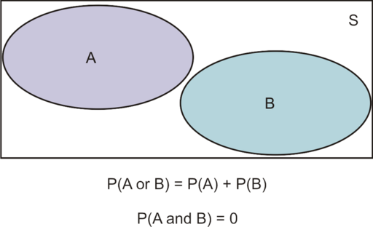
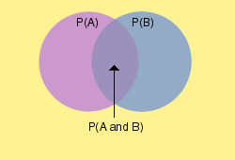
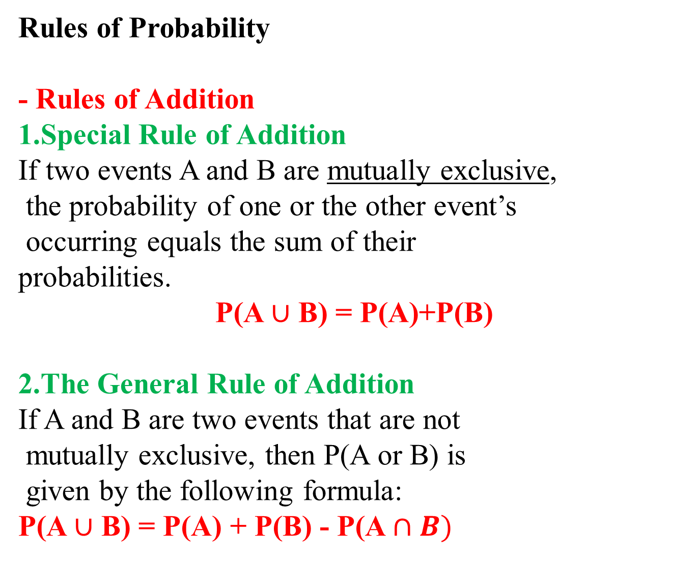
Rules of Probability
- Rules of Addition
1.Special Rule of Addition
If two events A and B are mutually exclusive,
the probability of one or the other event’s
occurring equals the sum of their
probabilities.
P(A $∪$ B) = P(A)+P(B)
2.The General Rule of Addition
If A and B are two events that are not
mutually exclusive, then P(A or B) is
given by the following formula:
P(A $∪$ B) = P(A) + P(B) - P(A $∩B)$

Slide 13
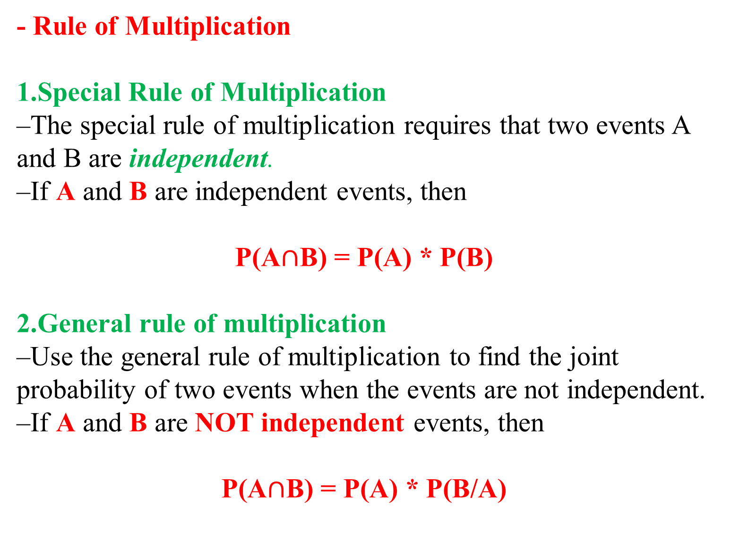
- Rule of Multiplication
1.Special Rule of Multiplication
–The special rule of multiplication requires that two events A and B are independent.
–If A and B are independent events, then
P(A$∩$B) = P(A) * P(B)
2.General rule of multiplication
–Use the general rule of multiplication to find the joint probability of two events when the events are not independent.
–If A and B are NOT independent events, then
P(A$∩$B) = P(A) * P(B/A)

Slide 14
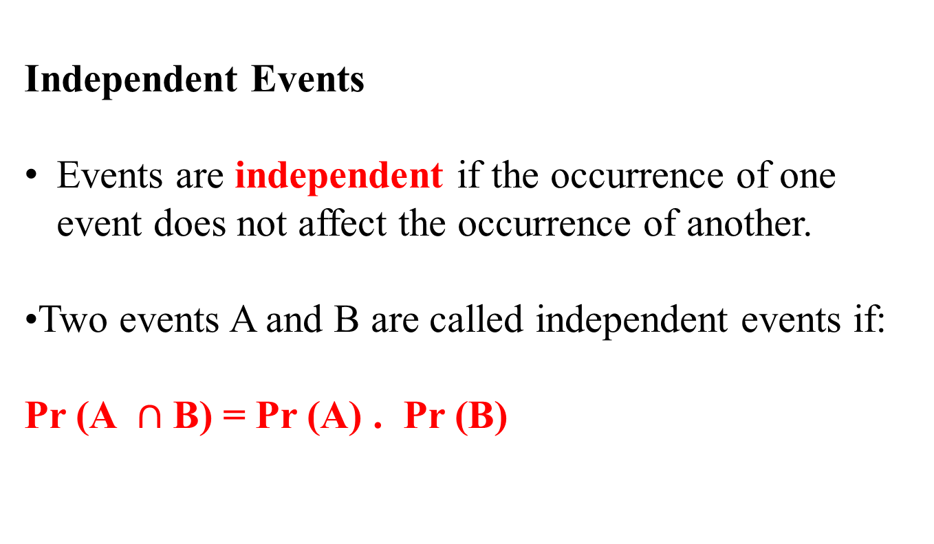
Independent Events
Events are independent if the occurrence of one event does not affect the occurrence of another.
•Two events A and B are called independent events if:
Pr (A $∩$B) = Pr (A) . Pr (B)

Slide 15
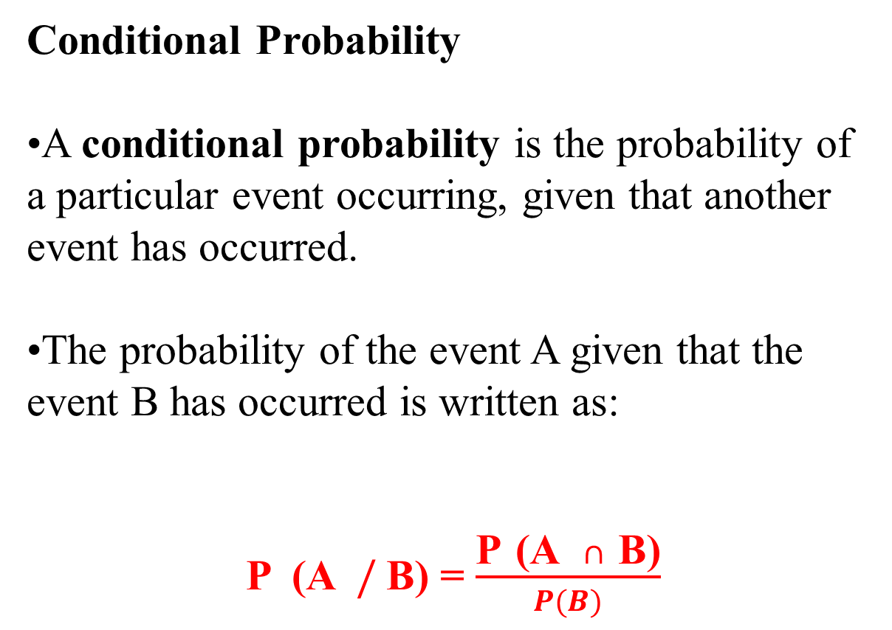
Conditional Probability
•A conditional probability is the probability of a particular event occurring, given that another event has occurred.
•The probability of the event A given that the event B has occurred is written as:
P (A $/$B) = $\frac{\text{P} \text{(}\text{A} ∩ \text{B}\text{)}}{P(B)}$

Slide 16
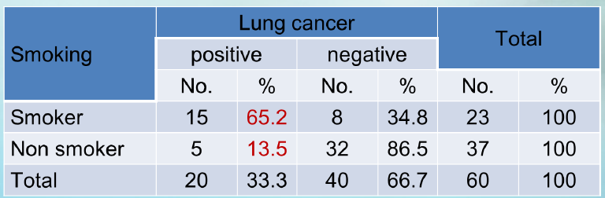
Example
If we chose one person at random, what is the probability that he is:
1.A smoker?
2.Has no cancer?
3.Smoker and has cancer?
4.Has cancer given that he is smoker?
5.Has no cancer or non smoker?

Slide 17
What is a Probability Distribution?
Probability Distribution:
A listing of all the outcomes of an experiment and the probability associated with each outcome.
Characteristics of a Probability Distribution
1.The probability of a particular outcome is between 0 and 1 inclusive.
2.The outcomes are mutually exclusive events.
3.The list is exhaustive. So the sum of the probabilities of the various events is equal to 1.

Slide 18
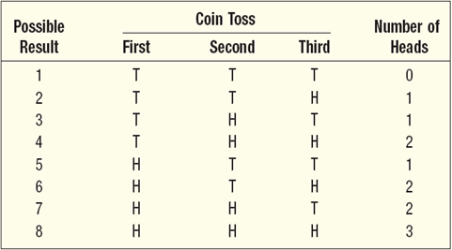
Probability Distributions for Discrete Random Variables
Experiment:
Toss a coin three times. Observe the number of heads. What is the probability distribution for the number of heads?

Slide 19
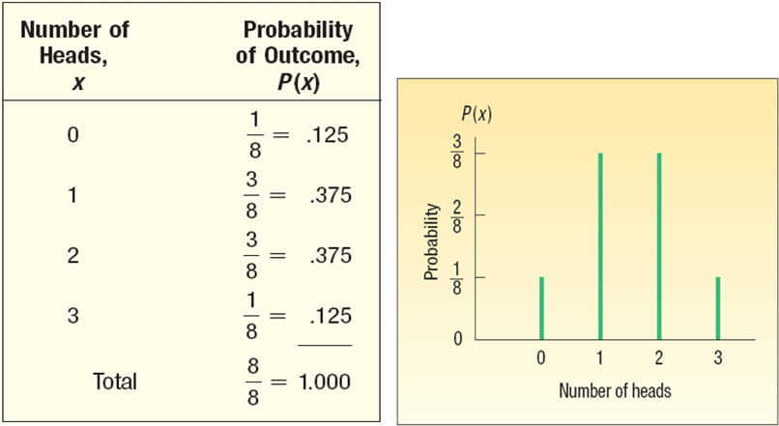

Slide 20
Example
•Many new drugs have been introduced in the past several decades to bring hypertension under control - that is, to reduce high blood pressure to normotensive levels.
•Suppose a physician agrees to use a new antihypertensive drug on atrial basis on the first four untreated hypertensives she encounters in her practice, before deciding whether to adopt the drug for routine use.
•Let X = the number of patients of four who are brought under control. Then X is a discrete random variable, which takes on the values 0, 1, 2, 3, 4.

Slide 21

•Suppose from previous experience with the drug, the drug company expects that for any clinical practice the probability that 0 patients of 4 will be brought under control is .008, 1 patient of 4 is .076, 2 patients of 4 is .265, 3 patients of 4 is .411, and all 4 patients is .240.
Probability-mass function for the hypertension-control example

Slide 22

•The number of combinations of n things taken k
at a time is:
•It represents the number of ways of selecting k objects out of n where the order of selection does not matter.

Slide 23
The Binomial Distribution
* All examples involving the binomial distribution have a common structure:
* A sample of n independent trials, each of which can have only two possible outcomes, denoted as “success” and “failure.”
* The probability of a success at each trial is assumed to be some constant p, and hence the probability of a failure at each trial is 1 − p = q.
* The term “success” is used in a general way, without any specific contextual meaning.

Slide 24
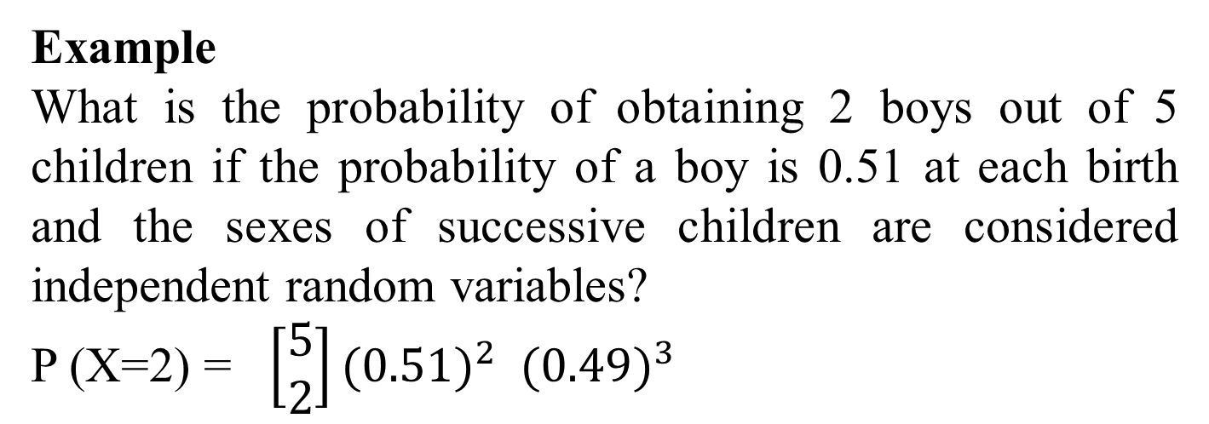
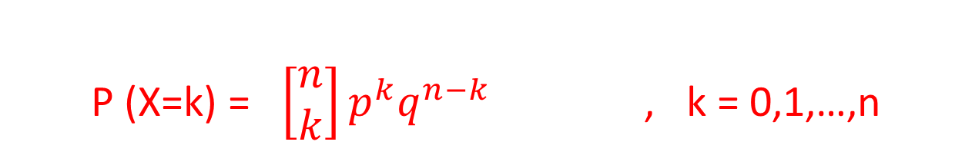
•The distribution of the number of successes in n statistically independent trials, where the probability of success on each trial is p, is known as the binomial distribution and has a probability-mass function given by:
P (X=k) = $\left[\begin{aligned}n \\ k\end{aligned}\right]p^{k}q^{n−k}$ , k = 0,1,…,n
Example
What is the probability of obtaining 2 boys out of 5 children if the probability of a boy is 0.51 at each birth and the sexes of successive children are considered independent random variables?
P (X=2) = $\left[\begin{aligned}5 \\ 2\end{aligned}\right]({0.51)}^{2}{ (0.49)}^{3}$

Slide 25
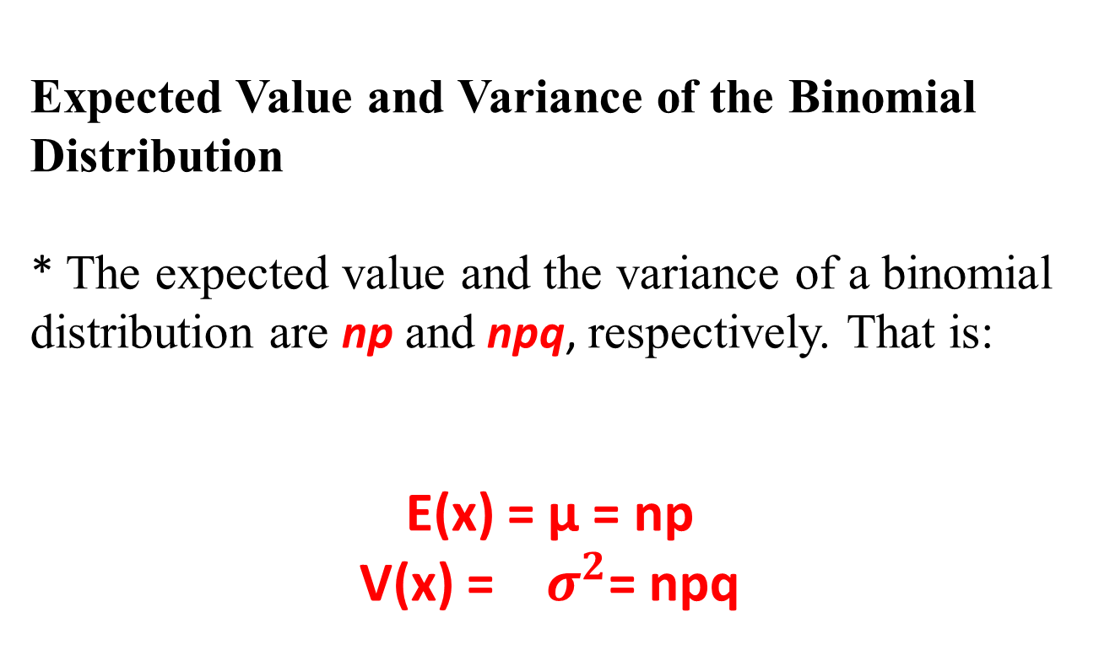
Expected Value and Variance of the Binomial Distribution
* The expected value and the variance of a binomial distribution are np and npq, respectively. That is:
E(x) = μ = np
V(x) = $σ^{2}$= npq

Slide 26
Practice Problem
•You are performing a cohort study. If the probability of developing disease in the exposed group is .05 for the study duration, then if you (randomly) sample 500 exposed people.
1.How many do you expect to develop the disease? Give a margin of error (+/- 1 standard deviation) for your estimate.
2.What’s the probability that at most 10 exposed people develop the disease?

Slide 27
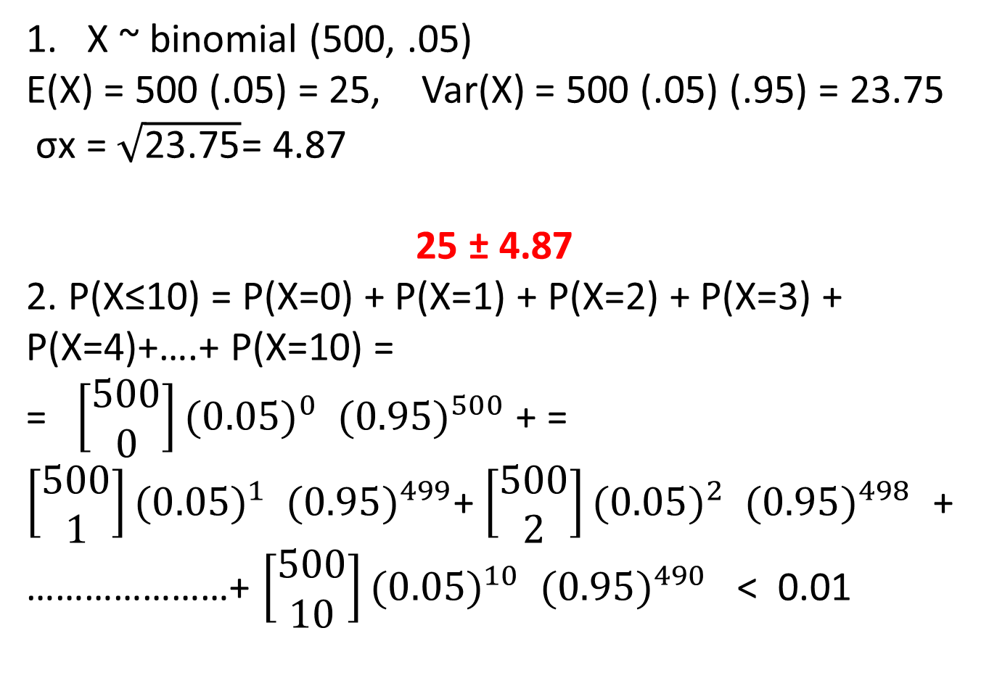
1. X ~ binomial (500, .05)
E(X) = 500 (.05) = 25, Var(X) = 500 (.05) (.95) = 23.75
σx = $\sqrt{\text{23.75}}$= 4.87
25 ± 4.87
2. P(X≤10) = P(X=0) + P(X=1) + P(X=2) + P(X=3) + P(X=4)+….+ P(X=10) =
= $\left[\begin{aligned}500 \\ 0\end{aligned}\right]({0.05)}^{0}{ (0.95)}^{500}$ + = $\left[\begin{aligned}500 \\ 1\end{aligned}\right]({0.05)}^{1}{ (0.95)}^{499}$+ $\left[\begin{aligned}500 \\ 2\end{aligned}\right]({0.05)}^{2}{ (0.95)}^{498}$ + …………………+ $\left[\begin{aligned}500 \\ 10\end{aligned}\right]({0.05)}^{10}{ (0.95)}^{490}$ < 0.01

Slide 28
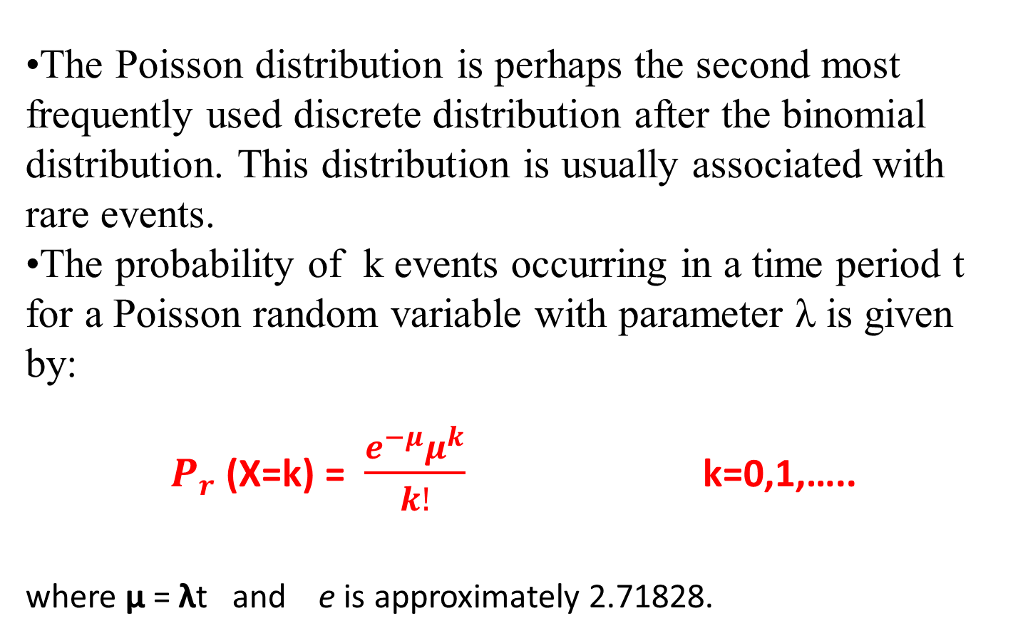
The Poisson Distribution
•The Poisson distribution is perhaps the second most frequently used discrete distribution after the binomial distribution. This distribution is usually associated with rare events.
•The probability of k events occurring in a time period t for a Poisson random variable with parameter λ is given by:
$P_{r}$ (X=k) = $\frac{e^{−μ}μ^{k}}{k!}$ k=0,1,…..
where μ = λt and e is approximately 2.71828.

Slide 29
•Thus the Poisson distribution depends on a single parameter μ = λt .
•Note that the parameter λ represents the expected number of events per unit time,whereas the parameter μ represents the expected number of events over time period t.
•One important difference between the Poisson and binomial distributions concerns the numbers of trials and events.
–For a binomial distribution there are a finite number of trials n, and the number of events can be no larger than n.
–For a Poisson distribution the number of trials is essentially infinite and the number of events (or number of deaths) can be indefinitely large, although the probability of k events becomes very small as k increases.

Slide 30
Expected Value and Variance of the Poisson Distribution
For a Poisson distribution with parameter μ, the mean and variance are both equal to μ.
•This fact is useful, because if we have a data set from a discrete distribution where the mean and variance are about the same

Slide 31
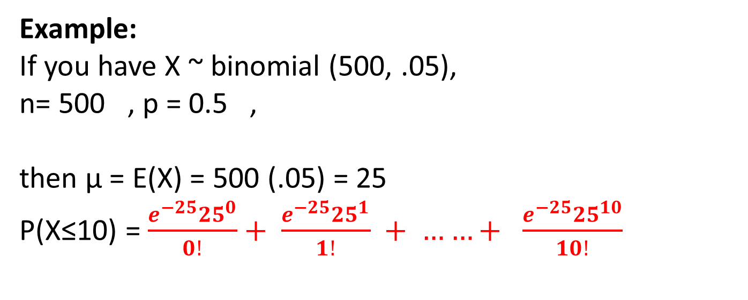
Poisson Approximation to the Binomial Distribution
The binomial distribution with large n and small p can be accurately approximated by a Poisson distribution with parameter μ = np.
Example:
If you have X ~ binomial (500, .05),
n= 500 , p = 0.5 ,
then μ = E(X) = 500 (.05) = 25
P(X≤10) = $\frac{e^{−25}{25}^{0}}{0!}+ \frac{e^{−25}{25}^{1}}{1!} + ……+ \frac{e^{−25}{25}^{10}}{10!}$

Slide 32
Example
•Assume that in Riyadh region an average of 13 new cases of lung cancer are diagnosed each year. If the annual incidence of lung cancer follows a Poisson distribution, find the probability of that in a given year the number of newly diagnosed cases of lung cancer will be:
a)Exactly 10.
b)At lest 8.
c)No more than 12.
d)Between 9 and 15.
e)Fewer than 7.

Slide 33
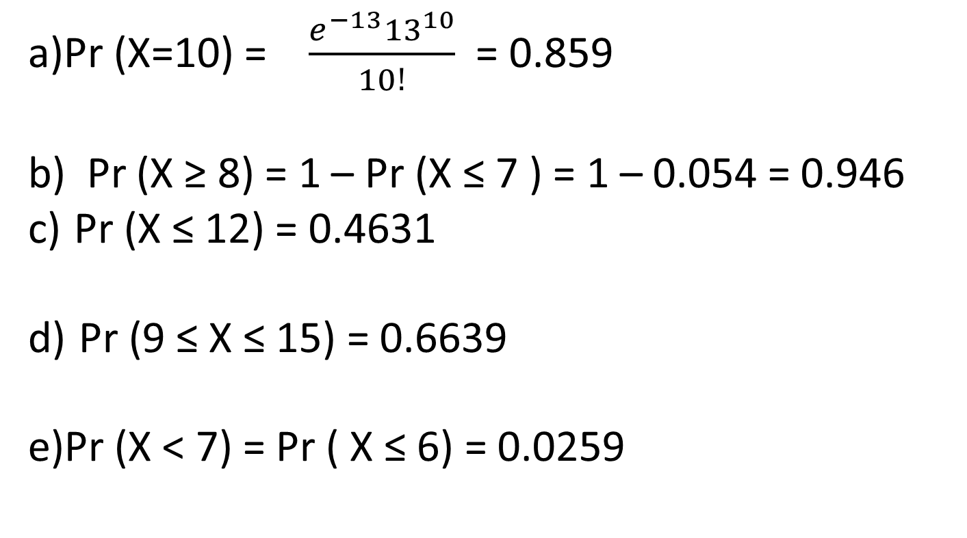
Solution:
a)Pr (X=10) = $\frac{e^{−13}{13}^{10}}{10!}$ = 0.859
b) Pr (X ≥ 8) = 1 – Pr (X ≤ 7 ) = 1 – 0.054 = 0.946
c) Pr (X ≤ 12) = 0.4631
d) Pr (9 ≤ X ≤ 15) = 0.6639
e)Pr (X < 7) = Pr ( X ≤ 6) = 0.0259

Slide 34
Continuous Probability Distributions
A reminder:
Discrete random variables have a countable number of outcomes
- Examples: Dead/alive, treatment/placebo, dice, counts, etc.
Continuous random variables have an infinite continuum of possible values.
- Examples: blood pressure, weight, the speed of a car, the real numbers from 1 to 6.

Slide 35
Properties of Continuous Probability Distributions:
•For continuous random variable, we use the following two concepts to describe the probability distribution:
The Normal Distribution
•Rules governing continuous distributions:
a)Area under the curve = 1.
b)P(X = a) = 0 , where a is a constant.
c)Area between two points a and b = P(a < x < b)

Slide 36
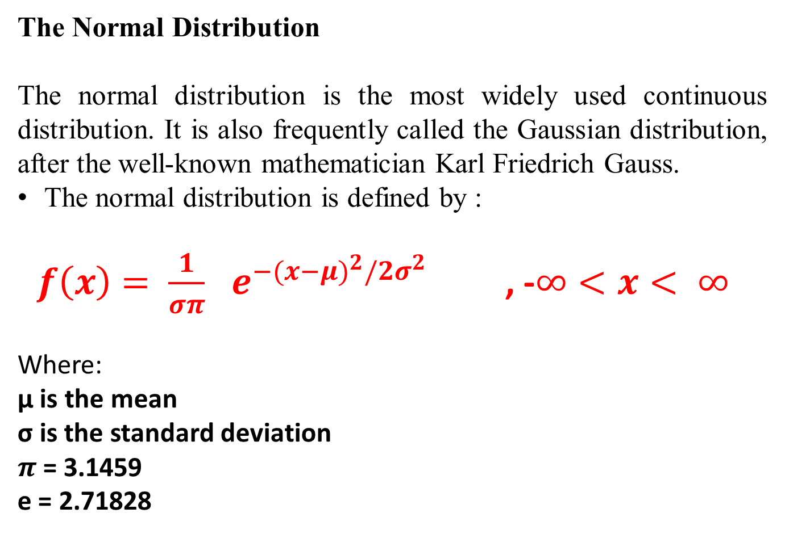
The Normal Distribution
The normal distribution is the most widely used continuous distribution. It is also frequently called the Gaussian distribution, after the well-known mathematician Karl Friedrich Gauss.
The normal distribution is defined by :
$f\left(x\right)= \frac{1}{σπ}$ $e^{−{(x−μ)}^{2}/{2σ}^{2}}$ , -$∞<x< ∞$
Where:
μ is the mean
σ is the standard deviation
$π$ = 3.1459
e = 2.71828

Slide 37
Characteristics of the normal distribution
•The distribution is symmetric about the mean μ, and is bell-shaped.
•The mean, the median, and the mode are all equal.
•The total area under the curve above the x-axis is one.
•The normal distribution is completely determined by the parameters μ and σ.

Slide 38
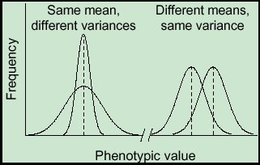
•The mean can be any numerical value: negative, zero, or positive and determines the location of the curve.
•The standard deviation determines the width of the curve: larger values result in wider, flatter curves.

Slide 39
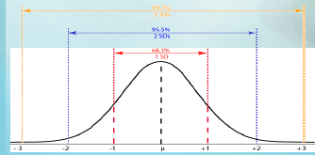
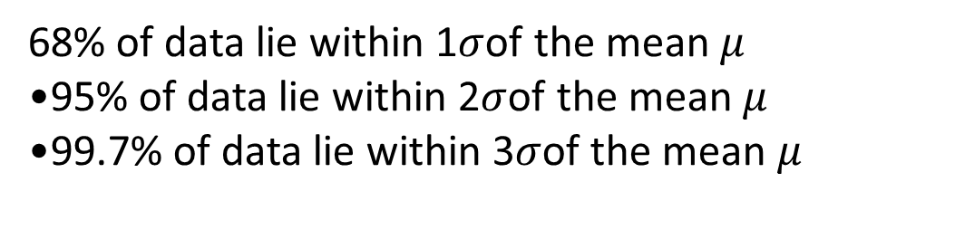
68% of data lie within 1$σ$of the mean $μ$
•95% of data lie within 2$σ$of the mean $μ$
•99.7% of data lie within 3$σ$of the mean $μ$

Slide 40
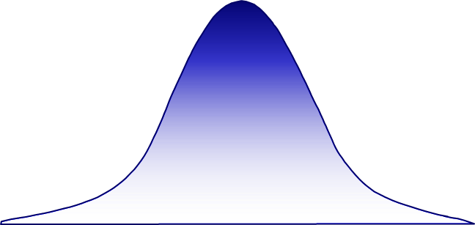
The Standard Normal Distribution
•Normal distribution with mean 0 and variance 1 is called a standard, or unit, normal distribution. This distribution is also called an N(0,1) distribution.
•The letter z is used to designate the standard normal random variable.

Slide 41
Random Variables
•A random variable is a function that assigns numeric values to different events in a sample space.
•When the values of a variable (height, weight, or age) can’t be predicted in advance, the variable is called a random variable.
RANDOM VARIABLE A quantity resulting from an experiment that, by chance, can assume different values.

Slide 42
DISCRETE RANDOM VARIABLE :
A random variable that can assume only certain clearly separated values. It is usually the result of counting something.
CONTINUOUS RANDOM VARIABLE :
can assume an infinite number of values within a given range. It is usually the result of some type of measurement .
EXAMPLES:
1. Diastolic blood-pressure (DBP) of group of people.
2. The weight of each student in this class.
3. The temperature of a patient.
4. Age of patients.
EXAMPLES:
1.The number of students in a class.
2.The number of children in a family.
3.The number of cigarettes smoked per day.
4.Number of motor-vehicle fatalities in a city during a week.

