Slide 1
Practical Immunology Antigens Preparation
Assist.Prof.Dr.Huda Sadoon Al Biaty

Slide 2
Antigen :-Substance that can recognized by immunoglobulin receptor of B-cell or by T-cell receptor when complex with MHC, are called AG.
Immunogen:-asubstance that induce aspecific humoral and/or cell mediated immune immune response
to get antigens able to trigger specific and efficient immune responses. We can improve their immunogenicity, by conjugation or fragmentation.
Hapten:- a small molecule which it could never induce an immune respons when administrated by themselves but which can when coupled to acarrier molecule.
.

Slide 3
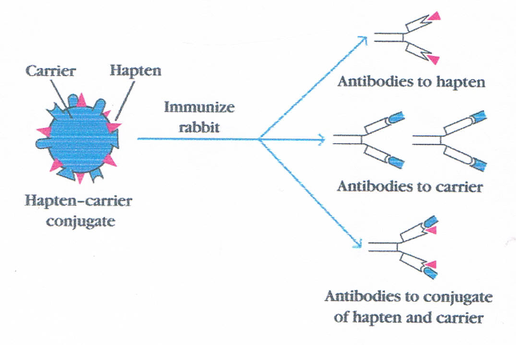

Slide 4
Types of antigens:-
1- Particulate Ags :-
Bacteria , viruses , parasites and erythrocytes .
2- Soluble Ags :-
serum protein ……

Slide 5
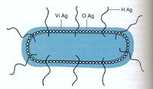
Types of bacterial antigens
Somatic antigen(O-Ag):
Heat stable
Consist of lipopolysaccharides (LPS)
Resist to weak acid and alcohol.
Example :Cell wall (LPS) of Gram negative bacteria
flageller antigen(H-Ag):
Heat labile
Consist of proteins
They are effect by weak acid and alcohol.
Example : Flagella of Salmonella spp.
Capsular Ags (vi-Ag):
Heat labile
Like the capsule of E. coli, Klebsiella pneumonia

Slide 6
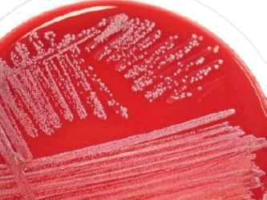
Method for preparation of somatic antigen:
Isolation and identification of the bacteria.
Overgrowth of the bacteria.
Harvesting the bacterial culture with pbs via harvester glass rod.
Collect the bacterial suspension by syringe and then killed by boiling in water bath for 1-2hrs.
Sterility test should be done to insure that the bacteria are killed by heating.
Washing the bacterial suspension 3 times with PBS by centrifugation 3000 rpm/30 minute.
For preservative the O-Ag, formal saline 0.3% should be added.
Finally we can do the standardization either by using the hemocytometer chamber or by using Mcfarland tubes to measures the turbidity.

Slide 7
Method for preparation of flageller Ag:
It is the same methods of preparation of O-Ag with some modification:
Reagents
We can use nutrient broth instead of Nutrient agar.
Formal saline 0.6%.
The method:
As the previous method, but the bacterial suspension will be killed by adding 0.6% formal saline for 24 hrs.
Washing 3 times with PBS and then add 0.3% formal saline.

Slide 8
McFarland standards:
It is a standard tube by which we can measure the turbidity of the tube.
"The turbidity of our tube should be the same as the turbidity of McFarland tube ".
McFarland standards are used as a reference to adjust the turbidity of bacterial suspensions so that the number of bacteria will be within a given range

Slide 9
McFarland standards:

Slide 10
Original McFarland standards were mixing specified amounts of barium chloride and sulfuric acid together. Mixing the two compounds forms a barium sulfate precipitate, which causes turbidity in the solution.
A 5.0 McFarland standard is prepared by mixing 0.5 mL of 1% barium chloride dihydrate (BaCl2•2H2O), with 9.5 mL of 1% sulfuric acid (H2SO4).

Slide 11
Standardization by using McFarland ′s tubes (10 capacity tubes contains
different concentrations of 1% BaCl2 & 1% H2SO4 .
Tube ……..3----------9× 10⁸ cell/ ml .
Tube ……….4 -----------1.2 × 10⁹ cell/ ml .
Or by using haemocytometer chamber , also , in case of H-Ag we used spectrophotometer .
McFarland Method :-
The method consists of comparing the opacity of the vaccine with a series of ten standard tubes containing varying amounts of barium sulfate in suspension.

Slide 13
Preparation of RBCs:-
Collect blood in sterile test tube containing suitable anticoagulants , Centrifugation and wash RBCs three times with isotonic saline solution , injection of RBCs in laboratory animals recording anti RBCs serum .
Preparation of immunoglobulin:-
Collect hyper immune serum , precipitation of immunoglobulin by using highly concentration of salts like ammonium sulfate , ligation of Ig with adjuvant , injected in laboratory animals , recording of anti immunoglobulin
(Antibodies) .

