Slide 1
Phylum : Rotifera
شعبة الدولابيات

Slide 2
General characters of Rotifera
Rotifera are microscopic , they are mainly freshwater ,and some species found in marine and humid terrestrial habitats.
Bilateral symmetry .
The general body plan consist of : head , neck , trunk(body) and the foot with two or three toes, contains adhesive glands permitting temporary attachment to objects.
The head has ciliated lobes or corona ( crown) that draw food into the mouth and help the swim. The characteristic movement of these cilia suggests a spinning wheel, hence the group name rotifer (wheel bearer)
The rotifers are pseudocoelomates .

Slide 3
The digestive system consists of a mouth , and a specialized pharynx called the Mastax, with its cuticular lining differentiated into Trophi, a series of pieces that act as jaws .and have esophagus , stomach , digestive glands , intestine and anus . They are feed on bacteria and algae, protozoa and detritus .
The excretory system consists of ciliated cells ( flame cells).
Nerve cells cluster in the head region .
Reproductive system is simple , consisting in the female of ovary , yolk gland , and oviduct .in male of testis and sperm duct .
The reproductive duct , inestine and excretory system (bladder) unite to form cloaca.

Slide 4
Classification of Rotifera
Class Bdelloidea : Does not have cuticular covering (lorica)with 2 ovaries , male have never been observed , and the females appear to be obligatery parthenogenic ( asexual ) produce diploid eggs that hatch into diploid females . Ex. Philodina .
Class Monogononta :have cuticular covering (lorica), with 1 ovary , sexual reproduction has been observed, although males are few. EX Brachionus
Females produce two kinds of eggs :
Amictic eggs -Diploid eggs that have not undergone reduction division , cannot be fertilized & develop only into females.
Mictic eggs -Haploid eggs – undergone meiosis and if ;
Unfertilized – develop quickly into males.
Fertilized –they secrete a thick shell and become dormant for several months before developing into females .
3. Class Seisonidea is the marine class , they are large and live in the gills of crustaceans. single genus :Seison

Slide 5
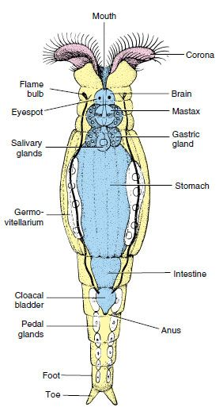
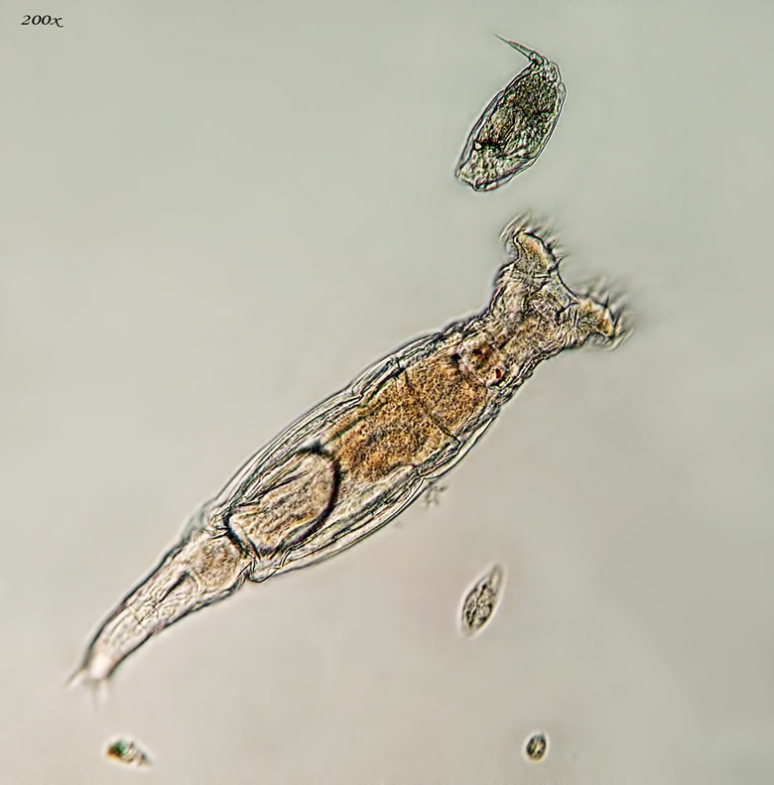
Class Bdelloidea ; Philodina
a live

Slide 6
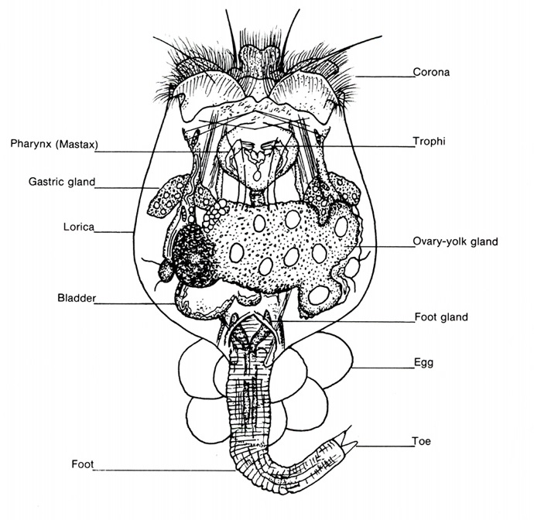
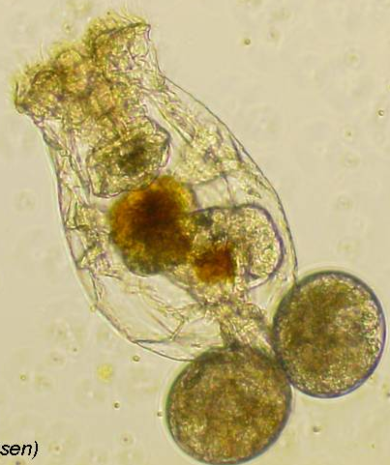
Class Monogononta : Brachionus
A live

Slide 7
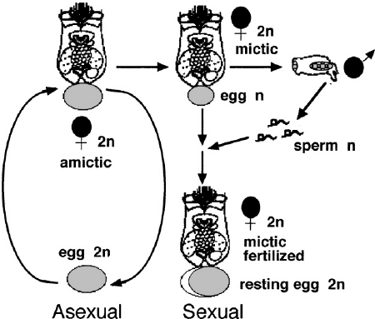
Class Monogononta : Brachionus Reproduction

Slide 8
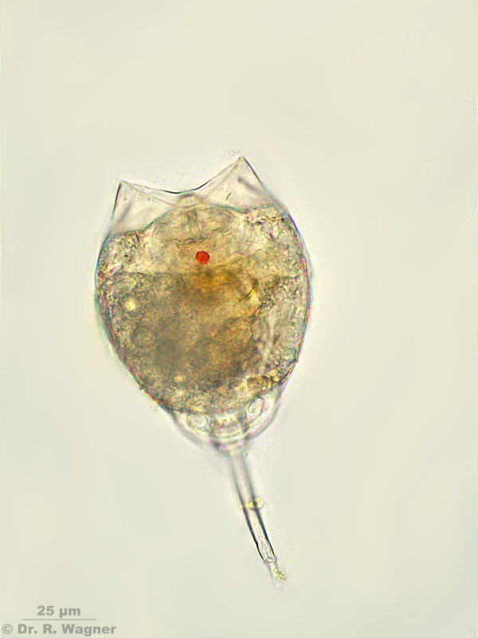
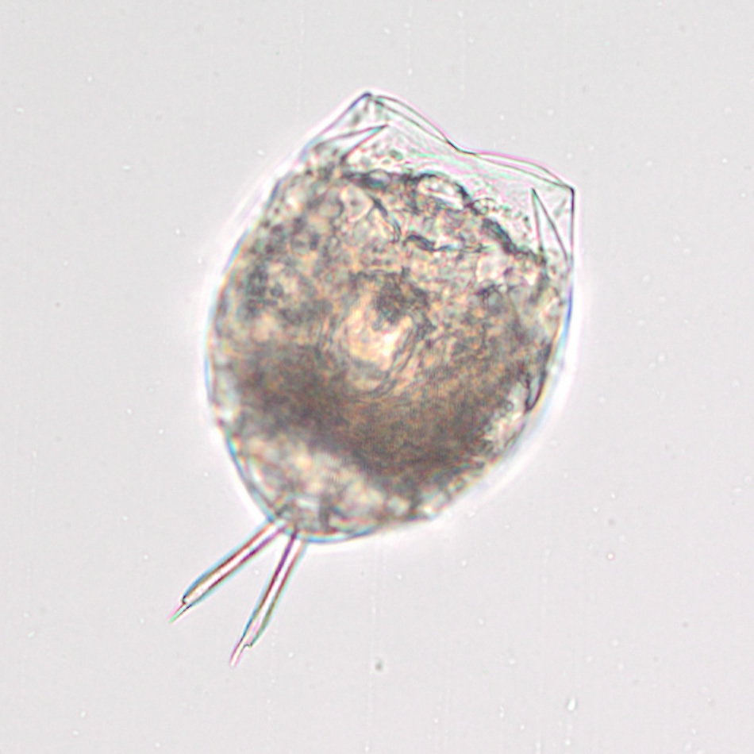
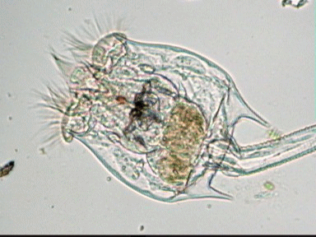
Phylum :Rotifera

Slide 9
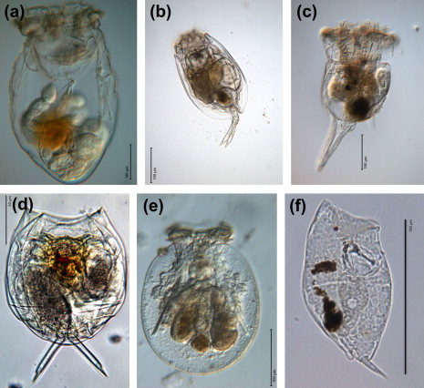

Slide 10
What kingdom is rotifer?
Animal
What are common features of animals?
All animals are eukaryotic, multicellular organisms, and most animals have complex tissue structure with differentiated and specialized tissue. Animals are heterotrophs; they must consume living or dead organisms since they cannot synthesize their own food and can be carnivores, herbivores, omnivores, or parasites

Slide 11
What do rotifers do? Are rotifers harmful or helpful? Why are rotifers important to humans?
Rotifers in the wild have little significance to humans. They may have some economic significance,
The rotifers are filter feeders that will eat dead material, algae, and other microscopic living organisms, and are therefore very important components of aquatic food webs.

Slide 12
What is the function of the Mastax?
The mastax and associated trophi are highly adaptive. The primary function of the mastax is to grind food particles, however, common adaptations are for grasping or sucking in complete food particles or the contents of large prey.

Slide 13
Do rotifers move?
There are a variety of different shapes of rotifer. ... Rotifers may be free swimming and truly planktonic, others move by inch worming along the substrate whilst some are sessile,. About 25 species are colonial, either sessile or planktonic.

Slide 14
Are rotifers dangerous?
No, rotifers are not parasitic or pathogenic

Slide 15
What does rotifer mean?
. Rotifers are so named because the circular arrangement of moving cilia (tiny hair like structures) at the front end resembles a rotating wheel.
What is the term for the jaws of a rotifer?
The jaws of rotifers, called trophi, are located in a muscular pharynx, which is termed the Mastax. Nine different kinds of trophi have been recognized. ... Diversity in form and function within Rotifera

