Slide 1
Phylum : Rotifera شعبة الدولابيات

Slide 2
General characters of Rotifera
Rotifera are microscopic , they are mainly freshwater ,and some species found in marine and humid terrestrial habitats.
Bilateral symmetry .
The general body plan consist of : head , neck , trunk(body) and the foot with two or three toes, contains adhesive glands permitting temporary attachment to objects.
The head has ciliated lobes or corona ( crown) that draw food into the mouth and help the swim. The characteristic movement of these cilia suggests a spinning wheel, hence the group name rotifer (wheel bearer)
The rotifers are pseudocoelomates .
The digestive system consists of a mouth , , and a specialized pharynx called the mastax, with its cuticular lining differentiated into trophi, a series of pieces that act as jaws .and have esophagus , stomach , digestive glands , intestine and anus . They are feed on bacteria and algae, protozoa and detritus .
The excretory system consists of ciliated cells ( flame cells).
Nerve cells cluster in the head region .
Reproductive system is simple , consisting in the female of ovary , yolk gland , and oviduct .in male of testis and sperm duct .
The reproductive duct , inestine and excretory system (bladder) unite to form cloaca.

Slide 3
Classification of Rotifera
Class Bdelloidea : Does not have cuticular covering (lorica)with 2 ovaries , male have never been observed , and the females appear to be obligatery parthenogenic ( asexual ) produce diploid eggs that hatch into diploid females . Ex. Philodina .
Class Monogononta :have cuticular covering (lorica), with 1 ovary , sexual reproduction has been observed, although males are few. EX Brachionus
Females produce two kinds of eggs :
Amictic eggs -Diploid eggs that have not undergone reduction division , cannot be fertilized & develop only into females.
Mictic eggs -Haploid eggs – undergone meiosis and if ;
Unfertilized – develop quickly into males.
Fertilized –they secrete a thick shell and become dormant for several months before developing into females .
3. Class Seisonidea is the marine class , they are large and live in the gills of crustaceans. single genus :Seison

Slide 4
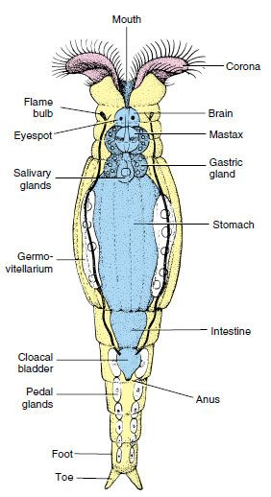
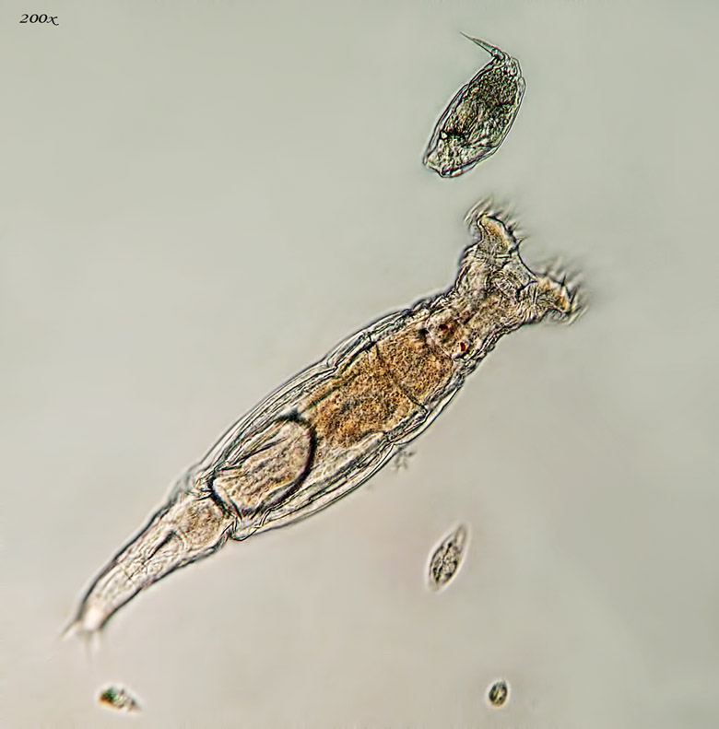
Class Bdelloidea ; Philodina
a live

Slide 5
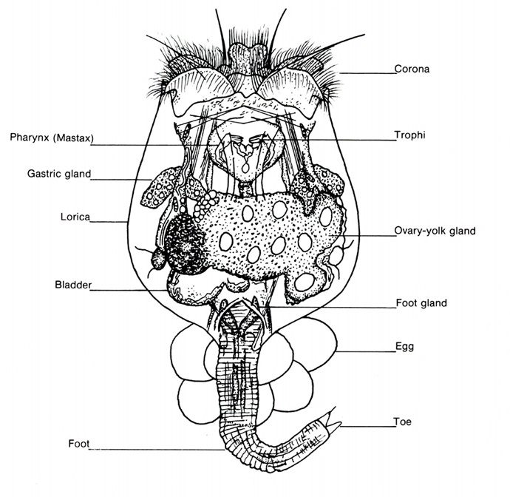
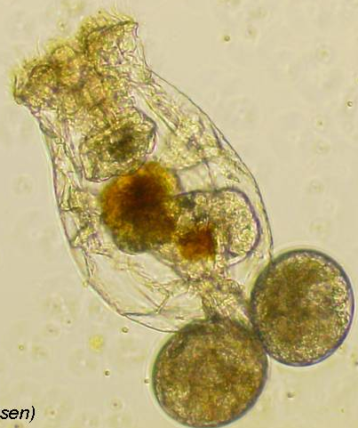
Class Monogononta : Brachionus
A live

Slide 6
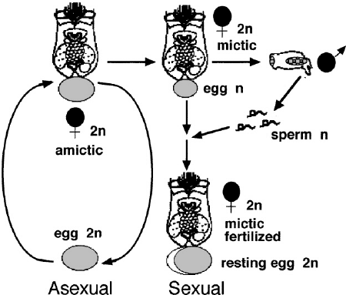
Class Monogononta : Brachionus Reproduction

Slide 7
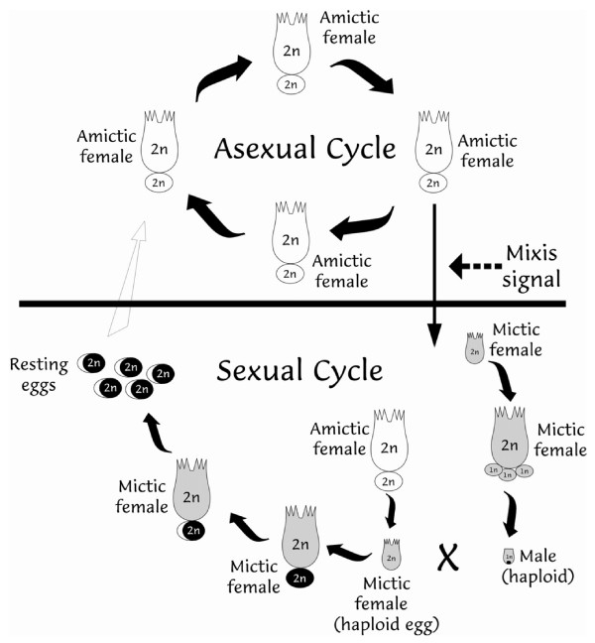
Class Monogononta : Brachionus Reproduction

Slide 8
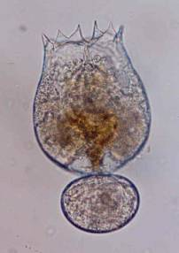
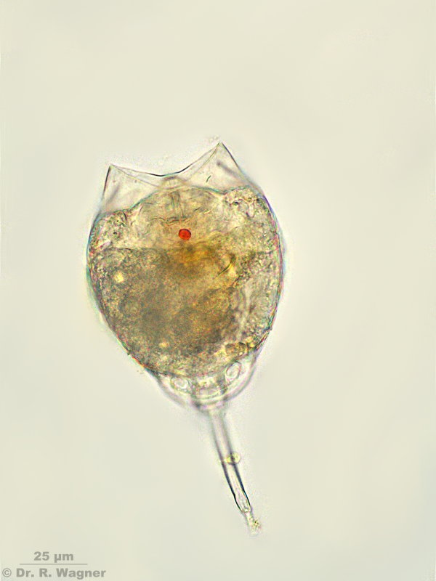
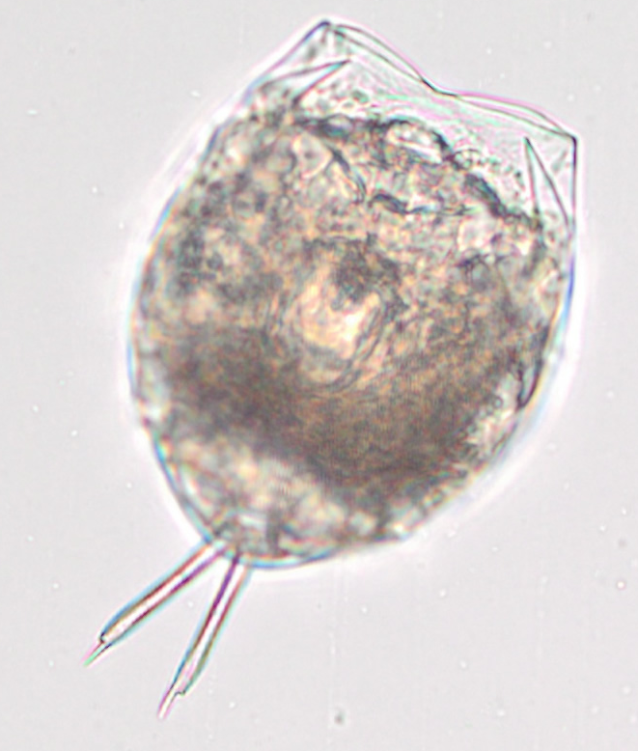
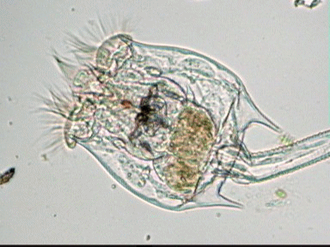
Phylum :Rotifera

Slide 10
شعبة المخلبيات

Slide 11
Phylum : Onycophora (Velvet worms )
The phylum Onycophora contains about 100 species of small , Caterpillar –like animals called velvet ,or wallking worms that live in rain forests and other moist , leafy habitats in tropical and sub tropical , through there are few temperate species in the southern hemisphere .

Slide 12
Characteristics of the Onychophora
Bilaterally symmetrical and vermiform .
Triploblastic , with true coelom (eucoelomate)
Free-living and terrestrial .
Have between 14-43 pairs of unsegmented walking legs. They have a series of pads towards their ends an a pair of claws at their trips.
With a thin chitinous cuticule –cover epidermis.
The head of three segments ,bearing : a pair of antenna , a pair of jaws, a pair of oral papillae , simple eyes are similar to annelids and found in the dorsal position .( not appendages ).
Possesses a straight gut with anus .
Nerves system includes a brain and a pair of ventral nerve cords.
Excretion by nephridia.
Possesses a simple respiratory system in the form of tracheae and spiracles.
Possesses circular , oblique and longitudinal muscle layers.
Onychophora are separates sex.
Possesses an open circulatory system with heart.
They have hyrostatic skeleton , which is a fluid enclosed in muscular wall.

Slide 13
Onychophorans are interest to Zoologists because they share so many characteristics of Annelids and Arthropoda that they have been considered by some to be the missing link between the two phyla

Slide 14
similarities Onychophorans-Annelids -characteristics
1. Presence of paired nephridia in al­most every segment of the body.
2. Reproductive tracts are lined by cilia.
3. Skin is thin and flexible.
4. Dermomuscular body wall like Hirudinea. (Body wall musculature smooth and composed of circular, dia­gonal and longitudinal muscle fibres).
5. True head is absent.
6. Simple eyes (Ocelli) rather than compound eyes.
7. Hollow and non-jointed appendages like those of parapodia.
8. Slime glands and coxal glands corre­spond with the similar glands of polychaetes and oligochaetes.
9. Straight gut with an anus.
10. Vermiform boy.
Dissimilarities Onychophorans-Annelids - characteristics
1. Ventrally placed mouth in Onychophores.
2. Heart and ostia present in Onychophores.
3. Clawed appendages in Onychophores.
4. Presence of antennae in Onychophores.
5. Ladder-like nervous system in Onychophores.
6. Tracheal tube for respiration in Onychophora.
7. Absence of true metamerism in Onychophora.
8. Texture on the skin in Onychophora.

Slide 15
Following features show that Onycho­phora is more related to Arthropoda:
Structural similarities:
The appendages are provided with claws.
2- Jaws are modified appendages .
3- Heart dorsal and tubular, perforated by lateral ostia.
4. Body is covered with chitinous cuticle and is moulted.
5. Jaws are provided with striated mus­cles.
6. Presence of antennae.
7. Brain is large and resembles the brain of typical arthropods.
8. Presence of tracheae as respiratory organs.
9. Excretory organs closely resemble the green glands of Crustacea.
Structural Dissimilarities:
Onycho­phores differ in many respect from the Ar­thropods.
1. Arrangement of tracheae is not arthropod-like. Here in each segment there are numerous permanently opened spiracles (no closing mecha­nism).
2. Jaw is the modification of second ap­pendages and the movements of jaws operate from anterior end and pro­ceed towards posterior end.
3. Segmentation not distinct in Onychophora.
4. Absence of malpighian tubules in Onychophores.
5. Simply, un-jointed, numerous stumpy legs in Onychophores.
6. Structure of eye is less complicated.
7. Two ventral nerve cords are widely separated and without true ganglia.

Slide 16
Onychophorans unique characteristics
The head appendages consist of a pair of antenna , a pair of jaws, and a pair of oral papillae .
Body has unjointed walking legs .
No blood pigment .
Propulsion generated by musculature of limbs , body remains rigid.
Limbs elevate above ground .

Slide 17
Classification : the Onychophora is divided into one order and two families:
Order Euonychophora
Family Peripatidae
Family Peripatopsidae

Slide 18
A very important example of phylum is the genus peripatus ,it is an ancient blue forest creature that is thought to be an evolutionary link between Annelida (worms ) and Arthropods.
Body and shape of peripatus , Common name : walking worm , velvet worm .

Slide 19
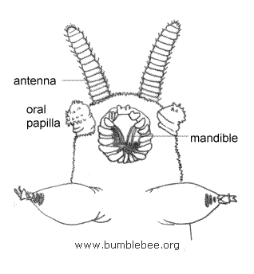
جهة امامية بطنية Peripatus

Slide 20
Peripatus is a terrestrial animal , nocturnal and carnivorous is feeding , it feeds on worms , mites and insects.
The body caterpiller –like .Soft , elongates , bilateral symmetrical and it length from 1.5-15 cm , many superficial lines mark the body and a thin cuticle covers the skin which has velvety texture with a number of fine ridges bearing papillae armed with spine . The color varies depends on the species from dark grey to brown . The body of peripatus is divided into indistinct and elongated trunk.

Slide 21
منظر عام جانبي Peripatus

Slide 22
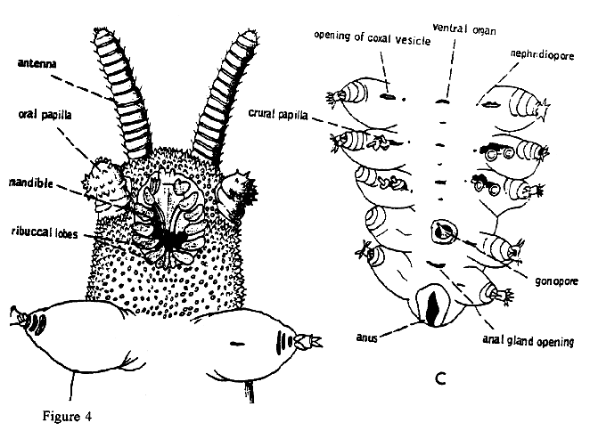
الجهة الخلفية البطنية
الجهة الامامية البطنية

Slide 23
Phylum :Arthropoda from Latin arthron =joint podus= foot
Arthropoda compose more than 75% of all animal species on earth. Their bodies have best shape represented in animal kingdom , those include , insects , spiders , scorpions, crabs, lobsters, shrimps and others.
Arthropoda ,like annelids, the body is consists of segments but some segements are fused or modified for certain specialization, this called Tagmatization

Slide 24
General characteristics:
Bilateral symmetrical but few have radial symmetry all are triploblastic . with strongly segmented bodies . Segmentation affects both extenal and internal structure .
Some segments are fused to form specialized body regions called tagmata. Segmented body allows infinite possibities for adaptive modifications , lots of fusion of segments into a variety of body forms: ( types of tagmatization in arthropods): cephalothorax & abdoman , head & trunk , head-thorax-abdoman. . And the process and condition of fusion is called Tagmosis
Hard exoskeleton of chitin consists of hardened chitin and protein in several layers secreted by epidermis excellent for protection and waterproof. The skeleton contains various folds, flaps and spines, some parts are modified for feeding, respiration, swimming, mating and or sensory organs.
Arthropods generally grow by molting their exoskeletons in process called Ecdysis .
Jointed appendages that give arthropodas generalized appendages which were modified into many specilized organs for walking , grasping, and eating.
Cephalization (well developed head) : with many sense organs, antennae and compound eyes are characteristic sense organs of arthropods.
Complex muscular system : layers of muscles around internal organs both striated and smooth muscle fibers muscle bundles to move skeleton.
Arthropoda are eucoelomate , Coelom is reduced as hemocoel in body cavity , so it is more important for circulation than movement.
Complete digestive system : many feeding appendages to get food into mouth with specialized areas for grinding and sorting food and accessory glands that secrete enzymes.
Open circulatory system .
Well- developed respiratory system : many different kinds depending on habitat such as : gill, book gills , lung , book lungs or tracheae.
Nervous system : similar to annelids in which dorsal brain and double nerve cord with paired ganglia in each segment.
Efficient excretory system prevents excessive water loss in land ( green or coxal gland).
Most are diacious.

Slide 25
Classification
A - Subphylum Chelicerata الشعبة الثانوية الكلابيات
1-Class: Merostomata (Horseshoe crabs , Eurypterids)صنف فخذي الافواه
2-Class: Pycnogonida ( Sea Spiders) صنف ملتحم المفاصل
3-Class: Arachnida( Spiders, Ticks, Mites) صنف العنكبوتيات
B-SubPhylum: Crustacea الشعبة الثانوية القشريات
Class : Malacostraca ناعم الدروع
Order : Isopoda – pillbugs, woodlice متشابهة الاقدام
Order : Amphipoda –Gammarus (رتبة مزدوجة الاقدام )
Order : Decapoda – Crabs , Lobsters , Shrimps ,Hermit crabs. رتبة عشرية الاقدام
Class : Branchiopoda صنف غلصمي الاقدام
order : Anostraca : (fairy shrimp Artemia sp ), رتبة اللادرعيات
order : Cladocera : water fleas (Daphinaرتبة متفرعة اللوامس
Order : Conchostraca رتبة الصدفيات
Class :Maxillopoda:
Order : Ostracoda – cypris sp الصنف الثانوي الدرعيات
Order : Copepoda – cyclop spالصنف الثانوي مجذافي الاقدام
Order : Cirripedia – Balanus sp . الصنف الثانوي ذؤابي الاقدام
C- SubPhylum: Uniramia
Class : Chilolpda- Centipedes صنف محيطي الاقدام
Class : Diplopoda –Millipedes صنف مزدوج الاقدام
Class : Insect( Hexapoda ) صنف الحشرات (سداسي الاقدام)
-Subclass : Apterygota- wingless insects
-Subclass : Pterygota- wing insects.

Slide 26
Subphylum Chelicerata
Chelicertes are characterized by the absence of antennae and jaws and the presence of feeding structure (Chelicera),Which are modified into pincer-like appendages used mainly for grasping and fragmenting food. They include : Spiders ,Scorpions other Arachnids(Class Arachnida), horseshoe crabs (Class Xiphosura) and the Sae Spiders ( Class Pycnogonida) as well as the extinct gaint sea scorpions ( Class Eurypterida) . Since Chelicerates belong to the arthropoda , they show characteristics common to all arthropods. They show a segmented body , Chitinous exoskeleton and jointed legs .

Slide 27
What makes Chelicerata different?
Tagmatization: Cephalothorax (Prosoma) and Abdomen (Opisthosoma). This is a result of the fusing of the head and thorax region, the abdomen often bears an un-segmented Telson .
1-They do not have antenna.
2-Cephalothorax usually bear 6 pairs of appendages:
A-A pair of Chelicera for feeding and grasping .
B-A pair of Pedipalps.
C-the remaining are four pairs of walking legs on the ventral side of the prosoma.
Chelicera and pedipalps may be modified for Feeding , Sensing , Defense, Reprodction or Lcomotion .

Slide 28
Subphylum Chelicerata – Class Merostomata
All marine and the opisthosoma is flattened and contains book gills for respiration.
Example : Limulus ,Common name: king crab, Horseshoe Crab
The body is covered by a smooth dark exoskeleton and consists of two tagma and a tail spine; the prosoma which is a convex carapace horse-shaped shielde, a middle portion which is the Opisthosoma and thin elongated tail called telson ( not a true tagma).
The prosoma bears a pair of simple eyes on the dorsal top and pair of compound eyes on the lateral sides of the carapace.
Six pairs of appendages on the ventral side of the prosoma , the first one is a pair of small chelicera for feeding , pair of pedipalps then 4 pairs of walking legs , the pedipalps are modified into walking legs in female and into grasping appendages in male which help the male in mating , all pairs of walking legs bear claws except the last which is modified for cleaning the gills from mud.
Between the last pair of walking legs , there is a pair of appendages called Chilaria and they are reduced in size and covered with hair and spines and they are residues of the first opisthomal segments .

Slide 30
The opisthosoma has spines protruded from the outer edge ; it has 6 pairs of appendages , the first pair is modified into genital operculum , and 5 pairs of book gills , each gill contains leaf-like folds called lamellae.
The last part of the body is the telson or caudal spine which is elongated and thin . The anus located under the anterior end of the telson . Excretion is by coxal glands .
Limulus is marine and swims upside down and found buried in the sand.
Feeding :Larval horseshoe crabs do not feed . Feeding begins after the first juvenile stage .horsehoe crabs do not have jaws , so they use their legs to grasp and crush prey ; they scavenge on almost any food items they find in the sediment , such as mollusks and worms.
Reproduction : horseshoe crabs are long –lived and mature later than other invertebrates . Males mature between 9 and 11 years of age and females between 10 and 12 years .

Slide 31
Class Arachnida
General aquatic with few terrestrial types, this class includes all spiders , Scorpions, Mites ,and Ticks. Body consists of two parts, Prosoma and Opisthosoma.

Slide 32
Subphylum-:Chelicerata Class:Arachnida , Order Scorpionida ,Genus : Buthus (Scorpion)
External features: scorpion body is divided into anterior cephalothorax or prosoma and posterior abdomen or opisthosoma . The abdomen is futher divided into wide anterior region – mesosoma and narrow posteroir –metasoma , the cephalothorax and mesosoma bear paired appendages but metasoma has no appendages . The cephalothorax is consist of six segments and covered by carapace on the dorsal side there are two dorsal median eyes and two groups of five small lateral eyes.

Slide 33
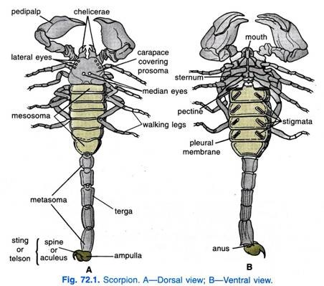

Slide 34
Appendages of cephalothorax:
The first appendages in the cephalothorax are chelicera and they are short , small and extending anteriorly from under the carapace . Each is consist of 3 joints.
The second pair of appendages is large prehensile pedipalps, scorpion use chelicera and pedipalp together in prehensile pinching mechanism. Each pedipalp is consist of 6 joints.
The next four pairs of appendages are walking legs , each walking leg consists of seven joints , coxa , trochanter, femur, patella, tibia, basitrasus, tarsus, the tarsus usually bears two tarsal claws.

Slide 35
Abdomen : the mesosoma is consist of seven wide abdominal segments then a narrow five segments that composes the metasoma then the telson at the posterior end of metasoma.
The first mesosoma segment appendages are usually modified ; on the venrtal side of the first segment there is a pair of genital opercula which cover the gonopore. The two genital opercula in female are separated while in male they are fused to form a single plate.
The second mesosoma segment has a strenite knows as basal piece and a pair of comb-like sensory pectines structures that have a chemo –and mechanical function .
The rest are five mesosoma segments , dorsally each one has a scleroized tergite and the segments from 3to 6 each bear a pair of ventral spiracles , each of which opens into book lung . The 7th mesosomal segment has no appendages.
Metasoma consist of five short cylindrical segments which have no appendages ; the posteior end bears the telson which is not a true segment , the telson bears ahollow terminal barb at the top which has two poison glands that contains neurotoxin produced by the glands and transfers via ducts to be discharged through a pore at the end of the barb . Scorpion poison is used for defense assassinating the pery ,it is also lethal for humans .

Slide 36
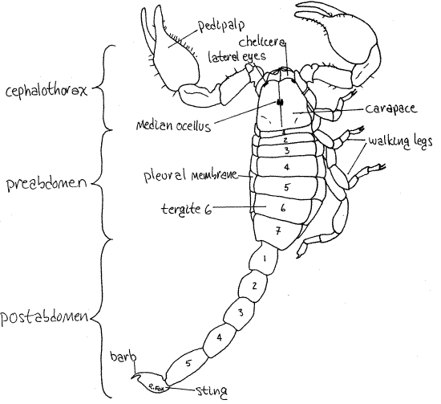

Slide 37
Sub phylum :chelicerata , class : arachnida , order : Araneae ( true spiders) Genus Argiope
External features of Argiope :
The body is covered by an exoskeleton or cuticle , regions of cuticle are hardened whereas others are soft and flexible , and in general , the exoskeleton tends to be softer than that of most insects and crustaceans.
Body is composed of two tagma : the anterior cephalothorax , or prosoma, and the posterior abdomen , or opisthosoma . They are connected by a narrow waist , or pedicel , bullous ovoid abdomen is much larger than the cephalothorax.

Slide 38
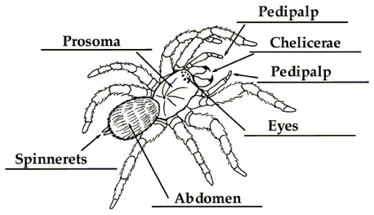

Slide 39
There are 4 pairs of eyes on the anterior end of cephalothorax , the first appendages of cephalothorax are the Chelicerae , the second appendages of cephalothorax are The pedipalps ,these are longer , leg –like remaining cephalothorax appendages are four of walking legs ,the end of each tarsus bears a pair of claws, legs are usually covered with seta that serves as sensory receptors .The abdomen (opisthosoma): it has no appendages and it is connected to the cephalothorax by a short pedicel that can be seen ventrally .Book lungs found on the anterior ventral part of abdomen , the spiracles of lungs just below them and called lung spiracles .There are 3 pairs of spinnerets , anterior and posterior spinnerets are large and the 3rd pair is medain spinnerets which are small found between the anterior and posterior pairs . These spinnerets are connected by ducts to silk gland in the abdomen . The anus located at the end of abdomen.

Slide 40
Spider venom:
Venom glands are located above the fangs or chelicerae. Venom ducts cross the chelicerae and open near tips. Venom glands originated as digestive glands , which aided in the external digestion of prey . The venom in spiders helps them in several ways . it immobilizes their prey , begins the process of digestion and is a defense against enemies. Venom is a complex mixture but The toxins are usually only a single substance

Slide 41
Reproduction :
Spiders reproduce sexually and fertilization is internal but indirect , in other words the sperm is not inserted into the females body by the males genitals ; male spiders do not produce ready- made spermatophores but spin small sperm webs on to which they ejaculate and then transfer the sperm to syringe –like structure on the tips of their pedipalps to the female.

Slide 42
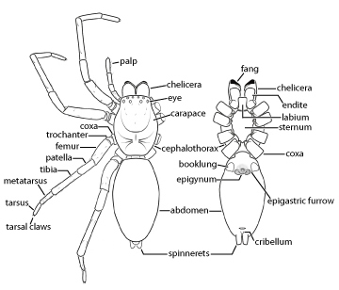

Slide 43
Genus : Ticks القراد , Mites الحلم
Ticks, like mites, There are mall arachnids, , have bodies which are divided into two primary sections: the Anterior capitulum (or gnathosoma), which contains the head and mouthparts; and the posterior idiosoma which contains the legs, digestive tract, and reproductive organs. Many have a hard, protective covering called a scutellum.

Slide 45
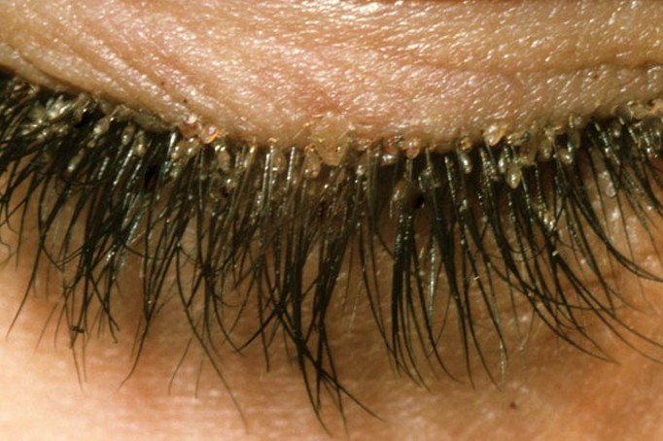

Slide 46
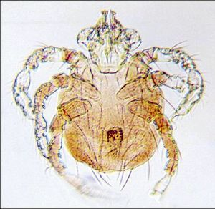

Slide 47
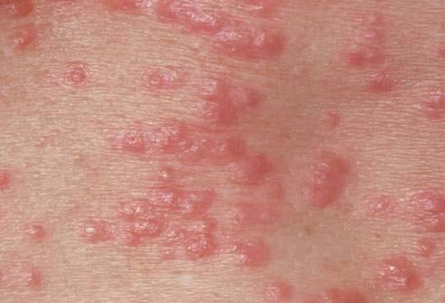

Slide 48
B-SubPhylum: Crustacea القشريات
All have two pairs of antenna (صفة مميزة زوجين من اللوامس ), a pair of mandibles, two pair of maxillae on their heads, followed by pair of appendages on each body segment (crustacean bodies usually are made up of head, thorax, and abdomen ,although the segments composing these tagmata differ among different classes). and a pair of compound eyes (usually on stalk ), and some have simple eyes .
Most of appendages are biramous (two branches ).
Excretion by Antennal gland or maxillary gland near antenna.
Crustaceans respire via gills, like other arthropoda , all have a hard but flexible exoskeleton.
The most common example of crustacean is the crayfish Astacus fan fact : 90 of all the crayfish in the world come from USA.

Slide 49
Class : Branchiopoda غلصمية الاقدام
Distinguishing features of branchiopoda include:
Leaflike or phylopodous thoracic appendages serves as a gill hence the name branchiopoda ( gill feet)
A small body (0.25mm-10cm long)
Paired compound eyes, single eye.
Simple mouth part.
branchiopods use their leaf-like appendages for feeding , locomotion, and respiration

Slide 50
Order : Anotostraca اللادرعيات Genus Artemia saline ( fairy shrimp ). ارتيميا
Ecology :
known as brine shrimp , are found worldwide in inland saltwater lakes, but not in oceans. Artemia are able to avoid cohabiting with most types of predators, such as fish, by their ability to live in waters of very high salinity (up to 25%).
Morphology :
The body of Artemia is divided into head, thorax, and abdomen. The entire body is covered with a thin, flexible exoskeleton of chitin , that have no carapace. In female Artemia a moult precedes every ovulation .Their blood contains the pigment haemoglobin,. Males differ from females by having the second antennae markedly enlarged, and modified into clasping organs used in mating ,They are easy to distinguish from all other branchiopods because they swim upside down with their legs extending upwards, elongate body and distinct head region. They have a pair of stalk compound eyes , median eye and 11,7 or 19 pairs of thoracic legs. the abdomen is narrow, and devoid of appendages.

Slide 51
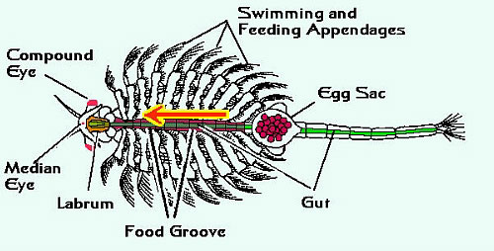

Slide 52
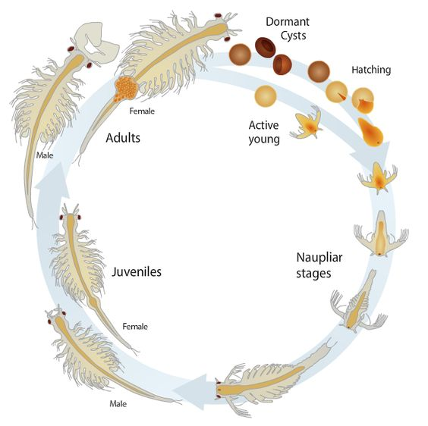
Reproduction of Artemia :

Slide 53
Order : Cladocera متفرعة اللوامس Family : Daphniidae Genus : Daphnia sp ( water fleas)دافنيا براغيث الماء
Are enclosed in the carapace but the head is not and extends in front of the carapace, it has two pairs of appendages , a pair of large biramous antenna and a pair of small antennules. Thorax bears 5 leaf-like biramous appendages ,they are used for feeding and locomotion. The postabdomen bears two long abdominal seta with terminal claws, the brood chamber is located dorsally in the carapace and is used to hold the eggs until they hatch.
The Cladocerans(متفرعة اللوامس ) are an important component of aquatic food-webs; they feed on phytoplankton and are themselves consumed by fish. Cladocerans have attracted much scientific interest , partly because they are easy to clture in the laboratory . they are often used in studies of Animal behaviour ,Functional ,Morphology ,Community ecology , Toxicity test.

Slide 55
Class :Maxillopoda:
Max­il­lopods in­clude Bar­na­cles, Cope­pods,Branchi­u­rans, Os­tra­cods, and re­lated groups. Most species are small. Most feed by means of their max­il­lae , bar­na­cles, are an ex­cep­tion feed with tho­racic ap­pendages, but in a way that is unique among crus­taceans. Other char­ac­ter­is­tics of max­il­lopods :in­clud­ing a basic plan of 5 head and 10 trunk seg­ments (6 tho­racic and usu­ally 4 ab­dom­i­nal), fol­lowed by a ter­mi­nal tel­son. The ab­dom­i­nal seg­ments typ­i­cally lack ap­pendages; ap­pendages else­where on the body are usu­ally bi­ra­mous.

Slide 56
Order: Copepoda , Genus : Cyclops sp
mostly free-living copepods , the body is usually short and cylindrical , it is distinctly segmented and composed of head , thorax and abdomen. Head with : compound eyes , the median naupliar eyes is typical of all copepods ,they have two pairs of antennae ,posteriorly the head is fused with first thoracic segment ,the thoracic region is usually tapered and is composed of four or five unfused segments with appendages (biramous ).
The abdomen is narrow, cylindrical , and devoid of appendages. it is composed of four segments, but in females the first two are usually fused, the telson bears two caudal rami.
The first pair of antennae are a long often sexually dimorphic and bear chemoreceptors and mechanoreceptors.

Slide 57
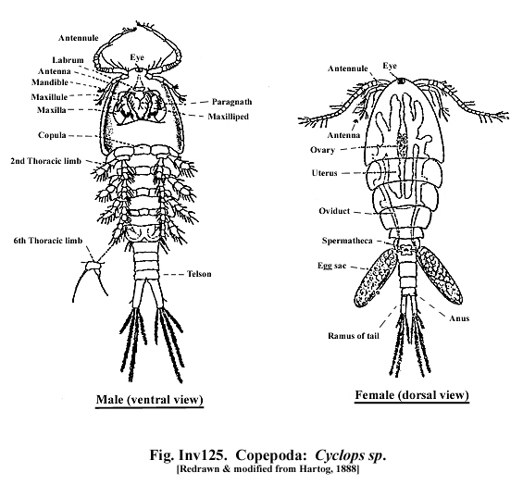

Slide 58
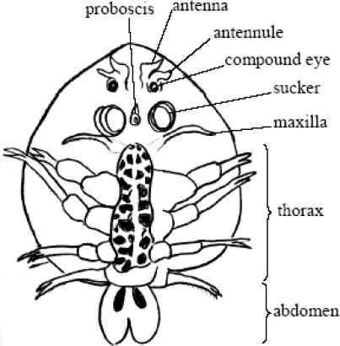
Order :Branchiura
all are parasites on fish; attach themselves onto the body surfaces such as fins and gills,- common genus is Argulus, fish louse ( قمل السمك )

Slide 59
Class: Malacostraca
the term Malacostraca comes from the Greek for "soft shell," the shell of different species may be large, small, or absent. Likewise, the abdomen may be long or short, and the eyes may show different forms, being on movable stalks or sessile. They share with other arthropods the possession of a segmented body, a pair of jointed appendages on each segment, and a hard exoskeleton that must be periodically shed for growth .The trunk of Malacostracans is typically composed of 14 segments ( first 8 from the thorax and the last 6 the abdomen .all of the segments bear appendages.

