Slide 1
شعبة المخلبيات

Slide 2
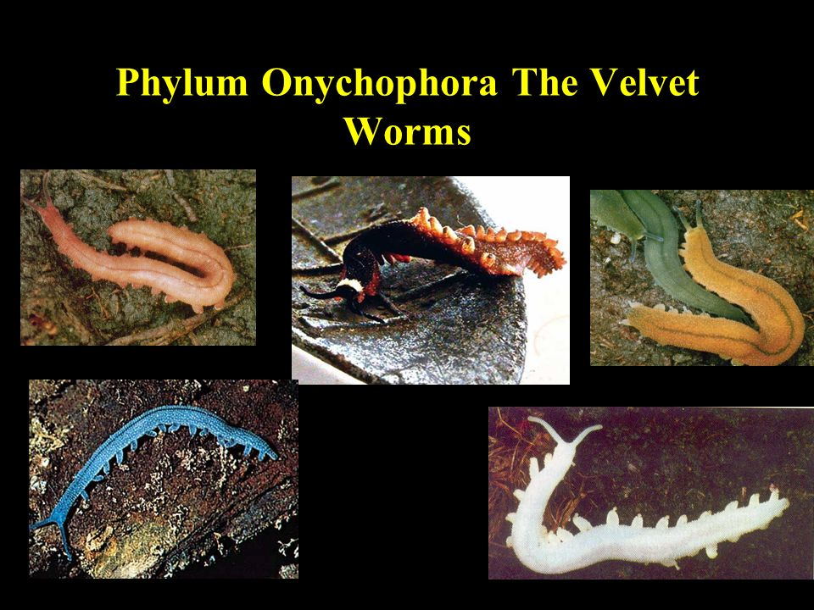

Slide 3
Phylum : Onycophora
(Velvet worms )
The phylum Onycophora contains about 100 species of small , Caterpillar –like animals called velvet ,or wallking worms that live in rain forests and other moist , leafy habitats in tropical and sub tropical , through there are few temperate species in the southern hemisphere .

Slide 4
Characteristics of the Onychophora
Bilaterally symmetrical and vermiform .
Triploblastic , with true coelom (Eucoelomate)
Free-living and terrestrial .
Have between 14-43 pairs of unsegmented walking legs. They have a series of pads towards their ends an a pair of claws .
With a thin chitinous cuticule –cover epidermis.
The head of three segments ,bearing : a pair of antenna , a pair of jaws, a pair of oral papillae , simple eyes are similar to annelids and found in the dorsal position.
Possesses a straight gut with anus .

Slide 5
Nerves system includes a brain and a pair of ventral nerve cords.
Excretion by Nephridia.
Possesses a simple respiratory system in the form of tracheae and spiracles.
Possesses circular , oblique and longitudinal muscle layers.
Onychophora are separates sex.
Possesses an open circulatory system with heart.
They have hyrostatic skeleton , which is a fluid enclosed in muscular wall.

Slide 6
Onychophorans are interest to Zoologists because they share so many characteristics of Annelids and Arthropoda that they have been considered by some to be the missing link between the two phyla

Slide 7
similarities Onychophorans-Annelids –characteristics
((الصفات المشتركة بين المخلبيات وديدان الحلقية
Presence of paired nephridia in al­most every segment of the body.
Reproductive tracts are lined by cilia.
Skin is thin and flexible.
Dermomuscular body wall like Hirudinea.
True head is absent.
Simple eyes (Ocelli) rather than compound eyes.
Hollow and non-jointed appendages like those of parapodia.
Slime glands and coxal glands corre­spond with the similar glands of polychaetes and oligochaetes.
Straight gut with an anus.
Vermiform boy.

Slide 8
Dissimilarities Onychophorans-Annelids characteristicsا
الصفات المختلفة بين المخلبيات والديدان الحلقية
Ventrally placed mouth in Onychophores.
Heart and ostia present in Onychophores.
Clawed appendages in Onychophores.
Presence of antennae in Onychophores.
Ladder-like nervous system in Onychophores.
Tracheal tube for respiration in Onychophora.
Absence of true metamerism in Onychophora.
Texture on the skin in Onychophora.

Slide 9
Following features show that Onycho­phora is more related to Arthropoda:Structural similarities: الصفات المشتركة بين المخلبيات والمفصليات
The appendages are provided with claws.
Jaws are modified appendages .
Heart dorsal and tubular, perforated by lateral ostia.
Body is covered with chitinous cuticle and is moulted.
Jaws are provided with striated mus­cles.
Presence of antennae.
Brain is large and resembles the brain of typical arthropods.
Presence of tracheae as respiratory organs.
Excretory organs closely resemble the green glands of Crustacea.

Slide 10
Structural Dissimilarities:الصفات المختلفة بين المخلبيات والمفصليات
Onycho­phores differ in many respect from the Ar­thropods.
Arrangement of tracheae is not arthropod-like.
Jaw is the modification of second ap­pendages and the movements of jaws operate from anterior end and pro­ceed towards posterior end.
Segmentation not distinct in Onychophora.
Absence of malpighian tubules in Onychophores.
Simply, un-jointed, numerous stumpy legs in Onychophores.
Structure of eye is less complicated.
Two ventral nerve cords are widely separated and without true ganglia.

Slide 11
Onychophorans unique characteristics
The head appendages consist of a pair of antenna , a pair of jaws, and a pair of oral papillae .
Body has unjointed walking legs .
No blood pigment .
Propulsion generated by musculature of limbs , body remains rigid.
Limbs elevate above ground .

Slide 12
Classification : the Onychophora is divided into one order and two families:
        Order Euonychophora
        Family Peripatidae
        Family Peripatopsidae

Slide 13
A very important example of phylum is the genus peripatus ,it is an ancient blue forest creature that is thought to be an evolutionary link between Annelida (worms ) and Arthropods.
Body and shape of peripatus , Common name : walking worm , velvet worm .

Slide 14
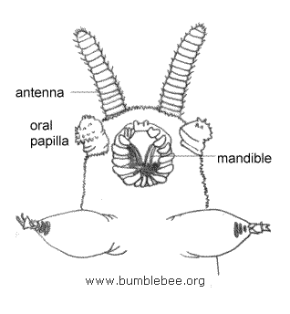
جهة امامية بطنية Peripatus

Slide 15
Peripatus is a terrestrial animal , nocturnal and carnivorous is feeding , it feeds on worms , mites and insects.
The body caterpiller –like .Soft , elongates , bilateral symmetrical and it length from 1.5-15 cm , many superficial lines mark the body and a thin cuticle covers the skin which has velvety texture with a number of fine ridges bearing papillae armed with spine . The color varies depends on the species from dark grey to brown . The body of peripatus is divided into indistinct and elongated trunk.

Slide 16
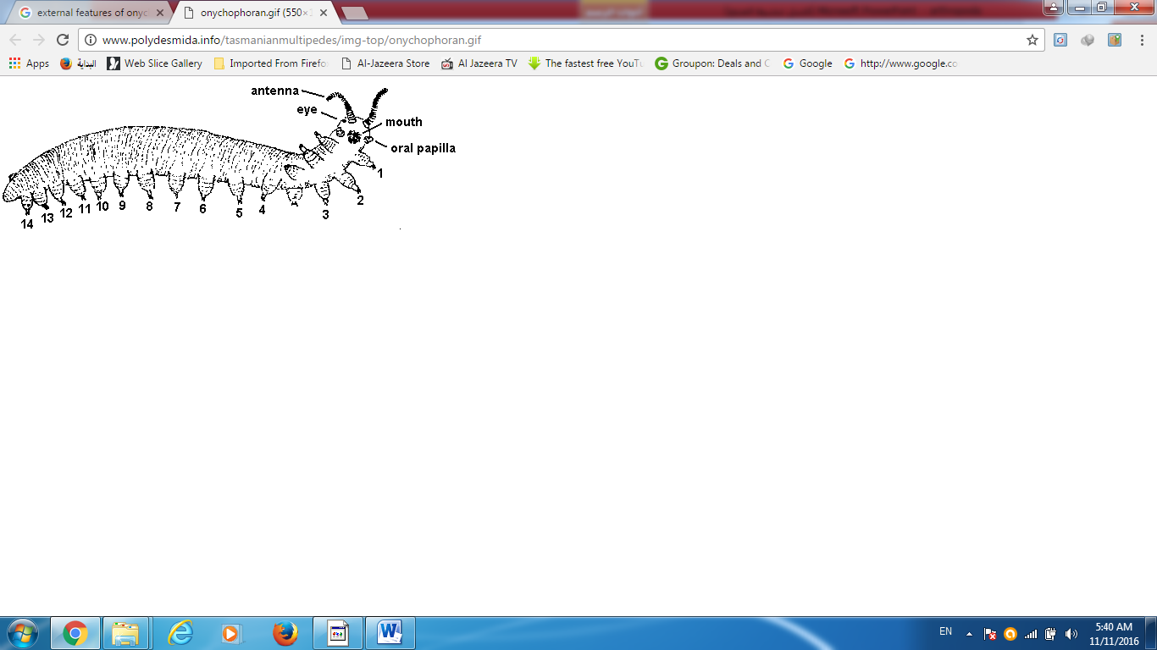
منظر عام جانبي Peripatus

Slide 17
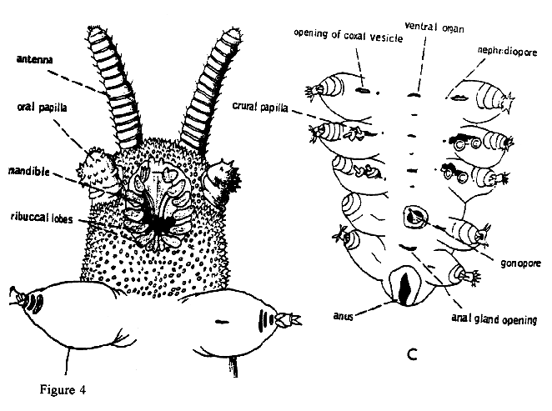
الجهة الخلفية البطنية
الجهة الامامية البطنية

