Slide 1
Phylum :Arthropoda from Latin arthron =joint podus= foot
Arthropoda compose more than 75% of all animal species on earth. Their bodies have best shape represented in animal kingdom , those include , insects , spiders , scorpions, crabs, lobsters, shrimps and others.
Arthropoda ,like annelids, the body is consists of segments but some segements are fused or modified for certain specialization, this called Tagmatization

Slide 2
General characteristics:
Bilateral symmetrical but few have radial symmetry all are triploblastic . with strongly segmented bodies . Segmentation affects both extenal and internal structure .
Some segments are fused to form specialized body regions called tagmata. Segmented body allows infinite possibities for adaptive modifications , lots of fusion of segments into a variety of body forms: ( types of tagmatization in arthropods): cephalothorax & abdoman , head & trunk , head-thorax-abdoman. . And the process and condition of fusion is called Tagmosis
Hard exoskeleton of chitin consists of hardened chitin and protein in several layers secreted by epidermis excellent for protection and waterproof. The skeleton contains various folds, flaps and spines, some parts are modified for feeding, respiration, swimming, mating and or sensory organs.
Arthropods generally grow by molting their exoskeletons in process called Ecdysis .
Jointed appendages that give arthropodas generalized appendages which were modified into many specilized organs for walking , grasping, and eating.
Cephalization (well developed head) : with many sense organs, antennae and compound eyes are characteristic sense organs of arthropods.
Complex muscular system : layers of muscles around internal organs both striated and smooth muscle fibers muscle bundles to move skeleton.

Slide 3
Arthropoda are eucoelomate , Coelom is reduced as hemocoel in body cavity , so it is more important for circulation than movement.
Complete digestive system : many feeding appendages to get food into mouth with specialized areas for grinding and sorting food and accessory glands that secrete enzymes.
Open circulatory system .
Well- developed respiratory system : many different kinds depending on habitat such as : gill, book gills , lung , book lungs or tracheae.
Nervous system : similar to annelids in which dorsal brain and double nerve cord with paired ganglia in each segment.
Efficient excretory system prevents excessive water loss in land ( green or coxal gland).
Most are diacious.

Slide 4
Classification
A - Subphylum Chelicerata الشعبة الثانوية الكلابيات
1-Class: Merostomata (Horseshoe crabs , Eurypterids)صنف فخذي الافواه
2-Class: Pycnogonida ( Sea Spiders) صنف ملتحم المفاصل
3-Class: Arachnida( Spiders, Ticks, Mites) صنف العنكبوتيات
B-SubPhylum: Crustacea الشعبة الثانوية القشريات
Class : Malacostraca ناعم الدروع
Order : Isopoda – pillbugs, woodlice متشابهة الاقدام
Order : Amphipoda –Gammarus (رتبة مزدوجة الاقدام )
Order : Decapoda – Crabs , Lobsters , Shrimps ,Hermit crabs. رتبة عشرية الاقدام
Class : Branchiopoda صنف غلصمي الاقدام
order : Anostraca : (fairy shrimp Artemia sp ), رتبة اللادرعيات
order : Cladocera : water fleas (Daphinaرتبة متفرعة اللوامس
Order : Conchostraca رتبة الصدفيات
Class :Maxillopoda:
Order : Ostracoda – cypris sp الصنف الثانوي الدرعيات
Order : Copepoda – cyclop spالصنف الثانوي مجذافي الاقدام
Order : Cirripedia – Balanus sp . الصنف الثانوي ذؤابي الاقدام
C- SubPhylum: Uniramia
Class : Chilolpda- Centipedes صنف محيطي الاقدام
Class : Diplopoda –Millipedes صنف مزدوج الاقدام
Class : Insect( Hexapoda ) صنف الحشرات (سداسي الاقدام)
-Subclass : Apterygota- wingless insects
-Subclass : Pterygota- wing insects.

Slide 5
Subphylum Chelicerata
Chelicertes are characterized by the absence of antennae and jaws and the presence of feeding structure (Chelicera),Which are modified into pincer-like appendages used mainly for grasping and fragmenting food. They include : Spiders ,Scorpions other Arachnids(Class Arachnida), horseshoe crabs (Class Xiphosura) and the Sae Spiders ( Class Pycnogonida) as well as the extinct gaint sea scorpions ( Class Eurypterida) . Since Chelicerates belong to the arthropoda , they show characteristics common to all arthropods. They show a segmented body , Chitinous exoskeleton and jointed legs .

Slide 6
What makes Chelicerata different?
Tagmatization: Cephalothorax (Prosoma) and Abdomen (Opisthosoma). This is a result of the fusing of the head and thorax region, the abdomen often bears an un-segmented Telson .
1-They do not have antenna.
2-Cephalothorax usually bear 6 pairs of appendages:
A-A pair of Chelicera for feeding and grasping .
B-A pair of Pedipalps.
C-the remaining are four pairs of walking legs on the ventral side of the prosoma.
Chelicera and pedipalps may be modified for Feeding , Sensing , Defense, Reprodction or Lcomotion .

Slide 7
Subphylum Chelicerata – Class Merostomata
All marine and the opisthosoma is flattened and contains book gills for respiration.
Example : Limulus ,Common name: king crab, Horseshoe Crab
The body is covered by a smooth dark exoskeleton and consists of two tagma and a tail spine; the prosoma which is a convex carapace horse-shaped shielde, a middle portion which is the Opisthosoma and thin elongated tail called telson .
The prosoma bears a pair of simple eyes on the dorsal top and pair of compound eyes on the lateral sides of the carapace.
Six pairs of appendages on the ventral side of the prosoma , the first one is a pair of small chelicera for feeding , pair of pedipalps then 4 pairs of walking legs , the pedipalps are modified into walking legs in female and into grasping appendages in male which help the male in mating , all pairs of walking legs bear claws except the last which is modified for cleaning the gills from mud.

Slide 8
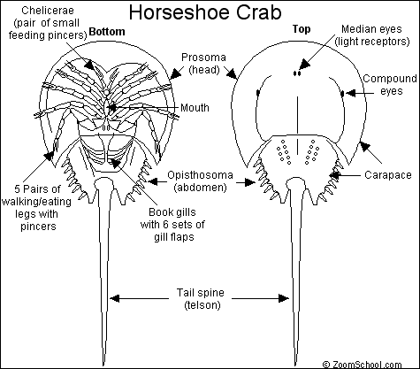

Slide 9
The opisthosoma has spines protruded from the outer edge ; it has 6 pairs of appendages , the first pair is modified into genital operculum , and 5 pairs of book gills , each gill contains leaf-like folds called lamellae.
The last part of the body is the telson or caudal spine which is elongated and thin . The anus located under the anterior end of the telson . Excretion is by coxal glands .
Limulus is marine and swims upside down and found buried in the sand.
Feeding :Larval horseshoe crabs do not feed . Feeding begins after the first juvenile stage .horsehoe crabs do not have jaws , so they use their legs to grasp and crush prey ; they scavenge on almost any food items they find in the sediment , such as mollusks and worms.
Reproduction : horseshoe crabs are long –lived and mature later than other invertebrates . Males mature between 9 and 11 years of age and females between 10 and 12 years .

Slide 10
Class Arachnida
General aquatic with few terrestrial types, this class includes all spiders , Scorpions, Mites ,and Ticks. Body consists of two parts, Prosoma and Opisthosoma.

Slide 11
Subphylum-:Chelicerata Class:Arachnida ,
Order Scorpionida ,Genus : Buthus (Scorpion)
External features: scorpion body is divided into anterior cephalothorax or prosoma and posterior abdomen or opisthosoma . The abdomen is futher divided into wide anterior region – mesosoma and narrow posteroir –metasoma , the cephalothorax and mesosoma bear paired appendages but metasoma has no appendages . The cephalothorax is consist of six segments and covered by carapace on the dorsal side there are two dorsal median eyes and two groups of five small lateral eyes.

Slide 12
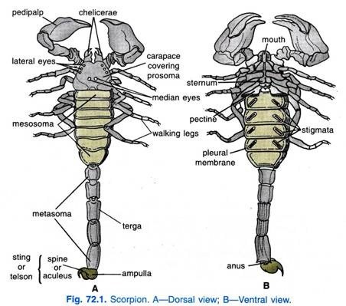

Slide 13
Appendages of cephalothorax:
The first appendages in the cephalothorax are chelicera and they are short , small and extending anteriorly from under the carapace . Each is consist of 3 joints.
The second pair of appendages is large prehensile pedipalps, scorpion use chelicera and pedipalp together in prehensile pinching mechanism. Each pedipalp is consist of 6 joints.
The next four pairs of appendages are walking legs , each walking leg consists of seven joints , coxa , trochanter, femur, patella, tibia, basitrasus, tarsus, the tarsus usually bears two tarsal claws.

Slide 14
Abdomen : the mesosoma is consist of seven wide abdominal segments then a narrow five segments that composes the metasoma then the telson at the posterior end of metasoma.
The first mesosoma segment appendages are usually modified ; on the venrtal side of the first segment there is a pair of genital opercula which cover the gonopore. The two genital opercula in female are separated while in male they are fused to form a single plate.
The second mesosoma segment has a strenite knows as basal piece and a pair of comb-like sensory pectines structures that have a chemo –and mechanical function .
The rest are five mesosoma segments , dorsally each one has a scleroized tergite and the segments from 3to 6 each bear a pair of ventral spiracles , each of which opens into book lung . The 7th mesosomal segment has no appendages.
Metasoma consist of five short cylindrical segments which have no appendages ; the posteior end bears the telson which is not a true segment , the telson bears ahollow terminal barb at the top which has two poison glands that contains neurotoxin produced by the glands and transfers via ducts to be discharged through a pore at the end of the barb . Scorpion poison is used for defense assassinating the pery ,it is also lethal for humans .

Slide 15
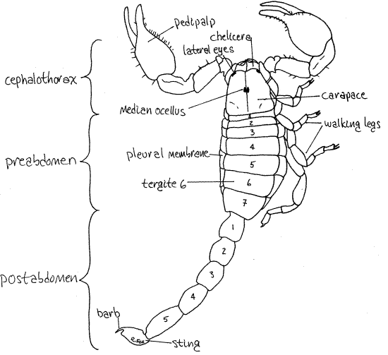

Slide 16
Sub phylum :chelicerata , class : arachnida , order : Araneae ( true spiders) Genus Argiope
External features of Argiope :
The body is covered by an exoskeleton or cuticle , regions of cuticle are hardened whereas others are soft and flexible , and in general , the exoskeleton tends to be softer than that of most insects and crustaceans.
Body is composed of two tagma : the anterior cephalothorax , or prosoma, and the posterior abdomen , or opisthosoma . They are connected by a narrow waist , or pedicel , bullous ovoid abdomen is much larger than the cephalothorax.

Slide 17
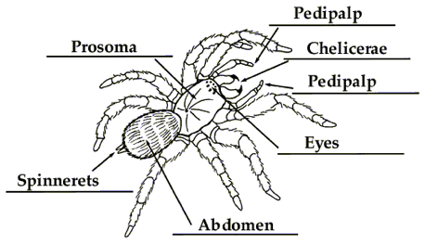

Slide 18
There are 4 pairs of eyes on the anterior end of cephalothorax , the first appendages of cephalothorax are the Chelicerae , the second appendages of cephalothorax are The pedipalps ,these are longer , leg –like remaining cephalothorax appendages are four of walking legs ,the end of each tarsus bears a pair of claws, legs are usually covered with seta that serves as sensory receptors .The abdomen (opisthosoma): it has no appendages and it is connected to the cephalothorax by a short pedicel that can be seen ventrally .Book lungs found on the anterior ventral part of abdomen , the spiracles of lungs just below them and called lung spiracles .There are 3 pairs of spinnerets , anterior and posterior spinnerets are large and the 3rd pair is medain spinnerets which are small found between the anterior and posterior pairs . These spinnerets are connected by ducts to silk gland in the abdomen . The anus located at the end of abdomen.

Slide 19
Spider venom:
Venom glands are located above the fangs or chelicerae. Venom ducts cross the chelicerae and open near tips. Venom glands originated as digestive glands , which aided in the external digestion of prey . The venom in spiders helps them in several ways . it immobilizes their prey , begins the process of digestion and is a defense against enemies. Venom is a complex mixture but The toxins are usually only a single substance

Slide 20
Reproduction :
Spiders reproduce sexually and fertilization is internal but indirect , in other words the sperm is not inserted into the females body by the males genitals ; male spiders do not produce ready- made spermatophores but spin small sperm webs on to which they ejaculate and then transfer the sperm to syringe –like structure on the tips of their pedipalps to the female.

Slide 21
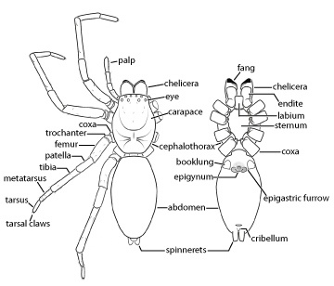

Slide 22
Genus : Ticks القراد , Mites الحلم
Ticks, like mites, There are mall arachnids, , have bodies which are divided into two primary sections: the Anterior capitulum (or gnathosoma), which contains the head and mouthparts; and the posterior idiosoma which contains the legs, digestive tract, and reproductive organs. Many have a hard, protective covering called a scutellum.

Slide 23
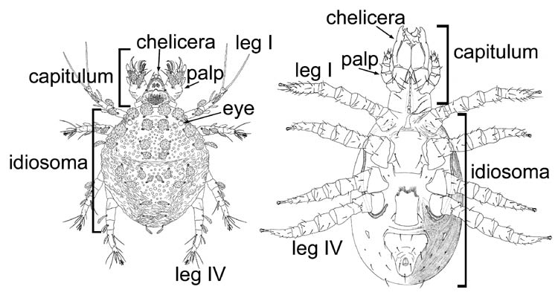

Slide 24
