Slide 1
الصف الثانيBIO-
لافقريات نظري
Phylum mollusk
شعبة النواعم
Instructor: Dr. Maysoon hassan

Slide 2
Phylum Mollusk
Molluscs are soft-bodied invertebrates whose main features are a foot for locomotion , a mantle which secretes a hard calcium shell, a general head region , and a stomach area for digestion .
Molluscs are very diverse with about 110,000 species distributed in terrestrial, freshwater and marine environments. the gastropoda (snails) include the largest number of species comprising over three quarters of species in the phylum .
The scientific study of molluscs is called malacology

Slide 3
General characters
Molluscs are Triploblastic .
They have a true coelom (eucoelom), any coelomic cavities have been reduced to vestiges around the heart , gonad , and metanephridia .
The body is often divided into a head ,with eyes or tentacles , a muscular foot and a visceral mass housing the organs.
Molluscs have a mantle , which is a fold of the outer skin lining the shell, and a muscular foot is used for motion.
Many molluscs have their mantle produce a calcium carbonate external shell and their gill extracts oxygen from the water and disposes waste.
All species of the phylum mollusca have a complete digestive tract that starts from the mouth to the anus.
Many have a feeding structure , the radula , mostly composed of chitin .
Development passes through one or two trochophore stages , one of which (the veliger)is unique to the group.

Slide 4
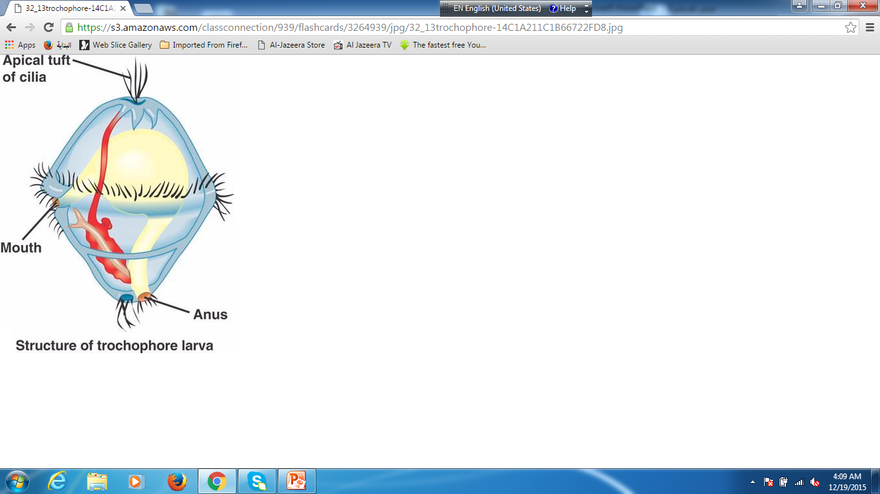
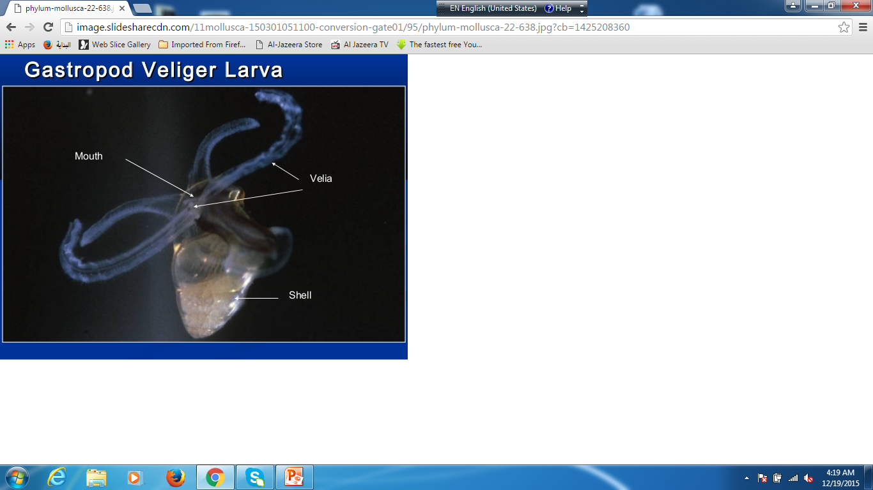
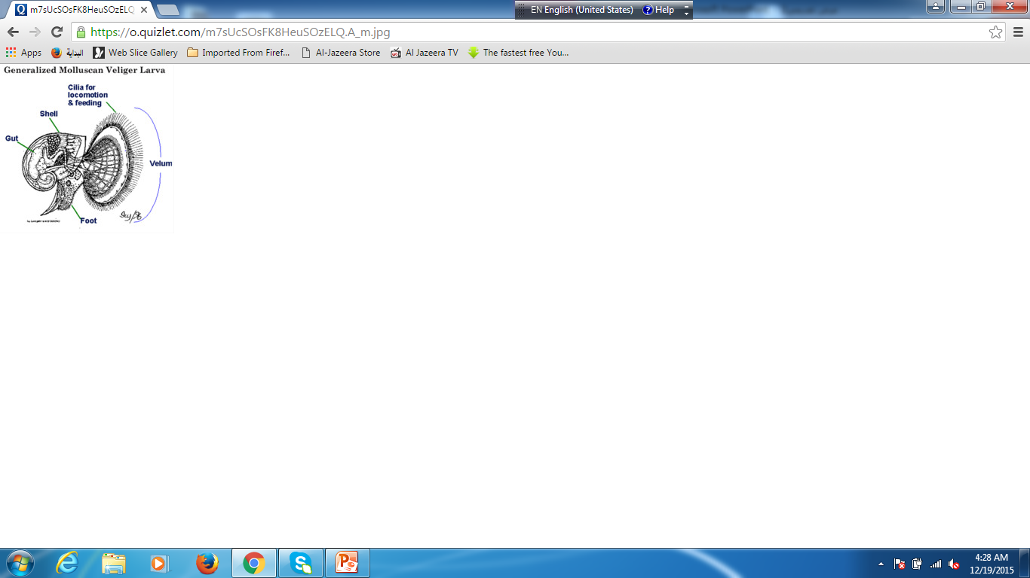

Slide 5
Classification of mollusks
There are nine classes of mollusks, eight still living and one known only from fossils:
Class Aplacophora عديم الاصداف ( Solenogasters , deep-sea wormlike creatures: 250 species).
Class Polyplacophora عديد الاصداف (chitons : 600 species , rocky marine shorelines)
Class monoplacophora وحيد الاصداف( deep- sea limpet-like creatures :11 living species)
Class Bivalvia ثنائية المصراع او طبري الاقدام (also Pelecypoda ) (clams , oysters, scallops,mussels:8,000 species)
Class Scaphopoda زورقي الاقدام (tusk shells:350 species ,all marine)
Class Gastropoda بطنية الاقدام ( Nudibranchs , snails and slugs , limpets, sea hares, sea angle, sae butterfl y, sea lemon : estimated 40,000-150,000 species)
Class Cephalopoda راسية الاقدام (Squid, Octopuses, Nautilus, Cuttlefish:786 species , all marine)

Slide 6
Class Gastropoda
The class gastropoda includes the Snails and Slugs
Most gastropods have a single, usually spirally coiled shell into which the body can withdrawn, but the shell is lost or reduced some important groups.
Many snails have an operculum , a horny plate that seals the opening when the snails body is drawn into the shell.
Gastropoda have a muscular foot which is used for creeping locomotion in most species . In some , it is modified for swimming or burrowing.
Most gastropods have a well-developed head that includes eyes, 1-2 pairs of tentacles, and a concentration of nervous tissue (ganglion)

Slide 7
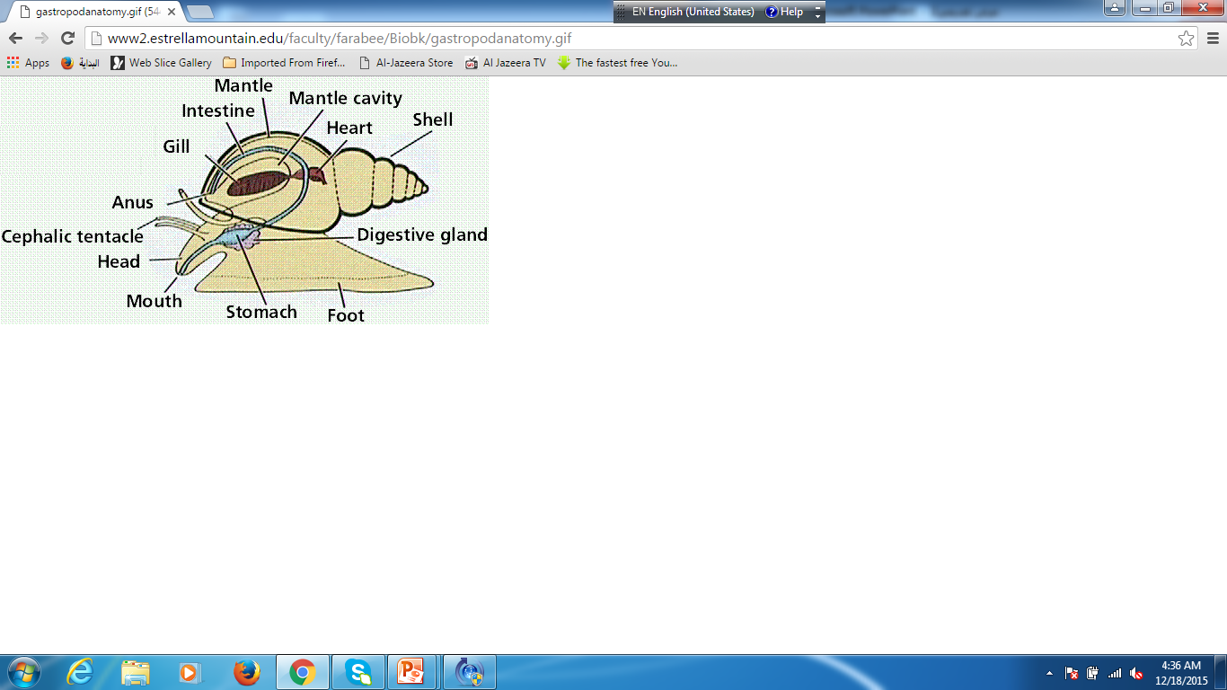
Gastropods anatomy

Slide 8
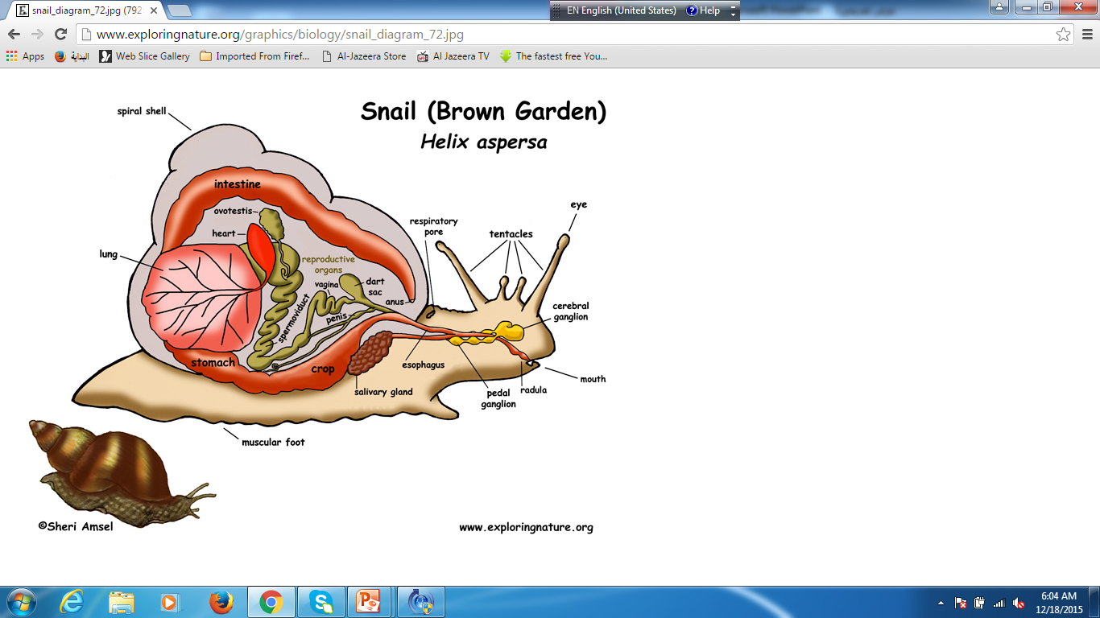

Slide 9
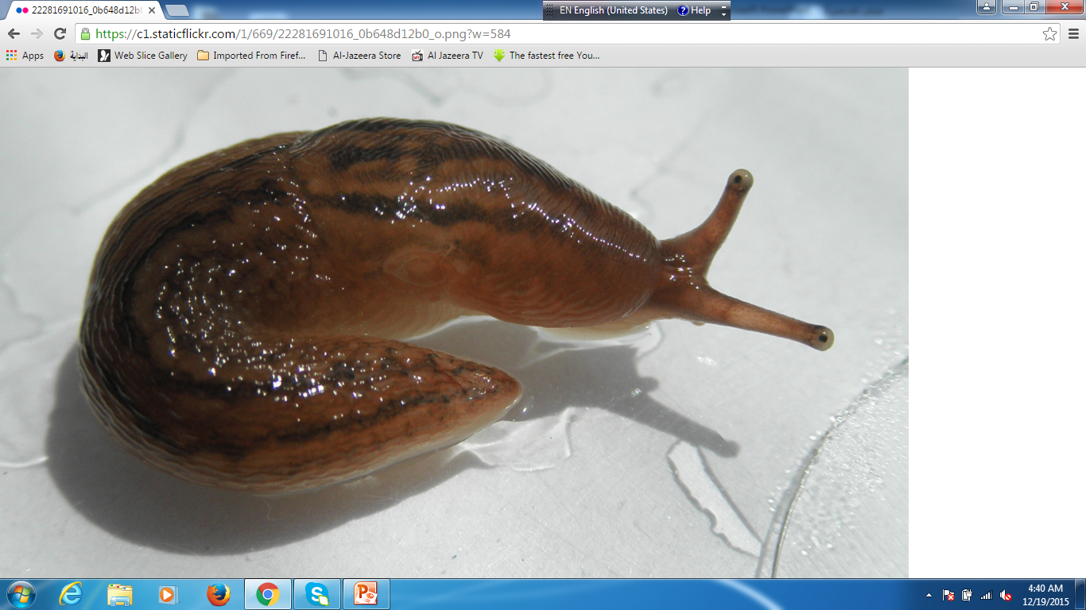
Slug

Slide 10
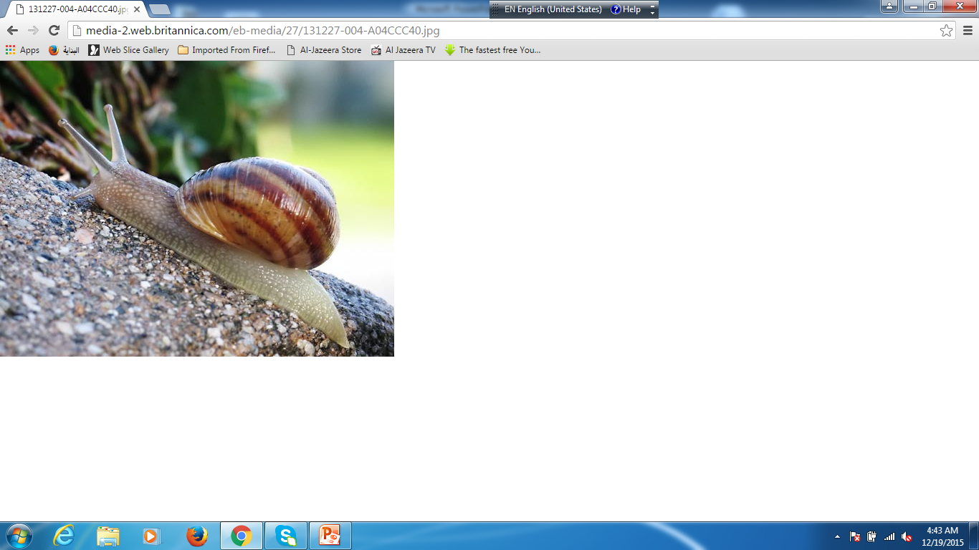
Land helix

Slide 11
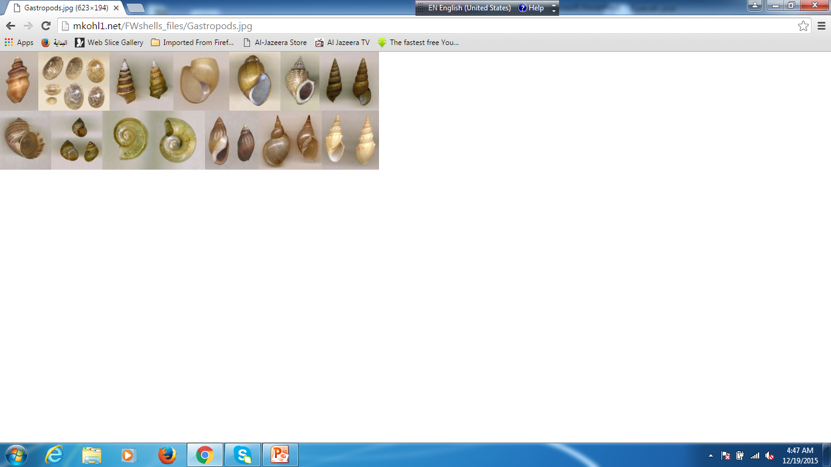
Freshwater gastropoda

Slide 12
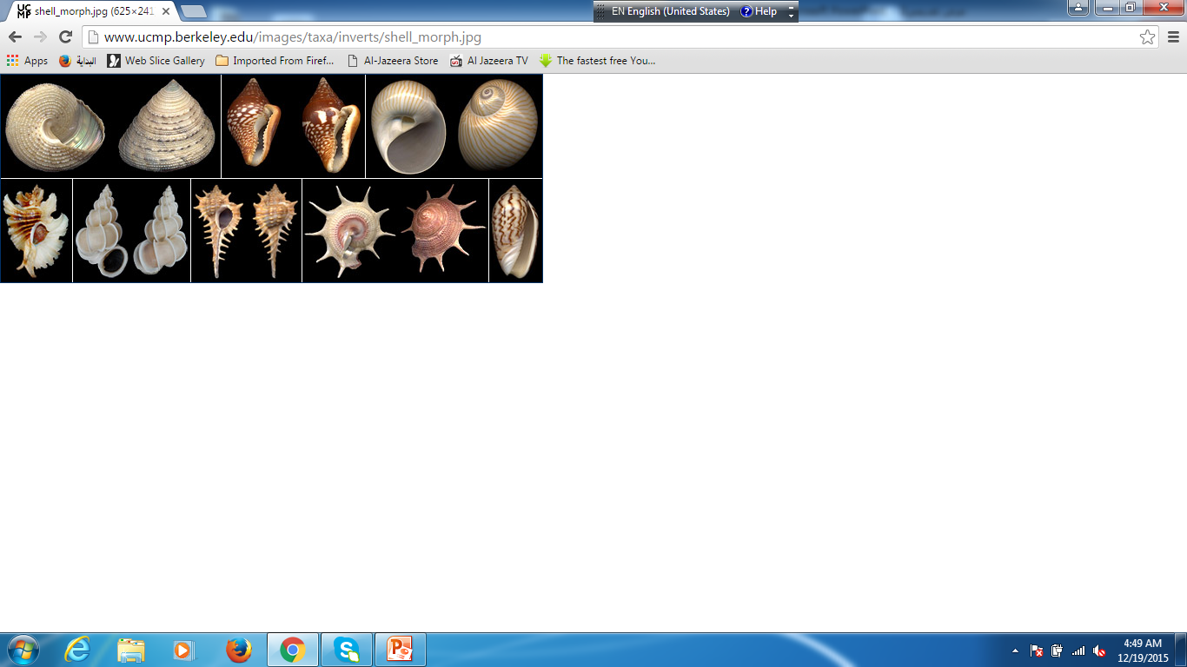

Slide 13
Torsion in gastropoda
Gastropoda are characterized by torsion ,a process that result in the rotation of the visceral mass and mantle on the foot . The result is that the mantle cavity (including anus) lies the anterior body ,over the head and mouth ,and the gut and nervous system are twisted. Torsion take place during the veliger stage. many snails have an operculum ,a horny plate that seals the opening when the snail body is drawn into the shell. some species reverse torsion (detorsion).

Slide 14
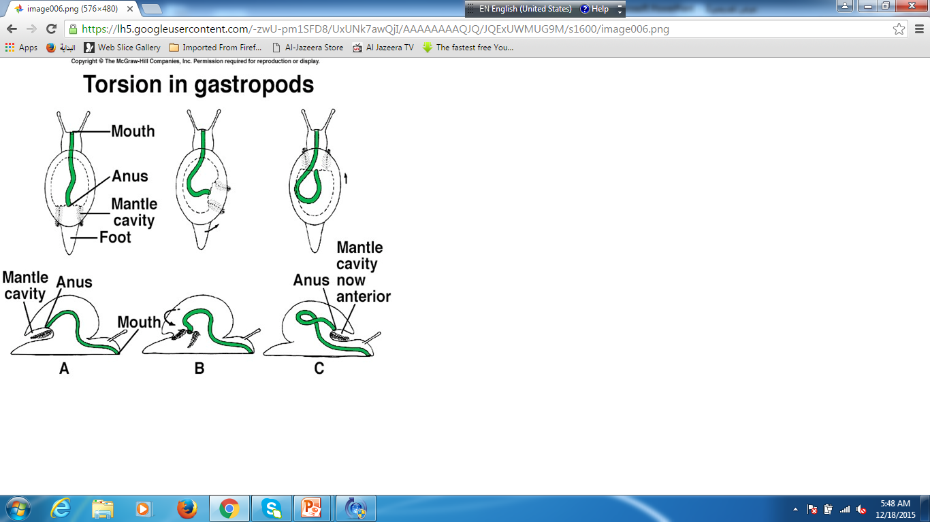

Slide 15
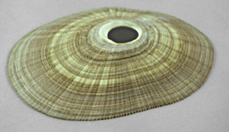

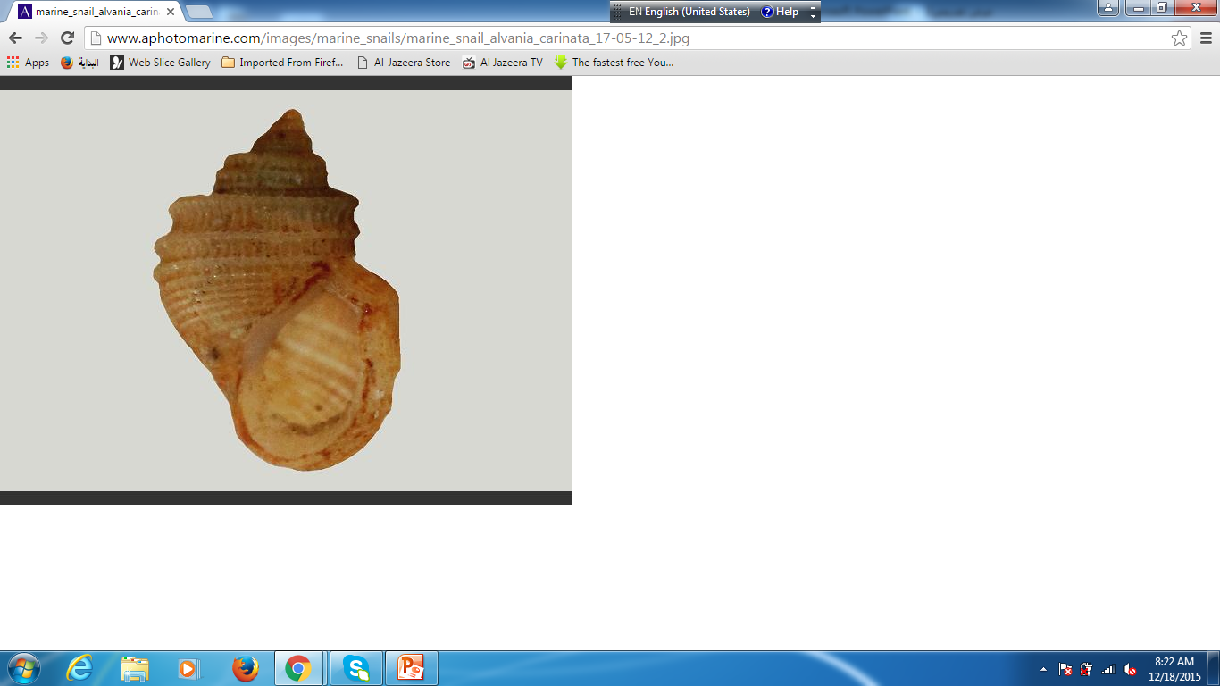
Shell morphology
Snail shells are important for use in systematic , there are three basic shell shapes :
Conicalمخروطي : these resemble one half of a clam shell and are restricted to one group of freshwater snails: the limpets
Planospiral : these snails secrete their shell in ever larger circles.
Spire : these shells look almost like a spiral staircase.
All three shell types are made of the same material. The inside of the shell is crystalized calcium carbonate mixed with protein.the calcium is absorbed from the snails food and the surrounding water.

Slide 16
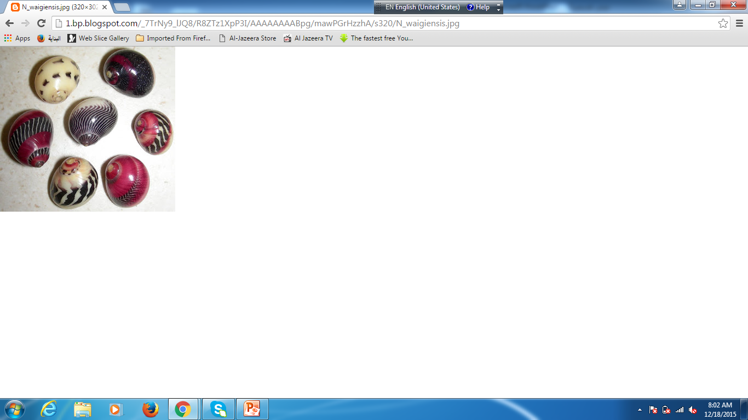
Gastropoda shell

Slide 17
Metabolsim OF gastropoda
The Prosobranchs possess a very efficient gill system that works the same as a fish gill.
The Pulmonates lack a gill : instead the use a pocket formed in the mantle as a primitive lung .Many species also acquire oxygen through their skin until they rise to the surface.
Snails collect their metabolic wastes in the coelom –which has been reduced to a sac surrounding the heart. Ammonia and other wastes. Are then funneled down metanephridial tubules where vital salts are reabsorbed. The remainder of waste (urine) is released into the mantle cavity where flush it out into the environment.

Slide 18
Reproduction / development
Gastropodas are dioecious , and some forms are hermaphroditic.
The prosobranchs and pulmonates have different modes of reproduction. Prosobranches have separate male and female sexes.
Pulmonates are hermaphroditic with both female and male reproductive parts in one animal.
Unlike their marine counterparts, land and freshwater snails never have a free-swimming larval stage. Young snails simply look like smaller versions of their parents.

Slide 19
Class Bivalvia
Also known as pelecypods, the approximately 15,000 species of this taxon are found in marine and freshwater habitats throughout the world . Bivalve is characterized by :
Possessing two shells secreted by a mantle that extends in a sheet on either side of the body the oldest part of the shell , the umbo . the two shells are joined at the dorsal end by a region called the ligament.
The body is laterally compressed . The only external structure are the labial palps : in some groups, there are sensory tentacles and photoreceptors at the edge of the mantle.
The edges of the mantle are fused in some taxa and prolonged to form tube –like siphons , one siphon carries water to the mantle cavity (the inhalent siphon) and one from it(the exhalent siphon) in many taxa they are fused but the water streams remain separate.
A bivalve uses its muscular foot either to attach itself to a substrate or to burrow.
Most bivalves are filter feeders , but some are scavengers or even predators.
Adult bivalves gills to extract oxygen from the water, however ,these gills are also the maim structure used to acquire food.
Bivalvia is the only molluscan class characterized by the absence of a redula.
Many bivalves (such as clams or oysters are used as food in places all over the world. Oysters are used for commercial production of pearls. Bivalves can also cause economic damage . The glochidia larvae of some freshwater mussels can be serious parasites of fish , and some marine bivalves bore through wood , causing damage to wooden ships.

Slide 20
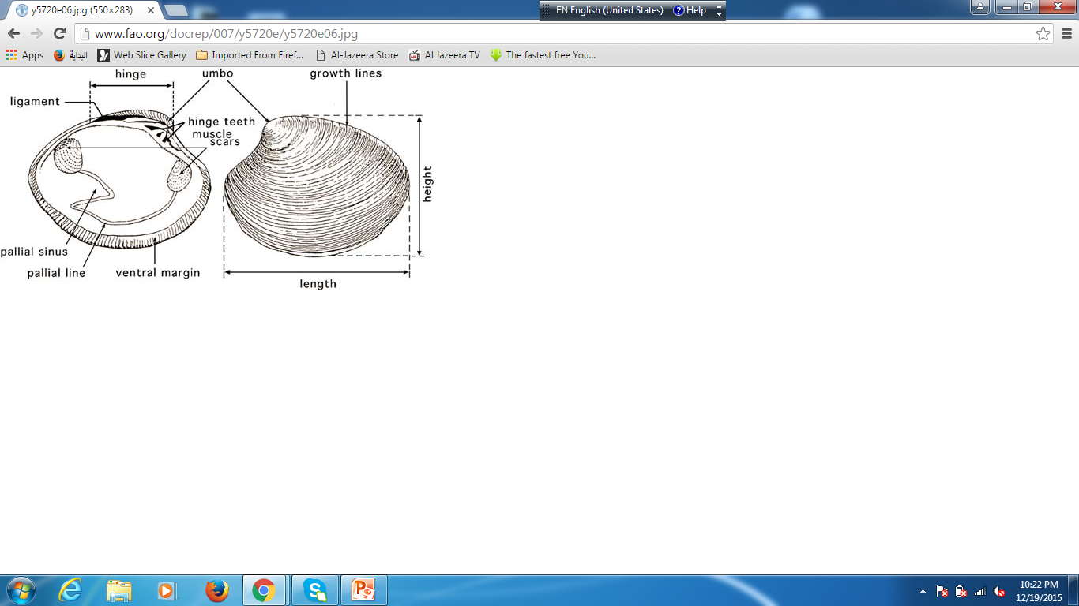
Bivalvia shell

Slide 21
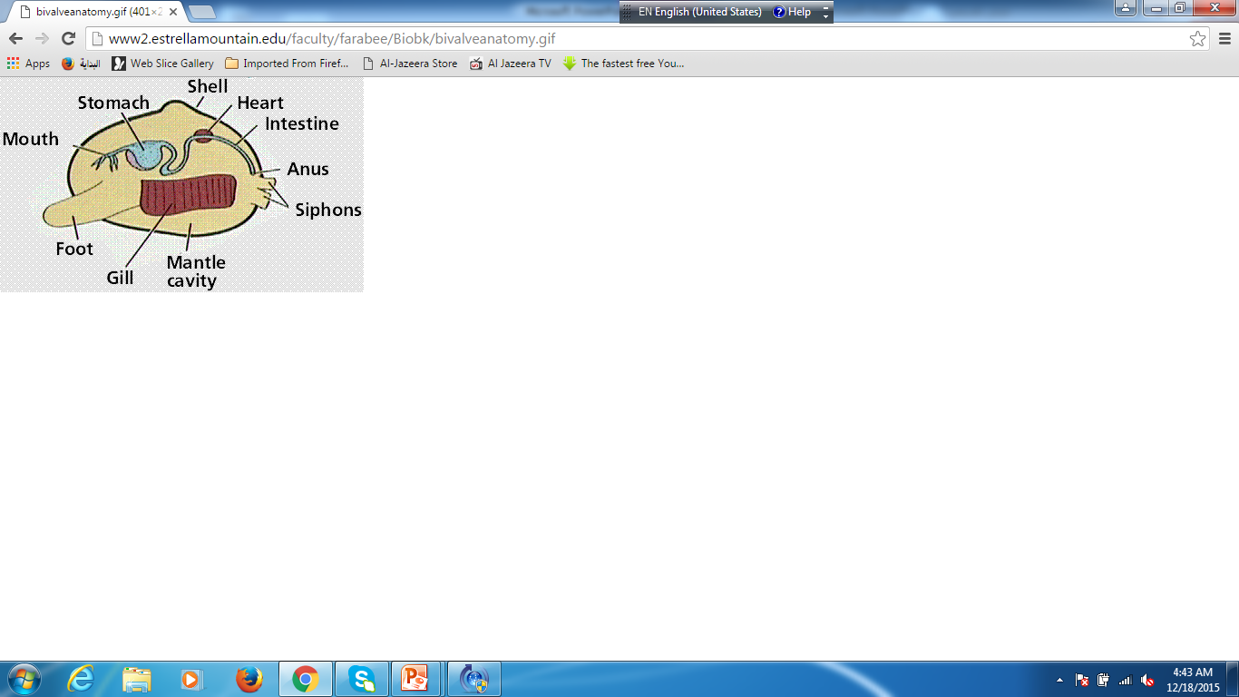
Class Bivalvia anatomy

Slide 22
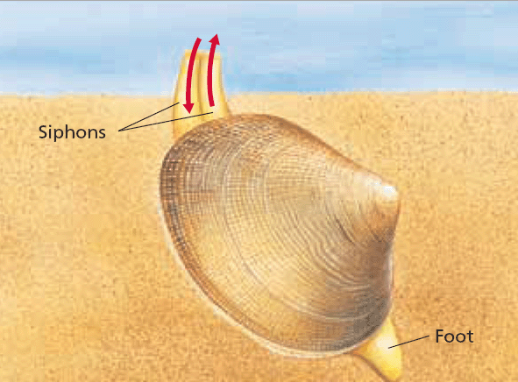

Slide 23
Larval morphology
Most marine bivalves go through a trochophore stage before turning into a free-swimming veliger larva this type of larva looks like a miniature bivalve with a row of cilia .
Freshwater species lack these stages instead , some go through larval stage known as the glochidium . Rather than being free-swimming, A glochidium attaches to fish or other objects that will not be swept downstream.

Slide 24

Larval morphology
Although bivalve species with free-swimming larvae are abundant in marine environments. They are much less common in freshwater. Zebra mussels have a free –swimming veliger larva . Its structure is very different from the ecto-parasitic glochida larvae that are typical of all freshwater clams .Glochidia are separated into three different types based on their host attachment structures:
Hooked glochidia ,these larvae are adapted to cut through fin and scales in order to attach to their fish host.
Non-hooked glochidia :do not have large hooks , but their inner margins have fine sharp spines. To attach well to gill filaments.
Axehead glochidia : have a left and right shell lobe that flares outward giving the appearance of an axe head. No one is sure these parasitic larvae attach to their host.

Slide 25
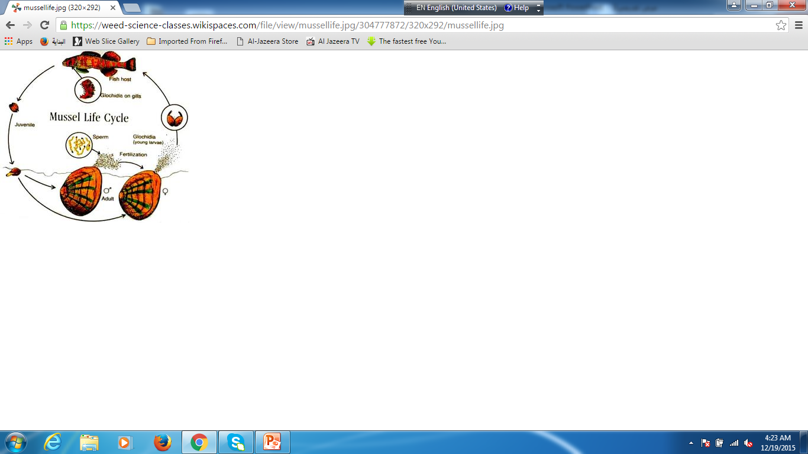
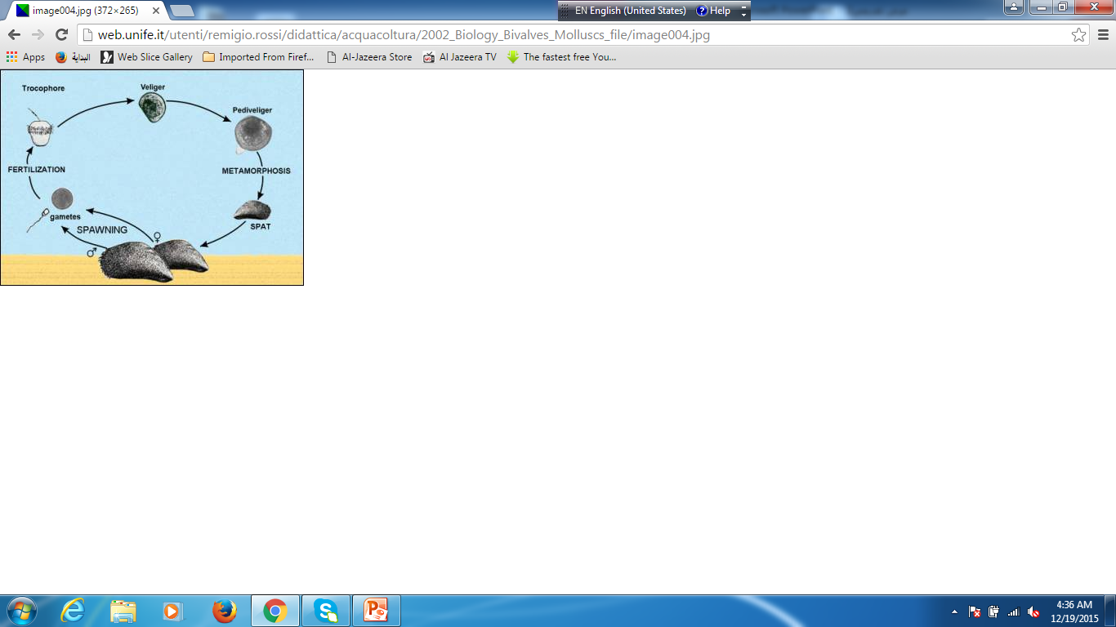

Slide 26
Class Cephalopoda
Cephalopda is the most morphologically and behaviorally complex class in phylum mollusca. Cephalopoda means head foot and this group has the most complex brain of any invertebrate. Cephalopods are strictly marine and are found in all of the worlds oceans. which includes octopus, , Sepia, and cuttlefish ; and Nautilus

Slide 27
Cephalopods are characterized by :
A completely merged head and foot , with a ring of arms and / or tentacles surrounding the head . The arms , tentacles , and funnel are all derivatives of foot.
The mantle surrounds the visceral sac and possesses strong muscles required for contraction of the cavity and resipartion . An opening in the mantle cavity serves as inhalant aperture, whereas the funnel serves as the exhalent aperture .
Whith the exception of Nautilus , cephalopods contain pigment –rich cells in the epidermis surrounded by cells containing contractile fibers . These cells, called chromatophores , are responsible for ability of the cephalopods to change color and patterns accurately and rapidly in response to danger or emotion. Chromatophores may also be under hormonal control.
A cephalopoda is also characterized by a horny beak secreted by the walls of the buccal cavity , and radula within the buccal cavity.
Cephalopods possess well- developed nervous systems complex sensory organs.t he eyes are highly developed and resemble vertebrate eyes ,these eyes are capable of forming images and distinguishing colors.
An external shell is possessed only by the Nautilus, Sepia have reduced inner shells , while octopus lack shells altogether.

Slide 28
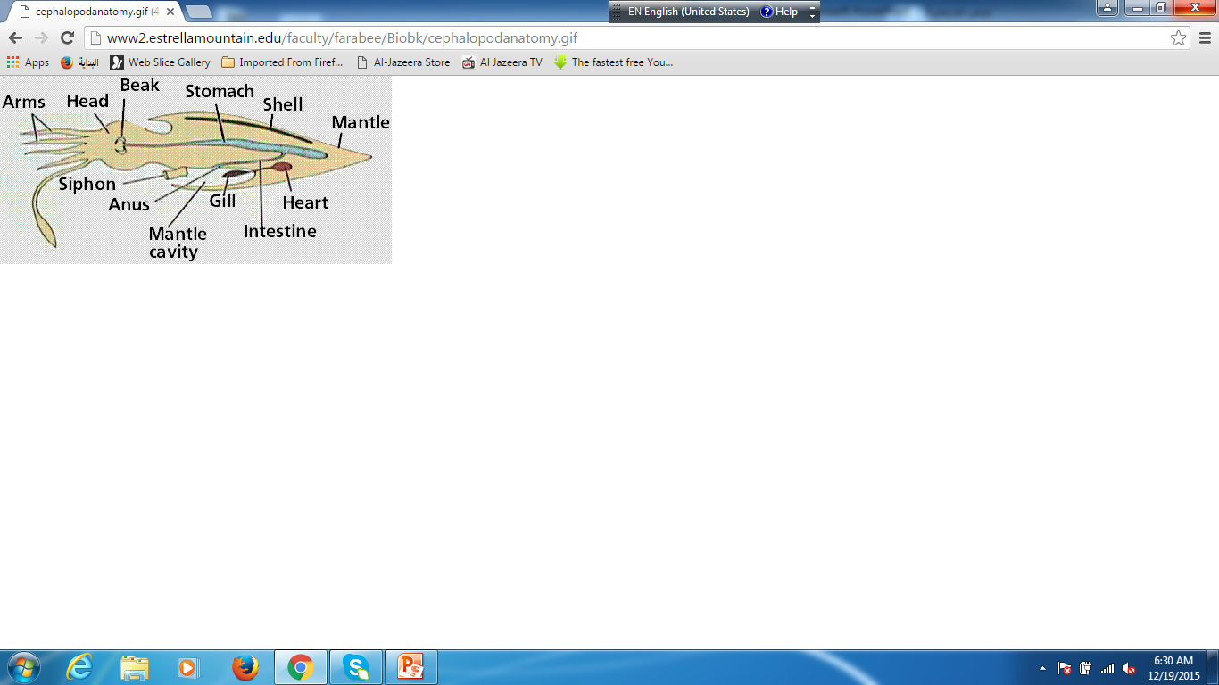
Cephalopoda anatomy

Slide 29
Digestive system
All cephalopods are carnivorous ,the strong beak is at the entrance to the buccal cavity on the floor of which lies the redula . There are two pairs of salivary glands , one of which may be poisonous , the digestive tract consists of three parts : esophagus ,which may contain a crop: stomach, which mashes food: and caecum, where most digestion and absorption occur. The posterior portion of the caecum contains a diverticulum that serves as an ink gland , producing a suspension of melanin that can be expelled through the mantle cavity.

Slide 30
Reproduction
Cephalopods are gonochronic( having the sexes separate : not hermaphroditic)
. A female typically possesses a single oviduct. A male produces spermatophores that transfers to the females genital pore by means of a specialized arm or tentacle , their development is direct , octopods typically tend their eggs until hatching .

Slide 31
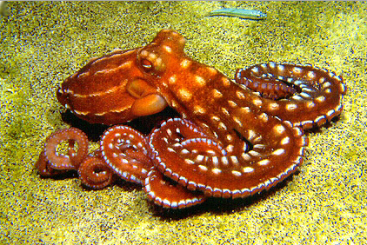
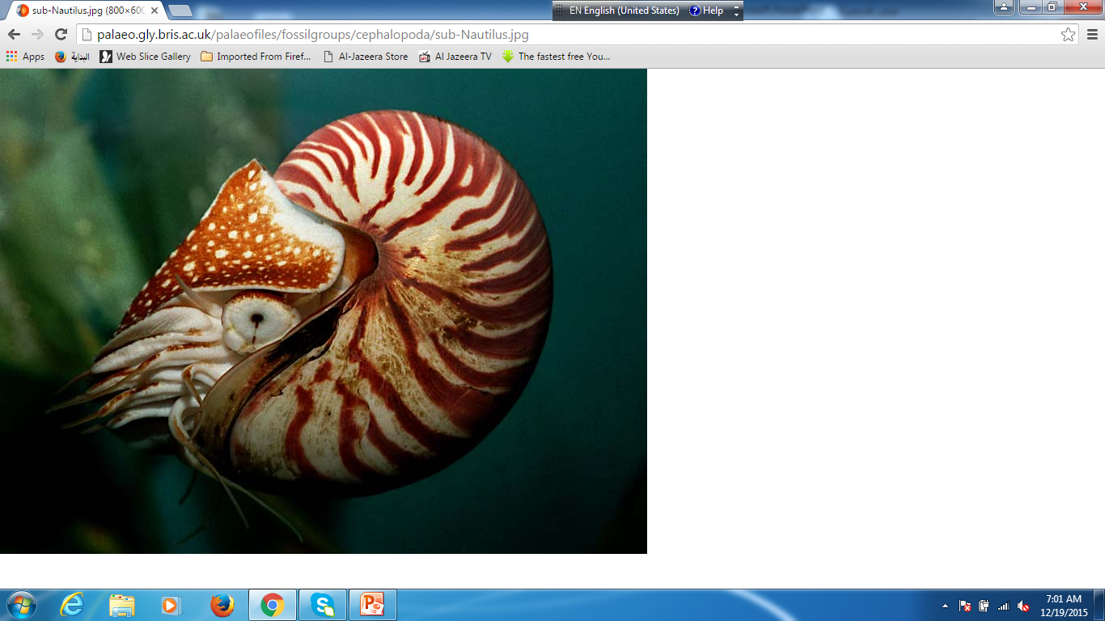
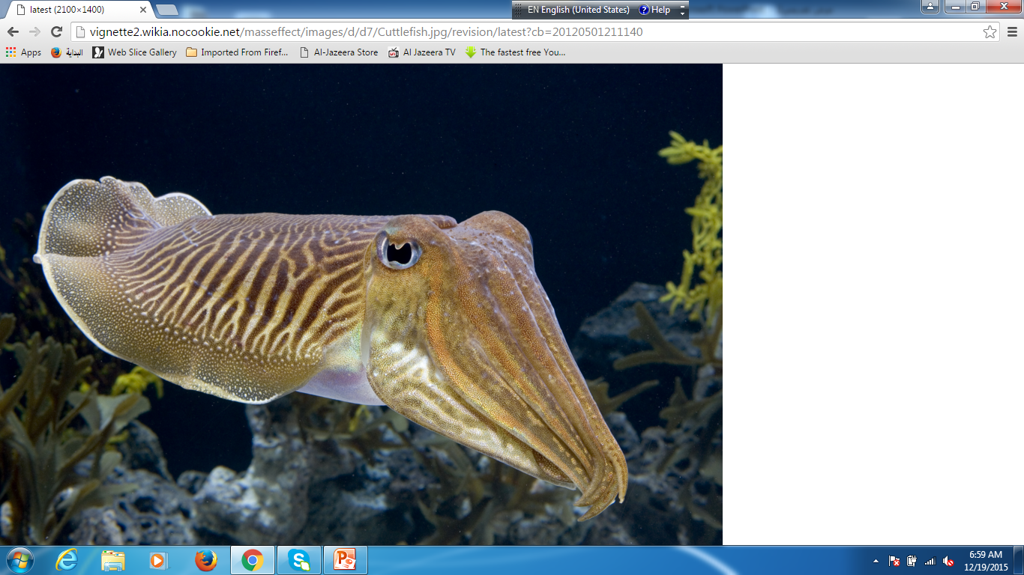
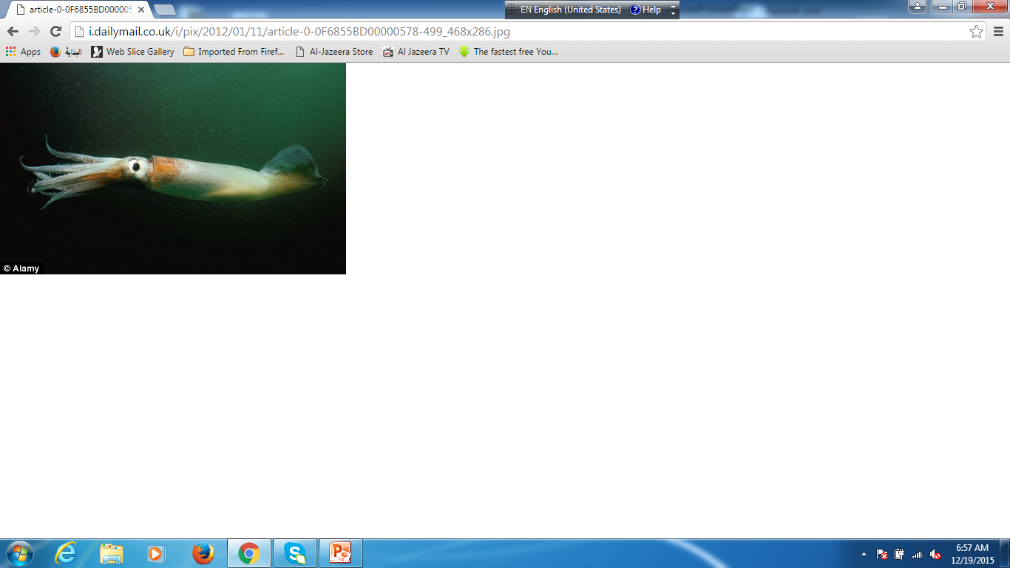
Class Cephalopoda
octopus
nautilus
cuttlefish
squid

Slide 32
