Slide 1
Class :Platyhelminthes
Platyhelminthes (GK. Platy ,flat, helminthes, worms).it is commonly known as the flatworms.

Slide 2
The main characters are :
Bilaterally symmetrical animals, acoelomate in which the space between the surface layer and the internal organs fills with the parenchyma.
Dorsoventrally flattened, vary in size from microscopic (free living)species to about 15 m long (tape worms).
With blind digestive system in which the mouth is only opening , lack anus , respiratory and circulatory systems.
Excretory system well organized and ends with flame cell . respiration through the body wall.
Nerve system with a brain in the Scolex and pair of cords connected by cross connection(ladder like).
The majority are Hermaphroditic , few are Dioecious , reproduce sexually , and some species able to reproduce asexually such as Turbellarians.
They are triploblastic ( Ectoderm , Mesoderm ,Endoderm ).
Some species occur in all major habitats (marine, freshwater, land), including many as parasites of other animals some forms are free living .

Slide 3
Classification of Platyhelminthes

Slide 4
Divided into FOUR Classes:
Class:Turbellaria is free living.
Class;Monogenia all parasitic, mainly ectoparasites.
Class:Trematoda all parasitic, mainly in digestive tract.
A. Subclass: Digenea -2 hosts ,one almost alwayes a mollusca.
B. Subclass: Aspidogastrea- 1 host , mainly mollusca.
C. Subclass: Didymozoidea- tissue dwelling parasites of fish.
4-Class :Cestoda. All parasitic found in vertebrates ,most species require at least 2 host.

Slide 5
Classification
Platyhelminthes phylum is Devided into three classes:
1-Class Turbelaria :
Mostly free living
Most of them have intestine except one Order Acoela
Most of them have Rhabdites structure, which dissolve and form a slim sheath around the worm.
Move by cilia which are distributed on the body wall.
In general they are predator ,or scavenger , a few are herbivores or commensals.

Slide 6
Cross-section of a flatworm

Slide 7
1-Class Turbelaria,Order Tricladida Eg :Planaria sp
Planaria free-living (nonparasitic) worms. The planarian is the simplest of all flatworms. Most planaria are found in freshwater or salt water, but a few live in moist soils on land.
with dark brown or gray color it is varied in size from body wall.
Consist of ciliated epidermis ,basal lamina ,circular , longitudinal and dorso-ventral muscles, and intercellular fibers to support the body wall, numerous gland cell present for providing adhesion and mucus secretion.
Rhabdite which rod shape secretion released to the surface where they dissolve to form mucus is important for attachment and prey trapping .
The name of the order Tricladida refer to the branching intestine of these groups of Turbellaria.

Slide 8
Digestive system of Planaria sp
Intestine composed of three principal branches , one anterior and two posterior , each the branches has many lateral diverticula . the three branches joint in the middle of the body to the muscular pharynx the mouth is located on the mid ventral surface of the body.
The gut is a blind sac , the mouth is used for ingestion.
Ingestion is extracellular in the first , and then the food fragments digested Intracellular by the phagocytic cells.

Slide 9
Digestive system of Planaria sp

Slide 11
Excretory system
Consist of a series of branched tubules, each of which has a closed inner end with a flame cell.
Flame cell is a cup shaped cell containing a tuft of cilia . The beating of the ciliary tuft is like the candle flame , from which is derives its name. the tubules open on to the body surface.

Slide 12
Excretory system

Slide 13
Nerve system
With one pair of cords, the cords have cross connections, the cords are organized in to an anterior brain consist of two ganglion fuse to form inverted V shape. One pair of eyes is present.
Respiration through the body wall.
Circulatory system is absent .

Slide 15
Reproductive system
The vast majority as flat worms are hermaphroditic except some species which are Dioecious.
The male part of the system consist of testes each leading to the sperm ducts , sperm ducts widen into tubular ( seminal vesicle) which is used for sperm storage, and finally the pairs ( copulatory organ). The peins receives secretions from prostate gland.
Female part consists of vagina which specialized as a gonopore , copulatory barsa, ( seminal receptacle) which is used for short and long term storage. Paired ovaries produces eggs and transports them out via an oviduct to the gonopore, and finally paired of yolk gland (vitellarium) for production of yolk filled nurse cells.
Reproduction by way of copulation the fertilization is internal ( cross fertilization) not self fertilize.
They can also reproduce asexually by binary fission .
Planaria can be cut into pieces, and each piece can regenerate into a complete organism.

Slide 16
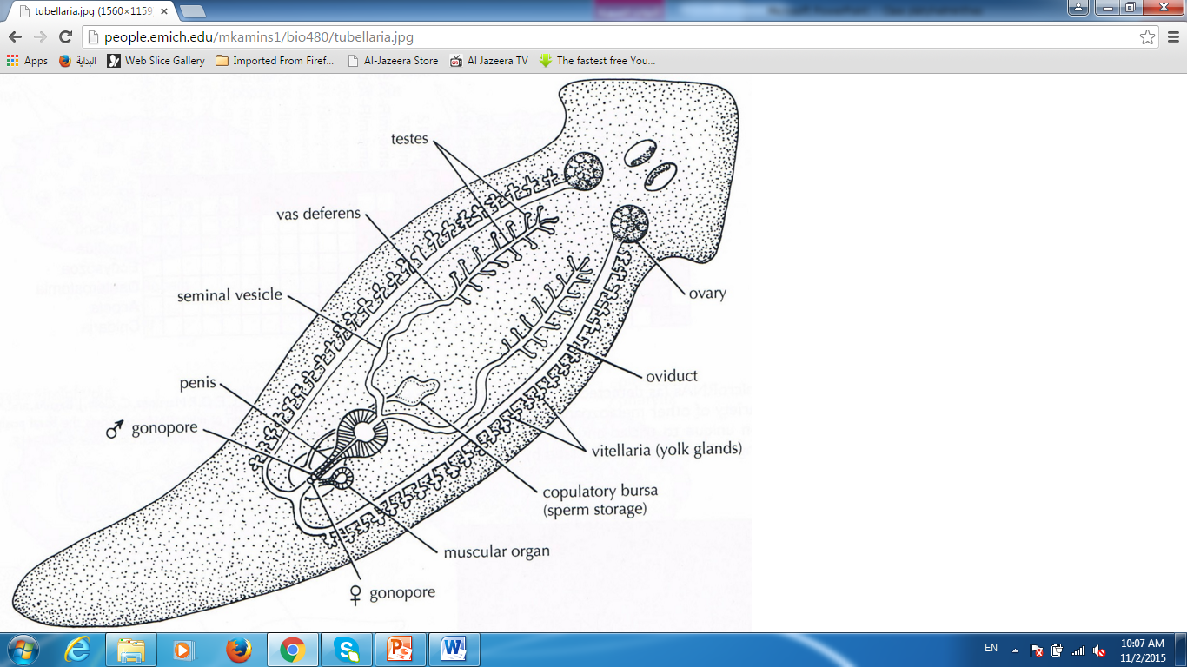
Reproductive system

Slide 17
Class Cestoda (tapeworms)
Tapeworms, have a scolex with hooks and suckers for attachment , neck , and a chain of proglottids budded off from the neck region.
Cut is absent. All parasitic.
Life cycle is indirect , involves a larval stages they need one or more intermediate host in their life cycle.
They are hermaphroditic worms, and all internal parasites.

Slide 18
Class Cestoda (tapeworms)

Slide 19
Life cycle Taenia saginata

Slide 20
Echinococcus granulosus

Slide 21
Life cycle of Echinococcus granulosus

Slide 22
Life cycle of Echinococcus granulosus

Slide 23
2- Class Trematoda(flukes ):
Consist the flukes, which are either internal or external parasites.
They have a forked digestive tract.
They have one or more suckers for attachment to the host.
Life cycle indirect with one or more different host and a number developmental stages such as (Schistosoma) or direct life cycle.
Hermaphroditic species , the reproductive system is adapted for copulation , except some species such as Schistosoma sp

Slide 24
Life cycle Schistosoma sp

Slide 25
Life cycle of Fasciola hepaticum (sheep liver fluke)

