Slide 1
"Baterial Cell Wall structure and Morphology"
Microbio. & Immuno. M./ 1st Year Class
2023-2024
Learning Objective
Explain bacterial cell wall and plasma membrane structure and components.
Explain and define Gram positive and Gram negative bacteria.
Mention types of bacterial cell morphology.

Slide 2
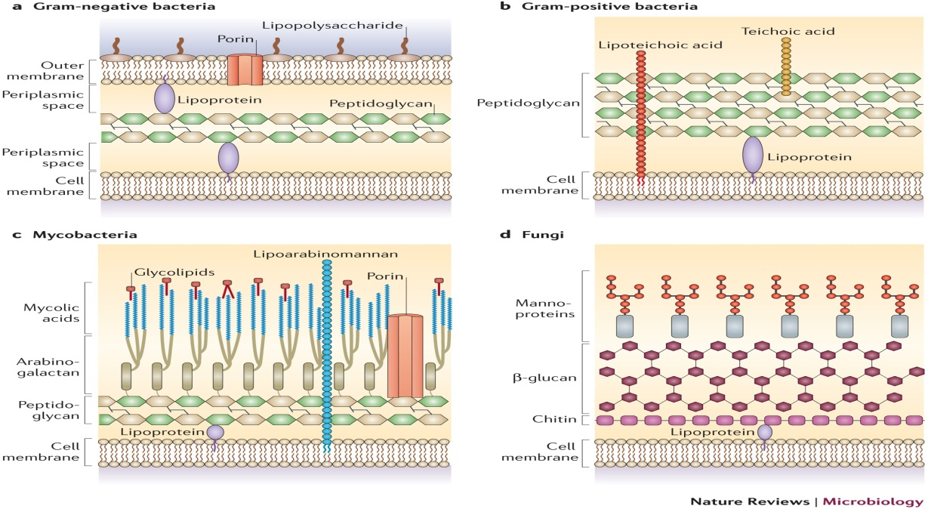
Bacterial cell morphology
Unlike cells of animals and other eukaryotes, Bacterial cells, as they are prokaryotes, do not contain a nucleus and rarely harbor membrane-bound organelles. The domains of Bacteria, according to last classification, include the kingdom ‘Heterotrophic Eubacteria’ that contains all human pathogenic bacteria.
The other kingdoms of bacteria for instance that of the photosynthetic Cyanobacteria, are not pathogenic. Bacteria reproduce asexually by binary transverse fission. The cell walls of these organisms are rigid (with some exceptions, e.g., the mycoplasma).

Slide 3
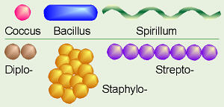
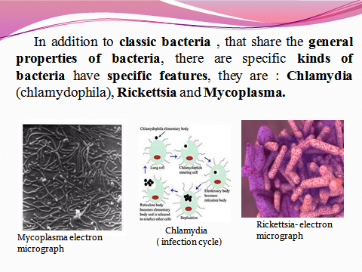
It is estimated that the number of bacterial species on earth is hundreds of thousands, of which only about 5500 have been discovered and described in detail. There are a variety of morphologies among bacteria, but three forms are the most common include: bacillus (rod-shaped), coccus (spherical), or spirillum (helical rods).
In addition to classic bacteria, that share the general properties of bacteria, there are specific kinds of bacteria have specific features, they are: Chlamydia,
Rickettsia and
Mycoplasma.

Slide 4
The size of bacteria
Bacterial size and shape can usually be determined with appropriate staining and a light microscope. The size of bacteria is measured in micrometer (μm) or micron (μ) (1 micron or micrometer is one thousandth of a millimeter) and varies from 0.1 μ-16/18μ. Most pathogenic bacteria measure from 0.1-10μ. The other unit of measurement of microorganisms is nanometer (nm) (one millionth of a millimeter).
Bacteria are very small in size.
Cocci are approx 0.5-1.0 μm in diameter.
Rods range from 2-5 μm in length by 0.5-1.0 μm in width.
Spirochetes are longer (up to 20μm) and narrower (0.1-1.0μm).

Slide 5
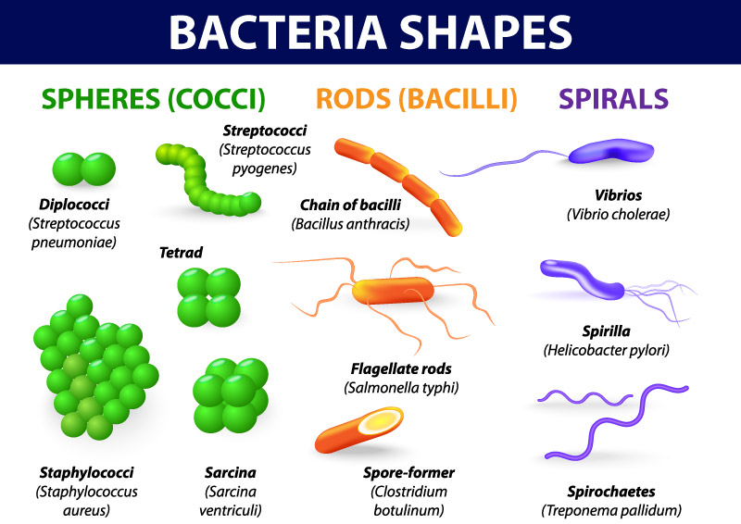
Shape of the Bacteria
Depending on their shape, bacteria are classified into several varieties:
Cocci (meaning berry) are spherical or oval cells (Staphylococcus).
Bacilli (meaning rod) are rod shaped cells.
  Coccobacillus – very short and plump ( Brucella abortus).
  Streptobacilli ( Bacillus subtilus).
  Diplobacilli.
Vibrios are comma
shaped curved rods
(spirillum - helical, comma,
twisted rod) and derive
their name from their
characteristics vibratory motilit.
    Spirochete – spring-like- flexible ( Treponema pallidum).
    Vibrio – gently curved ( Vibrio cholera).
    Spirilla- rigid ( Borrelia species).

Slide 6
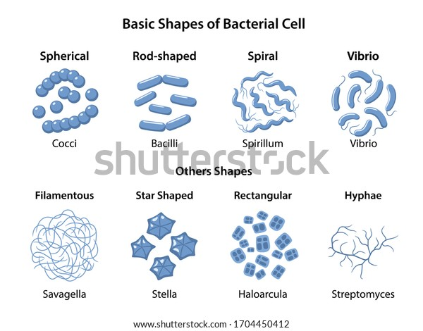
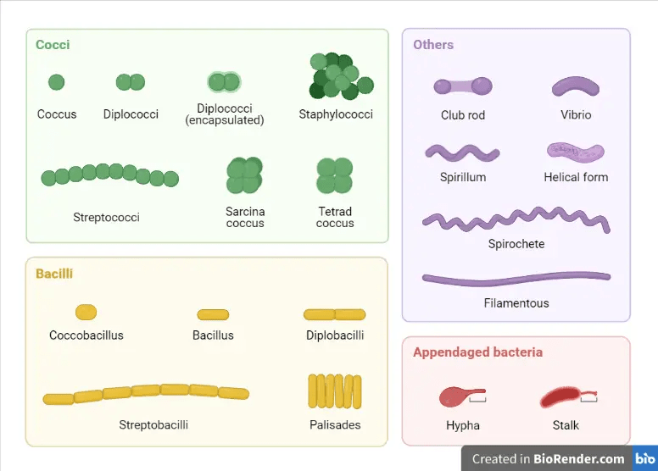
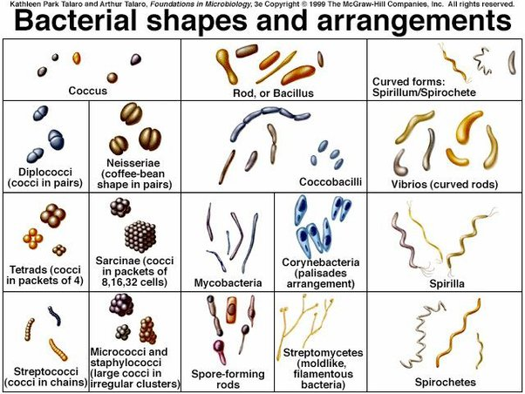
Pleomorphic : variable in shape ( Corynebacterium) and other :
Actinomycetes are branching filamentous bacteria.
Mycoplasmas are cell wall deficient (lack cell wall).
Unusual shapes
Star- shaped stella.
Square haloarcula.
Most bacteria are monomorphic a few are pleomorphic ( variable
shapes during life cycle).

Slide 7
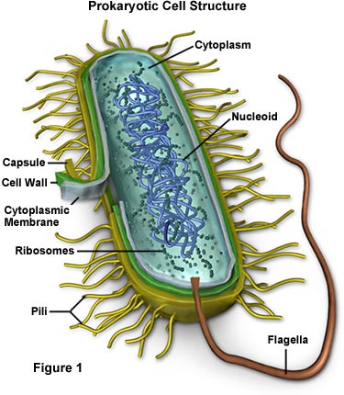
The Cell Envelope
Prokaryotic cells are surrounded by complex envelope layers that differ in composition among the major groups. These structures protect the organisms from host environments, such as extreme osmolarity, harsh chemicals, and even antibiotics.
The cell envelope is composed of the macromolecular layers that surround the bacterium. It includes:
A cell membrane and a peptidoglycan layer except for mycoplasma.
An outer membrane layer in Gram-negative bacteria.
A capsule, a glycocalyx layer, or both (sometimes).
Antigens that frequently induce a specific antibody response.

Slide 8
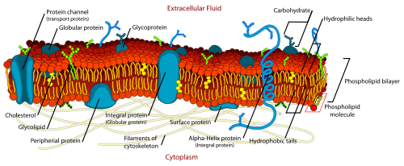
The Cell Membrane
A. Structure: The bacterial cell membrane, also called the cytoplasmic membrane. It is a typical “unit membrane” composed of phospholipids and upward of 200 different kinds of proteins.
B. Function:
Selective permeability and transport of solutes.
Electron transport and oxidative phosphorylation in aerobic species.
Excretion of hydrolytic exoenzymes.
Bearing the enzymes and carrier molecules that function in the biosynthesis of DNA, cell wall polymers, and membrane lipids.
Bearing the receptors and other proteins of the chemotactic and other sensory transduction systems.

Slide 9
The Cell Wall:
Each bacterium is enclosed by a rigid cell wall composed of peptidoglycan, a protein-sugar (polysaccharide) molecule. The wall gives the cell its shape and surrounds the cytoplasmic membrane, protecting it from the environment. It also helps to anchor appendages like the pili and flagella, which originate in the cytoplasm membrane and protrude through the wall to the outside. The strength of the wall is responsible for keeping the cell from bursting when there are large differences in osmotic pressure between the cytoplasm and the environment. The bacterial cell wall owes its strength to a layer composed of a substance variously referred to as murein, mucopeptide, or peptidoglycan. Most bacteria are classified as gram positive or gram negative according to their response to the Gram-staining procedure. This was named for the histologist Hans Christian Gram, who developed this differential staining procedure in an attempt to stain bacteria in infected tissues.

Slide 10
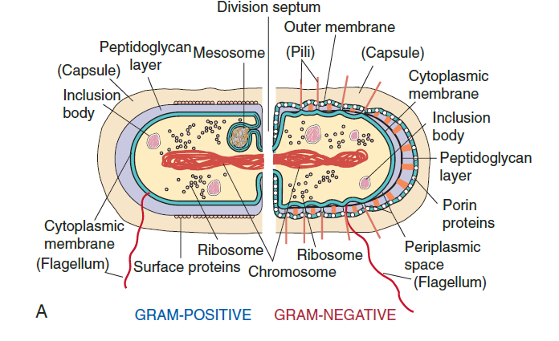
Peptidoglycan (also called mucopeptide or murein) is unique to prokaryotes. It is found in all bacterial cell walls except Mycoplasma contian Sterol. In Gram-positive bacteria, it comprises up to 50% of the cell wall. While in Gram-negative bacteria, it comprises only 5-10 % of the cell wall material.
Most Gram-positive cell walls contain considerable amounts of teichoic and teichuronic acids, The term teichoic acids encompasses all wall, membrane, or capsular polymers containing glycerophosphate or ribitol phosphate residues. Most Gram-positive bacteria have a relatively thick (about 20 to 80 nm), continuous cell wall (often called the sacculus), which is composed largely of peptidoglycan.

Slide 11
Gram-negative cell walls contain three components that lie outside of the peptidoglycan layer: lipoprotein, outer membrane, and lipopolysaccharide(LPS).
In contrast, the peptidoglycan layer in Gram-negative bacteria is thin (about 5-10 nm thick). Outside the peptidoglycan layer in the Gram-negative envelope is an outer membrane structure (about 7.5-10 nm thick). In most Gram-negative bacteria, this membrane structure is anchored noncovalently to lipoprotein molecules (Braun's lipoprotein), which, in turn, are covalently linked to the peptidoglycan. The lipopolysaccharides of the Gram-negative cell envelope form part of the outer leaflet of the outer membrane structure.

Slide 12
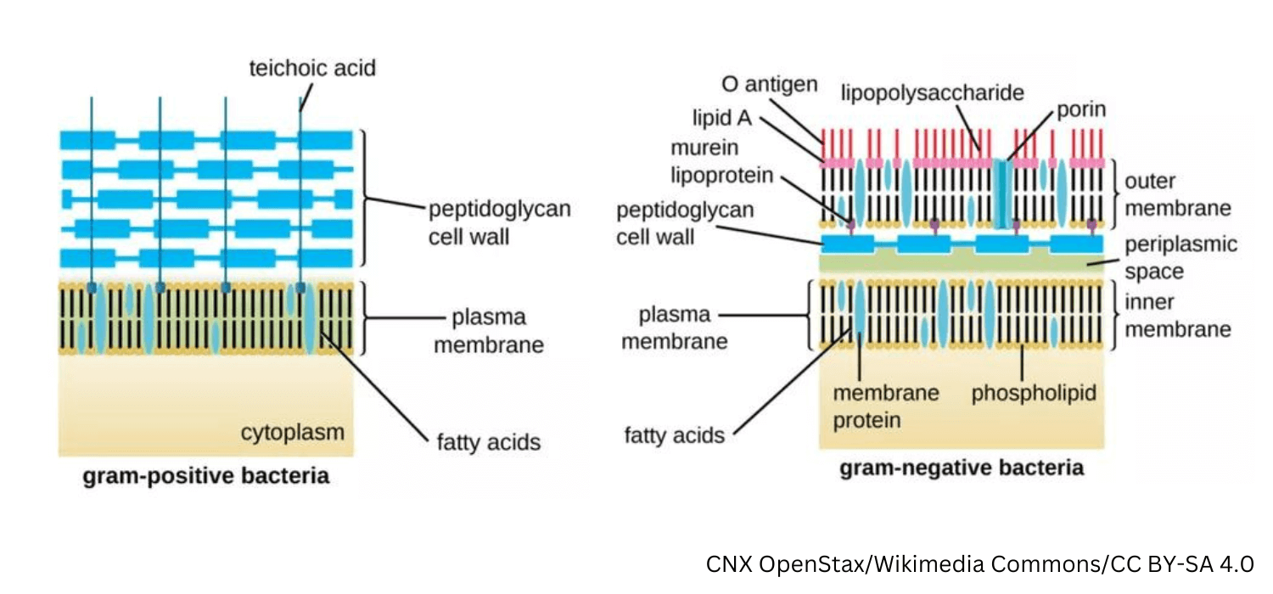
Figure: Schematic structure of Gram-positive and Gram-negative cell walls. Gram+ve cell walls contain only one lipid plasma membrane and a thick peptidoglycan layer interlinked with teichoic and lipoteichoic acids, whereas Gram-ve bacteria have an inner and an outer cell membrane and only a thin layer of peptidoglycan in the periplasmic space between the inner and outer membrane. There is a layer of lipopolysaccharide lining the outer membrane of Gram-ve bacteria.

Slide 13
Gram negative bacteria components are:
Outer membrane: The outer membrane is chemically distinct from all other biological membranes, that it's a bilayered structure; its inner leaflet resembles in composition that of the cell membrane, and its outer leaflet contains a lipopolysaccharide(LPS). However, the outer membrane has special channels, consisting of protein molecules called porins that permit the passive diffusion of low-molecular weight hydrophilic compounds such as sugars, amino acids, and certain ions. It is found in Gram-negative cells, including matrix porins (nonspecific pores).Functions:
Protects cells from harmful enzymes and some antibiotics.
Prevents leakage of Periplasmic proteins.
Lipopolysaccharide (LPS): Which is consists of a complex glycolipid, called lipid A, which is attached a polysaccharide made up of a core and a terminal series of repeat units. The lipid A component is embedded in the outer leaflet of the membrane anchoring the LPS. The presence of LPS is required for the function of many outer membrane proteins.

Slide 14
Lipoprotein: Molecules of an unusual lipoprotein cross-link the outer membrane and peptidoglycan layers. Its function is to stabilize the outer membrane and anchor it to the peptidoglycan layer.
The periplasmic space: The space between the inner and outer membranes, called the periplasmic space, contains the peptidoglycan layer and a gel-like solution of proteins. The periplasmic space is approximately 20–40% of the cell volume, which is far from insignificant. The periplasmic proteins include binding proteins for specific substrates (e.g, amino acids, sugars, vitamins, and ions), hydrolytic enzymes (e.g, alkaline phosphatase and 5′-nucleotidase) that break down non transportable substrates into transportable ones, and detoxifying enzymes (eg, β-lactamase and aminoglycoside-phosphorylase) that inactivate certain antibiotics.

Slide 15
Comparisons of gram positive and gram negative bacteria
Characteristic | Gram-positive | Gram-negative
Gram reaction | Retain crystal violet dye and stain dark violet or purple | Can be decolorized to accept counterstain (safranin) and stain Red
Peptidoglycan layer | Thick (multilayered) | Thin (single-layered
Teichoic acid | Present in many | Absent
Periplasmic space | Absent | Present
Outer membrane | Absent (Fig. 1.7) | Present (Fig. 1.7)
Lipopolysaccharide (LPS) content | Virtually none | High
Lipid and lipoprotein content | Low (acid fast bacteria have lipids linked to peptidoglycan) | High (due to presence of outer membrane)
Flagellar structure | 2 rings in basal bodies | 4 rings in basal bodies
Toxins produced | Primarily exotoxins | Primarily endotoxins
Resistance to physical disruption | High | Low
Cell wall disruption by lysozyme | High | Low
Resistance to drying | High | Low
Inhibition by basic dyes | High | Low
Susceptibility to Anionic detergents | High | Low

Slide 16
Cytoplasmic Membrane
Just inside the peptidoglycan layer of the cell wall lies the cytoplasmic membrane, which is composed of a phospholipid bilayer similar in microscopic appearance to that in eukaryotic cells. They are chemically similar, but eukaryotic membranes contain sterols, whereas prokaryotes generally do not. The only prokaryotes that have sterols in their membranes are members of the genus Mycoplasma. The membrane has four important functions:
Active transport of molecules into the cell.
Energy generation by oxidative phosphorylation.
Synthesis of precursors of the cell wall.
Secretion of enzymes and toxins.
Cytoplasm
The cytoplasm has two distinct areas when seen in the electron microscope:
An amorphous matrix that contains ribosomes, nutrient granules, metabolites, and plasmids.
An inner, nucleoid region composed of DNA.

Slide 17
Ribosomes
Bacterial ribosomes are the site of protein synthesis as in eukaryotic cells, but they differ from eukaryotic ribosomes in size and chemical composition. Bacterial ribosomes are 70S in size, with 505 and 30S subunits, whereas eukaryotic ribosomes are 80S in size, with 60S and 40S subunits. The differences in both the ribosomal RNAs and proteins constitute the basis of the selective action of several antibiotics that inhibit bacterial, but not human, protein synthesis.
Granules
The cytoplasm contains several different types of granules that serve as storage areas for nutrients and stain characteristically with certain dyes. For example, volutin is a reserve of high energy stored in the form of polymerized metaphosphate. It appears as a "metachromatic" granule since it stains red with methylene blue dye instead of blue as one would expect. Metachromatic granules are a characteristic feature of Corynebacterium diphtheriae, the cause of diphtheria.

Slide 18
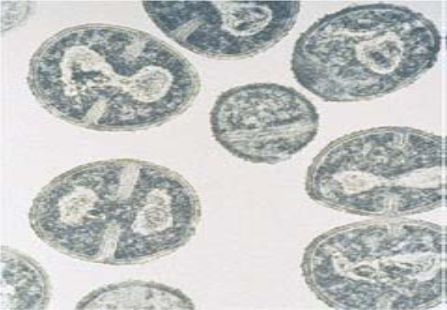
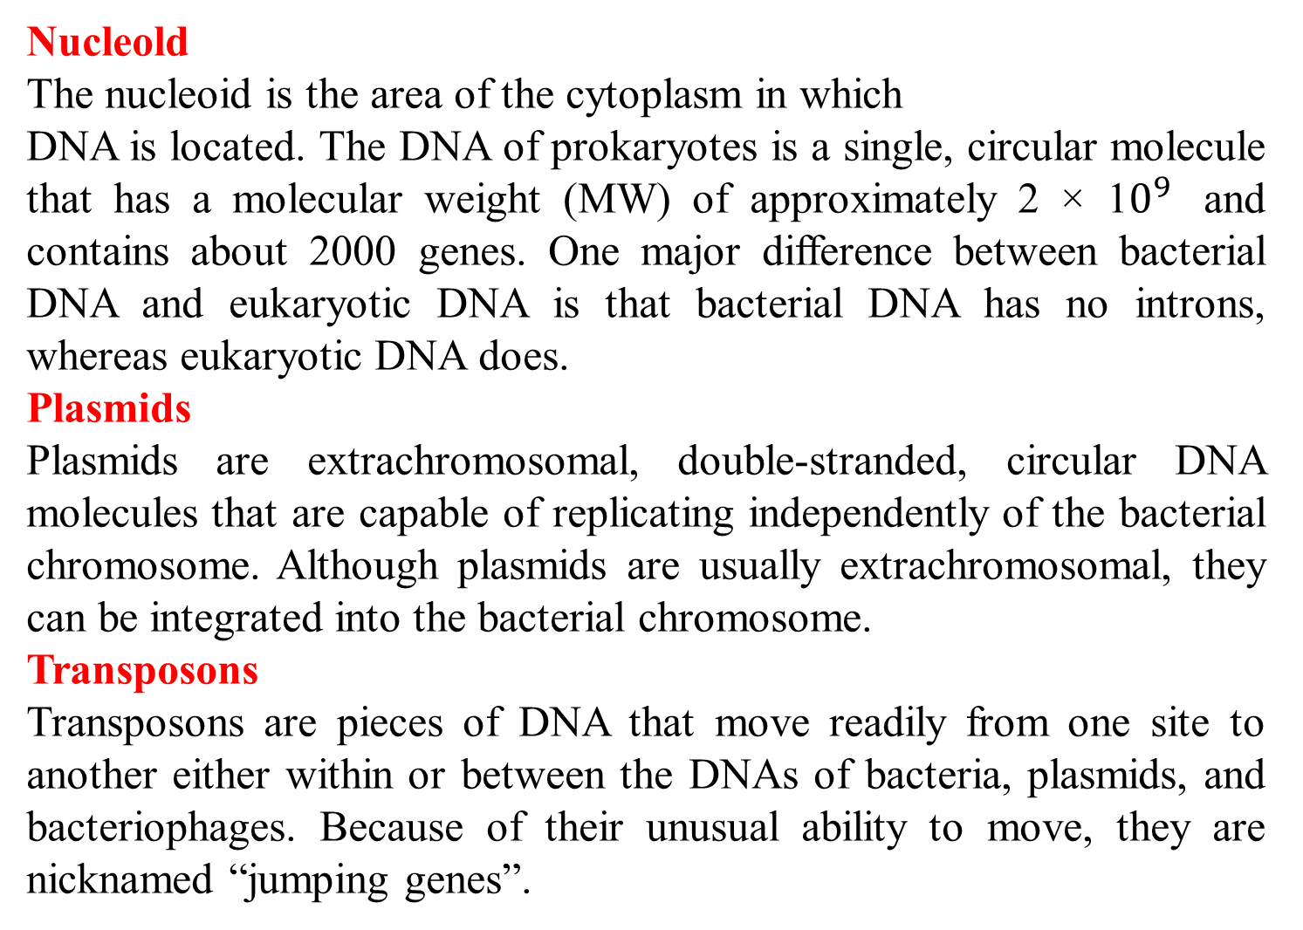
Nucleold
The nucleoid is the area of the cytoplasm in which
DNA is located. The DNA of prokaryotes is a single, circular molecule that has a molecular weight (MW) of approximately 2 × 1$0^{9}$ and contains about 2000 genes. One major difference between bacterial DNA and eukaryotic DNA is that bacterial DNA has no introns, whereas eukaryotic DNA does.
Plasmids
Plasmids are extrachromosomal, double-stranded, circular DNA molecules that are capable of replicating independently of the bacterial chromosome. Although plasmids are usually extrachromosomal, they can be integrated into the bacterial chromosome.
Transposons
Transposons are pieces of DNA that move readily from one site to another either within or between the DNAs of bacteria, plasmids, and bacteriophages. Because of their unusual ability to move, they are nicknamed “jumping genes”.

Slide 19
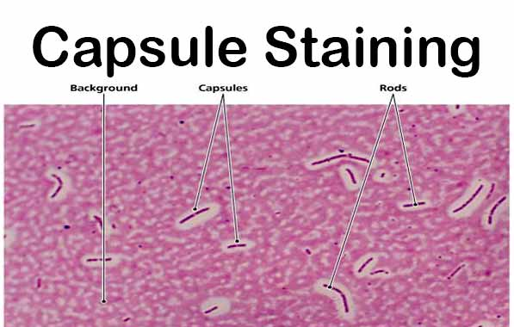
Structures Outside the Cell Wall
Capsule
The capsule is a gelatinous layer covering the
entire bacterium. It is composed of polysaccharide,
except in the anthrax bacillus, which has a capsule of
polymerized d-lutamic acid. The sugar components of the polysaccharide vary from one species of bacteria to another and frequently determine the serologic type (serotype) within a species. For example, there are 84 different serotypes of Streptococcus pneumoniae, which are distinguished by the antigenic differences of the sugars in the polysaccharide capsule. The functions:
It is a determinant of virulence of many bacteria since it limits the ability of phagocytes to engulf the bacteria.
Specific identification of an organism can be made by using antiserum against the capsular polysaccharide, which is used in the clinical laboratory to identify certain organisms, is called the quelling reaction.
Capsular polysaccharides are used as the antigens in certain vaccines because they are capable of eliciting protective antibodies.
The capsule may play a role in the adherence of bacteria to human tissues, which is an important initial step in causing infection.

Slide 20
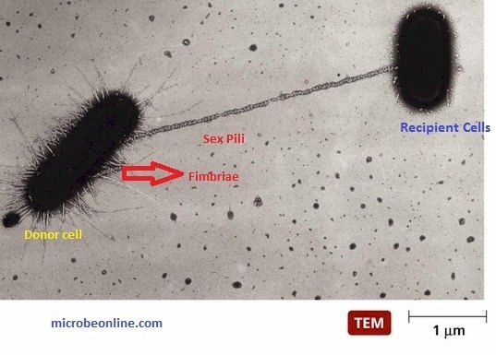
Pili (Attachment Pili , Conjugation Pili ) (Fimbriae)
    Pili are hair like filaments that extend from the cell surface. They are shorter and straighter than flagella and are composed of subunits of pilin, a protein arranged in helical strands. They are found mainly on gram-negative organisms. Pili functions:
They mediate the attachment of bacteria to specific receptors on the human cell surface, which is a necessary step in the initiation of infection for some organisms.
A specialized kind of pilus, the sex pilus, forms the attachment between the male (donor) and the female (recipient) bacteria during conjugation.
The conjugation pili (sex pili) are also present only in Gram -negative bacteria, they are required for the process of conjugation and thus for transfer of conjugative plasmids.

Slide 21
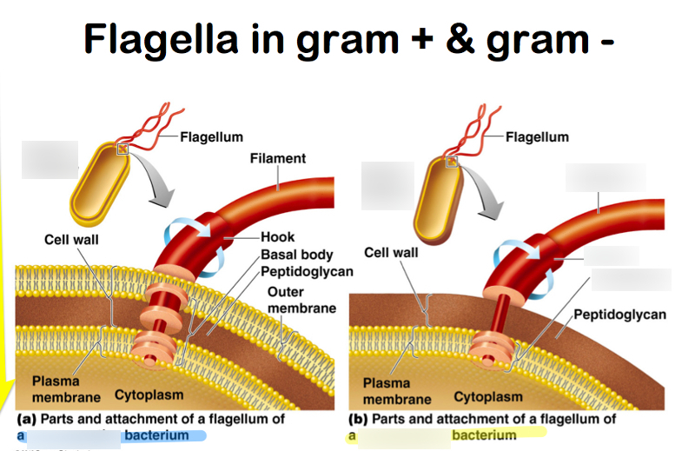
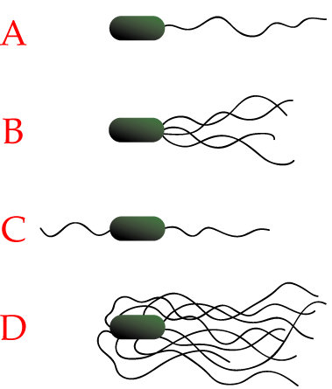
Flagella
Flagella (singular flagellum) are long, whip like appendages that move the bacteria toward nutrients and other attractants, a process called chemotaxis. The long filament, which acts as a propeller, is composed of many subunits of a single protein, flagellin, arranged in several intertwined chains. The energy for movement, the proton motive force, is provided by adenosine triphosphate (ATP), derived from the passage of ions across the membrane. Flagella are medically important for two reasons:
Some species of motile bacteria (e.g., E. coli and Proteus species) are common causes of urinary tract infections. Flagella may play a role in pathogenesis by propelling the bacteria up the urethra into the bladder.
Some species of bacteria (e.g., Salmonella species) are identified in the clinical laboratory by the use of specific antibodies against flagellar proteins.
(A)monotrichous; (polar flagellum) e.g., Vibrio spp.
(B)lophotrichous;(bundle of flagella at one end of the cell)e.g.,Spirillum volutans.
(C) amphitrichous; (polar flagellum at each end of the cell).
(D) peritrichous;peritrichous (several flagella distributed around the cell)e.g.,E.coli.

Slide 22
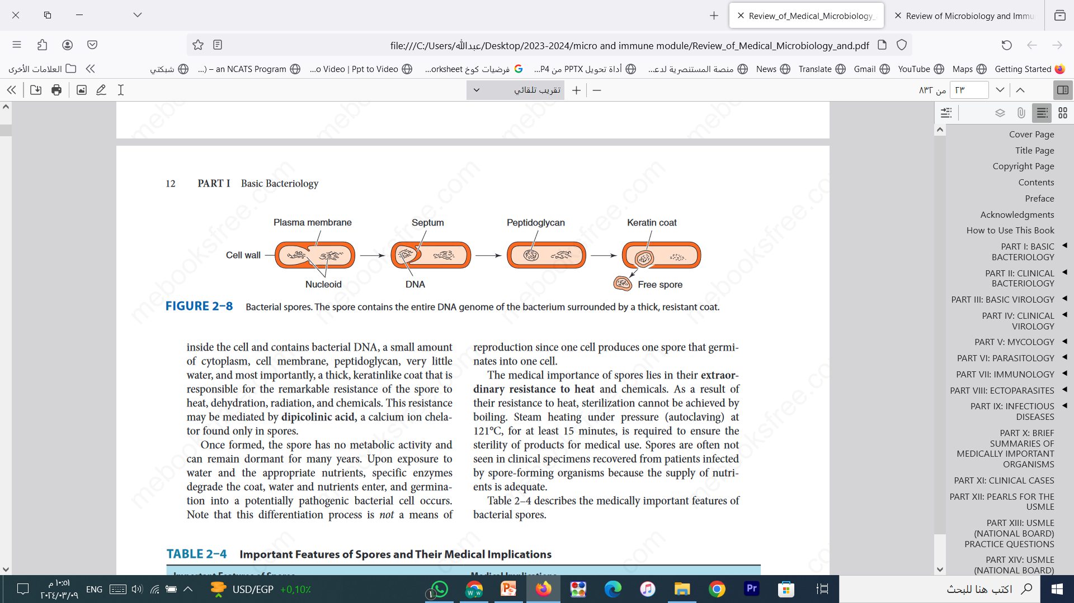
Bacterial Spores
These highly resistant structures are formed in response to adverse conditions by two genera of medically important gram-positive rods: the genus Bacillus, which includes the agent of anthrax, and the genus Clostridium, which includes the agents of tetanus and botulism. Spore formation (sporulation) occurs when nutrients, such as sources of carbon and nitrogen. The spore forms inside the cell and contains bacterial DNA, a small amount of cytoplasm, cell membrane, peptidoglycan, very little water, and most importantly, a thick, keratin like coat that is responsible for the remarkable resistance of the spore to heat, dehydration, radiation, and chemicals. This resistance may be mediated by dipicolinic acid, a calcium ion chelator found only in spores. They are spherical to oval in shape and are characterized by a thick wall and a high level of resistance to chemical and physical noxae.

Slide 23
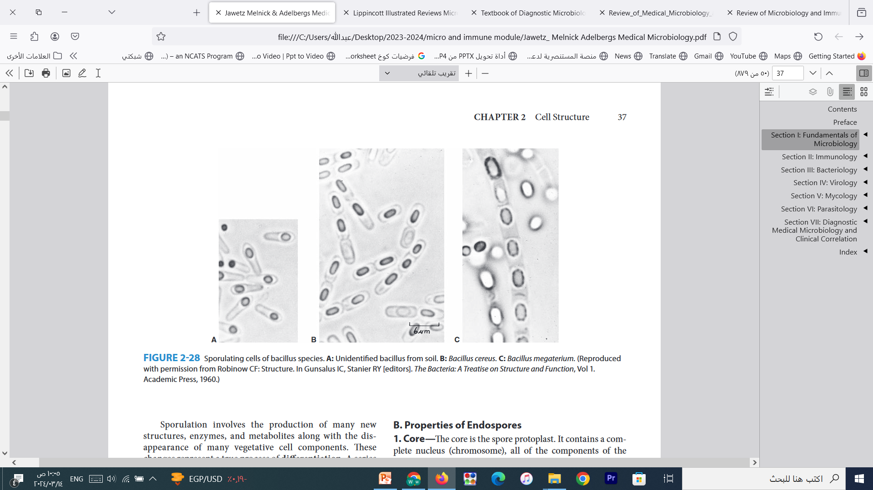
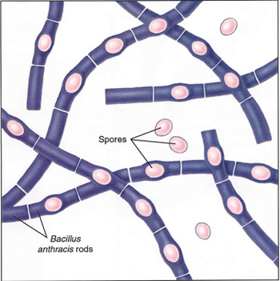
Once formed, the spore has no metabolic activity and can remain dormant for many years. Upon exposure to water and the appropriate nutrients, specific enzymes degrade the coat, water and nutrients enter, and germination into a potentially pathogenic bacterial cell occurs. Note that this differentiation process is not a means of reproduction since one cell produces one spore that germinates into one cell. The medical importance of spores lies in their extraordinary resistance to heat and chemicals. As a result of their resistance to heat, sterilization cannot be achieved by boiling. Steam heating under pressure (autoclaving) at 121°C, for at least 15 minutes, is required to ensure the sterility of products for medical use. Spores are often not seen in clinical specimens recovered from patients infected by spore-forming organisms because the supply of nutrients is adequate.
Bacterial spores - Bacillus anthracis

Slide 24


