Slide 1
Blood samples and culture
Haemopoitic and lymphatic Module
2023-2024
Learning Objectives
Determine blood culture.
Explain samples and media,
Analyze the diagnosis and results.
Taking blood cultures.
Managing blood sample correctly ( prevent spilling, correct labled container).

Slide 2
Blood Culture
A blood culture is a laboratory test in which blood, taken from the patient, is inoculated into bottles containing culture media to determine whether infection-causing microorganisms (bacteria or fungi) are present in the patient’s bloodstream. Some bacteria prefer oxygen (aerobes), while others thrive in a reduced oxygen environment (anaerobes). Compared to sepsis which is defined as bacteraemia in the presence of clinical symptoms and signs such as chills, fever, tachycardia, tachypnea and hypotension. If you experience these symptoms following a recent infection, surgical procedure, artificial heart valve replacement, or immunosuppressive therapy, you are more likely to have a systemic infection and taking blood cultures would be appropriate. Blood cultures are taken more frequently in newborns who may have an infection but may not have the typical signs and symptoms of sepsis. Similarly, blood cultures are collected in young children to detect serious infections.

Slide 3
Blood cultures are intended to:
Confirm the presence of microorganisms in the bloodstream.
Identify the microbial etiology of the bloodstream infection.
Provide an organism for susceptibility testing and optimization of antimicrobial therapy.
Blood culture should be made for cases with suspected septicemia, endocarditis, and bacteremia secondary to localized infections (pneumonia, intra abdominal abscesses, pyelonephritis, epiglottitis, meningitis).
BACTERAEMIA VS. SEPTICAEMIA
Bacteraemia: The presence of bacteria in the blood. It occurs in:
Typhoid fever, Brucellosis, Leptospirosis and Endocarditis.
Some conditions have a period of bacteremia as part of the disease process( meningitis, endocarditis).
Septicaemia: bacteremia plus clinical signs and symptoms of bacterial invasion and toxin production.

Slide 4
Blood collection and transport:Timing of blood collection
Before antibiotics are administered.
Two or three blood samples are taken, separated by intervals of one hour (or less if it must not be delayed).
Samples should be taken as soon as possible after a spike of fever. Samples should not be refrigerated.
The advantages of repeated blood culture:
The chance of missing a transient bacterimia is reduced.
The pathogenic role of saprophytic isolates e.g.: Staph. epidermidis is confirmed if they are recovered from multiple venepuncture.
Usually, two containers are collected during one draw, one of which is designed for aerobic organisms that require oxygen, and one of which is for anaerobic organisms, that do not. These two containers are referred to as a set of blood cultures. Two sets of blood cultures are sometimes collected from two different blood draw sites. If an organism only appears in one of the two sets, it is more likely to represent contamination with skin flora than a true bloodstream infection.

Slide 5
Skin disinfection:
Skin antisepsis therefore plays a critical role in reducing these contaminants.
Iodine, povidone-iodine, alcohol 70% or chlorohexidine 0.5% in alcohol 70%.
Type and volume of sample ( Quantity of blood ):
Adults – Purple top and Silver/Blue top bottles. Inoculate up to 10ml to each bottle.
Children – Pink top bottle. Inoculate up to 2-5 ml.
Neonates and Infants – Pink top bottle. Inoculate preferably 1‐2ml.
Do not exceed the manufacturer’s recommended maximum volume for each bottle as shown on label.

Slide 6
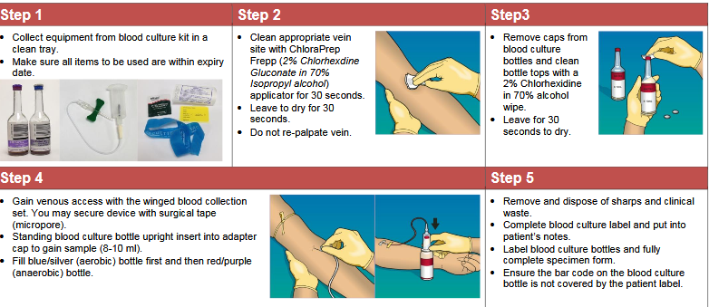

Slide 7
Blood culture media
Broth like: Trypticase Soy broth
Quantity of blood about 5ml of blood + 45ml of broth and this WHY ? because:
To dilute any bacteriaocidal effect of human serum.
To dilute any antibiotic that present in blood sample.
Anticoagulant
SPS (Sodium Polyanethol Sulfonate ) and it is also inhibits the antibacterial effect of serum and phagocyte (The anticoagulant in blood culture medium must not harm the bacteria and must prevent clotting of the blood, which entrap bacteria and prevent their detection). Hence substances such as liquoid (Sodium polyanethol sulfonate, SPS) may be used as a non-toxic anticoagulant which enables bacterial growth and prevents the action of natural bacterial inhibitors of blood.

Slide 8
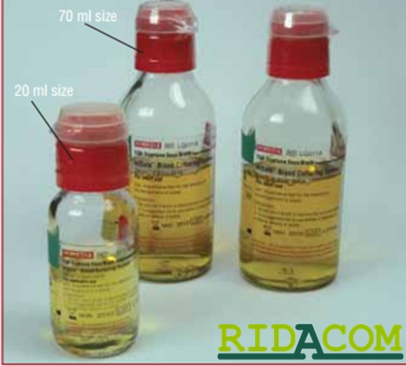
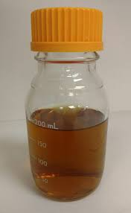
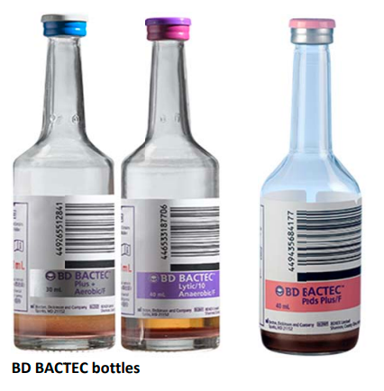
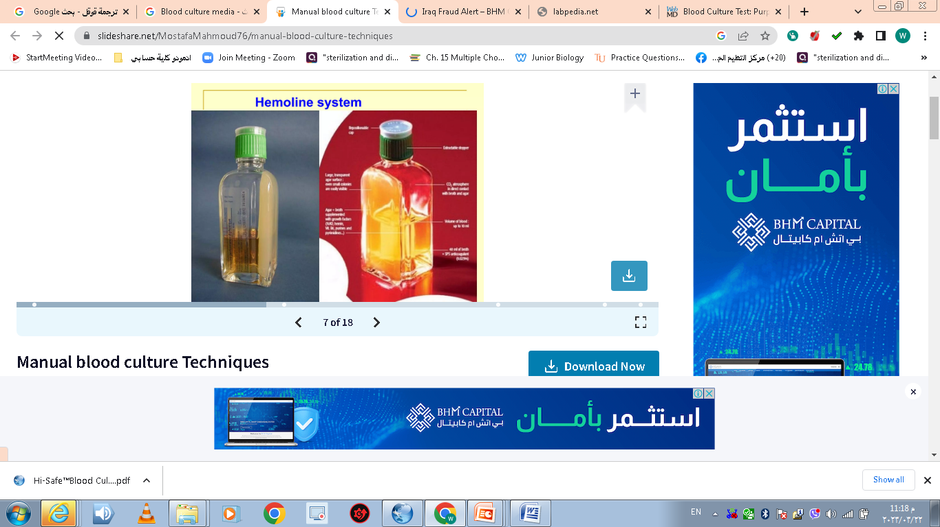
Blood culture containers:
Screw – cup bottle.
Commercial blood culture bottle contain CO2.
Castaneda bottle (broth and solid slant) one of the flat surface of bottle (diphasic). It is recommended for culturing of Brucella spp.

Slide 9
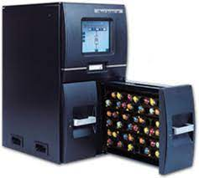
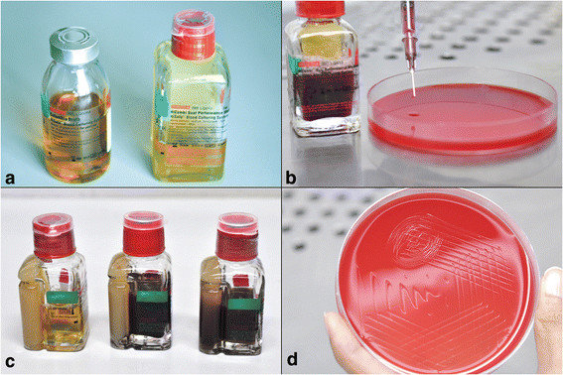
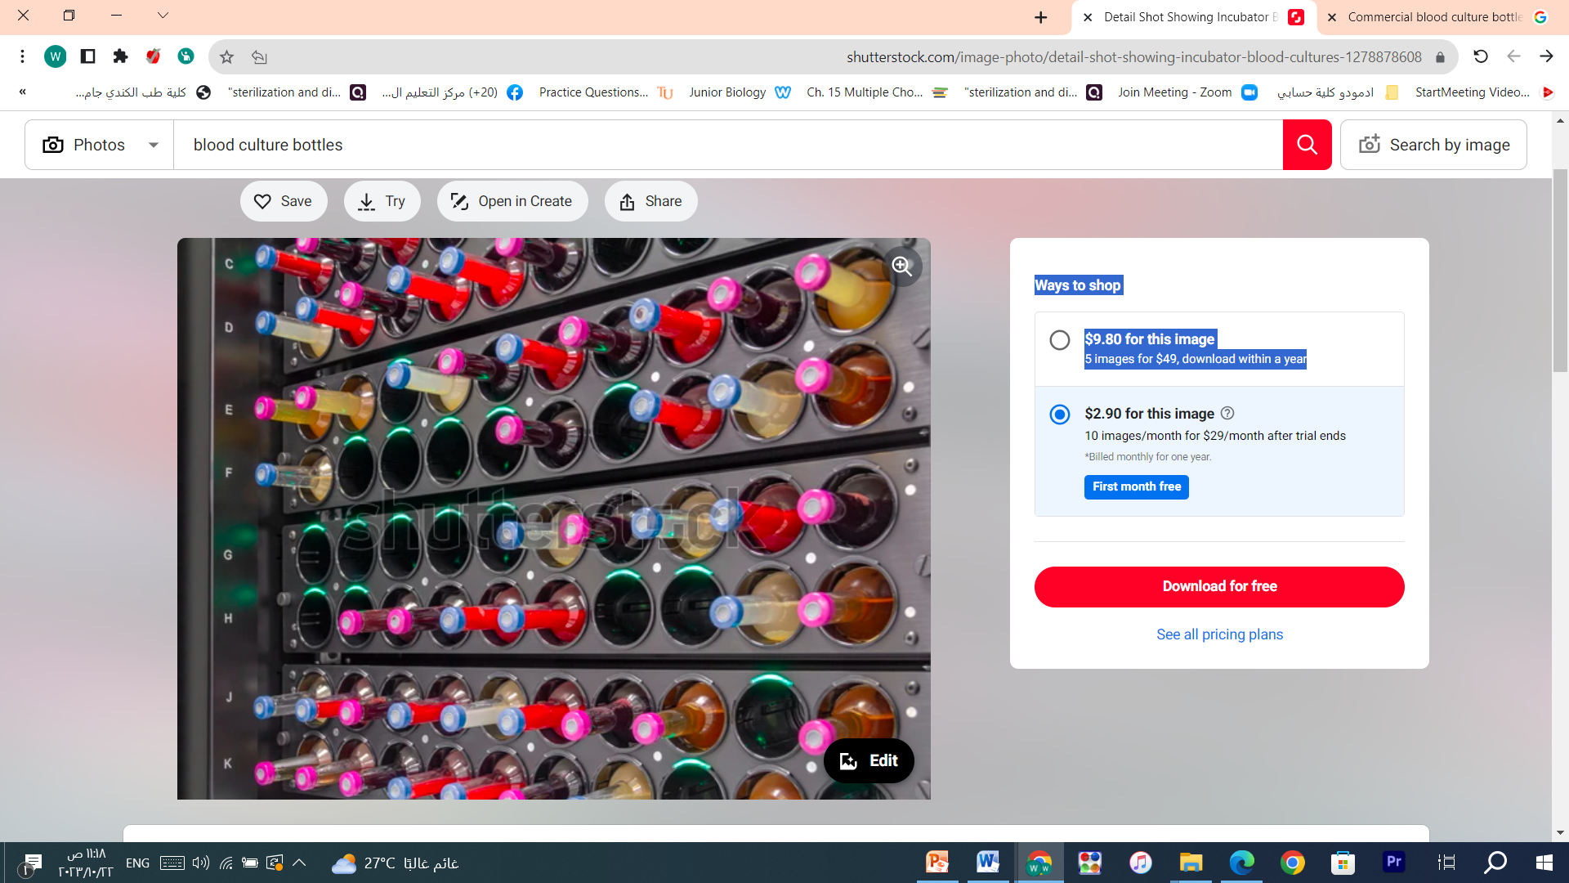
Processing of blood culture
Incubation at 35-37°C and inspected twice day (at least for first 3 days) for signs of microbial growth.
Sterile culture usually shows a layer of sediment red blood covered by a pale yellow transparent broth.
Blood bottles incubator

Slide 10
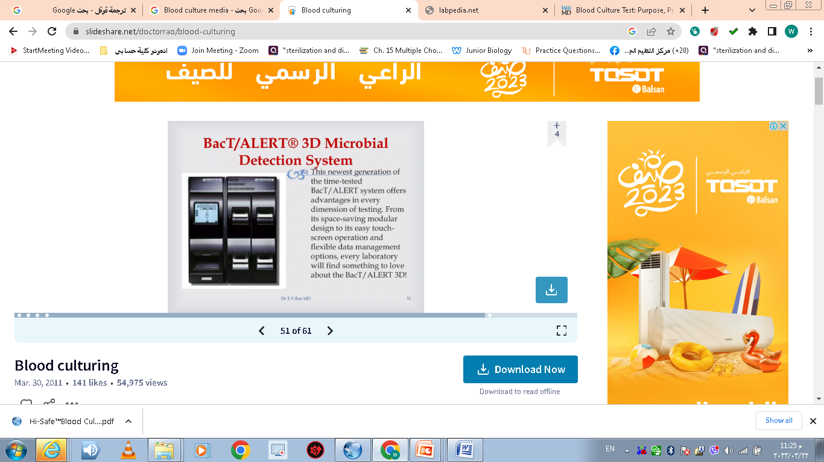
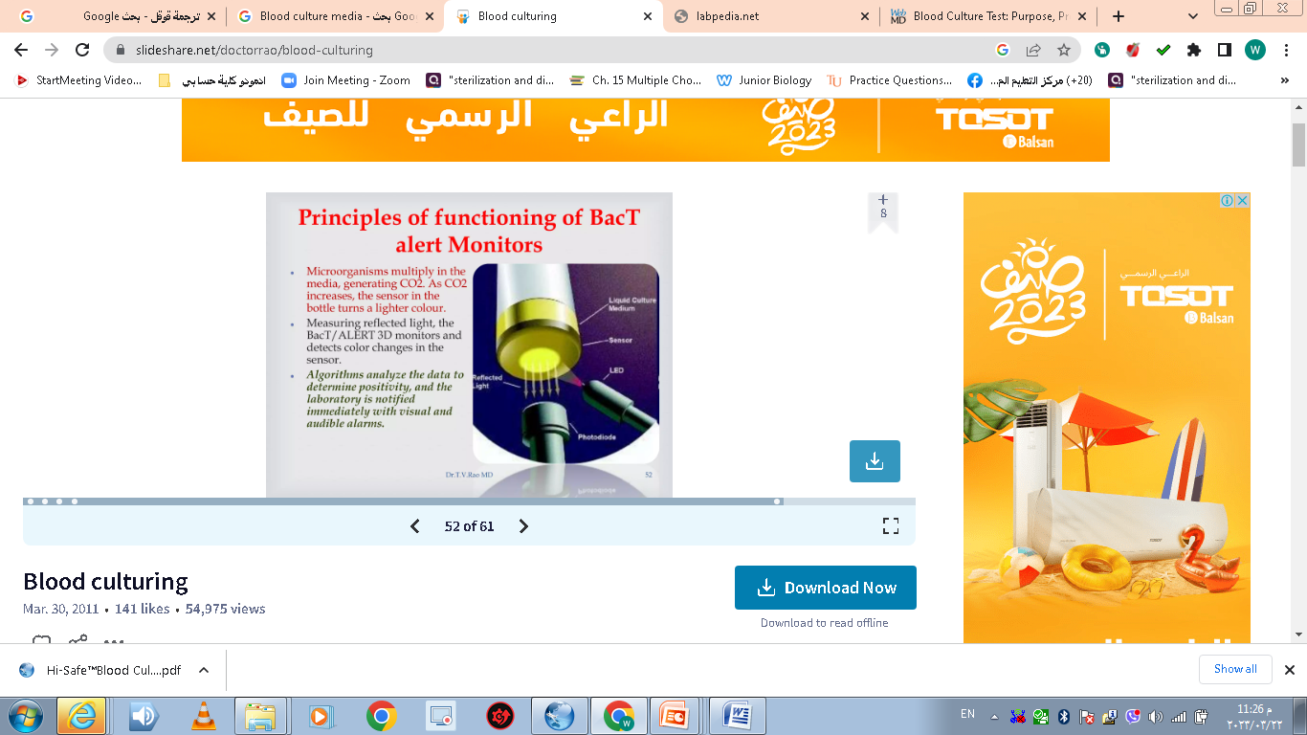

Slide 11
Processing of blood culture
Incubation at 35-37°C and inspected twice day (at least for first 3 days) for signs of microbial growth.
Sterile culture usually shows a layer of sediment red blood covered by a pale yellow transparent broth.
Incubation for 5-7 days, often extended to 14-21 days for suspected bacterial endocarditis or infection with Brucella spp. or yeasts.
The organism is identified by Gram stain of the broth, colony appearance after subculture to solid media and biochemical and/or antigen tests.
Most pathogens grow within 1-2 days; some organisms may require longer eg, Candida spp, Brucella spp.

Slide 12
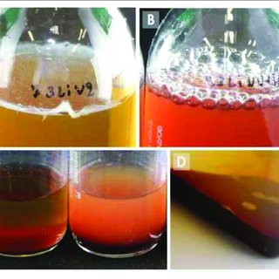
Growth in blood culture evidenced by:
Haemolysis.
Surface pellicle.
Coagulation of broth.
Production of gas (CO2).
Alteration in redox potential or change in pH.
Follicular deposit on the top of the blood layer.
Uniform or subsurface turbidity.
White grains on the surface or deep in the blood layer.
When ever visible growth appears the bottle opened aseptically, a small amount of broth removed with sterile loop and Grams stained smear examined for the presence of microorganisms.

Slide 13
Contaminants
Even in ideal conditions 3-5% of blood culture grow contaminants originated from the skin (streptococcus epidemidis, P. acnes, Clostridium spp., diphtheriods) or from the environment (Acintobacter, Bacillus spp.) such organisms may sometimes behave as pathogens and even cause endocarditis. Also Coagulase negative staphylococci (CoNS) and Corynebacterium spp
A true infection should be suspected in the following situations:
If the same organisms grows in tow bottles of the same blood specimen.
If the same organisms grows in culture from more than one specimen.
If growth is rapid with 48hrs.
Pseudobacterimia (False- Positive blood culture) may be result from contaminated antiseptic solution, syringes or needles. Some bacteria persist in the deeper skin layers and may gain to the blood (Staph. Epidermidis, P. acnes and even spores of Clostridium.

Slide 14
Most common causes of bacterimia
G –ve organisms
E.coli, Klebsilla spp., Enterobacter spp., Protues spp.,Salmonella typhi other Salmonelli spp., P.aerogenosa, Neisseria meningitides, Haemophius influenzae, Brucella spp., Bacteroides fragilis (anaerobes) , Pseudomonoas pseudomallei (in certain areas).
G + ve organisms
Staphylococcus aureus, S.epidermidis, Sterptococcus viridans, Enterococcus faecalis , S.pneumniae, S.pyogenes, S.agalactiae, Listeria monocytogenes, Closteridium perfringens, Peptococcus spp.,(anaerobes) ,peptostreptococcus spp.
Fungi Organisms :
Candida albicans and other yeast –like fungi e.g.:
Cryptococcus neoformans.
NOTE: Blood does not have a normal microbial flora.

Slide 15
Thank You

