Slide 1
Chapter 4
Diffusion

Slide 2
Materials of all types are often heat-treated to improve their properties. The phenomena that occur during a heat treatment almost always involve atomic diffusion.
Diffusion.
Diffusion is the material transport by atomic motion.
Many reactions and processes that are important in the treatment of materials rely on the transfer of mass either within a specific solid (ordinarily on a microscopic level) or from a liquid, a gas, or another solid phase.
The phenomenon of diffusion may be demonstrated with the use of a diffusion couple. which is formed by joining bars of two different metals together (copper–nickel diffusion couple).

Slide 3
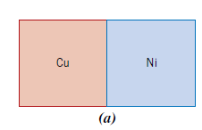
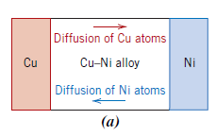
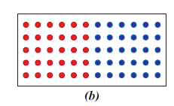
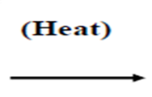
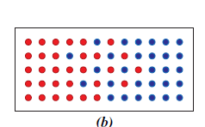
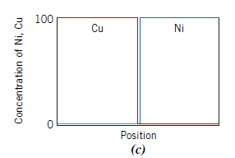
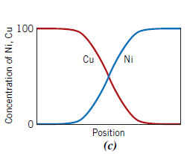
This couple is heated for an extended period at an elevated temperature (but below the melting temperature of both metals) and cooled to room temperature.

Slide 4
The process by which atoms of one metal diffuse into another is termed interdiffusion, or impurity diffusion.
Diffusion also occurs for pure metals, but all atoms exchanging positions are of the same type; this is termed self-diffusion.
DIFFUSION MECHANISMS
For an atom to make such a move, two conditions must be met:
(1) there must be an empty adjacent site, and
(2) the atom must have sufficient energy to break bonds with its neighbor atoms and then cause some lattice distortion during the displacement. This energy is vibrational in nature.

Slide 5
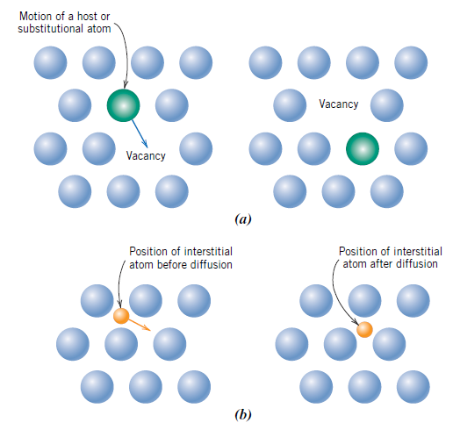
- Two dominate for metallic diffusion.
1- Vacancy Diffusion
2- Interstitial Diffusion

Slide 6
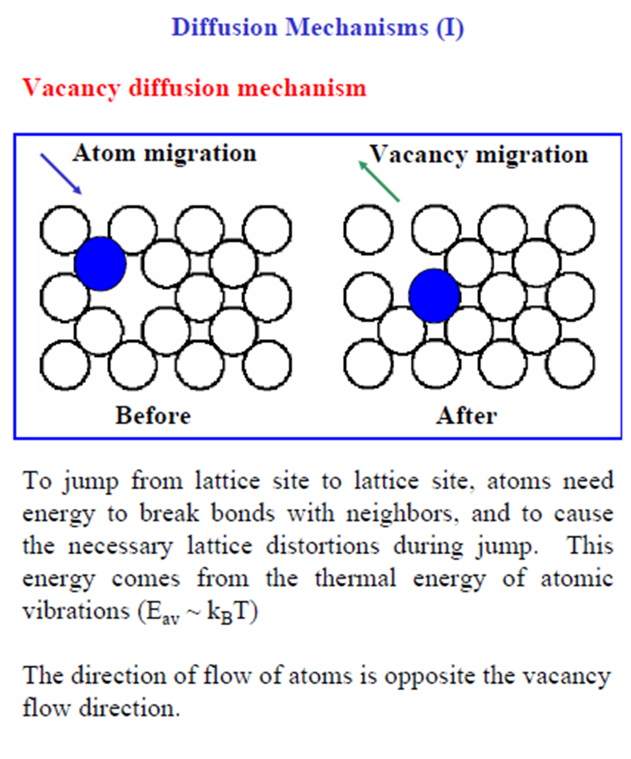
- Both of self-diffusion and inter-diffusion occur by this mechanism.

Slide 7
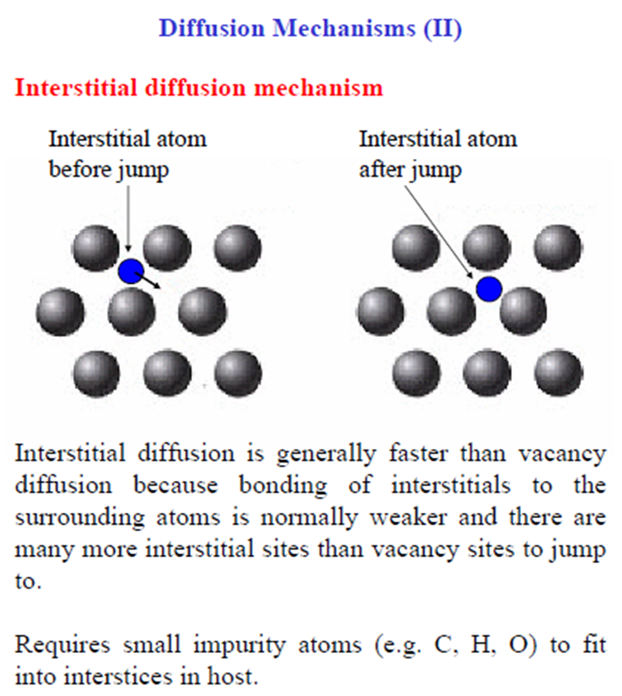
Diffusion in this type involves atoms that migrate from an interstitial position to a neighboring one that is empty. This mechanism is found for interdiffusion of impurities

Slide 8

diffusion flux
Diffusion is a time-dependent process, that is the quantity of an element that is transported within another is a function of time.
the rate of mass transfer is called diffusion flux (J).
diffusion flux is the mass (or, equivalently, the number of atoms) M diffusing through and perpendicular to a unit cross-sectional area of solid per unit of time.
where A : the area across which diffusion is occurring , t : diffusion time. The units for J are (kg/m^2.s or atoms/m^2.s).

Slide 9
Steady-state diffusion: Fick’s first law
- If the diffusion flux does not change with time, a steady-state diffusion exists.
The diffusion flux is proportional to the concentration gradient, through the expression
This equation is sometimes called Fick’s first law.
The constant of proportionality D is called the diffusion coefficient, which is expressed in square meters per second.
The negative sign in this expression indicates that the direction of diffusion is down the concentration gradient, from a high to a low concentration.
Fick’s first law may be applied to the diffusion of atoms of a gas through a thin metal plate for which the concentrations (or pressures) of the diffusing species on both surfaces of the plate are held constant.

Slide 10

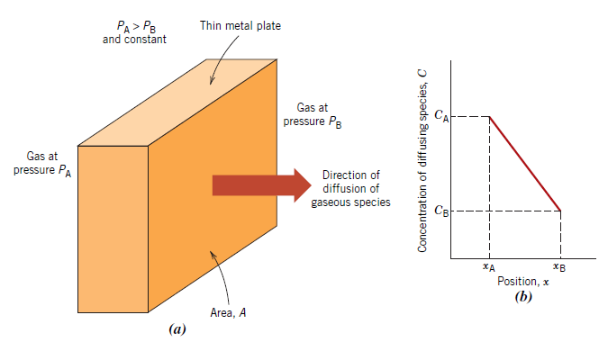
When concentration C is plotted versus position (or distance) within the solid x, the
resulting curve is termed the concentration profile.

Slide 11

- Concentration gradient is the slope at a particular point on the concentration profile
concentration gradient =
- Driving force is the concentration gradient in diffusion.

Slide 12

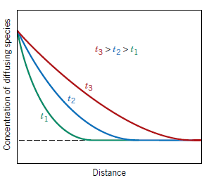
Nonsteady-state diffusion: Fick’s second law
Most practical diffusion situations the diffusion flux and the concentration gradient at particular point change with time. The changes of the concentration profile can be described by differential question
(Fick’s second law)
Concentration profiles for nonsteady-state diffusion taken at three different times, t1, t2, and t3

Slide 13
FACTORS THAT INFLUENCE DIFFUSION
1- Diffusing Species
- The magnitude of the diffusion coefficient D is indicative of the rate at which atoms diffuse. The diffusing species and the host material influence the diffusion coefficient.
- For example, there is a significant difference in magnitude between self-diffusion and carbon interdiffusion in a-iron at 500 ͦͦ C, the D value being greater for the carbon interdiffusion (3.0 x 10 ̂ -21 vs. 2.4 x10 ̂ -12 m ̂ 2/s). This comparison also provides a contrast between rates of diffusion via vacancy and interstitial modes. Self-diffusion occurs by a vacancy mechanism, whereas carbon diffusion in iron is interstitial.

Slide 14

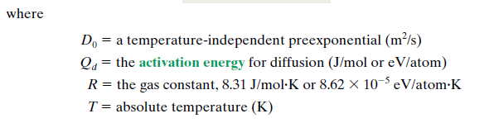
2- Temperature
Temperature has a profound influence on the coefficients and diffusion rates.
For example, for the self-diffusion of Fe in a-Fe, the diffusion coefficient increases approximately six orders of magnitude (from 3.0 x 10 ̂ -21 to 1.8 x10 ̂ -15 m ̂ 2/s) in rising temperature from 500 ͦ C to 900 ͦ C. The temperature dependence of the diffusion coefficients is

Slide 15
The activation energy is energy required to produce the diffusive motion of one mole of atoms.
A large activation energy results in a relatively small diffusion coefficient.
Taking natural logarithms of above equation yields
- If log D is plotted versus the reciprocal of the absolute temperature, a straight line should result, having slope and intercept of - Qd/2.3R and log D0, respectively. The values of Qd and D0 can be determined experimentally from this plot.

Slide 16
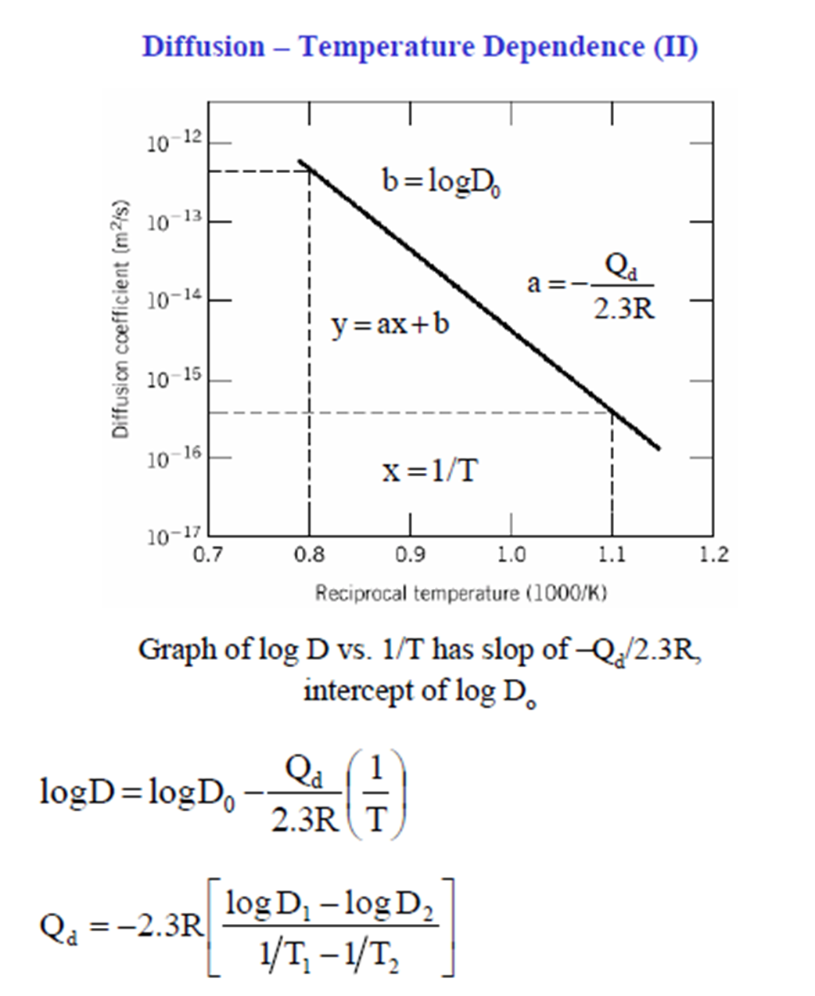

Slide 17
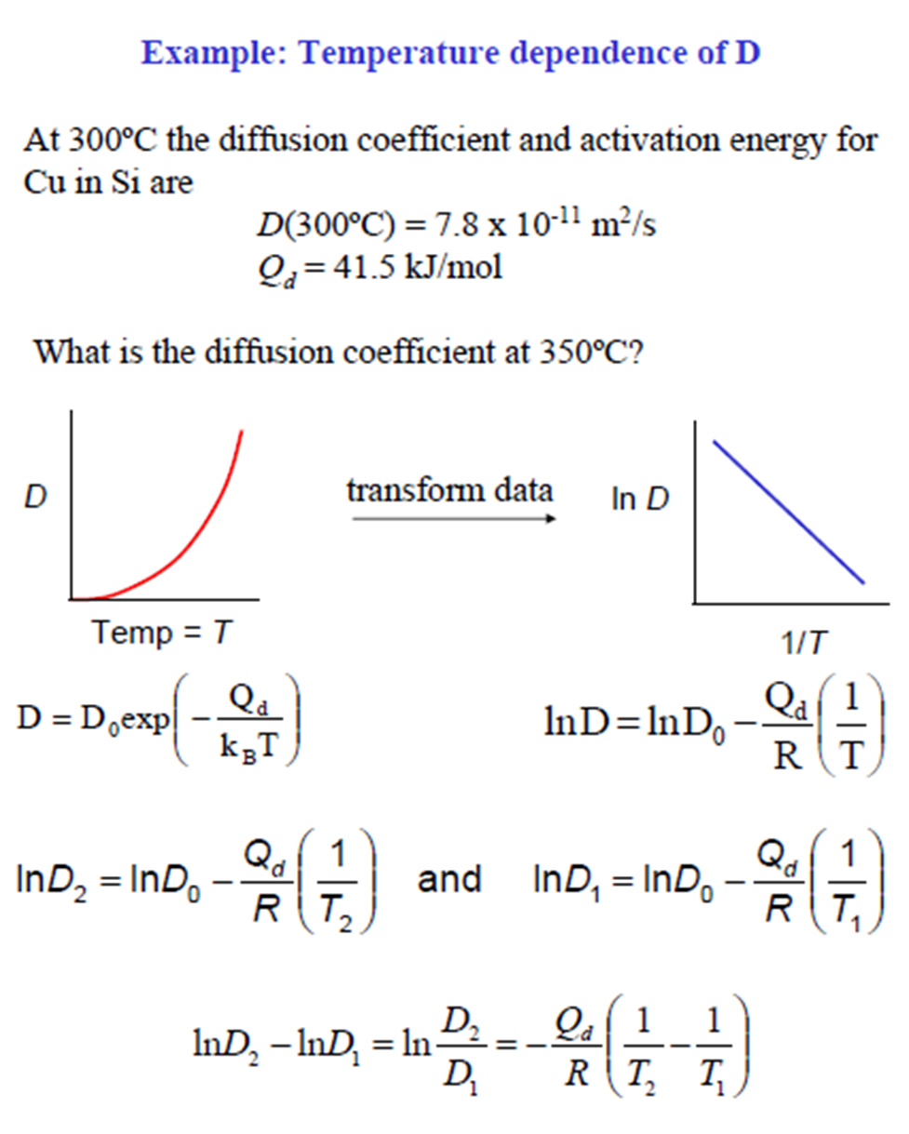

Slide 18
