Slide 1
Growth and development
Dr. Ali Kadhim Alqurishi
Department of Pediatrics
Al-Kindy college of medicine

Slide 2
Definition
Growth: refers to an increase in the size of the body as a whole or the increase in its separate parts
Development: refers to how a child become able to do more complex things as the get older

Slide 3
Factors affecting growth and development
Genetic causes
Chronic disease : any illness in pediatric age group during prenatal, natal and post natal period (infection ,structural abnormality, immunological disease )
nutritional: especially during the first year of life when there is rapid growth and development
Others: includes social and emotional factors

Slide 4
Assessment of growth
Growth assessment is an essential component of pediatric health surveillance. Growth failure may be the first sign of an underlying problem. The most powerful tool in growth assessment is the growth chart used in combination with accurate measurements of height, weight, and head circumference
Infants and early children: the most useful physical measurements are head circumference , length and weight
Older children : measurement of stature and weight
Adolescence :includes in addition to the height and weight , assessments of sexual maturity rate ,height velocity ,body fat content ,skin fold thickness, mid arm and mid leg circumference .

Slide 5
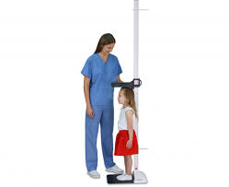
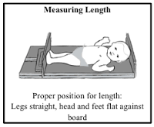
Parameters of growth
Length or height: the child in supine
position using measuring board.
For older children using a stadiometer
At birth the length is always in range of 45 -55 cm. Average 50 cm
increment in the length during first year is about 25cm. during the second year the increment is about 12 cm. in toddlers and school age is about 6 cm per year
at first year the length is 75 cm, at second year 87 cm
Its doubled by the age of 4 years (100 cm) and triple by age of 13 years (150 cm)

Slide 6
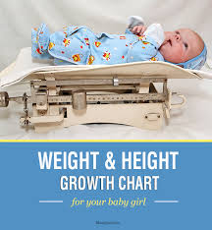
Parameters of growth
Weight
Birth weight ranges from 2.5- 4. kg. Average 3.5 kg. Any weight below 2.5 kg termed low birth weight. Any weight above 4. kg termed large birth weight.
A newborn's weight may decrease 10% below birth weight in the 1st wk as a result of excretion of excess extravascular fluid and limited intake.
Nutrition improves as colostrum is replaced by higher-fat breast milk, as infants learn to lactation and suck more efficiently, and as mothers become more comfortable with feeding techniques. Infants regain birth weight by 2 wk of age
gain is approximately(30g/day)during first tow month of life and (20g / day) during 3- 4 month of life.
Weight is doubled between 5- 6 month of life, tripled by the end of first year and quadrupled by the end of second year ,At the age of 7 years the average child weight is 7 times of his or her birth weight.

Slide 7
The formulas for approximate average Height and Weight of normal infants and children
Weight :
From 3- 12 mo the formula (age in month +9) divided by 2
From 1- 6 yr the formula (age in year x 2 +8)
From 7- 12 yr the formula (age in year x 7 – 5) divided by 2
Height :
At birth is 50 cm. at 1 year is 75 cm
Between 2- 12 yr the formula (age in year x 6 + 77)

Slide 8
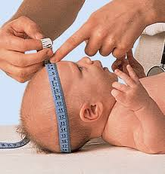
Parameters of growth
Head circumference :mean occipito-frontal circumference
Head circumference is determined using a flexible tape measure run from the supraorbital ridge to the occiput (three measurement and depending on the largest one)
normal full term neonate is usually ranges from 33-37 Cm, average 35 Cm. The maximum increases in head circumference occur at first year which mean also growth of brain.
Its approximately increase about 2 cm / month for the first three month
then it increase about 1 cm / month for second three month .
Then it increase about 0.5 cm / month for last six month
At age of 2 year average H.C. is 49 cm
At age of 5 year average H.C. is 51 cm
At birth if head circumference below 33 cm called microcephaly and above 37 cm called macrocephaly

Slide 9
Growth charts
There are five standard charts :
weight for age
Height (length and stature) for age.
Head circumference for age.
Weight for height.
The body mass index for children over 2 yr of age can be calculated as weight in kilograms/(height in meters)2
Separate charts are provided for boys and girls
Charts with lines for the 3rd or 5th and 95th or 97th percentiles are available.
Each chart is composed of 7 or 8 percentile curves
The percentile: is the percentage of individuals in the group who have achieved a certain measured quantity
The median or 50th percentile is also termed the standard value
the 9 mo age line intersects the 25th percentile curve at 8.6 kg, indicating that 25% of the 9 mo old boys in the National Center for Health Statistics sample weigh less than 8.6 kg (75% weigh more).

Slide 10
failure to thrive
FTT usually refers to growth below the 3rd or 5th percentile or a change in growth that has crossed two major growth percentiles (from above the 75th percentile to below the 25th) in a short time
is considered if a child's weight is below the 5th percentile
or if weight for height is less than the 5th percentile. Weight for height below the 5th percentile remains the single best growth chart indicator of acute undernutrition
BMI less than the 5th percentile also indicates that a child is underweight
Children who have been chronically malnourished may be short as well as thin, so that their weight-for-height curves may appear relatively normal.
Chronic and severe undernutrition in infancy may depress head growth

Slide 11
Developmental Assessment
The developmental skills can be divided
into four main categories:
gross motor ( postural and movement) are those involve the large muscles of the body to perform everyday functions, such as standing and walking, running and jumping.
Vision and fine motor (are involved smaller movements that occur in the wrists, hands, fingers, and the feet and toes.)
Hearing and speech.
Social behavior.

Slide 12
posture and movement (gross motor)
The term new born :in supine position lies with his elbow is flexed; knee and hips are partly flexed
in prone position lies on his abdomen, the pelvis is high and knee up under his abdomen
1 month of age :in prone position can raise the head briefly to the plain of body.
2 months :in prone position can sustain the head in that plain
3 months the infant can raise the head above the plane in prone position They will also start to kick and bend their legs while lying there
3-4 months when the infant is pulled from supine to sitting position, the head is held steady (no head lag)

Slide 13
Head lag

Slide 14
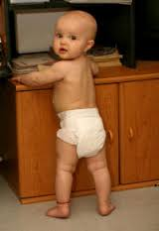
posture and movement (gross motor)
4 months infant can rolling from belly to back .
5months rolls both ways
6 months infant can sitting with support
7-8months they can sitting position
unsupported with back straight.
9 months start crawling
10 months Pulls self-up to stand and then Take steps holding on to furniture (cruising)
11 months infant can standing alone
12 months May take some steps without support (can walk alone 12-15 month)

Slide 15
posture and movement (gross motor)
15 months the infant can walk alone and crawl up stairs .
18 months they can run and climb up stairs with one hand is held stair quarry.
20 months they can go down stairs with one hand is held stair quarry .
24 months they can walks up and down stairs and Can jump with both feet and Can kick a ball
3rd years can goes up stairs alternating feet, Can balance on one foot for a few seconds and rides tricycle.
4-5 years Alternating foot is used to descent stairs , Throw ball over head and can skip .

Slide 16
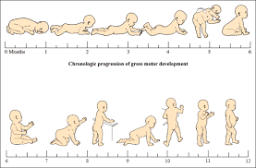

Slide 17
Vision and fine manipulation
In the first few days of life infant watch his, her mother, can fixate on objects placed close to or move through their line of vision 20-30 cm from child face.
1 month the infant can watches persons and follows moving object.
2 month the infant follows moving object 180 degree.
3 month can follow an object over 180 and following it up ward and down ward.
Above 7 month can follow objects in all directions.
2 year vision is tested by showing small toys hold at 3 meter away from him and ask him to match them or if he can name them.

Slide 18
Vision and fine manipulation
Reflexive grasp (at birth)
Bring hand to mouth at 3 months
Holding objects in the palm of 2 hands (by 3 months) or palm of one hand (by 5 months)
4 month infant can make contact with objects .grasping them and bring them to the midline and to the mouth.
5 months Plays with feet and brings feet to mouth when on back
6 month most infant can grasp a large object by one hand and transfer it from hand to hand.
7-8 month can approaches the objects with ulnar border of the hand and taken it (palmer grasp).
9 month infant approaches the objects with radial border and taken it in a scissor grasp between side of thumb and index finger.
10 month they can club hands and wave bye-bye.

Slide 19
Vision and fine motor developmental (fine manipulation)
12 month he approaches the object with index finger and taken it between the end of the thumb and index finger this called (pincer grasp).
12 month turns pages of book.
15 month draw scribbling ( 2year)draw straight line (3 year) draw circle (4year) draw cross line (4.5 year) square (5 year) triangle.
15 month build tower of 2 cubes and at 18 months build tower of 4 cubes and at 24 month build tower of 6-8 cubes and 3year build tower of 10 cubes.

Slide 20
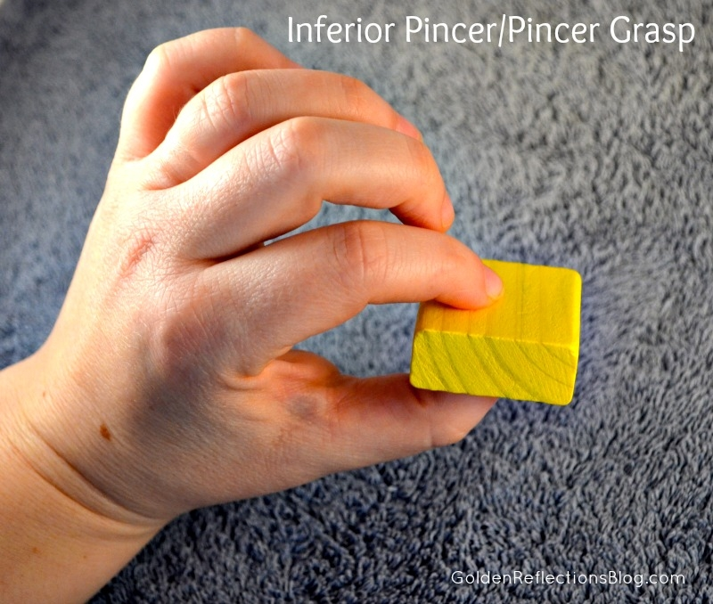

Slide 21
Hearing and speech
First 3 months When hear a sound may quite, blink, or startle or cry.
7 month the infant turn to sound 45 cm lateral to ear,
9 month the infant turn to sound 90 cm lateral,
12 month the infant turn to sound 90 cm vertically above his head.
15 months the child follows simple commands and respond to his name.
2 months may coos .
6 month infant start babbling sounds.

Slide 22
Hearing and speech
7 month the infant can make repetitive vowel sounds.
9-10 month the infant can make sounds like word .
12month the infant can make few words .

Slide 23
Hearing and speech
18 month the child can speak 10 words.
2 years he can puts 3 wards together (subject, verb, and object)
2 years he can identify at least 4 parts of his body.
3years the child knows his age and name and his sex and he can repeat 3 numbers.
4 years he counts 4 coins and he tells a story.
5 years he names 4 colors, count 10 digits .

Slide 24
Social behavior
.
2 month become smile.
4 month infants start laugh.
6 month infant starts to imitate, for example if you tap on the table he will do the same
7 months Distinguish between familiar family and friends and strangers
8 month infants Show frustration when a toy is taken away.
9 months develop anxiety on separation from regular caretaker
10 months Hold a cup and drink with help
11-12 months Feed themselves small bites of food

Slide 25
Social behavior
2 years he handles the spoon well and Holds and drinks from cup independently.
2 years he is able to tell his mother when he is urinate or go to potty and listens to stories with pictures .
3 year washing hands and dry during day and night and Eating without assistance ,Become aware that they are a boy or girl
4 year plays with other children. Share toys with other kids and He goes to toilet alone.
5year he dresses and undresses. Coordinating hands to brush teeth or hair.

Slide 26
MATURITY
Child maturity can be assessed by :
Skeletal maturity: (assessed by bone age is the degree of maturation of child bone ,girls usually continue to grow until bone age about 14 years and boys at age about 16 years )
Dental maturity : The first tooth appears at 5-9 month ,first year total number of teeth is 6-8 the child completes the deciduous teeth which are 20 in number at (tow and half years ,the first permanent tooth appear at age of 6 years
Sexual maturity: starts from the age at which secondary sexual characteristics appears

