Slide 1
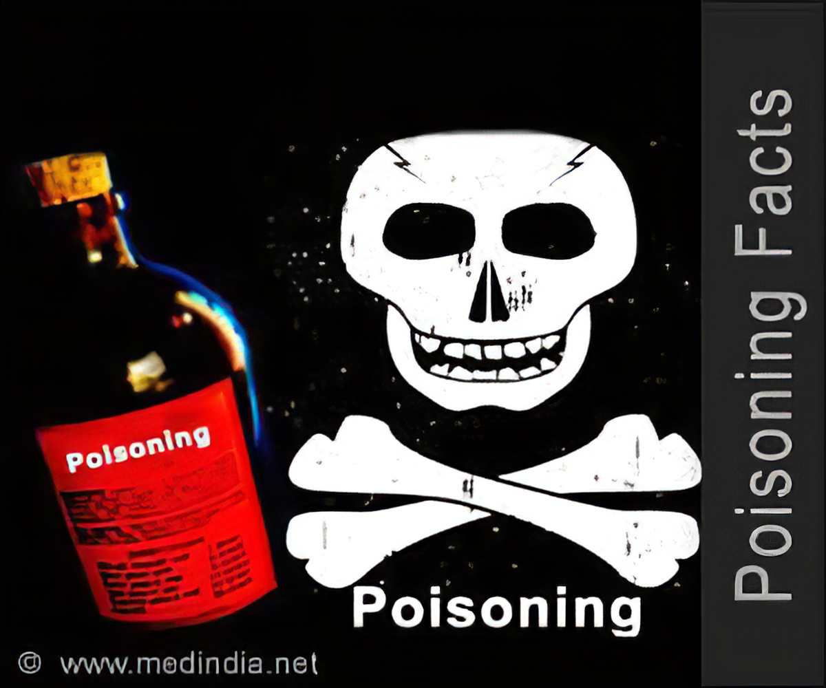
Dr. Ali Kadhim Alqurishi
Department of Pediatrics
Al-Kindy college of medicine

Slide 2
Definition of poisoning
Exposure to a chemical or other agent that adversely affects function of organism
Acute Poisoning in children is still an important public health problem and represents a frequent cause of admission in emergency units.
>50% occur in children 5 yr of age or younger

Slide 3
Routes of exposure
Ingestion
Injection
Inhalation
Cutaneous exposure
Ingestion is the most common route of poisoning exposure
Approximately 50% of cases involve nondrug substances, such as common household products (cosmetics, personal care items, cleaning solutions, plants, foreign bodies, hydrocarbons).

Slide 4
Approach to the poisoned patient
History
detailed history and physical examination serves as the foundation for a thoughtful differential diagnosis and the formation of an initial prognosis
Product names (brand, generic, chemical) and ingredients
determine as accurately as possible how much of the substance has been ingested
Time of Exposure toxic manifestations may be delayed for hr or days and Progression of Symptoms

Slide 5
Physical Findings
Odor
Ocular signs
Cutaneous signs
Oral signs
Intestinal signs
Cardiac signs
Respiratory signs
CNS signs

Slide 6
Toxicology laboratory analyses
Serum and urine toxicology
Metabolic acidosis
Hypoglycemia
Hyperglycemia
Hypocalcemia

Slide 7
Initial medical care
Antidotes for Poisoning
Preventing absorption : Several procedures are used to prevent absorption of an ingested toxin from the stomach and gastrointestinal tract
Most liquid drug products are almost completely absorbed within 30–45 min of ingestion, and most solid dosage forms are absorbed within 1–2 hr. When a large overdose involves solid dose forms (tablets, powder-filled capsules), complete intestinal absorption can be delayed by as much as 3–6 hr, and anticholinergic drugs absorption can be delayed up to 8–12 hr

Slide 8
Activated Charcoal
decrease or prevent the intestinal absorption of a few drugs and toxins
Some toxins, including heavy metals, iron, lithium, hydrocarbons, cyanide, and low molecular weight alcohols are not significantly bound to charcoal
Usually, a dose of 10–50 g (≈1 g/kg) for a child and 50–100 g for an adolescent

Slide 9
Whole Bowel Irrigation
Whole bowel irrigation involves instilling large volumes (30 mL/kg/hr) of a nonabsorbed polyethylene glycol electrolyte solution into the stomach. This technique has been successfully used to remove slowly absorbed products, such as iron

Slide 10
Emesis
The emetic use is syrup of ipecac ,The onset of emesis is usually 20–30 min after dosing ,The dose is 10 mL for infants 6–12 mo of age, 20 mL for children 1–6 yr of age, and 30 mL for older children
Ipecac should not be used in infants younger than 6 mo of age because risk of aspiration. Ipecac should be followed by at least 6–8 oz of water

Slide 11
Gastric Lavage
This technique involves placing a tube into the stomach to aspirate contents, followed by flushing with normal saline

Slide 12
III. Increase secretion of toxin
Diuresis
Dialysis: Hemodialysis and peritoneal dialysis have been used successfully to treat poisonings by select agents Examples of toxins for which dialysis may be useful include the toxic alcohols, methanol and ethylene glycol as well as large symptomatic ingestions of salicylates, theophylline or lithium.
Hemoperfusion

Slide 13
Acetaminophen
Acetaminophen is the most widely used analgesic and antipyretic in pediatrics
Acetaminophen intoxication is a common cause of acute liver failure in adolescents and adults.
The acute toxic dose of acetaminophen is generally considered to be >200 mg/kg in children younger than 12 yr of age

Slide 14
Clinical Manifestations
patients with an acute overdose may pass through the 4 stages of acetaminophen toxicity
Clinical manifestation | TIME AFTER INGESTION | STAGE
Anorexia, nausea, vomiting, malaise, pallor, | 0.5–24 hr | I
Resolution of earlier symptoms; right upper quadrant abdominal pain and tenderness; elevated bilirubin, prothrombin time, hepatic enzymes; oliguria | 24–48 hr | II
Peak liver function abnormalities; anorexia, vomiting, and malaise | 72–96 hr | III
liver failure | 4 days–2 wk | IV

Slide 15
Laboratory finding and treatment
A minimum of 2 plasma acetaminophen concentrations should be obtained from patients; the 1st at least 4 hr after the ingesed and a 2nd sample 4–6 hr after the 1st.
oral NAC(N-acetylcysteine ) dose (140 mg NAC/kg oral loading dose) + (70 mg oral NAC/kg every 4 hr) for a total of 17 doses
Oral NAC is unpalatable and can be irritating to the gastrointestinal tract, so it should be diluted to a 5% solution with soda or fruit juice to minimize vomiting Antiemetics may be used to control vomiting
IV preparation of NAC is also available (Acetadote) initial IV loading dose of 150 mg/kg is infused over 15–60 min

Slide 16
Salicylate poisoning
It is analgesic and antipyretic with anti inflammatory agent
Normal dose less than 12 years 60 -80 mg kg day OR (10-15 mg/kg every 4-6 hr)
The acute toxic dose of salicylates is generally considered >150 mg/kg for mild symptoms and >300–500 mg/kg for moderate to severe intoxication

Slide 17
Clinical Feature
nausea and vomiting
respiratory alkalosis
Dehydration and progressive metabolic acidosis
Important signs of serious toxicity are CNS changes. Agitation, restlessness, and confusion are common in children. Coma may develop as a result of cerebral edema
hemorrhage may develop in more severe cases. Hyperglycemia (acute) or hypoglycemia (chronic)
Hepatotoxicity
Both potassium and sodium bicarbonate are excreted in the urine

Slide 18
Diagnosis
History
Serial serum salicylate concentrations (initially at 4 hr postingestion and then every 3–4 hr) patients with serum salicylate concentrations of >20 mg/dL should undergo continued observation and monitoring. Acute serum concentrations of >70–100 mg/dL may produce life-threatening effects.

Slide 19
Treatment
Activated charcoal
Bowel irrigation
Gastric lavage
I.V fluid
Sodium bicarbonate
hemodialysis
No specific antidote

Slide 20
Indication of hemodialysis
serum salicylate concentrations of >90 mg/dL
Neurotoxicity
metabolic acidosis, severe hypokalemia, and renal failure
Cardiopulmonary instability

Slide 21
Lead poisoning
Lead is a highly toxic metal and a very strong poison. Lead poisoning is a serious and sometimes fatal condition
Lead is found in lead-based paints, including paint on the walls of old houses and toys.
Symptoms:
Abdominal pain
Constipation
Anemia and loss of appetite
Irritability and aggressive behavior
Renal failure
high toxic dose of lead poisoning cause seizures ,coma and encephalopathy

Slide 22
Diagnosis
History
Blood lead level
CBC
erythrocyte protoporphyrin in blood samples increase when the amount of lead in the blood is high
X-Ray

Slide 23
Treatment
Chelation therapy
Treatment of anemia ( iron deficiency anemia)
Lead containing material removal by surgical
Lead encephalopathy treatment by anti convulsion ,steroid and mannitol

Slide 24
Kerosin poisoning
Group of substance that contain hydrogen and carbon
Mechanism of poisoning :
Swallowing
Inhalation
Direct skin absorption

Slide 25
symptom
Aspiration is characterized by coughing, which usually is the first clinical finding. Cough usually begins immediately or within 2–5 min of the aspiration
Dyspnea
Chest and abdominal pain
gastrointestinal mucosal irritation
Bloody stools
Vomiting
Hypotension
Convulsion
Skin burn or irritation

Slide 26
Management
Diagnosis:
Chest X-Ray after 6 hr or longer from the time of exposure
Blood gas analysis
Treatment:
Emesis is contraindicated because of the risk of aspiration
gastric lavage is contraindicated, except under special circumstances of ingestion of very large amount . If gastric lavage is to be performed, the patient should be intubated to protect the airway from further aspiration
Oxygen
I.V fluid
Observation
Corticosteroids should be avoided because they are not effective and may increase the risk of infection
Prophylactic antibiotics should not be given

Slide 27
Iron poisoning
Iron is one of the most common causes of childhood poisoning death. Iron-containing products are common in many homes, and iron-containing vitamins
Greater than 60 mg/kg of elemental iron is generally considered a toxic dose

Slide 28
Clinical feature
Phase 1:within 30 min to 6 hr after ingestion
GIT effect (vomiting , diarrhea and abdominal pain)
Phase 2 : 6-12 hours post ingestion
Improvement in symptoms
Phase 3: within 12-24 hours
Hypovolemic shock ,fit ,acidosis and cardiac syptome
Phase 4: (2-3 weeks post ingestion)
Liver injury and failure
Phase 5: (2-6 weeks post ingestion)
Pyloric obstruction and liver cirrhosis

Slide 29
Treatment
Serum iron concentrations should be measured and evaluated in the context of symptoms and should be obtained approximately 4 hr after ingestion. Serum iron concentrations of <500 mg/dL, measured 4–8 hr after ingestion, indicate a low risk of significant toxicity. Serum concentrations of >500 mg/dL indicate that significant toxicity
Desferal (Desferrioxamine) as iron –chelating agent
I.V fluid
Ipecac-induced emesis may be used to remove tablets from the stomach and whole bowel irrigation may be of benefit.

Slide 30
organophosphorous
Symptom
Muscarinic signs and symptoms include diaphoresis, emesis, urinary and fecal incontinence, tearing, drooling, bronchorrhea and bronchospasm, miosis, hypotension, and bradycardia.
Nicotinic signs and symptoms include muscle weakness, fasciculations, tremors, hypoventilation
CNS effects include malaise, confusion, delirium, seizures, and coma

Slide 31
Management
Diagnosis : blood cholinesterase level
Treatment:
washing all exposed skin with soap and water and immediate removal of all exposed clothing
Atropin sulphate I.V at dose 0.02 mg /kg every 20 minute till pupil are normal size
Oxygen
Gastric lavage

Slide 32
CAUSTICS
Caustics : include acids and alkalis agents
Causing tissue necrosis with the risk of perforation.
The severity depends on :
the pH of the agent, the concentration of the agent, and the length of contact time. Agents with a pH of <2 or >12 are most likely to produce significant injury.

Slide 33
Clinical Manifestations
Ingestion of caustic materials may produce
oral burns (Symptoms include pain, drooling, vomiting, and difficulty swallowing or refusal to swallow)
burns of the esophagus are likely to cause strictures on healing, which may require repeated dilation or surgical correction
Strong acids may sometimes produce scarring around the pylorus leading to delayed onset of gastric obstruction
Caustics on the skin can cause significant tissue damage

Slide 34
Treatment
1-removal of the product from the skin or eye by flushing with water
2-Contaminated clothing should also be removed.
Emesis and lavage are contraindicated.
Activated charcoal should not be used because it does not bind these agents and may predispose the patient to vomiting and possible aspiration.
3-Patients should be evaluated for evidence of esophageal burns and if symptoms are present nothing by mouth and Endoscopy should be performed

