Slide 1
green algae( Division: chlorophyta )
Class: chlorophyceae
order: chlorococcales :
Genus: Scendusmus
2. order: volvocales
Genus: Chlamydomonas, Volvox
3. order: zygnematales
Family: desmideaceae
Genus: Closterium Genus: Cosmarium

Slide 2
General characteristics
The simplest algae occurring essentially as solitary cells or be aggregated into plate –like or globular colonies. or occurring as filamentous form. Surrounded by thin mucilage layer
1- Contain chlorophyll type A and B.
2- Contain accessory pigments: xanthophyll, carotenoid (B-carotene)
3- Chloroplast is present and vary in shape, size and number.
4- Chlorophyta store their food as (pyrenoids) in chloroplast.
5- Flagellated stages are present
6- Sexual reproduction is present. in addition to asexual and vegetative reproduction.
7- The structural part of cell wall mainly consists of cellulose.

Slide 3
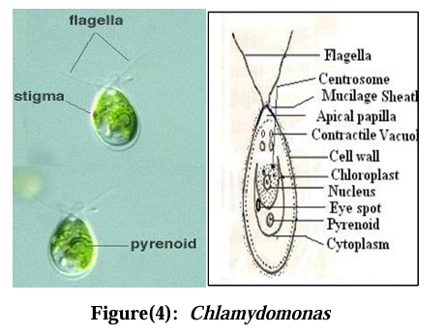
Chlamydomonas
unicellular alga
motile by two anterior flagella
cup shape chloroplast which has a single large pyrenoid.
eye spot (stigma) present in the anterior portion of the chloroplast for photosensitivity

Slide 4
Volvox
spherical colonies with hollow center (hollow ball).
the cells are similar to Chlamydomonas , these cells are embedded within mucoid matrix
colony motile ,this motility derived from the flagellated individual cells.
there are specialized cells within Volvox colony:
a-vegetative cells: (most of colony cells specialized for nutrition ,movement)
b -generative cells:
gonidia :larger but fewer than somatic cells, specialized for asexual reproduction through producing daughter colonies
antheridia: specialized for sexual reproduction through producing male swimmers(male gametes)
Oogonia: larger and fewer in number than antheridia. specialized for sexual reproduction through producing ovum (female gametes).

Slide 5
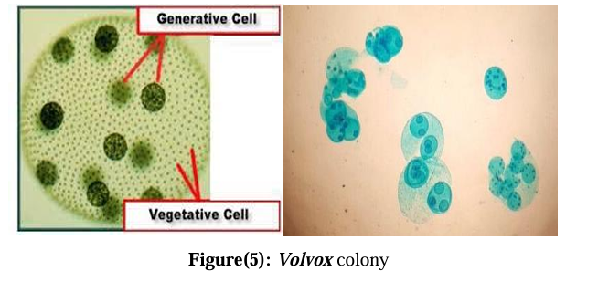

Slide 6
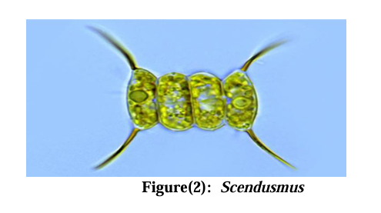
Scendusmus
Plate-like cells (usually 4 or 8) aggregated parallel to one another to form a colonies ,The colonies ends are surrounded by fork-like appendages

Slide 7
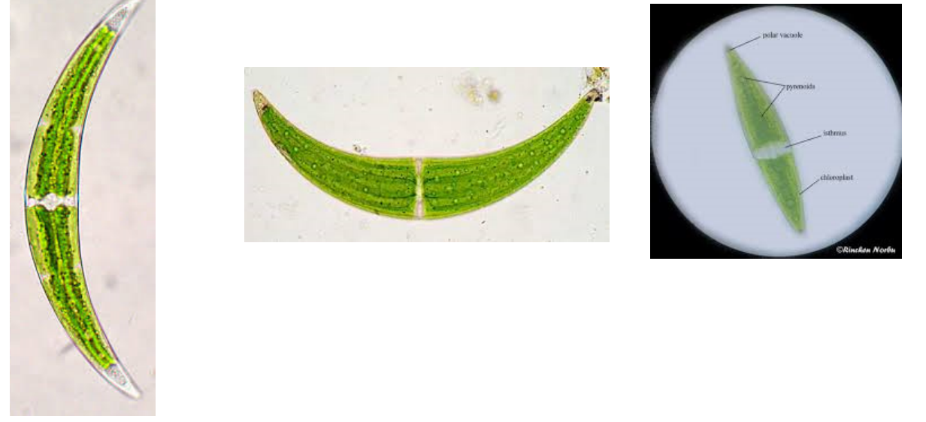
Family: Desmideaceae
Genus: Closterium
1-unicellular desmids consisting of two semi cells joined at an isthmus. with central nucleus and chloroplast in each semi cell.
2-reproduce by simple division and sexually by conjugation Closterium is characterized with crescent shape.

Slide 8
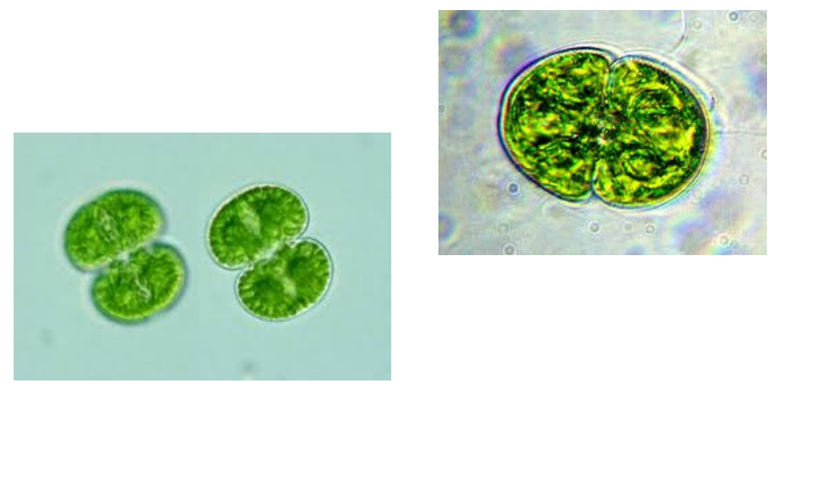
Cosmarium
It has a central nucleus and two chloroplasts in each semi cell, each with a central pyrenoid

