Slide 1
Division Phaeophyta -Brown algae (sea weeds(
Class 1 :-Heterogenerate
Order:-Laminariales
Genus:-Laminaria
Class 2 :-Cyclosporae
Order:-Fucales
Family:-Fucaceae
Genus:-Fucu
conceptacl(male)
Conceptacl(female)

Slide 2
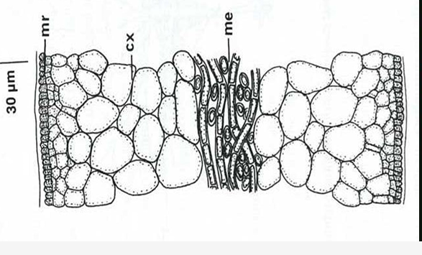
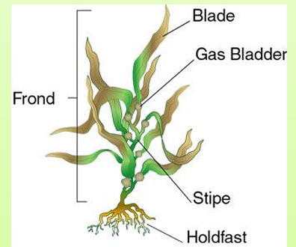
General characteristics
Mostly marine.
Food reserves: laminarin, mannitol.
Photosynthetic pigments: chlorophyll a and c, beta carotene, Dinoxanthin ,violaxanthin, and Fucoxanthin.
Brown Algal Tissue Differentiation: Epidermis, Cortex and Medulla
Some members of phaeophyta have
Containing bladders or airbags
Morphology:
A]Holdfast :which attachment the alga
to the substrate
B] Stipe which is stem-like
C] Laminae (blades) which are leaf-like

Slide 3
individuals with a macroscopic sporophyte generation diploid and a microscopic gametophyte generation haploid. The haploid phase begins when the mature organism releases many spores, which then germinate to become male or female gametophytes.
The sporophytes are large with a holdfast, stipe, and one or more blade or blades.
The stipe is usually cylindrical. It is either simple or branched.
Gametophytes are filamentous. The Antheridia of the male gametophyte produce antherozoid. The Oogonia of the female gametophyte produces a single egg.

Slide 4
Laminaria
Exhibits a life cycle called alternation of generations
It has three distinct multicellular organs: a holdfast, that attaches the organism to a substrate, a broad flat blade that carries out the bulk of photosynthesis, and a stipe (stalk) that connects the blade to the holdfast .
The internal structure of the blade is characterized by the following layers:
Upper Epidermis: The cells are cuboidal, contain plastids, and are covered externally by a gelatinous layer. This layer is also characterized by the presence of sporangium and paraphysis for protection between the gametangia.
Cortex: It contains intercellular spaces filled with gelatinous material. The air bladder can also be observed, which helps the algae float in water.
Medulla: Its function is transport, containing elongated cells with expanded ends, resembling trumpet hyphae that function similarly to sieve plates.
Lower Epidermis

Slide 5
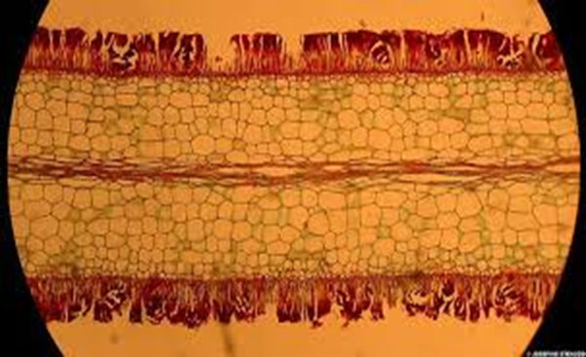
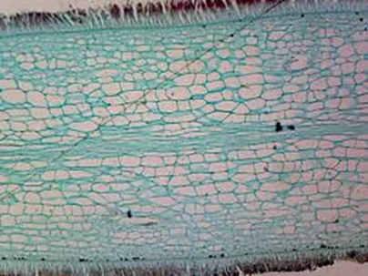
C.S in Laminaria blade
بشرة سفلى
البشرة
الحوافظ
الهايفات البوقية
القشرة

Slide 7
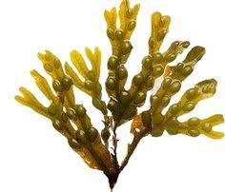
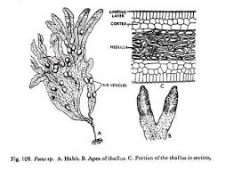
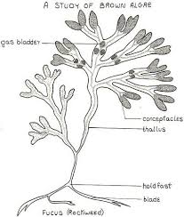
Fucus
A.The common name is rock weed.
b- The thallus of these algae is leathery dichotomously branched, supported by a short narrow stalk that is attached to a disk-shaped holdfasts. The blade is mucilage- covered resist desiccation and temperature changes. And contains air bladders (to keep the thallus floating in vertical position when submerged.

Slide 8
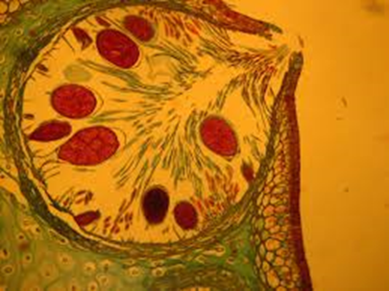
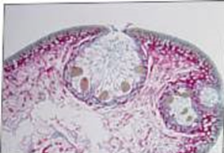
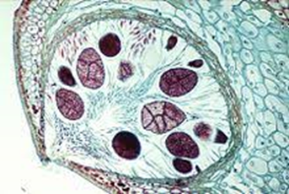
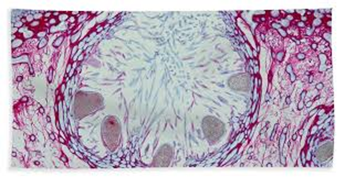
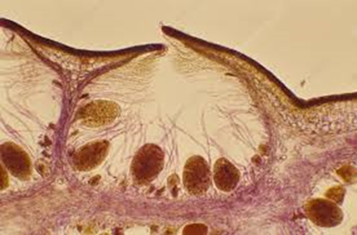
Conceptacl(female) Oogonia
Conceptacl(female

Slide 9
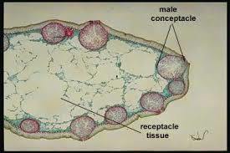
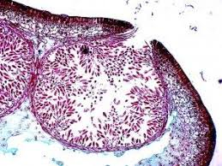
conceptacl(male) Antheridia

