Slide 1
Division:-Chrysophyta (golden algae
2- Class: bacillariophyceae (Diatomes)
1- Order: Pennales
Genus : Navicula
2- Order: centrales
Genus : cyclotella

Slide 2
General Characteristics of Bacillariophyta
Very important for aquatic food chains: they provide phytoplankton
Most of their species are unicellular ,filamentous colonies or aggregates.
The cell wall of the diatom is called the frustule.
The frustule consists of two halves; the upper half is called Hybotheca, while the lower half is referred to as
Epitheca.
The cell wall is primarily composed of silica.
The food as oil and chrysolaminarin

Slide 3
The Cells are surrounded by rigid 2 part box or petri dish pieces like cell wall, composed of Silica and is known as “Frustule”.
- Thus two-part frustules surround the protoplasm. It consist of two halves the smaller or the lower one is known as hypotheca and the larger or the upper one is known as Epitheca.
The two halves are connected by connecting band called girdle
Each diatom cell has two appearances:
1- gridle view
2-valve view

Slide 4
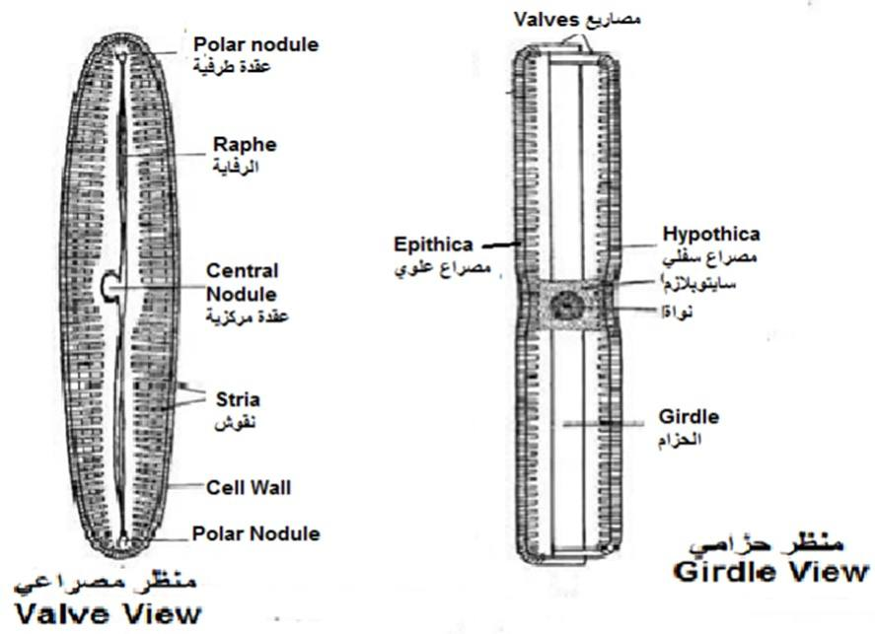

Slide 5
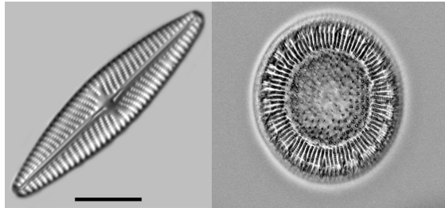
Order: Centrales | Order: Pennales
Radial Summetry 1- | Summetry 1- Bilateral
2- Discoid chloroplast | 2- Elongated chloroplast
3- Rapfe is absent | 3- Raphe is present
Gliding motion-4 | 4- No Gliding motion
5- ex Cyclotella | 5- ex Navcula

Slide 6
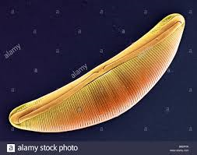
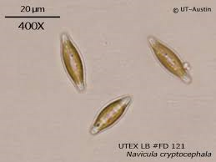
Navicula

Slide 7
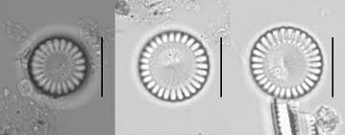
cyclotella

