Slide 1
phylum Pyrrophyta (dinoflagellates)
Class: Peridinea Order: Peridiniida Family: Peridiniidae Genus: Peridinum , Ceratium

Slide 2
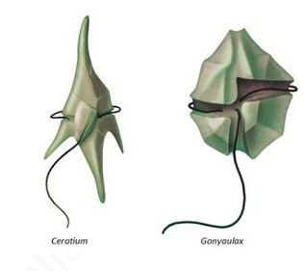
General characteristics
They commonly have a cell covering structure named (theca) composed of cellulose or polysaccharide. The theca is laced with spine.
unicellular algae that has a yellow brown color
has two different flagella which are ribbon-shaped. A longer flagellum lies in a groove called the sulcus, and a shorter flagellum lies perpendicular to the first in a groove called the girdle. The positioning of the flagella causest he cell to swim in a rotating motion.
pigments (chlorophyll-a, chlorophyll-b, c1, c2 and fucoxanthin) that can photosynthesize.
food is starch and oil.

Slide 3
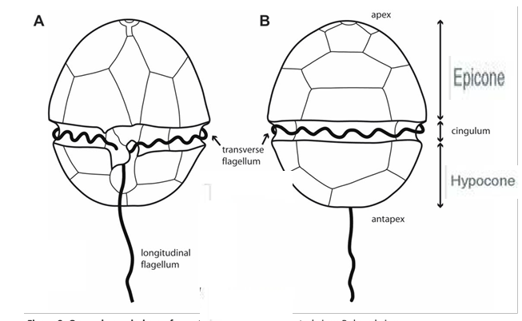
-algal bodies are composed of upper part (Epicon) and lower part (Hypocon) separated by transverse groove or annulus. In addition, having a longitudinal groove called (sulcus) containing pair of flagella (long and short).

Slide 4
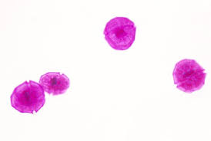
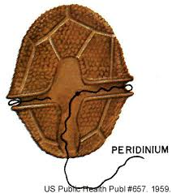
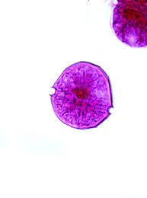
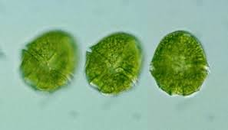
Peridinium

Slide 5
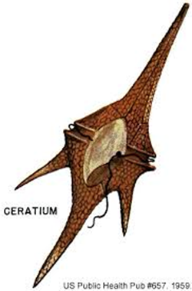
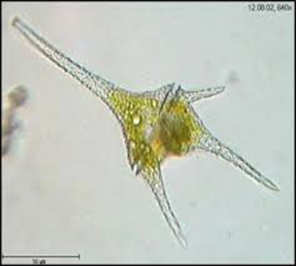
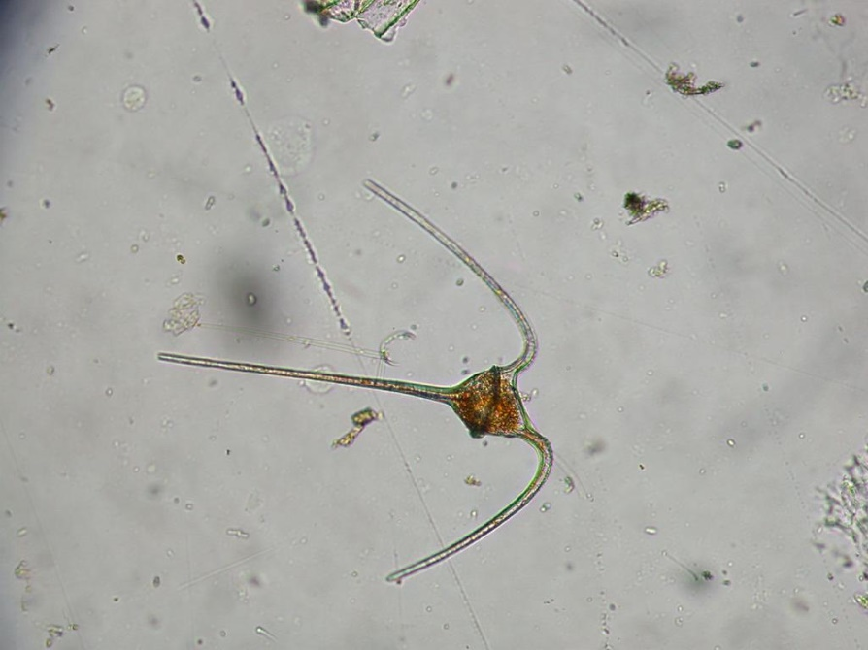
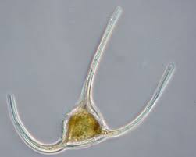
Ceratium
This alga is similar to the former one except that the epicon contains a fork like structures called ( dorsal horn) and the hypocon contains double fork called (ventral horn).

Slide 6
Division: chrysophyta (Yellow-green)
1- Class: xanthophyceae
Family : Vaucheriaceae.
Genus: Vaucheria

Slide 7
General characteristics of chrysophyta:
Yellow-green algae
Pigments: Chlorophyll a, e, β carotene and xanthophylls
Eukaryotic unicellular to simple filamentous
the main Food Type Stock leucosin and oil droplets.
-Reproduction: Vegetative, Asexual and Sexual (Mainly Isogamous, Anisogamy is rare, Oogamous in Vaucheria)

Slide 8
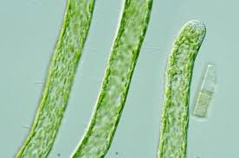
vaucheria
fialmens cylindrical form, irregular branded
This genus is characterized by lacking cross
walls called (coenocytic) except in association
with reproductive organs.
reproduce sexually by Oogamous reproduction. There are two characterized species in Vaucheria:
a- Vaucheria sessils: in this species reproductive organs are setting directly on algal body.
b- Vaucheria geminata: in this species reproductive organs are stalked on a small holder.

Slide 9
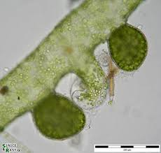
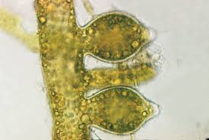
vaucheria Sessiles

Slide 10
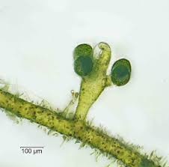
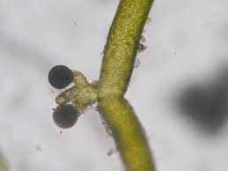
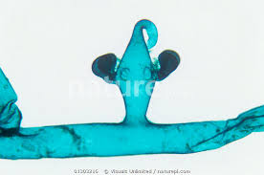
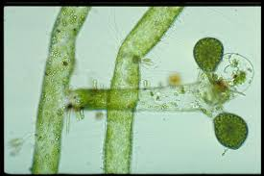
Vaucheria geminata

