Slide 1
طحالب عملي (6)
المرحلة الثانية

Slide 2
Division: Chlorophyta
Class : Charophyceae
Order: Charales
Family: Characeae
Genus: Chara , Nitella

Slide 3
The Thallus is macroscopic, branched and multicellular, The main axis is differentiated into nodes and internodes.
Both sex organs, the male sex organ is called 'globule' and female organ 'nucule', are present at one point on the node of the short lateral branch.
This phylum is characterized by being an intermediate position between green algae and mosses
Their reproductive organs are surrounded by a sterile cover similar to what is found in members of the moss phylum
Similarity to algae in terms of living, type of food stored, and pigments.

Slide 4
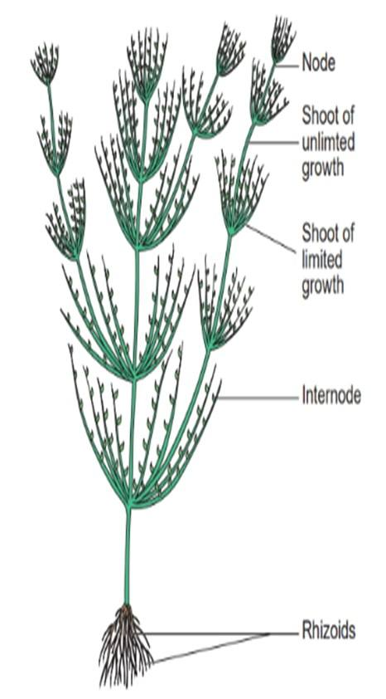
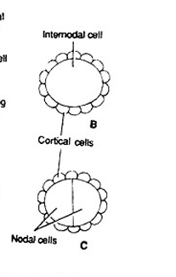
Chara
The plant body is calcified and commonly called "stone worts".
2. It is attached to bottom of pool by rhizoids.
3. The main axis consists of a series of alternating nodes and internodes.
The node consists of a pair of central small cells surrounded by 6-20 peripheral cells.
-There are two types of branching :
1- Primary branches: They are limited
growth branches (they grow for a certain
period)and their growth stops, making
them dense and bearing reproductive organs.

Slide 5
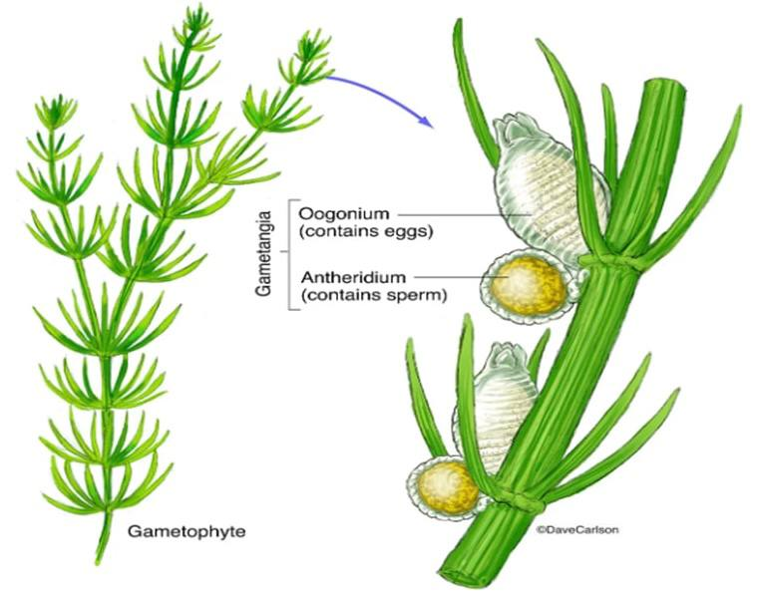
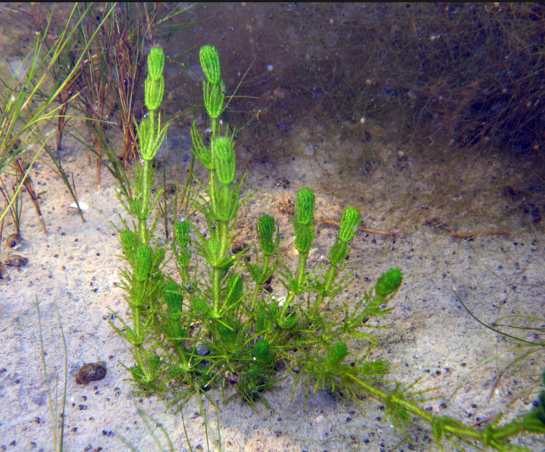
Secondary branches: These are unlimited growth branches (they continue to grow) that originate from the node area and resemble the main axis (containing internodes and nodes).

Slide 6
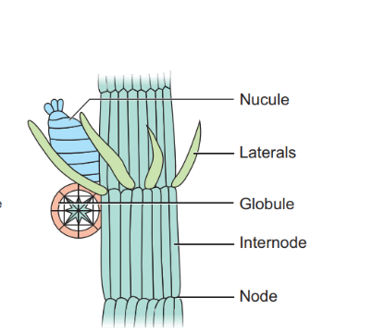
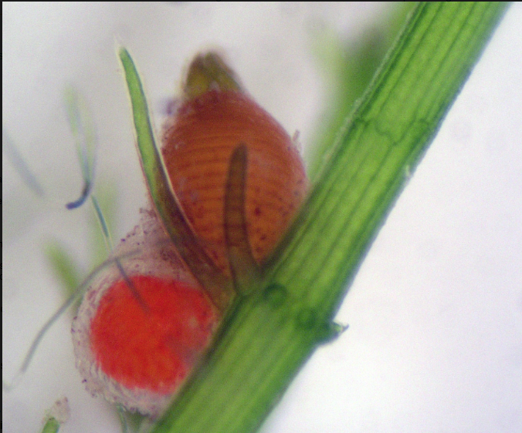
Reproductive Organs
1. Sexual reproduction in Chara is oogamous. The sexual organs are of the Sessiles type.
2. The male sex organ is a large, round bright yellow or red structure; it is globule (antheridium). It is located below the female reproductive organ. Does not contain coronal cells.
3. The female reproductive organ is a large, oval body covered with multicellular envelope, It contains crown cells arranged in two rows: three cells in the front and two cells in the back.
it is known as nucule.

Slide 7
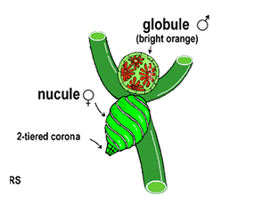
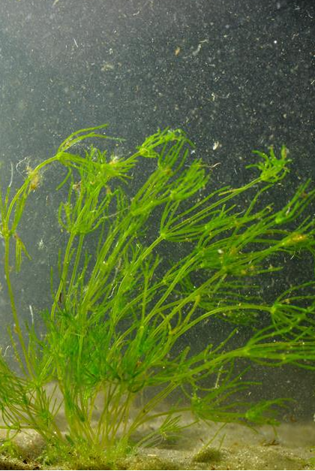
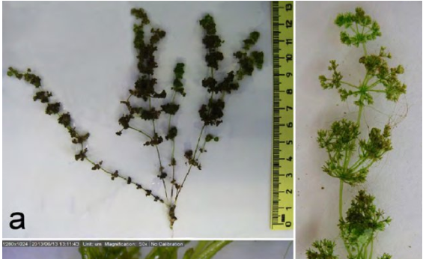
Nitella
Similar to Chara but :
Globule are produced above the nucule.
Oogonium are with a crown of 10 cells in two rows.
It contains both limited and unlimited branches.

