Slide 1
University of Baghdad
College of Science for Women
Department of Chemistry
Instrumental Analysis Chemistry
Undergraduate program
First Semester
Basic Principles of Atomic Absorption Spectroscopy
Lecturer
Asst. Prof. Dr. Maha Al-Tameemi
Texts:
Principle of Instrumental Analysis, by Douglas A. Skoog, F.James Holler, Stanley R. Crouch, Chapter 9, 10, 11, and 12(6th Edition)
Spectrochemical Analysis, by James D. Ingle,Jr and Stanley R. Crouch, Chapter 7, 8, 9, 10, and 11.
Most Analytical Chemistry Textbooks.
Handout

Slide 2
General Introduction
Dr. Maha Al-Tameemi
Atomic Absorption Spectroscopy
Absorbance = -log(I_{t}/I₀)
I_{o} = incident radiation (on sample)
I_{t} = transmitted radiation.
Atomic Spectroscopy
Identification based on
Electromagnetic spectrum | Mass spectrum
Atomic Absorption Flame AAS Graphite Furnace AAS Vapor (Hydride) Generation AAS
Atomic Emission MP-AES ICP-OES X-ray Fluorescence (XRF) | ICP-MS
Atomic Interference X-ray Diffraction (XRD)
Atomic Emission Spectroscopy
Absorbance = -log(I_{t}/I₀)
I₀ =intensity of radiation reaching detector
in the absence of sample.
I_{t} = intensity of radiation reaching detector
when sample is being aspirated.
Both methods are used to determine the concentration of an element in solution.
Both methods use a standard curve.
Difference between UV and IR spectroscopy is that sample must be atomized.
Sample may be atomized by:
(1) A flame
(2) Electrically heated furnace
(3) A Plasma
Microwave plasma atomic emission spectroscopy (MP-AES)
Inductively coupled plasma optical emission spectroscopy (ICP-OES)
Inductively coupled plasma mass spectroscopy

Slide 3
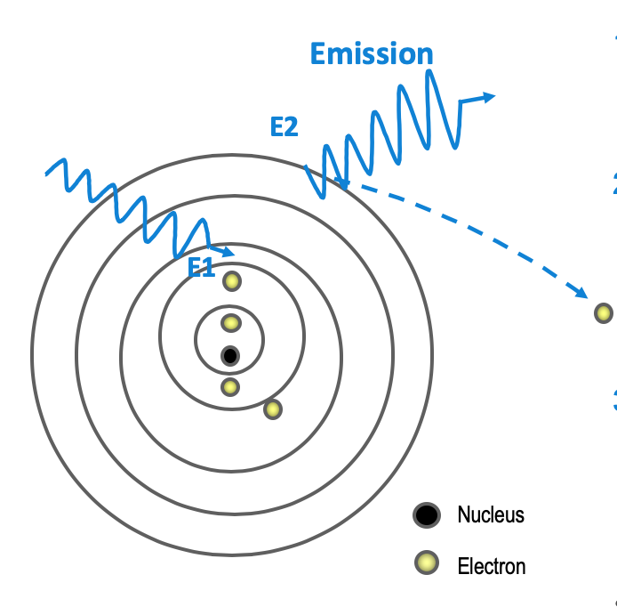
What’s Measured?
Dr. Maha Al-Tameemi
Absorption of energy causes
an electron to move to a higher energy level (E2) → AA
The excited electron will eventually drop back to the ground state and emit light
at a particular wavelength (emission) → MP-AES, ICP-OES
If there is enough energy, the electron will leave the atom completely and leave behind a positively charged ion (ionization) → ICP-MS
Microwave plasma atomic emission spectroscopy (MP-AES)
Inductively coupled plasma optical emission spectroscopy (ICP-OES)
Inductively coupled plasma mass spectroscopy

Slide 4
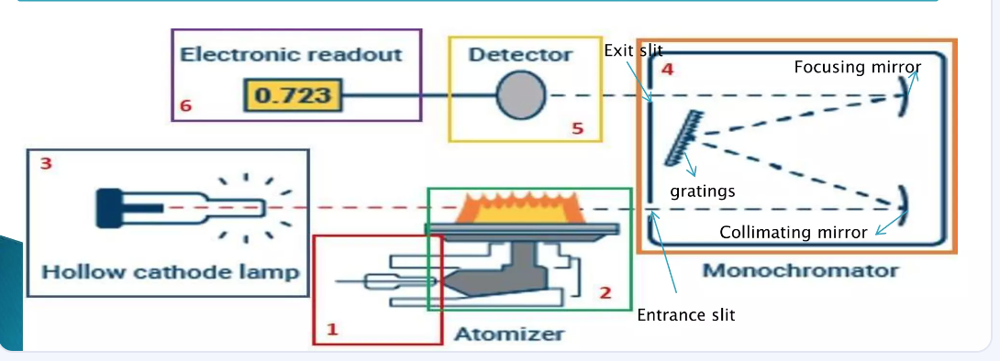
Atomic Absorption Spectroscopy
Dr. Maha Al-Tameemi
Introduction
The Working principle of AAS
Instrumentation
Interferences
Applications

Slide 5
Introduction
Dr. Maha Al-Tameemi
Metal contamination of drugs and their intermediates may be introduced by several ways, such as through raw materials, reagents, solvents and equipment used for the synthesis.
Many of these impurities can also be introduced after the synthesis and could be indicators of non adequate handling and storage or be used as fingerprints for the source of drug raw material.
Many metals, due to their presence and wide distribution in soil and environmental pollution assimilate in herbal drugs.
Traces of cadmium and lead were detected in many of the herbal drugs.
Monitoring of heavy metals in process intermediates and final drug substances is an important activity in pharmaceutical industry.
It is not only because of their ability to catalyze decomposition but also potential for toxicity.
Several trace elements have toxic effects and some of them could decrease the stability of active ingredients even at ultra-trace concentrations.
Lead (Pb), cadmium (Cd), and mercury (Hg) are potential for toxicity and pose the risk of serious health hazards even at very low toxic at lower concentration.
So, the question is what is an appropriate technique can be used to measure these elements???????? Do you know tell me

Slide 6
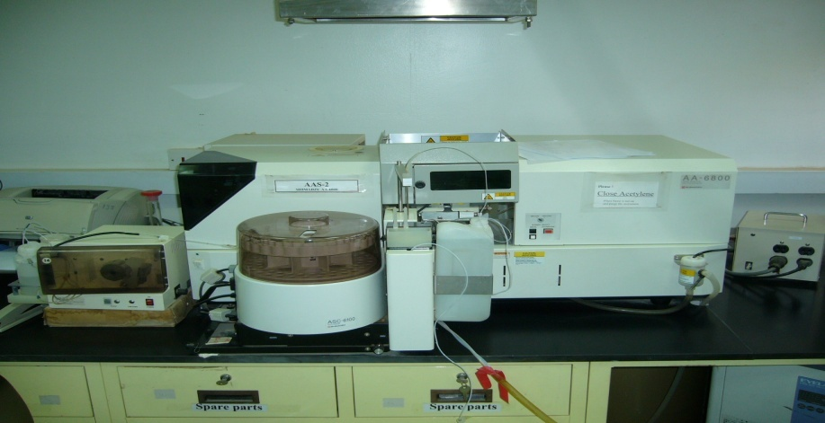
Atomic Absorption Spectroscopy (AAS)
Dr. Maha Al-Tameemi
AAS was employed in Australia in 1950 by Alan Walsh.
Used for qualitative and quantitative detection of metallic and nonmetallic elements in inorganic or organic materials.
It’s used to determine the presence and concentrations of metals in liquid samples.
Metals that can be detected include Fe, Cu, Al, Pb, Ca, Zn, Cd, and many more.
The concentration range is in the low mg/L (ppm) range.
Sample may be atomized by:
(1) A flame
(2) Electrically heated furnace
(3) A Plasma

Slide 7
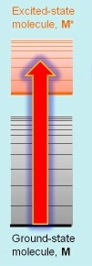
Principle of Atomic Absorption spectroscopy
Dr. Maha Al-Tameemi
Atomic Absorption (AA) is based on the principle that a ground-state atom can absorb light of the same characteristic wavelength as it would emit if excited to a higher energy level.
In flame AA, a cloud of ground-state atoms is formed by aspirating a solution of the sample into a flame of a temperature sufficient to convert the element to its atomic state.
The degree of absorption of characteristic radiation produced by a suitable source will be proportional to the population of ground-state atoms in the flame, and hence to the concentration of the element in the analyte.
Electrons promote to higher orbitals for a short amount of time by absorbing energy
M + hv → M*
Relies on Beer-Lambert Law[The amount of radiation absorbed by the sample is given by Beer’s law]
A= a.b.c or A = log(I₀/I) = abc
where: A = absorbance I₀ = intensity of radiation incident on the flame
I = intensity of radiation exiting the flame
a = molar absorptivity
b = path length through the flame
c = concentration of atoms in the flame Absorbance is directly related to the concentration of atoms in the flame

Slide 8
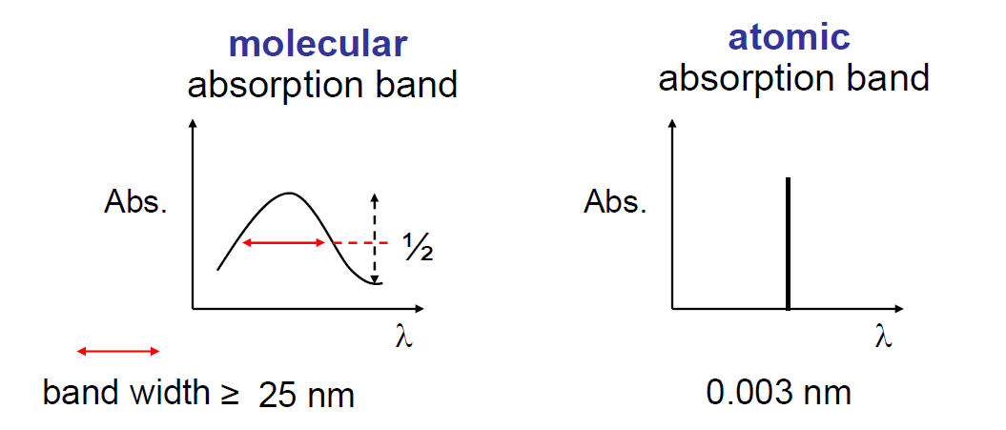
Atomic Absorption Spectrum: atomic spectra show only electron transitions.
Definition: An atomic absorption spectrum is produced when free atoms absorb light at specific wavelengths corresponding to the energy difference between electronic energy levels in the atom.
Nature of Species: It involves individual atoms, often in a gaseous state.
Transitions: The absorption occurs due to electronic transitions between discrete energy levels. Each element has a unique set of energy levels, resulting in a characteristic spectrum(line or sharp spectra)
Example: The spectrum of sodium (Na) will show sharp lines at specific wavelengths 589 nm, corresponding to the transitions of its electrons.
Dr. Maha Al-Tameemi
A molecular absorption spectrum
Definition: Arises when molecules absorb light, leading to transitions that involve not only electronic states but also vibrational and rotational states.
Nature of Species: Involves molecules, which are composed of two or more atoms bonded together.
Transitions: The absorption can involve transitions between electronic states, as well as changes in vibrational (vibrations of the bonds) and rotational (rotation of the molecule) states. This results in broader and more complex spectral features because of the additional energy levels associated with vibrations and rotations.
Example: The absorption spectrum of water (H₂O) will show a series of bands rather than sharp lines, reflecting the various vibrational and rotational transitions that can occur.
In summary, atomic absorption spectra are characterized by sharp lines due to electronic transitions of individual atoms, while molecular absorption spectra exhibit broader bands due to the complex interactions of electronic, vibrational, and rotational transitions in molecules.
Band Width = W_{1/2} = width of the band at half the height

Slide 9
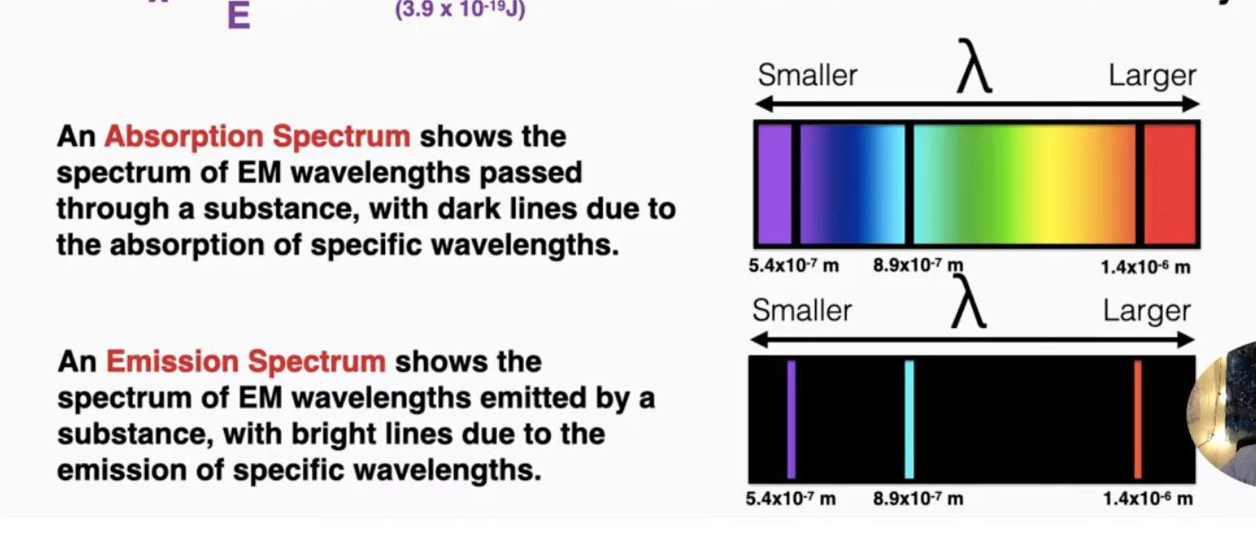
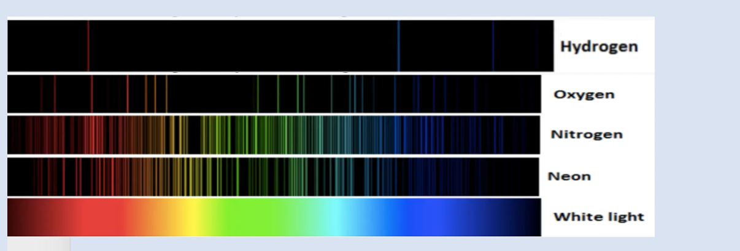
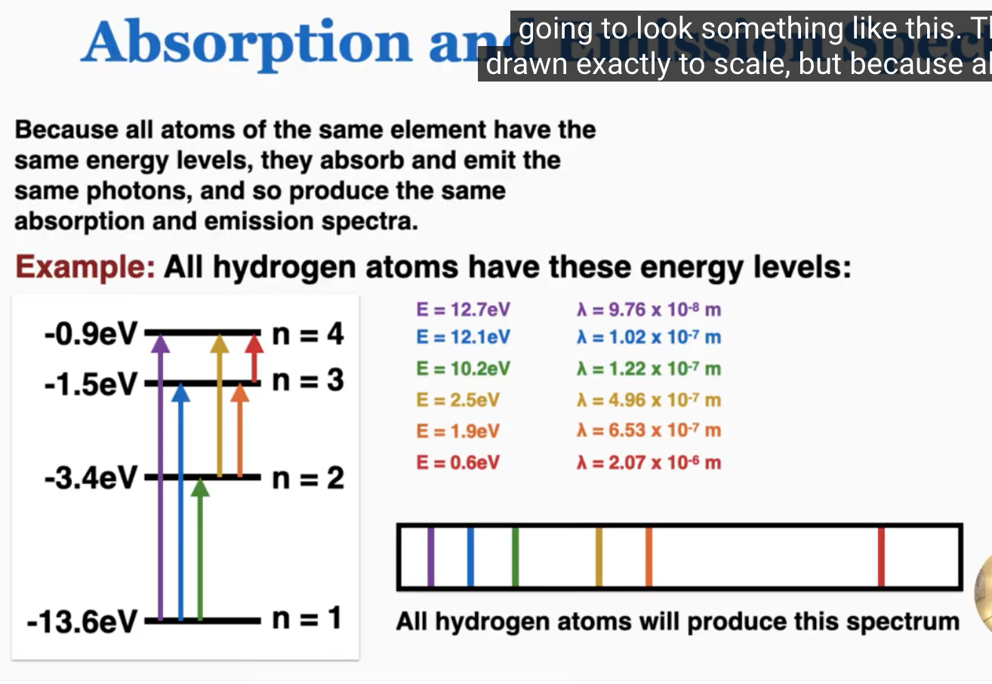
Absorption and Emission spectra
The spectrum of an element is like a fingerprint.
we can also use it to identify which elements light has passed through or been emitted from

Slide 10
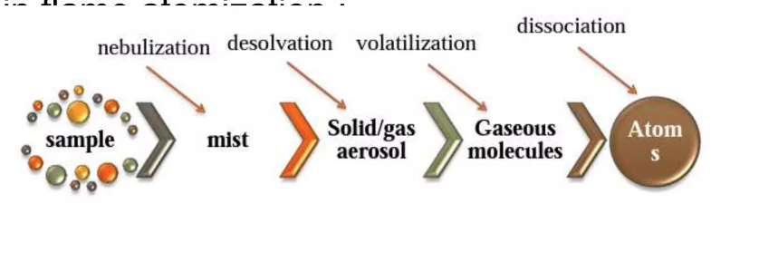
Sample Atomization – expose sample to flame or high-temperature
Dr. Maha Al-Tameemi
Need to break the sample into atoms to observe atomic spectra
Basic steps:
a) Nebulization – solution sample, get into fine droplets by spraying through a thin nozzle or passing over vibrating crystal.
  b) Desolvation - heat droplets to evaporate off solvent just leaving the analyte and other matrix compounds
  c) Volatilization – convert solid analyte/matrix particles into the gas phase
  d) Dissociation – breaking up molecules in the gas phase into atoms.
  e) Ionization – causes the atoms to become charged
  f) Excitation – with light, heat, etc. for spectra measurement.
M* M⁺ + e_
Mº M*
MA Mº + Aº
Solid Solution
Ionization
Excitation
Atomization
Vaporization

Slide 11
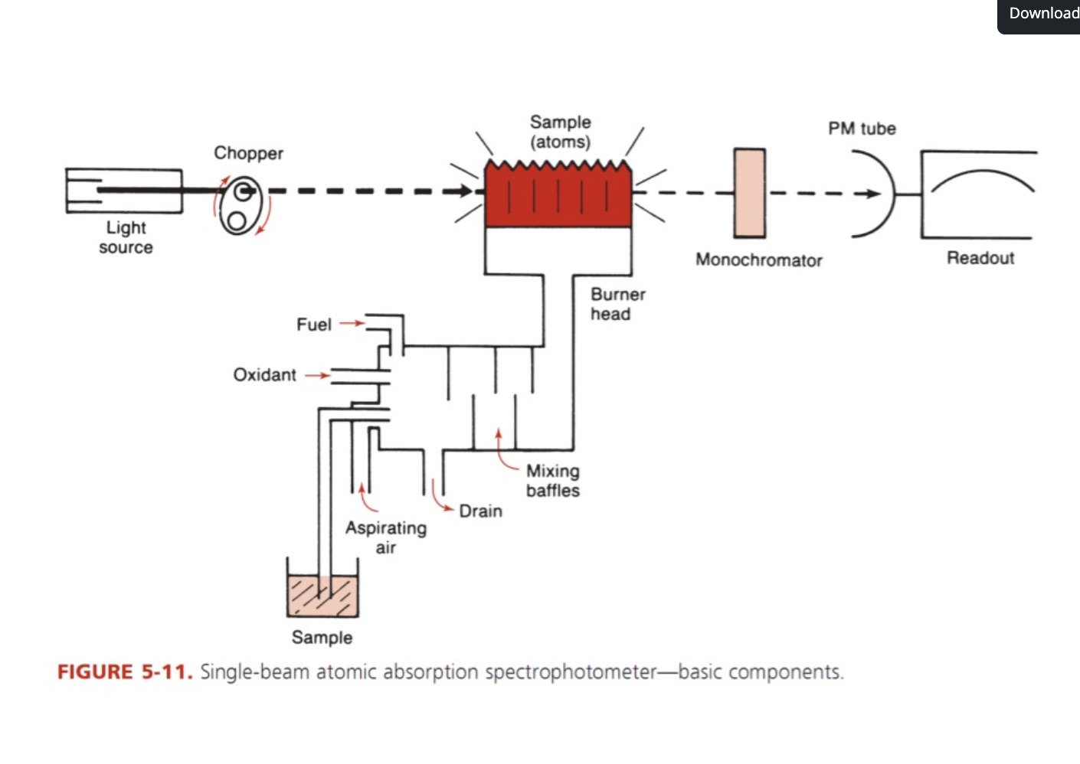
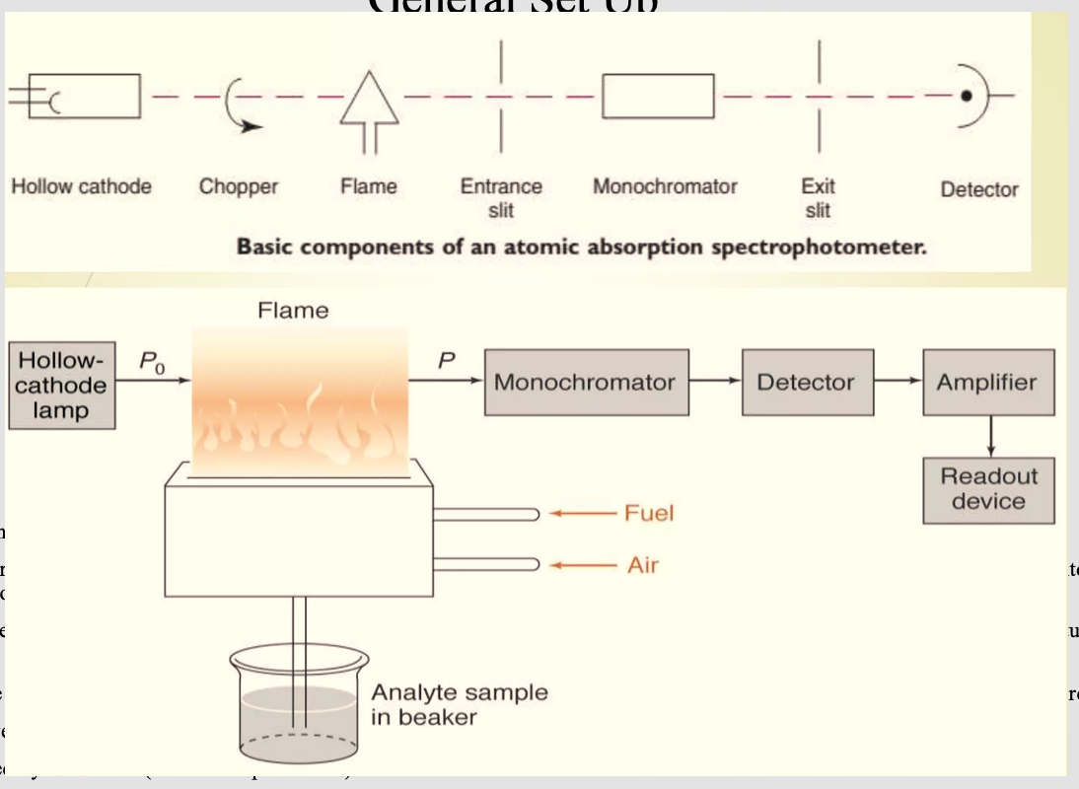
Atomic Absorption Spectroscopy: General Set-Up
Dr. Maha Al-Tameemi
Light source: The lamp emits light for the element of interest
. Chopper: A rotating wheel is interposed between the hollow cathode lamp and flame. It breaks the steady light coming from the lamp into pulsing light, which is used to measure the intensity of light absorbed by elements without interference by radiation from the flame itself.
Atomizer: is the separation of particles into individual molecules and breaking molecules into atoms this is done by exposing the analyte to high Temperature in a (Flame atomizer OR Graphite tube atomizer.
Nebulizer: Suck up a liquid sample at a controlled rate, create a fine aerosol spry for introduction into flame then mix the aerosol and fuel, and oxidant thoroughly for introduction into flame. The common method of nebulization(formation of small droplets) is by use of gas moving at a velocity called pneumatic nebulization
Monochromator: selects the wavelength used for measurement
Detector: measures light absorbed by free atoms)Photomultiplier tube )

Slide 12
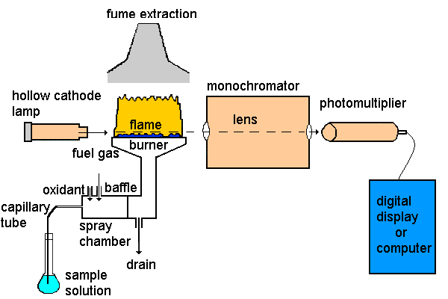
The simple diagram for the AAS
Dr. Maha Al-Tameemi
4. The element in the sample will absorb some of the light, thus reducing its intensity
5. The monochromator isolates the line of interest
3. A beam of UV light will be focused on the sample
1. We set the instrument at certain wavelength suitable for a certain element
2. The element in the sample will be atomized by heat
6. The detector measures the change in intensity
7. A computer data system converts the change in intensity into an absorbance

Slide 13
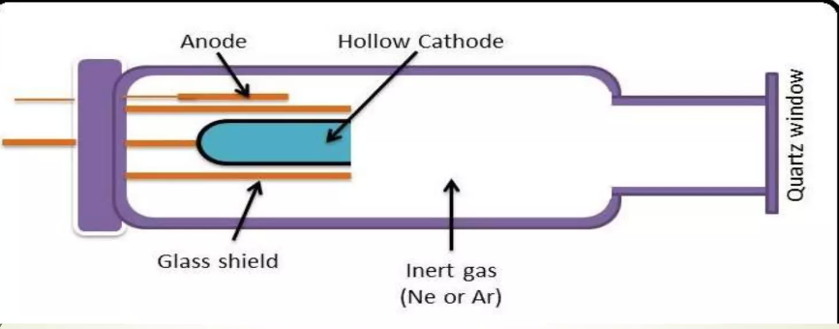
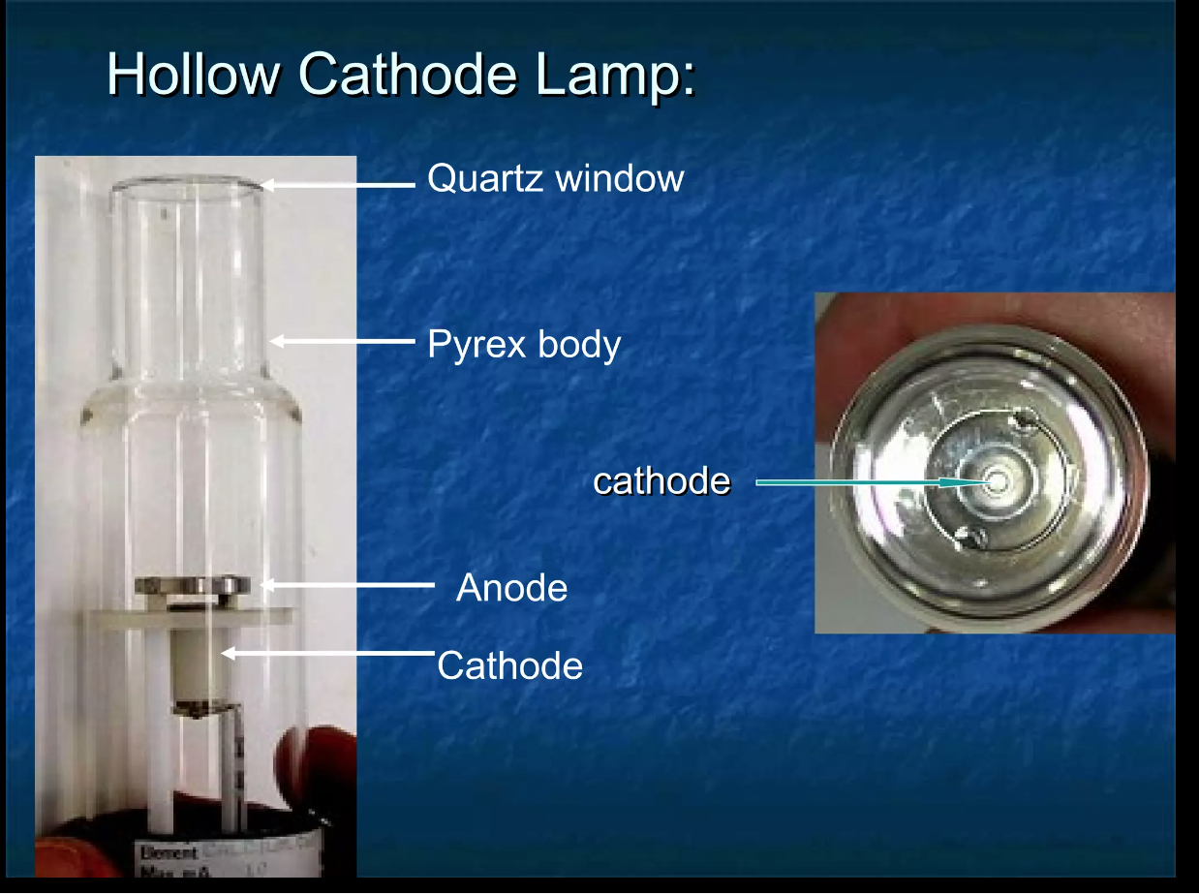
Light source: 3 types: Hollow Cathode Lamp, Electrodeless Discharge Lamps, and Continuum Sources
1-Hollow Cathode Lamp(HCL)
Dr. Maha Al-Tameemi
1-Consists of a cathode and an anode. The cathode is made of the element of interest ((Na, Ca, K, Fe,.. or a mixture of several metals) )and the anode is Tungsten wire a cylindrical cathode sealed in a glass tube filled with Ne or Ar.
2- A large voltage across the anode and cathode will cause the inert gas(Ne or Ar) to ionize.
3- The inert gas ions will then be accelerated into the cathode, sputtering off ) and dislodged into the gas phase (atoms from the cathode.
4-Both the inert gas and the sputtered cathode atoms will in turn be excited by collisions with each other.
5-When these excited atoms decay to lower energy levels they emit a few spectral lines characteristic of the element of interest.
6-The light is emitted directionally through the lamp’s window, a window made of glass transparent in the UV and visible wavelengths.
7-The light can then be detected, and a spectrum can be determined.
8-hollow cathode lamps are available as both single-element and multi-element sources.
9-The cylindrical configuration of the cathode tends to concentrate the radiation in a limited region of the metal tube this design also enhances the probability that redeposition will occur at the cathode rather than on the glass walls.

Slide 14
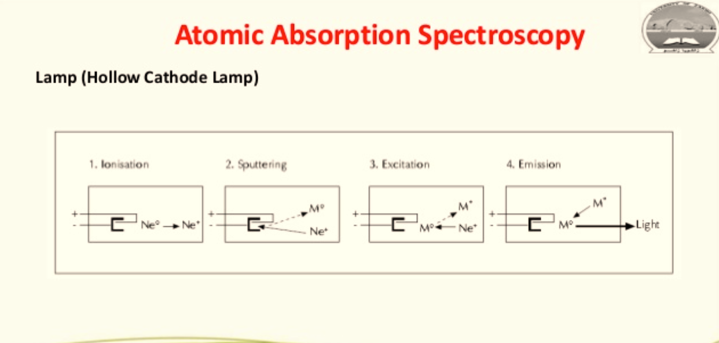
Reactions in the Hollow Cathode Lamp
Dr. Maha Al-Tameemi
Apply sufficiently high voltage between the cathode and the anode:
(1) Ionization of the filler gas:
  Ne + e⁻ = Ne⁺ + 2e⁻
(2) Sputtering of the cathode element (M):
  M(s) + Ne⁺ = M(g) + Ne
(3) Excitation of the cathode element (M)
  M(g) + Ne⁺ = M*(g) + Ne
(4) Emission of radiation
  M*(g) → (M(g) + hν
-Advantage: sharp lines specific for element of interest
- Disadvantage: can be expensive, need to use different lamp for each element tested.

Slide 15
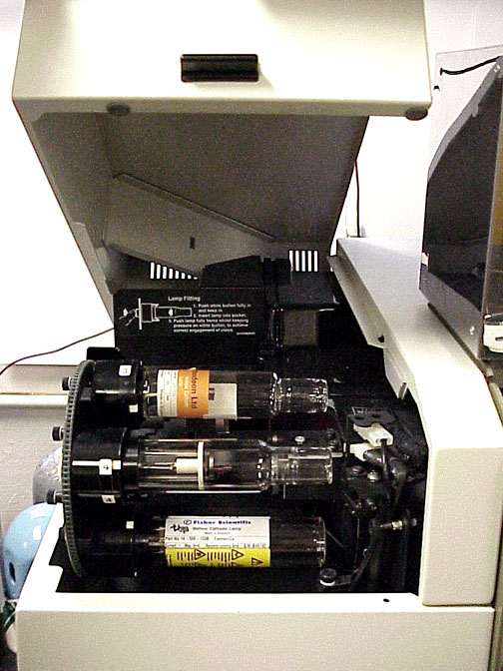
Dr. Maha Al-Tameemi
The intensity of the atomic line radiation produced depends on the number of sputtered metal atoms, which depends on the kinetic energy of the neon ions, which, in turn, is dictated by the lamp current.
Consequently, a higher lamp current produces a greater spectral line intensity from the source, which in turn provides a greater analytical sensitivity.
However, at high lamp currents, an excess of metal atoms is sputtered from the cathode surface.
The resulting dense cloud of metal atoms absorbs radiation emitted from nearby excited-state metal atoms.
When self-absorption of this type occurs within the HCL, the level of radiation available for absorption by the free atoms from the sample, produced via atomization, is reduced and sensitivity is lost.
This process of self-absorption is called “self-reversal” and dictates the maximum operating current of the HCL, and the peak of the spectrum will be dent.
The multi-element HCL operates under the same principles governing the single-element HCL, except that the cathode is fabricated from pressed alloys or powders of several elements, instead of just a single element.
For a cost comparable to that of the single-element HCL, the multi-element HCL provides simultaneous detection of several metals.
Despite the economic advantages, the multi-element HCL typically has a shorter lifetime than the single-element HCL, primarily because the metal atoms of the cathode have different degrees of volatility.
The sensitivities of the inaccessible metal atoms will decrease over time and ultimately shorten the effective lifetime of the HCL.The lamp is housed inside the lamp compartment of the instrument.
Notes:
Self-absorption is an effect when a photon emitted by an atom may be absorbed by a different atom before it escapes from the source.

Slide 16
Dr. Maha Al-Tameemi
AAS is relatively free from elemental interferences because it determines elements using absorption by specific lamps for the metal under test. However, it is prone to background interferences caused by:
absorbing molecular species of the sample, e.g. some absorptions by other species in the sample may occur at the same wavelength as the element under test.
(b) absorbing atomic species from other elements in the sample, e.g. phosphorus in the presence of calcium.
(c) particles from high salt concentrations in the atom cell can cause light scattering.

Slide 17
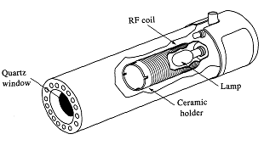
1(B). Electrodeless Discharge Lamps
The electrodeless discharge lamp (EDL) is another atomic line source used in AAS.
The EDL is also available in a multi-element format.
The EDL is fabricated by sealing a small amount of the metal or metal iodide(metal salt) of interest in a quartz tube filled with an inert gas, usually argon, at reduced pressures.
The EDL is placed in a microwave, radio-frequency field to ionize the inert gas.
The metal or metal iodide species collide with the free electrons from the ionized inert gas, producing excited-state metal atoms.
In a process analogous to that described for the HCL, these excited-state metal atoms emit the characteristic atomic lines of the metal as they relax to the ground state. It is available for 15 or more elements
The performance of EDL is not as reliable as that of the HCL but for elements like Se, As, Cd, and Sb EDL exhibits better detection limits than HCL because EDL is more intense for these elements than HCL.
In comparison to the HCL, the EDL produces an atomic line source of greater intensity(two orders of magnitude greater than HCL), resulting in enhanced analytical sensitivities. However, the EDL requires a separate power supply that increases the instrumental cost of the AAS(Not preferred).
Dr. Maha Al-Tameemi
They sometimes provide superior performance to HCL.
Their useful lifetime is longer than HCL
They provide light intensity 10-100 times more than that of HCL.
They are less stable than HCL

Slide 18
Dr. Maha Al-Tameemi
3- Continuum Sources
For purely economic reasons, the use of a continuum source in AAS is attractive because it eliminates the need to purchase multiple HCL sources.
However, in practice, the bandpass of a typical monochromator (0.1 to 0.2 nm) is much greater than the atomic line width of the absorbing atoms (0.002 nm).
Consequently, a large fraction of the radiation produced by the source falling on the detector is unabsorbed.
The small amount of radiation that is absorbed results in a low analytical sensitivity.
Continuum sources utilizing scanning Echelle grating monochromators have largely overcome the bandpass difficulty, but overall, they still provide lower sensitivity in comparison to the narrow lines produced by the HCL.
When using a continuum source, the high-intensity xenon arc lamp is preferred over the deuterium continuum source because of the higher analytical sensitivity obtainable.
advantage:
  -available in most instruments
  easy to do
disadvantage:
  difficult to perfectly match lamps (can give + or – errors)

Slide 19
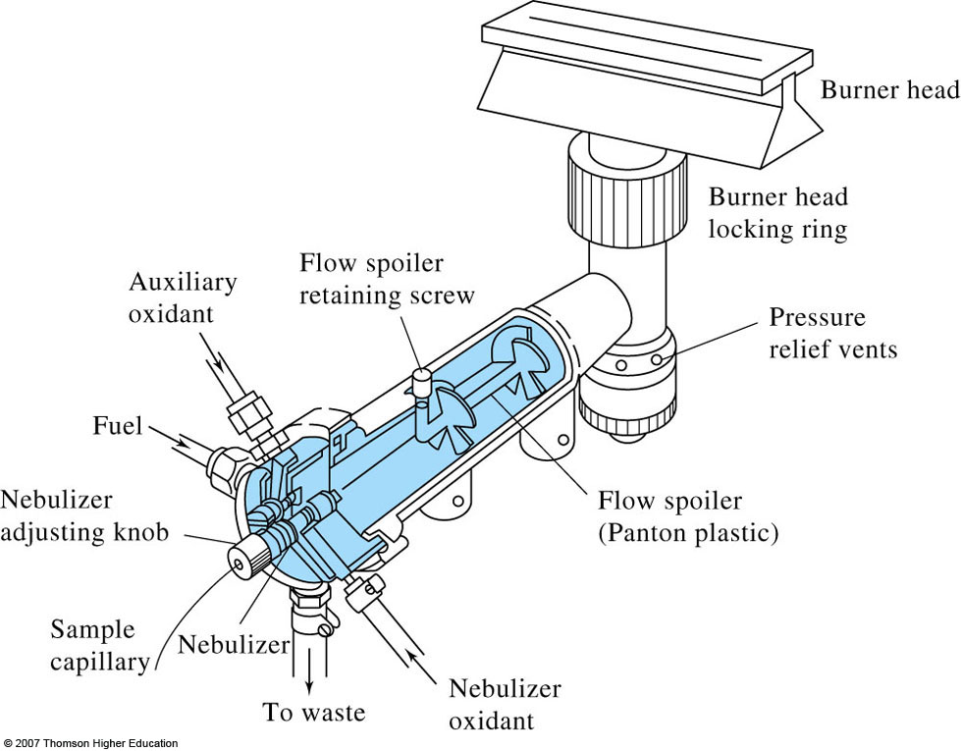
Flame Atomizer (Laminar Flow Burner)
The separation of particles into individual molecules and breaking molecules into atoms is done by exposing the analyte to high Temperature in a (Flame atomizer OR Graphite tube atomizer
The flame atomizer consist of a total consumption burner, Premixed burner.
Total consumption burner: In this whole sample is atomized into the flame hence named as total consumption burner, in this burner the sample solution the fuel and oxidizing gases are passed through separate passages to meet at the opening of the base of the flame, then the flame breaks the sample in liquid form into the droplets which are evaporated and burns leaving the residue which reduced to atoms.
Premixed burner: It is most widely used because of its uniform in flame intensity, the sample solution, fuel and oxidant are mixed before they reach the tip, the fine droplets get carried out along with the fuel gas at the outlet the large drops of sample get collected in the chamber and are drained out. Aflame atomizer will usually have a long narrow burner head that serves as a sample path(b) which tends to enhance sensitivity and reproducibility in AAS
Example: Laminar Flow Burner
- adjust the fuel/oxidant mixture for optimum excitation of desired compounds
- usually 1:1 fuel/oxidant mix but some metals forming oxides use increased fuel mix
- different mixes give different temperatures.
Laminar – non-turbulent streamline flow
sample, oxidant and fuel are mixed
only finest solution droplets reach burner
most of sample collects in waste
provides quite flame and a long path length

Slide 20
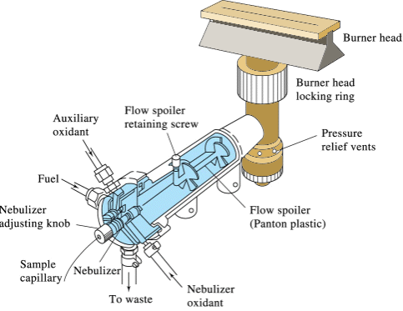
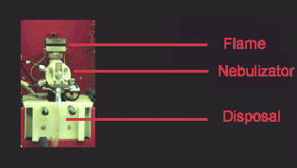
2. Atomizer(Laminar Flow Burner)
Dr. Maha Al-Tameemi
4. The mixture flows immediately into the burner head.
5. It burns as a smooth, laminar flame evenly distributed along a narrow slot.
1. mixes acetylene (the fuel)
and oxidant
(air or nitrous oxide).
3. The result is a heterogeneous mixture of gases (fuel + oxidant) and suspended aerosol (finely dispersed sample).
6. Liquid sample not flowing into the flame collects in the waste.
2. A negative pressure is formed at the end of the small diameter, plastic nebulizer tube→ (aspiration).
Note:
When do we use NO2 ?

Slide 21
Dr. Maha Al-Tameemi
Ignition
The process of lighting the AAS flame involves:
turning on first the fuel then the oxidant and then lighting the flame with the instrument's auto ignition system.
The flame breaks down the analyte's matrix → create the elemental form of the analyte atom.

Slide 22
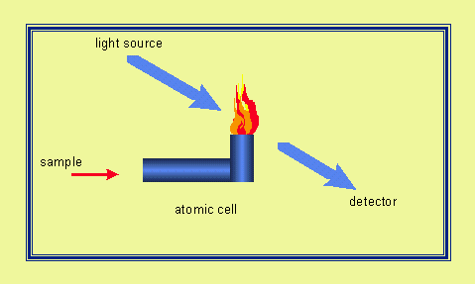
Optimization is accomplished by:
Dr. Maha Al-Tameemi
Aspirating a solution containing the element.
Adjusting the fuel: oxidant mix until the maximum light absorbance is achieved.
Careful control of the fuel: air mixture is important because each element's response depends on that mix in the burning flame.
During combustion, atoms of the element of interest in the sample are reduced to free, unexcited ground state atoms, which absorb light at characteristic wavelengths, as shown in the figure below.

Slide 23
Different mixes and flow rates give different temperature profile in flame
  - gives different degrees of excitation of compounds in path of light source
Dr. Maha Al-Tameemi
1700-2400 C⁰ with the various fuel when air is the oxidant, at these T ONLY, easily decomposed samples are atomized
Oxygen or Nitrous oxide must be used as the oxidant for more refractory samples(refractory elements such as B, P, W, Nb, Zr and U)
Properties of Flames
Fuel | Oxidant | Temperature (C⁰)
Natural gas | Air | 1700-1900
Natural gas | Oxygen | 2700-2800
Hydrogen | Air | 2000-2100
Hydrogen | Oxygen | 2550-2700
Acetylene | Air | 2100-2400
Acetylene | Oxygen | 3050-3150
Acetylene | Nitrous oxide | 2600-2800
Acetylene flow rate: 1000 ml/minute
Air flow rate: 5000 ml/minute
Sample uptake: 2 ml/minute
≈ 80% of sample goes to waste.
Therefore, dilution factor = ≈ 15,000
Highly inefficient!
The most commune fuel to use is acetylene
Either air or N₂O are used as oxidant with N₂O producing a hotter flame
N₂O also tend to produce a nosier flame

Slide 24
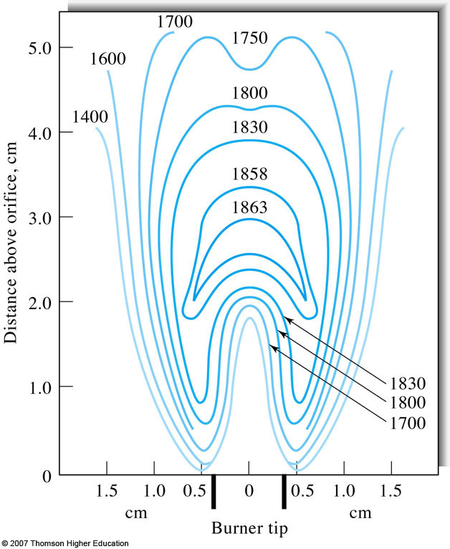
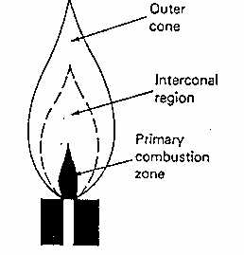
Dr. Maha Al-Tameemi
Flame Structure – selection of correct flame region is important for optimal performance
a) primary combustion zone – blue inner cone (blue due to emission from C₂, CH &
other radicals)
- not in thermal equilibrium and not used
b) intarconal region
- region of highest temperature (rich in free atoms)
- often used in spectroscopy
- can be narrower in some flames (hydrocarbon) tall in others (acetylene)
c) outer cone
- cooler region
- rich in O₂ (due to surrounding air)
- gives metal oxide formation
Temperature varies across flame –
need to focus on correct part of flame
Primary region for spectroscopy
-
Not in thermal equilibrium and not used for spectroscopy
Flame profile: depends on type of fuel and oxidant and mixture ration

Slide 25
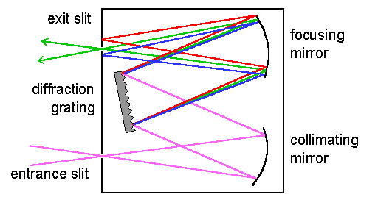
Dr. Maha Al-Tameemi
Monochromator
The operation and sensitivity of the atomic absorption spectrometer depends on the spectral band width of the resonance line emitted by the primary radiation source (the hollow cathode lamp).
The function of the monochromator is to isolate the resonance line from non-absorbing lines close to it in the source spectrum and from background continua and molecular emissions originating in the flame.
Hollow cathode lamps emit a number of lines, in the case of multi-element lamps, the number can be quite large and it is necessary to isolate the line of interest.

Slide 26
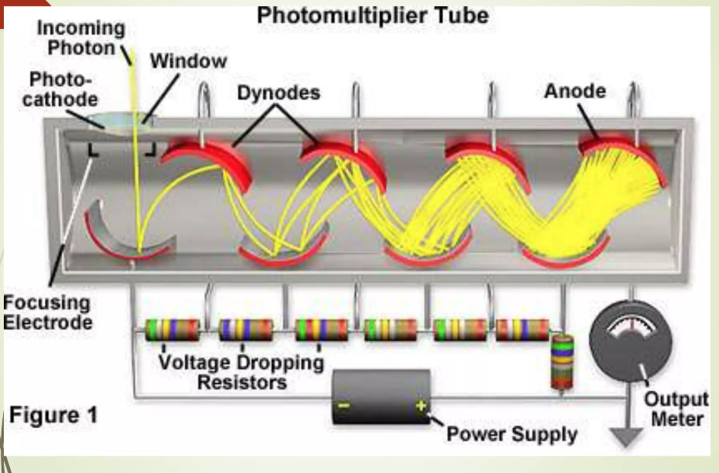
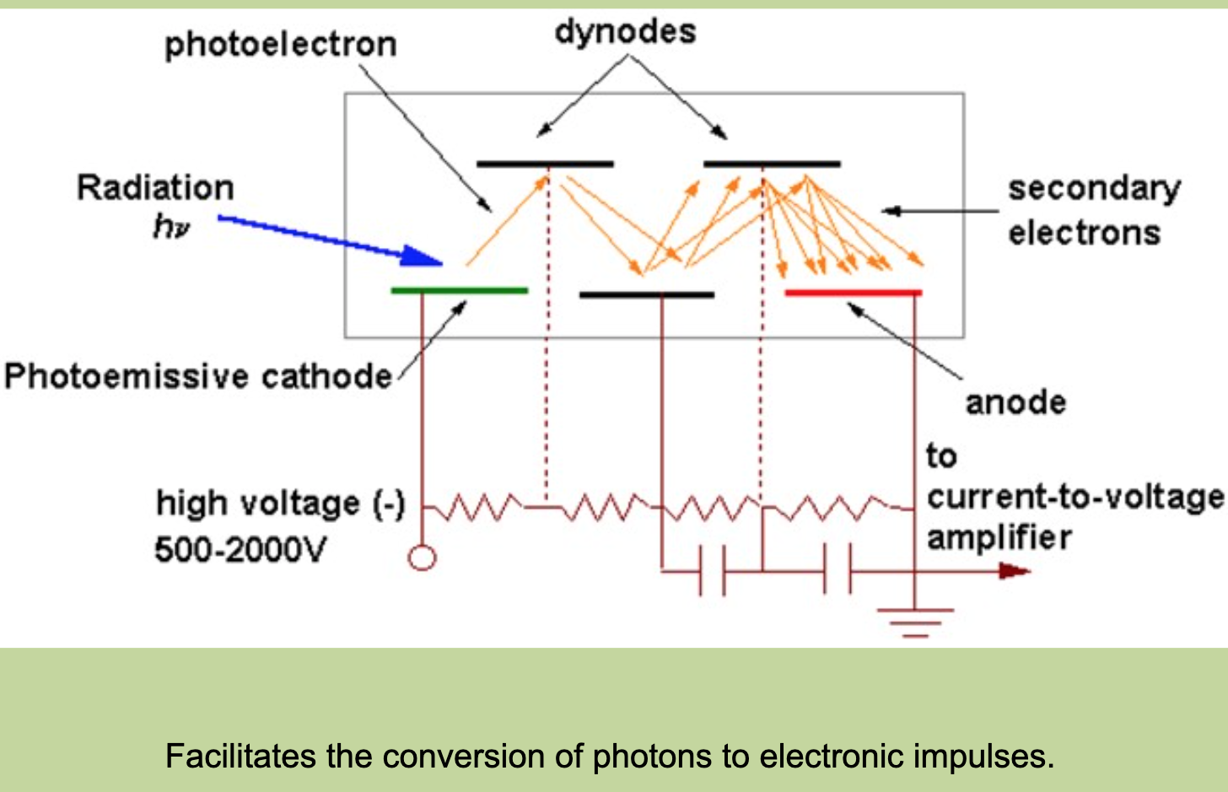
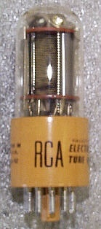
Detector [Photomultiplier Tube (PMT)]
Dr. Maha Al-Tameemi
The intensity of the line source is measured with a photomultiplier, which produces an electrical signal proportional to the intensity of the incident light.
This signal is amplified and processed electronically to produce an output that on older instruments was read on a digital or analog meter in either absorbance or concentration mode.
In modern instruments, the output is usually displayed on the computer screen of the PC controlling the instrument.
To eliminate the unwanted emissions from the flame, the light source is modulated by a chopper which is located between the hollow cathode lamp and the flame.
The amplifier which modifies the signal from the photomultiplier is tuned into the same frequency.
(Alternatively, the hollow cathode lamp may be modulated by applying an AC voltage at say 50 Hz.).
PMT

Slide 27
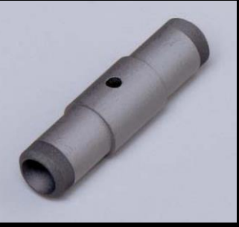
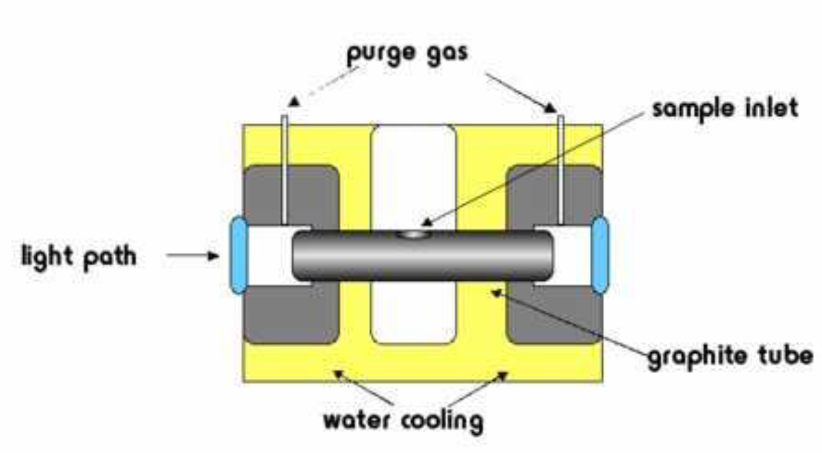
Flameless Atomization
(Electrothermal atomization or Graphite furnace atomization)
The sample holder consists of a graphite tube.
The tube is heated electrically
A beam of light passes through the tube.
Offers greater sensitivity than flames.
(The sample's residence time is greater, so you have improved detection limits and sensitivity )
Solid samples can also be assayed
using a smaller volume of sample, typically 5 - 50 μl (0.005 - 0.05 ml).
All of the sample is atomized in the graphite tube.
The atomized sample is confined to the optical path for several seconds (residence time in flame is very short).
Two inert gas stream are provided
External Ar gas prevents outside air from entering/incinerating the tube (air oxidation of the heated graphite )the furnace.
Internal Ar gas circulates the gaseous analyte(internal stream ensures that vapors generated from the sample matrix are quickly removed from the oven.
Ar is often used as a purge gas to:
Remove excess materials during the dry and ashing phases and after atomization
Reduce oxidation of the tube
Provide a protective blanket during atomization since high
temperature carbon will react with nitrogen to produce cyanogen
Dr. Maha Al-Tameemi

Slide 28
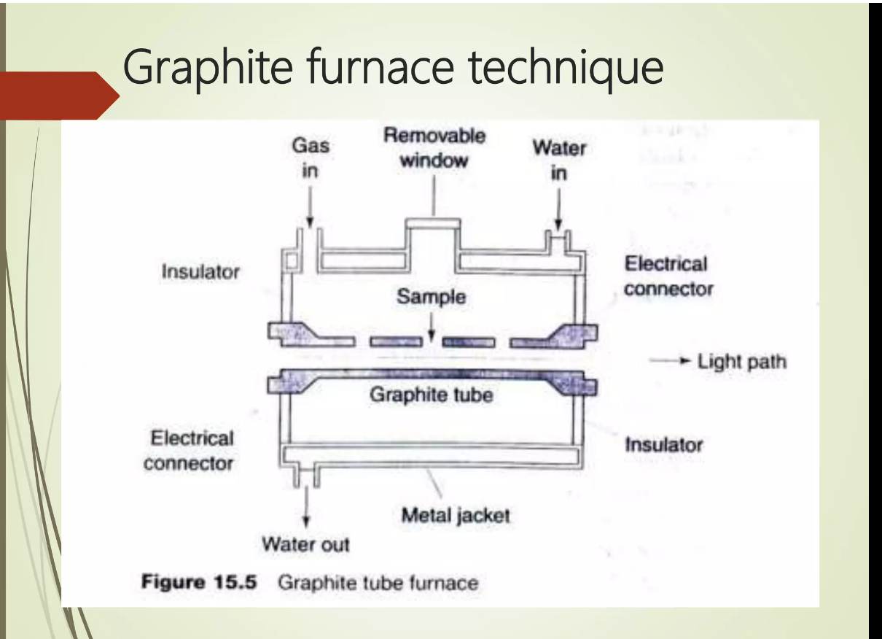

Atomization process
Dr. Maha Al-Tameemi
You can not simply heat you sample to atomization temperatures, or the sample will splatter
We use a temperature program to ensure reproducible atomization and if the sample heated to atomization T it will splatter
Steps of GF atomization:
5-100$μl$ sample
Drying
Ashing
Atomization
Cooling

Slide 29
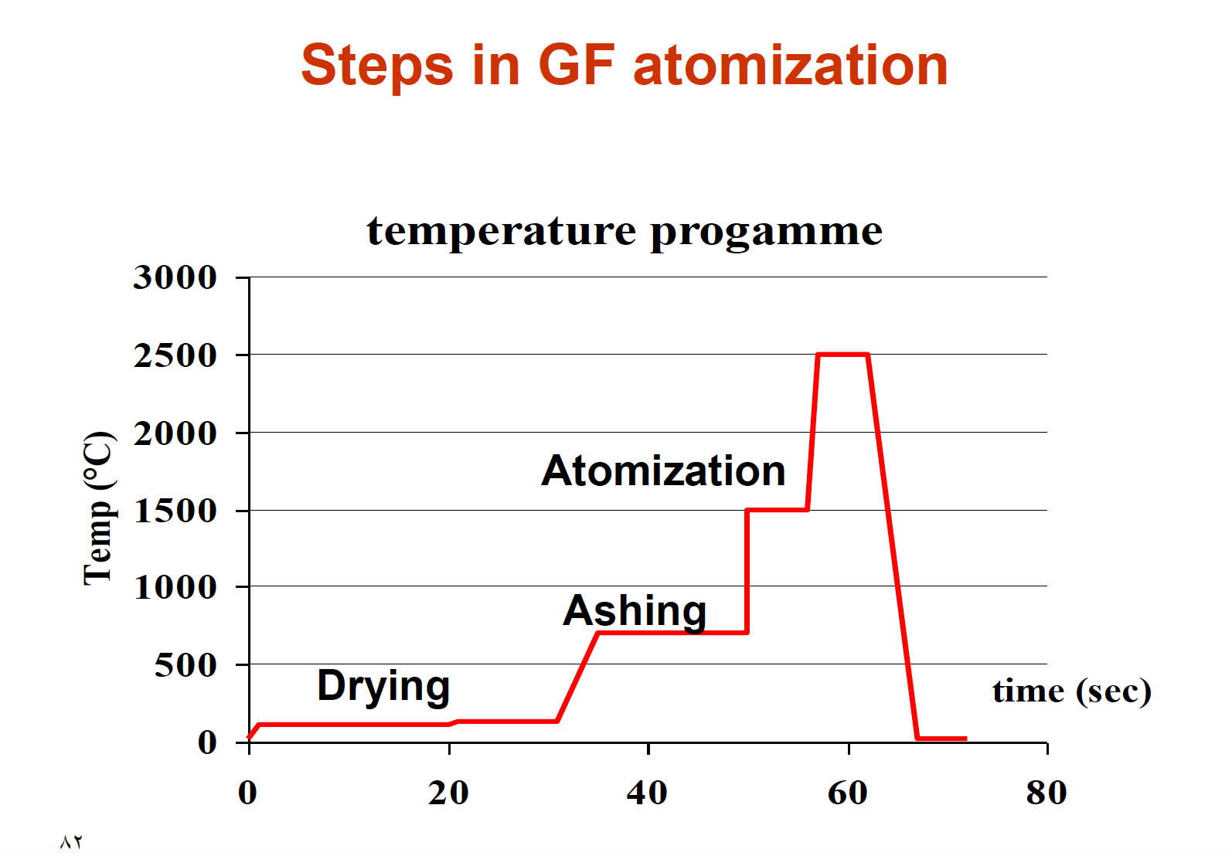
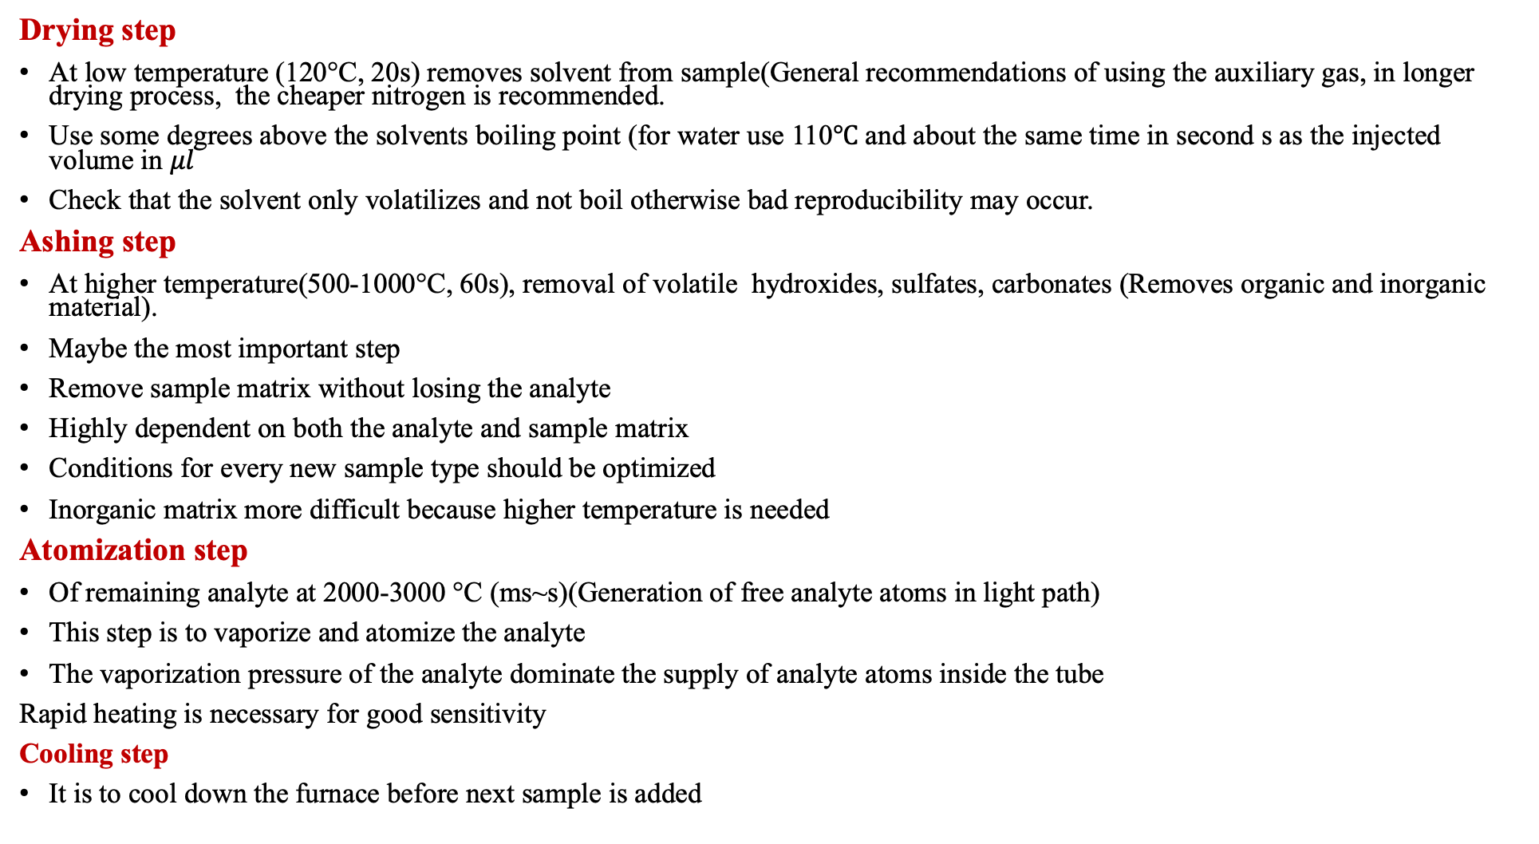
Dr. Maha Al-Tameemi
Drying step
At low temperature (120°C, 20s) removes solvent from sample(General recommendations of using the auxiliary gas, in longer drying process, the cheaper nitrogen is recommended.
Use some degrees above the solvents boiling point (for water use 110$℃$ and about the same time in second s as the injected volume in $μl$
Check that the solvent only volatilizes and not boil otherwise bad reproducibility may occur.
Ashing step
At higher temperature(500-1000°C, 60s), removal of volatile hydroxides, sulfates, carbonates (Removes organic and inorganic material).
Maybe the most important step
Remove sample matrix without losing the analyte
Highly dependent on both the analyte and sample matrix
Conditions for every new sample type should be optimized
Inorganic matrix more difficult because higher temperature is needed
Atomization step
Of remaining analyte at 2000-3000 °C (ms~s)(Generation of free analyte atoms in light path)
This step is to vaporize and atomize the analyte
The vaporization pressure of the analyte dominate the supply of analyte atoms inside the tube
Rapid heating is necessary for good sensitivity
Cooling step
It is to cool down the furnace before next sample is added

Slide 30
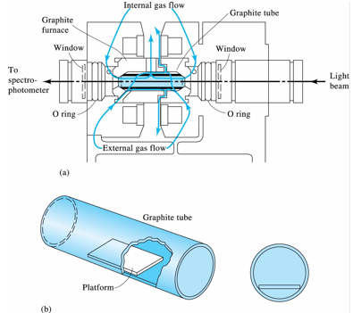
Dr. Maha Al-Tameemi
5. The monochromator isolates the light of the element of interest from the background lights to the PMT. The PMT tube measures the change intensity.
4. The graphite tube is permanently flushed with argon while it is in operation
1. The source of light (lamp) emits light with a wavelength specific to the element of interest
2. A controlled voltage is applied at the ends of the graphite tube, which is heated rapidly to high temperatures (up to 2600°C).
3. Samples are deposited in the graphite tube → heated to vaporize and atomize the analyte → atoms absorb ultraviolet or visible light and make transitions to higher electronic energy levels.

Slide 31
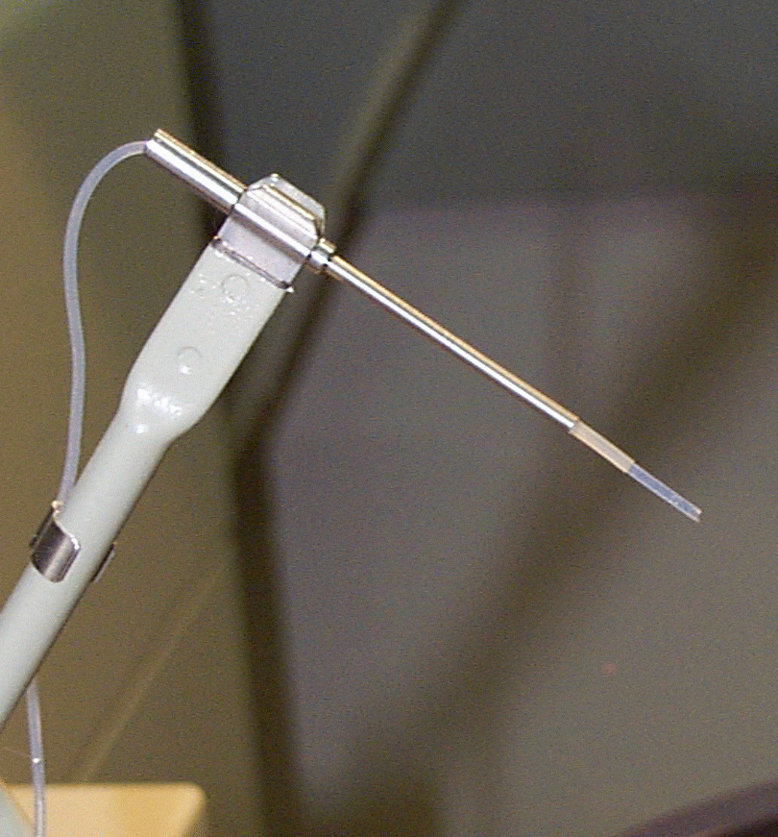
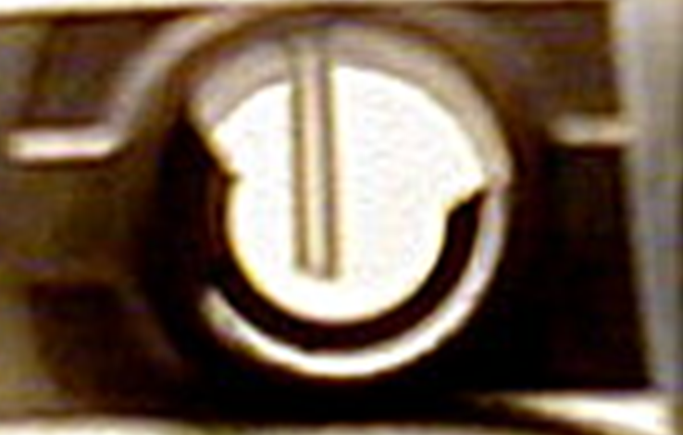

Sample introduction
Dr. Maha Al-Tameemi
The sample is injected usually between 10-30 $μl$ but sometimes the range could be extended to 100 $μl$
The solution is preferably made up of dilute nitric acid as matrix which used to decompose and dissolve the sample (wet ashing) combustion in an oxygen bomb or other closed container to avoid loss of analyte and and to minimize the spectral and chemical interferences.
Sometimes solid samples are introduced

Slide 32
Atomic Absorption Spectroscopy
Elemental Coverage in AAS
Dr. Maha Al-Tameemi
H |  |  |  |  | Flame Only |  |  |  |  |  |  |  |  |  |  |  | He
Li | Be |  |  |  | Flame & Furnace |  |  |  |  |  |  | B | C | N | O | F | Ne
Na | Mg |  |  |  |  |  |  |  |  |  |  | Al | Si | P | S | Cl | Ar
K | Ca | Sc | Ti | V | Cr | Mn | Fe | Co | Ni | Cu | Zn | Ga | Ge | As | Se | Br | Kr
Rb | Sr | Y | Zr | Nb | Mo | Tc | Ru | Rh | Pd | Ag | Cd | In | Sn | SB | Te | I | Xe
Cs | Ba | La | Hf | Ta | W | Re | Os | Ir | Pt | Au | Hg | Tl | Pb | Bi | Po | At | Rn
Fr | Ra | Ac
 |  |  |  | Ce | Pr | Nd | Pm | Sm | Eu | Gd | Tb | Dy | Ho | Er | Tm | Yb | Lu
 |  |  |  | Th | Pa | U | Np | Pu | AM | Cm | Bk | Cf | Es | Fm | Mo | No | Lr

Slide 33
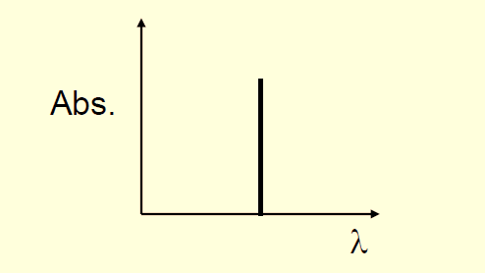
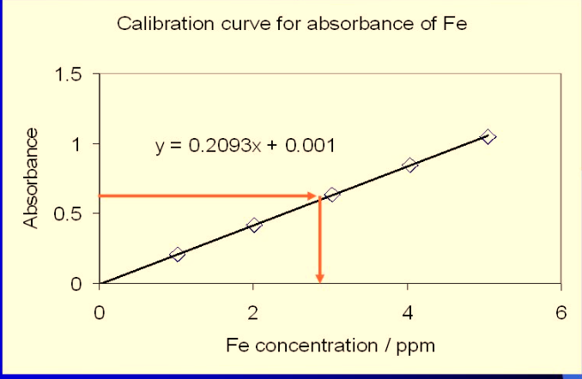
Qualitative and Quantitative analysis
Dr. Maha Al-Tameemi
Qualitative Analysis: An absorbance spectrum(HCL)
It consists of a series of well-defined, extremely narrow lines arising from the electronic transition of the outermost electrons
Quantitative Analysis: Calibration curve
Prepare standards of the analyte using several solutions of known concentrations of at least four standards and blank then measure absorbance at a specified wavelength.
Usually, standards are measured in the order of increasing concentration
After the measuring with one solution distilled water is aspirated into the flame to remove all the traces of the solution before proceeding to the next solution.
The absorbance of each known solution is measured, and then a calibration curve of concentration vs. absorbance is plotted.
From measuring the absorbance of the sample concentration of analyte in the sample(unknown) can be obtained from the calibration curve using either the equation (y = mx + b) or looking at the A in the X axis and drawing a line into Y axis to find the unknown C.
e can be obtained from the slope of the
calibration curve for a given wavelength (λ)
Absorbance of unknown
concentration of unknown
where:
A = absorbance (no units)
= molar absorptivity (L mol⁻¹ cm⁻¹)
b = cell pathlength (cm)
c = concentration of analyte (mol/L)
C_{ppm}= M x M.wt x 1000

Slide 34
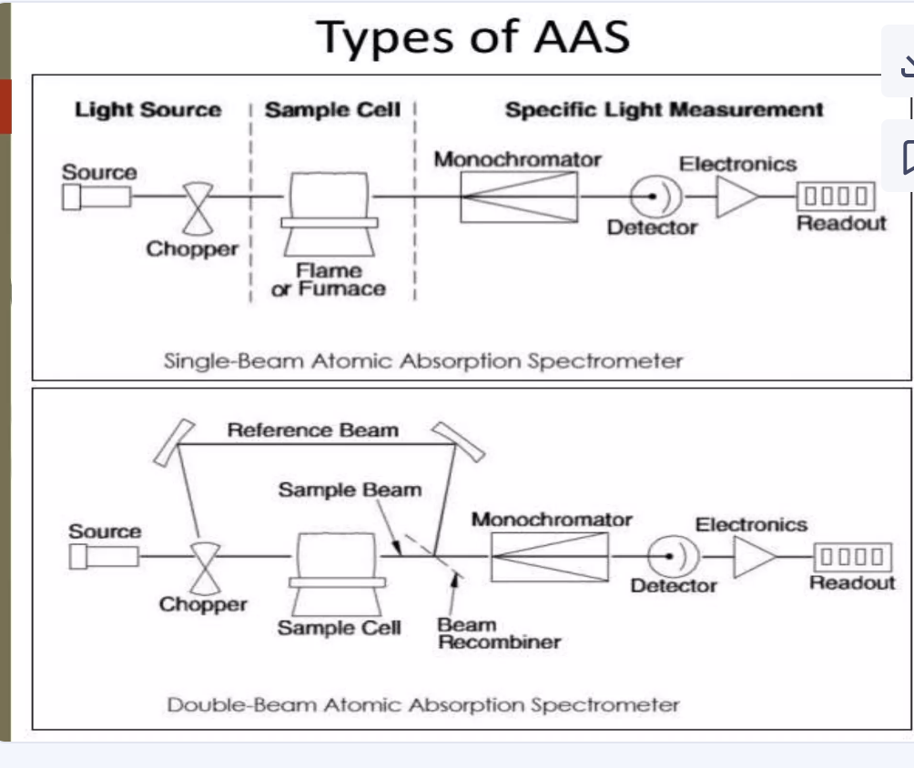

Slide 35
Advantages and Disadvantages of Flame AAS
Dr. Maha Al-Tameemi
Advantages
  equipment relatively cheap
  easy to use (training easy compared to furnace)
  good precision
  high sample throughput
  relatively facile method development
  cheap to run
Disadvantages
Only solutions can be analyzed or gases.
lack of sensitivity (compared to furnace) a large fraction of the sample flows down the drain)Flashback.
problems with refractory elements
  require a large sample size (1 – 2 mL).
  sample must be in the solution
  the small amount of time that the sample is in the light path
  not sample efficient (90-99% sample loss before flame)
  A distractive technique

Slide 36
Advantages and Disadvantages of Electrothermal Atomization
Dr. Maha Al-Tameemi
Advantages
  very sensitive to many elements
  Small sample size (typically 5 – 50 µL). -
  A longer time of the sample in the light beam
  the lower limit of detection (LOD)
  Solutions, slurries, and solid samples can be analyzed.
Disadvantages
  Poor precision
  Long cycle times mean a low sample throughput
  expensive to purchase and run (argon, tubes)
  requires background correction
  method development is lengthy and complicated
  requires a high degree of operator skill (compared to flame AAS)
  A distractive technique

Slide 37
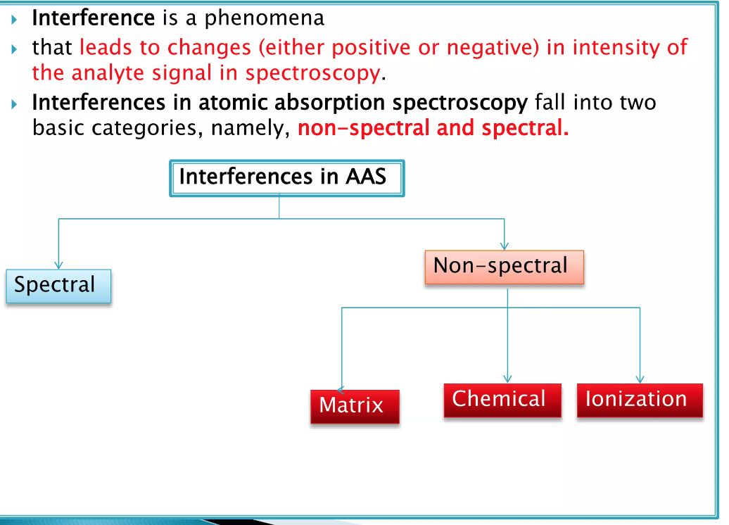
Interferences in AAS
Dr. Maha Al-Tameemi
Interference is any effect that changes(positive or negative) in the signal when analyte concentrations remain unchanged.
Interferent is a substance present in the sample, standards, or blank which affects the signal of the analyte
Interferences in atomic absorption spectroscopy fall into two basic categories namely spectral and non-spectral
Effect the formation of analyte atoms

Slide 38
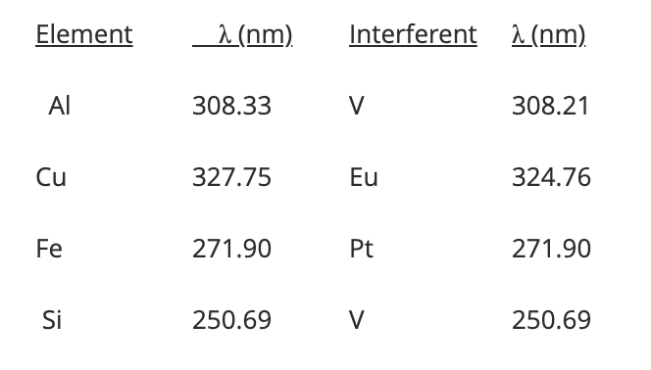
1-Spectral Interference
Dr. Maha Al-Tameemi
Spectral interferences are caused by the presence of:
1- Another atomic absorption line
2- A molecule band close to the spectral line element of interest
Most common spectral interferences are due to molecular emission from oxides of other elements in the sample
The main cause of background absorption is the presence of undissociated molecule species and tiny solid particles, unvaporized solvent droplets, or molecular species in the flame, which may scatter light over a wide wavelength region.
When this type of non-specific adsorption overlaps the atomic absorption of the analyte background absorption occurs.
The problem is overcome by:
Measuring and subtracting the background absorption from the total measured absorption to determine the true atomic absorption
By choosing another line for the analyte (which may be less sensitive)
The example: the presence of Al and V in the same solution will interfere with each other
  Al 308.216 nm
  V 308.211 nm
  This interference is avoided by employing the Al line at 309.27 nm

Slide 39
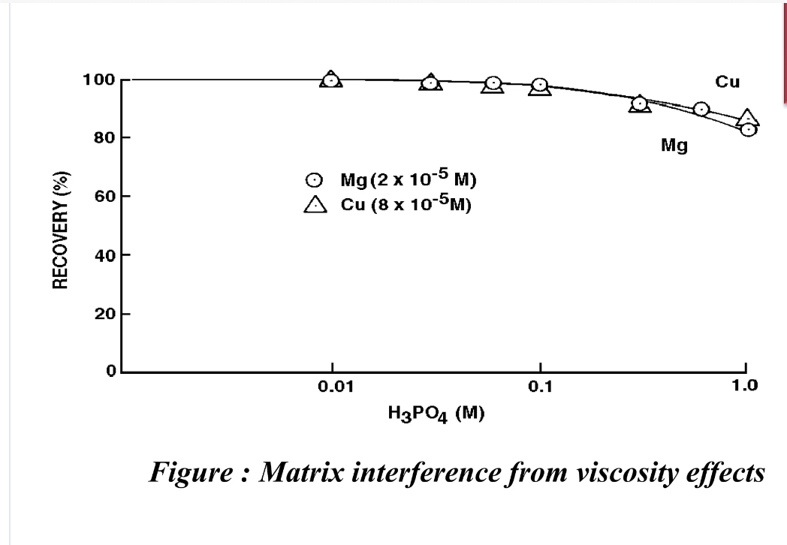
2- Matrix or Physical interference
Spray efficiency fluctuations due to differences in physical properties e.g. viscosity, density, and surface tension between the standards and sample, result in differences in sample uptake rate due to changes in nebulization efficiency.
In other words, the amount of sample reaching the flame and the size of the droplet are dependent on the solution's physical properties.
Change in flame temperature
Variation in gas flow
To avoid differences in the amount of sample and standard reaching the flame, it is necessary that the physical properties of both be matched as closely as possible(matching matrix composition of standard and sample)
For example, in the analysis of blood, the increased signal in the presence of ethanol is due to lower surface tension, which produces smaller droplets.

Slide 40
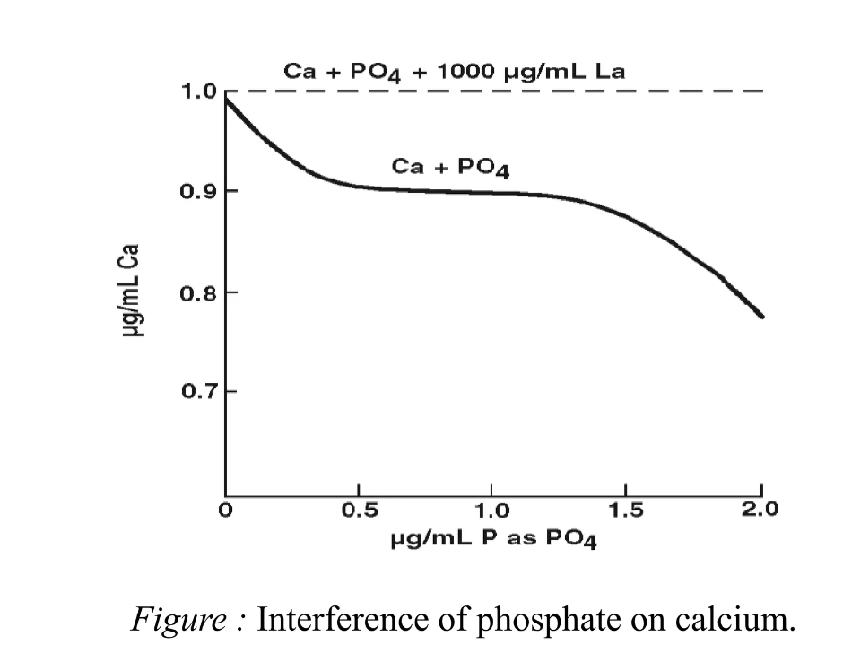
3-Chemical Interference - more common
Dr. Maha Al-Tameemi
1) Formation of Compounds of Low Volatility
- Anions + Cations → Salt
Ca²⁺ +SO₄²⁻ → CaSO₄ (s)
- Decreases the amount of analyte atomized → decreases the absorbance signal
- Avoid by:
> Increase temperature of flame (increase atom production) (nitrous oxide/acetylene)
> Add “releasing agents” – other items that bind to interfering ions
eg. For Ca²⁺ detection add Sr²⁺
Sr²⁺ + SO₄²⁻ → SrSO₄ (s) increases Ca atoms and Ca absorbance
> add “protecting agents” – bind to analyte but are volatile
eg. For Ca²⁺ detection add EDTA⁴⁻
Ca²⁺ + EDTA⁴⁻ → CaEDTA²⁻ → Ca atoms
2) Formation of Oxides/Hydroxides(sample conation a species which forms a thermally stable compound with the analyte that is not completely decomposed by the energy available in the flame the chemical interference exists.
Refractory elements such as Ti, W, Zr, Mo, and Al may combine with oxygen to form thermally stable oxides
M + O » MO
M + 2OH » M(OH)₂
- M is an analyte
- Avoid by:
> Increase the temperature of the flame (nitrous oxide/acetylene to provide higher dissociation energy)
> Use less oxidant
non-volatile & intense molecular absorbance

Slide 41
4-Ionization Interference
Dr. Maha Al-Tameemi
Ionization of atoms and molecules is small in combustion mixtures that involve air as the oxidant and can often be neglected, in higher T flame where O or N₂O serves as the oxidant. However, ionization becomes important and there is a significant concentration of free electrons produced by the equilibrium
The dissociation process does not stop at the formation of ground - state atoms
The excess energy of the flame can lead to the excitation of ground - state atoms to ionic by loss of electrons thereby resulting in the depletion of ground - state atoms.
In cooler flames such as interference is encountered with easily ionized elements such as alkali metals and alkaline earth
M(g) → M⁺(g) + e⁻
A problem in the analysis of alkali metal ions at low flame temperatures and other elements at higher temperatures.
Because alkali metals have the lowest ionization potentials, they are most extensively ionized in flames.
At 2450 K and a pressure of 0.1 Pa, sodium is 5% ionized.
Potassium is 33% ionized under the same conditions.
Ionized atoms have energy levels that are different from the parent atoms therefore the analytical signal is reduced.
  a. All the alkali metals show this interference in the acetylene-air flame.
  b. Most elements show this interference in the acetylene-nitrous oxide flame.

Slide 42
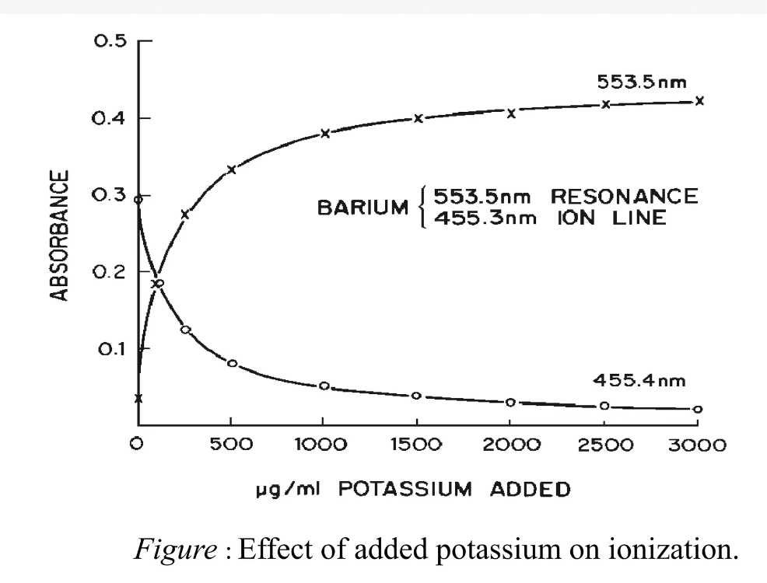
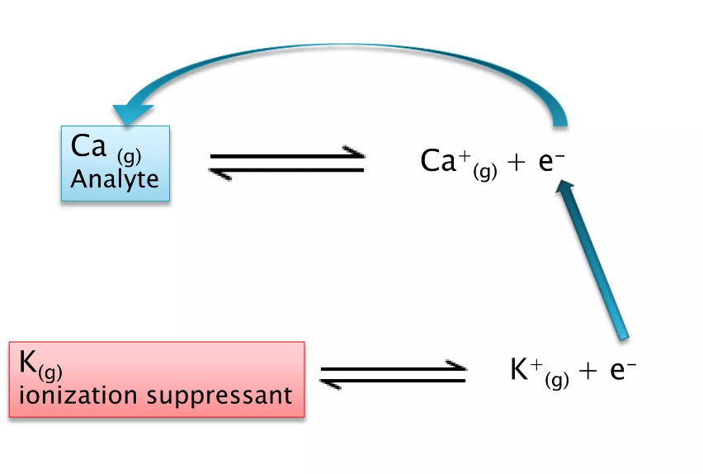
Avoid by
lower temperature
Add ionization suppressor – creates a large number of electrons in the flame and suppresses the ionization of the analyte.
A high concentration of e⁻ suppresses M⁺ by shifting equilibrium.
Salt of such elements as K, Rb, and Cs are commonly used as ionization suppressor
Add 1000 ppm of CsCl when analyzing Na or K.
Cs is more readily ionized than either Na or K.
This produces a high concentration of electrons in the flame.
Dr. Maha Al-Tameemi

Slide 43
Applications of AAS
Dr. Maha Al-Tameemi
Agricultural analysis
  soils
  plants
Clinical and biochemistry
  whole blood, plasma and serum Ca, Mg, Li, Na, K, Cu, Zn, Fe etc.
Metallurgy
  ores, metals and alloys
Lubricating oils
  Ba, Ca, Mg and Zn additives
Greases
  Li, Na, Ca
Water and effluents
  many elements e.g. Ca, Mg, Fe, Si, Al, Ba
Food
  wide range of elements
Animal feedstuffs
  Mn, Fe, Co, Cu, Zn, Cr, Se
Medicines
  range of elements

