Slide 1
University of Baghdad College of Science for Women Department of Chemistry Instrumental Analysis Chemistry Undergraduate Program Second Semester First grade Volumetric Analytical Chemistry
Lecturer
Dr. Amera Hasan
Asst. Prof. Dr. Maha Al-Tameemi
mahaks_chem@csw.uobaghdad.edu.iq
Lecture: Sunday at (8:30 AM-10:30 AM), (10:30 AM-12:30 PM),
Texts:
Most Analytical Chemistry Textbooks.
Handout

Slide 2
Titration Methods
Titrimetric method: - This includes a large powerful group of quantitative procedures, based on measuring the amount of reagent of known concentration consumed by an analyte.
Volumetric titrimetric: - These involve measuring the volume of a standard solution of known concentration that is needed to react essentially completely with the analyte
Types of titrimetric determinations
Direct titration
Back-titration (on residue)
Substitute titration (displacement titration)
Revertive titration
Direct titration – titrant is added to an analyte solution and it reacts with a determined substance. А + Т = product
The requirement to react in direct titration
Reaction involving the titrant and analyte must be of known stoichiometry, quantitatively
The titration reaction must occur rapidly
A suitable method must be available for determining the endpoint with an acceptable level of accuracy
Reactions should proceed at room temperature
Titration should not be accompanied by collateral reactions which deform the results of the analysis
Reactions should be specific
A suitable indicator is available

Slide 3
Back titration The titration of excess of a standard solution that has reacted completely with an analyte, or this process in which the excess of standard solution used to consume an analyte is determined by titration with a second standard solution.
This titration is used, when:
The titration reaction is too slow
A suitable indicator is not available
There is no useful direct titration reaction
The standard solution lacks stability (fugitive)
А + Т_{excess} = product₁ + Т_{residue}
Т_{residue} + Т_{padding} = product₂
Displacement titration. A titration in which the analyte displaces a species, usually from a complex and the amount of the displaced species is determined by a titration
This titration is used, when:
The analytes are unstable substances
It is impossible to indicate the equivalent (end) point in a direct reaction
Analyte doesn’t react with titrant
Reaction involving the titrant and analyte mustn’t be of known stoichiometry, quantitatively

Slide 4
А + Т_{1(padding compounds)} = А_{1(substituent)}
А_{1(substituent)} + Т = product
CrCl₂ + FeCl₃ = CrCl₃ + FeCl₂
analyte substitute
5FeCl₂ + KMnO₄ + HCl = 5FeCl₃ + KCl + MnCl₂ + 4H₂O
Revertive titration is a process in which the standard solution is titrated by the solution of an investigated substance.
This titration is used, when:
The titration reaction is too slow
A suitable indicator is not available
Side-effects are observed
А(in burette) + Т(in flask) = product

Slide 5
Some terms used in volumetric titrations
Titration: In an acid-base titration, a solution of known concentration (titrant) is slowly added to a solution of unknown concentration from a burette until the reaction is complete. When the reaction is complete we have reached the endpoint of the titration.
A standard solution is a reagent of known concentration and is used in titrations and many other chemical analyses.
Analyte: the solution of unknown concentration but known volume.
Titrant: the solution of known concentration. Analyte + Titrant → Products
The equivalence point: is the point in a titration when the amount of added standard reagent is equivalent to the amount of analyte. (When the moles of H₃O⁺ = moles of OH⁻, the titration has reached its equivalence point)
(the chemical reaction comes to an end )
The endpoint: is the point in a titration when a physical change occurs that is associated with the condition of chemical equivalence(where the color change occurs in a system)
Indicator: a substance added to the analyte solution to produce an observable physical change (changes color when the pH changes)at or near the equivalence point.

Slide 6
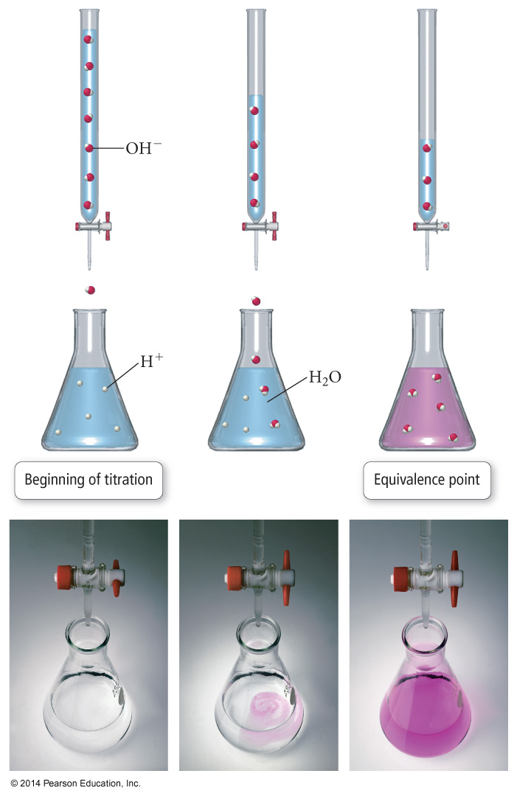
Titration

Slide 7
The indicator is specified the following requirements:
1) The indicator should have high absorbance to see its coloration with eyes even at a small amount of indicator.
2) Changing of coloration must be contrasted.
3) The range of changing color must be as narrow at it’s possible.
4) A small amount of an indicator is needed. If a large amount of indicator is used, the indicator will affect the final pH, lowering the accuracy of the experiment.
5) The indicator should also have a pK_{a} value near the pH of the titration's end point.

Slide 8
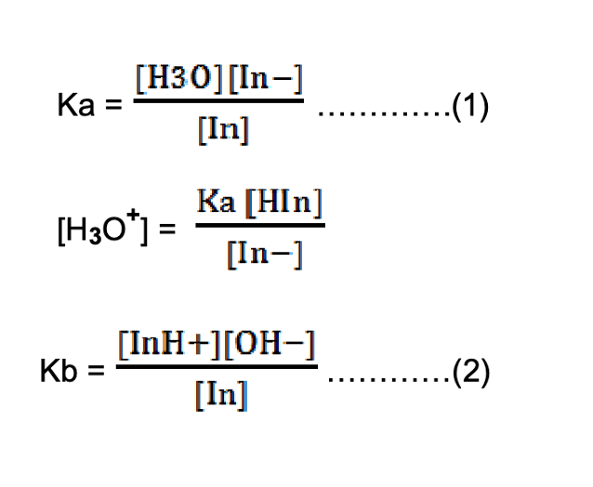
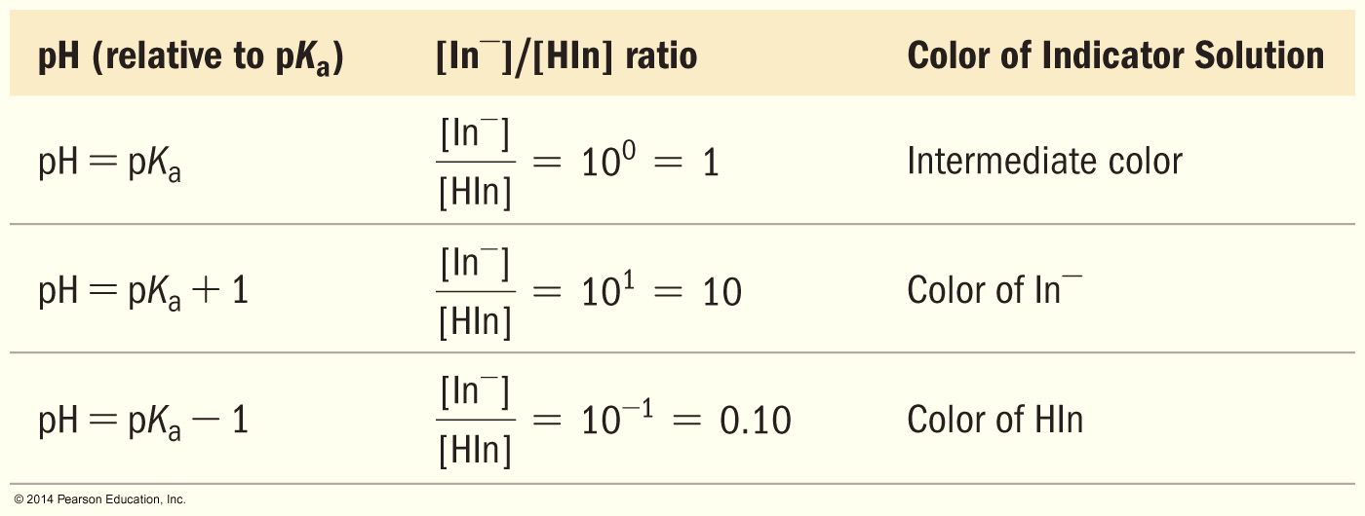
Indicators in acid-base titration
Many dyes change color depending on the pH of the solution. These dyes are weak acids, establishing an equilibrium with the H₂O and H₃O⁺ in the solution. (pK_{a} of HIn ≈ pH at equivalence point)
The equilibrium for a base–type indicator, In, is
In⁻ (aq) + H₂O↔ InH⁺(aq) +OH⁻ (aq)
Base form acid form
Color 1 color2
The change in color of the indicator can be detected by an average observer occurs within a limited range of concentration ratios from about 10 to about 1 therefore, acidic color can be observed when :
Where: HIn = acidic indicator In = basic indicator

Slide 9
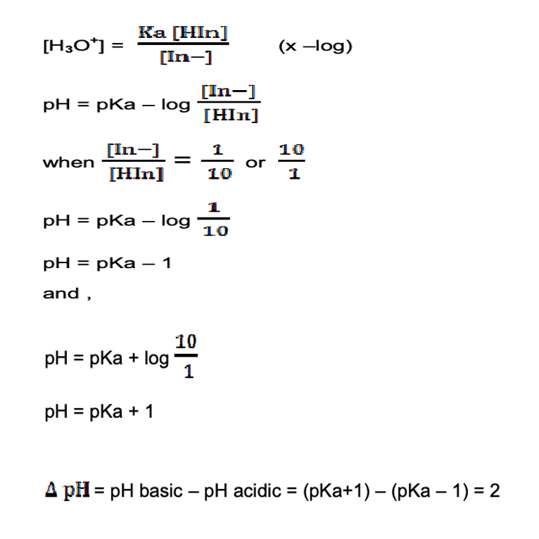
Some indicators require smaller ratio changes and others longer. If equation (1) is multiplying by (- log) , then :
That means when we assume that pK_{a} = 5, the change in color of the indicator occurs when the pH value variant from (5-1) to (5+1) e.g. (4-6).
pH range of indicator = pK_{a} ± 1

Slide 10
Example 1:-Calculate the pH range of the indicator that is a weak acid having K_{a}=1x10⁻⁵
Solution:-
pK_{a}=-logK_{a} =-log 1x10⁻⁵
pH range = pK_{a}± 5 =4 to 6
pH ranges for the most widely used indicators
INDICATOR | COLORING |  | pH interval of the color change
 | Acidic medium | Basic medium
Thymol blue | Red | Yellow | 1.2-2.8
Methyl orange | Red | Yellow | 3.1-4.4
Methyl red | Red | Yellow | 4.2-6.3
Litmus | Red | Blue | 5.0-8.0
Phenol red | Yellow | Red | 6.4-8.0
Phenolphthalein | Colorless | Crimson(pink) | 8.0-9.8
Thymolphthalein | Colorless | Blue | 9.3-10.5
Alizarin yellow | Yellow | Lilac-colored | 10.0-12.0
Methyl violet | Yellow | Violate | 0-1.6
Bromothymol blue | Yellow | Blue | 6-7.6

Slide 11
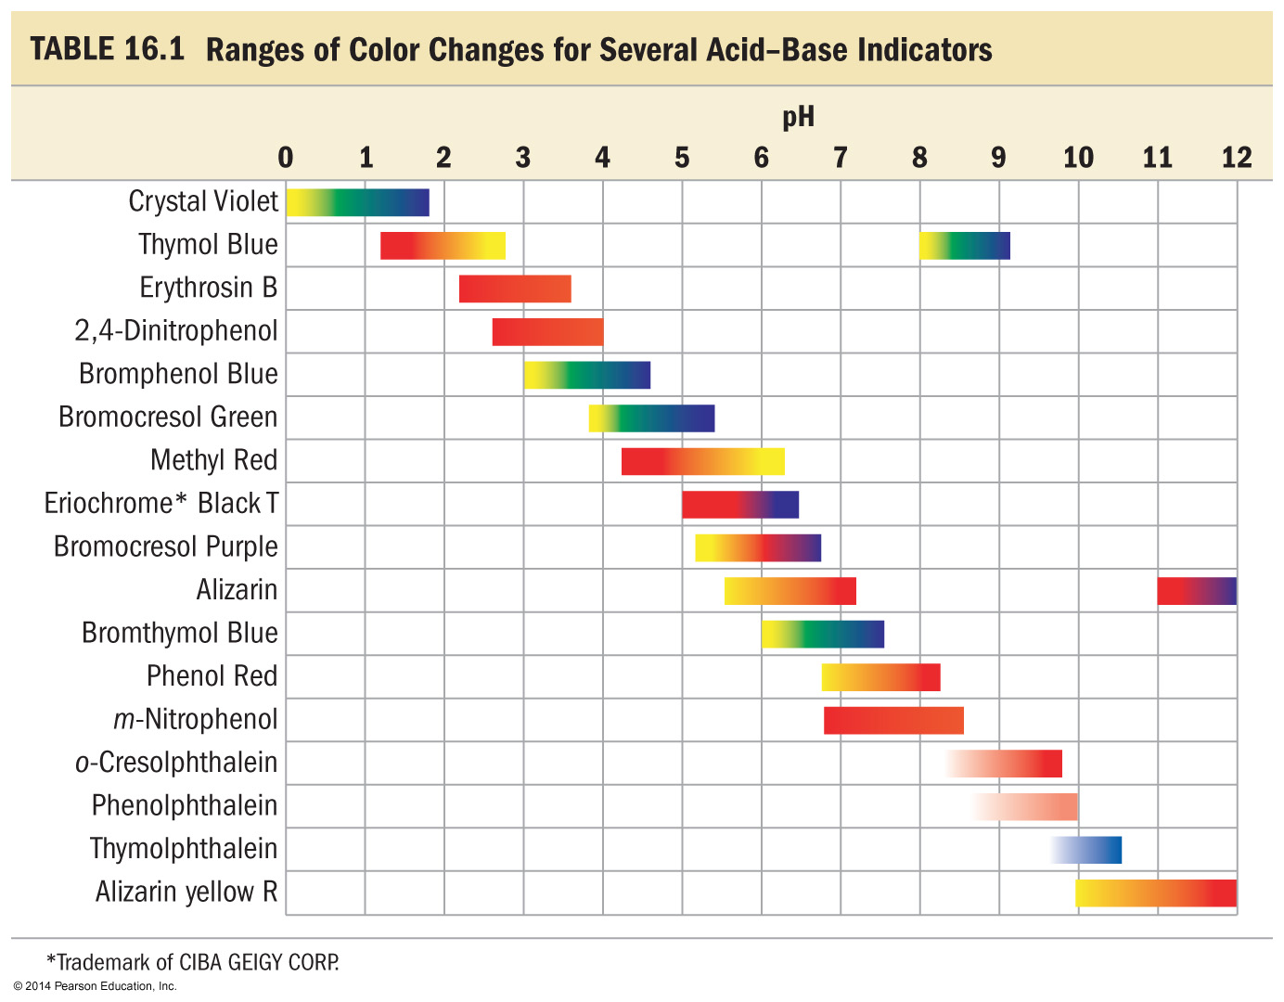
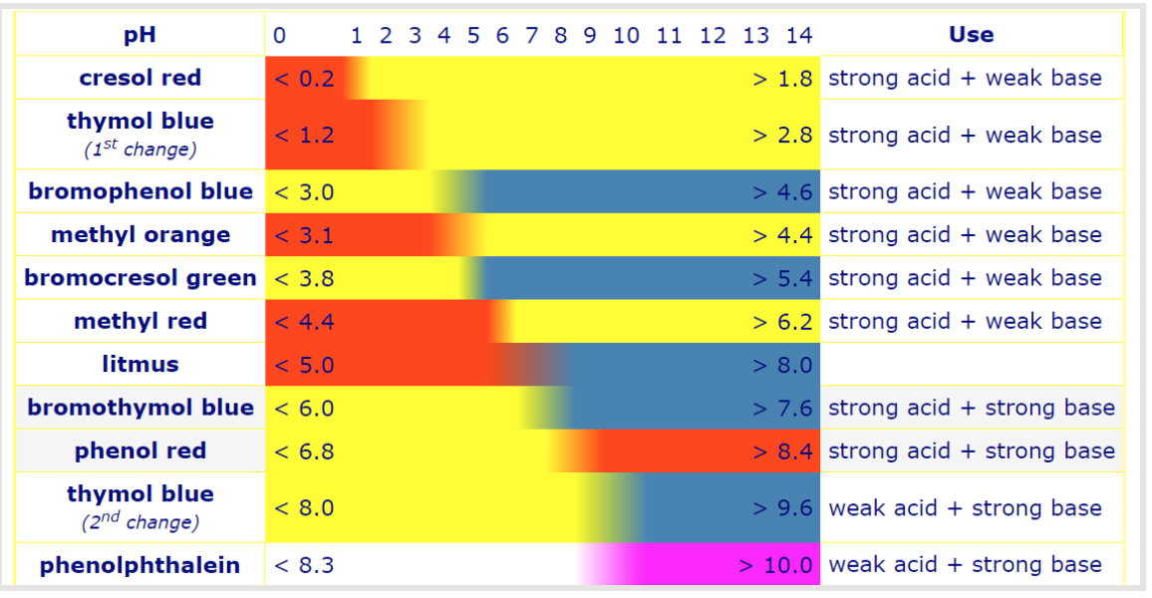
Acid-Base Indicators

Slide 12
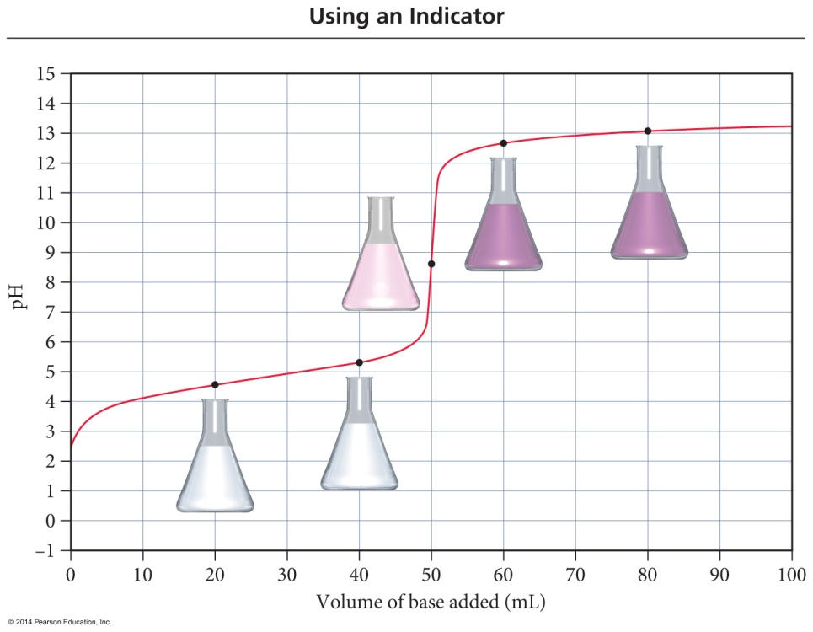
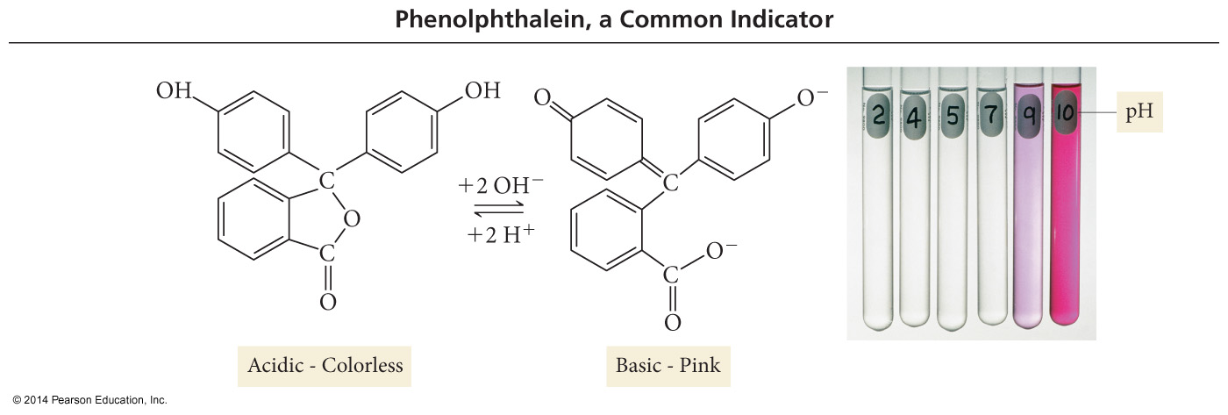
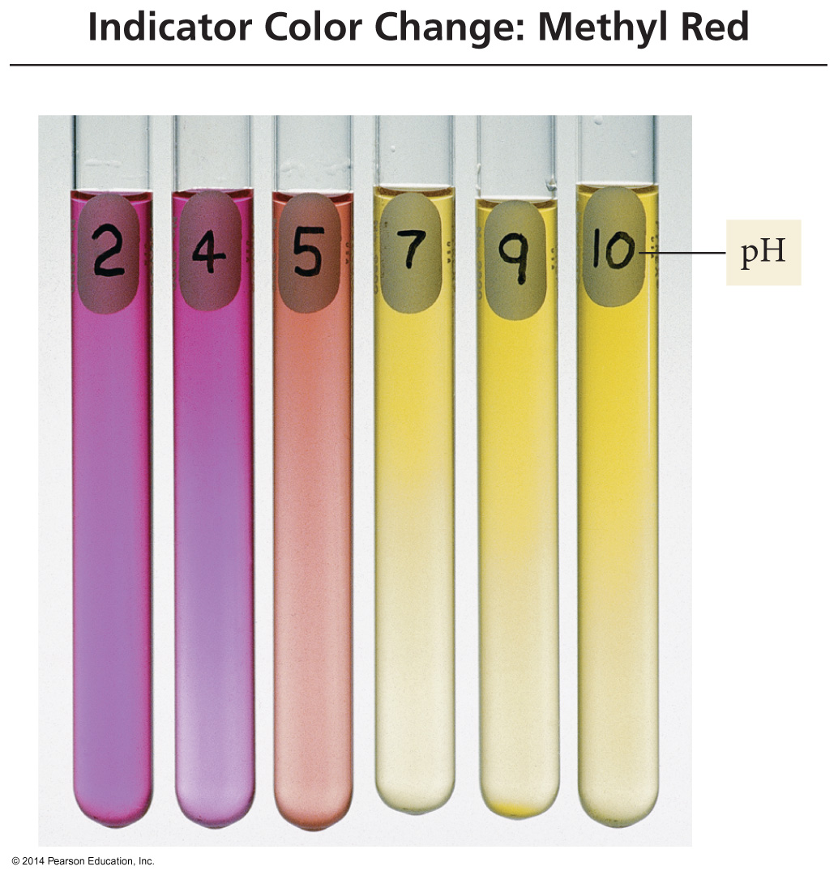
Phenolphthalein
Methyl Red

Slide 13
Example 2:- Find an indicator for the titration of a 0.05 M solution of a weak acid HA (K_{a}=6.2x10⁻⁶) with 0.1M NaOH solution.
Solution First, you should estimate the pH at the equivalence point, at which the solution is 0.05 M NaA. This is a hydrolysis problem, but the following method employs the general principle of equilibrium
A⁻ + H₂O ↔HA+OH⁻
0.05-y y y
If we multiply the numerator and the denominator by [H⁺ ], rearrange the terms, note that [H⁺][OH⁻] =K_{w,} and by the definition of Ka of the acid, we have the following relationship:
y² [HA][OH⁻] [H⁺] K_{w}
----------= ------------- . ---------= ---------
0.05-y [A⁻] [H⁺] K_{a}
y= [(0.05)(K_{w}/K_{a})] ^{(1/2)} =9.0x10^{-6,} pOH=-log[OH⁻] =-log 9.0x10⁻⁶ =5.05, pH=14-5.05 = 8.95
Phenolphthalein in the table has a pKa value of 9.7, which is the closest to the pH of the equivalence point in the titration, this indicator is colorless in acidic solution, but a light PINK appears when the pH is > 8. The color becomes more intense pink as the pH rises.

Slide 14
Type of Titrations
Classified into four types based on the type of reaction involved:
Acid-base titrations, in which an acidic or basic titrant reacts with an analyte that is a base or an acid(Neutralization reactions).
Complexometric titration, involving a metal-ligand complexation reaction.
Precipitation titrations in which the analyte and titrant react to form a precipitate.
Redox titration, where the titrant is an oxidizing or reducing agent.
Theory of Neutralization Titration
Neutralization reactions
Neutralization reactions refer to acid and base reactions producing salt and water the equivalent amounts of acid react with a base to form an equivalent amount of salt and water. When the reaction is complete, acid and base are said to neutralize each other since water is produced.
A neutralization reaction is also referred to as a “water-forming reaction”
Acid+ base → salt +water

Slide 15
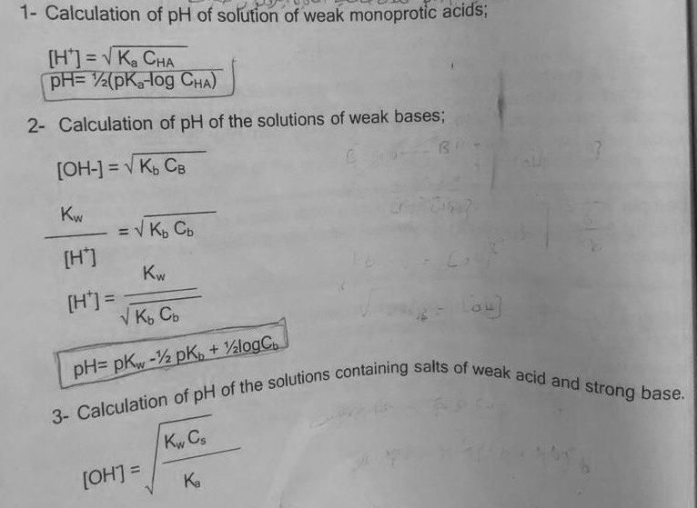
Acid-base equilibrium: pH calculation
Calculation of pH and pOH requires a numerical value for the equilibrium constant for the reaction of weak acid or base with water; we will summarize the relationships, which connect the equilibrium constants and pH calculation that would be useful for neutralization titrations.

Slide 16
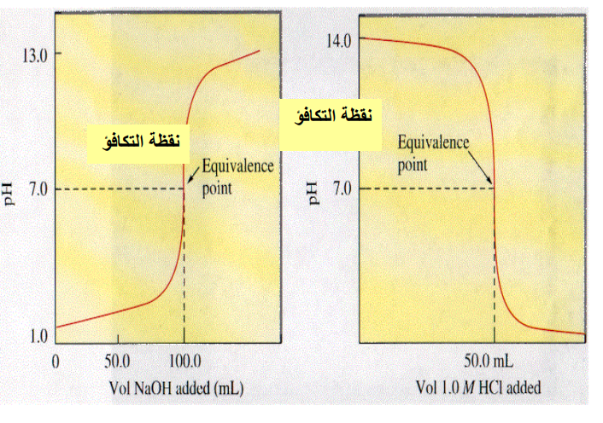
Titration Curve
A titration curve is a graph showing the pH of an acid or base as a function of the volume of titrant (base or acid solution) added.
The x-axis units are always reagent or titrant volume.
The Y-axis may be increments of analyte reacted or product formed (linear segment curve) or a p-function such as pH (s—curve).
The equivalence point is characterized by large changes in the relative concertation of the reagent and analyte.
The inflection point of the curve is the equivalence point of the titration.
Before the equivalence point, the unknown solution in the flask is in excess, so the pH is closest to its pH.
The pH of the equivalence point depends on the pH of the salt solution.
The equivalence point of a neutral salt, pH = 7
Equivalence point of acidic salt, pH < 7 (NH₄⁺)
Equivalence point of basic salt, pH > 7 (A⁻)
Beyond the equivalence point, the known solution in the burette
is in excess, so the pH approaches its pH.
Types of Titration Curve
Strong Acid–Strong Base
Weak Acid- Strong Base
Weak Base- Strong Acid

Slide 17
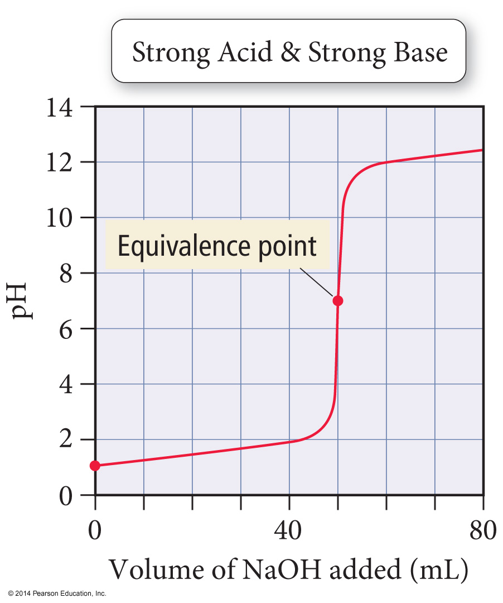
Titration Curve: Strong Base- Strong Acid

Slide 18
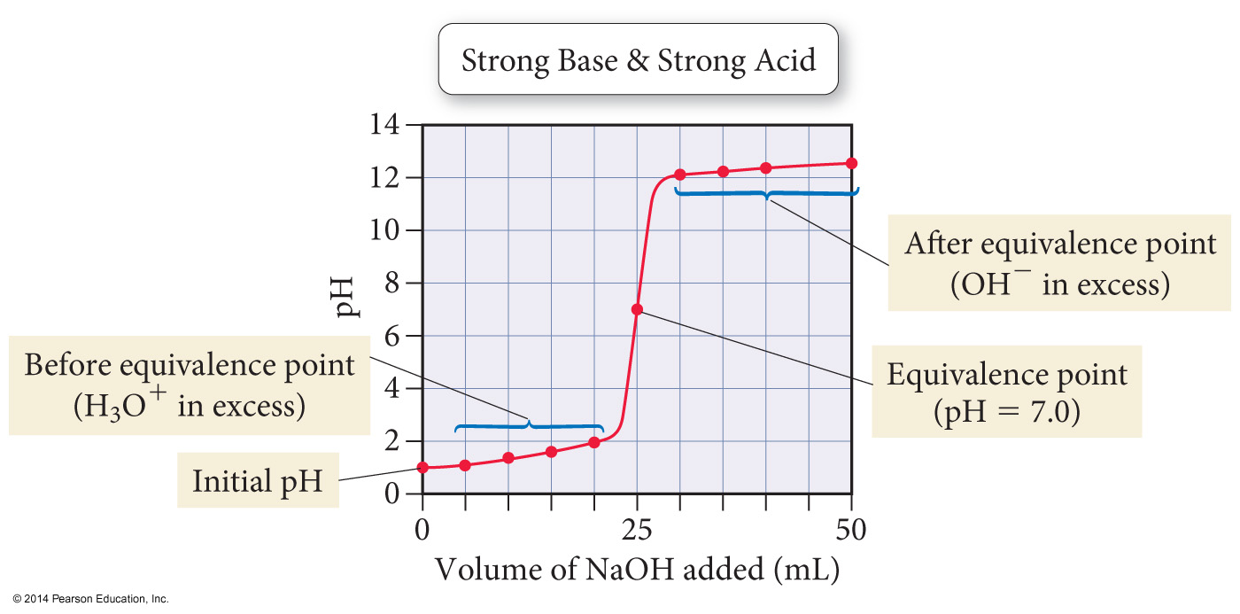
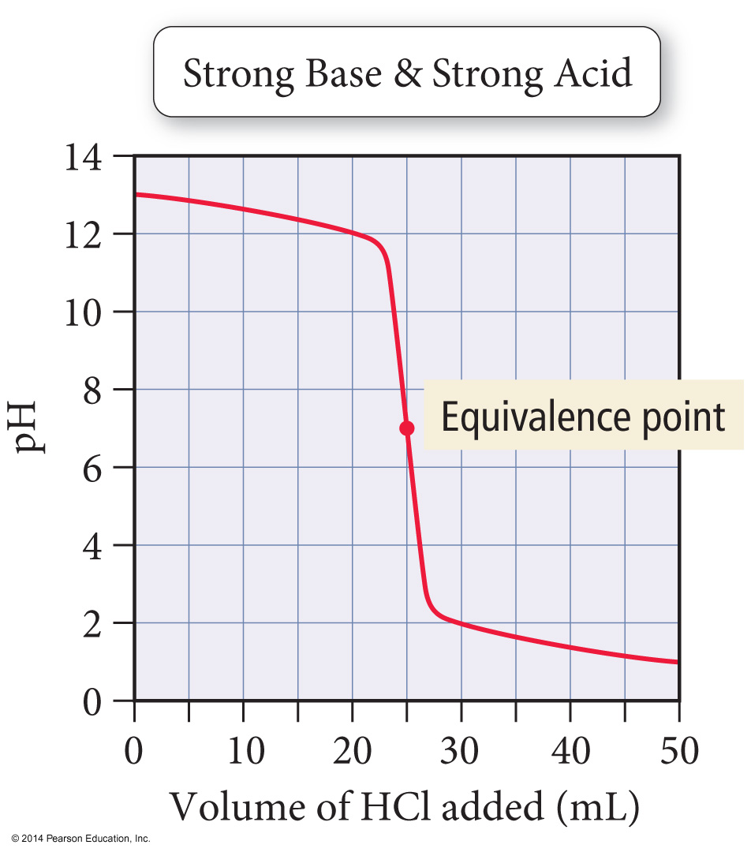
Titration Curve: Strong Base- Strong Acid
If the titration is run so that the acid is in the burette and the base is in the flask, the titration curve will be the reflection of the one just shown.

Slide 19
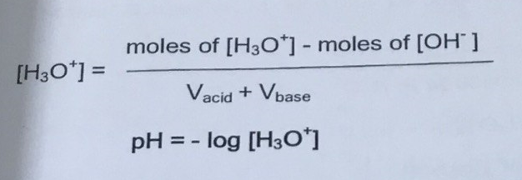
Titration curves for strong acid vs. Strong base
In this titration curve, strong acid (HCl) is titrated with a strong base (NaOH)
Initial: Before any NaOH has been added, the pH is low because all that is present is H₃O⁺ from a strong acid
Thus, pH=-log [H₃O⁺]
2- pH before equivalence point (pre-equivalent point): The pH gradually increases as NaOH neutralizes HCl.
The increase more sharply closer to the point
The number of moles of OH⁻ added equals the number of moles of H₃O⁺, which have reacted.
Subtract the number of moles of H₃O⁺
Divide the moles of H₃O⁺ by the total solution volume to obtain [H₃O⁺]
3- pH at the equivalence point
At the equivalence point, the same number of moles of NaOH has been added, as there were moles of HCl initially.
The solution contains only neutral ions (cations of strong bases and anions of strong acids) and H₂O, and is therefore neutral:
[H₃O⁺]= 1.0X10⁻⁷ M, pH=7

Slide 20
4- pH after the equivalence point (post-equivalent point):
The pH continues to increase sharply at first; then slowly as more NaOH is added. All of the H₃O⁺ has been neutralized, so the amount of OH⁻ in excess must be determined.
Subtract the initial number of moles of H₃O⁺ from the number of moles of OH⁻ added
Divide the moles of OH⁻by total solution volume to obtain [OH⁻]
Determine the pOH and pH

Slide 21
Titration Strong Acid with a Strong Base
Titration of 20 ml of 0.5M HCl with 0.5M NaOH, Calculate pH(a) after the addition of 0.0ml NaOH
(a) Before any addition of base, the solution contains only acid(0.5 M HCl)
HCl + H₂O H₃O⁺ +Cl⁻
0.5M 0.5M
pH=- log [H₃O⁺]= -log[0.5]=0.301
(b) after the addition of 10.0ml NaOH
The amount(moles#) of OH⁻ should be neutralized with the amount(moles#) of H₃O⁺ that was originally in the solution, so we need to calculate the # of H₃O⁺ moles) in 20 ml of 0.5M HCl
[H₃O⁺ ]=$\frac{mol}{L}$. 0.5= $\frac{mol}{20/1000},$0.5= $\frac{mol}{0.02}$. ,,,,,,,, [H₃O⁺ ]=0.01 mols
Also we need to calculate the # of OH⁻ moles) in 10 ml 0.5M NaOH
NaOH OH⁻ +Na⁺
0.5M 0.5M
[OH⁻ ]=$\frac{mol}{L}$. 0.5= $\frac{mol}{10/1000},$0.5= $\frac{mol}{0.01}$. ,,,,,,,, [OH⁻ ]=0.005 mols
Calculate the number of moles of H₃O⁺ remaining by setting up a table based on the neutralization reaction that shows the amount of H₃O⁺ before the addition, the amount of OH⁻ added, and the amounts of of H₃O⁺ left after the addition.
H₃O⁺ + OH⁻ 2H₂O
0.01 0.005
0.005 0.005
0.005 0
All # of OH⁻ moles completely neutralize with # of H₃O⁺ moles these, half of H₃O⁺
(0.01) neutralize with NaOH(0.005)
By substract(-)

Slide 22
Now we have to calculate the conc. of HCl from the amount of [H₃O⁺ remaining by the total volume (initial volume plus added volume).
[H₃O⁺ ]=$\frac{mol}{L}$. = $\frac{0.005}{20+10/1000},$=. $\frac{0.005}{0.03}$ ,,,,,,,, [H₃O⁺ ]=0.17 M, pH=- log [H₃O⁺]= -log[0.17]=0.77
(c) after the addition of 20.0ml NaOH
Calculate the number of moles of OH⁻ is added to the solution
[OH⁻ ]=$\frac{mol}{L}$. 0.5= $\frac{mol}{20/1000},$0.5= $\frac{mol}{0.02}$. ,,,,,,,, [OH⁻ ]=0.01 mols
Moles # of H₃O⁺ that was originally in the solution is [H₃O⁺ ]=$\frac{mol}{L}$. 0.5= $\frac{mol}{20/1000},$0.5= $\frac{mol}{0.02}$. ,,,,,,,, [H₃O⁺ ]=0.01 mols[Moles # of H₃O⁺ are equal to Moles # of OH⁻] [the equivalence point]
H₃O⁺ + OH⁻ 2H₂O [pH here is for H₂O because the Na⁺ and Cl⁻ don’t react with water]pH = 7
(d) after the addition of 20.20ml NaOH
[OH⁻ ]=$\frac{mol}{L}$. 0.5= $\frac{mol}{20.20/1000},$0.5= $\frac{mol}{0.02020}$. ,,,,,,,, [OH⁻ ]=0.0101 mols
Now we have to calculate the conc. of OH⁻ from the amount of [OH⁻] remaining by the total volume (initial volume plus added volume).
[OH⁻ ]=$\frac{mol}{L}$
[OH⁻ ]=$\frac{orginal \# of moles HCl − \# ofmoles NaOH ddded}{total volume}$, [OH⁻ ]=$\frac{0.01−0.0101}{20+20.20/1000}$, [OH⁻ ]=$\frac{0.0001}{0.0420}$, [OH⁻ ]=0.002M
pOH=- log [OH⁻]= -log[0.002]=2.7
pH=14-pOH, 14-2.7= 11.3(solution is basic)

Slide 23
Example: Strong Acid–Strong Base Titration pH Curve
A 50.0 mL sample of 0.200 M sodium hydroxide is titrated with 0.200 M nitric acid. Calculate pH:
a. after adding 30.00 mL of HNO₃ b. at the equivalence point
Solution
a. Begin by calculating the initial amount of NaOH (in moles) from the volume and molarity of the NaOH solution. Because NaOH is a strong base, it dissociates completely, so the amount of OH– is equal to the amount of NaOH.
Calculate the amount of HNO₃ (in moles) added at 30.0 mL from the molarity of the HNO₃ solution.
As HNO₃ is added to the solution, it neutralizes some of the OH–. Calculate the number of moles of OH– remaining by setting up a table based on the neutralization reaction that shows the amount of OH– before the addition, the amount of H₃O⁺ added, and the amounts left after the addition.

Slide 24
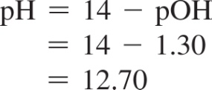
Example: Strong Acid–Strong Base Titration pH Curve
Continued
Calculate the OH– concentration by dividing the amount of OH– remaining by the total volume (initial volume plus added volume).
Calculate the pOH from [OH–].
Calculate the pH from the pOH using the equation pH + pOH = 14.
b. At the equivalence point, the strong base has completely neutralized the strong acid. The [H₃O⁺] at 25 °C from the ionization of water is 1.00 × 10^{–7} M and the pH is therefore 7.00.
pH = 7.00

Slide 25
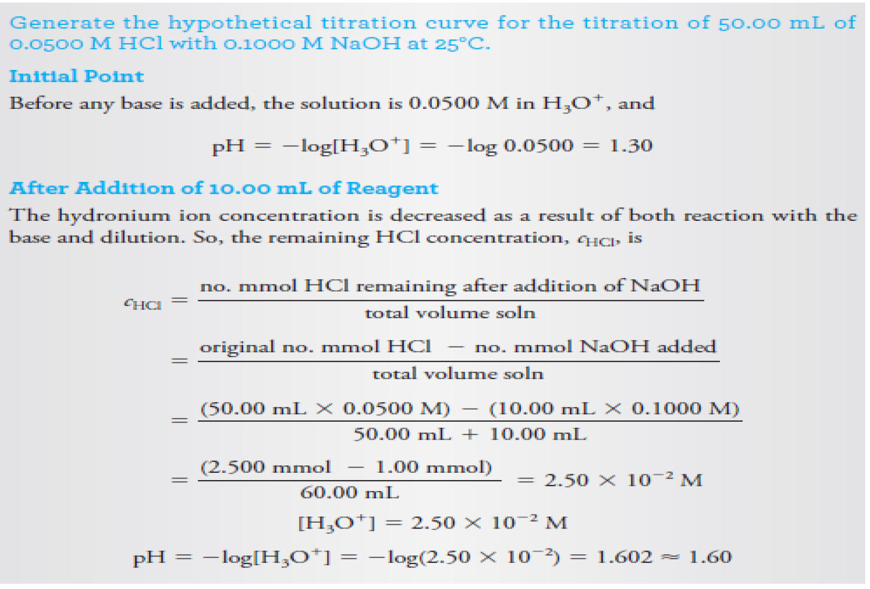
50/1000=0.05
10/1000=0.01
0.05+0.01

Slide 26
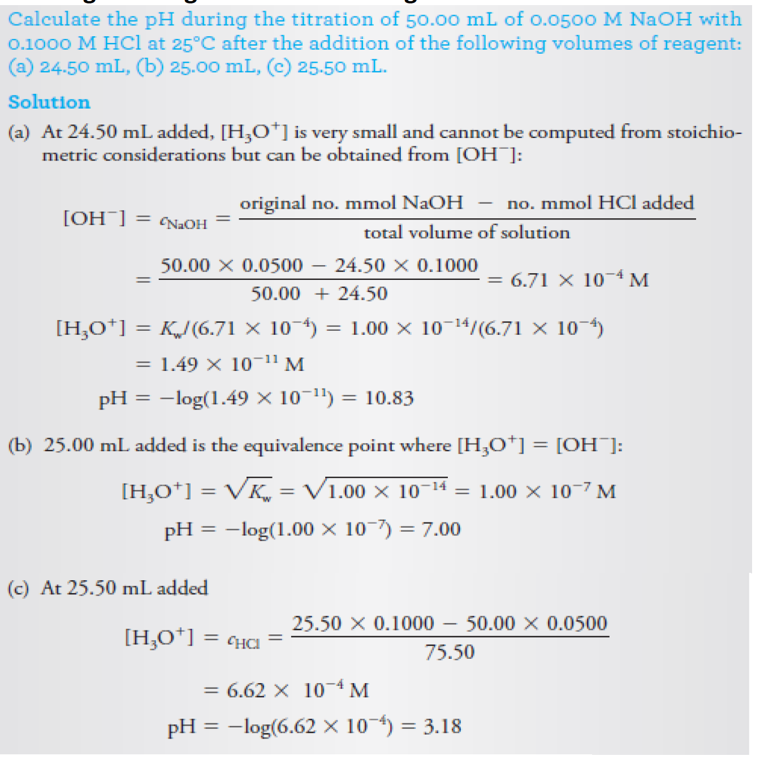
Titration curve for strong base vs. strong acid

Slide 27
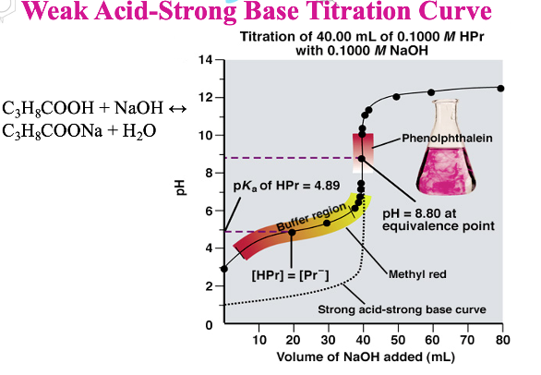
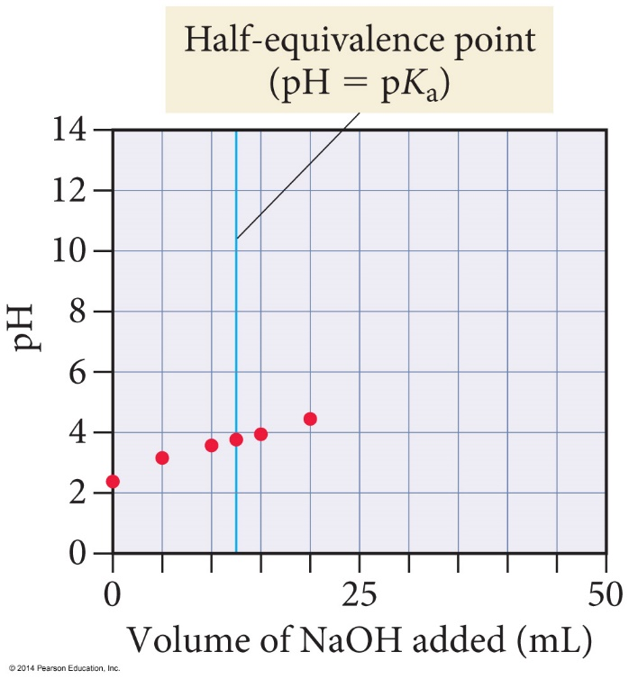
Titration Weak Acid with a Strong Base
Titrating a weak acid with a strong base results in differences in the titration curve at the equivalence point and excess acid region.
The initial pH is that of the weak acid solution(The initial pH is determined using the K_{a} of the weak acid)
Calculate like a weak acid equilibrium problem.
Before the equivalence point, the solution becomes a buffer(The pH in the excess acid region is determined as you would determine the pH of a buffer)
The pH at the equivalence point is determined using the K_{b} of the conjugate base of the weak acid.
The pH after equivalence is dominated by the excess strong base.
The basicity from the conjugate base anion is negligible.
Calculate mol HA_{init} and mol A⁻_{init} using reaction stoichiometry
Calculate pH with Henderson–Hasselbalch(An equation derived from the K_{a} expression that allows us to calculate the pH of a buffer solution) using mol HA_{init} and mol A⁻_{init}
Half-neutralization pH = pK_{a}

Slide 28
Titration curve for weak acids vs. strong base
For types of calculations needed to derive the titration curve for weak acids vs. strong bases, these are:
Before the addition of the base
Before the equivalence point (buffer region)
At the equivalence point
After the equivalence point
Titration curve for weak acid vs. strong base
1. Initial pH
The initial pH is higher than for the strong acid titration, science a weak acid dissociates less than a strong acid at the same concentration (less H₃O⁺ higher pH)
Science we have a dilute solution of a weak acid, solve for x = [H₃O+], and find the pH
HA↔H⁺+A⁻ Ka
2. pH before the equivalence point
As OH is added, some HA is converted to its conjugate base, A⁻ slowly raising the pH of the solution
Before the equivalence point is reached, the solution is a mixture of a weak acid, HA, and its conjugate base, A- and is a buffer. the pH can be calculated from the Hasselbalch equation .(it is not necessary to a count for the change in volume , since this will cancel out in the concentration ratio ) at the midpoint of the buffer region.

Slide 29
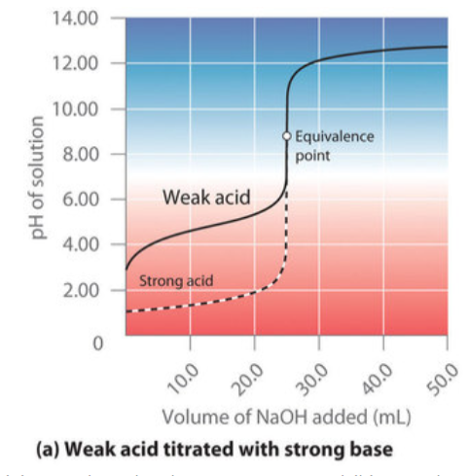
3. pH at the equivalence point
At the equivalence point, enough moles of OH⁻ have been added to turn all of the HA into A⁻. The solution is no longer a buffer. The pH is greater than 7, since A⁻ is the conjugate base of a weak acid, and reacts with it to produce OH⁻, yielding a basic solution. The pH is calculated in an ICE table using the base dissociation of A⁻(make sure to use the total solution volume when calculating [A-]:
A⁻(aq) + H₂O→ HA (aq) +OH⁻
4. pH after the equivalence point
The pH continues to increase slowly as more bases are added. The pH is calculated the same way as in a strong acid- strong base titration

Slide 30
Titration Weak Acid with a Strong Base
Titration of 50 ml of 0.2M CH₃COOH with 0.05M NaOH, Calculate pH(a) after the addition 0f 0.0 ml of 0.05 NaOH , Ka is 1.8 $×$10⁻⁵
(a) Before any addition of base, the solution contains only acid 0.2 M CH₃COOH)weak acid dissociation is not complete need to set the ICE box
CH₃COOH + H₂O H₃O⁺ +CH₃COO⁻
0.2. 0 0
-X +X +X
0.2-X X X,,,,,,,,,,,,,,,Ka=$\frac{\left[CH3COO−\right][H3O+]}{[CH3COOH]}$ , ,,,,,,,,,,,,,,,Ka=$\frac{X2}{0.2−X }$,,,, X= 0.0019M[H₃O⁺ ] , pH=- log [H₃O⁺]= -log[0.0019]=2.27
(b) after the addition of 100ml NaOH
We need to calculate the amount(moles#) of OH⁻ added to the solution , [OH⁻ ]=$\frac{mol}{L}$. 0.05= $\frac{mol}{100/1000},$ 0.5= $\frac{mol}{0.1},$[OH⁻ ]=0.005 mole
Also we need to calculate moles # of CH₃COOH that was originally in the solution is [CH₃COOH]=$\frac{mol}{L}$. 0.2= $\frac{mol}{50/1000},$0.2= $\frac{mol}{0.05}$, [CH₃COOH]=0.01 mole
Now we have to calculate the conc. of CH₃COOH and CH₃COO⁻ remaining after the addition of OH⁻ by the total volume (initial volume plus added volume).
CH₃COOH + OH⁻ H₂O +CH₃COO⁻
[CH₃COOH ]= $\frac{orginal \# of moles CH3COOH − \# ofmoles NaOH ddded}{total volume}$, [CH₃COOH ]=$\frac{0.01−0.005}{50+100/1000}$, [CH₃COOH ]=$\frac{0.005}{0.15}$, [CH₃COOH]=0.033M
[CH₃COO⁻ ]= $\frac{orginal \# of moles CH3COO− − \# ofmoles NaOH ddded}{total volume}$, [CH₃COO⁻ ]=$\frac{0.0−0.005}{50+100/1000}$, [CH₃COO⁻ ]=$\frac{0.005}{0.15}$, [CH₃COO⁻]=0.033M( this is a buffer solution)
Calculate the pH of buffer solution pH =pKa + log $\frac{[A−]}{[HA]}$, , pKa – log Ka = - log 1.8 $×$10⁻⁵ = 4.74, pH =4.74 + log $\frac{0.033}{0.033}$, pH = 4.47
Can you say this is the equivalent point???????????explain why

Slide 31
(c) after the addition of 200ml NaOH
We need to calculate the amount(moles#) of OH⁻ added to the solution , [OH⁻ ]=$\frac{mol}{L}$. 0.05= $\frac{mol}{200/1000},$ 0.05= $\frac{mol}{0.2},$[OH⁻ ]=0.01 mole
Also we need to calculate moles # of CH₃COOH that was originally in the solution is [CH₃COOH]=$\frac{mol}{L}$. 0.2= $\frac{mol}{50/1000},$0.2= $\frac{mol}{0.05}$, [CH₃COOH]=0.01 mole
Now we have to calculate the conc. of OH⁻, CH₃COOH and CH₃COO⁻ remaining after the addition of OH⁻ by the total volume (initial volume plus added volume).
CH₃COOH + OH⁻ H₂O +CH₃COO⁻
[CH₃COOH ]= $\frac{orginal \# of moles CH3COOH − \# ofmoles NaOH ddded}{total volume}$, [CH₃COOH]=$\frac{0.01−0.01}{50+200/1000}$, [CH₃COOH ]=$\frac{0.0}{0.25}$, [CH₃COOH]=0.0M
[CH₃COO⁻ ]= $\frac{orginal \# of moles CH3COO− − \# ofmoles NaOH ddded}{total volume}$, [CH₃COO⁻ ]=$\frac{0.0−0.01}{50+200/1000}$, [CH₃COO⁻ ]=$\frac{0.01}{0.25}$, [CH₃COO⁻]=0.04M
[OH⁻ ]=$\frac{orginal \# of moles NaOH − \# ofmoles NaOH ddded}{total volume}$, [OH⁻ ]=$\frac{0.01−0.01}{50+200/1000}$, [OH⁻ ]=$\frac{0.0}{0.25}$, [OH⁻ ]=0.0M
[The ratio between CH₃COOH and NaOH is 1:1[this is the equivalence point]
And at the equivalence point we have the CH₃COO⁻ which will be react with the water to give CH₃COOH
CH₃COO⁻ + H₂O CH₃COOH+ OH⁻
0.04 0 0
-X + X +X
0.04-x x. x
K_{b}=$\frac{\left[CH3COOH\right][OH−]}{[CH3COO−]}$ , ,,,,,,,,,,,,,,, 5.6 $×$10⁻¹⁰ =$\frac{X2}{0.04−X }$,,,, X= 4.7 $×$10⁻⁶ M[OH⁻ ] , pOH=- log [OH⁻]= -log[4.7 $×$10⁻⁶ ]=5.33
pH=14-pOH, pH= 14- 5.33= 8.67(solution is basic)
K_{b}=K_{w}/K_{a}=1.0 $×$10⁻¹⁴/1.8 $×$10⁻⁵
K_{b}= 5.6 $×$10⁻¹⁰
Because the CH₃COO⁻ is the conjugated base for the weak acid CH₃COOH we used the K_{b} instead of Ka

Slide 32
(d) after the addition of 300ml NaOH
We need to calculate the amount(moles#) of OH⁻ added to the solution , [OH⁻ ]=$\frac{mol}{L}$. 0.05= $\frac{mol}{300/1000},$ 0.05= $\frac{mol}{0.3}$[OH⁻ ]=0.015 mole
Now we have to calculate number of moles of OH⁻ and the conc. of OH⁻remaining after the addition of OH⁻ by the total volume (initial volume plus added volume).
Number of moles of OH⁻ remaining $= orginal \# of moles CH3COOH − \# ofmoles NaOH ddded$=0.01-0.015=0.005mole
[OH⁻]= $\frac{orginal \# of moles CH3COOH − \# ofmoles NaOH ddded}{total volume}$, [OH⁻ ]=$\frac{0.01−0.015}{50+300/1000}$, [OH⁻ ]=$\frac{0.005}{0.35}$, [OH⁻]=0.014M
,pOH=- log [OH⁻]= -log[0.014]=1.85
pH=14-pOH, pH= 14- 1.85= 12.15(solution is basic)

Slide 33
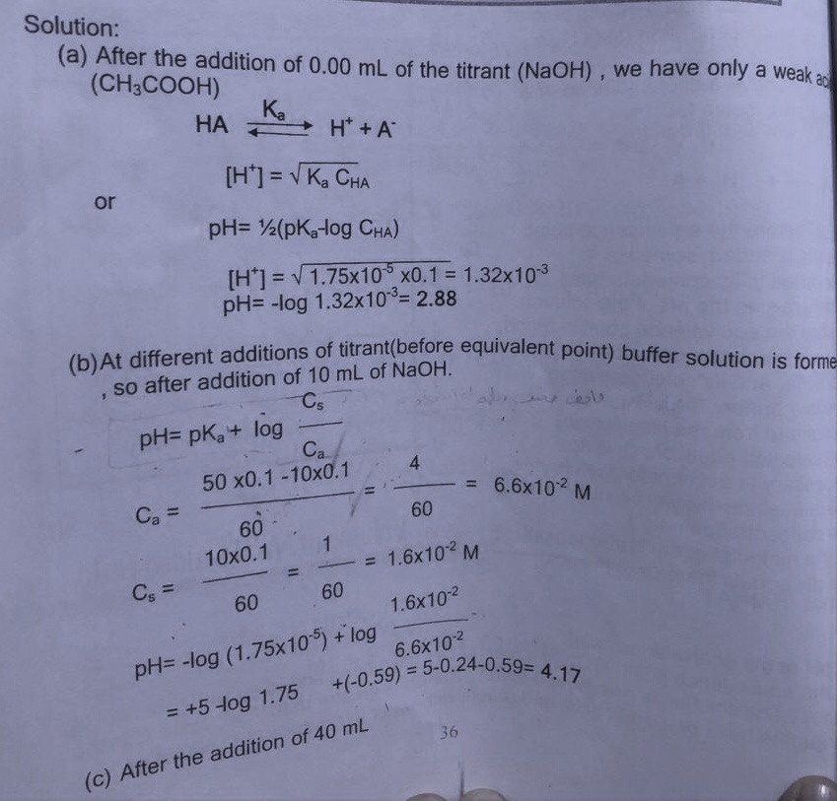
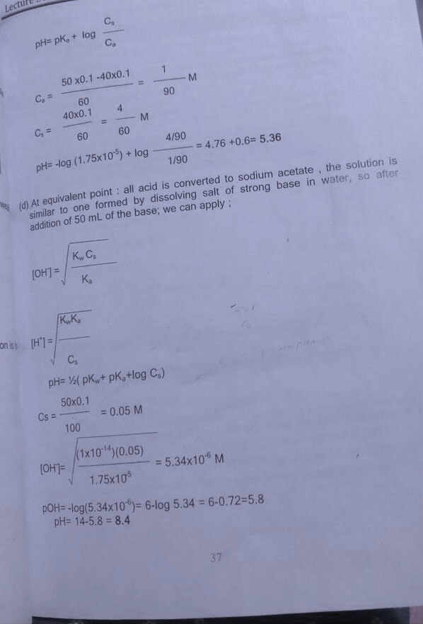
Example: Derive the titration curve for 50 ml of 0.1 M acetic acid (K_{a}= 1.7x10⁻⁵) with 0.1M NaOH, after the addition of
a) 0.00 ml b) 10 ml c) 40 ml d) 50 ml
90

Slide 34
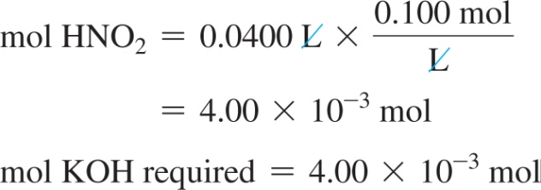
Example: Weak Acid–Strong Base Titration pH Curve
A 40.0 mL sample of 0.100 M HNO₂ is titrated with 0.200 M KOH. Calculate:
a. the volume required to reach the equivalence point
b. the pH after adding 5.00 mL of KOH
c. the pH at one-half the equivalence point
Solution
a. The equivalence point occurs when the amount (in moles) of added base equals the amount (in moles) of acid initially in the solution. Begin by calculating the amount (in moles) of acid initially in the solution. The amount (in moles) of KOH that must be added is equal to the amount of the weak acid.
Calculate the volume of KOH required from the number of moles of KOH and the molarity.

Slide 35
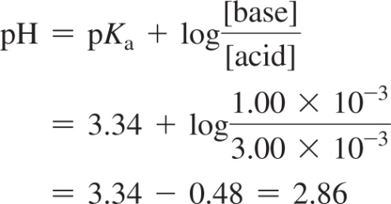
Example: Weak Acid–Strong Base Titration pH Curve
Continued
b. Use the concentration of the KOH solution to calculate the amount (in moles) of OH– in 5.00 mL of the solution.
Prepare a table showing the amounts of HNO₂ and NO₂– before and after the addition of 5.00 mL KOH. The addition of the KOH stoichiometrically reduces the concentration of HNO₂ and increases the concentration of NO₂–.
Since the solution now contains significant amounts of a weak acid and its conjugate base, use the Henderson–Hasselbalch equation and pK_{a} for HNO₂ (which is 3.34) to calculate the pH of the solution.

Slide 36
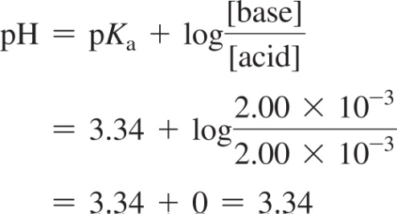
Example: Weak Acid–Strong Base Titration pH Curve
Continued
c. At one-half the equivalence point, the amount of added base is exactly one-half the initial amount of acid. The base converts exactly half of the HNO₂ into NO₂–, resulting in equal amounts of the weak acid and its conjugate base. The pH is therefore equal to pK_{a}.

Slide 37
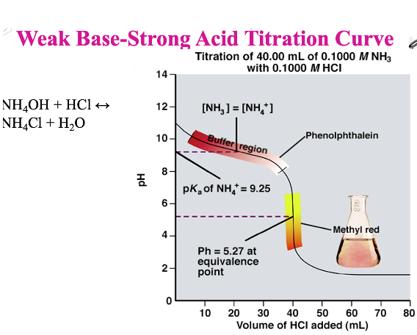
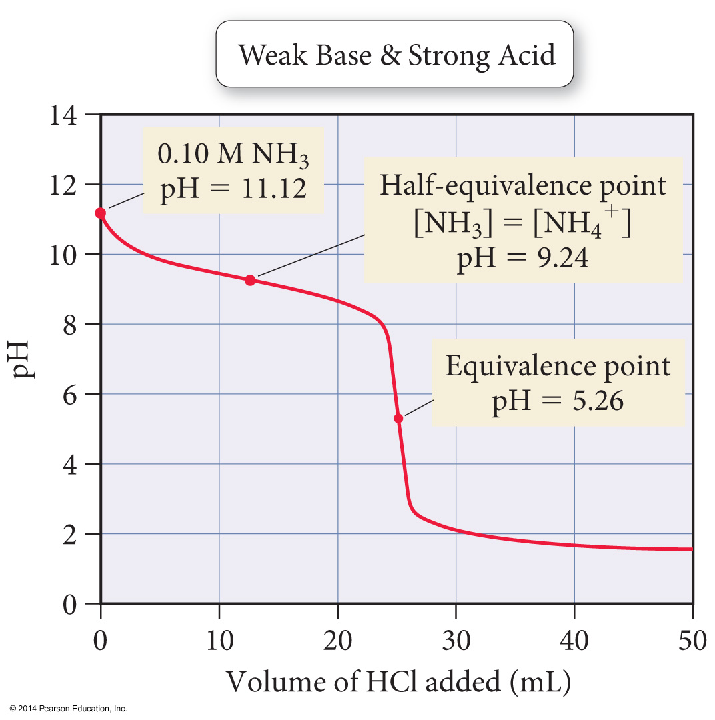
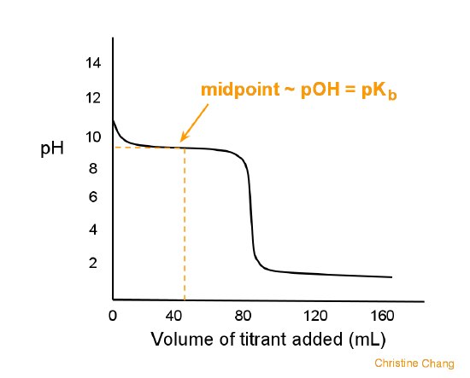
Titration Curve of a Weak Base with a Strong Acid
In this titration curve, a weak base (B) is titrated with strong acid .calculating the pH along this curve is similar to a weak acid-strong base curve, except that the solution starts basic, and becomes more acidic as the titrate is added.
The pH at the equivalence point is less than pH7, because the entire weak base B has been converted to its conjugate acid BH.

Slide 38
Titration Curve of a Weak Base with a Strong Acid
Titration of 40 ml of 0.1M NH₃ with 0.1M HCl, Calculate pH, K_{b} is 1.8 $×$10⁻⁵
(a)What is the pH before any acid is added?
(a) Before any addition of acid, the solution contains only base 0.1 M (NH₃)weak base dissociation is not complete need to set the ICE box
NH₃ + H₂O NH₄⁺ +OH⁻
0.1 0 0
-X +X +X
0.1-X X X,,,,,,,,,,,,,,,K_{b}=$\frac{\left[NH4+\right][OH−]}{[NH3]}$ , ,,,,,,,,,,,,,,,K_{b}=$\frac{X2}{0.1−X }$,,,, X= 0.0013M[OH⁻ ] , pOH=- log [OH⁻ ]= -log[0.0013]=2.87
pH=14-pOH, pH=14-2.87=11.11
(b) What is the pH after the addition of 20 ml 0.1M HCl?
We need to calculate the amount(moles#) of HCl added to the solution , [HCl ]=$\frac{mol}{L}$. 0.1= $\frac{mol}{20/1000},$ 0.1= $\frac{mol}{0.02},$[HCl ]=0.002 mole(# of H⁺ or H₃O⁺ mole)
Also we need to calculate moles # of NH₃ that was originally in the solution is [NH₃ ]=$\frac{mol}{L}$. 0.1= $\frac{mol}{40/1000},$0.1= $\frac{mol}{0.04}$, [NH₃ ]=0.004 mole
Write the eaction equation NH₃ + H₃O⁺ NH₄⁺ +H₂O
Now we have to calculate the conc. of NH₃ and NH₄⁺ remaining after the addition of H₃O⁺ by the total volume (initial volume plus added volume)
[NH₃ ]= $\frac{orginal \# of moles\text{NH}\text{3}− \# ofmoles HCl ddded}{total volume}$, [NH₃ ]=$\frac{0.004−0.002}{40+20/1000}$, [NH₃ ]=$\frac{0.002}{0.06}$, [NH₃]=0.0333M
[NH₄⁺ ]= $\frac{orginal \# of moles\text{NH}\text{4}\text{+}− \# ofmoles HCl ddded}{total volume}$, [NH₄⁺ ]=$\frac{0.0−0.002}{40+20/1000}$, [NH₄⁺ ]=$\frac{0.002}{0.06}$, NH₄⁺ ]=0.0333M(buffer solution)
[H₃O⁺ ]=$\frac{orginal \# of mole \text{HCl}− \# ofmoles HCl ddded}{total volume}$, [H₃O⁺ ]=$\frac{0.002−0.002}{40+20/1000}$, [H₃O⁺ ]=$\frac{0.0}{0.06}$, [H₃O⁺ ]=0.0M
Calculate the pH of buffer solution pH =pK_{a} + log $\frac{[A−]}{[HA]}$, , pK_{a} – log K_{a} = - log 5.6 $×$10⁻¹⁰ = 9.25
pH =9.25 + log $\frac{0.0333}{0.0333}$, pH = 9.25
K_{a}=K_{w}/K_{b}=1.0 $×$10⁻¹⁴/1.8 $×$10⁻⁵
K_{a}= 5.6 $×$10⁻¹⁰
Because the NH₄⁺ is the conjugated acid for the weak base NH₃ we used the K_{a} instead of Kb
Can you say this is the equivalent point???????????explain why

Slide 39
(c) What is the pH after the addition of 40 ml 0.1M HCl?
We need to calculate the amount(moles#) of HCl added to the solution , [HCl ]=$\frac{mol}{L}$. 0.1= $\frac{mol}{40/1000},$ 0.1= $\frac{mol}{0.04},$[HCl ]=0.004 mole(# of H⁺ or H₃O⁺ mole)
Also we need to calculate moles # of NH₃ that was originally in the solution is [NH₃ ]=$\frac{mol}{L}$. 0.1= $\frac{mol}{40/1000},$0.1= $\frac{mol}{0.04}$, [NH₃ ]=0.004 mole
NH₃ + H₃O⁺ NH₄⁺ +H₂O
Now we have to calculate the conc. of NH₃ and NH₄⁺ remaining after the addition of H₃O⁺ by the total volume (initial volume plus added volume)
[NH₃ ]= $\frac{orginal \# of moles\text{NH}\text{3}− \# ofmoles HCl ddded}{total volume}$, [NH₃ ]=$\frac{0.004−0.004}{40+40/1000}$, [NH₃ ]=$\frac{0.0}{0.08}$, [NH₃]=0.0M
[NH₄⁺ ]= $\frac{orginal \# of moles\text{NH}\text{4}\text{+}− \# ofmoles\text{HC} \text{l} \text{added} }{total volume}$, [NH₄⁺ ]=$\frac{0.0−0.004}{40+40/1000}$, [NH₄⁺ ]=$\frac{0.004}{0.08}$, [NH₄⁺ ]=0.05M
[H₃O⁺ ]=$\frac{orginal \# of mole \text{HCl}− \# ofmoles HCl ddded}{total volume}$, [H₃O⁺ ]=$\frac{0.004−0.004}{40+40/1000}$, [H₃O⁺ ]=$\frac{0.0}{0.08}$, [H₃O⁺ ]=0.0M
The ratio between HCl and NH₃ is 1:1[this is the equivalence point]
And at the equivalence point we have the NH₄⁺ which will be react with the water to give NH₃
NH₄⁺+ H₂O NH₃ + H₃O⁺
0.05. 0 0
-x +x. +x
0.05-x x x
K_{a}=$\frac{\left[\text{NH}\text{3}\right][\text{H}\text{3}\text{O}\text{+}]}{[\text{NH}\text{4}\text{+}]}$ , ,,,,,,,,,,,,,,, 1.8 $×$10⁻⁵ =$\frac{X2}{0.05−X }$,,,, X= 5.3 $×$10⁻⁶ M[H₃O⁺] , pH=- log [H₃O⁺]= -log[5.3 $×$10⁻⁶ ]=5.28
Because the NH₄⁺ is the conjugated acid for the weak base NH₃ we used the K_{a} instead of K_{b}

Slide 40
(c) What is the pH after the addition of 60 ml 0.1M HCl?
We need to calculate the amount(moles#) of HCl added to the solution , [HCl ]=$\frac{mol}{L}$. 0.1= $\frac{mol}{60/1000},$ 0.1= $\frac{mol}{0.06},$[HCl ]=0.006 mole(# of H⁺ or H₃O⁺ mole)
Also we need to calculate moles # of NH₃ that was originally in the solution is [NH₃ ]=$\frac{mol}{L}$. 0.1= $\frac{mol}{40/1000},$0.1= $\frac{mol}{0.04}$, [NH₃ ]=0.004 mole
[H₃O⁺ ]=$\frac{orginal \# of mole\text{NH}\text{4}\text{+}− \# ofmoles HCl ddded}{total volume}$, [H₃O⁺ ]=$\frac{0.004−0.006}{40+60/1000}$, [H₃O⁺ ]=$\frac{0.002}{0.1}$, [H₃O⁺ ]=0.02M
pH=- log [H₃O⁺]= -log[0.02]=1.699

Slide 41
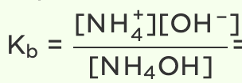
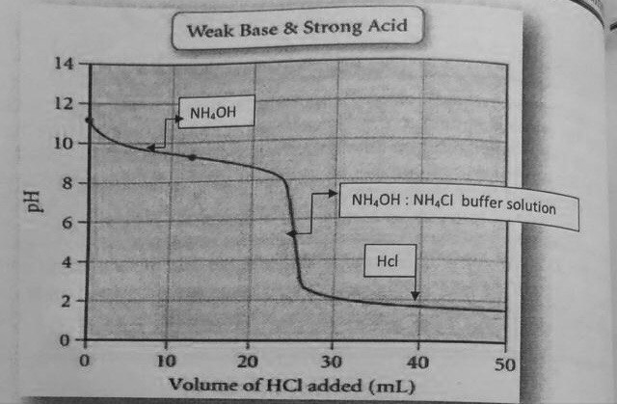
Example: 20 ml of 0.5 M NH₄OH is diluted to 100 with water and titrated with 0.5 M HCl. Calculate the pH value
(a) at the start (b) at the equivalent point. Show the general form of the titration curve. K_{b} =1.7x10⁻⁵
Solution
We find the concentration of NH₄OH
C_{B} = 20 x 0.5/100=0.1M
at start (0.0ml) HCl
[OH] =√K_{b}C_{B} =√1.75x10⁻⁵x0.1 =1.32x10⁻³
pOH=-loց 1.32x10⁻³ =2.878
pH=14-2.878 = 11.12
b) V x 0.5(HCL)=100x0.1(NaOH)=20ml volume of HCl needed for equivalent point
Cs= (0.1x100) ⁄ (100+20) =0.0833M
The pH can be calculated from
pH=½( pK_{w}-pK_{b}- loց Cs) (Hydrolysis of Salt of Strong Acids and Weak Bases) salt is NH₄Cl
= ½ (14-4.76- loց 0.0833)
=½ (99.24+1.08)= 5.16
I 0.1 0 0
C -X +X +X
E 0.1-X X X

Slide 42
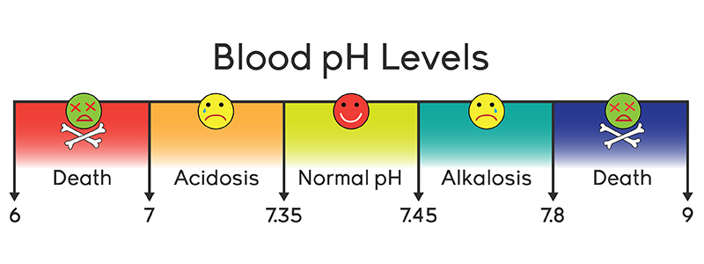
Buffer Solutions
Buffer solution is defined as a solution that resists change in pH as a result of either dilution or addition of acid or base.
Buffer solution is a mixture of :
a) a weak acid and its salt, CH₃COOH + CH₃COONa
b) weak base and its salt, NH₃ + NH4Cl
Blood has a mixture of H₂CO₃ and HCO₃⁻
Q: Why does buffer solution resist the change in pH value in case of dilution or adding acid or base to solution?
When adding a strong acid, like HCl :
HCl → H₃O⁺ + Cl-
CH₃COOH $⇌$H₃O⁺ + CH₃COO⁻
CH₃COONa $⇌$ Na⁺ + CH₃COO⁻
H₃O⁺+ CH₃COO⁻ $⇌$CH₃COOH
From the equation, the pH value does not change or it changes very little because the hydronium ion from HCl reacts with CH₃COO- to produce CH₃COOH that is ionized very little, therefore, pH does not decrease.
2) When adding a strong base, like NaOH :
CH₃COOH $⇌$H₃O⁺ + CH₃COO⁻
CH₃COONa $⇌$ Na⁺ + CH₃COO⁻
NaOH→ Na⁺ + OH⁻
H₃O⁺ + OH⁻ $⇌$H₂O
OH⁻ from the base (NaOH) reacts with H₃O⁺ from the acid to produce H₂O, and that leads to more dissociation of CH₃COONa to substitute the losses in H₃O⁺ This means, the solution will resist the change in pH value when adding a strong base while the solution still acidic (containing CH₃COOH molecules) nonionized.

Slide 46
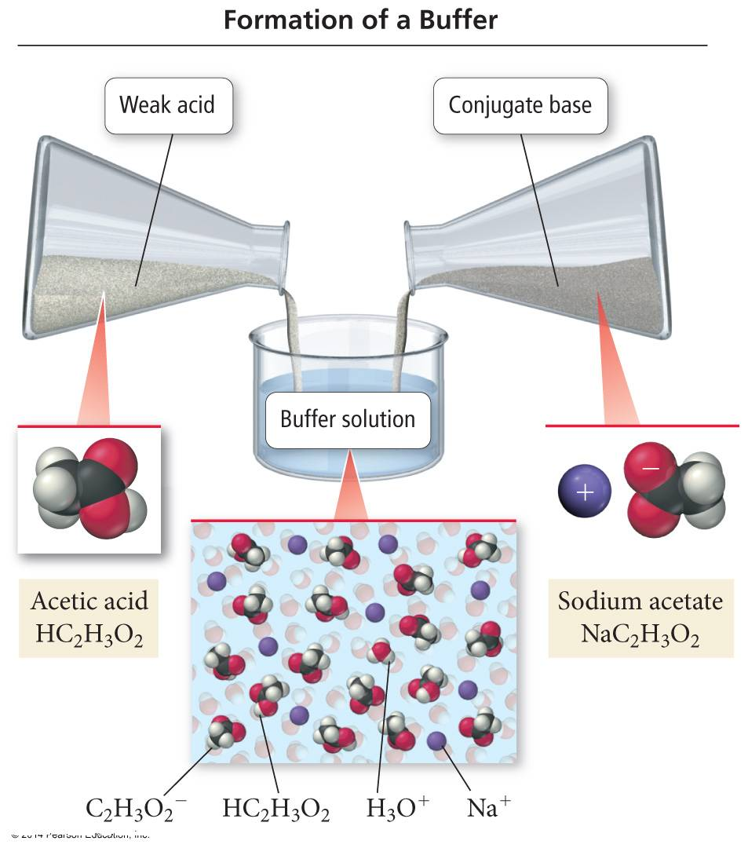
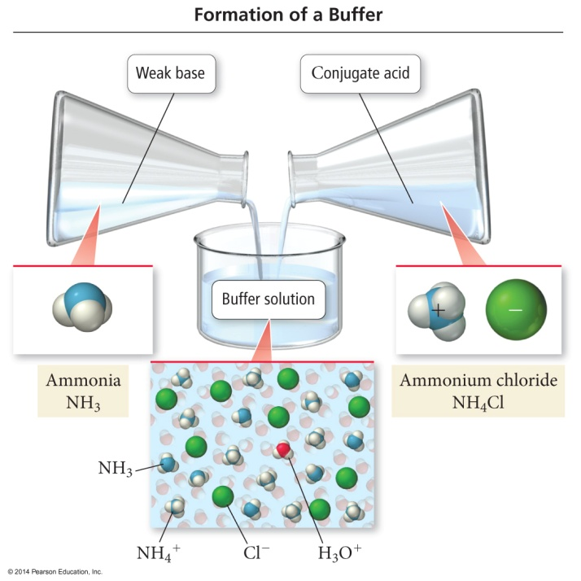
Making an Acidic and basic Buffer Solution
It must contain significant amounts of both a weak acid and its conjugate base.
It must contain significant amounts of both a weak base and its conjugate acid

Slide 47
An Acidic Buffer Solution
If a strong base is added, it is neutralized by the weak acid (HC₂H₃O₂) in the buffer.
NaOH(aq) + HC₂H₃O₂(aq) → H₂O(l) + NaC₂H₃O₂(aq)
If the amount of NaOH added is less than the amount of acetic acid present, the pH change is small.
If a strong acid is added, it is neutralized by the conjugate base (NaC₂H₃O₂) in the buffer.
HCl(aq) + NaC₂H₃O₂ → HC₂H₃O₂(aq) + NaCl(aq)
If the amount of HCl is less than the amount of NaC₂H₃O₂ present, the pH change is small.
How Acid Buffers Work: Addition of Base
HA_{(aq)} + H₂O_{(l)} ⇔ A⁻_{(aq)} + H₃O⁺_{(aq)}
Buffers work by applying Le Châtelier’s principle to weak acid equilibrium.
Buffer solutions contain significant amounts of the weak acid molecules, HA.
These molecules react with an added base to neutralize it.
HA(aq) + OH⁻(aq) → A⁻(aq) + H₂O(l)

Slide 48
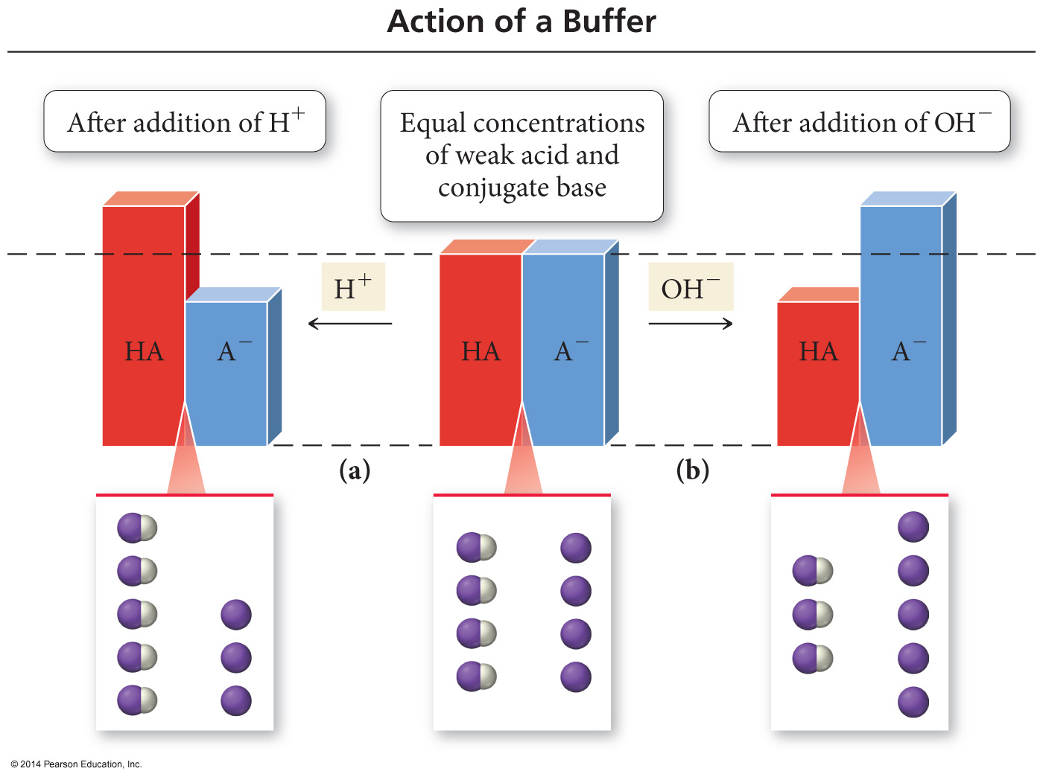
The action of a Buffer
Figure 16.3 pg 762

Slide 49
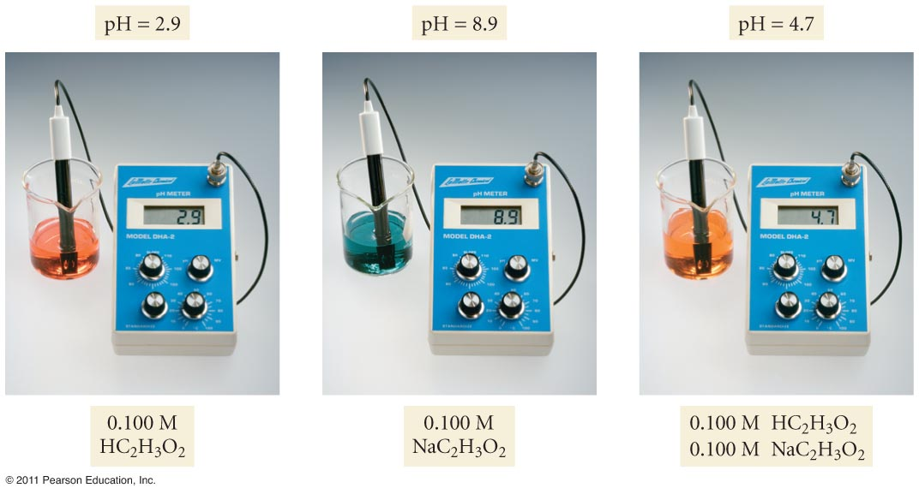
How Acid Buffers Work: Addition of Acid
HA_{(aq)} + H₂O_{(l)} ⇔ A⁻_{(aq)} + H₃O⁺_{(aq)}
The buffer solution also contains significant amounts of the conjugate base anion, A⁻.
These ions combine with added acid to make more HA.
H⁺(aq) + A⁻(aq) → HA(aq)
After the equilibrium shifts, the concentration of H₃O⁺ is kept constant.
Common Ion Effect HA_{(aq)} + H₂O_{(l)} ⇔ A⁻_{(aq)} + H₃O⁺_{(aq)}
Adding a salt containing the anion NaA, which is the conjugate base of the acid (the common ion), shifts the position of equilibrium to the left.
This causes the pH to be higher than the pH of the acid solution, lowering the H₃O⁺ ion concentration.

Slide 50
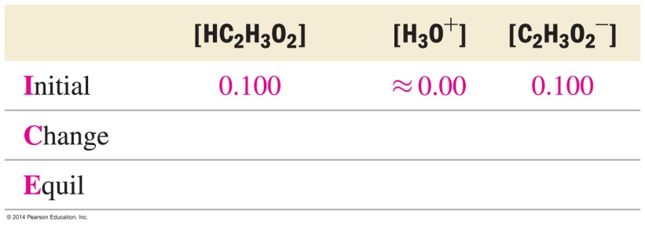
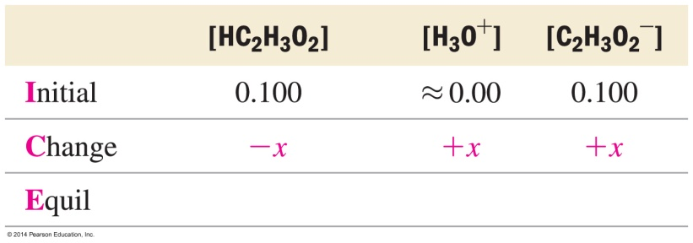
Example: Calculating the pH of a Buffer Solution
Calculate the pH of a buffer solution that is 0.100 M in HC₂H₃O₂ and 0.100 M in NaC₂H₃O₂
Solution
1. Write the balanced equation for the ionization of the acid and use it as a guide to prepare an ICE table showing the given concentrations of the acid and its conjugate base as the initial concentrations. Leave room in the table for the changes in concentrations and the equilibrium concentrations.
2. Represent the change in the concentration of H₃O⁺ with the variable x. Express the changes in the concentrations of the other reactants and products in terms of x.

Slide 51
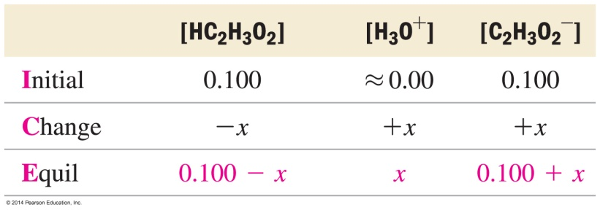
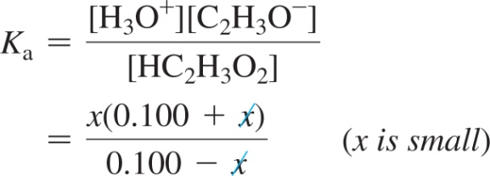
Example: Calculating the pH of a Buffer Solution
Continued
3. Sum each column to determine the equilibrium concentrations in terms of the initial concentrations and the variable x.
4. Substitute the expressions for the equilibrium concentrations (from step 3) into the expression for the acid ionization constant.
In most cases, you can make the approximation that x is small. (See Sections 14.8 and 15.6 to review the x is a small approximation.)

Slide 52
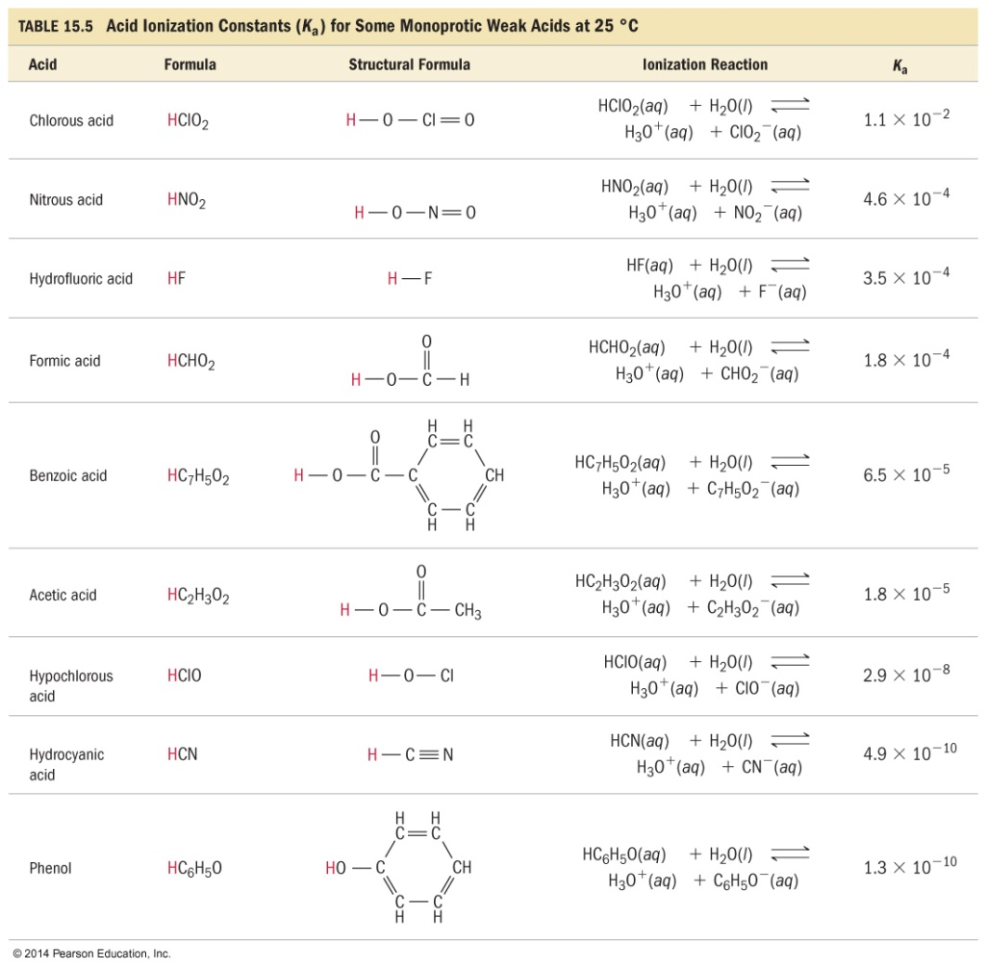
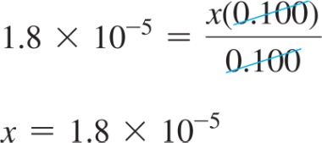
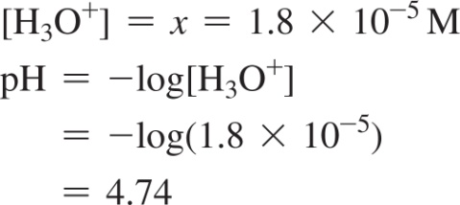
Example: Calculating the pH of a Buffer Solution
Continued
Substitute the value of the acid ionization constant (from Table 15.5) into the K_{a} expression and solve for x.
Confirm that x is small by calculating the ratio of x and the number it was subtracted from in the approximation. The ratio should be less than 0.05 (or 5%).
Therefore the approximation is valid.
5. Determine the H₃O⁺ concentration from the calculated value of x and substitute into the pH equation to find pH.

Slide 53
Calculate the pH for a solution prepared by adding 10 ml of 0.1M acetic acid to 20 ml of 0.1M sodium acetate, K_{a} = 1.75x10⁻⁵.
Solution
We should calculate the conc. of acid and salt, final vol. = 30ml
for CH₃COOH : M1V1 = M2V2, 0.1M x 10ml = M2 x 30ml, M2(HOAc) = 0.033 M
For CH₃COONa (OAc-): M1V1 = M2V2. 0.1 M x 20ml = M(OAc-) x 30ml M(OAc-) = 0.067 M
OR
OR
pH = 4.67 + log 0.067/ 0.033
pH= 4.67 + log 2
pH = 5.06

Slide 54
Calculate the concentration of ammonia and weight of ammonia chloride (NH₄Cl) that is needed to prepare 100ml of buffer sol. with pH = 10 salt conc. = 0.2M , pK_{b} = 4.67?
Solution
We can calculate the conc. of NH₃ from : pOH = pKw – pH, pOH = 14 – 10 = 4
4 = 4.67 + log 0.2M/ [NH₃]
-0.67= log 0.2 M/ [NH₃]. (x-log)
-10^{-0.67}= log 0.2 M/ [NH₃].
10⁻¹ $×$10^{0.24} =1.7 $×\text{10}\text{−1}$ =0.17
[NH₃]= 0.2/0.17= 1.2 M
m.moles NH₄Cl = 0.2m.mole/ml x 100ml = 20 m.moles
mg(NH₄Cl) = 20m.moles x 53.5 mg/m.mole = 107 x 10⁻³mg
OR
OR

Slide 55
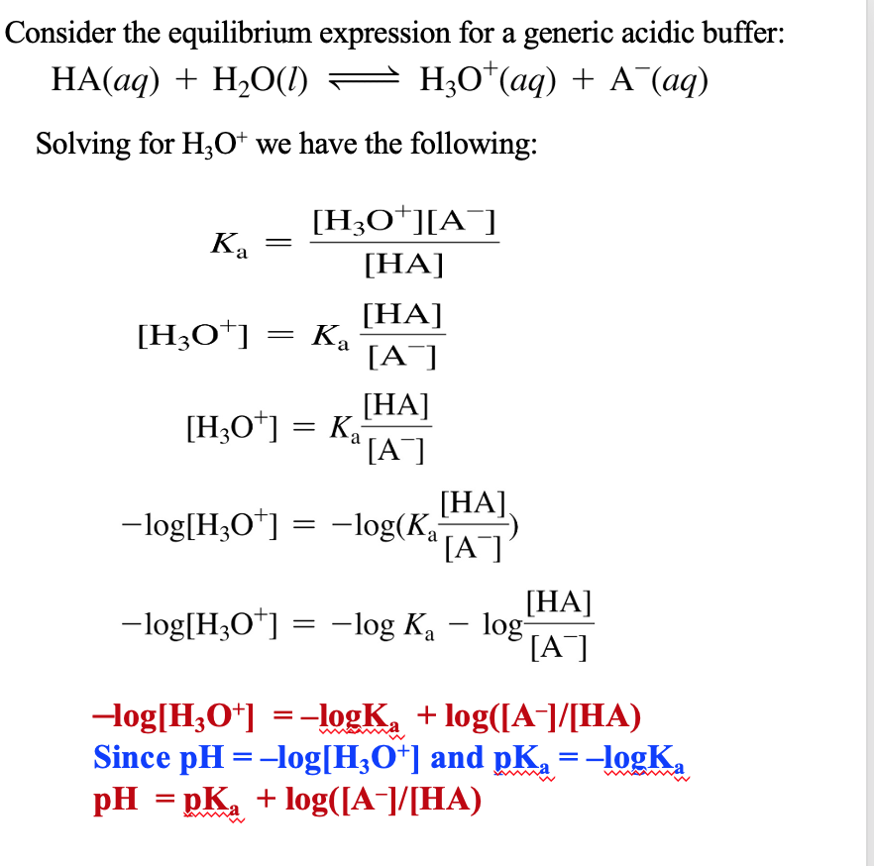
Henderson–Hasselbalch Equation for Acid Buffer
An equation derived from the K_{a} expression that allows us to calculate the pH of a buffer solution.
The equation calculates the pH of a buffer from the pK_{a} and initial concentrations of the weak acid and salt of the conjugate base, as long as the “x is small” approximation is valid.

Slide 56
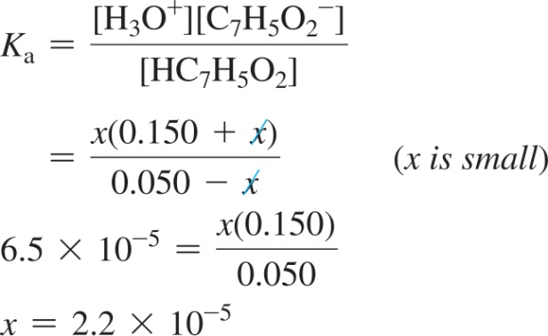
Example: Calculating the pH of a Buffer Solution as an Equilibrium Problem and with the Henderson–Hasselbalch Equation
Calculate the pH of a buffer solution that is 0.050 M in benzoic acid (HC₇H₅O₂) and 0.150 M in sodium benzoate (NaC₇H₅O₂). For benzoic acid, K_{a} = 6.5 × 10^{–5}.
Solution
Equilibrium Approach
Write the balanced equation for the ionization of the acid and use it as a guide to prepare an ICE table.
Substitute the expressions for the equilibrium concentrations into the expression for the acid ionization constant. Make the x is a small approximation and solve for x.

Slide 57
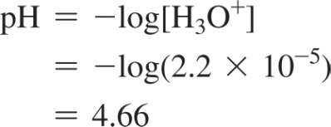
Example: Calculating the pH of a Buffer Solution as an Equilibrium Problem and with the Henderson–Hasselbalch Equation
Continued
Since [H₃O⁺] = x, we calculate pH as follows:
Confirm that the x is small approximation is valid by calculating the ratio of x to the number it was subtracted from in the approximation. The ratio should be less than 0.05 (or 5%). (See Sections 14.8 and 15.6 to review the x is small approximation.)
The approximation is valid.
Henderson–Hasselbalch Approach
To find the pH of this solution, determine which component is the acid and which is the base and substitute their concentrations into the Henderson–Hasselbalch equation to calculate pH.

Slide 58
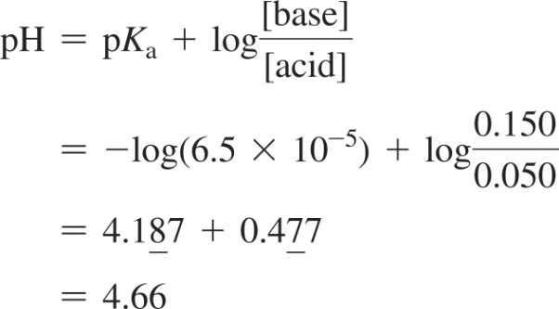
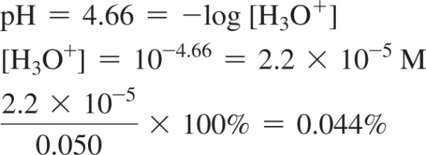
Example: Calculating the pH of a Buffer Solution as an Equilibrium Problem and with the Henderson–Hasselbalch Equation
Continued
HC₇H₅O₂ is the acid and NaC₇H₅O₂ is the base. Therefore, we calculate the pH as follows:
Confirm that the x is a small approximation is valid by calculating the [H₃O⁺] from the pH. Since [H₃O⁺] is formed by ionization of the acid, the calculated [H₃O⁺] has to be less than 0.05 (or 5%) of the initial concentration of the acid for the x is a small approximation to be valid.
The approximation is valid.

Slide 59
Henderson–Hasselbalch Equation for the Basic Buffer
The Henderson-Hasselbalch equation also applies to a weak base. A weak base dissociates as follows:
B + H₂O ⇔ HB⁺ + OH^{−.}
To apply the Henderson–Hasselbalch equation, the chemical equation of the basic buffer must be looked at like an acid reaction.
pK_{a} + pK_{b} = 14

Slide 60
How Much Does the pH of a Buffer Change When an Acid or Base Is Added?
Calculating the new pH after adding acid or base requires breaking the problem into two parts:
A stoichiometry calculation for the reaction of the added chemical with one of the ingredients of the buffer to reduce its initial concentration and increase the concentration of the other.
Added acid reacts with the A⁻ to make more HA
Added base reacts with the HA to make more A⁻
An equilibrium calculation of [H₃O⁺] using the new initial values of [HA] and [A⁻]

Slide 61
Example: Calculating the pH Change in a Buffer Solution after the Addition of a Small Amount of Strong Acid or Base
A 1.0 L buffer solution contains 0.100 mol HC₂H₃O₂ and 0.100 mol NaC₂H₃O₂. The value of K_{a} for HC₂H₃O₂ is 1.8 × 10^{–5}. Because the initial amounts of acid and conjugate base are equal, the pH of the buffer is equal to pK_{a} = –log(1.8 × 10^{–5}) = 4.74. Calculate the new pH after adding 0.010 mol of solid NaOH to the buffer. For comparison, calculate the pH after adding 0.010 mol of solid NaOH to 1.0 L of pure water. (Ignore any small changes in volume that might occur upon the addition of the base.)
Solution
Part I: Stoichiometry. The addition of the base converts a stoichiometric amount of acid to the conjugate base (adding base creates more base). Write an equation showing the neutralization reaction and then set up a table to track the changes.
Part II: Equilibrium. Write the balanced equation for the ionization of the acid and use it as a guide to prepare an ICE table. Use the amounts of acid and conjugate base from part I as the initial amounts of acid and conjugate base in the ICE table.

Slide 62
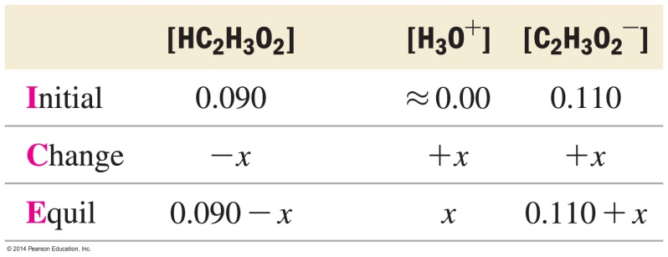
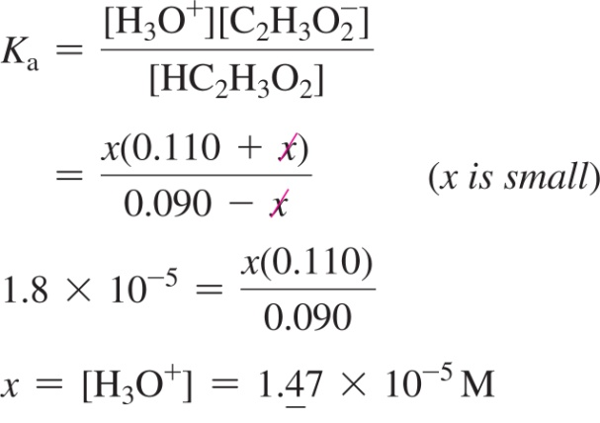
Example: Calculating the pH Change in a Buffer Solution after the Addition of a Small Amount of Strong Acid or Base
Continued
Substitute the expressions for the equilibrium concentrations of acid and conjugate base into the expression for the acid ionization constant. Make the x is a small approximation and solve for x. Calculate the pH from the value of x, which is equal to [H₃O⁺].

Slide 63
Example: Calculating the pH Change in a Buffer Solution after the Addition of a Small Amount of Strong Acid or Base
Continued
Confirm that the x is a small approximation is valid by calculating the ratio of x to the smallest number it was subtracted from in the approximation. The ratio should be less than 0.05 (or 5%).
The approximation is valid.
Part II: Equilibrium Alternative (using the Henderson–Hasselbalch equation). As long as the x is small approximation is valid, you can substitute the quantities of acid and conjugate base after the addition (from part I) into the Henderson–Hasselbalch equation and calculate the new pH.

Slide 64
Example: Calculating the pH Change in a Buffer Solution after the Addition of a Small Amount of Strong Acid or Base
Continued
The pH of 1.0 L of water after adding 0.010 mol of NaOH is calculated from the [OH–]. For a strong base, [OH–] is simply the number of moles of OH– divided by the number of liters of solution.
Check
Notice that the buffer solution changed from pH = 4.74 to pH = 4.83 upon addition of the base (a small fraction of a single pH unit). In contrast, the pure water changed from pH = 7.00 to pH = 12.00, five whole pH units (a factor of 10⁵). Notice also that even the buffer solution got slightly more basic upon the addition of a base, as we would expect. To check your answer, always make sure the pH goes in the direction you expect: adding base should make the solution more basic (higher pH); adding acid should make the solution more acidic (lower pH).

