Slide 1
Instrumental Analysis
Asst. Prof. Dr. Maha Al-Tameemi
Office hours: Monday at ( 9:00-11:00 AM)
Email: mahaks_chem@csw.uobaghdad.edu.iq
Lecture: Group A on Wednesday at (10:00 AM -1:00 PM ), Group B at (1:00 PM -4:00 PM ).
Course Goals:
To understand the concept and principle for Instrumental analysis:
Chemical /physical properties and the origin of chemical/ physical properties were measured.
Instrument design and nature of response.
Signal processing and the relationship between property measurement and instrument readout.
Course Grading Scheme:
Midterm exam =100 (two exams per semester)
Homework=100
Presentation =100
Attendance =100
Weekly discussion(oral quiz)=100
Final exam =100

Slide 2
Dr. Maha Al-Tameemi
مفردات التحليل الالي
Instrumental Analysis
الاشعة الكهرومغناطيسية Electromagnetic radiation
الاطياف الذرية Atomic Spectra
الاطياف الجزئية Molecular Spectra
التفلور(التالق)Fluorescence
التفسفر Phosphorescence
طيف الامتصاص الجزيئي Molecular Absorption spectra
مناطق الطيف Spectral Regions
مكونات وتركيب اجهزة القياس الطيفي
المصادر العملية للاشعاع الطيفي
المصادر الخطية Line sources
المصادر المستمرة Continuous sources
اختيار الاطوال الموجية
المرشحات Filters
موحدات اللون Mono chromates
خلايا الامتصاص Absorption Cells
المكشافات Detectors
المكشافات ما فوق البنفسجية والمرئية Ultra violet and visible radiation detectors
المكشافات ماتحت الحمراء Infrared detectors
قارئ او مسجل الاشارة للمكشاف Red out(Recorder of detector signal)
طيف المنطقة فوق البنفسجية والمرئية Ultra violet and visible spectroscopy
قانون بير Beer Law
الانحرافات عن قانون بير Deviation of Beer Low
اسباب الانحرافات عن قانون بير The reasons of deviation

Slide 3
Dr. Maha Al-Tameemi
تطبيقات قانون بير Application of beer low
الأجهزة المستخدمة في القياسات الطيفية
سبكتروفوتوميتر احادي الشعاع Single beam spectrophotometer
سبكتروفوتوميتر ثنائي الشعاع Double beam spectrophotometer
التطبيقات الكيمياوية لأطياف فوق البنفسجية واللونية Chemical application of UV-Visible spectra
التحليل بواسطه الأشعة تحت الحمراء Analysis by using infrared radiation
طيف امتصاص ما تحت الحمراء Absorption spectra of IR radiation
أنواع الاهتزازات الأساسية
طريقة تحضير العينات لأغراض التحليل بأطياف امتصاص
أجهزة سبكتروفوتومتر
المصادر المستخدمة ما تحت الحمراء
Flame atomic absorption الامتصاص الذري
Flame less absorption الامتصاص الذري اللهبي
المكونات الأساسية لجهاز الامتصاص الذري
مصادر الشعاع
Atomization of elements تذرية العناصر
أنواع اللهوب الكيمياوية
Types of nebulizer أنواع المرذاذ
Chromatography الكروموتوغرافيا
تصنيف الطرق الكروموتوغرافيه
High performance liquid chromatography (HPLC) تقنيه السائل عالية الأداء
Gas chromatography (GC) تقنيه كرموتوغرافيا الغاز
Electro chemical analysis طرق الكهربائية في التحليل
Potentiometry طرق قياس الجهد او المجهادية
Conductivity القياسات التوصيلية
polarography قياسات البولاروغرافي
Thermal analysis التحاليل الحرارية
Thermo gravimetric analysis(TG) التحاليل الحرارية الوزنية
Differential thermal analysis(DTA) التحليل الحراري التفاضلي
Differential scanning calorimetry analysis(DSC) المسح المسعري التفاضلي

Slide 4
Dr. Maha Al-Tameemi
المصادر:
1- اساسيات التحليل الالي ,تاليف: دوغلاس أ.سكوج ,دونالد ام.ويست ,ترجمة : د. زهير متي قصير د. ادمون ميخائيل حنا ,د. عبد اللطيف عبد الرزاق عبد الحليم .
2-الكيمياء التحليلية ومفهوم التحليل الكيمياوي الالي , تاليف : د.عبد المحسن الحيدري .
3- التحليل الكيمياوي الالي , تاليف : د.فاضل جاسم محمد ,د.صبري ميخائيل فروحة
4--الكيمياء التحليلية الاساسية الحديثة الاساسيات النظرية في طرق التحليل الالي , تاليف : د.معين سكندر , د.عبد المحسن الحيدري د.هادي كاظم عوض ,د. جواد سلمان البدري.
5-- Principles of instrumental analysis 6th Edition, 2007 .Douglas A. Skoog ,James Holler, Stanly R.Crouch.
6-Understanding Chemistry,INSTRUMENTAL ANALYSIS .
Jim Clark 2008
7-Analytical Chemistry for Technicians.. Third Edition,2003. by John Kenkel. Southeast Community College, Lincoln, Nebraska Printed in the United States of America

Slide 5
Infrared Spectroscopy (IR) Theory and Interpretation of IR spectra
Dr. Maha Al-Tameemi

Slide 6
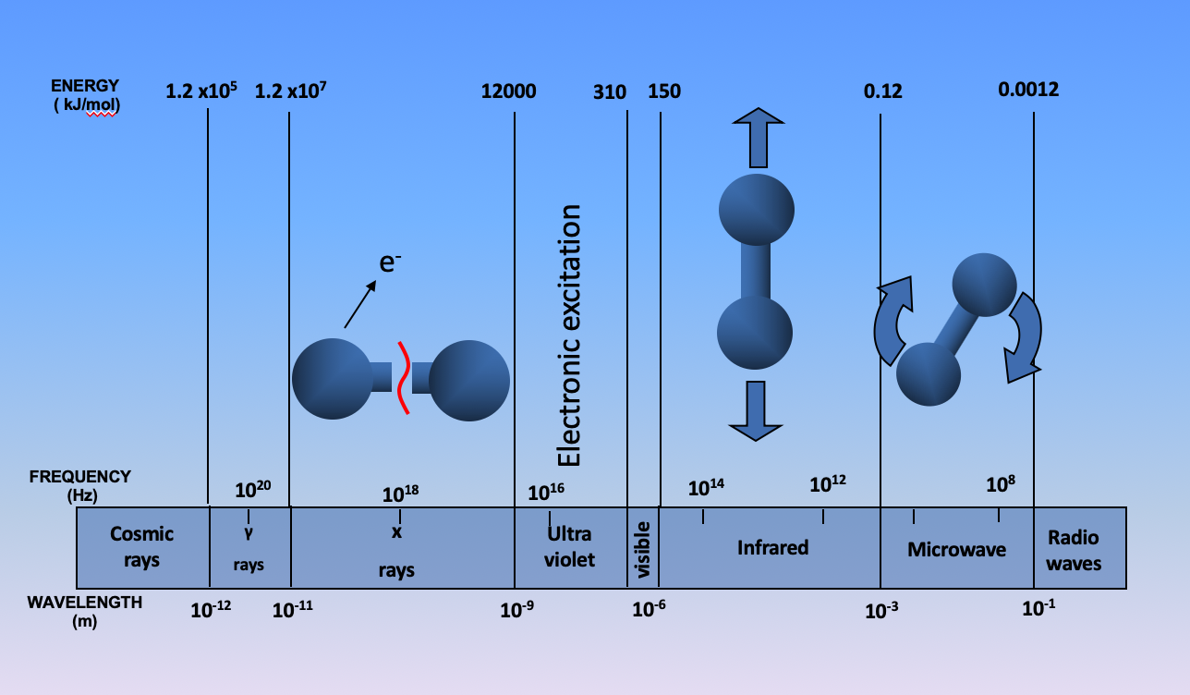
Dr. Maha Al-Tameemi
The strength of the radiation energy will interact with the molecules in different ways:
High energy sources produce the breaking of bonds X-Ray, γ Rays
Medium energy sources excite electrons
UV / VISIBLE Spectroscopy
(Electronic +Vibrational + Rotational transition)
Low energy sources produce vibrations in chemical bonds Infrared Energy
(Vibrational + Rotational transition)
Very low energy sources produce rotation of the chemical bonds Microwaves and Radio waves(Rotational transition)

Slide 8
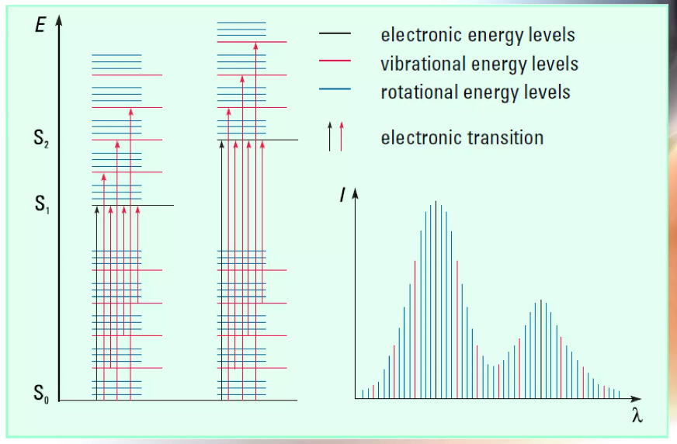

Slide 9
Energy levels in Infrared Absorption
Excited states
hν
Infrared Absorption and Emission
h(ν₂ - ν₁) (overtone)
ν₃
ν₂
h(ν₁ - ν₀ )
h(ν₁ - ν₀)
Ground (vibrational) states
ν₁
ν₀
Infrared absorption occurs among the ground vibrational states, the energy differences, and the corresponding spectrum, determined by the specific molecular vibration(s). The infrared absorption is a net energy gain for the molecule and is recorded as an energy loss for the analysis beam.

Slide 10
What is IR radiation?
Dr. Maha Al-Tameemi
Infrared radiation (IR) lies between the visible and microwave portions of the electromagnetic spectrum.
The term “infrared" covers the range of the electromagnetic spectrum between 0.78 and 1000 μm.
In the context of infrared spectroscopy, the wavelength is measured in "wavenumbers", which have the unit’s cm⁻¹
)Wave number = 1 / wavelength in centimeters(
Like a fingerprint, no two unique molecular structures produce the same infrared spectrum.
This makes infrared spectroscopy useful for several types of analysis.
Gives information about the functional groups in a molecule, its chemical nature, and molecular structures
Widely applied in the analysis of organic materials, also useful for polyatomic inorganic molecules and for organometallic compounds.
IR region is subdivided into 3-subregions infrared region:
Near IR [It affects electronic, vibrational, and rotational E levels].
Mid IR [It affects only vibrational, and rotational E levels].
Far IR [It affects only rotational E levels].
Mid IR region is the most useful IR region

Slide 11
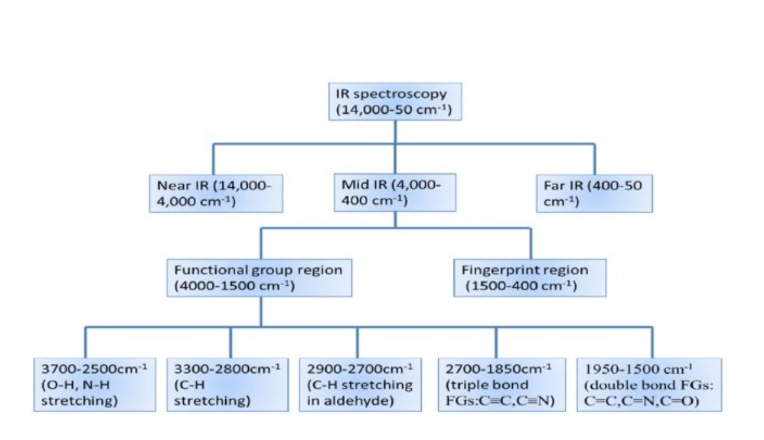
Stretching vibrations occur in the Functional group region
Bending vibrations occur in the Fingerprint region
Single bond region
Single bond region

Slide 12
In the fingerprint region, the spectra usually consist of bending vibrations within the molecule.
The pattern of peaks is more complicated, and it is much more difficult to pick out individual bonds in this region.
The fingerprint region is important because each different compound produces its own unique pattern of peaks (like a fingerprint) in this region.
Both spectra are quite similar in the functional group region, but their absorption patterns in the fingerprint region are completely different.

Slide 13
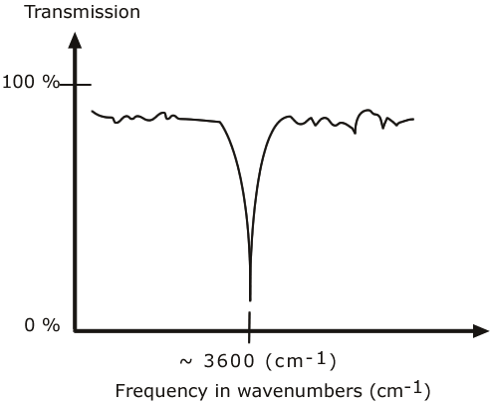
Dr. Maha Al-Tameemi
Infrared spectra are traditionally displayed as %T (percent transmittance) versus wave number (4000-400 cm⁻¹).
Infrared spectroscopy is the measurement of the wavelength and intensity of the absorption of mid-infrared light by a sample. (Mid-infrared is energetic enough to excite molecular vibrations to higher energy levels)
The wavelength of infrared absorption bands is characteristic of specific types of chemical bonds, and infrared spectroscopy finds its greatest utility in the identification of organic and organometallic molecules.
The high selectivity of the method makes the estimation of an analyte in a complex matrix possible.
A molecule can be characterized (identified) by its molecular vibrations, based on the absorption and intensity of specific infrared wavelengths.

Slide 14
Theory of Infrared Absorption Spectroscopy
Dr. Maha Al-Tameemi
In any molecule, atoms or groups of atoms are connected by bonds that are springs and are not rigid.
Bonded atoms have different strengths due to different masses.
The presence of separate areas of partial positive and negative charge in a molecule allows the electric field component of the electromagnetic wave to excite the vibrational energy of the molecule. So a bond will only interact with the electromagnetic infrared radiation if it is polar. The change in the vibrational energy produces a corresponding change in the dipole moment of the molecule. The intensity of the absorption depends on the polarity of the bond.
Molecular vibrational frequencies of molecules lie in the IR region of the electromagnetic spectrum, and they can be measured using IR spectroscopy.
In this technique, light of different frequencies is passed through a sample, and the intensity of the transmitted light is measured for each frequency.
Infrared spectroscopy measures the vibrations of atoms, from which the structure of molecules can be determined.
When molecules absorb infrared radiation, the electrons absorb photons of infrared light. The energy from the photons is then transferred to the electrons, which allows them to transition from a ground state to an excited vibrational state.
Depending on its structure, molecules absorb different frequencies of IR radiation.
In general, stronger bonds and light atoms vibrate at a higher frequency.
Absorption of IR energy will cause a vibrational change in the molecule and a beak will be observed when :
1- Selection rule for IR spectroscopy: Dipole moment of bonds should change during vibration.
2- When applied infrared frequency= Natural frequency vibration.
3- When covalent bonds are polar.
When the sample obeys these conditions then it gets vibrated by absorbing radiation and gives IR spectrum.
If the frequency of the radiation matches the vibrational frequency of the molecule, then radiation will be absorbed, causing a change in the amplitude of molecular vibration.

Slide 15
Molecular rotations
Simple diatomic molecules such as HCL, HBr, and HI can only vibrate when the bond stretches
In more complex molecules, different types of vibration can occur, such as bending so that a complex range of frequencies is present
Dr. Maha Al-Tameemi
The positions of atoms in molecules are not fixed; they are subject to several different vibrations. Vibrations fall into the two main categories:
Stretching [higher energy / higher wave number (cm⁻¹)]
Bending [lower energy / lower wave number (cm⁻¹)
How much movement occurs in the vibration of a C-C bond?
154 pm
4º
10 pm
Bending vibration [bond angle]
Stretching vibration [bond length]
10 pm

Slide 16
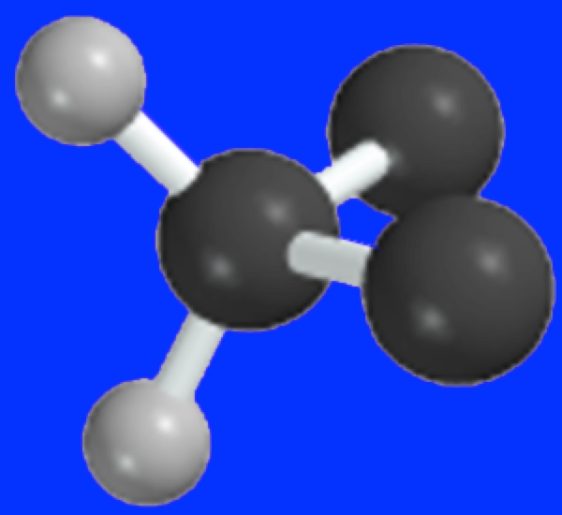
Stretching Vibrations of a CH₂ Group
Dr. Maha Al-Tameemi
Stretching: Change in inter-atomic distance along bond axis
Antisymmetric
Symmetric
Notes:
2

Slide 17
Bending Vibrations of a CH₂ Group
Dr. Maha Al-Tameemi
Bending: Change in angle between two bonds. There are four types of bend:
Rocking
Scissoring
Wagging
Twisting
In plane Scissoring
In plane Rocking
Notes:
2

Slide 18
Bending Vibrations of a CH₂ Group
Dr. Maha Al-Tameemi
Out of plane Twisting
Out of plane Wagging
Notes:
2

Slide 19
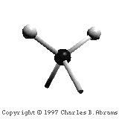
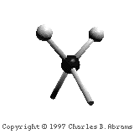
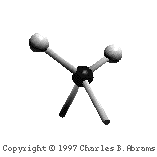
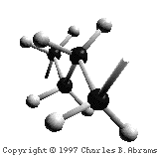
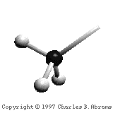
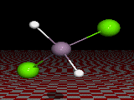
asymmetric
In-plane scissoring
symmetric
Out-of-plane twisting
In-plane rocking
Out-of-plane wagging

Slide 20
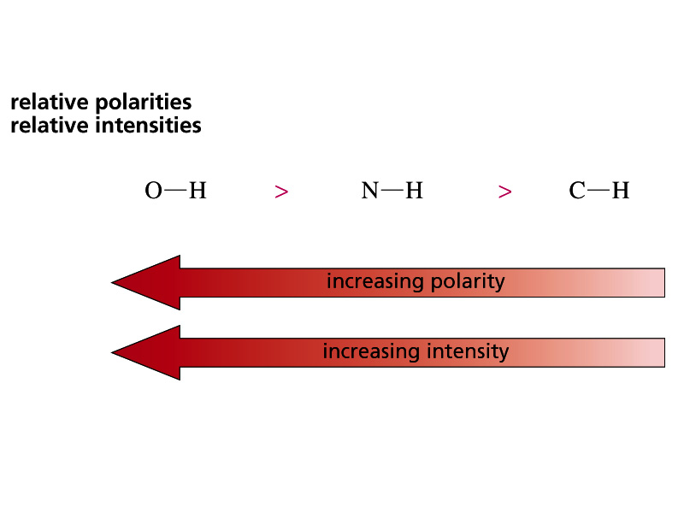
Dr. Maha Al-Tameemi
What is a vibration in a molecule?
Only vibrations that cause a change in ‘polarity’ give rise to bands in IR spectra.
A bond must have a dipole or an induced dipole in order to have an absorbance in the IR spectrum.
Any change in shape of the molecule- stretching of bonds, bending of bonds, or internal rotation around single bonds.
When the bond stretches, the increasing distance between the atoms increases the dipole moment.
Therefore, the greater the dipole, the more intense the absorption. (i.e., The greater the molar extinction coefficient (ε) in Beer’s law, A = εbc.
What vibrations change the dipole moment of a molecule?
Asymmetrical stretching/bending and internal rotation change the dipole moment of a molecule:
Asymmetrical stretching/bending are IR active.
Symmetrical stretching/bending does not. Not IR active.

Slide 21
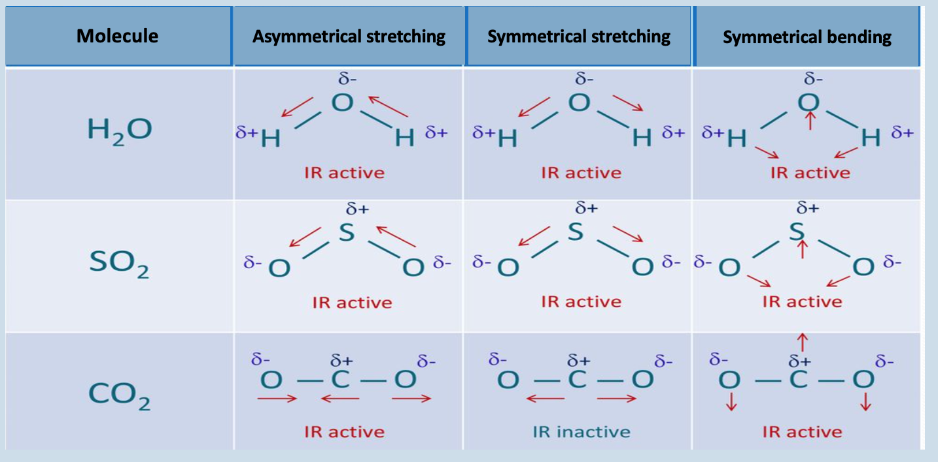
Vibrations of H₂O, SO₂, and CO₂

Slide 22
Factors that effect vibration
Dr. Maha Al-Tameemi
Type of vibration
bending is easier to bend than stretching vibration for the same bond, therefore, absorption due to bending tends to occur at a higher wavelength than searching.
Strength of bonds
Strong bonds need more energy to make bonds vibrate, so stronger bonds absorb at lower wavelengths.[triple> double> single].
Mass of atoms
Heavy atoms vibrate more slowly than lighter ones. Therefore, heavier atoms vibrate at a lower frequency than lighter ones.
Example: C-Br bond absorbs at a lower frequency than the C-Cl bond due to Br being heavier than Cl.

Slide 23
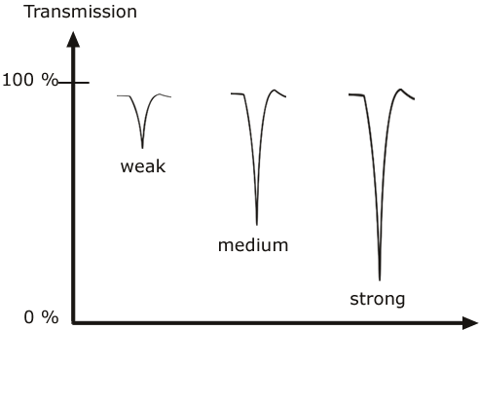
Infrared active bonds
Dr. Maha Al-Tameemi
Not all covalent bonds display bands in the IR spectrum. Only polar bonds do so. These are referred to as IR active.
The intensity of the bands depends on the magnitude of the dipole moment associated with the bond in question
Strongly polar bonds such as carbonyl groups (C=O) produce strong bands.
Medium polarity bonds and asymmetric bonds produce medium bands.
Weakly polar bond and symmetric bonds produce weak or non observable bands.

Slide 24
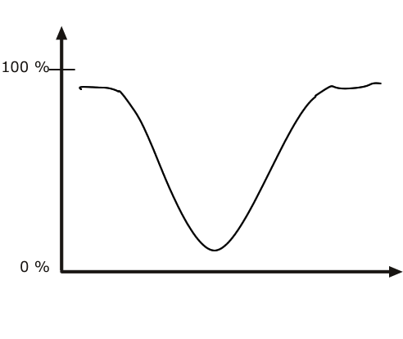
Infrared band shapes
Dr. Maha Al-Tameemi
Infrared band shapes come in various forms. Two of the most common are narrow and broad.
Narrow bands are thin and pointed, like a dagger.
Broad bands are wide and smoother.
A typical example of a broad band is that displayed by O-H bonds, such as those found in alcohols and carboxylic acids, as shown below.

Slide 25
Information obtained from IR spectra
Dr. Maha Al-Tameemi
IR is most useful in providing information about the presence or absence of specific functional groups.
IR can provide a molecular fingerprint that can be used when comparing samples. If two pure samples display the same IR spectrum it can be argued that they are the same compound.
IR does not provide detailed information or proof of molecular formula or structure. It provides information on molecular fragments, specifically functional groups.
Therefore, it is very limited in scope and must be used in conjunction with other techniques to provide a more complete picture of the molecular structure.

Slide 26
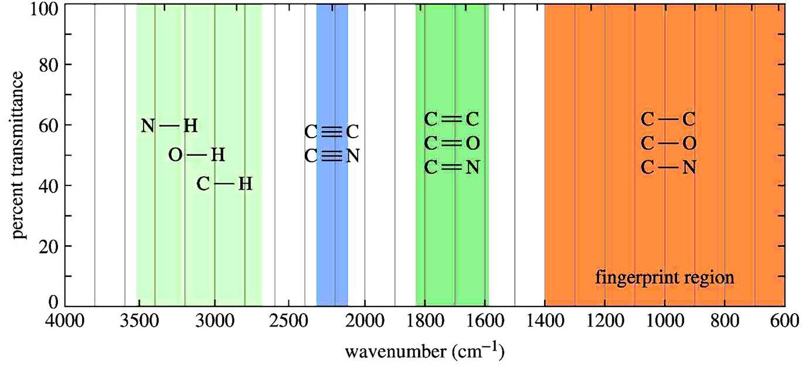
IR absorption range
Dr. Maha Al-Tameemi
The typical IR absorption range for covalent bonds is 600 - 4000 cm⁻¹.
The graph shows the regions of the spectrum where the following types of bonds normally absorb.
For example, a sharp band around 2200-2400 cm⁻¹ would indicate the possible presence of a C-N or a C-C triple bond.

Slide 27
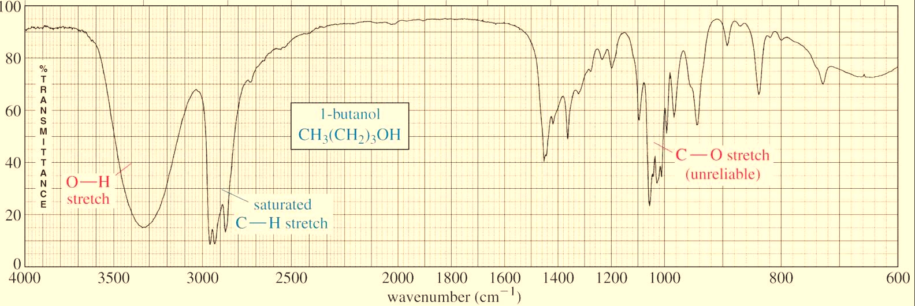
The fingerprint region
Dr. Maha Al-Tameemi
Although the entire IR spectrum can be used as a fingerprint for the purposes of comparing molecules, the 600 - 1400 cm⁻¹ range is called the fingerprint region.
This is normally a complex area showing many bands, frequently overlapping each other. This complexity limits its use to that of a fingerprint and should be ignored by beginners when analyzing the spectrum.
As a student, you should focus your analysis on the rest of the spectrum, that is the region to the left of 1400 cm⁻¹.
Focus your analysis on this region. This is where most stretching frequencies appear.
Fingerprint region: complex and difficult to interpret reliably.

Slide 28
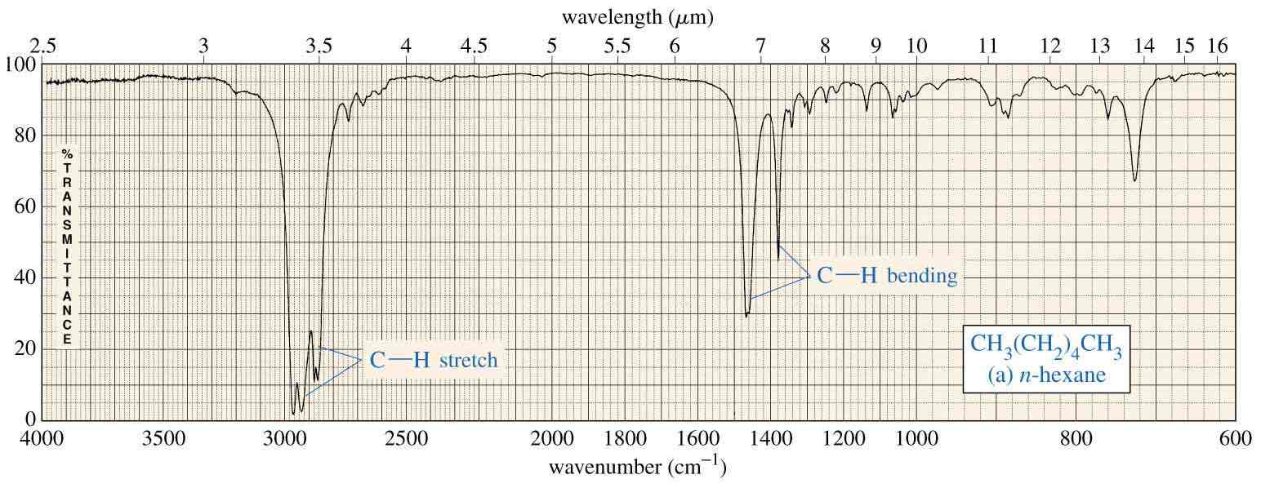
IR spectrum of Alkanes
Dr. Maha Al-Tameemi
Alkanes have no functional groups. Their IR spectrum displays only C-C and C-H bond vibrations.
The most useful are the C-H bands, which appear around 3000 cm⁻¹.
Since most organic molecules have such bonds, most organic molecules will display those bands in their spectrum.

Slide 29
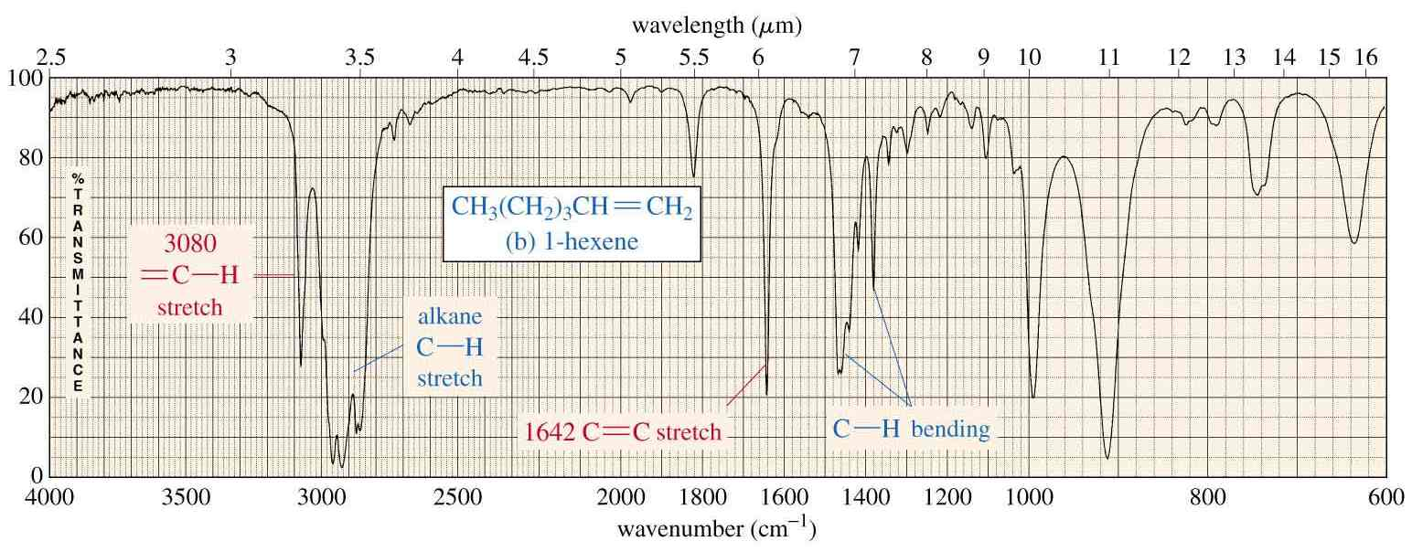
IR spectrum of Alkenes
Dr. Maha Al-Tameemi
Besides the presence of C-H bonds, alkenes also show sharp, medium bands corresponding to the C=C bond stretching vibration at about 1600-1700 cm⁻¹.
Some alkenes might also show a band for the =C-H bond stretch, appearing around 3080 cm⁻¹ as shown below. However, this band could be obscured by the broader bands appearing around 3000 cm⁻¹ (see next slide).

Slide 30
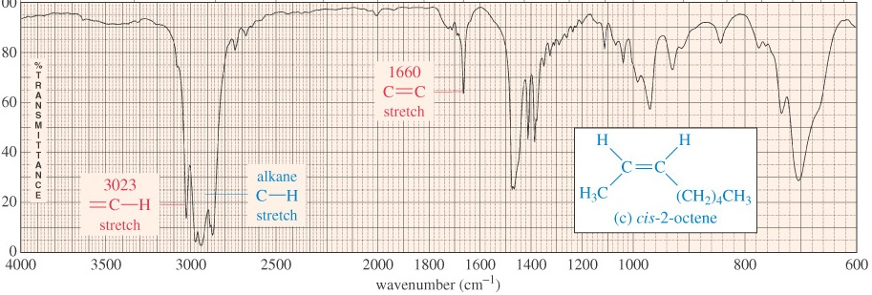
IR spectrum of Alkenes
Dr. Maha Al-Tameemi
This spectrum shows that the band appearing around 3080 cm⁻¹ can be obscured by the broader bands appearing around 3000 cm⁻¹.

Slide 31
IR spectrum of Alkynes
Dr. Maha Al-Tameemi
The most prominent band in alkynes corresponds to the carbon-carbon triple bond.
It shows as a sharp, weak band at about 2100 cm⁻¹. The reason it’s weak is because the triple bond is not very polar.
In some cases, such as in highly symmetrical alkynes, it may not show at all due to the low polarity of the triple bond associated with those alkynes.
Terminal alkynes, those where the triple bond is at the end of a carbon chain, have C-H bonds involving the sp carbon (the carbon that forms part of the triple bond). Therefore they may also show a sharp, weak band at about 3300 cm⁻¹ corresponding to the C-H stretch.
Internal alkynes, that is those where the triple bond is in the middle of a carbon chain, do not have C-H bonds to the sp carbon and therefore lack the band.
The following slide shows a comparison between an unsymmetrical terminal alkyne (1-octyne) and a symmetrical internal alkyne (4-octyne).

Slide 32
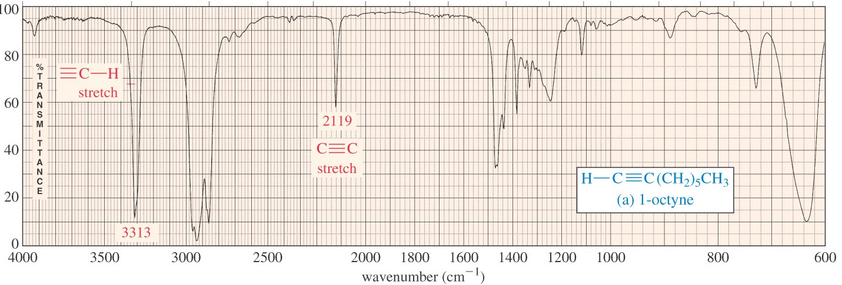
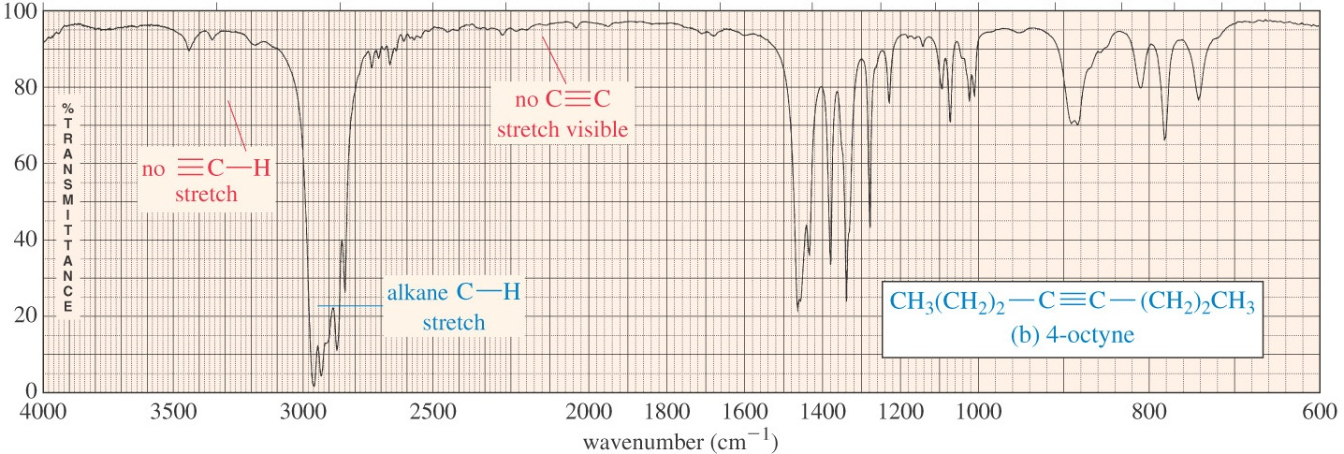
IR spectrum of Alkynes
Dr. Maha Al-Tameemi
Graphics source: Wade, Jr., L.G. Organic Chemistry, 6th ed. Pearson Prentice Hall Inc., 2006

Slide 33
IR spectrum of Nitrile
Dr. Maha Al-Tameemi
In a manner very similar to alkynes, nitriles show a prominent band around 2250 cm⁻¹ caused by the CN triple bond. This band has a sharp, pointed shape just like the alkyne C-C triple bond, but because the CN triple bond is more polar, this band is stronger than in alkynes.
Graphics source: Wade, Jr., L.G. Organic Chemistry, 6th ed. Pearson Prentice Hall Inc., 2006

Slide 34
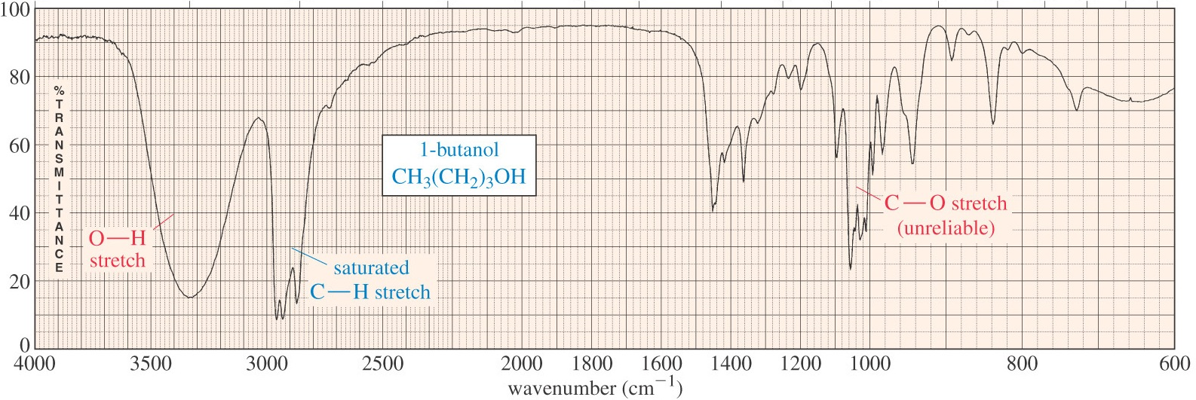
IR spectrum of Alcohol
Dr. Maha Al-Tameemi
The most prominent band in alcohols is due to the O-H bond, and it appears as a strong, broad band covering the range of about 3000 - 3700 cm⁻¹.
The sheer size and broad shape of the band dominate the IR spectrum and make it hard to miss.
Graphics source: Wade, Jr., L.G. Organic Chemistry, 6th ed. Pearson Prentice Hall Inc., 2006

Slide 35
IR spectrum of Aldehydes and Ketones
Dr. Maha Al-Tameemi
Carbonyl compounds are those that contain the C=O functional group.
In aldehydes, this group is at the end of a carbon chain, whereas in ketones it’s in the middle of the chain.
As a result, the carbon in the C=O bond of aldehydes is also bonded to another carbon and a hydrogen, whereas the same carbon in a ketone is bonded to two other carbons.
Aldehydes and ketones show a strong, prominent, stake-shaped band around 1710 - 1720 cm⁻¹ (right in the middle of the spectrum).
This band is due to the highly polar C=O bond. Because of its position, shape, and size, it is hard to miss.
Because aldehydes also contain a C-H bond to the sp² carbon of the C=O bond, they also show a pair of medium strength bands positioned about 2700 and 2800 cm⁻¹.
These bands are missing in the spectrum of a ketone because the sp² carbon of the ketone lacks the C-H bond.
The following slide shows a spectrum of an aldehyde and a ketone. Study the similarities and the differences so that you can distinguish between the two.

Slide 36
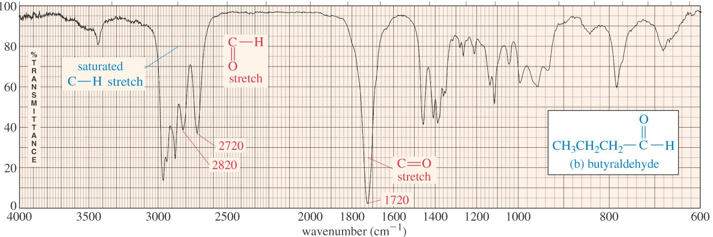
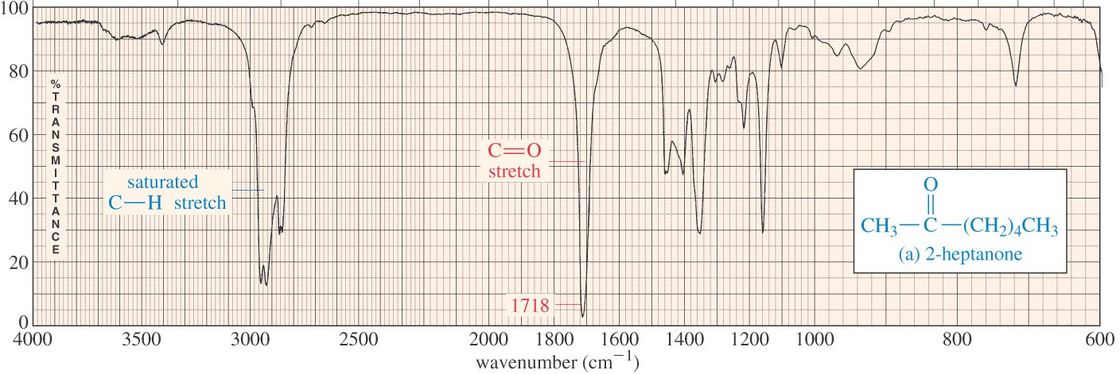
IR spectrum of Aldehydes and Ketones
Dr. Maha Al-Tameemi
Graphics source: Wade, Jr., L.G. Organic Chemistry, 6th ed. Pearson Prentice Hall Inc., 2006

Slide 37
IR spectrum of Carboxylic acid
Dr. Maha Al-Tameemi
A carboxylic acid functional group combines the features of alcohols and ketones because it has both the O-H bond and the C=O bond.
Therefore carboxylic acids show a very strong and broad band covering a wide range between 2800 and 3500 cm⁻¹ for the O-H stretch.
At the same time they also show the stake-shaped band in the middle of the spectrum around 1710 cm⁻¹ corresponding to the C=O stretch.
Graphics source: Wade, Jr., L.G. Organic Chemistry, 6th ed. Pearson Prentice Hall Inc., 2006

Slide 38
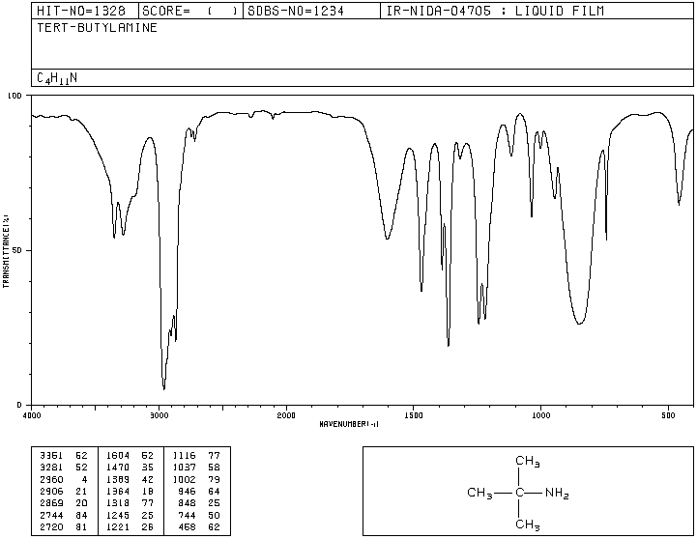
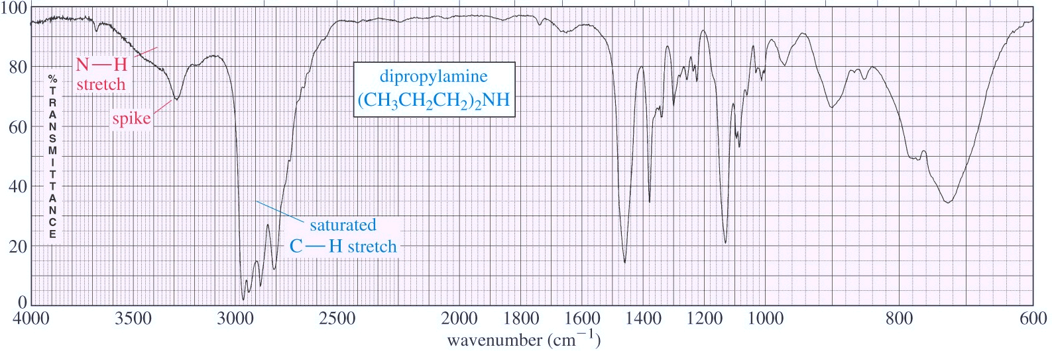
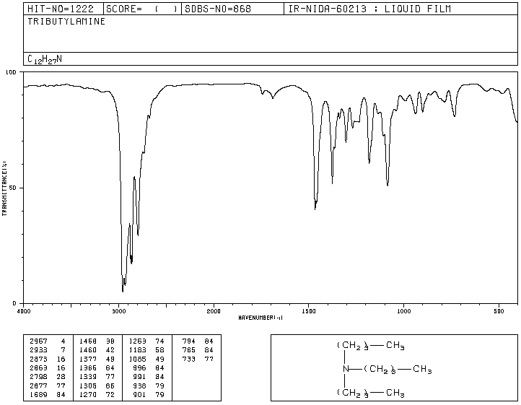
IR spectrum of Amines
Dr. Maha Al-Tameemi
The most characteristic band in amines is due to the N-H bond stretch, and it appears as a weak to medium, somewhat broadband (but not as broad as the O-H band of alcohols).
This band is positioned at the left end of the spectrum, in the range of about 3200 - 3600 cm⁻¹.
Primary amines have two N-H bonds; therefore they typically show two spikes that make this band resemble a molar tooth.
Secondary amines have only one N-H bond, which makes them show only one spike, resembling a canine tooth.
Finally, tertiary amines have no N-H bonds, and therefore this band is absent from the IR spectrum altogether. The spectrum below shows a secondary amine.
Graphics source: Wade, Jr., L.G. Organic Chemistry, 6th ed. Pearson Prentice Hall Inc., 2006

Slide 39
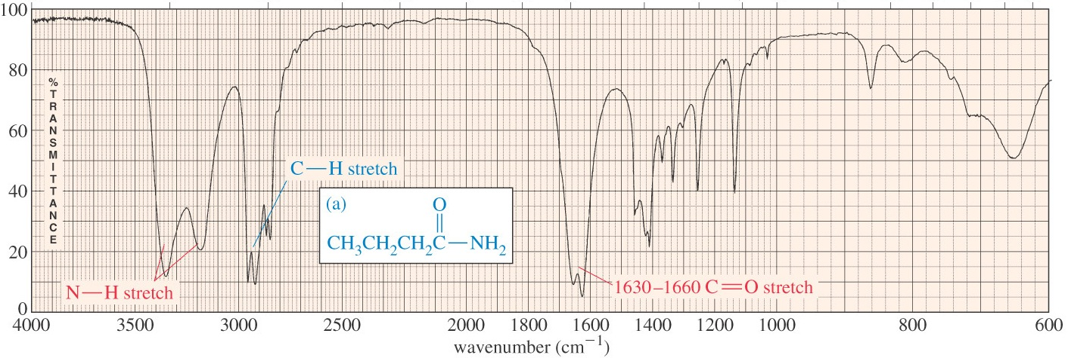
IR spectrum of Amides
Dr. Maha Al-Tameemi
The amide functional group combines the features of amines and ketones because it has both the
N-H bond and the C=O bond.
Therefore amides show a very strong, somewhat broad band at the left end of the spectrum, in the range between 3100 and 3500 cm⁻¹ for the N-H stretch.
At the same time they also show the stake-shaped band in the middle of the spectrum around 1710 cm⁻¹ for the C=O stretch. As with amines, primary amides show two spikes, whereas secondary amides show only one spike.
Graphics source: Wade, Jr., L.G. Organic Chemistry, 6th ed. Pearson Prentice Hall Inc., 2006

