Slide 1
University of Baghdad
College of Science for Women
Department of Chemistry
Instrumental Analysis Chemistry
Second Semester
Electroanalytical Chemistry
Basic Principle of Polarography
Lecturer
Asst. Prof. Dr. Maha Al-Tameemi
Lecture Time: Group A&B on Tuesday at (8:30 AM -11:30 PM )
Texts:
Principle of Instrumental Analysis, by Douglas A. Skoog, F.James Holler, Stanley R. Crouch, Chapters 9, 10, 11, and 12(6th Edition)
Spectrochemical Analysis, by James D. Ingle,Jr and Stanley R. Crouch, Chapters 7, 8, 9, 10, and 11.
Most Analytical Chemistry Textbooks.
Handout

Slide 2
Polarography
Polarography: is one of the Voltametric methods of analysis in which chemical species(ions or molecules)undergo oxidation (lose electrons)or reduction(gain electrons)at the surface of a dropping mercury electrode(DME) at an applied potential. Polarography only applies to the DME
Objective of photography
Polarography is an electroanalytical technique that measures the current flowing between two electrodes in the solution (in the presence of a gradually increasing applied voltage)to determine the concentration of solute and its nature, respectively
Usually, this current is proportional to the concentration of the analyte.
The apparatus for carrying out polarography contains three electrodes:
The working electrode is a dropping mercury electrode, or a mercury droplet(DME) suspended from the bottom of a glass capillary tube(a microelectrode whose potential is varied with time)
The analyte is either reduced (in most of cases) or oxidized at the surface of the mercury drop.
The counter or auxiliary electrode is a platinum wire)completes the circuit, conducts electrons from the signal source through the solution to the working electrode
The reference electrode (potential remains constant) calomel SCE or Ag/AgCl
The potential of the mercury drop is measured by the reference electrode.

Slide 3
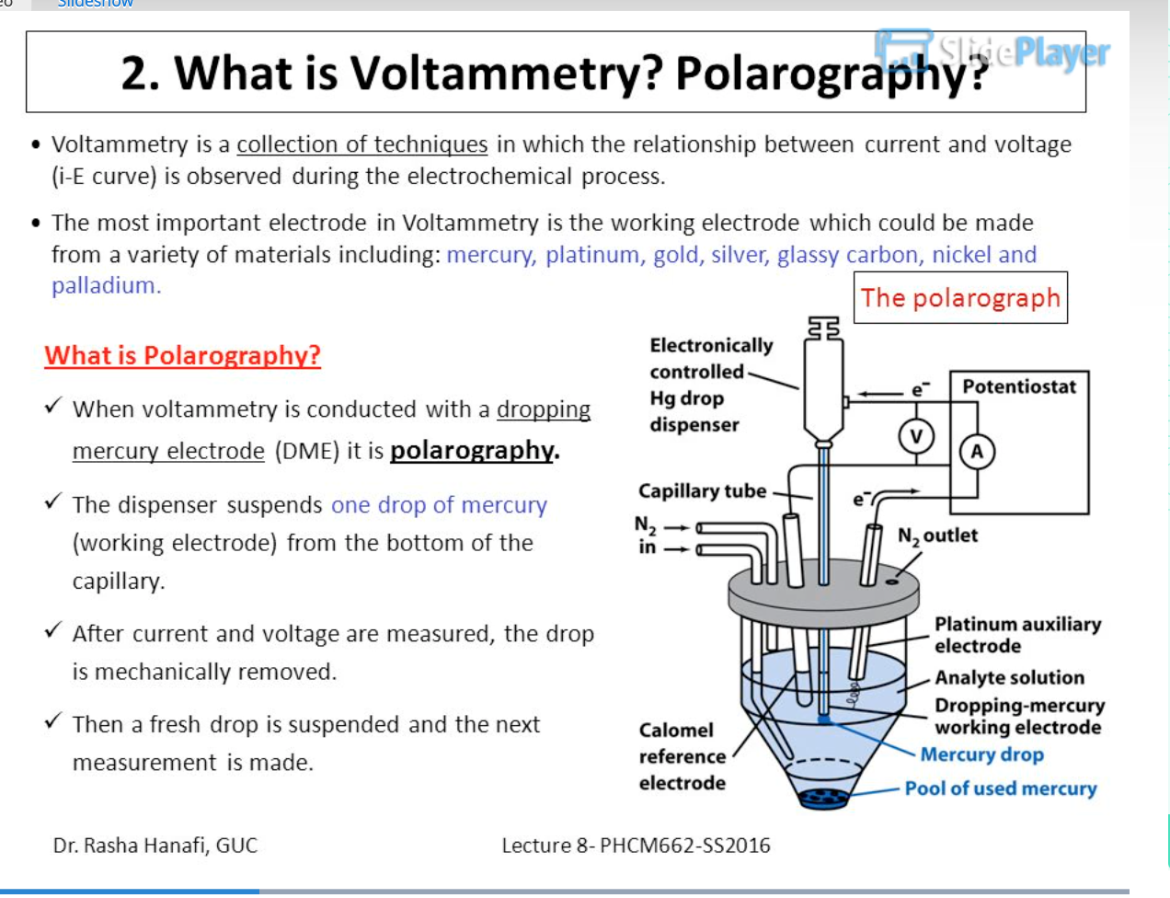
The Polarographic Cell
The mercury drop, which is normally a cathode of the polarographic cell flows from a glass capillary tube, which is attached to a reservoir of mercury.
The counter electrode, which is a pool of mercury into which the drop falls, acts as an anode.
In the original polarograph, the cell is connected in series with a galvanometer (for measuring the flow of current) in an electrical circuit that also contains a battery or other source of direct current and a device for varying the voltage.
The electroactive species which is being studied is present in a highly conducting electrolytic medium.
The concentration of this electrolyte is about 100 times higher and is electroactive in the sense that it will not undergo a charge transfer reaction on the electrode surface.
Hence it is called a supporting or indifferent electrolyte.
The need for such a medium is to let the majority current due to an applied electric field called migration current be carried by the ions of the supporting electrolyte.
This will allow the species of interest to follow diffusional transport towards the electrode surface

Slide 4
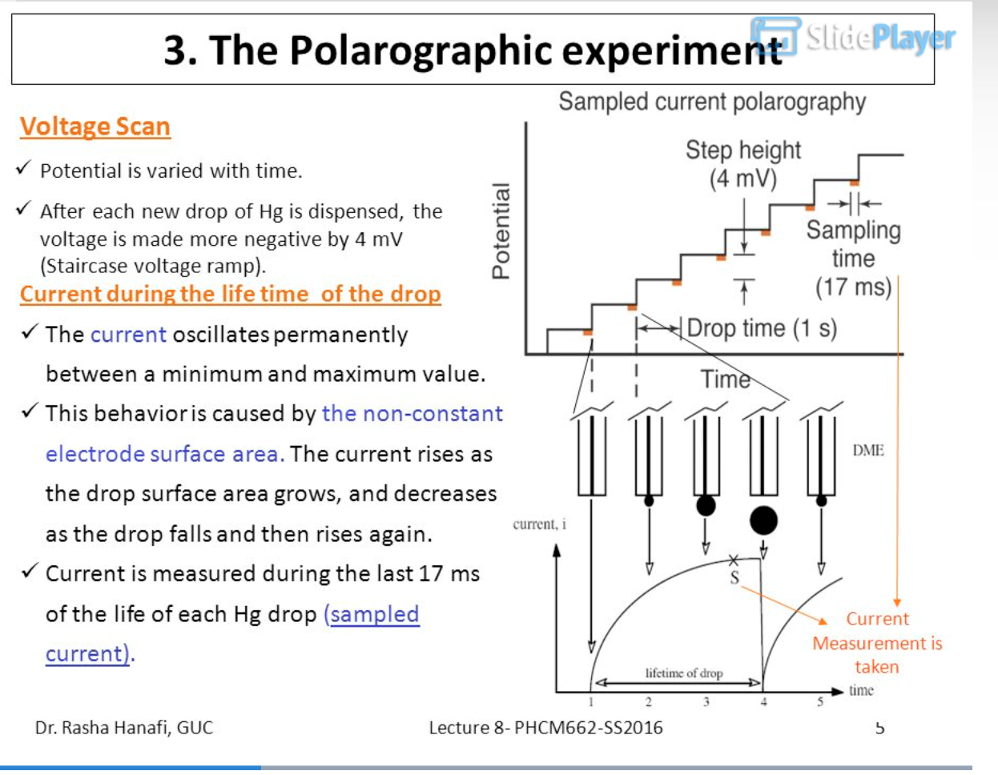
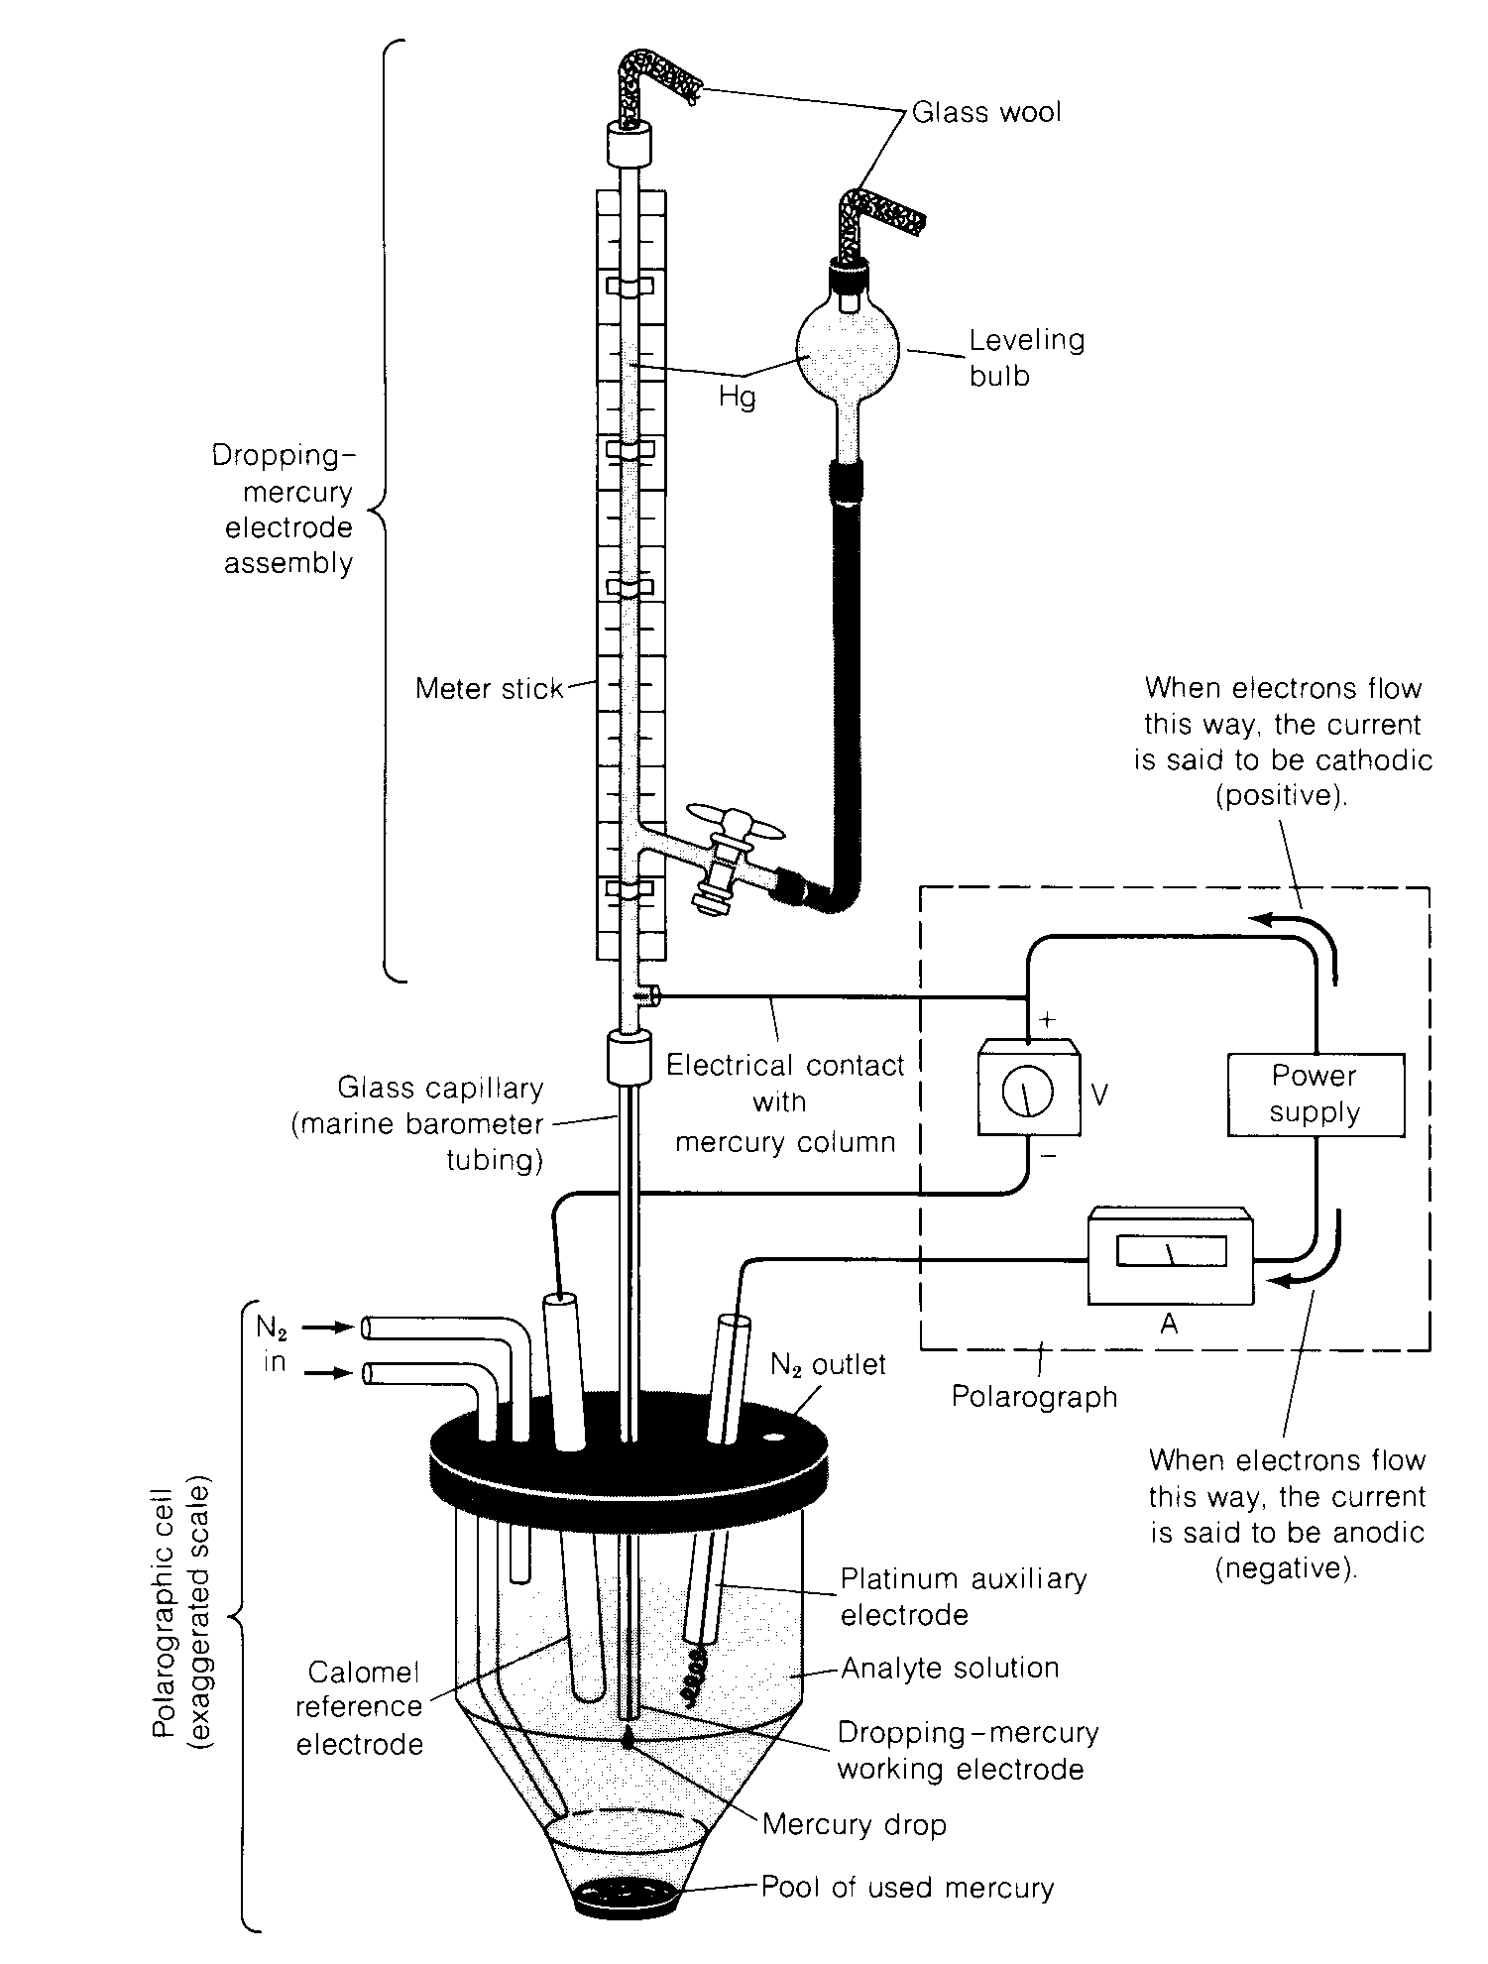
Typical electrochemical cell used in polarography

Slide 5
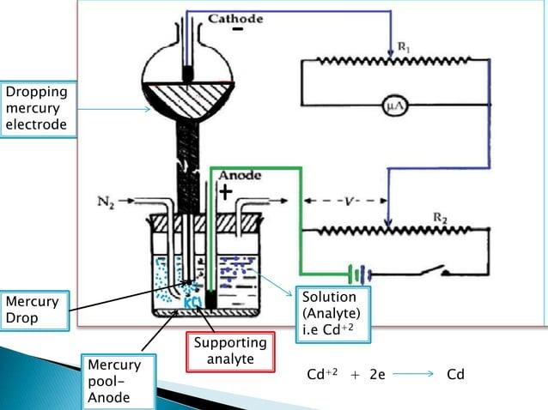
Dropping Mercury Electrode
Construction
A dropping Mercury Electrode (DME) consists of a mercury reservoir from which mercury drops come down as small drops through a capillary it generally acts as a cathode(-) it is known as an indicator electrode or microelectrode
The height of the mercury reservoir is adjusted to set the drop time (1 to 5 seconds)
Drop time is the time required to form every fresh drop of mercury from a capillary
Inside the tubing, wire contact is made where mercury flows through
The anode consists of a mercury pool at the bottom of the reservoir which acts as the reference electrode and its area is large so that is not polarized
Both anode and cathode are connected across the appropriate end of the battery
The applied voltage can changed by adjusting the sliding contact along the potentiometer wire EF

Slide 6
Working
DME is a polarizable electrode {a very large change in potential(the change in potential energy equals the gain in kinetic energy, which can then be used to find the speed)upon passages of a small current}
Can be act as both anode(+) and cathode(-) but generally used as cathode
The pool of mercury act as counter electrode (anode(+) if DME is cathode(-)
Note: a pool of mercury due large surface area has a low current density and is non-polarizable therefore has constant
Example: Consider the polygraphy cell containing a solution of cadmium chloride to which external EMF is applied
To the analyte, (i.e. cadmium) supporting electrolyte like KCL is added 50-100 times of sample concentration to eliminate the migration current(additional current produced by electrostatic attraction of cations to the surface of a dropping electrode, an unpredictable voltammeter)
Pure nitrogen or hydrogen gas is bubbled to expel the dissolved oxygen
The positively charged ions(Cd⁺²) present in the solution will be attracted to the drooping mercury electrode(-)by an electrical force and by diffusion force resulting from the concentration gradient formed at the surf non-polarizable, ace of the electrode
Thus total current flowing through the cell may be regarded as the sum of electrical and diffusive forces
When the applied voltage is increased and the current is recorded a graph will be obtained
The graph is plotted between the voltage applied and the current; this graph is called a polarograph, and the apparatus is known as a polarogram
The electromotive force (EMF) is the maximum potential difference between two electrodes

Slide 7
Why Dropping Mercury Electrode?
The fact that Mercury is a liquid metal provides several advantages such as:
Hg yields reproducible current‑potential data.
Excellent renewability and reproducibility of the surface, this reproducibility can be attributed to the continuous exposure of fresh surfaces to the growing mercury drop.
With any other electrode (such as Pt in various forms), the potential depends on its surface condition and therefore on its previous treatment.
Many reactions studied with the mercury electrode are reductions.
At a Pt surface, the reduction of solvent is expected to compete with the reduction of many analyte species, especially in acidic solutions.
The high overpotential for H⁺ reduction at the mercury surface. Therefore, H⁺ reduction does not interfere with many reductions.
Hg displays a wide potential range of operations in aqueous solution due to its large hydrogen overpotential.
Hg surface is readily regenerated by producing a new drop or film
Many metal ions can be reversibly reduced into it.
Mercury can be easily purified as it is a liquid with an atomically smooth surface.

Slide 8
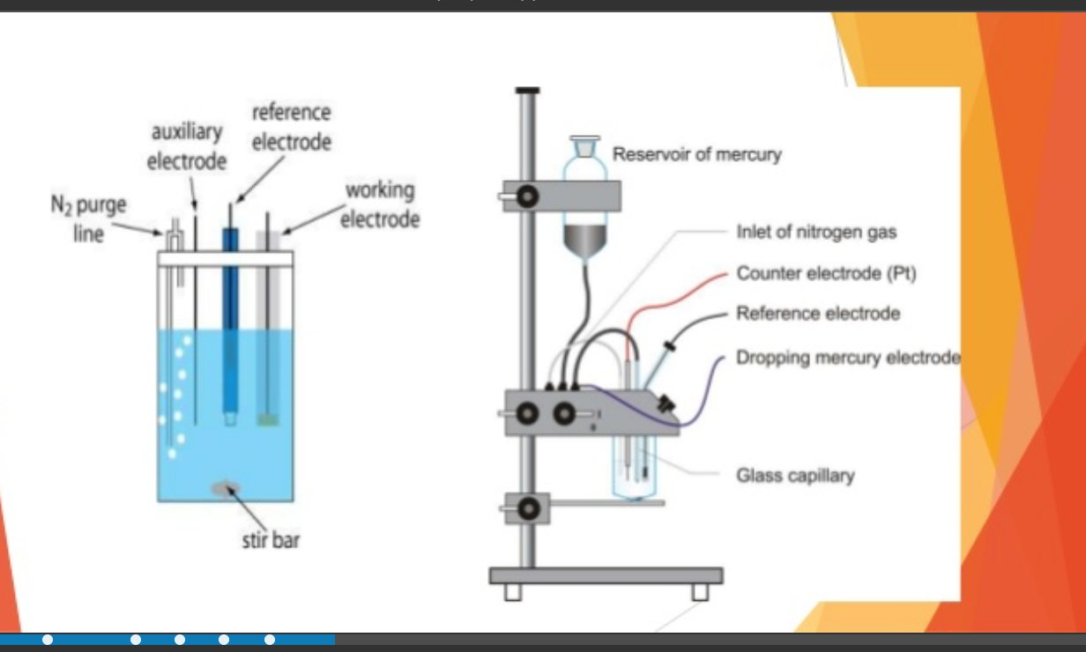
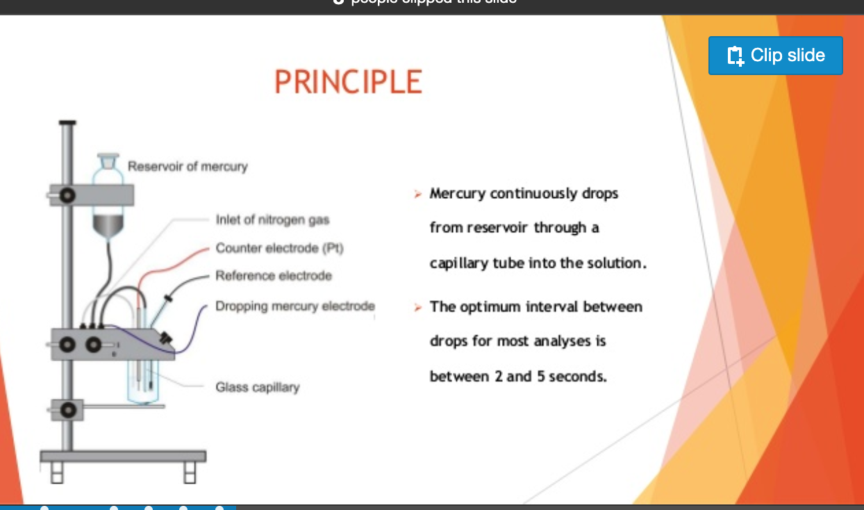
Principle
Study of solutions or electrode processes using electrolysis with two electrodes, one polarizable and the other unpolarizable, the former formed by mercury regularly dropping capillary tube.
Polarized electrode dropping mercury electrode(DME)(If the electrode potential has great changes when infinite small current flow through the electrode, such electrode is referred to as Polarized electrode like DME)
Depolarized electrode saturated calomel electrode(If the electrode potential does not change with current such electrode is called ideal depolarized electrode like SCE)
Hg continuously drops from the reservoir through a capillary tube into the solution.
The optimum interval between drops for most analytes is between 2 and 5 seconds

Slide 9
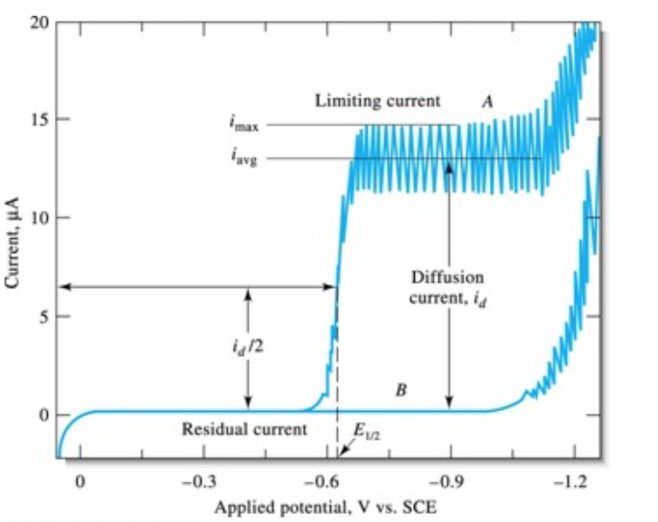
Definition of Types of Currents
1-Residual Current (ir): is the current that flows even when no depolarizer (analyte) is present. (i.e. This current arises from factors such as impurities in the solution and the supporting electrolyte itself. The supporting electrolyte has to be taken into consideration while interpreting the polarograms
It is the sum of the relatively large condenser current(ic) and the very small faradic current(if)
Condenser current(ic): is due to the formation of the Helmholtz double layer at the mercury surface
Faradaic current(if)
Due to the oxidation or reduction of trace impurities like O_{2,} this indicates that dissolved oxygen interferes with the determination of most metal ions.
Therefore, dissolved O₂ has to be removed by bubbling nitrogen for 5-10 min into the solution to expel oxygen before recording the polarogram
Heavy metal ions in deionized water
Ions salt from the supporting electrolyte

Slide 10
2-Diffusion Current(id)
The difference between Residual current and limiting current is called diffusion current(id)
Diffusion current is due to the actual diffusion of elctoreducible ions from the bulk of the sample to the surface of the mercury droplet due to the concentration gradient
When the potential of the working electrode is sufficiently negative, the rate of reduction of Cd²⁺ ions is governed by the rate at which Cd²⁺ can reach the electrode.
In the figure below it occurs at potentials more negative than ‑0.7 V.
In an unstirred solution, the rate of reduction is controlled by the rate of diffusion of the analyte to the electrode.
In this case, the limiting current is called the diffusion current.
The solution must be perfectly quiet to reach the diffusion limit in polarography.
Thus, the diffusion current is the limiting current when the rate of electrolysis is controlled by the rate of diffusion of species to the electrode.
I_{d}= limiting current –residual current
Cd²⁺ + 2e Cd

Slide 11
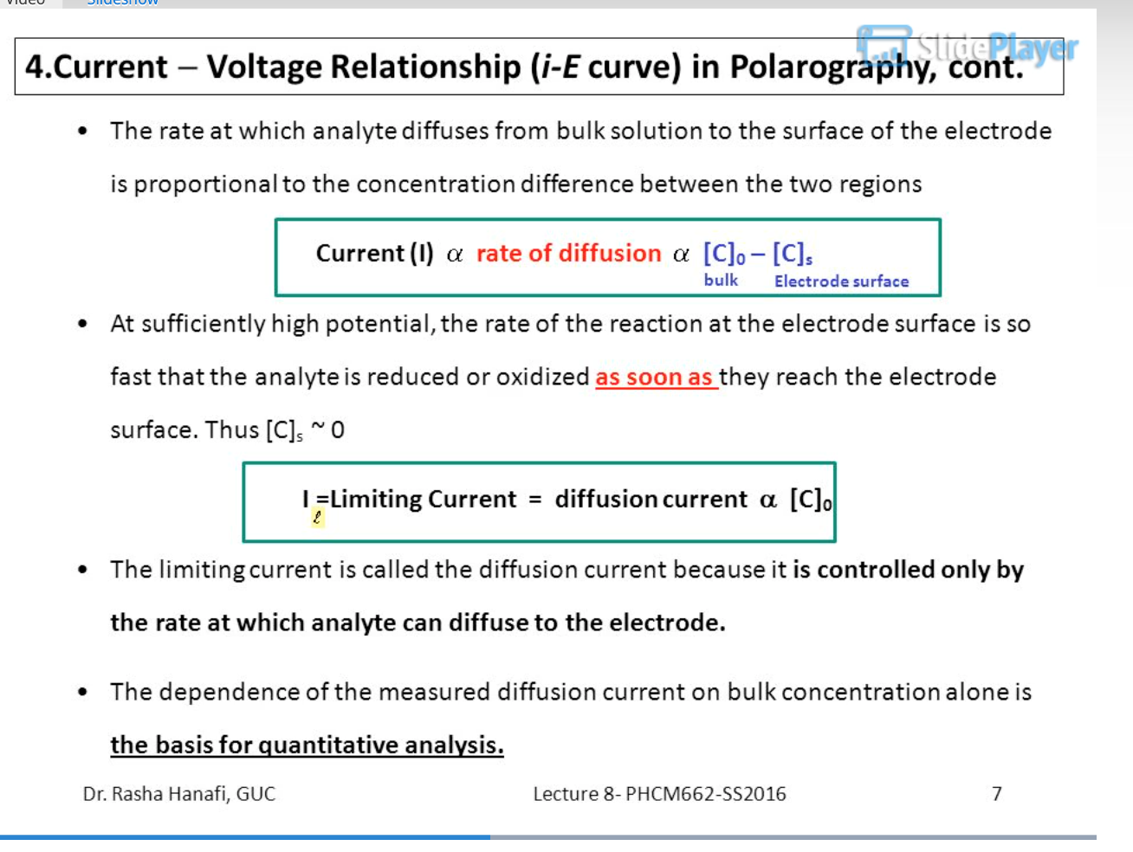
3- Limiting current(il)
This maximum current that passes through the cell when the concentration of the electro-active species at the electrode surface is zero is called ‘the limiting current’
Beyond a certain potential, the current reaches a steady state value
At this point, the rate of the diffusion of ions is equal to the rate of reduction of ions, and the state of the electrode is said to be concentration-polarized

Slide 12
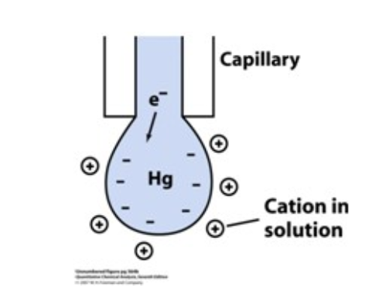
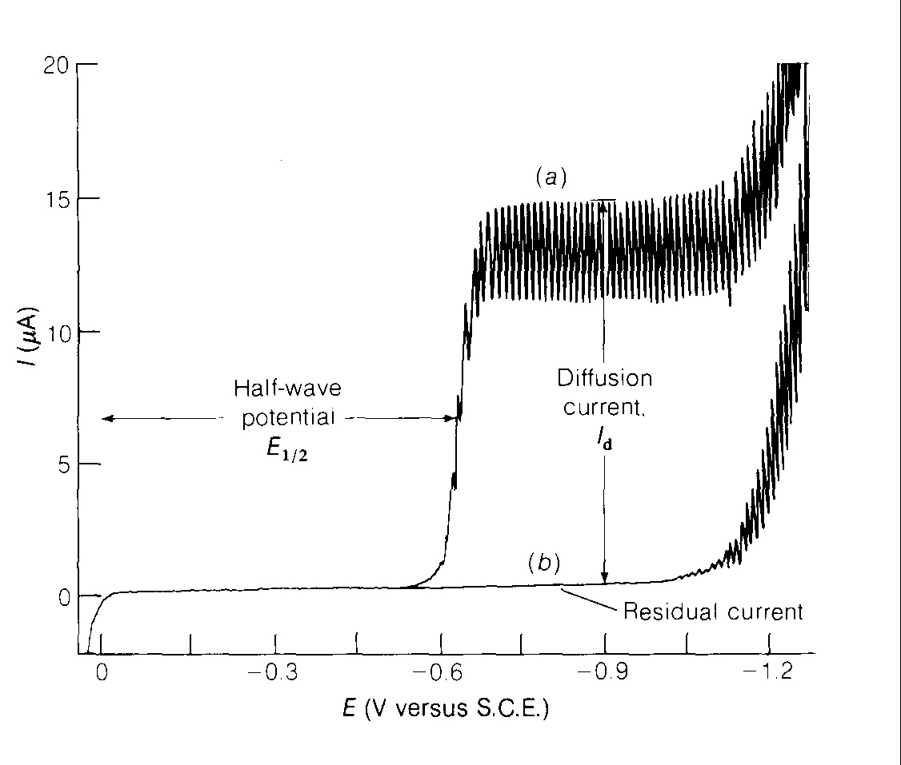
4-Migration current(im): It is due to the migration of cations from the bulk of the solution towards the cathode due to diffusive force, irrespective of the concentration gradient
Due to the electrostatic attraction (or repulsion) of positive species of analyte ions by the negative electrode, it can be reduced to a negligible level by the presence of a high concentration of supporting electrolyte (1 M KCl).
Increasing concentrations of electrolyte reduces the net current, since the rate of arrival of cationic analyte at the negative Hg surface is decreased.
Typically, a supporting electrolyte concentration 50‑100 times greater than the analyte concentration
Concentration will reduce the electrostatic transport of the analyte to a negligible level.
5- Half wave potential: This is the potential at which the concentration of oxidized and reduced forms at the electrode surface is equal, i.e., 50% of oxidized and 50% reduced forms are present.

Slide 13
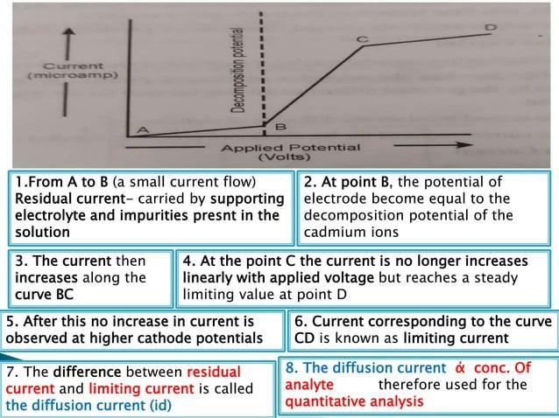

Slide 14
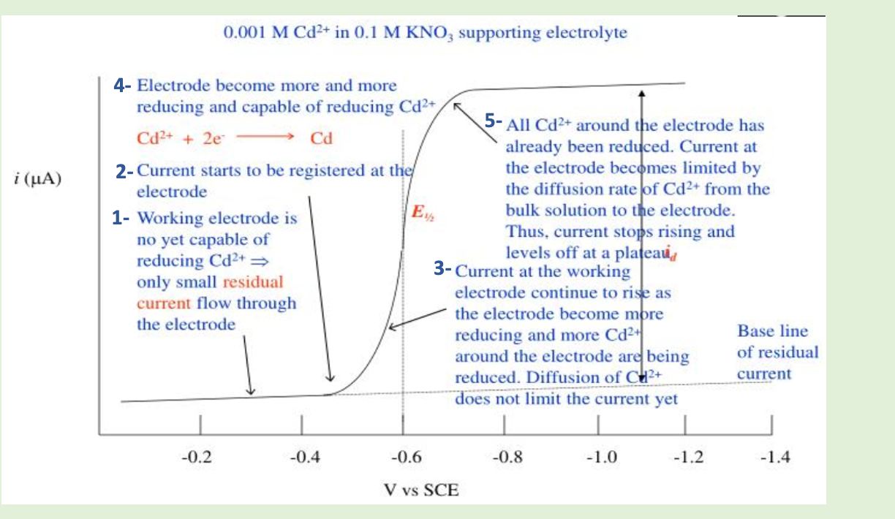
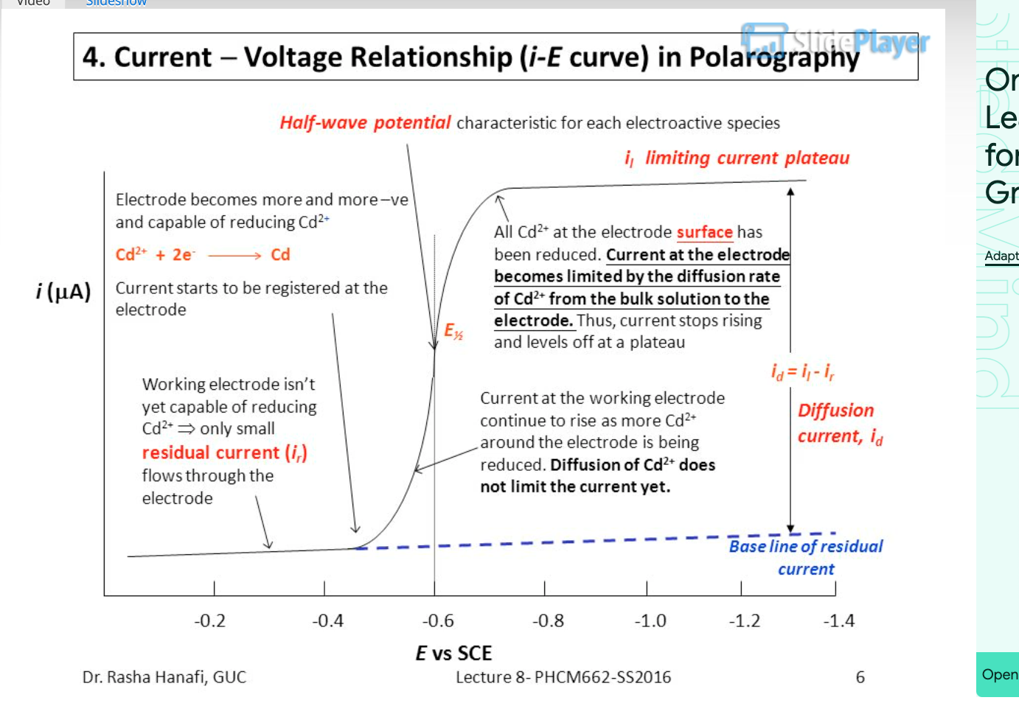
When the potential is only slightly negative concerning the calomel electrode, essentially no reduction of Cd²⁺ occurs. Only a small residual current flows.
At a sufficiently negative potential, reduction of Cd²⁺ commences, and the current increases. The reduced Cd dissolves in the Hg to form an amalgam.
After a steep increase in current, concentration polarization sets in: The rate of electron transfer becomes limited by the rate at which Cd²⁺ can diffuse from the bulk solution to the surface of the electrode.
The magnitude of this diffusion current I_{d} is proportional to Cd²⁺ concentration and is used for quantitative analysis. The upper trace in the Figure above is called a polarographic wave.

Slide 15
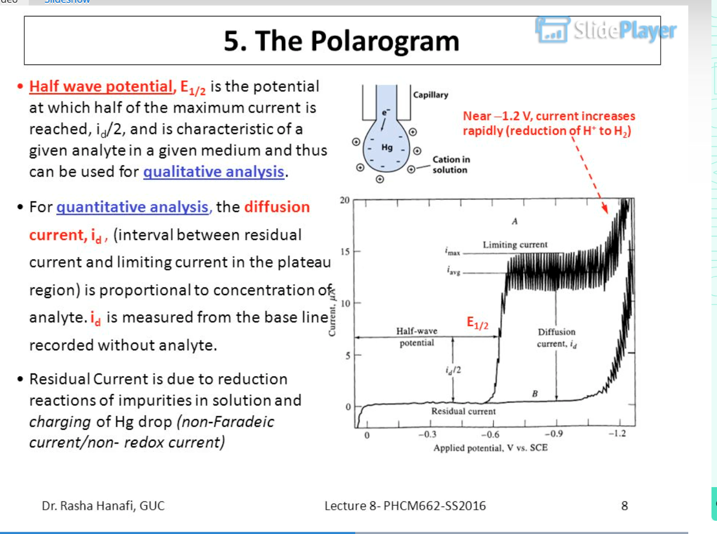
Polarogram
Polarogram: a graph of current versus potential in a polarographic analysis
The trace is called a polarographic wave
i (residual current), which is the current obtained when no electrochemical change takes place
I_{av} (average current) is the current obtained by averaging current values throughout the lifetime of the drop
I_{d} (diffusion current), which is the current resulting from the diffusion of electroactive species to the drop surface(reduction of the sample), which is directly proportional to the concentration of analyte and is used in the quantitative analysis
The half-wave potential is characteristic of every compound and this is used in qualitative analysis
The maximum current that passes through the cell when the concentration of the electro-active species at the electrode surface is zero is called ‘the limiting current’

Slide 16
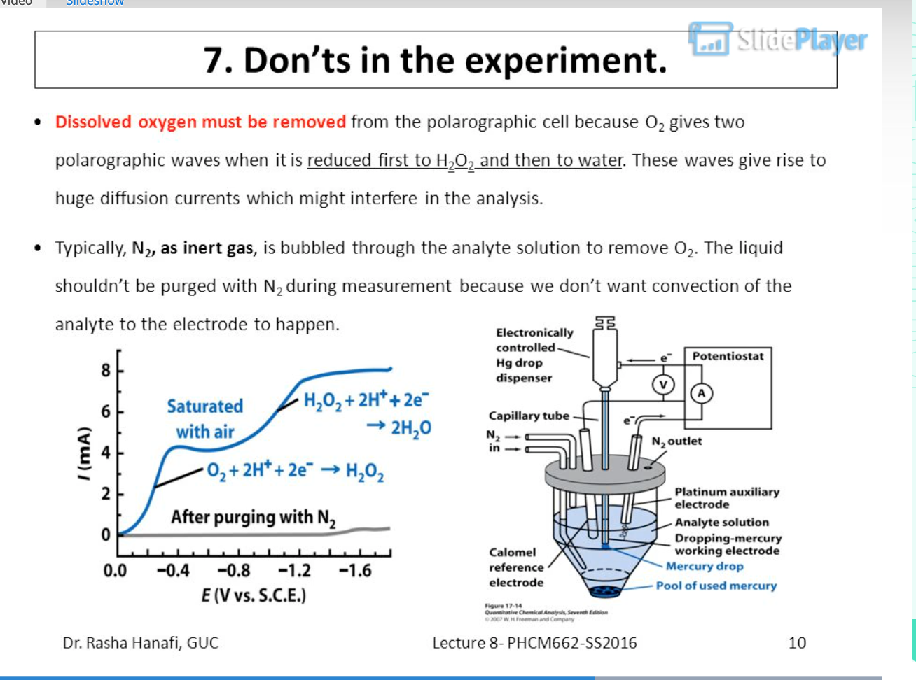
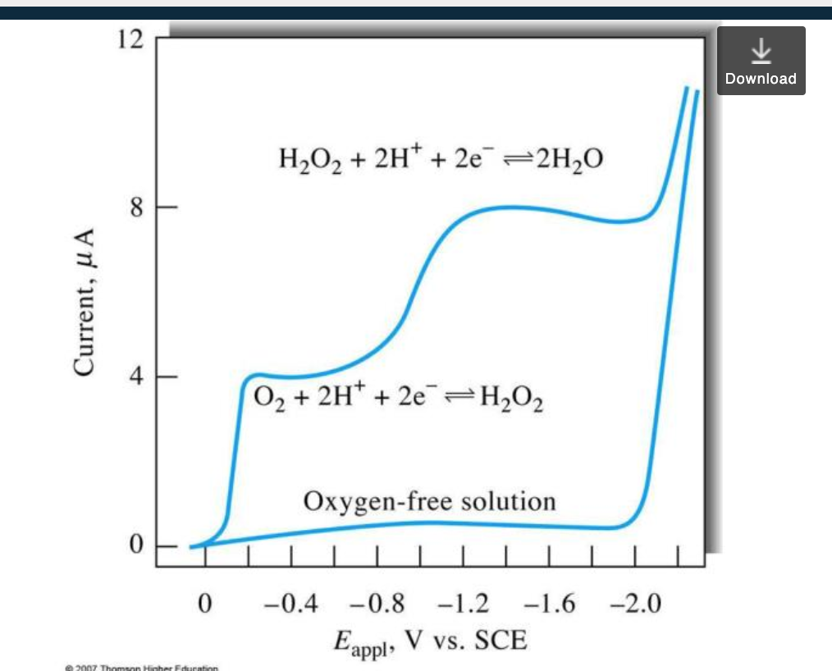
Effect of Dissolved Oxygen
Oxygen dissolved in the solution will be reduced at the DME, leading to two well-defined waves which were attributed to the following reactions:
O₂(g) + 2H⁺ + 2e⁻ < ==== > H₂O₂; E_{1/2} = - 0.1V
H₂O₂ + 2H⁺ +2e⁻ < ==== > 2H₂O; E_{1/2} = - 0.9V
E_{1/2} values for these reductions in acid solution correspond to -0.05V and -0.8V versus SCE.
This indicates that dissolved oxygen interferes with the determination of most metal ions.
Therefore, dissolved O₂ has to be removed by bubbling nitrogen into the solution before recording the polarogram.

Slide 17
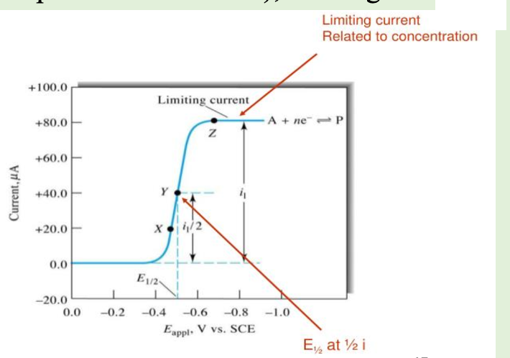
Qualitative analysis
Half wave potential, E_{1/2} is an important feature can be derived from the polarogram.
It is the potential corresponding to one half the limiting current i.e. i_{d}/2.
E_{l/2} is a characteristic for each element and thus used for qualitative analysis.
E_{l/2} depend on the nature of electrolyte solution (composition of solution), it change with pH change.

Slide 18
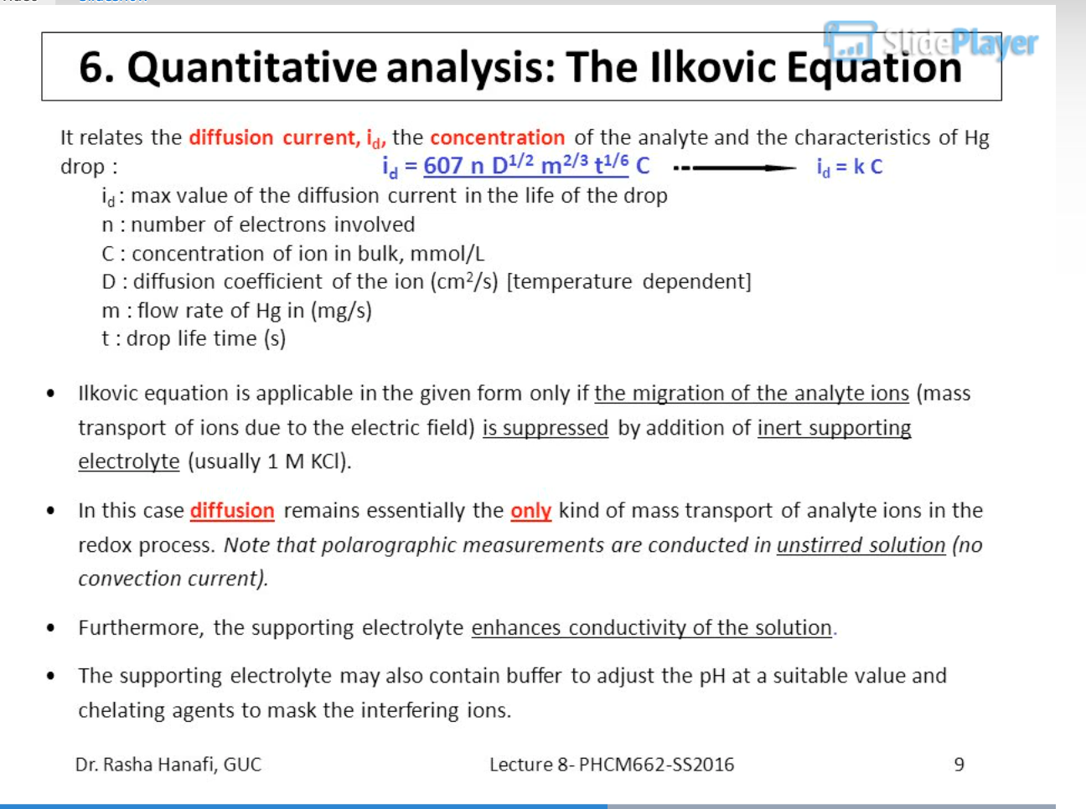

Quantitative analysis
The magnitude of the diffusion current is given by the Ilkovic equation:
i_{d} = 607 nD^{1/2} Cm ^{2/3} t ^{1/6}
where i_{d} = diffusion current, measured at the top of the oscillations in the Figure above with the units microamperes(µA)
The number 607 is a combination of several constants (Faraday constant, Hg density, and $π$) whose dimensions are such that i_{d} will be given in µA
n = number of electrons per molecule involved in the oxidation or reduction of the electroactive species.
D = diffusion coefficient of electroactive species, with the units cm²/s
C = concentration of electroactive species, with the units mmol/L
m = (mass of Hg flows inside the capillary tube) or rate of flow of Hg, in mg/s
t = time interval fall between 2 drops, in seconds

Slide 19
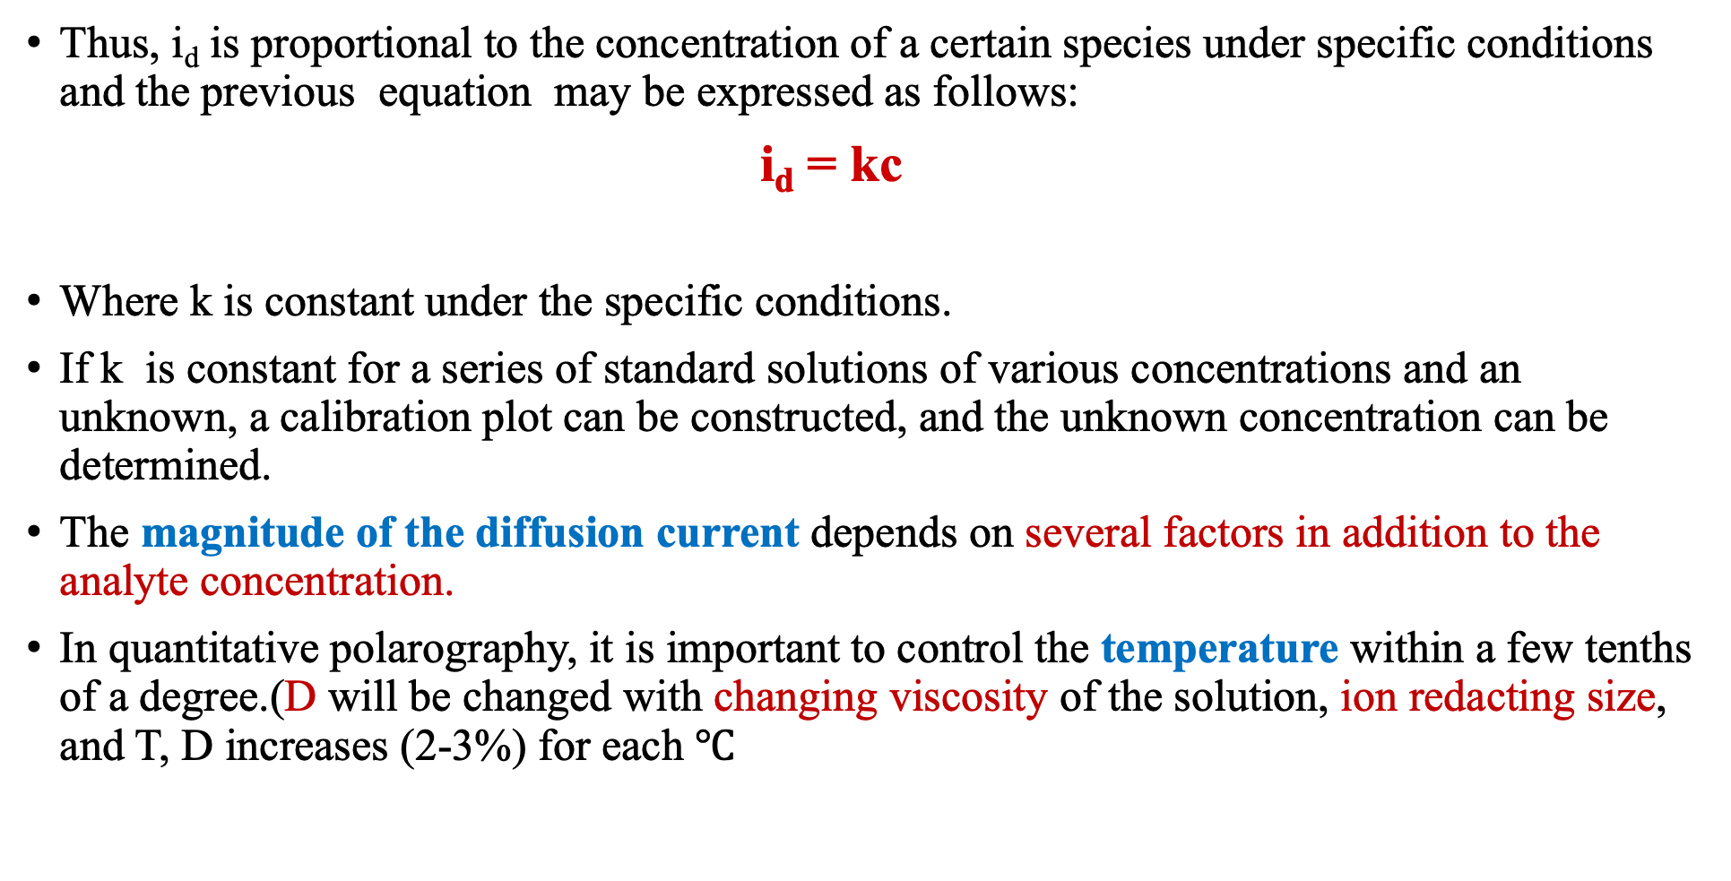
Thus, i_{d} is proportional to the concentration of a certain species under specific conditions and the previous equation may be expressed as follows:
i_{d} = kc
Where k is constant under the specific conditions.
If k is constant for a series of standard solutions of various concentrations and an unknown, a calibration plot can be constructed, and the unknown concentration can be determined.
The magnitude of the diffusion current depends on several factors in addition to the analyte concentration.
In quantitative polarography, it is important to control the temperature within a few tenths of a degree.(D will be changed with changing viscosity of the solution, ion redacting size, and T, D increases (2-3%) for each $℃$

Slide 20
Quantitative Analysis
The principal use of polarography is in quantitative analysis.
Since the magnitude of the diffusion current is proportional to the concentration of analyte, the height of a polarographic wave tells how much analyte is present.
Two methods are used to find the concentration of unknown:
Standard curves method
Standard addition method

Slide 21
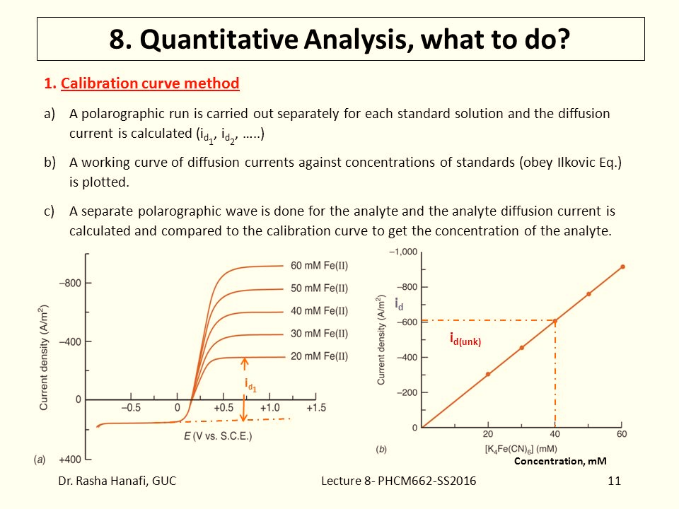
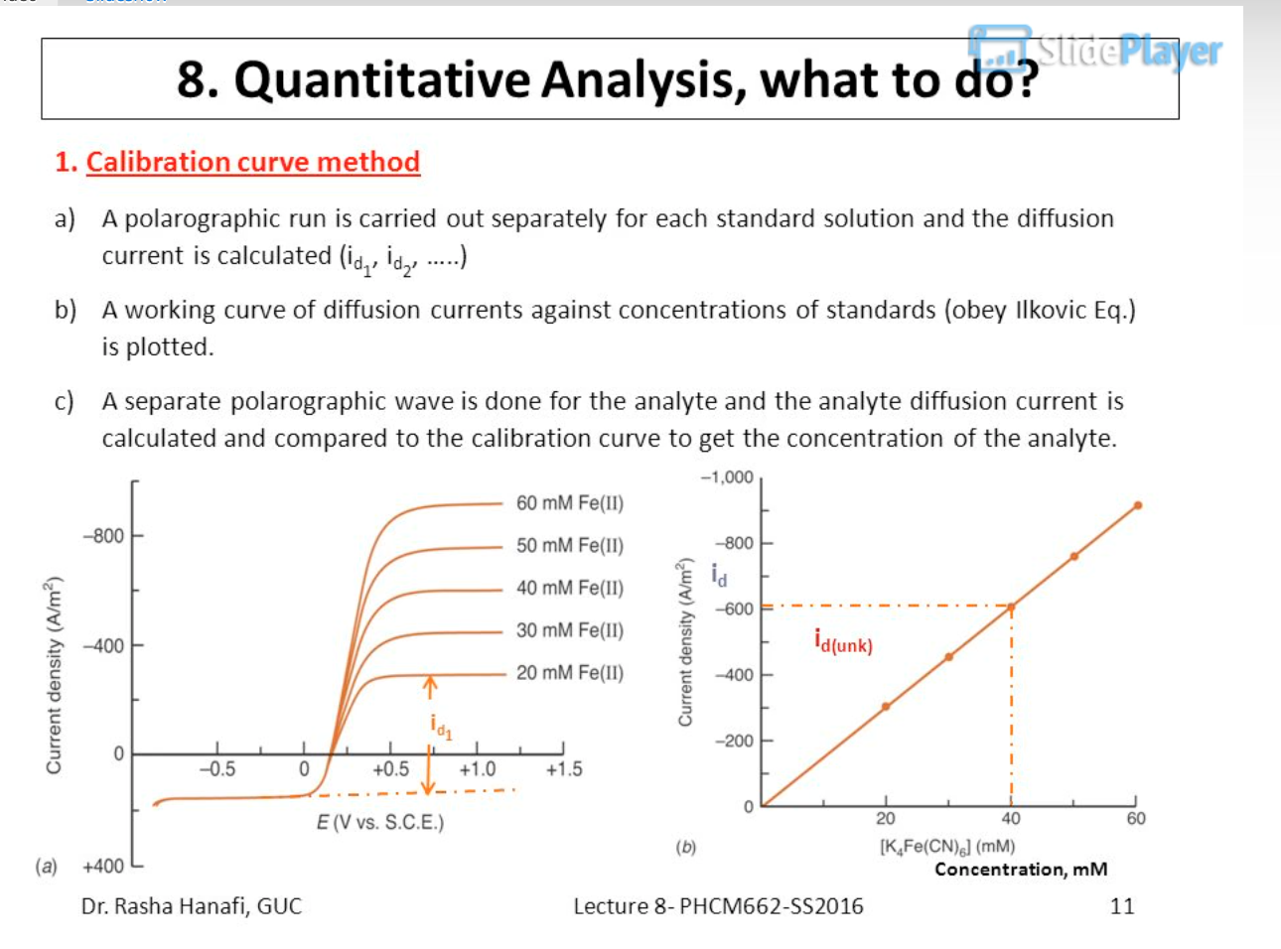
Standard curves method
The most reliable, but tedious, method of quantitative analysis is to prepare a series of known concentrations of analyte in otherwise identical solutions.
A polarogram of each solution is recorded, and a graph of the diffusion current versus analyte concentration is prepared.
Finally, a polarogram of the unknown is recorded, using the same conditions.
From the measured diffusion current and the standard curve, the concentration of analyte in the sample can be determined.
The figure below shows an example of the linear relationship between diffusion current and concentration.

Slide 22
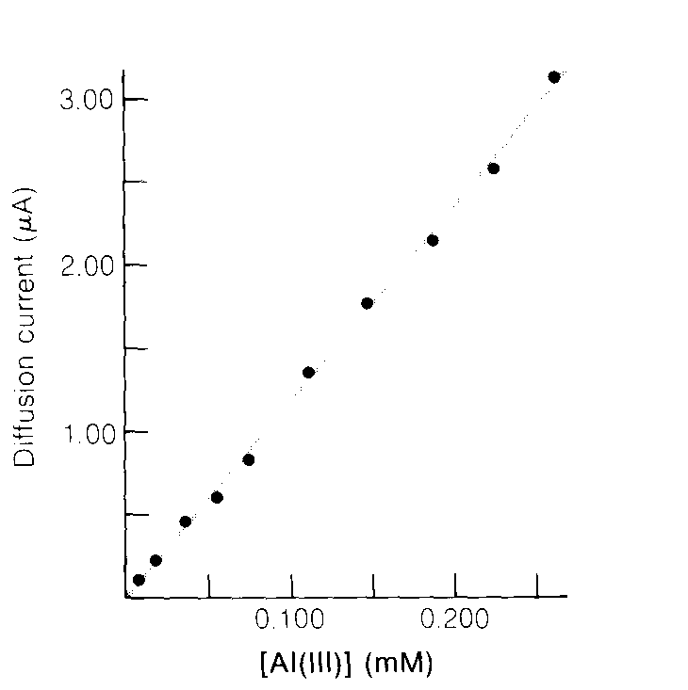
Example 1/ Using a Standard Curve
Suppose that 5.00 mL of an unknown sample of Al(III) was placed in a 100 mL volumetric flask containing 25.00 mL of 0.8 M sodium acetate (pH 4.7) and 2.4 mM pontachrome violet SW (a maximum suppressor). After dilution to 100 mL, an aliquot of the solution was analyzed by polarography. The height of the polarographic wave was 1.53 µA, and the residual current measured at the same potential with a similar solution containing no Al(III) was 0.12 µA. Find the concentration of Al(III) in the unknown.
The corrected diffusion current is 1.53 ‑ 0.12 = 1.41 µA.
In the figure below, 1.41 µA corresponds to [AI(III)] = 0.126 mm.
Since the unknown was diluted by a factor of 20.0
(from 5.00 mL to 100 mL) for analysis(100 ml/5 ml=20ml)
the original concentration of unknown must have been
(20.0)(0.126) = 2.46 mM.
I_{d}= limiting current –residual current

Slide 23
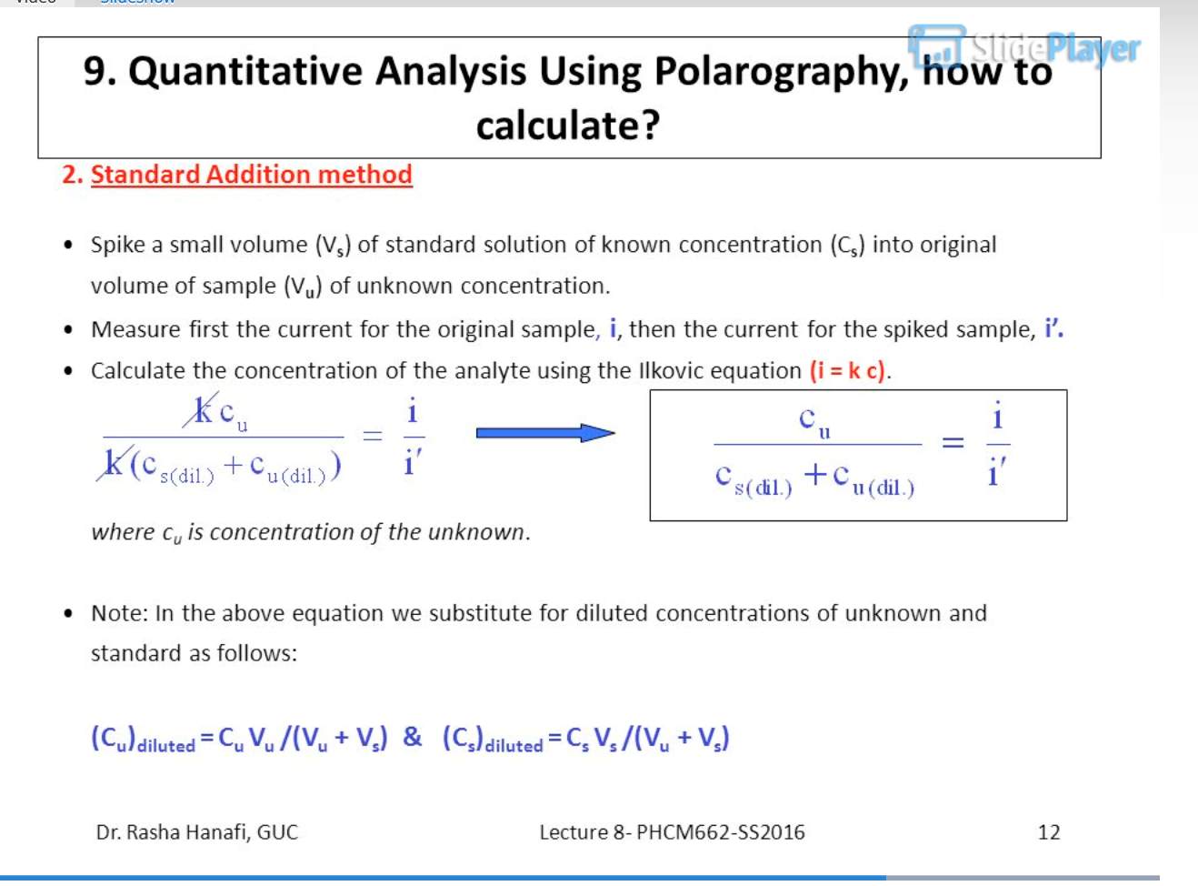
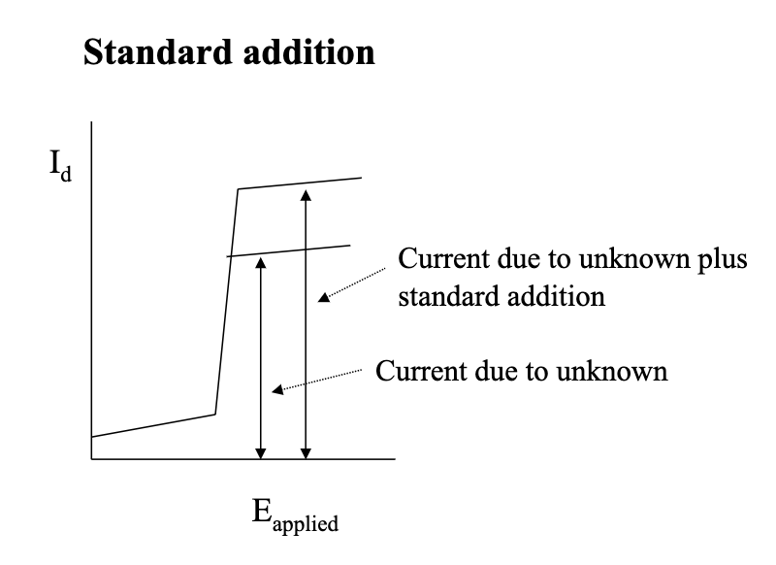
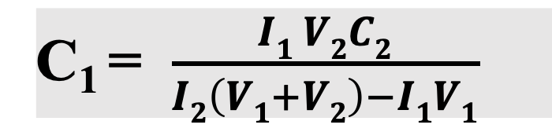
Standard addition method
The standard addition method is most useful when the sample matrix is unknown or difficult to duplicate in synthetic standard solutions.
This method is faster but usually not as reliable as the method employing a standard curve.
First, a polarogram of the unknown is recorded. Then, a small volume of concentrated solution containing a known quantity of the analyte is added to the sample.
With the assumption that the response is linear, the increase in diffusion current of this new solution can be used to estimate the amount of unknown in the original solution.
For the greatest accuracy, several standard additions are made.
C₁ = $\frac{I1 V2C2}{I2\left(V1+V2\right)−I1V1}$
C₁ Concentration of unknown
C₂ Concentration of standard solution
V₂ mL of standard solution is added to V₁ mL of unknown
I₁ Diffusion current of unknown
I₂ Diffusion current of standard solution

Slide 24
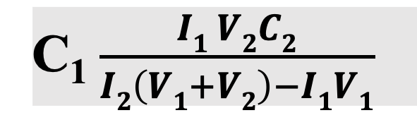
Example 2/ Standard Addition Calculation
A 25mL sample of Ni²⁺ gave a wave height of 2.36 µA (corrected for residual current) in a polarographic analysis, when 0.5mL of solution containing 28.7 mM Ni²⁺ was added, the wave height increased to 3.79 µA. Find the concentration of Ni²⁺ in the unknown.
The increase in wave height is proportional to the increase in Ni²⁺ concentration.
First, calculate the change in wave height (3.79 - 2.36 = 1.43 µA).
Then calculate the concentration of Ni2+ added: (28.7 mM) * (0.5 mL) = 14.3 mM*mL.
Next, find the total volume after the addition: 25 mL + 0.5 mL = 25.5 mL.
Then, we can use the following formula:
2.36/x = 1.43/((14.3/25.5)). Solving for x: x = (2.36 * 14.3)/ (1.43 * 25.5) = 0.927 mM. Therefore, the concentration of Ni2+ in the unknown sample is approximately 0.927 mM.
C₁$\frac{I1 V2C2}{I2\left(V1+V2\right)−I1V1}$

Slide 25
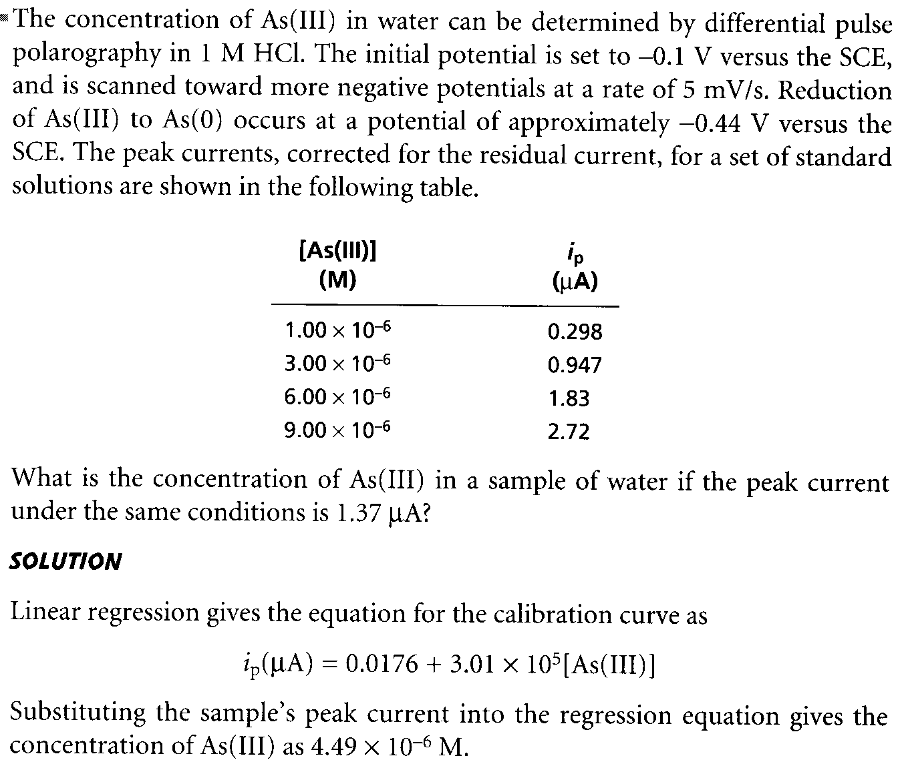
Example 2

Slide 26
Advantages of DME
Surface area is reproducible with a given capillary
It provides a smooth, fresh surface for the reaction
The high overpotential for H⁺ reduction at the mercury surface, i.e., H₂ does not evolve on the Hg surface unless a very high negative potential(-1.2V) is reached, and thus H⁺ will not interfere in the determination of many ions
Each drop remains unaffected and does not become contaminated by the deposited metal
Diffusion equilibrium is readily established at the mercury-solution interface
The surface area of a drop can be calculated from the weight of a drop
Mercury forms amalgams (solid solution ) with many metals and thus decreases their reduction potentials
Limitation
It is highly toxic and has a measurable vapor pressure, so care should be taken in handling
The surface area of a drop of mercury is never constant
Applied voltage produces a change in surface tension and hence a change in drop size
Mercury has limited application in analysis
Capillary is very small and thus can be easily blocked
It can not be used at higher positive potential due to the oxidation of mercury prevents the use of more positive(oxidizing)potential
Hg can not be used for the determination of species that can be oxidized above +0.4V

Slide 27
Application of Polarography:
Qualitative analysis: helps in the characterization of organic matter and various metal interactions from the half-wave potential of the current v/s voltage graph
Quantitative analysis: polarography is used in the determination of the concentration of drugs, metal ions, etc in the given sample
Determination of inorganic compounds: polarography is used in the determination of cations and anions in the presence of interfering ions
Determination of organic compounds: polarography is used in the determination of structure, quantitative analysis of the mixture of organic compounds
estimation of dissolved oxygen: the amount of oxygen dissolved in an aqueous solution or organic solvent can be calculated with the help of polarography
Pharmaceutical applications: tetracycline antibiotics, and sulphonamides can be analyzed by polarography
Polarography has been used extensively to determine trace metals in Pharmaceutical products and to estimate drugs that contain metals as a constituent, the metals examined include antimony, arsenic, cadmium, copper, iron, lead, magnesium, mercury, vanadium, and zinc

Slide 28
