Slide 1
University of Baghdad
College of Science for Women
Department of Chemistry
Instrumental Analysis Chemistry
Second Semester
Electroanalytical Chemistry
Basic Principles of Conductivity
Lecturer
Asst. Prof. Dr. Maha Al-Tameemi
Lecture Time : Group A&B on Tuesday at (8:30 AM -11:30 PM )
Texts:
Principle of Instrumental Analysis, by Douglas A. Skoog, F.James Holler, Stanley R. Crouch, Chapter 9, 10, 11, and 12(6th Edition)
Spectrochemical Analysis, by James D. Ingle,Jr and Stanley R. Crouch, Chapter 7, 8, 9, 10, and 11.
Most Analytical Chemistry Textbooks.
Handout

Slide 2
Introduction to Electrochemistry
1.) Electroanalytical Chemistry:
A group of quantitative analytical methods based on the electrical properties of analytes when part of an electrochemical cell
Analytical calculations are based on the measurement of electrical quantities (current, potential, charge, or resistance) and their relationship to chemical parameters
2.) Why Electroanalytical Chemistry?(General Advantages of Electrochemistry)
a) Selective for particular redox state of a species e.g. Ce^{III} vs. Ce^{IV}
b) less expensive equipment than spectroscopy instruments
c) Measurements are easy to automate as they are electrical signals
d) Low concentrations of analytes are determined without difficulty e) fast
e) in situ
f) information about:
‚ oxidation states
‚ stoichiometry
‚ rates
‚ charge transfer
‚ equilibrium constants

Slide 3
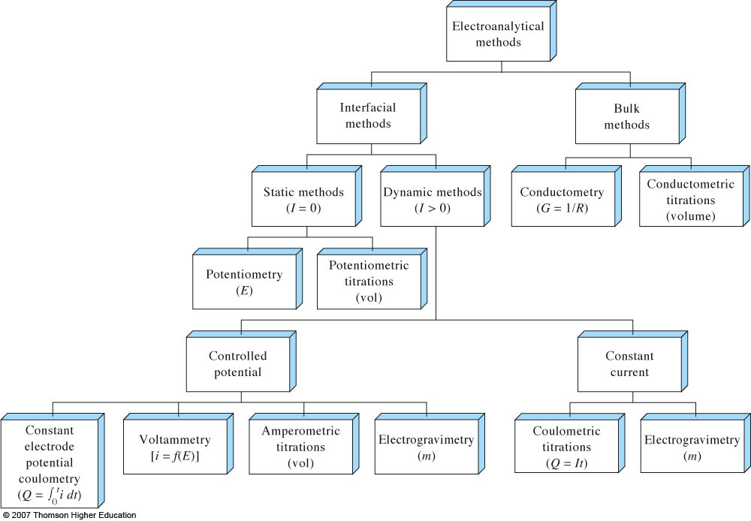
Types of Electroanalytical Methods

Slide 4
Conductometry means measuring the conductivity of ionic solutions caused by the mobility of ions toward respective electrodes in the presence of an electric field.
Conductivity is measured using a conductometer. The Unit of conductivity is mhos(Ω⁻¹).
Conductivity is generally measured using a Wheatstone bridge circuit and a conductivity cell made of platinum.
The electrical conductivity measurement detects the number of cations or anions (salts) in solution
The greater the number of anions or cations, the greater the electrical conductivity reading.
The ions generally associated with salinity are Ca²⁺, Mg²⁺, K⁺, Na⁺, H⁺ (cations), or NO₃⁻, SO₄²⁻, Cl⁻, HCO₃⁻, OH⁻ (anions).
The magnitude of conductometric titration is based on Ohm’s law.
The ability of an ion to carry current is a function of:
  Ions charge (more charge, more current)
  Ions mass or size (larger ions conduct less)
  Water with absolutely no impurities (does not exist)[Conducts electricity very poorly]
  Impurities in water increase conductivity, so, when measuring the conductivity of water, one can estimate the degree of impurities
E is the potential difference,
i is the current intensity.

Slide 5
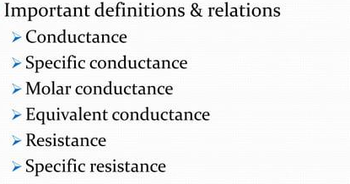

Slide 6
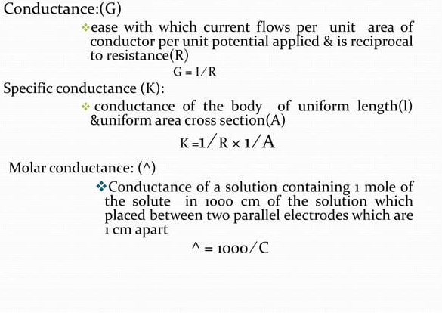

Slide 7
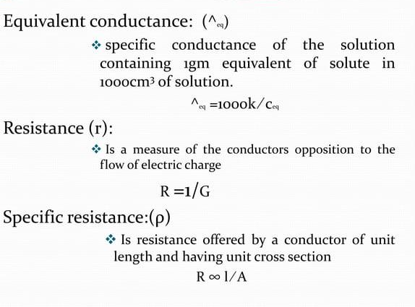

Slide 8
What is a conductive solution?
Conductivity is typically measured in aqueous solutions of electrolytes.
Electrolytes are substances containing ions, i.e. solutions of ionic salts or of compounds that ionize in solution.
The ions formed in solution are responsible for carrying the electric current.
Electrolyte: Substances whose aqueous solution is a conductor of electricity
Electrolytes include acids, bases and salts and can be either strong or weak.
Most conductive solutions measured are aqueous solutions, as water has the capability of stabilizing the ions formed by a process called solvation.
Strong electrolytes
Strong electrolytes are substances that are fully ionized in solution. As a result, the concentration of ions in solution is proportional to the concentration of the electrolyte added.
They include ionic solids and strong acids, for example HCl.
Solutions of strong electrolytes conduct electricity because the positive and negative ions can migrate largely independently under the influence of an electric field.
Weak electrolytes
Weak electrolytes are substances that are not fully ionized in solution.
For example, acetic acid partially dissociates into acetate ions and hydrogen ions, so that an acetic acid solution contains both molecules and ions.
A solution of a weak electrolyte can conduct electricity, but usually not as well as a strong electrolyte because there are fewer ions to carry the charge from one electrode to the other.
Nonelectrolytes
  None of the molecules are dissociated into ions

Slide 9
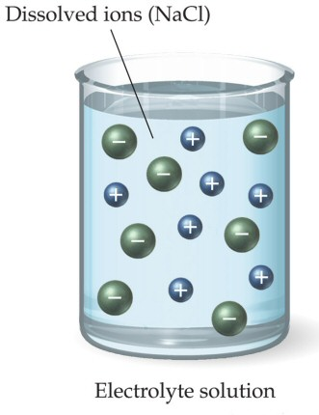
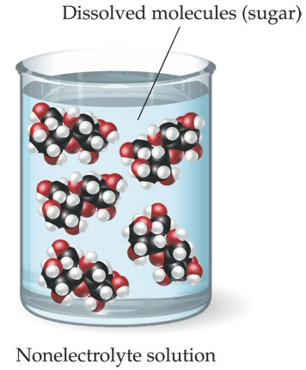
Electrolytes
Dissociation of Water

Slide 10
The conductance of the solution depends on:
1. Temperature:
-The increase in temperature increases conductivity
-Temperature decreases ionic activity and the viscosity of a solution.
A temperature rise may also increase the number of ions and their mobility in the solution.
-This is why the conductivity of a solution is impacted by an increase in the solution’s temperature, i.e. conductivity increases
2. Viscosity
High viscosity , low conductance
3. Nature of ion
Size of ions, molecular weight, Number of ions, and Charge of ions
  Ions charge (more charge, more current)
  Ions' mass or size (larger ions conduct less)
4. The concentration of ions
As the number of ions increases, the conductance of the solution rises (The conductivity of a solution is proportional to its ion concentration).
5. The size of the electrodes
Specific conductivity is conductivity offered by a substance of 1cm length and 1sq.cm surface area. units are mhos/cm.
Equivalent conductivity is conductivity offered by a solution containing an equivalent weight of solute in it.
L/A is cell constant , (A)= surface area of electrode, (L)=distance between two electrodes
K is the specific conductance or conductivity
ohm⁻¹cm⁻¹ or seimen/cm.

Slide 11
Effect of Dilution
Conductance increases with dilution
Conductance depends on the number of ions present in the solution
The degree of ionization of electrolytes increases leading to more ion production
Specific conductance decreases on dilution because the number of current carrying ions or particles decreases per c.c
Equivalent and molecular condctance increases on dilution
On dilution produce more and more electrolytes (degree of ionization)
Whole substance has ionized further dilution produce less or no charge in equivalent and molecular conductivities
Called equivalent conductance at infinite dilution
Equivalent conductance tends to become maximum as conc. Decreases and dilution increases
KCl maximum conductivity reached at comparatively higher conc. Or lower dilution as compared to CH3COOH

Slide 12
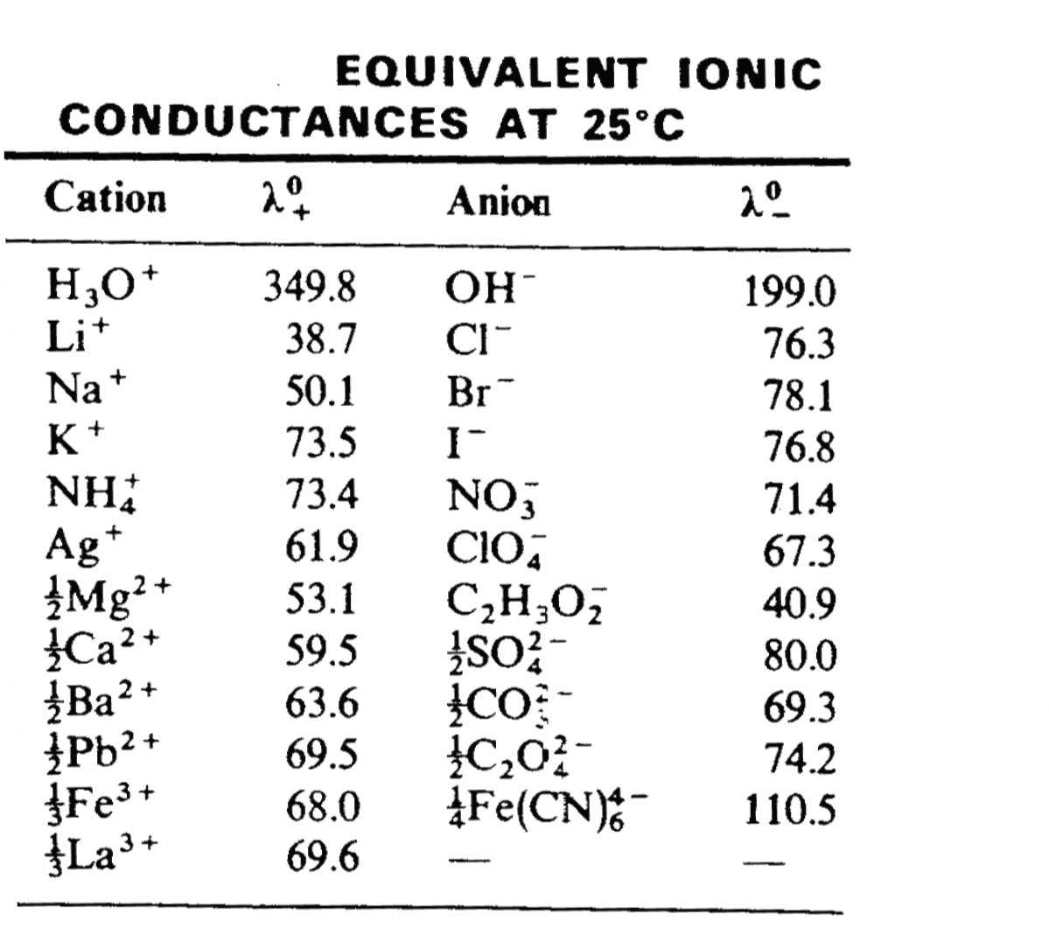
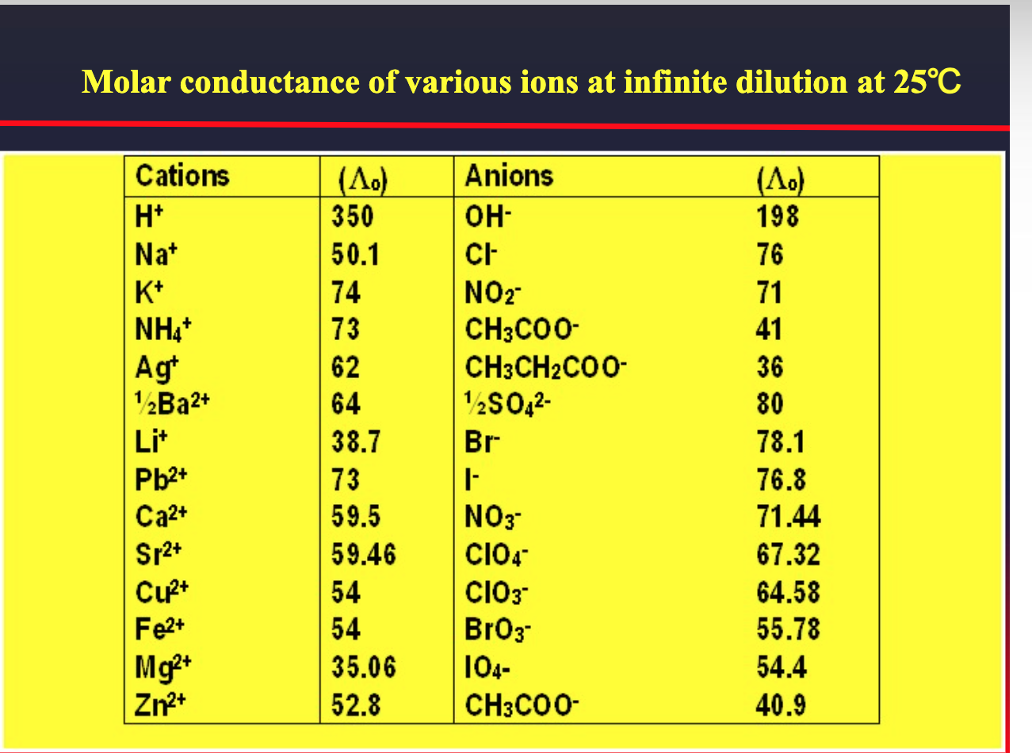
Molar conductance of various ions at infinite dilution at 25℃

Slide 13
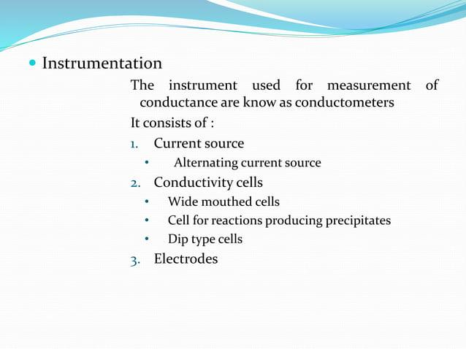

Slide 14
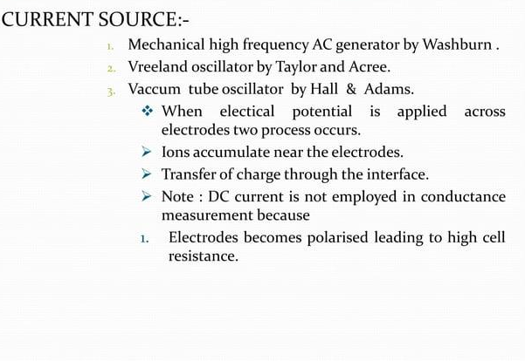

Slide 15
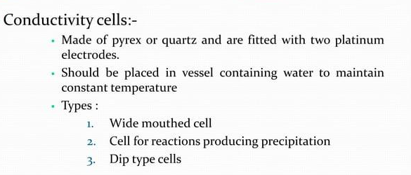
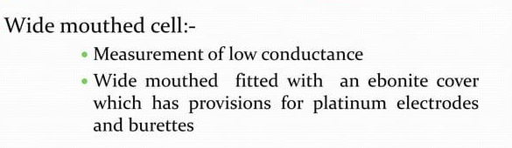

Slide 16
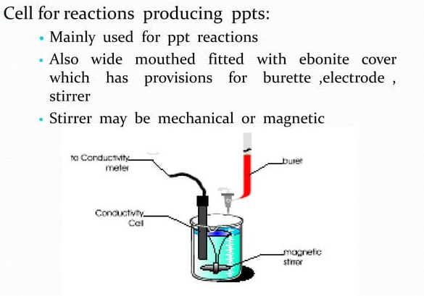

Slide 17
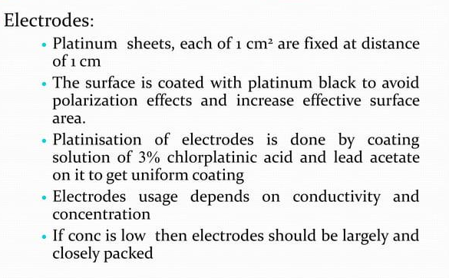

Slide 18
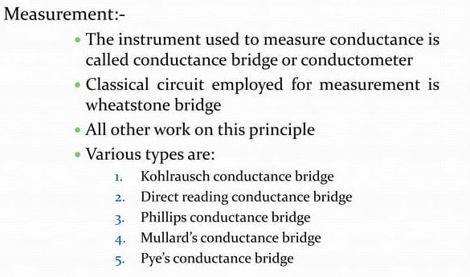

Slide 19
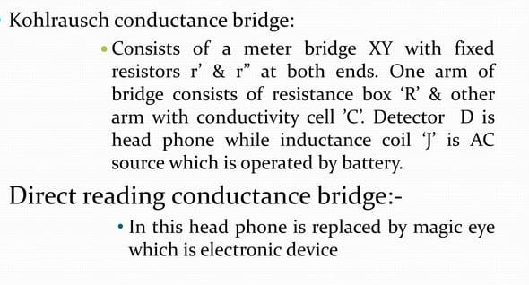

Slide 20
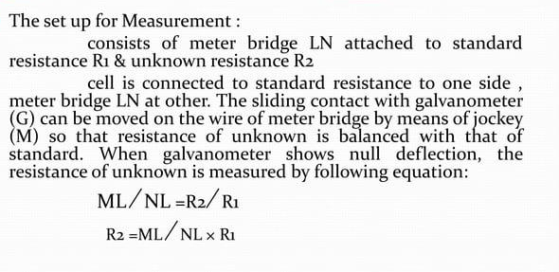

Slide 21
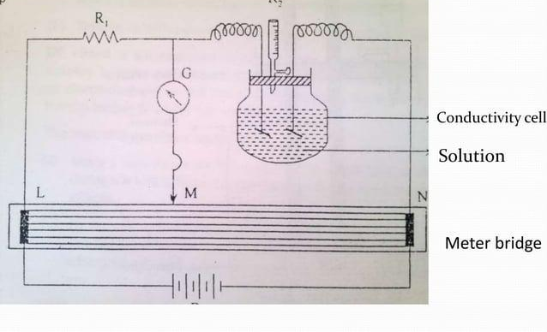

Slide 22
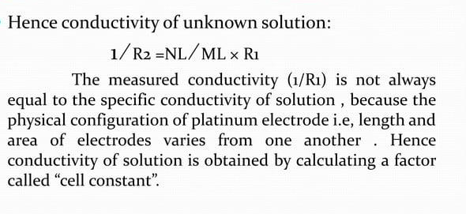
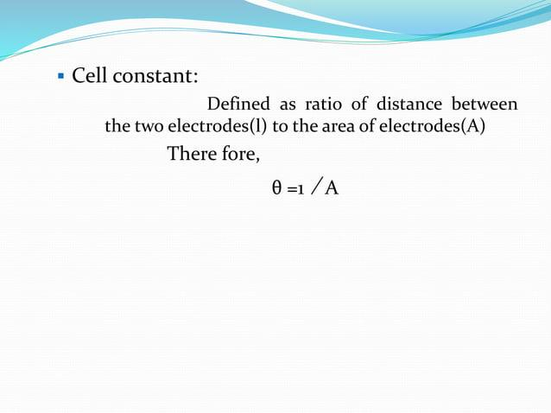

Slide 23

Principle of Conductivity Measurement
2 metals in contact with electrolyte solution
Voltage is applied to electrodes and the resulting current that flows between electrodes is used to determine the conductance
The voltage drop caused by the resistance of the solution is used to calculate the conductivity per centimeter.
Conductivity(G) the inverse of resistivity(R) is determined from the voltage and current values according to Ohm’s law.
The meter converts the probe measurement to micro mhos per cm and displays the result.
The amount of current flowing depends on:
  Solution conductivity
  Length, surface area, geometry of electrodes
Apply an AC Voltage to Two Electrodes of Exact Dimensions
Acids, Bases and Salts (NaCl) Dissolve in Solution and Act as Current Carriers
Current Flow is Directly Proportional to the Total Dissolved Solids in the Solution
Physical Dimensions of a Conductivity Electrode are Referred to as the Cell Constant
Cell Constant is Length/Area Relationship
  Distance Between Plates = 1.0 cm
  Area of Each Plate = 1.0 cm x 1.0 cm
  Cell Constant = 1.0 cm⁻¹

Slide 24
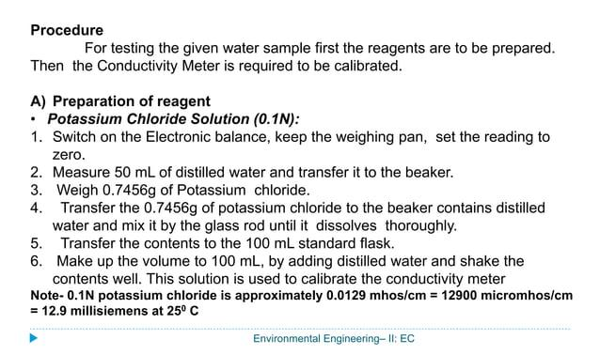
Calibration Method of the Conductivity

Slide 25
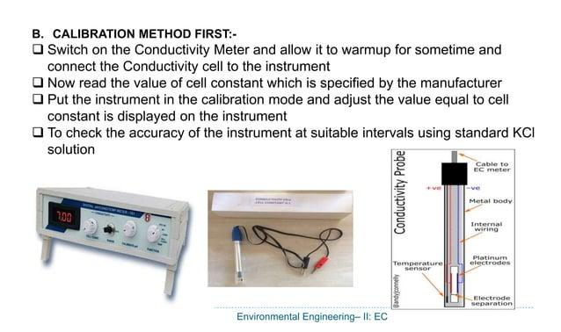

Slide 26
CONDUCTOMETRIC TITRATIONS
Determining the endpoint of a titration using conductivity measurements is known as conductometric titrations.
The conductometric data are plotted as a function of titrant volume.
The principle of conductometric titration is based on the fact that during the titration, one of the ions is replaced by the other, and invariably, these two ions differ in the ionic
conductivity, with the result that the conductivity of the solution varies during the course
of titration.
The equivalence point may be located graphically by plotting the change in conductance as a function of the volume of titrant added.

Slide 27
Types of conductometric titrations:
Acid-base titration
Precipitation titration
Replacement titration
Redox (oxidation-reduction) titration
Complexometric titration

Slide 28
Acid-Base Titration
Neutralization titrations are particularly well adapted to the conductometric end point because of the large ionic conductance of hydrogen and hydroxide ions compared with the conductance of the species that replace them in solution.
Titration of Strong Acids or Bases. The solid line in Figure below represents a curve(corrected for volume change) obtained when hydrochloric- acid is titrated with sodium hydroxide.
Also plotted are the calculated contributions of the individual ions to the conductance of the solution. During neutralization, hydrogen ions are replaced by an equivalent number of less mobile sodium ions; the conductance changes to lower values as a result of this substitution.
At the equivalence point, the concentrations of hydrogen and hydroxide ions are at a minimum and the solution exhibits its lowest conductance.
A reversal of slope occurs past the end point as the sodium ion and hydroxide ion concentrations increase.
With the exception of the immediate equivalence-point region, an excellent linearity exists between conductance and the volume of base added.

Slide 29
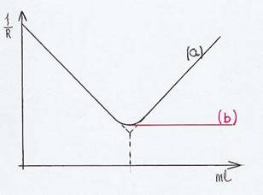
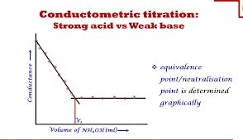
Acid-base titrations
Titration of strong acid
(a) with a strong base.g. HCl with NaOH
(b) with a weak base e.g. HCl with NH₄OH
Before NaOH is added, the conductance is high due to highly mobile hydrogen ions. When the base is added, the conductance falls due to the replacement of hydrogen ions by the added cation as H⁺ ions react with OH ⁻ ions to form undissociated water.
This decrease in the conductance continues till the equivalence point.
At the equivalence point, the solution contains only NaCl.
After the equivalence point, the conductance increases due to the large conductivity of OH⁻ ions
In the case of (b) HCl with NH₄OH after the equivalence point, an excess of NH₄OH is added, and the conductance remains constant due to the common ions effect

Slide 30
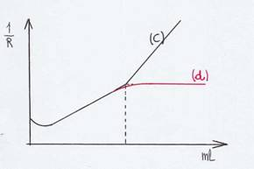
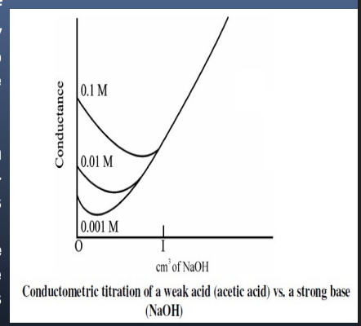
Titration of a weak acid
(c) with a strong base e.g. CH₃COOH with NaOH
(d) with weak base e.g. CH₃COOH with NH₄OH
(c) A strong base e.g. CH₃COOH with NaOH
1-Initially the conductance is low due to the feeble ionization of acetic acid.
2-On the addition of base, there is a decrease in conductance not only due to the replacement of H+ by Na+ but also suppresses the dissociation of acetic acid due to standard ion acetate.
3-But very soon, the conductance increases on adding NaOH as NaOH neutralizes the un-dissociated CH3COOH to CH3COONa which is the strong electrolyte.
4-This increase in conductance continues to rise up to the equivalence point.
5-The graph near the equivalence point is curved due to the hydrolysis of salt CH3COONa.
6- Beyond the equivalence point, conductance increases more rapidly with the addition of NaOH due to the highly conducting OH − ions
(d) A weak base e.g. CH₃COOH with NH₄OH
The nature of the curve before the equivalence point is similar to the curve obtained by titrating weak acid against a strong base.
After the equivalence point, conductance virtually remains the same as the weak base which is being added is feebly ionized and, therefore, is not much conducting.

Slide 31
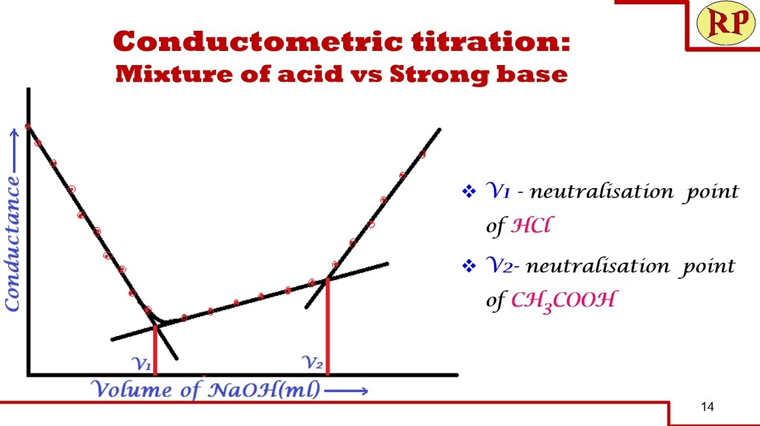
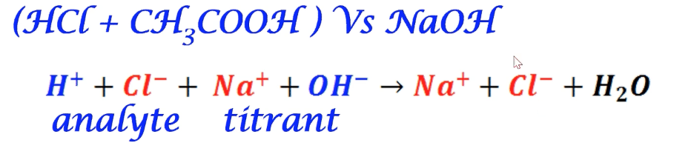
Determination of the mixture of hydrochloric acid (strong acid) and acetic acid (weak acid) with sodium hydroxide (strong base)
Base: In this curve, there are two break points.
1-The first break point corresponds to the neutralization of strong acid.
2- H⁺ and OH⁻ (High ionic conductivity), Na⁺ and Cl⁻ (Low ionic conductivity),
3- Before titration HCl and CH₃COOH are present, and Conductivity is high because of H⁺
4- CH₃COOH dose not dissociate, then H⁺ is replaced with Na⁺ Conductivity decreases.

Slide 32
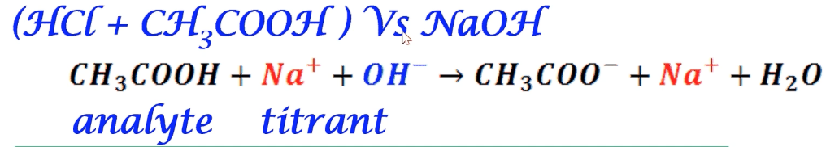
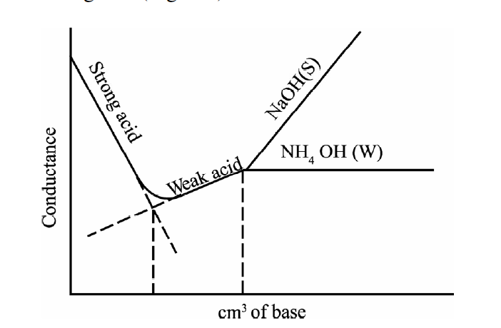
2- When the strong acid has been completely
neutralized only then does the weak acid start neutralizing.
The second break point corresponds to the neutralization of weak acid.
CH₃COOH does not dissociate easily
CH₃COONa dissociates better than CH₃COOH
NaOH dissociates immediately
Na⁺ has a low ionic conductivity
H⁺ and OH⁻ (High ionic conductivity)
After Complete neutralization of HCl Initial addition of NaOH- NaCl, CH₃COOH, and small amount of CH₃COONa CH₃COOH does not dissociate easily, because of the common ion effect of CH₃COO⁻ Slow decrease in conductivity
During titration till the equivalence point of CH₃COOH, CH₃COONa ionizes better than CH₃COOH conductance increases slowly.
After equivalence point excess NaOH is added, accumulation of OH⁻ with high conductivity, conductance increases

Slide 33

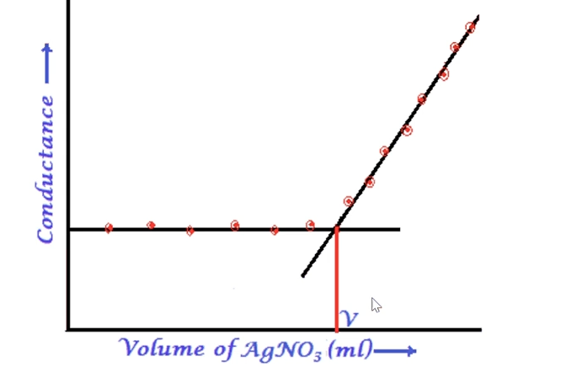
Precipitation Titration
AgCl is a sparingly soluble salt that does not dissociate,
Similar ionic conductivity[Cl ^{-,} NO₃⁻]
Before titration, only KCl is present, Presence of K+ and Cl- with low ionic conductivity-low conductance c During titration till the equivalent point, AgCl is a sparingly soluble salt that does not dissociate, and Cl is replaced by NO₃⁻ with similar ionic conductivity –conductance remains constant.
At the equivalence point, AgCl and KNO₃ are present (All KCl has reacted with AgNO₃)
After the equivalence point, excess AgNO₃ is added
Accumulation of AgNO₃ which can dissociate conductance increases

Slide 34
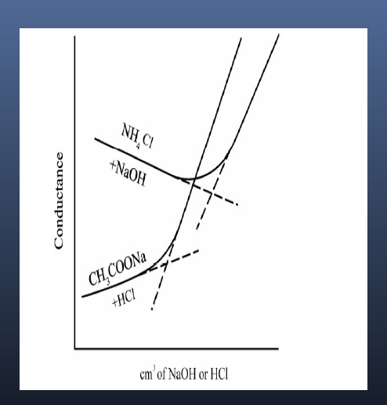
Replacement Titration
Salt of strong acid and weak base vs. strong base
[The addition of a strong base to the salt of a weak base, the cation of the weak
base is replaced by that of the stronger one, and the weak base itself is generated in the undissociated form.
Ex: Ammonium chloride vs. sodium hydroxide
NH₄Cl+NaOH→NH₄OH+NaCl
The decrease in conductivity during the displacement is caused by the displacement of ammonium ions of greater conductivity by sodium ions of smaller conductivity.
Salt of strong base and weak acid vs. strong acid
Eg: Sodium acetate vs. hydrochloric acid
CH₃COONa+HCl→CH₃COOH+NaCl
[When a salt of a weak acid is titrated with a strong acid, the anion of the weak acid is replaced by that of the strong acid, and the weak acid itself is liberated in the undissociated form]
The acetate ion is replaced by the chloride ion after the endpoint
The initial increase in conductivity is because the conductivity of the chloride ion is slightly greater than that of the acetate ion.
Until the replacement is nearly complete, the solution contains enough sodium acetate to suppress the ionization of the liberated acetic acid, so resulting in a negligible increase in the conductivity of the solution.
However, near the equivalent point, the acetic acid is sufficiently
ionized to affect the conductivity, and a rounded portion of the curve is obtained.
Beyond the equivalence point, when an excess of HCl is present (ionization of acetic acid is very much suppressed) therefore, the conductivity arises rapidly

Slide 35
Redox (Oxidation-Reduction) Titration
Titration of ferrous ions with dichromate ions:
6 Fe²⁺+Cr₂O₇²⁻+14H⁺→6Fe³⁺+2Cr³⁺+7H₂O
Redox Reaction-(Oxidation-reduction reaction),
Reactions in which electrons are transferred from one substance to another, Oxidation( Loss of electrons)
Reduction(Gain of electrons)
Consider the titration of a reducing agent (e.g., iron(II) ion) with an oxidizing agent (e.g., potassium dichromate, K₂Cr₂O₇). Conducted in an acidic medium
In this method, the decrease in the hydrogen ions concentration shows the decrease in the conductivity at the end point
Since the mobility of H+ ions is high, so a sharp decrease in the conductivity is expected during the initial part of the titration
After the equivalent point the addition of the titrant shows the stability in the conductivity.
Conductance
K₂Cr₂O₇, ml

Slide 36
Complexometric Titration
Ex.:-KCl vs. Hg(ClO₄)₂
Non-aqueous titrations can also be measured using conductometry.
Ex:-
a)Titration of weak bases vs. perchloric acid in dioxan-formic acid.
b)Titration of weak organic acids in methanol vs. tetramethyl ammonium hydroxide in methanol-benzene.

Slide 37
ADVANTAGES OF CONDUCTOMETRIC TITRATIONS
No need of an indicator
Colored or dilute solutions or turbid suspensions can be used for titrations.
Temperature is maintained constant throughout the titration.
The end point can be determined accurately and errors are minimized as the end point is being determined graphically.

Slide 38
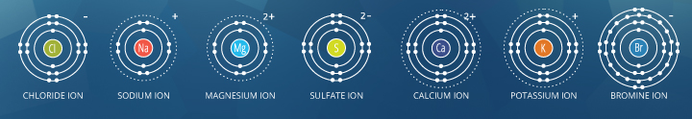
Measuring TDS With Conductivity Method
The units for TDS are usually expressed as milligrams per liter (mg/L), which is the same as parts per million (ppm). Some TDS meters also show parts per thousand (ppt), which is equal to 1,000 ppm.
Water contains dissolved minerals, which are commonly referred to as total dissolved solids (TDS) or sometimes as total dissolved salts.
The amount of TDS depends on the water’s location and source. Some of the TDS can be toxic if present at concentrations beyond recommended levels.
The standard method for measuring TDS is evaporating all the water from a 0.1-liter sample and weighing the residual minerals left in the vessel. However, collecting a sample and conducting a standard laboratory analysis or sending the sample to a water quality testing facility can be time-consuming.
An electrical conductivity (EC) or TDS meter is a quick method to estimate TDS.
Water conducts electricity due to the presence of minerals (ions), so the more dissolved minerals, the more conductive the water becomes.
Pure (distilled) water is a poor conductor of electricity because it contains very few dissolved minerals.
Salinity is the total concentration of all dissolved salts in water
The most common ions in sea water

Slide 39
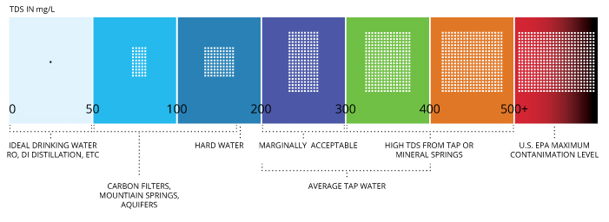
Conductivity, Salinity, TDS
TDS = 0.7 σ
  σ = conductivity (μs/cm)
Total dissolved solids (TDS) combine the sum of all ion particles that are smaller than 2 microns
EPA recommends an upper limit of 500 mg/L TDS

Slide 40
Sample Measurements
Rinse the conductivity cell sensing element with DI water between sample
Dip the cell up and down in the sample 2-3 times to completely wet the surface
Allow air bubbles to escape from conductivity cell side holes by tilting cell slightly
It is important to control sample temp
  Since reading will continue to drift until the temp has stabilized

Slide 41
Cleaning
Storage
1. Best to store the conductivity probe so that electrodes are immersed in DI water
2. Can also store dry
  Before use:
  The probe should be soaked in DI water for 5-10 minutes
  To ensure complete wetting of the electrodes
1. For most applications, a hot solution of water with mild lab detergent can be used for cleaning
2. Dilute 1% nitric acid may be used followed by DI water rinsing

Slide 42
RECENT DEVLOPEMNTS
In refinary industries.
Estimation of polyelectrolytic solution.
Biotechnology.
Microbiosensors for enviromental monitoring.

Slide 43
Applications of Conductometry
It can be used for the determination of:-
Solubility of soluble salts
Ionic product of water
Basicity of organic acids
Salinity of seawater
Chemical equilibrium in ionic reactions
Conductometric titration
Conductometric titrations are used significantly in the food industry, specifically by food microbiologists, to trace various microorganisms.
Conductometric titration can be used in determining deionized and distilled water purity or freshness by examining the equilibrium of chemicals in ionic reactions.
It is also used largely in the pharmaceutical industries to detect many antibiotics and to check the levels of basicity in various organic acids.

Slide 44
