Slide 1
Infra-Red Absorption Spectroscopy
Theoretical Principles
Introduction
Dr. Maha Al-Tameemi

Slide 2
Infrared Absorption Frequencies
Dr. Maha Al-Tameemi
Structural unit Frequency, cm⁻¹
Stretching vibrations (single bonds)
sp C—H 3310-3320
sp² C—H 3000-3100
sp³ C—H 2850-2950
sp² C—O 1200
sp³ C—O 1025-1200
Notes:
8

Slide 3
Infrared Absorption Frequencies
Dr. Maha Al-Tameemi
Structural unit Frequency, cm⁻¹
Stretching vibrations (multiple bonds)
C
C
1620-1680
—C
C—
2100-2200
—C
N
2240-2280
Notes:
8

Slide 4
Infrared Absorption Frequencies
Dr. Maha Al-Tameemi
C
O
Structural unit Frequency, cm⁻¹
Stretching vibrations (carbonyl groups)
Aldehydes and ketones 1710-1750
Carboxylic acids 1700-1725
Acid anhydrides 1800-1850 and 1740-1790
Esters 1730-1750
Amides 1680-1700
Notes:
8

Slide 5
Infrared Absorption Frequencies: functional groups
Dr. Maha Al-Tameemi
Structural unit Frequency, cm⁻¹
Stretching vibrations (single bonds)
O—H (alcohols) 3200-3600
O—H (carboxylic acids) 3000-3100
N—H 3350-3500
Notes:
8

Slide 6
Dr. Maha Al-Tameemi

Slide 7
Dr. Maha Al-Tameemi

Slide 8
Dr. Maha Al-Tameemi

Slide 9
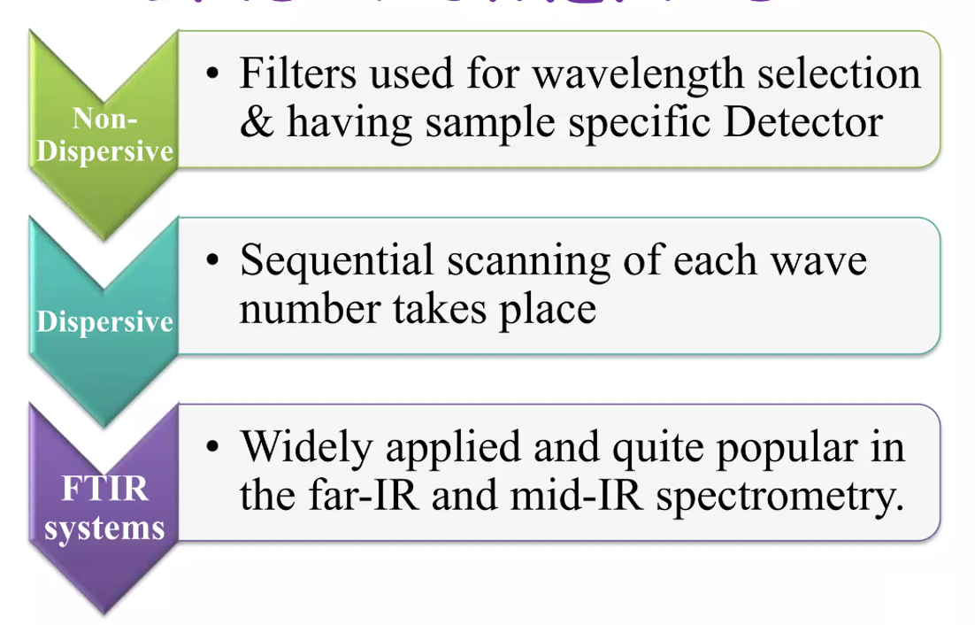
Types of IR instruments

Slide 10
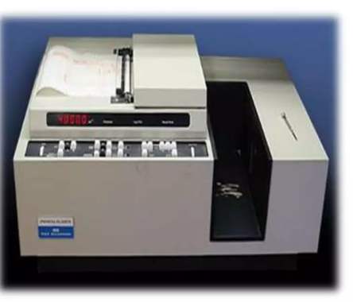
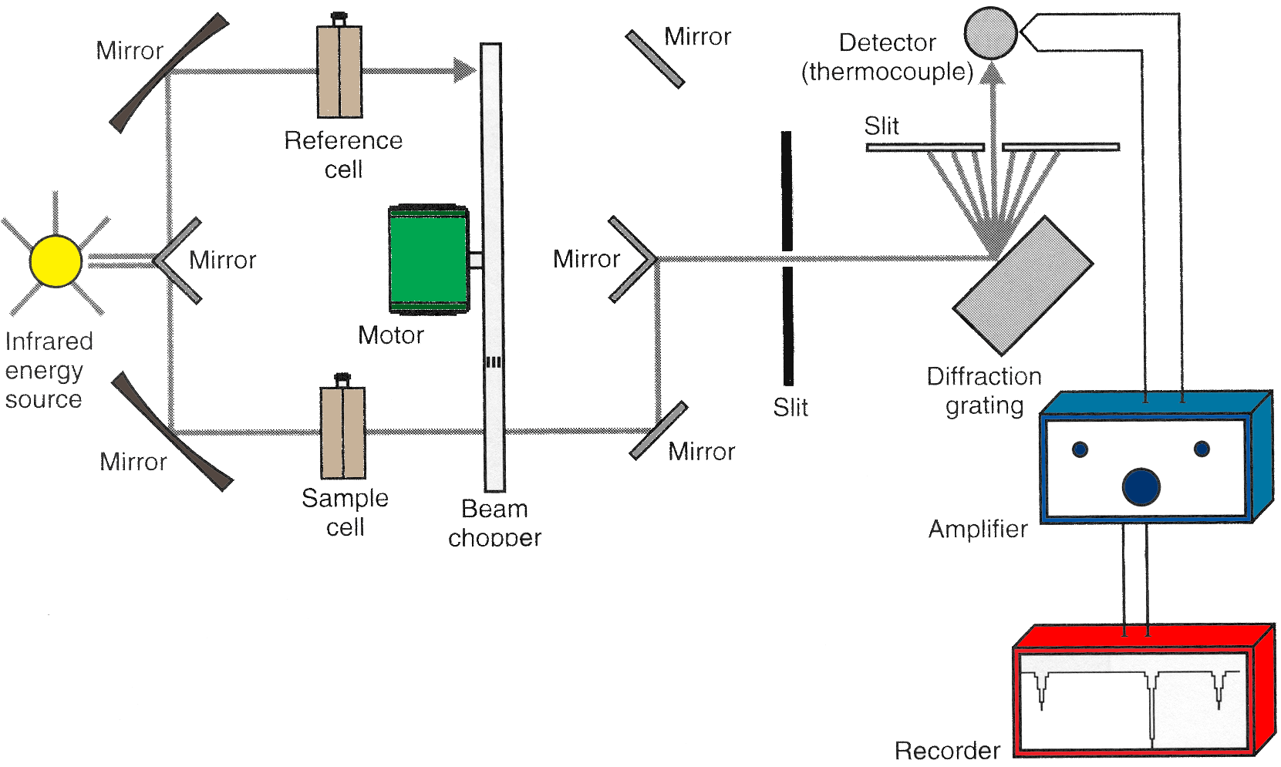
Dispersive IR Instrument
Dr. Maha Al-Tameemi
Dispersive IR Spectrometers
        Light Source
        Sample cell
        Monochromator
        Detector
        Amplifier
        Recorder
        Dispersive IR Instruments were introduced in 1940’s
        Double-beam Instruments are used more than Single beam Instruments because of the following reasons:
        -The low intensity of IR radiation
        -low sensitivity of IR transducers
        - Large signal amplification needed
        In a Double-beam spectrometer, a beam is separated into two and passes to sample and reference, The Prism Monochromator has been replaced with a Grating Monochromator
        In Dispersive IR sequential scanning of wave numbers of light takes place.
        Dispersive IR failed due to the monochromator containing narrow slits which limit the wavenumber of radiation

Slide 11
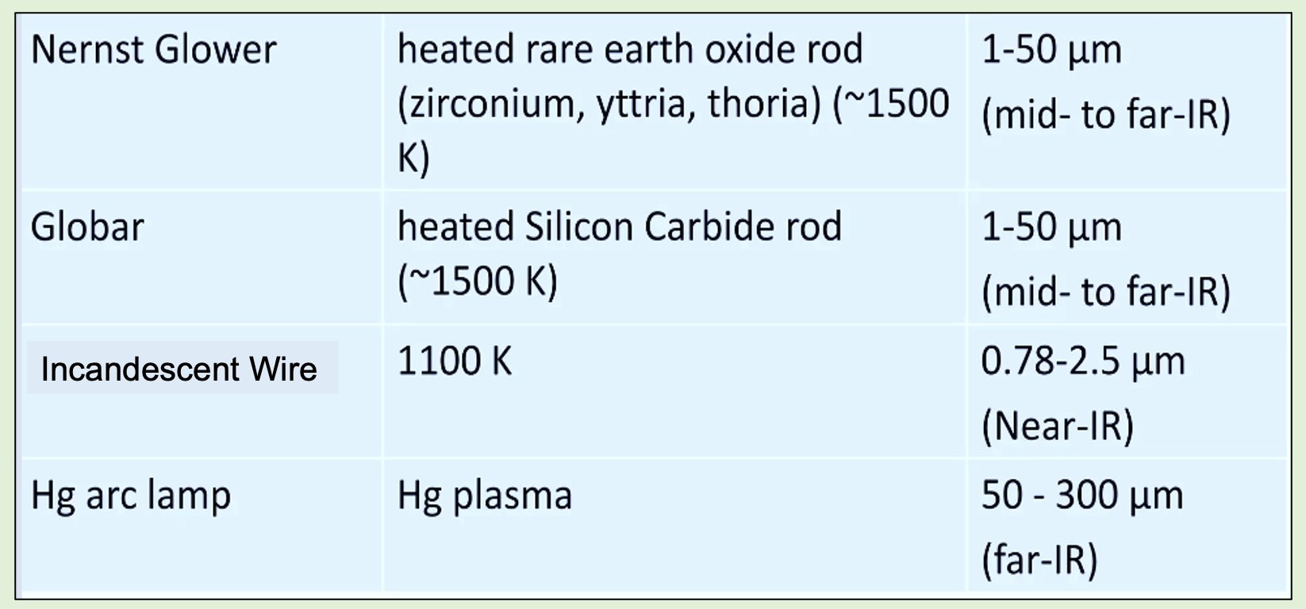
Dr. Maha Al-Tameemi
  1) Light Source: (a light source that provides the electromagnetic. energy required for the analysis).
  - Must produce IR radiation
  - Can’t use glass since absorbs IR radiation
  - Several possible types

Slide 12
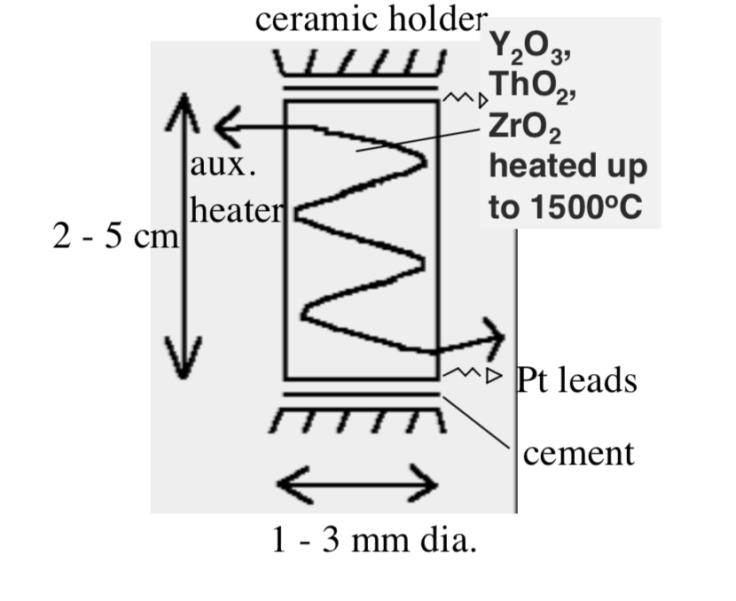
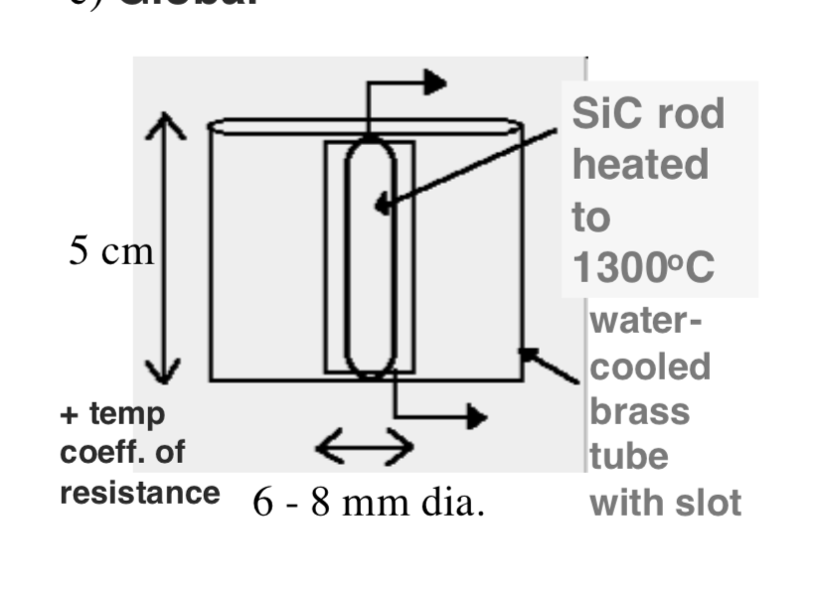
  a) Nernst Glower
  -Consists of the cylinder hollow rod or tube having a diameter
  of 1-3 mm and a length of 30 mm, sealed by platinum leads to the ends of the electrical connection
  -It is composed of a mixture of rare earth oxides such as ZrO₂, Y₂O₃, and thoria) they heated electrically to about (1200 – 2200º C).
  -It provides maximum radiation of about 7100cm⁻¹
  -Need good current control or overheats and damaged
  -Lifetime depends on the operation temperature and the care taken in handling it
  b) Globar Source
  - Similar to Nernst Glower but uses silicon carbide rod instead of rare earth oxides usually about 50 mm in length and 5 mm in diameter, heated to about 2000º C
  - It provides maximum radiation of about 5200 cm⁻¹
  - The power consumption is normally higher than that of the Nernst Glower
  -Water cooling is needed to cool metallic electrodes attached to the rod to prevent arcing.
  - Less convenient to use, more expensive, and less intense than Nernst Glower.

Slide 13
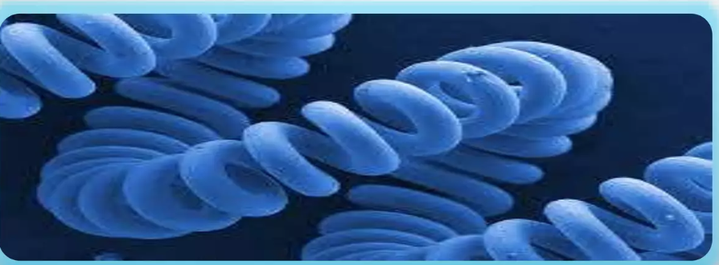
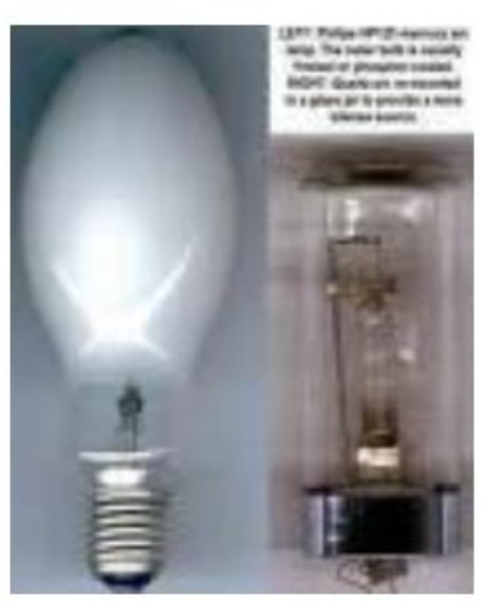
  c) Incandescent Wire Source
  - Lower intensity IR source but longer life than the GLOWER or NERNST
  -Tightly wound Spiral of nichrome or rhodium wire that is electrically heated to about 1100k by an electric current
  -Same principle as Nernst Glower
  d) The Mercury Arc Source
  Used for Far IR region(Wave < 200 cm⁻¹)
  It is a high-pressure mercury arc that consists of a quartz-jacked tube containing Hg at P > 1 atm
  When current passes through the lamp mercury is vaporized excited and ionized forming a plasma discharge at high pressure.
  In the UV and visible regions this lamp emits atomic Hg emission lines that are very narrow and discrete but emit an intense continuum in the Far-IR region.
  2) Sample Cell and Sampling of substance
  - IR spectra may be obtained for gases liquids or solids(neat or in solution).
-Material containing the sample must be transparent to the IR radiation, So salts like NaCl, and KBr are only used(KBr is used as a carrier for the IR sample because is transparent for the light in the range of IR measurements and has no absorption spectrum in the region (4000-400 cm⁻¹).
Dr. Maha Al-Tameemi

Slide 14
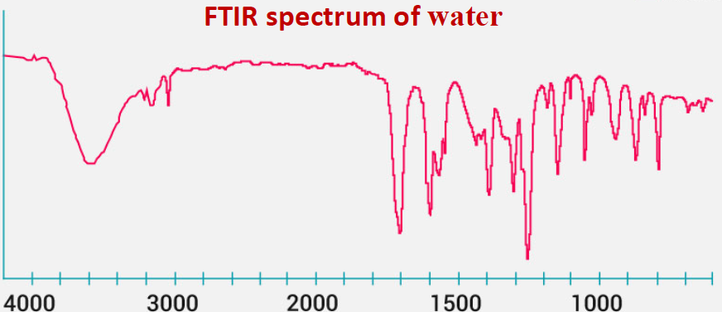
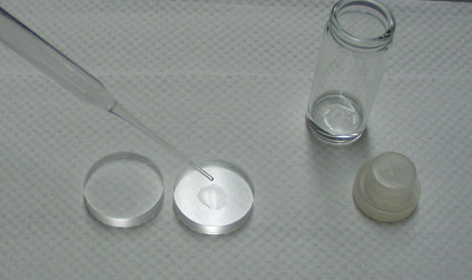
  A) Sampling of Solids
  -Various techniques used for preparing solid samples are as follows:
  1- Solids Run in Solution:
  -In this technique, a Solid sample may be dissolved in a non-aqueous solution solvent.
  Provided there is no chemical interaction with the solvent , the solvent is not absorbed in the range to be studied.
  A drop of solution is placed on the surface of the alkali metal disc solvent to dryness leaving a thin film of the solute.
Commonly used solvents in IR solution cells are CCl₄, CS₂, and CHCl₃; they are usually transparent in the important absorption region of the spectrum, acetonitrile, and acetone are useful solvents for polar materials
Why water is not used in FTIR?
Because water has two high infrared absorption peaks, it cannot be employed as a solvent for IR spectroscopy, Also, water is a polar solvent that dissolves alkali halide disks, which are extensively employed in IR. Water tends to dissolve the salt plates.
Notes:
CCl₄ Carbon tetrachloride, CS₂ carbon Disulfide, CHCl₃ Chloroform, or trichloromethane

Slide 15
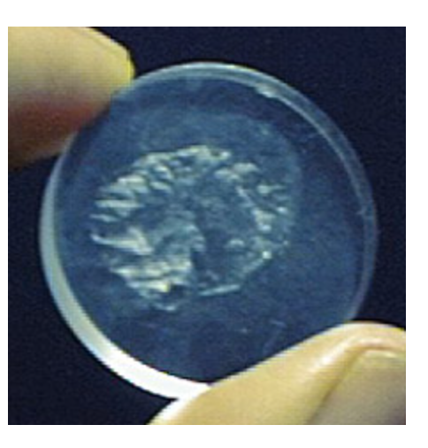
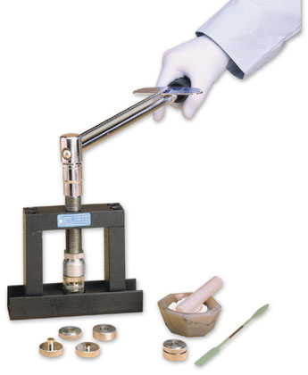
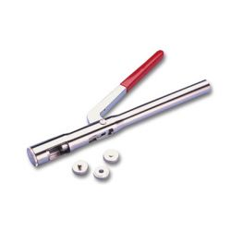
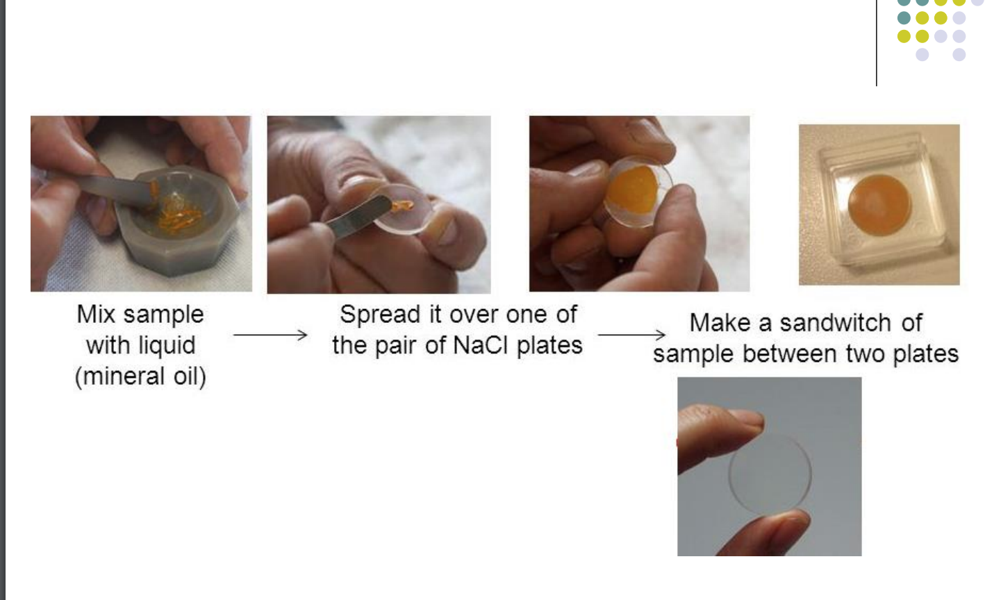
  2-Solid Film Technique: If the solid is amorphous in nature, then the sample is deposited on the surface of the KBr or NaCl cell by evaporation of a solution of the solid. Ensure the film is not too thick to pass the radiation.
  3- Pressed Pellet Technique:
  - In this technique, a small amount of finely ground solid sample is mixed with 100 times its weight of KBr and compressed
  - To form a thin transparent pellet (1-2 mm thick and I cm in diameter) using a hydraulic press.
  These pellets are transparent to IR radiation and it is used for analysis.
  Advantage
  KBr pellets stored for long periods, Resolution of the spectrum is superior
  Disadvantage:
  Always have a band at 3450 cm⁻¹ due to the OH group of moisture.
  Due to high pressure (25000 psig) polymorphic changes occur.
  Not successful for polymers(difficult to grind with KBr).
  4- Mull Technique:
  In this Technique, the finely crushed sample is mixed with Nujol(mineral oil
  A thin film is applied to the salt plates
  Then mounted in a path of an IR beam the spectrum is recorded.
  Pressed Pellet Technique
  Mull Technique

Slide 16
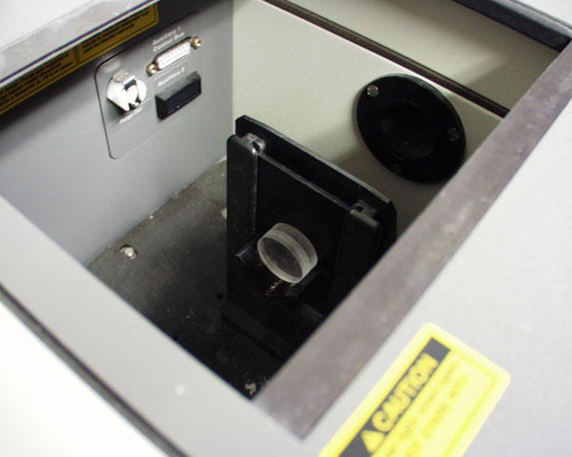
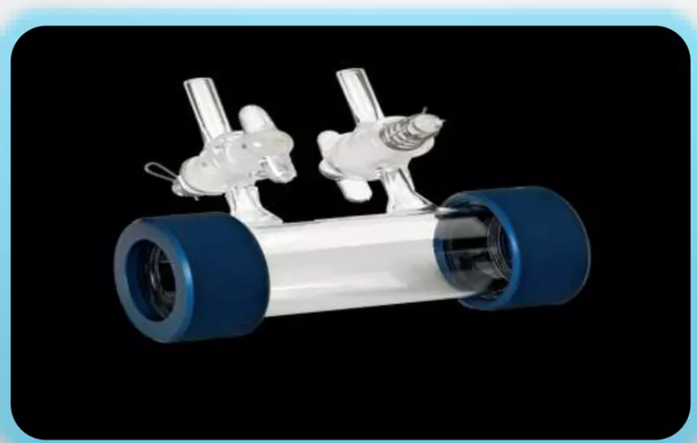
  B) Sampling of Liquids:
  -Liquid sample cells can be sandwiched using liquid sample cells of highly purified alkali halides normally NaCl and KBr can also be used.
  -Aqueous solvents can not be used because they dissolve alkali halides organic solvents like Chloroform can be used.
  -The sample thickness should be selected so that the transmittance lies between 15- 20%
  -For most liquids, the sample cell thickness is 0.01-0.05mm.
  -Some salt plates are highly soluble in water so the sample and washing reagent must be anhydrous.
  C) Sampling of Gases:
  -The sample cell is made up of NaCl, and KBr.
  -It is similar to the liquid sample cell
  -A sample cell with a long path length(5-10 cm) is needed because
  the gases show relatively weak aberrance.
  -Gas analyses are not commonly used because of a lack of sensitivity.

Slide 17
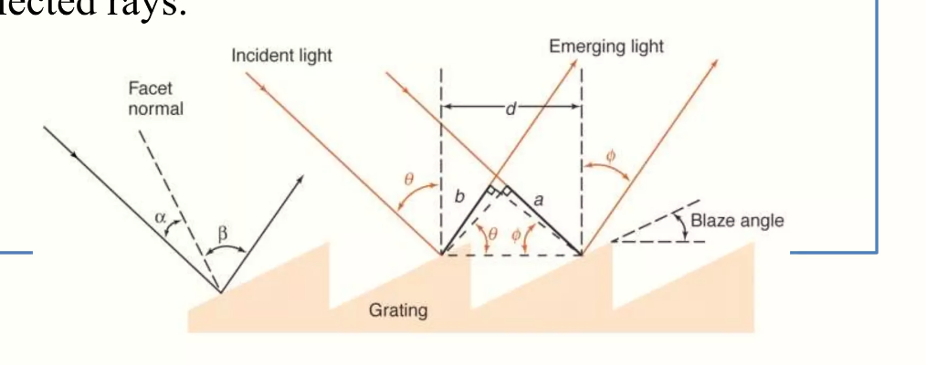
  3) Monochromator:
  Filtration of desired frequency of radiation Monochromators are 2 types
  Prism Monochromator and Grating Monochromator
  Prism Monochromator: Composed of glass or quartz and coated by alkyl halide salts (NaCl) these salts are subjected to mechanical and thermal instability or water solubility.
  These are 2 types, Mono pass Prism Monochromator radiation will pass once through the prism, and Double pass Prism Monochromator radiation will pass twice through the prism.
  Grating Monochromator: introduced in the 1950’s made with material like Aluminum
  High dispersion and resolution than prism monochromator
  There are 2 types
  Reflection grating monochromators are more common than Transmittance gratings
  Advantages Gratings over Prism are linear groove lines that are made of aluminum which is not attacked by moisture and are used over a considerable wavelength range

Slide 18
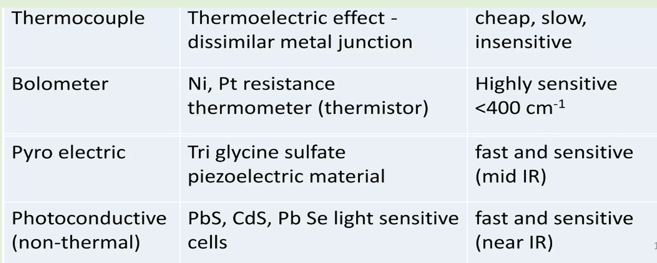
  Detectors
  a transducer which converts light to a voltage or current
  - Three main types of common IR instruments

Slide 19
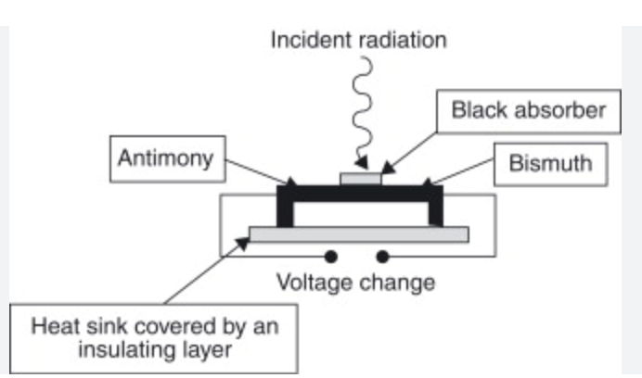
Dr. Maha Al-Tameemi
  a) Thermal Detectors:
  - Their response depends on the heating effect of radiation, thermal detectors can be used over a wide range of wavelengths and they operate at room temperature.
  -With these devices, the radiation is absorbed by a small blackbody, and the resultant temperature rise is measured. The radiation power level is very small (10⁻⁷-10⁻⁹W)
  The main disadvantages of thermal detectors are:
  Thermal noise from the surroundings, Slow response time, Lower sensitivity relative to other types of detectors.
  1) Thermocouple
  - Made up of 2 dissimilar metals LIKE bismuth and antimony coated together by metal oxides fused together at the ends.
  - If wires of 2 dissimilar metals joined head to tail then a difference in temperature between head and tail causes a current to flow in the wire.
  - This current is proportional to the intensity of radiation,
  - Material should be thermally active and these are used in dispersive instruments
  - Response time is 30 milliseconds and they give a response for all Frequencies.
  - Placed in an evacuated tube with a window transparent to IR (not glass or quartz)
  - Can use several thermocouples to increase sensitivity these are also called thermopile detector

Slide 20
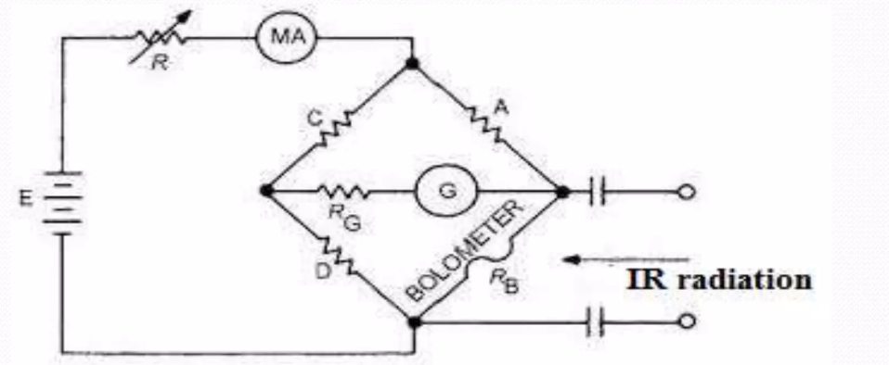
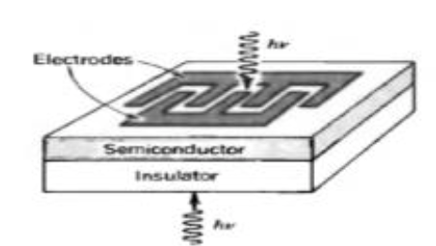
Dr. Maha Al-Tameemi
  2) Bolometer(Far-IR detector)
  A Bolometer functions by changing resistance when heated(type of resistance thermometer)
  It is constructed of Strips of metal (Pt, Ge, or Ni) or semiconductors that have a large change in resistance to current with temperature.
  Relatively large change in resistance as a function of temperature results (large response time)
  When IR radiation falls, Unbalanced due to a change in resistance, current flows through it.
  The galvanometer amount of current flow measures the intensity of radiation response time 4 m sec
  Rarely used in mid-IR as other IR transducers
  Very sensitive
  b) Photoconductive Detectors(Most sensitive)
  -It depends on the interaction between photons and a semiconductor
  -It consists of a thin film of a semiconductor material such as lead sulphide(PbS) mercury cadmium telluride(HgCdTe), or indium antimonide(InSb) deposited on a nonconducting glass surface and sealed in an evacuated envelope to protect the semiconductor from the atmosphere.
  -When IR absorbs nonconducting valence electrons, it promotes a higher energy conducting state so resistance decreases → increase in current
  -The voltage drop is a measure of the power of the beam radiation
  -The lead sulphide detector is used for the near-IR region of the spectrum(10,000 to 333cm-1)
  -For Mid and Far-IR radiation the mercury cadmium telluride is used.
  -It must be cooled with liquid nitrogen(77K) to minimize disturbances
  -These detectors have better response characteristics than pyroelectric detectors and are used in FT-IR instruments - particularly in GC - FT-IR

Slide 21
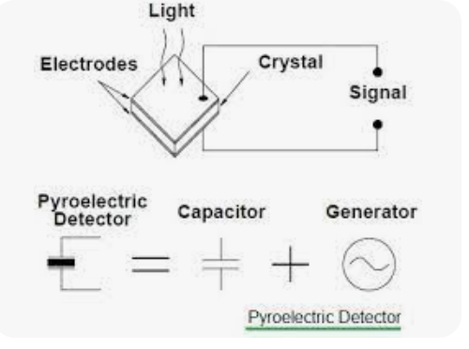
Dr. Maha Al-Tameemi
  c) Pyroelectric Detectors:
  -The pyroelectric effect depends on the rate of change of the detector temperature rather than on the temperature itself.
  -Pyroelectric materials (ceramic, lithium tantalite(LiTaO₃), Triglycine sulfate ) are dielectric materials that have special thermal and electrical properties.
  -The principle involved is electric polarization and involves multiple scanning.
  -When an electric field is applied and the field is removed the polarization persists it is the temperature-dependent and the sem-conductor acts as a capacitor
  -When IR radiation reaches the detector, The incident Infrared heating causes a change in the capacitance of the material producing a current that is proportional to the rate of change in temperature,
  -Pyroelectric detectors are used in mid-IR region works in room T
  - Fast response, good for FTIR
        5- Amplifier and Recorder
        (to control data acquisition and analysis).

Slide 22

Dr. Maha Al-Tameemi
      Source is a heated nichrome wire which produces a broad band continuum of IR light (as heat)
      The beam is directed through both the sample and a reference cell
      A rapidly rotating sector (beam chopper) continuously switches between directing the two beams to a diffraction grating
      The diffraction grating slowly rotates, such that only one narrow frequency band of IR light is at the proper angle to reach the detector
      A simple circuit compares the light from the sample and reference and sends the difference to a chart recorder
One beam passes through the sample.
The second beam passes through the reference
The purpose of reference is to eliminate absorption caused by CO₂ and H₂O vapor in air or absorptions from the bond in the solvent used.
Baseline=100% teansmittance
Why is the monochromator in the IR instrument put it after the sample cell?
Notes:
As IR radiation is weak energy radiation it can not cause, damage or lysis of analyte, as UV radiation (high energy),
may cause. So no need to mount an absorption monochromator in between IR Source and Sample. Further
emission monochromator avoids scattered and stray radiation reaching to the detector

Slide 23
Calibration of IR
Polystyrene film is useful for routine checking of FT-IR spectrometer performance, but variations in film thickness and scattering can cause large variations in the results. Several pharmacopeias propose two tests for the resolution of Fourier transform infrared (FT-IR) spectrometers using films of polystyrene
The Polystyrene wavelength standard
is a certified wavenumber for calibration purposes, it is made of polystyrene film. It can be used to meet the requirements of FTIR – Mid IR and the wavenumber ranges from 545 cm-1 to 3082 cm-1 (14 peaks). There are two versions, one for ATR in the Mid-IR and the other for the NIR region which has additional certified peaks. Polystyrene (PS) is a crystal clear, strong, and durable inexpensive thermoplastic. Films made from this material have excellent transparency, spark, and gloss. They also have very good antistatic properties, high tear resistance, and are generally printable.
Polystyrene IR spectrum
Notes:
Attenuated total reflectance or ATR is, along with transmission, one of the most common sampling techniques in Fourier transform infrared (FTIR) spectroscopy. ATR is based on total internal reflection where infrared (IR) light and sample interact only at the point where IR light is reflected.

Slide 24

Disadvantages of Dispersion Infrared Instrumentation
Dr. Maha Al-Tameemi
✗ It contains all movable parts which cause mechanical slippage
✗ Slow scan speed
✗ Less resolution accuracy and sensitivity
✗ Only a narrow frequency range can be studied
✗ Involvement of stray light
✗ Atmospheric absorptions by CO, water also take place
To overcome all these problems FTIR has been developed

Slide 25
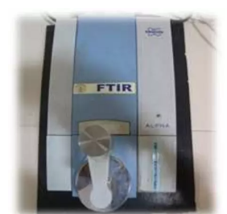
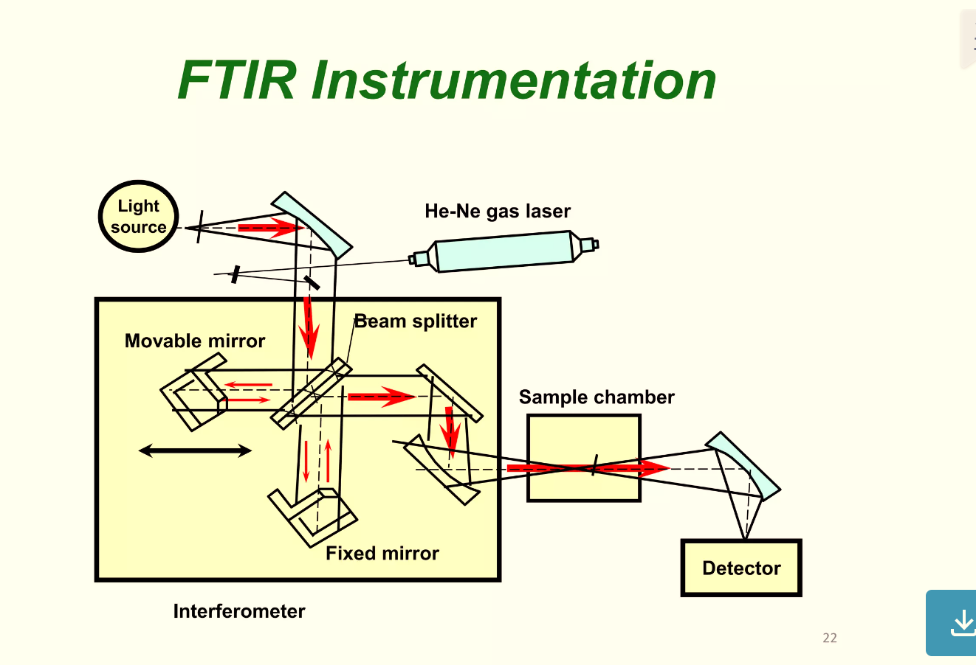
Fourier Transform IR(FT-IR)
Dr. Maha Al-Tameemi
Fourier Transform Infrared (FT-IR) spectrometry was developed to overcome the limitations encountered with dispersive instruments mainly the slow scanning process.
A solution was developed that employed a very simple optical device called an interferometer. The interferometer produces a unique type of signal which has all of the infrared frequencies “encoded” into it. The signal can be measured very quickly, usually on the order of one second or so.
FTIR collects all wavelengths simultaneously and scans at once
FTIR works based on the Michelson Interferometer which has:
Beam splitter
Fixed mirror
Movable mirror

Slide 26
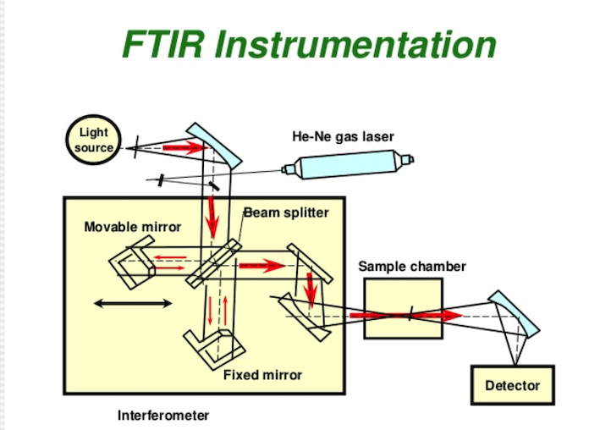
Dr. Maha Al-Tameemi
FT-IR Spectroscopy
The system is based on the Michelson interferometer
Laser source IR light strikes the beam splitter and produces two beams one bean going to a fixed mirror(a flat highly reflective surface) and the other is only a moving part (oscillating mirror) and is reflected back to the beam splitter
The beam splitter recombines and the differences in their path length create constructive and destructive interferences known as an interferogram.
The recombined beam passes through the sample absorbs all the wavelengths characteristic of its spectrum and then subtracts specific wavelengths from the interferogram the detector now reports variation in energy-versus-time for all wavelengths simultaneously. A laser beam is superimposed to provide a reference for the operation of the instrument.

Slide 27
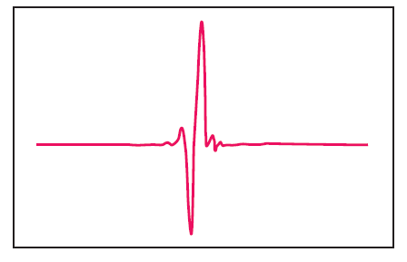
Dr. Maha Al-Tameemi
      The resulting signal is essentially a plot of intensity vs. time
      Such information if plotted would look like the following:
      This is meaningless to a chemist – we need this to be in the frequency domain rather than time….

Slide 28
Dr. Maha Al-Tameemi
The resulting signal is called an interferogram, which has the unique property that every data point (a function of the moving mirror position), which makes up the signal has information about every infrared frequency, which comes from the source.
This means that as the interferogram is measured, all frequencies are being measured simultaneously.
Thus, the use of the interferometer results in extremely fast measurements.
Because the analyst requires a frequency spectrum (a plot of the intensity at each individual frequency) in order to make identification, the measured interferogram signal cannot be interpreted directly.
A means of “decoding” the individual frequencies is required.
This can be accomplished via a well-known mathematical technique called the Fourier transformation.
This transformation is performed by the computer, which then presents the user with the desired spectral information for analysis.

Slide 29
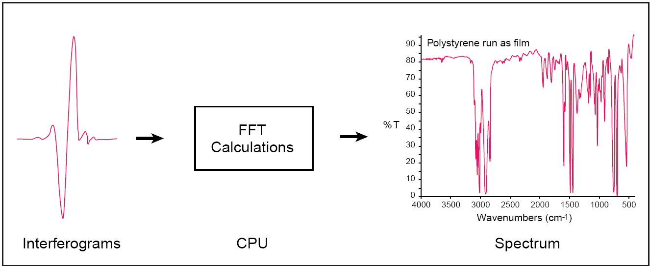
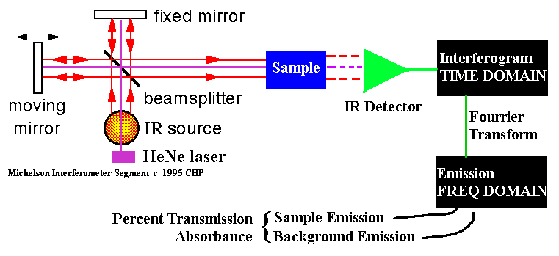
FT-IR
Dr. Maha Al-Tameemi
Time axis
Time domain
decoding
Wavenumber
Frequency domain
by FFT

Slide 30
Dr. Maha Al-Tameemi
The normal instrumental process is as follows:
1. The Source: The laser source produces a single beam with a definite wavelength for internal calibration Infrared energy is emitted from a glowing blackbody source. This beam passes through an aperture, which controls the amount of energy presented to the sample (and, ultimately, to the detector).
2. The Interferometer: A device in which two or more radiation beams interfere with each other after passing through different optical paths. It produces a unique type of signal that has all of the infrared frequencies(encoded) into it, the output is an interferogram or interference record. The two domains of distance and frequency are interconvertible by the mathematical method of Fourier transformation.
3. The Sample: The beam enters the sample compartment where it is transmitted through or reflected off of the surface of the sample, depending on the type of analysis being accomplished. This is where specific frequencies of energy, which are uniquely characteristic of the sample, are absorbed.

Slide 31
Dr. Maha Al-Tameemi
4. The Detector: The beam finally passes to the detector for final measurement. The detectors used are specially designed to measure the special interferogram signal.
DTGS(Deuterium triglycine sulphat) in a temperature resistance alkali halide window
MCT(Mercury cadmium telluride)(sensitive work)
The detector has to be coated with liquid nitrogen the output from the detector goes to a preamplifier where it is converted into a voltage signal that varies with time.
5. The Computer: The measured signal is digitized and sent to the computer where the Fourier transformation takes place. The final infrared spectrum is then presented to the user for interpretation and any further manipulation.

Slide 32

Advantages of FTIR Instrumentation
✓ Fast and sensitive.
✓ All frequencies can be modulated at once.
✓ Simple mechanical design with only one moving part.
✓ No stray light is involved.
✓ When using the He-Ne laser as an internal standard no need for external calibration.
✓ Availability of easy sampling accessories.
✓ Air pollutants like CO, ethylene oxide, etc, can be analyzed.

Slide 33
Differences between Dispersion IR Spectrometer and FTIR
Features | Dispersive IR | FT-IR
SNR(Signal-to-noise ratio) | Low | Very high
Wavenumber accuracy | Low (± 2 to ± 8 cm ⁻¹) | High(± 0.01 cm ⁻¹)
Speed | Low scan speed-several minutes(3-5min) | High scan speed-a few seconds only one moving part
Mechanical design | Many moving parts results in mechanical slippage and wear | Only one moving part
Stray light | Stray light within instrument causes spurious reading | Negligible/no stray light affect
Calibration | Calibration against reference spectra is required to measure the frequencies | No external use of laser provides higher precision
Resolution | less | Extermely high(0.01-0.005cm ⁻¹)
Spectrum /Frecuancy | Discontinuous spectrum as only a narrow frequency range can be used | Continuous spectrum as all frequency can be used
Source effect | A sample is subject to thermal effect from the source due to the long scan time | A sample is not subject to thermal effect from the source due to very shoet scan time
Sensitivity | Less Sensitivity , time counsuming | High Sensitivity , precision, faster
Beam optics | Double beam optics | Single beam optics
Light detection | A detector receives only a few % of the energy from the light source | A detector receives up to f 50% of the energy from the light source

Slide 34
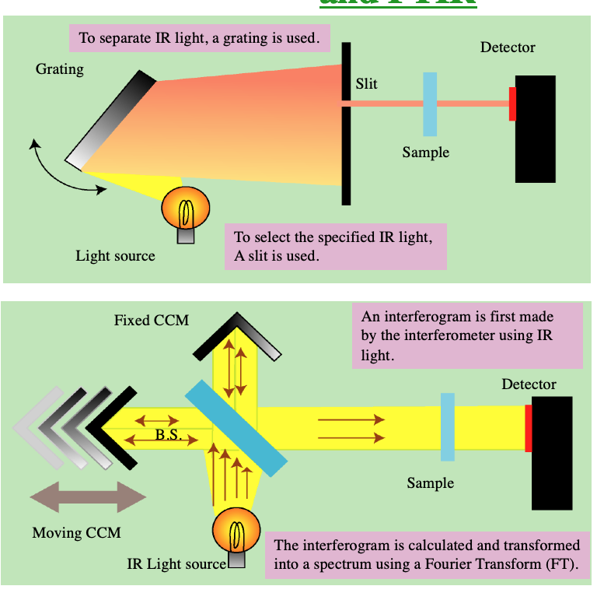
Comparison Between Dispersion IR Spectrometer and FTIR
Dispersion IR Spectrometer
In order to measure an IR spectrum,
the dispersion Spectrometer takes
several minutes. Also, the detector receives only
a few % of the energy of
original light source.
FTIR
In order to measure an IR spectrum,
FTIR takes only a few seconds. Moreover, the detector receives up to 50% of the energy of the original light source. (much larger than the dispersion spectrometer.)

Slide 35
Dr. Maha Al-Tameemi
Advantages of Fourier transform IR over dispersive IR
Improved frequency resolution
Improved frequency reproducibility (older dispersive instruments must be recalibrated for each session of use)
Higher energy throughput
Faster operation
Computer-based (allowing storage of spectra and facilities for processing spectra)
Easily adapted for remote use (such as diverting the beam to pass through an external cell and detector, as in GC - FT-IR)

Slide 36
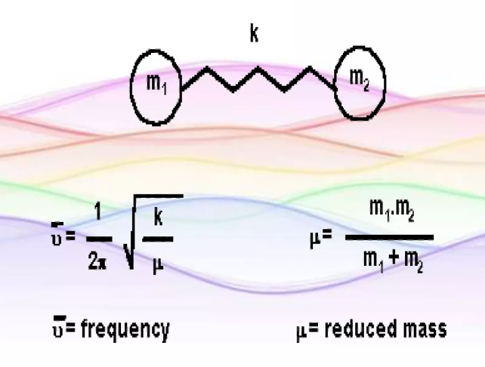

Calculation of Frequency
The frequency of vibrations is obtained from Hooke’s law, which is used to calculate the approximate position of the bond.
  Here is the derivation of Hooke’s Law we will apply to IR theory:
  Vibrational frequency is given by:
  $ν$: frequency
    K: force constant – bond strength(in Dynes/cm)
    µ: reduced mass = m₁m₂/(m₁+m₂)
    m: atomic masses of atom1&2
    $π$ = 3.14
  Reduced mass is used, as each atom in the covalent
  bond oscillates about the center of the two masses
Dr. Maha Al-Tameemi

Slide 37
Dr. Maha Al-Tameemi
  What does this mean for the different covalent bonds in a molecule?
  Let’s consider reduced mass, m, first:
  The C-H and C-C single bonds differ by only 16 kcal/mole:
    99 kcal · mol⁻¹ vs. 83 kcal · mol⁻¹ (similar K)
  Due to the reduced mass term, these two bonds of similar strength show up in very different regions of the IR spectrum:
    C─C 1200 cm⁻¹ m = (12 x 12)/(12 + 12) = 6 (0.41)
    C─H 3000 cm⁻¹ m = (1 x 12)/(1 + 12) = 0.92 (0.95)
  A smaller atom therefore gives rise to a higher wavenumber (and v and E)

Slide 38
Dr. Maha Al-Tameemi
Force constant, k:
The force constant, which can be thought of as a measure of bond “stiffness,” can be correlated with such bond properties as bond order and bond strength. Because the frequency is related directly to the square root of the force constant, we know that the frequency of bond vibrations should decrease as bonds decrease in strength.

Slide 39
Capabilities of Infrared Analysis
Identification and quantitation of organic solid, liquid, or gas samples.
Analysis of powders, solids, gels, emulsions, pastes, pure liquids, solutions, polymers, pure and mixed gases.
Infrared is used for research, methods development, quality control, and quality assurance applications.
Samples range in size from single fibers of only 20 microns in length to atmospheric pollution studies involving large areas.

Slide 40
Applications of Infrared Analysis
Pharmaceutical research
Forensic investigations
Polymer analysis
Lubricant formulation and fuel additives
Foods research
Quality assurance and control
Environmental and water quality analysis methods
Biochemical and biomedical research
Coatings and surfactants
Etc.

Slide 41
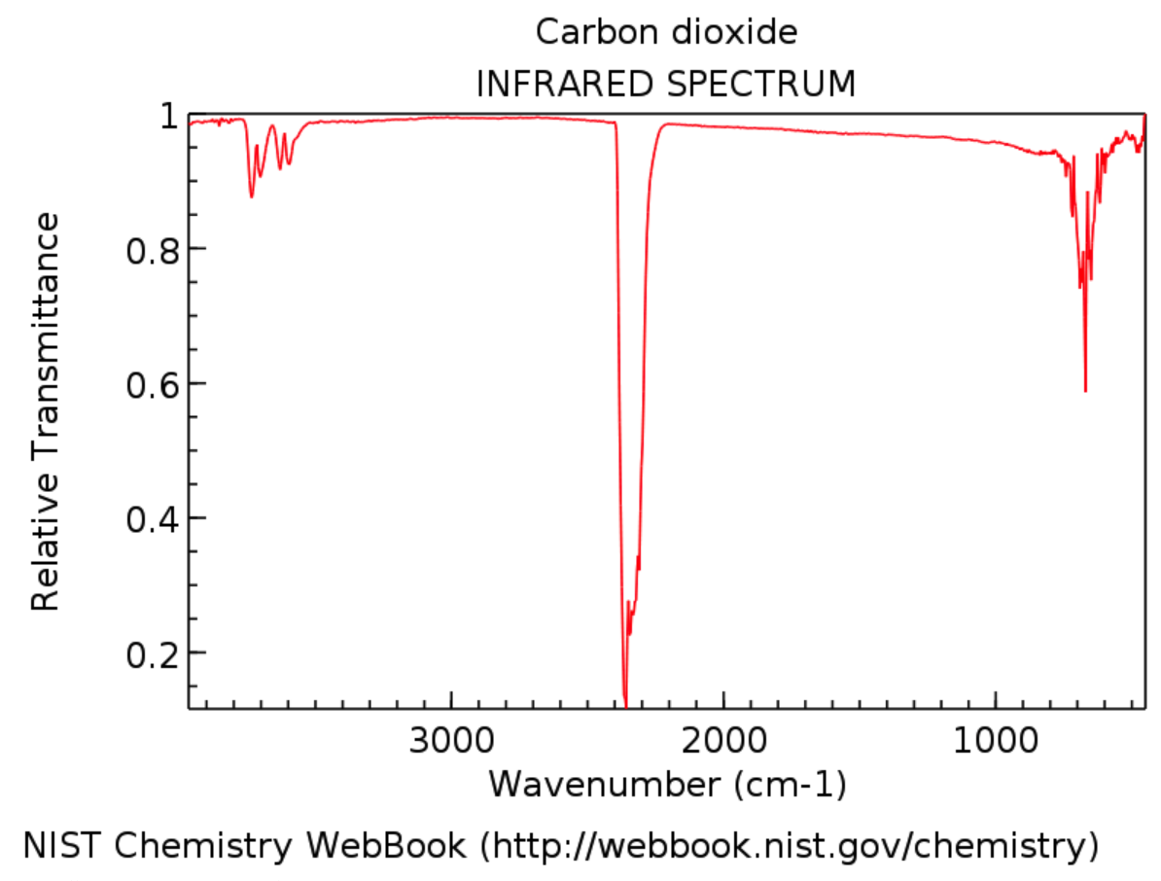
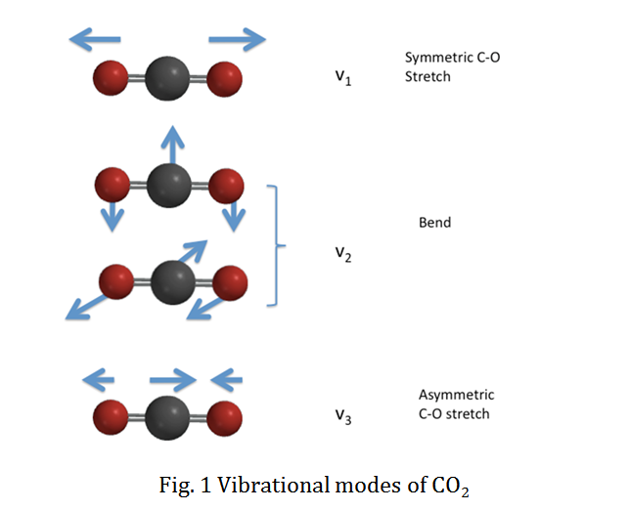
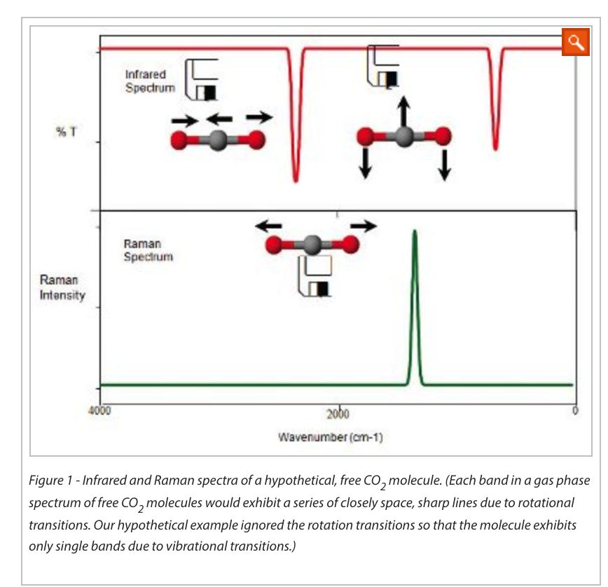
Dr. Maha Al-Tameemi
667cm⁻¹
2350 cm⁻¹

