Slide 1
University of Baghdad College of Science for Women Department of Chemistry Instrumental Analysis Chemistry Undergraduate Program Second Semester First grade Volumetric Analytical Chemistry
Lecturer
Dr. Amera Hasan
Asst. Prof. Dr. Maha Al-Tameemi
mahaks_chem@csw.uobaghdad.edu.iq
Lecture: Sunday at (8:30 AM-10:30 AM), (10:30 AM-12:30 PM),
Texts:
Most Analytical Chemistry Textbooks.
Handout

Slide 2
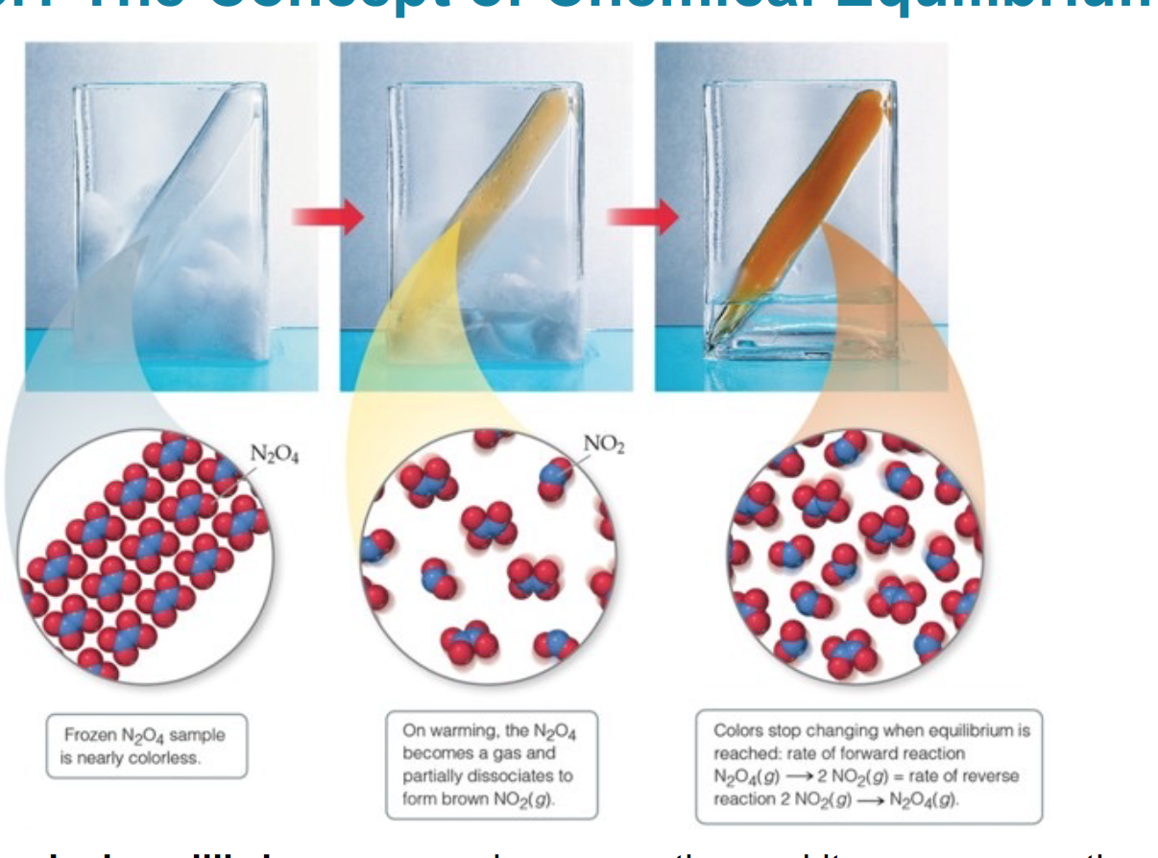
Chemical Equilibrium
The Concept of Chemical Equilibrium
Chemical equilibrium occurs when a reaction and its reverse reaction proceed at the same rate. In the figure below, equilibrium is finally reached in the third picture.

Slide 3
The reactions used in analytical chemistry are mostly reversible i.e they proceed simultaneously in two mutually opposite directions consider the following chemical reaction:-
aA+bB ↔ cC + dD (1)
In this reaction the equality (=) is replaced by two opposite arrows ( ↔ ) to define the reversibility.
The one proceeding to the right of the equation ( → ) is known as the forward reaction and the other to the left ( ← ) is the backward (reverse )reaction.
Chemical equilibrium is attained when the rates of forward and reverse reactions become equal due to changes in the concentration of the reacting substance .
As we know the reactions are measured by changes in the concentrations of the reactants in unit time.
Thus mean the rate of forward is proportional to the concentration of substances A&B multiplied by their number of moles a&b we can write the rate of forward reaction as follows:-
Rate =K_{f} [A]ª[B]^{b} ------------- (2)
Where K_{f} is the rate constant & depends on the temperature and the presence of a catalyst. [A][B] represents the molar concentration.
Similarly for the rate of reverse (backward) reaction we may write:-
Rate =K_{b} [C]^{c}[D]^{d} ------------ (3)
Where K_{b} is the rate constant for the backward reaction.

Slide 4
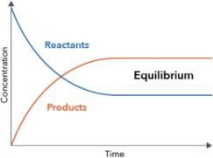
As the reaction proceeds the concentration of substances A and B decreases &those of substances C&D increase.
Consequently, the rate of forward reaction must gradually fall with time and that of reverse reaction must increase from zero.
The two reactions must eventually become equal. At this point, the concentration of A, B, C, and D remain constant and the system remains dynamic with two reactions and continues at an equal rate (rate f=rate b).
K_{f} [A]ª[B]^{b}= K_{b} [C]^{c}[D]^{d} ------------ (4)
The state of the system of reacting substance, at which the rates of the forward and backward become equal. Is called chemical equilibrium. by arrangement of eq 4 we get:-
[C]^{c}[D]^{d}/ [A]ª[B]^{b} = K_{b}/K_{f} =Ke (5)
Importance equilibrium constant:-
1. It permits the use to perform computations that relate to the
concentration of reactants and products in an equilibrium system.
2. The magnitude of Ke provides us with useful qualitative information
3. In analytical chemistry, the following table (1) shows the types of chemical equilibria and equilibrium constants that are important in analytical chemistry

Slide 5
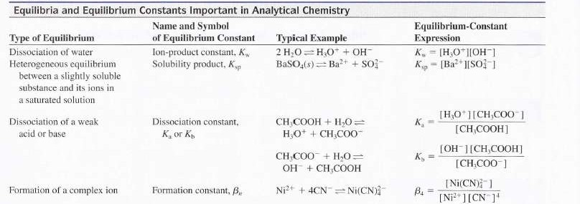

Slide 6
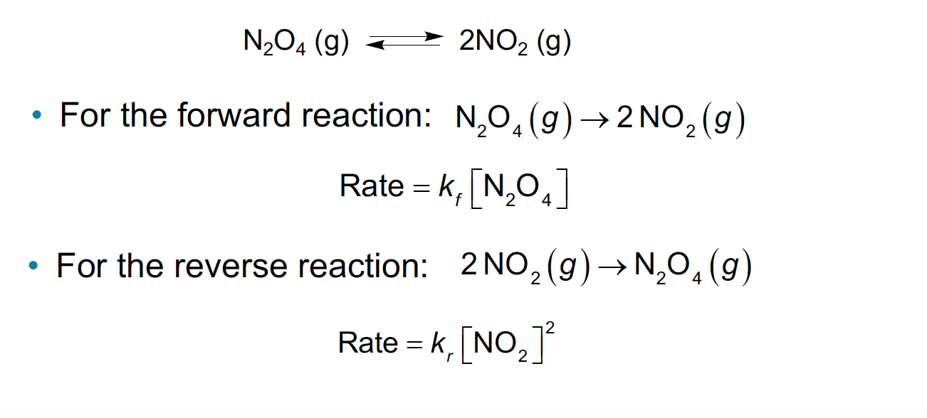
The Equilibrium Constant
In a system at equilibrium, both the forward and reverse reactions are being carried out.
The equation is written with a double arrow:
In the Equilibrium Constant Expression Only includes gases(g) and aqueous species (eq), solid(s) and pure water will not be included in the expression since it does not make sense to discuss a solid in terms of a concentration
Equilibrium Constant Expression

Slide 8
The Chemical Composition of Aqueous Solution
Water is the most plentiful solvent on earth, is easily purified, and is not toxic. It therefore finds widespread use as a medium for carrying out chemical analysis.
Classifying Solutions of Electrolytes
Most of the solutes we will discuss are electrolytes, which form ions when dissolved in water (or certain other solvents) and thus produce solutions that conduct electricity.
Strong electrolytes ionize essentially completely in a solvent. Such as
Acids :- HCl, HBr, HNO₃, HBrO₃,H₂SO₄,HClO₄
Bases :- LiOH, NaOH , KOH , Ca(OH) ₂, (CH₃)NOH
Salts :- NaCl, KNO₃,Na₂SO₄, NH₄C₂H₃O₂
Weak electrolytes ionize only partially. This means that a solution of a weak electrolyte will not conduct electricity as well as a solution containing an equal concentration of a strong electrolyte.
Acid :- H₃BO₃,H₂SO₃, H₂S, H₂CO₃,H₃PO₄
Bases :- NH₃, CH₃NH₂,(CH₃)₂NH
Salts :- HgCl₂,CdCl₂, Cd(CN)₂, Zn(CNS)₂

Slide 9
Acids and Bases: According to the Bronsted-Lowry theory, an acid is a proton donor and a base is a proton acceptor. For a molecule to behave as an acid, it must encounter a proton acceptor (or base). A molecule that can accept a proton behaves as a base if it encounters an acid.
Conjugate Acids and Bases: The product formed when an acid gives up a proton is a potential proton acceptor and is called the conjugate base of the parent acid.
For example, when the species, acid gives up a proton, the species base, is formed, as shown by the reaction:-
Acid 1 → base 1 + proton
Here, acid 1 and base 1 are a conjugate acid/base pair. Similarly, every base produces a conjugate acid as a result of accepting a proton. That is,
Base 2+ proton→ acid 2
When these two processes are combined, the result is an acid/base, or neutralization reaction
Acid 1+ base 2 $⇌$ base 1+ Acid 2
The degree of electrolytic dissociation or ionization of weak electrolytes became great when the solution was made more diluted.
The dissociation or ionization of weak electrolytes or slightly soluble substances is quantitatively described by the equilibrium constant. Suppose the dissociation of AB

Slide 10
The equilibrium constant Ke of this dissociation is generally written as Ke = [A][B]/ [AB]
When Ke large, this means that the compound is highly dissociated. For example, if Ke for acid is large, it would be strong. Some substances are dissociated in sequence steps, so the equilibrium constant may be written for each step. Suppose the dissociation of A₂B:
A₂B↔A+AB K₁= [A][AB]/[A₂B] ----------1
AB↔A+B K₂= [A][B] /[AB]------------2
By multiplication of eq. (1) and (2) . we get the overall equilibrium constant for the reaction:
A₂B↔ 2A +B ----------- (3)
Ke=K₁$×$K₂ = [A] [AB]/[A₂B] $×$[A][B]/[AB]=[A]²[B]/[A₂B]

Slide 11
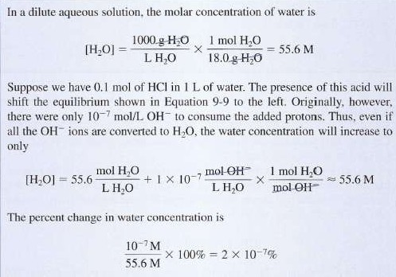
Ion-Product Constant for Water
Aqueous solutions contain small concentrations of hydronium and hydroxide ions because of the dissociation reaction.
An equilibrium constant for this reaction can be formulated as shown in the equation below:
Because water is amphiprotic, one water molecule can react with another to form an OH– ion and an H₃O⁺ ion in an autoionization process:
2H₂O_{(l)}⇋H₃O⁺ _{(aq)} + OH– _{(aq)}
• Equilibrium constant K for this reaction can be written as
[H₃O⁺] [OH–]
[H₂O]²
1 L of water contains 55.5 moles of water. In dilute aqueous solutions:
The water concentration is many orders of magnitude greater than the ion concentrations. The concentration is essentially that of pure water. Recall that the activity of pure water is 1.
When pure liquid water is in equilibrium with hydronium and hydroxide ions at 25ºC, the concentrations of hydronium ion and hydroxide ion are equal:
The concentration of water in dilute aqueous solutions is enormous, however, when compared with the concentration of hydrogen and hydroxide ions. The ion-product constant (K_{w}) for water permits the ready calculation of the hydronium and hydroxide ion concentrations of expression for an aqueous solution.

Slide 12
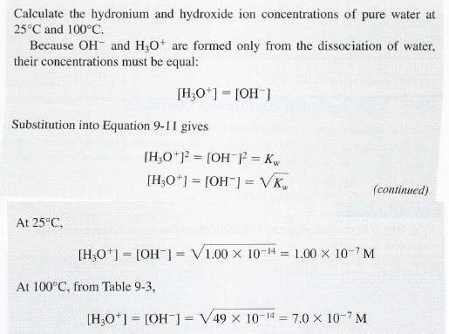
Table (1) shows the dependence of this constant on temperature
Temperature | Kw
0 | 0.144x10⁻¹⁴
25 | 1.01x10⁻¹⁴
50 | 5.47x10⁻¹⁴
100 | 49x10⁻¹⁴

Slide 14
Acid-Base Dissociation Constants
When a weak acid or a weak base is dissolved in water, partial dissociation occurs. Thus,
All weak acids, denoted HA, react with water by donating a proton to H₂O
Dissociation of weak acid: HA+H₂O↔H₃O⁺ + A⁻ OR, HA↔ H⁺+A⁻ , K_{a}= [H⁺][A⁻]/[HA]
The equilibrium constant K_{a} is called the acid dissociation constant. A weak acid is only partially dissociated in water. This definition means that K_{a} is small for weak acid
For nitrous acid, we can write where K_{a}; is the acid dissociation constant for nitrous acid:
A weak acid has K_{a} < 1 leads to a small [H] and pH of 2-7.
Similarly, weak bases, B react with water by abstracting a proton from H₂O:
Base hydrolysis B+H₂O ↔ BH⁺+OH⁻
K_{b} = [BH⁺][OH⁻]/[B]
The equilibrium constant Kb is called base dissociation constant definition, a weak base is one for which K_{b} is small
Analogously, the base dissociation constant (K_{b}) for ammonia is:
The weak base has K_{b}<1 leads to small [OH] and pH of 7-12
K_{a} is large means more products
K_{a} is small means more reactants
K_{a} large means more acidic high[H] and lower PH
K_{b} is large means more products
K_{b} is small means more reactants
K_{b} large means more basic high[OH] and lower POH

Slide 15
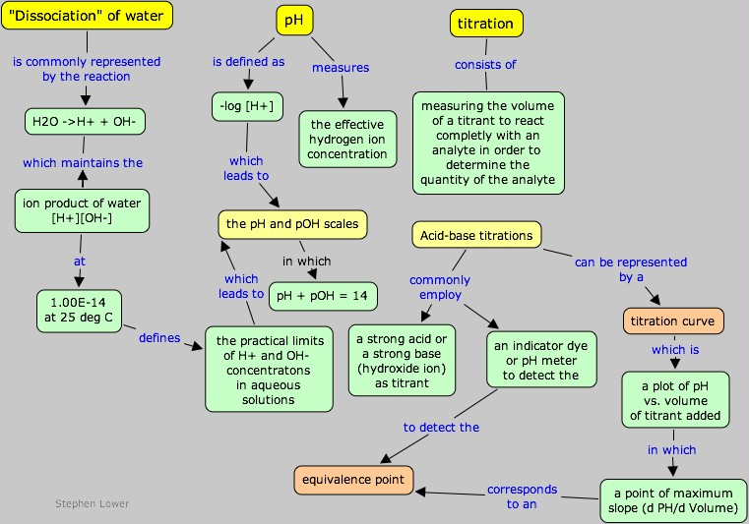
The K_{a} and K_{b}
http://www.chem1.com/acad/webtext/abcon/abcon-2.html

Slide 16
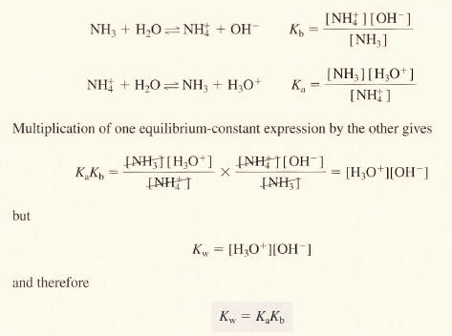
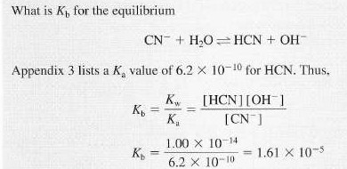
Dissociation Constants for Conjugate Acid/Base Pairs
Consider the base dissociation-constant expression for ammonia and the acid dissociation-constant expression for its conjugate acid, ammonium ion:

Slide 17
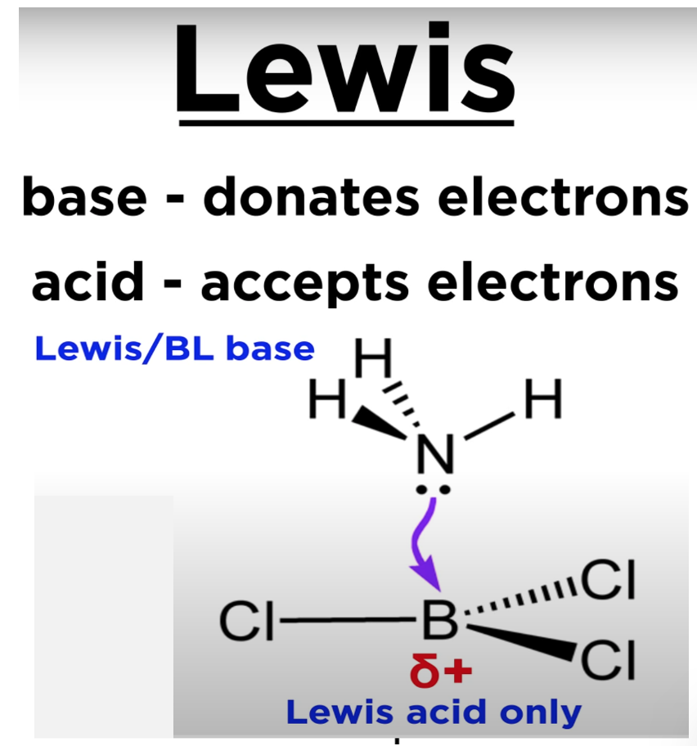
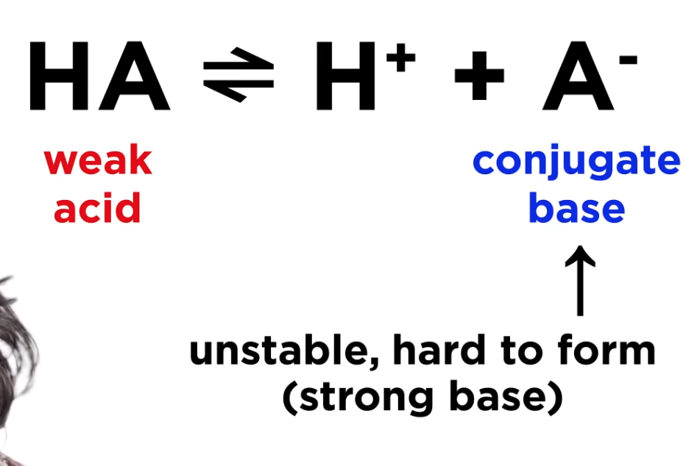
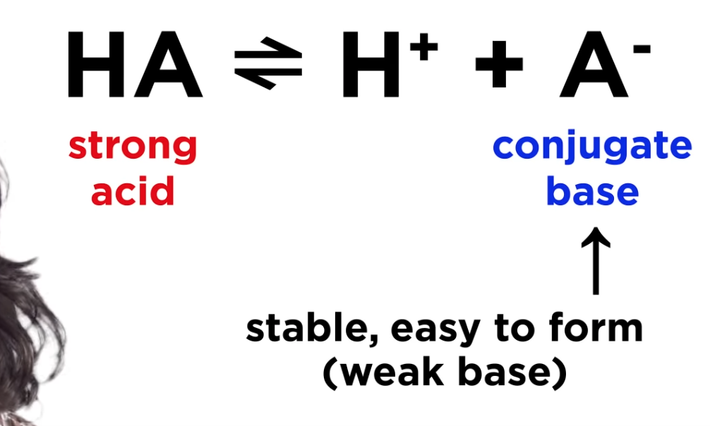

Slide 19
Hydronium Ion Concentration of Solutions of Weak Acids
When the weak acid HA is dissolved in water, two equilibria are established that yield hydronium ions: Ordinarily, the hydronium ions produced from the first reaction suppress the dissociation of water. The contribution of hydronium ions from the second equilibrium is negligible.
Furthermore, the sum of the molar concentrations of the weak acid and its conjugate base must equal the analytical concentration of the acid C_{HA} because the solution contains no other source of A⁻ so:
[A⁻]$≈$[H₃O⁺]
C_{HA}=[A⁻]+[HA]
C_{HA}=[H₃O⁺]+ [HA]

Slide 20
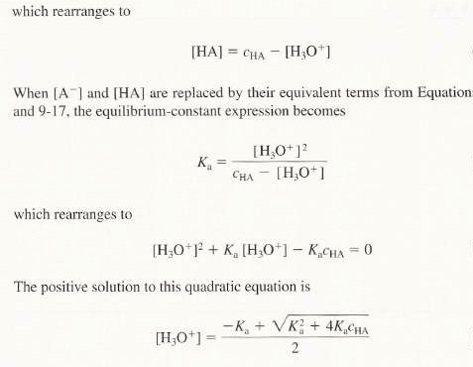
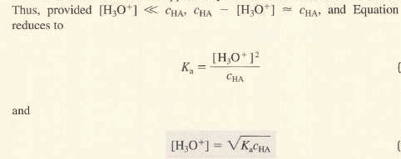
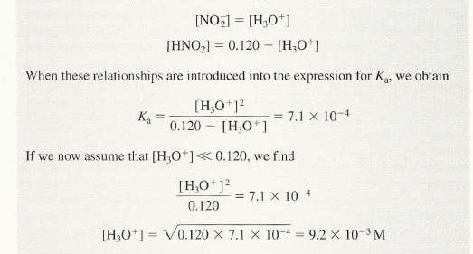
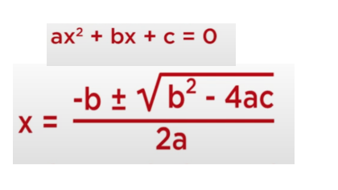
Where [HA] and C_{HA} are the molar and analytical concentrations respectively.

Slide 21
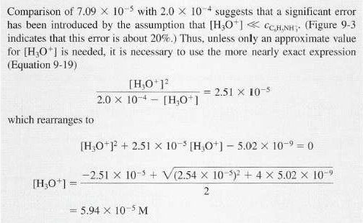

Slide 22
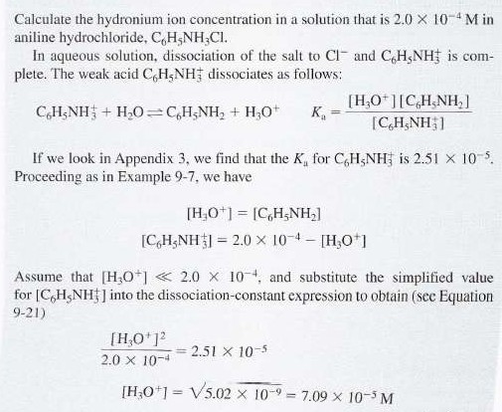
Hydronium Ion Concentration of Solutions of Weak Bases
The techniques discussed in previous sections are readily adapted to the calculation of the hydroxide or hydronium ion concentration in solutions of weak bases.
[A⁻]$≈$[H₃O⁺]
C_{HA}=[A⁻]+[HA]
C_{HA}=[H₃O⁺]+ [HA]

Slide 23
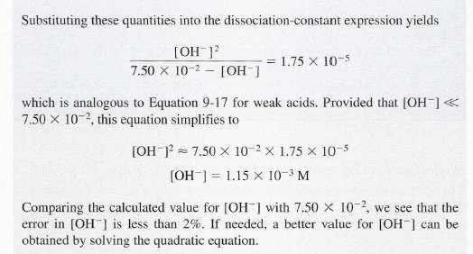
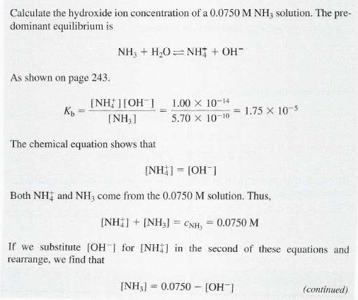
Go to slide 16 look at equation =K_{b}=K_{w}/K_{a}

Slide 24
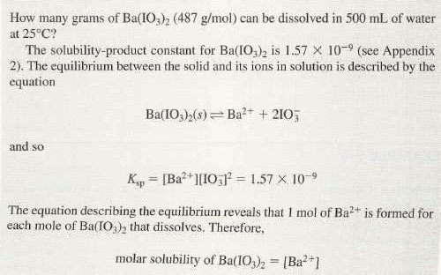
Applying Solubility-Product Constants
Most, but not all, sparingly soluble salts are essentially completely dissociated in a saturated aqueous solution. For example, when an excess of barium iodate is equilibrated with water, the dissociation process is adequately described by the equation:
Where the new constant is called the solubility-product constant or the solubility product. The solubility-product expression permits the ready calculation of the solubility of a sparingly soluble substance that ionizes completely in water
Factors affecting Ksp
1-Temperature: Ksp is increased with increasing the temperature.
2- Common ion: increasing the concentration of any ion in solution leads to a decrease the solubility (except if the ion forms a soluble complex with the salt).

Slide 25
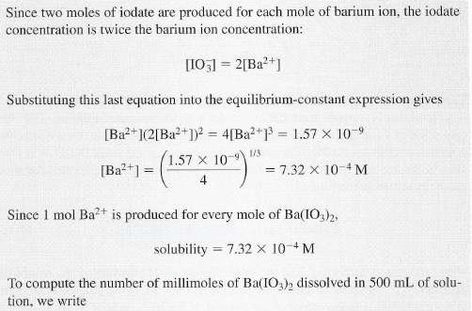
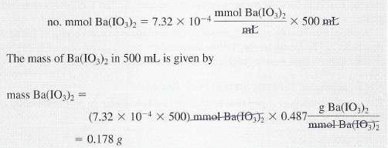
Checking Comprehension

Slide 26
The Effect of a Common Ion on the Solubility of a Precipitate
If we place some Cds in a 0.01M CdBr what will be the molar solubility of the Cds?
The common-ion effect is a mass-action effect predicted by Le Châtelier’s principle and is demonstrated by the following examples.
(If we try to dissolve salt in a solution of another salt containing the same cation or anion, this common ion has a cumulative effect on the solubility equilibrium)
For example, suppose we have a solution of Iron(II)sulfide.
If we dissolve some sodium sulfide in the solution, the presence of the additional sulfide may cause the precipitation of FeS.
The solution now contains less FeS. The decrease in the concentration of the FeS in a solution of Na₂S is an example of the common ion effect.
In general, any ionic equilibrium is affected by a substance producing an ion involved in the equilibrium.
X
Ksp is tiny compared to the Cd ion

Slide 27
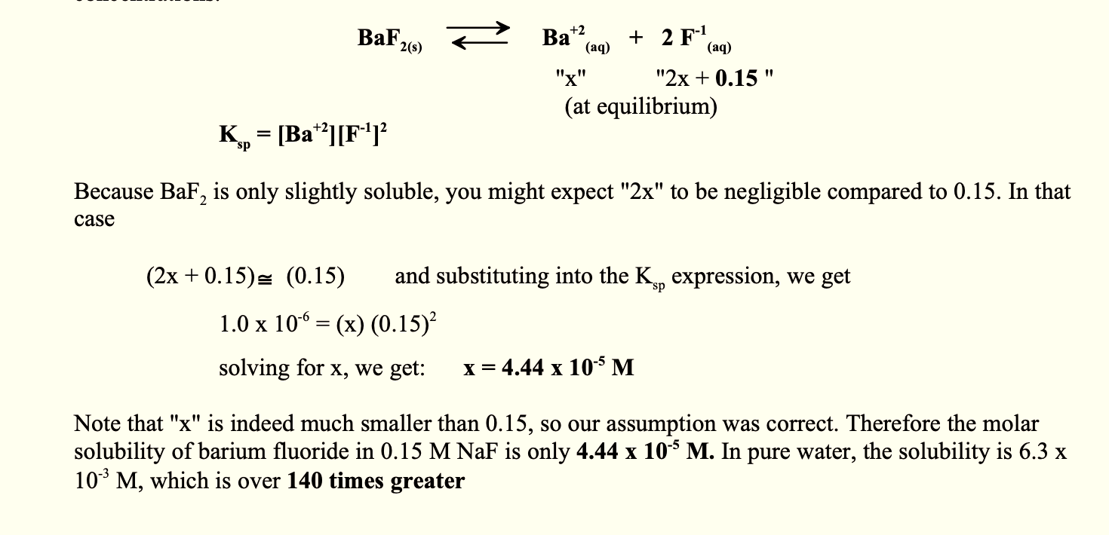
Checking Comprehension
Calculating the solubility of a Slightly Soluble Salt in a Solution of a Common Ion(a) Calculate the molar solubility of barium fluoride, BaF₂, in water at 25$℃$ The Ksp at 25 $℃$ is 1.0 x 10⁻⁶
Now, to illustrate the common ion effect. (b) What is the molar solubility of barium fluoride in a solution that is 0.15 M NaF at 25 $℃$ Since the solution is already 0.15 M in F⁻¹ ions, we must make an addition to our equilibrium concentrations.

Slide 28
Calculations using equilibria and equilibrium constants
To illustrate the types of computation that one might perform either to evaluate an equilibrium constant from measured concentration or to use the equilibrium constant to calculate the concentration of reactants and products in a particular equilibrium mixture.
These equilibria are fundamentally the same, as any other equilibrium, but the calculations do not usually get as messy as other types of calculation.
Write the balanced equation and use the stoichiometry to express the concentration of all species in terms of the initial concentration of one of the species and variable x.
Write the equilibrium constant expression from the balanced equation and substitute the equilibrium concentration into it.
Solve the expression for x and determine all equilibrium concentrations
Ionization constant
The ionization constant is equal to the product ionic species divided by the conc. of undissociated substance All concentrations are expressed in mol/L.
The law of chemical equilibrium can be applied to such a system. Where the concentration of undissociated acid would not be zero (not like for strong acid) based on the idea, equilibrium will exist in the solution between molecular and dissociated ideas.

Slide 29
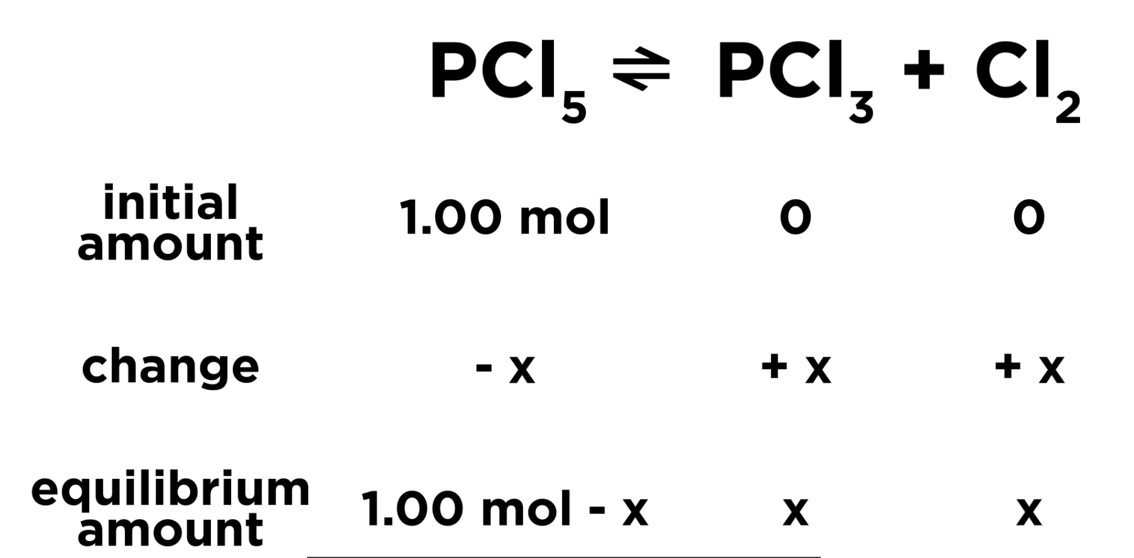
The Equilibrium Constant
ICE box
Initial
Change
Equilibrium
In the Equilibrium Constant Expression Only includes gases(g) and aqueous species (eq), solid(s) and pure water will not be included in the expression since it does not make sense to discuss a solid in terms of a concentration
Initial= We put the initial amount of each thing we start with just one mole at reactant so we put one them and zero for
the products since there were not any of them at first.
Change= We do not know exactly how much the change was to get to equilibrium so we call it X for the reactant we put negative (-X )because that is being depleted and in this case, moles of each product are being formed we should make these two or three X as necessary if the coefficient were different and for the products X is positive because these are being formed.
Equilibrium= add up the initial and the change to get the amount present at equilibrium.

Slide 30
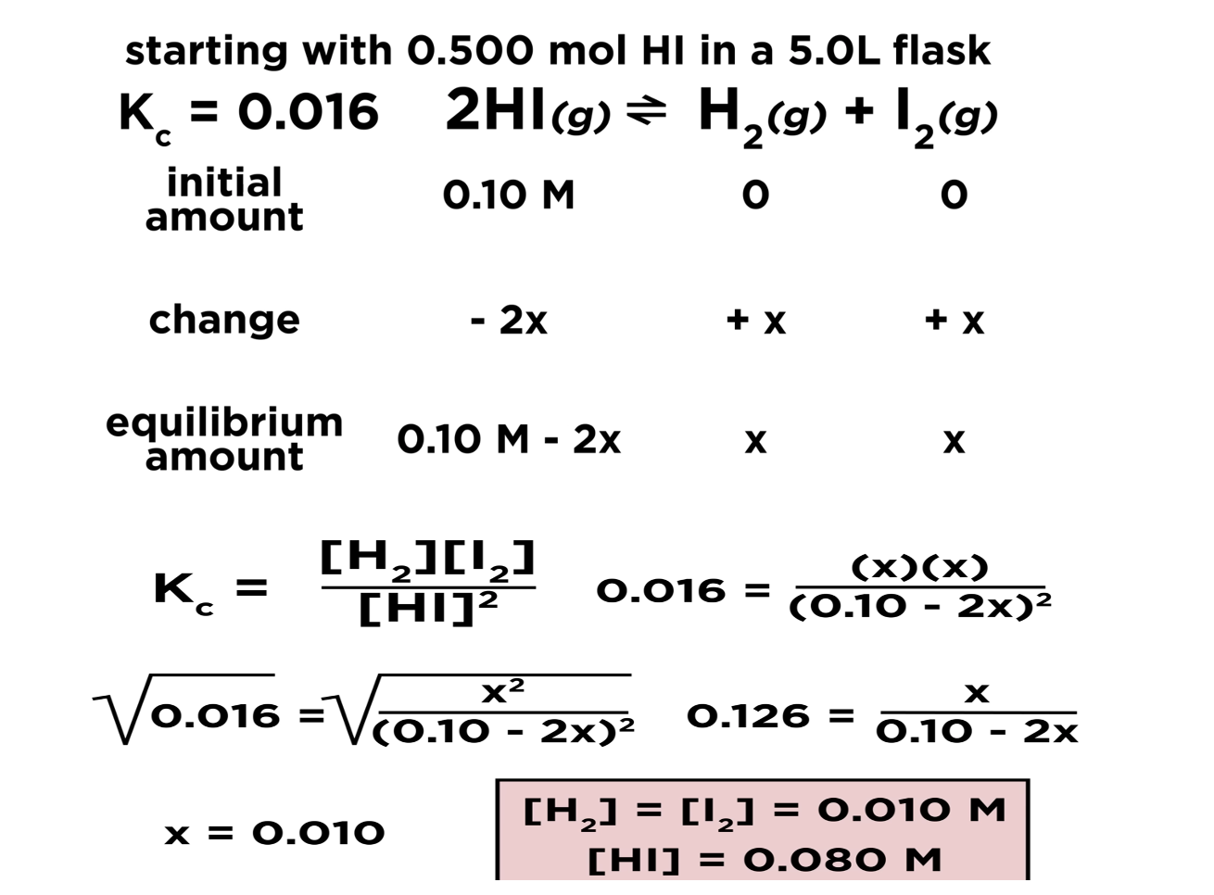
Checking Comprehension
$$\frac{\# of mols(n)}{volume(L)}$$
= 0.5/5=0.10 m

Slide 31
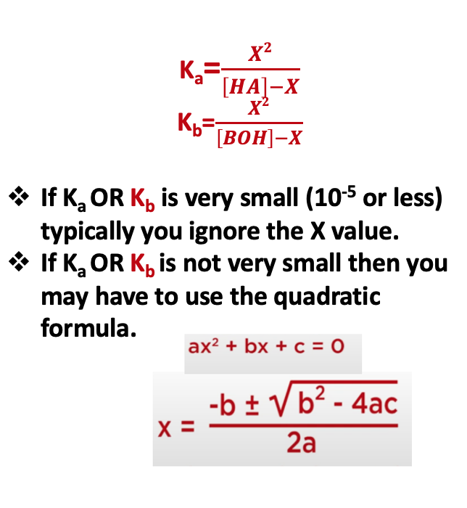
Checking Comprehension

Slide 32
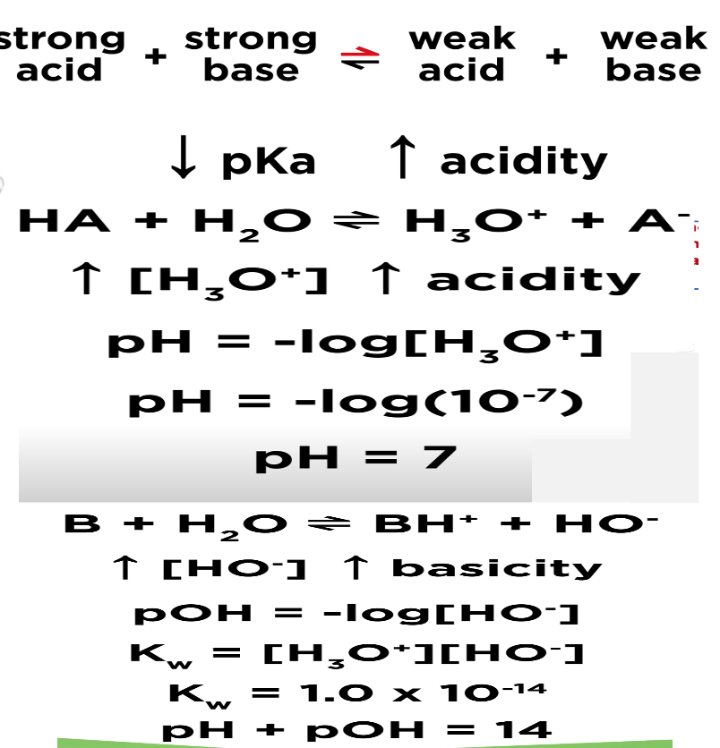
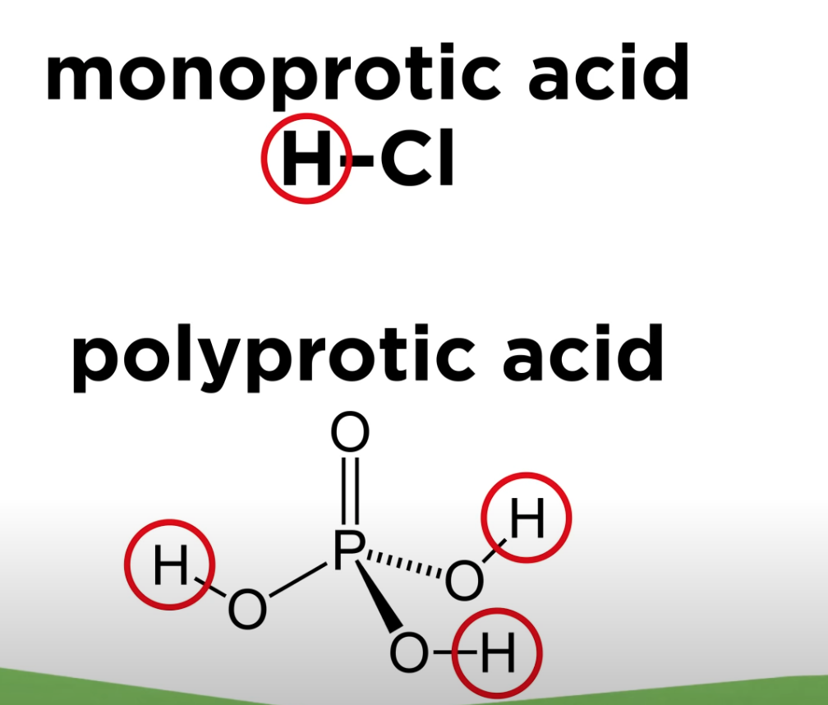
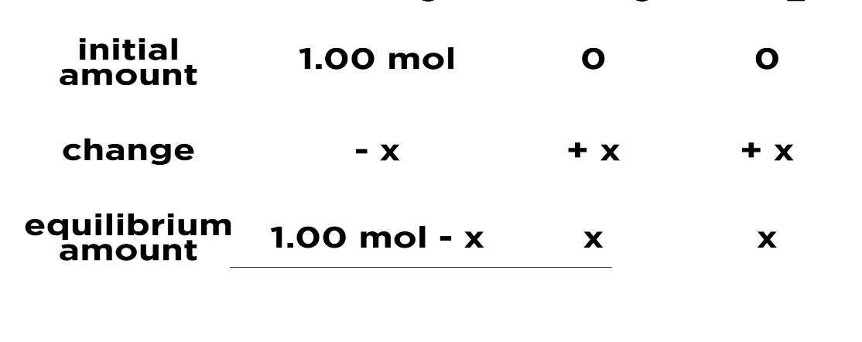
Ionization Constant of Weak Monotropic Acids (K_{a}) and pH of Solution
Let us consider a solution of a weak monobasic acid AH which reacts with water to give
K_{a} is large means more products
K_{a} is small means more reactants
K_{a} large means more acidic and lower PH
ICE box
Initial
Change
Equilibrium
Polyprotic acid became less acidic with each deprotonation

Slide 33
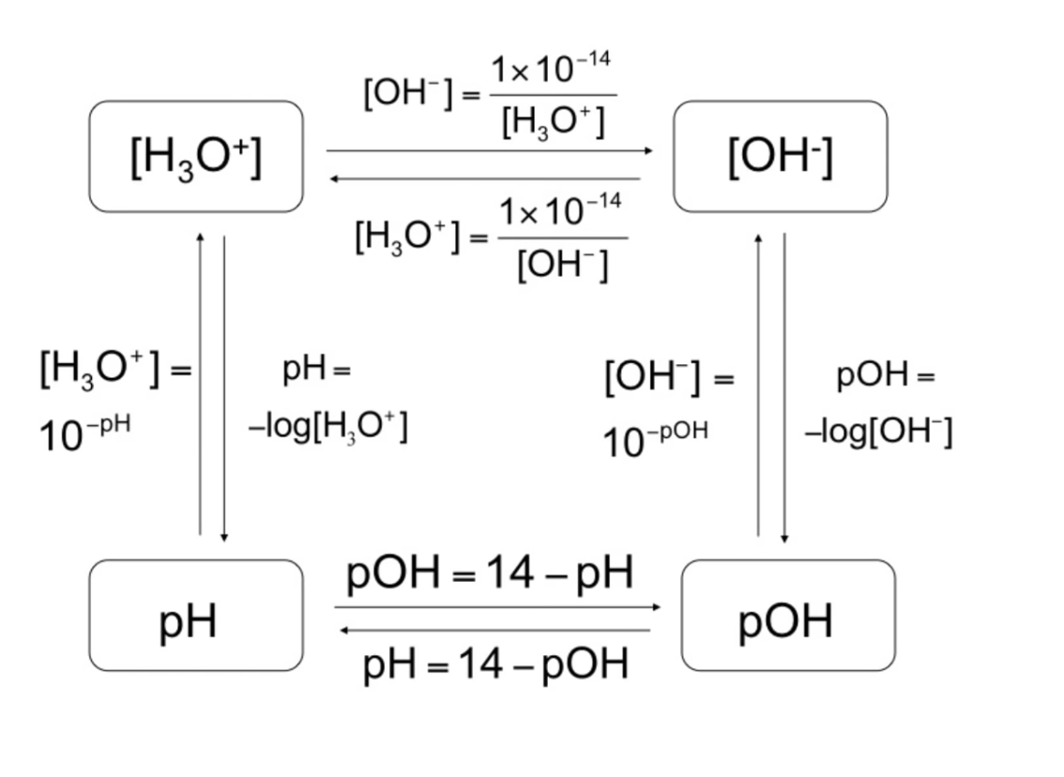

Slide 34
What is the pH of a 0.40 M NH₄Cl? K_{b} is 1.8 × 10⁻⁵
NH₄⁺ +H₂O$⇄$ H₃O⁺ +NH₃
I 0.4 0 0
C -x +x +x
E 0.4 -x x x
K_{a}.K_{b}=K_{w}
K_{a}= 1 × 10⁻¹⁴ / 1.8 × 10⁻⁵ = 5.56 × 10⁻¹⁰
K_{a} = $\frac{x2}{0.4−x}$
X²=2.224 × 10⁻¹⁰ (take the square root to each side)
X=1.49 × 10⁻⁵ x=[H₃O⁺]
pH= - log[H₃O⁺]
pH= - log[1.49 × 10⁻⁵]
pH=4.83

Slide 35
What is the pH of a1.5 M NaF? K_{a} of HF is 7.2 × 10⁻⁴
F⁻ +H₂O$⇄$ HF +OH⁻
I 1.5 0 0
C -x +x +x
E 1.5 -x x x
K_{b} = $\frac{\left[HF\right][OH−]}{[F−]}$
K_{a}.K_{b}=K_{w}
K_{a}= 1 × 10⁻¹⁴ / 7.2 × 10⁻⁴ = 1.39 × 10⁻¹¹
K_{a} = $\frac{x2}{1.5−x}$
X²=2.085 × 10⁻¹¹ (take the square root to each side )
X=4.566 × 10⁻⁶ x=[OH⁻]
pOH= - log[OH⁻]
pOH= - log[4.566 × 10⁻⁶ ]
pOH=5.34
pH+pOH=14------------- pH=14-5.34=8.66

Slide 36
Checking Comprehension

Slide 37
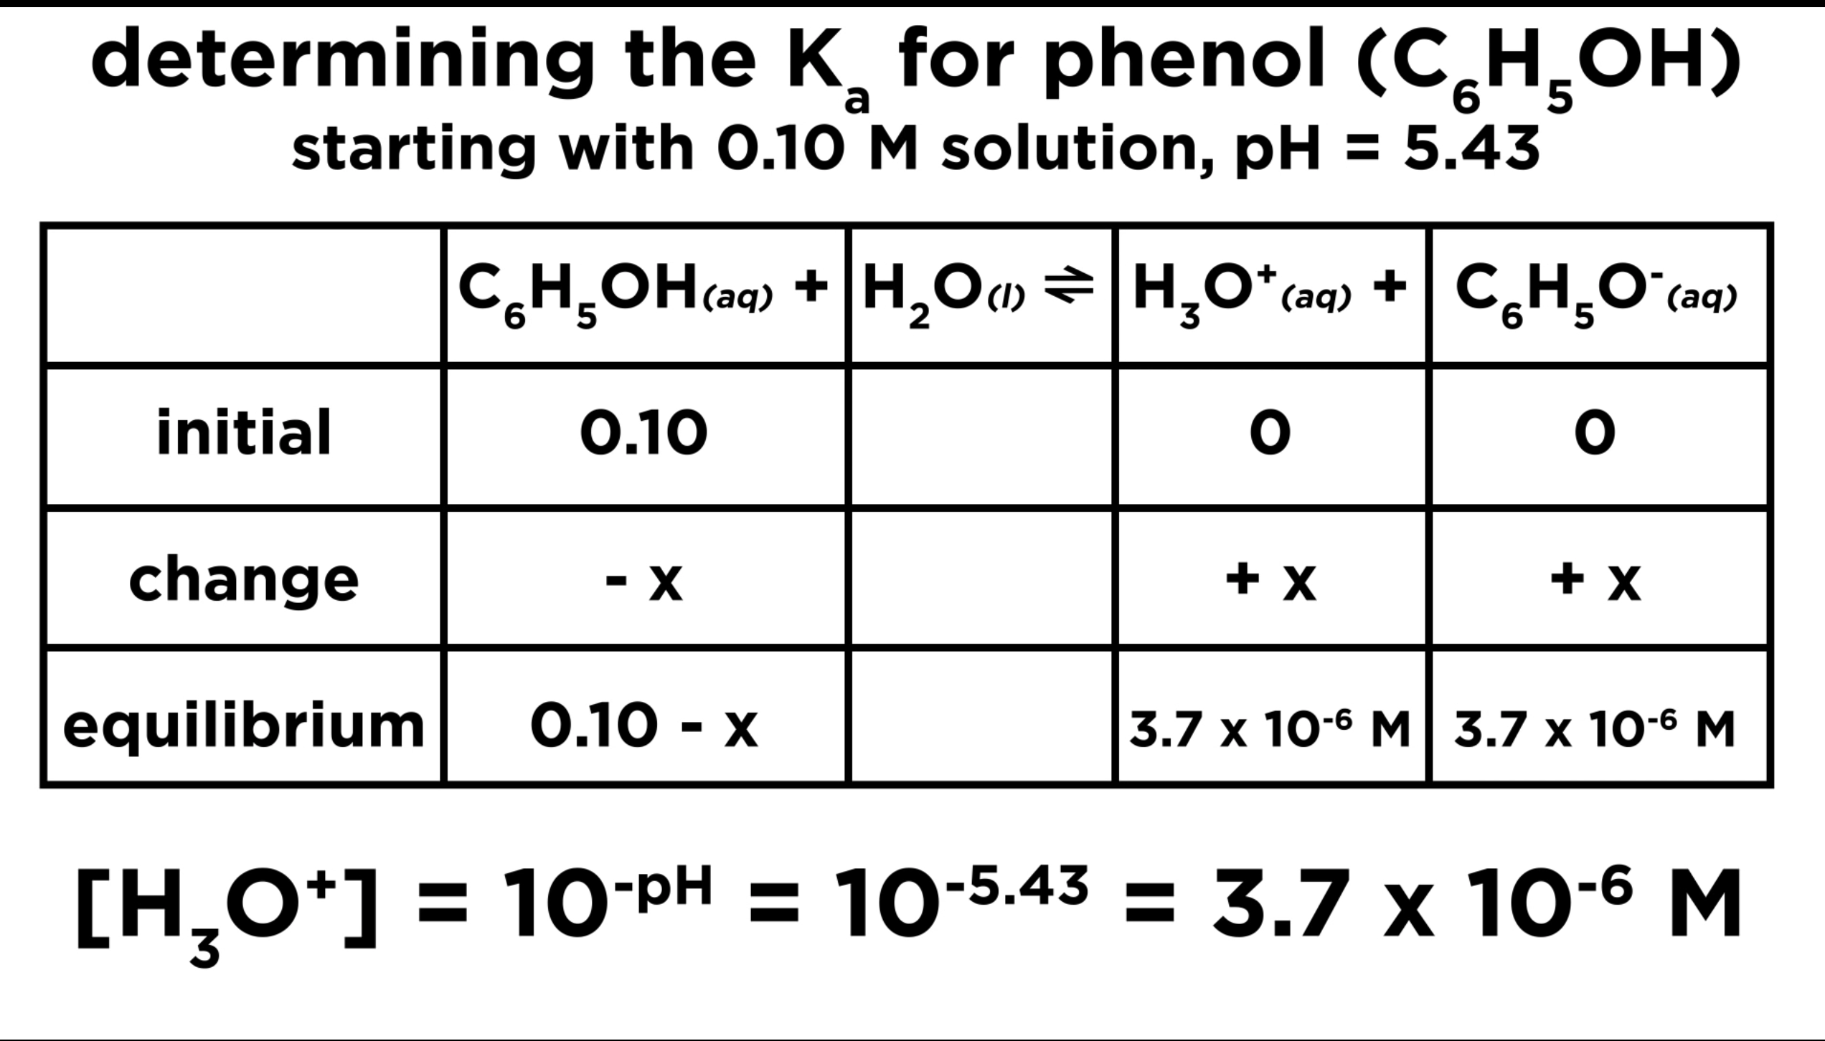
+X
+X
0.10-x= 0.10 because the change in the initial concentration of the acid is so small that is negligible and we treat things as though none go used up (0.10- 3.7.3$×$10⁻⁶ $≈$ 0.10 M

Slide 38
Degree of Ionization (α) of weak acid
It is known that an acid is any substance capable of yielding H⁺ in a water solution (Arrhenius). The strength of an acid is, therefore, determined by the extent to which it is ionized giving hydronium ions.
In terms of BrѲnsted –Lowery sense, the tendency of an acid to lose or donate protons is a measure of its strength.
The extent or degree of ionization (α) of an acid at equilibrium is given as:
α = [H₃O] / C_{a} OR α = [X] / [HA] ---------- (6)
Where Ca is the molar concentration of the acid
100 α= percent ionization = [H₃O]/ C_{a} x100 OR [X] / [HA] x100 ----------- (7)
Degree of ionization = The ratio of ionized to unionized acid molecules in the solution.
Percent of ionization= Degree of ionization * 100.
From the previous example of phenol, we calculated the Degree of ionization and Percent of ionization as follows :

Slide 39
Concentartion HCN $⇄$ H⁺ + CN⁻
Initial | 0.30 | 0 | 0
Change | -X | +X | +X
Equilibrium | (0.30-X) | X | X

Slide 40
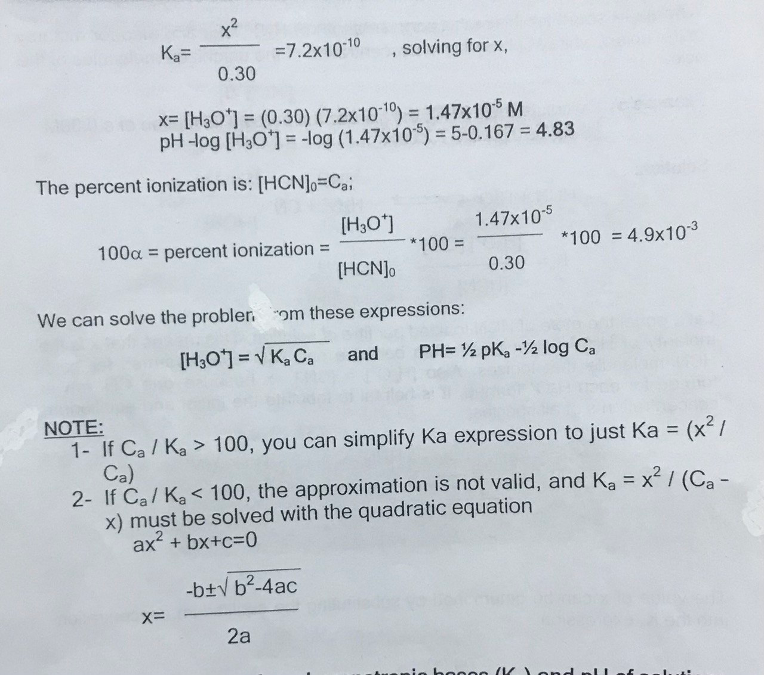

Slide 41
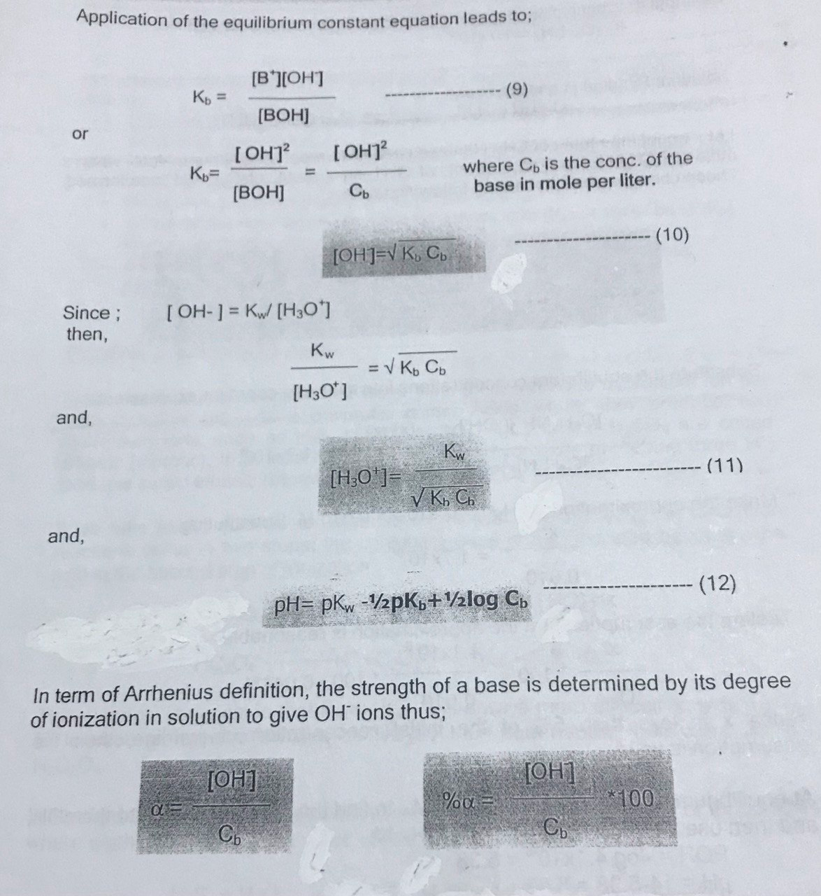
Ionization Constant of Weak Monotropoic Bases (Kb) and pH of the Solution
Consider an aqueous solution solution of monotropic weak base BOH, which is ionized as follows: BOH↔B⁺+OH⁻
K_{b} is large means more products
K_{b} is small means more reactants
K_{b} large means more basic high[OH] and lower POH
α = [OH] / C_{b} OR α = [X] / [BOH]
Where C_{b} is the molar concentration of the base
100 α= percent ionization = [OH] / C_{b} x100
OR [OH] / C_{b} x100

Slide 42
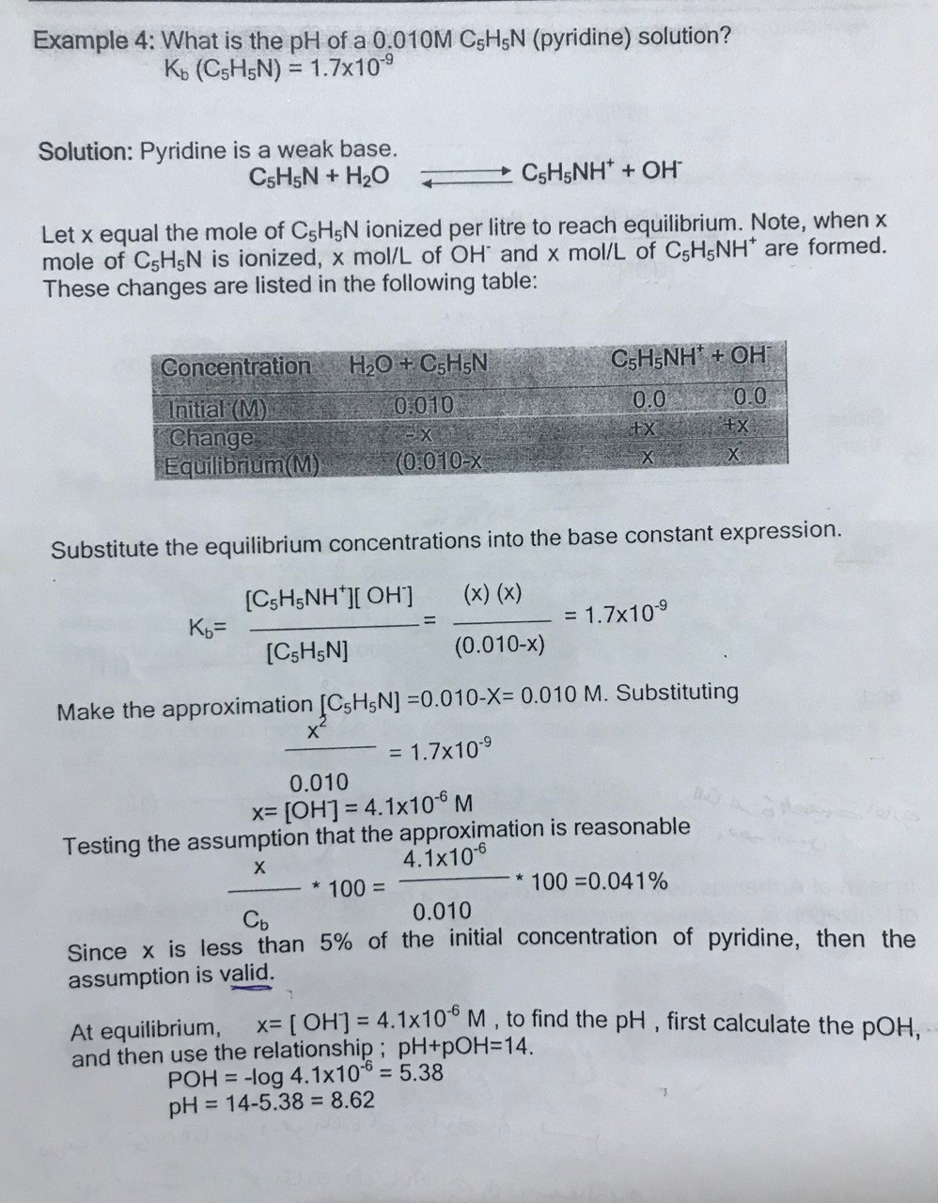

Slide 43
In summary: when you have finished studying these examples, you should be able to:
Calculate the equilibrium concentration of H₃O⁺ and OH⁻ in a solution of a weak acid, given the Ka.
Calculate the equilibrium concertation of H₃O⁺ and OH⁻ in a solution of a weak base, given the K_{b}.
Relate the quantities [H₃O⁺] ,[OH⁻] ,pH, pH, pK_{w}
Calculate the constant for weak acid (K_{a}) or weak base (K_{b}) from experimental information [H₃O⁺] or [OH⁻] or pH or pH
Use the Ka of a weak acid to calculate the percent ionization, relate percent ionization to acid strength
Polybasic (polyprotic) acids
Acids that in their reaction with water yield more than one hydronium ion per one molecule are called polyprotic acids .acids that can produce two hydronium ions, such as H₂S ,H₂CO₃,H₂SO₄,H₂C₂O_{4 ,} and H₂SO₄ are called dibasic (diprotic).
If an acid has three ions that can produce three H⁺ then it is called tribasic (triprotic) acid. such as H₃PO₄ ,H₃ASO_{4 .}
If we take oxalic acid as an example for dibasic acid H₂C₂O₄ , the ionization reactions occur in two steps: the conjugate base in the first step becomes the acid in the second step of ionization :
H₂C₂O₄⁻ then form equal molecular such as H₂C₂O₄⁻
When hydrogen sulphide reacts with water, it undergoes two steps of ionization, where each step has its value of ionization constant.

Slide 44
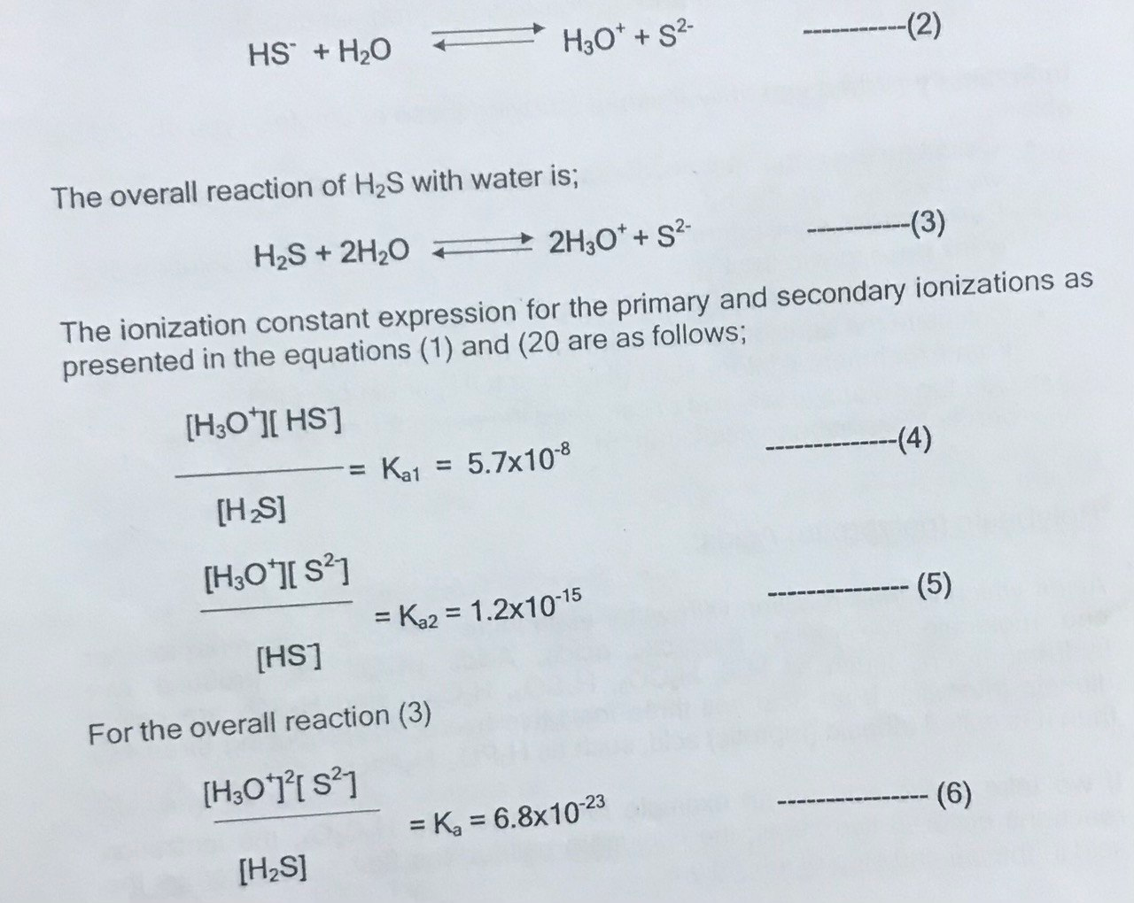
H₂S + H₂O ↔ H₃O⁺ +HS⁻ --------- (1)
The overall ionization constant K_{a} shown in (6) is actually obtained by multiplying the equation (4) and (5)

Slide 45
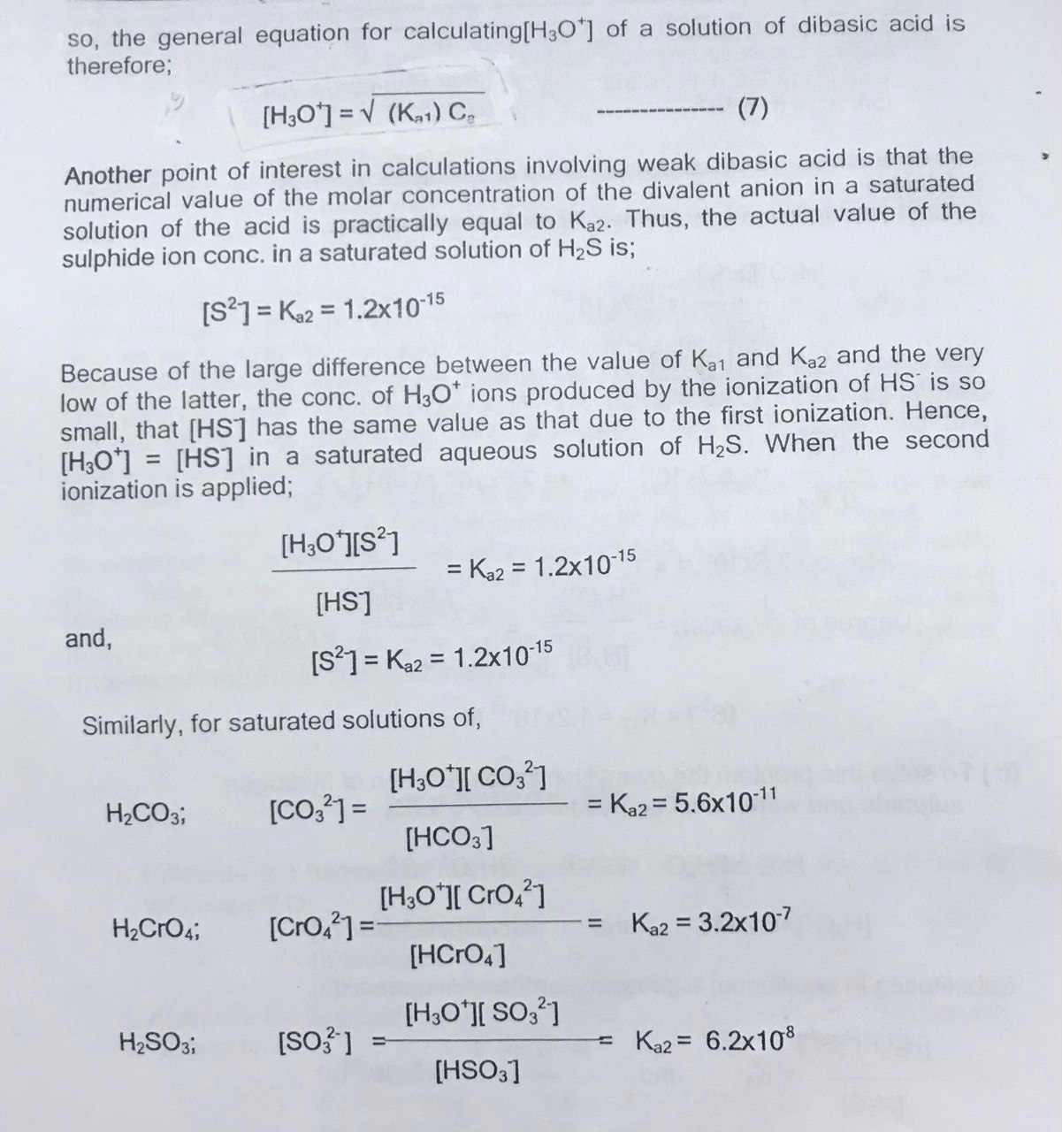
It can be observed that K_{a1} is almost 5x10⁷ times greater than K_{a2} , thus H₂S is a much stronger acid than HS⁻ ion. therefore, the molar concentration of hydronium ion H₂S is calculated as if it is derived from the primary ionization alone .hence equation (4) is applied for calculating [H₃O⁺] when the solution contains only H₂S and H₂O it is obvious, that [H₂S]=[H₃O⁺] and then ----- [H₃O⁺]/ [H₂S] =K_{a1}= 5.7x10⁻⁸

Slide 46
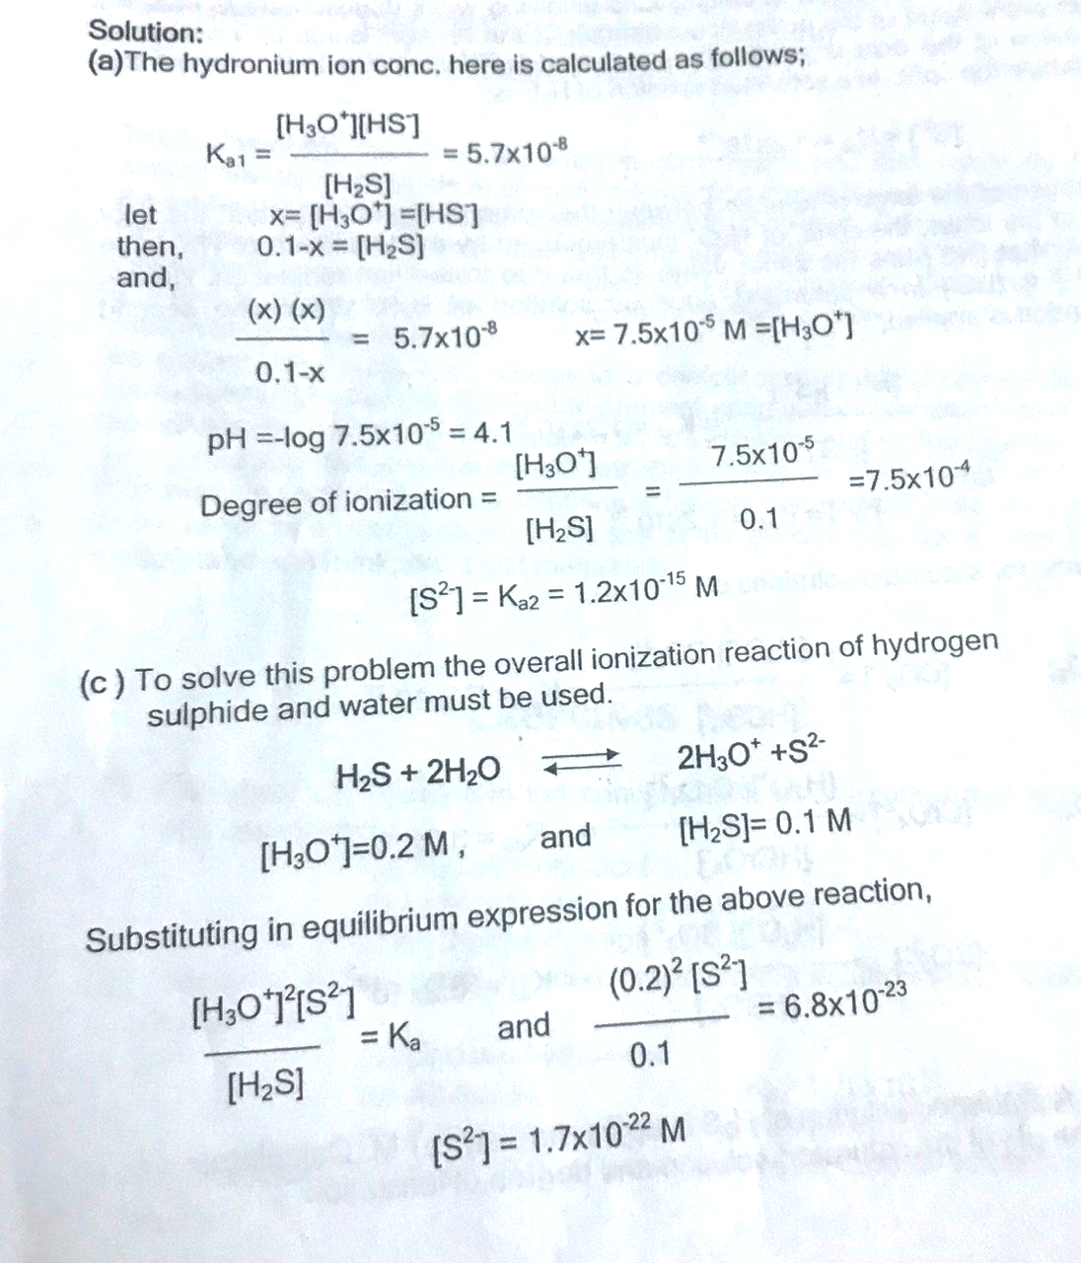
Example: - A saturated solution of H₂S is approximately 0.1M Calculate, a) The pH of the saturated solution and degree of ionization, The sulphide ion concentration of the saturated solution, The sulphide ion concentration of the solution when a strong acid is added to make the solution 0.2Mwith respect to H₃O⁺ ion K_{a1} =5.7x10⁻⁸ , K_{a2}=1.2x10⁻¹⁵

Slide 47
Ionic Strength
The ionic strength $μ$ of a solution is a measure of the electrical intensity due to the presence of ions in the solution(Measure of the total concentration of ions in solution)
It is given by half of the sum of all terms obtained by multiplying the molality of each ion by the square of its valency we have;
Where z₁, z₂, ……. are related to the formal concentration of each ion. and Z₁, Z₂, ……. are the vacancies of the various ions present in the solution.
The unit of ionic strength is either Molar (mol/L solution) or Molal (mol/kg solvent).
As the number of ions in the solution increases, so does the ionic strength of the solution.
Ions with a large charge number have a greater contribution to the ionic strength.
In general, increasing ionic strength increases salt solubility (Opposite of the common ion effect).
Limitation: It applies to solutions containing strong electrolytes ONLY

Slide 49
Example: Calculate the ionic strength of(a) 0.1M solution of KNO₃, (b) 0.1 M Na₂SO₃, and (c) 0.05 M KNO₃ + 0.1M Na₂SO₄
Solution:
(a) For the KNO₃ solution [K⁺]and[NO⁻₃] are 0.1. M and $μ$ =1/2{[K⁺] $×$(-1)² + [NO⁻₃] $×$(-1)²}
=1/2{0.1$× 1$+0.1$×$1}= 0.1 M
(b) For the Na₂SO₄ solution, [Na⁺]=0.2 and [SO₄⁼ = 0.1, Therefore, $μ$ =1/2{[Na⁺] $×$(+1)² + [SO₄⁼] $×$(-2)²}
=1/2{0.2 $×$ 1+0.1$×$4}=0.3M
(c) $μ$ =1/2{[K⁺] $×$(+1)² + [NO⁻₃] $×$(-1)² +[Na⁺] $×$(+1)² + [SO₄⁼] $×$(-2)²}
=1/2{0.05 $×$1²+0.05$×$1²+0.2$×$1²+0.1$×$2²=0.35 M
It is apparent from these examples that for a 1:1 electrolyte (KNO₃), the ionic strength equals the molarity. For any other stoichiometry (such as 2:1 electrolyte Na₂SO₄. ionic strength is greater than the molarity.
If a solution contains three ions: A, B, and C the ionic strength can be expressed as:

Slide 50
Checking Comprehension
Notice that for the simple salt of two monovalent ions, the ionic strength is just the concentration of the salt.

Slide 51
If a solution contains three ions: A, B, and C the ionic strength can be expressed as:

Slide 52
Checking Comprehension

Slide 53
Activity and Activity Coefficients
The effective concentration of ions in solution is expressed with activity and the ideal concentration is described by the activity coefficient($γi)$.
Activity coefficients can be computed from the Debye-Hückel equation:
Where:
$μ$ is related to the ionic strength of the solution , Z indicates the charge on the ion , $α i$s the effective diameter of the hydrated ion in (nm)which can be found from the table.
$γ$ approaches 1 in very dilute solution at which $μ$ approaches 0, (Activity coefficient depends on ionic strength)
The effect of $μ$ on $γ$ is grater for larger z and small $α,$ For example $γ$ Ca⁺² $<$ $γ$ F⁻
$γ$ is always ≤ 1
Note:
The equation valid at 25$℃$ for μ≤ 0.1M.
If μ$>$0.1M it is necessary to experimentally determine $γ,$otherwise use the reference table as an approximation.
Limitation of Debye-Hϋckel Equation
Debye-Hϋckel predicts $γ$decreases as $μ$ increases
- true up to m = 0.10 M
At higher $μ$ , the equation is no longer accurate
- at $μ$ ≥ 0.5 M, most ions actually show an increase in $γ$ with an increase in $μ$
- at higher $μ$, solvent is actually a mixture instead of just water

Slide 54
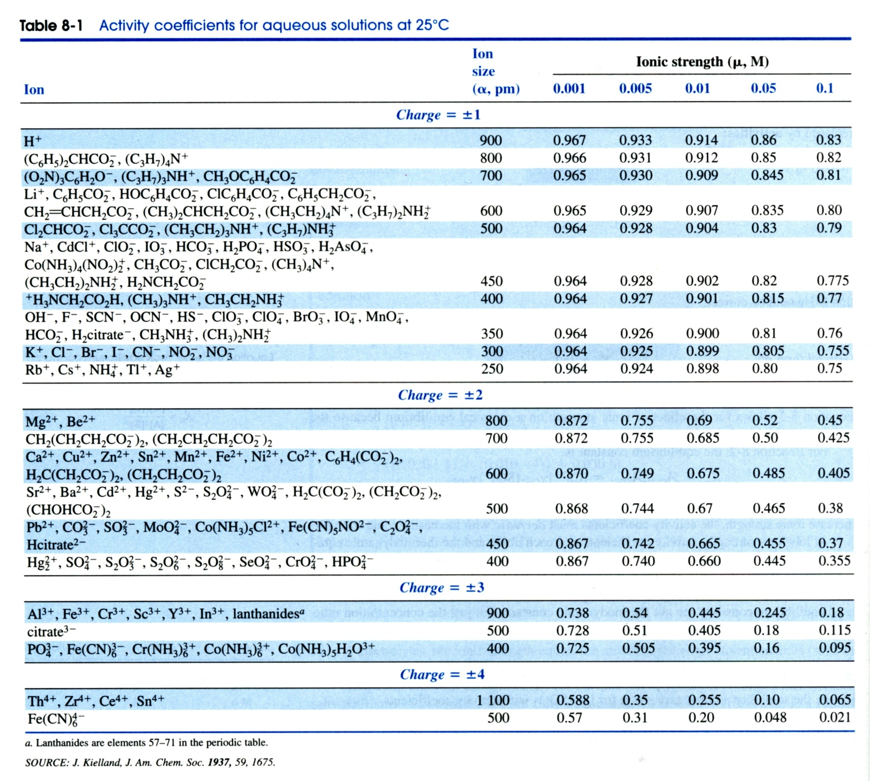

Slide 55
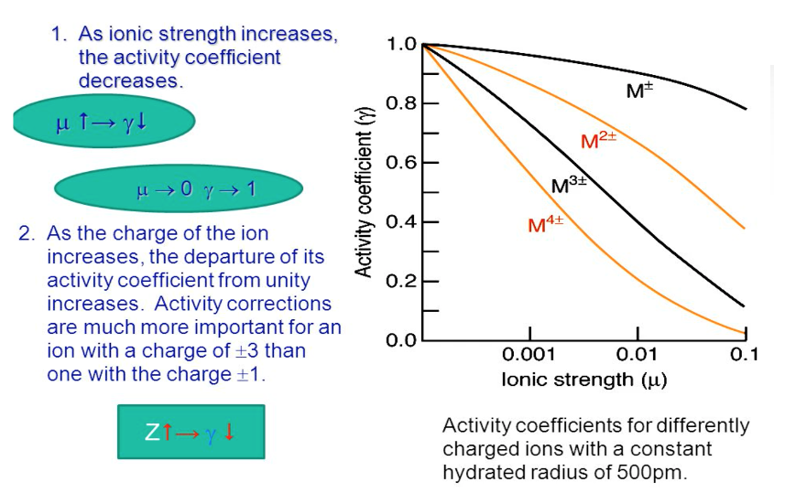
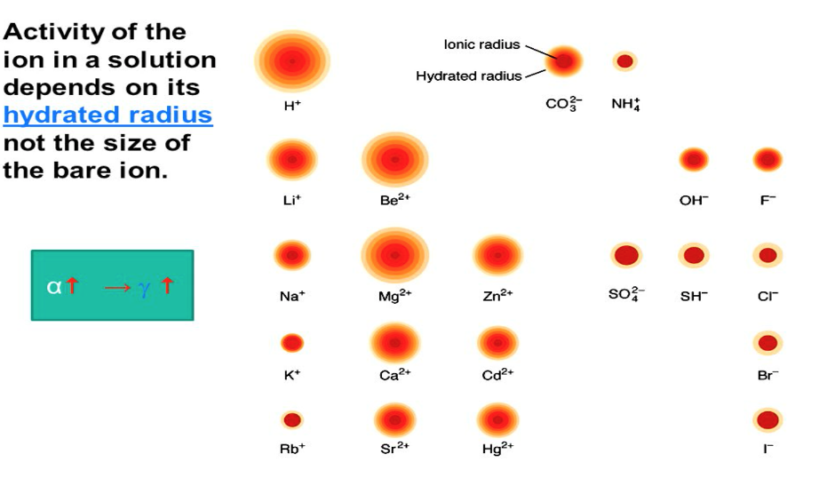

Slide 56
What is the activity coefficient of Hg₂²⁺ in a solution of 0.033 M Hg₂(NO₃)₂?
Solution: Step 1 – Determine $μ$
Solution: Step 2 – Identify the Activity Coefficient from the table at corresponding ionic strength.
γ = 0.355 at μ = 0.10 M

Slide 57
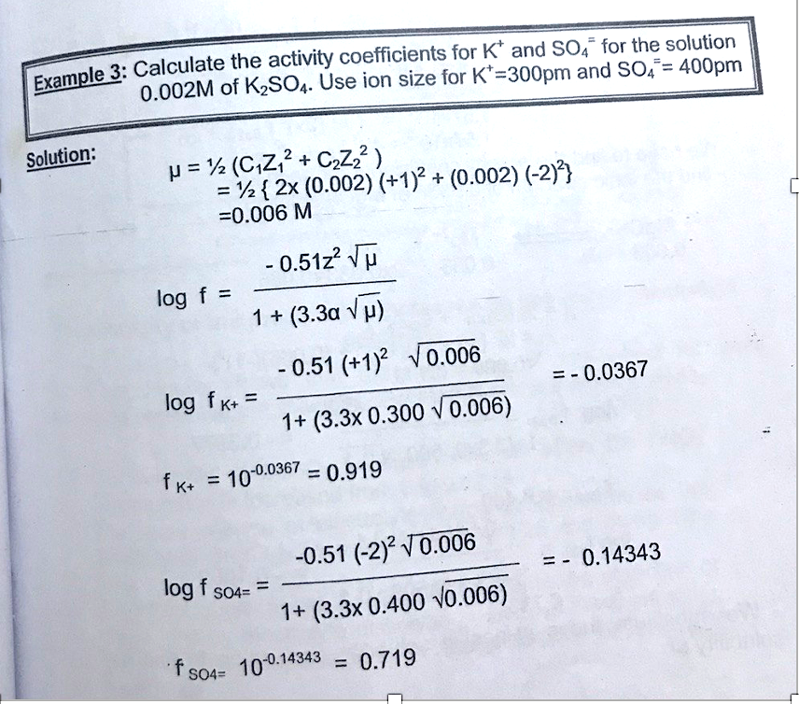

Slide 58
Properties of Activity vs Concentration
For Dilute Solutions (IDEAL SOLUTIONS)
✓ When μ < 0.01 then ϒχ => 1 then ai => [i]
For NON-IDEAL SOLUTIONS
✓ When μ < 0.1 then ϒχ < 1 then ai < [i]
✓ When μ > 0.1 then things get complicated
✓ In general when we try to keep ionic strength
< 0.1 so that we can use concentration instead of activities.

Slide 59
Equilibrium Calculation with Activities

Slide 60
Equilibrium Calculation with Activities

Slide 61
Acids, Bases, and Activity
1.) When we measure pH with a pH meter, we are measuring the negative logarithm of the hydrogen ion activity
Not measuring concentration
2.) Affect of pH with the Addition of a Salt
Changes in ionic strength → Changes H⁺ and OH⁻ activity
Measuring the H⁺ ion concentration impacted by ionic shielding, it is measuring the activity, is the true of the apparent concentration as impacted by non-zero ionic strength, and how many of those hydrogen ions are actually available to be measured is going to be affected well whatever else in the solution. So how do we compute the actual pH of the solution
especially when it's in the presence of another salt that is not contributing H⁺ and OH⁻

Slide 62
Acids, Bases, and Activity
Calculate the pH and [H⁺] in 0.05 M LiNO₃
From the table in slide 55 the activity coefficient at 0.05 M for [H+], [OH-] is $γ$_{H+ = 0.86,}$γ$_{OH- = 0.81}
H₂O $⇌$ H⁺ +OH⁻
I - 0 0
C - +x +x
E - x x
K_{W}= 1x10⁻¹⁴ = [H⁺][OH⁻]. Replaced with activity to get:
1x10⁻¹⁴ = [H⁺]0.86 [OH⁻]0.81
[H⁺] [OH⁻]= $\frac{\text{1}\text{x}\text{10−14}}{\text{0.86} ×\text{0.81}}$ ……… [H⁺] [OH⁻]= 1.4355x10⁻¹⁴
[H⁺] [OH⁻]= X.X …….. [H⁺] [OH⁻]= X²
X² = 1.4355x10^{-14.} (take the root for each side to get)
X=1.19x10⁻⁷
Find the AH+ A_{H+. =} [H⁺]$γ$_{H+}
^{A}_{H+ =} (1.19x10⁻⁷)0.86= 1.02x10⁻⁷ M
pH = -log 1.02x10⁻⁷ = 6.99

Slide 63
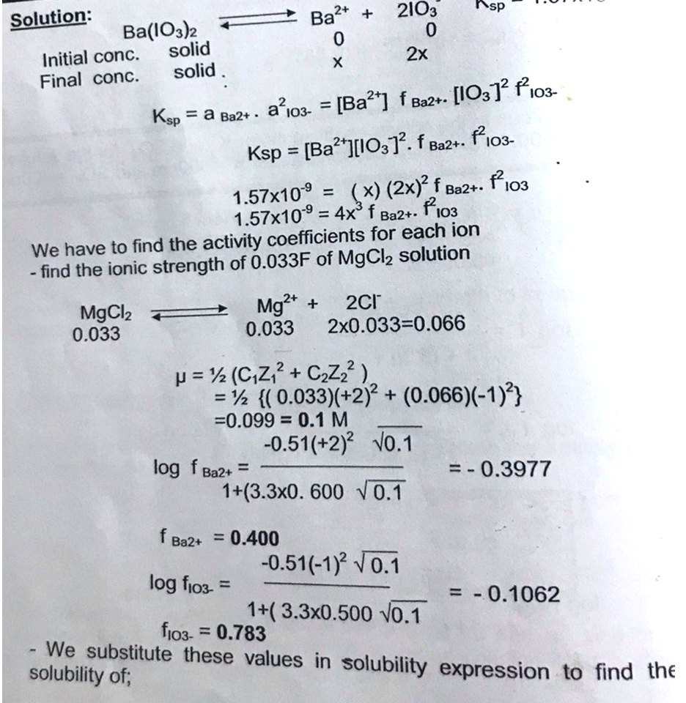
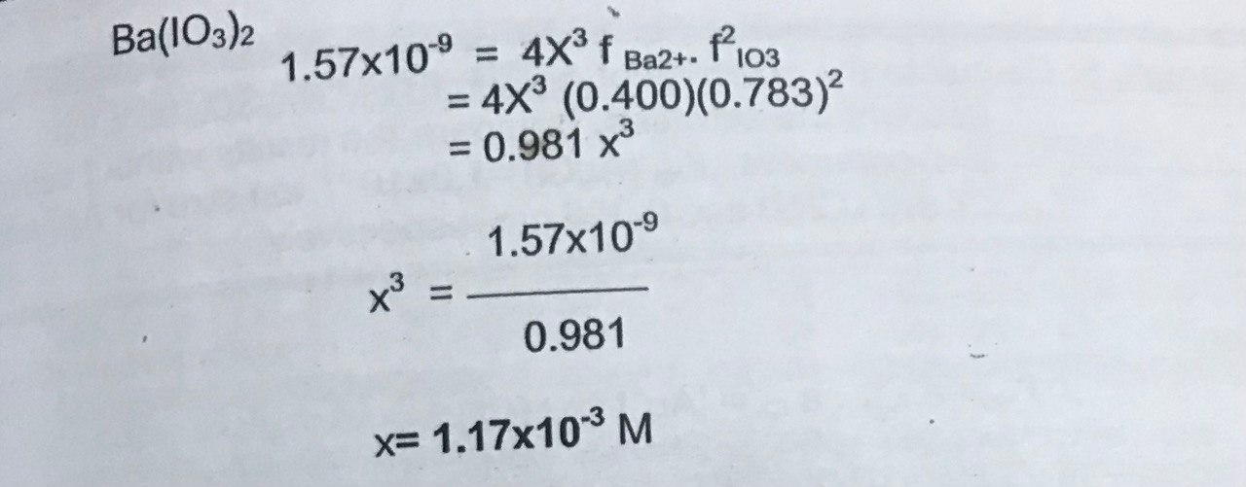
Example: use activities to calculate the solubility of Ba(IO₃)₂ in a solution containing 0.033 M of MgCl₂, Ksp =1.57 $×$10⁻⁹ . use ion size for Ba⁺² =600pm and IO₃⁻=500pm .
Solubility and Activity

Slide 64
Solubility and Activity
What is the molar solubility of AgI (K_{sp}= 8.3 x10⁻¹⁷)in the presence of 0.05 M KNO₃?
AgI $⇌$ Ag⁺ + I⁻
I - 0 0
C - -x -x
E - x x
K_{sp} =[Ag⁺][I⁻], replace the concentration by activity to get:
K_{sp} =A_{Ag+} A _{I-} , K_{sp}= [Ag⁺] $γ$_{Ag+}[I⁻] $γ$_{I-}
solving for ionic strength:
$μ$ =1/2{[K⁺] $×$(+1)² + [NO⁻₃] $×$(-1)²
$μ$ =1/2{(0.05)+ $×$(0.05)⁼ 0.05
From the table in slide 55 the activity coefficient at 0.05 M for [Ag⁺], [I⁻] is $γ$_{Ag+ = 0.80,}$γ$_{I}⁻ _{= 0.805}
K_{sp}= [Ag⁺] $γ$_{Ag+}[I⁻] $γ$_{I-}
K_{sp}= [X] $γ$_{Ag+}[X] $γ$_{I-}
K_{sp}= [X] 0.80[X] 0.805, 8.3 x10⁻¹⁷ = 0.644 $× X$²
$X$² = $\frac{\text{8.3} \text{x}\text{10−17}}{\text{0}\text{.6}\text{44}}$ . (take the root for each side to get)
X=1.14x10⁻⁸

Slide 65
Hydrolysis of Salt and the pH Calculation
The process of salt reacting with water to produce an acidic, basic, or neutral solution is called hydrolysis
The amphoteric property of water makes possible the reaction of water as:
A weak acid with salts of strong bases.
A weak base with salts of strong acids.
However, the solution may be tested acidic, basic, or neutral depending upon the hydrolysis of the dissolved salt.
Hydrolysis is the reaction between water and the negative or positive ion of the salt. the hydrolysis of salt plays an important role in acid-base titrations since only the salt formed should be present at the endpoint, and the production of the salt solution established at the endpoint titration the proper indicator for each particular acid-base titration can be chosen.
Salt that can react with water are classified as follows:
Salts of strong acids and strong bases (salts whose ions are aprotic )
e.g. NaCl. KNO₃, KClO₄, RbCl
Salts of weak acids and strong bases (salts whose anions are basic )
KCN, CH₃COONa, Na₂CO₃, and Na₂S
Salts of strong acids and weak bases (salts whose cations are acidic )
e.g NH₄Cl, NH₄CN, CH₃COONH₄
Salts of weak acids and weak acids and weak bases (salts whose anions are basic, and whose cation are acidic) , e.g.: NH₄CN,CH₃COONH₄

Slide 66
Hydrolysis of Salts of Strong Acids and Strong Bases
Salts are ionic compounds. When they dissolve in water they dissociate 100% producing free aqueous ions.
When both ions come from strong acids and bases, they have no interactions with the ions formed by the dissociation of water (hydrogen and hydroxide ions), however, if the ions come from weak acids and bases, then they interact with the ions from water establishing equilibria. For example sodium chloride salt.
K⁺ +NO⁻₃+ 2H₂O$→$ K⁺ + NO⁻₃ + H₃O⁺ + OH⁻
It can be seen that no hydrolysis is taking place between ions of salts of strong acid and strong bases, and water.
If mass action law is applied, the only equilibrium that can be set up is that of water. The spectator ions can be canceled from both sides of the equation.
2H₂O$→$ H₃O⁺ + OH⁻
[H₃O⁺][OH⁻]=K_{W}=1$×$10⁻¹⁴ at 25$℃$
[H₃O⁺]= [OH⁻]= K_{W}=1$×$10⁻¹⁴ = 1$×$10⁻⁷
pH=7

Slide 67
Hydrolysis of Salts of Weak Acid and Strong Base
Salts of ethanoic acid produce free ethanoate ions in solution that can interact with the hydrogen ions from the water. The ethanoate ions set up an equilibrium producing ethanoic acid molecules by absorbing free hydrogen ions from the water. This affects the overall pH of the solution. Example: Sodium ethanoate solution - CH₃COOH(aq) Sodium ethanoate is 100% dissociated into ions:-
Sodium ions do not interact with the water ions. They remain free in the solution. However, the ethanoate ions do interact with the hydrogen ions from the water equilibrium.
We know that this last equilibrium lies to the side of the ethanoic acid (to the right), removing the hydrogen ions from the solution. As [H⁺] decreases, the pH rises. Hence a solution of sodium ethanoate has a pH greater than 7. We say that sodium ethanoate is basic by hydrolysis.
The anions of this type of salt are Monotropic such as CN^{- ,} Ditropic such as CO₃⁻² , Triprotic such as PO₃⁻³
Consider the reaction of the sodium salt of hydrogen cyanide with water, which can be presented as follows:
NaCN $→$Na⁺ + CN⁻
Na+ ion can neither gain nor lose a proton, but the anion CN⁻ is base (proton acceptor), thus taking up a proton from water leaving a hydroxide ion in the solution. Thus, the basicity of NaCN solution in water is due to this formation of OH⁻ ions pH>7): CN⁻ +HOH $⇄$ HCN+ OH⁻ ……….hydorlysis, Applying the equilibrium expression for this reaction we get:
$\frac{\left[HCN\right][OH−]}{\left[CN−\right][H2O]}$⁼ K_{e}…………..(1)
Where K_{e} is the equilibrium constant for hydrolysis reaction, and K_{h} is the hydrolysis constant, $\frac{\left[HCN\right][OH−]}{\left[CN−\right]}$⁼ K_{e} [H₂O]=K_{h}…………..(2)
Where K_{e} is the equilibrium constant for the hydroysis reaction and K_{h} is the hydrolysis constsnt.
Subsituting Kw/[H₃O⁺] For [OH⁻] in equation 2 to get, $\frac{\left[HCN\right][Kw]}{\left[CN−\right][H3O+]}$⁼ K_{h}……………………(3), since $\frac{\left[HCN\right]}{\left[CN−\right][H3O+]}$⁼$\frac{1}{Ka}$

Slide 68
Where K_{a} is the ionization of constant of HCN, then,
$\frac{\left[HCN\right][Kw]}{\left[CN−\right][H3O+]}= \frac{Kw}{Ka}$ = K_{h}…………..(4)
When the ratio K_{w}/K_{a} is subsitiuted in equation (2) we obtain:
$\frac{\left[HCN\right][OH−]}{\left[CN−\right]}= \frac{Kw}{Ka}$ = K_{h}…………..(5)
In the hydrolysis reaction [HCN]=[OH] ,and assuming complete ionization of NaCN and the conversion of CN⁻ to HCN is relatively small , the molar conc. of CN⁻ ion well approximately be the same as that of salt: so that [CN⁻]=C_{S} where Cs is the conc. of the salt in mol/L
$\frac{ \left[OH−\right]2}{Cs}= \frac{Kw}{Ka }$ ^{= ………………….} (6)
[OH⁻]²= $\frac{Kw Cs}{Ka}$……………(7)
Converting [OH⁻] to K_{w}/[H₃O⁺] gives:
$\frac{\left(Kw\right)2}{\left[H3O−\right]2}$ = $\frac{Kw Cs}{ Ka }$ and [H₃O⁺]= $\sqrt{\frac{KwKa}{Cs}}$………………(8)
pH= -log[H₃O⁺]= ½(-log $\frac{KwKa}{Cs}$ )
pH= ½ (-log $Kw −$ log $Ka$ +log $Cs$)
pH= ½ (pK_{w}+pK_{a}+log $Cs$)…………….(9)
Calculation of the hydronium ion concertation.
Calculation of pH of the salt solution

Slide 69
The degree of hydrolysis of a salt whose anion is base is calculated from equation (7).
Degree of hydrolysis= $\frac{ \left[OH−\right]}{Cs}$, and Percent hydrolysis= $\frac{ \left[OH−\right]}{Cs} ×$100
Equation (8) will be applied from which the value [OH⁻] will be driven for the purpose of calculating the degree of hydrolysis.
[H₃O⁺]= $\sqrt{\frac{KwKa}{Cs}}$ = $\sqrt{\frac{(1×10−14)(1.8 ×10−5)}{0.030}}.$[H₃O⁺]= 2.45 $×$10⁻⁹ M
pH= -log[H₃O⁺]= -log (2.45 $×$10⁻⁹)=9-0.389=8.6
pOH=14-pH=14-8.6=5.4
[OH⁻]=10-5.4=4.1 $×$10⁻⁵ M
The Degree of hydrolysis= $\frac{ \left[OH−\right]}{Cs}$ = $\frac{\text{4.1} ×\text{10}\text{−5}}{0.030}$ = 1.4 $×$10^{-4,} we can also determine [OH⁻] directly from equation(7)
Example: What is the pH and percent hydrolysis of 0.3M Na₂CO₃ solution 24 ml of which were diluted with water to give
100 ml? Ka =5.6x10⁻¹¹
Calculation the Degree of hydrolysis and the Percent of hydrolysis

Slide 70
Hydrolysis of Salt of Strong Acids and Weak Bases
Ammonium chloride is a classic example of a salt formed by a strong acid (hydrochloric acid ) and a weak base (ammonia).
When it is dissolved in water the ammonium ions interact with the free hydroxide ions from water, creating ammonia and water molecules.
The effect is the removal of hydroxide ions, which must be compensated for by increasing the hydrogen ion content of the solution to keep K_{w} unchanged. Example: Ammonium chloride solution, NH₄Cl, Ammonium chloride dissociates 100% into ions in solution.
The ammonium ions interact with the hydroxide ions from the water removing them from the solution (equilibrium lies to the right).
This increases the concentration of hydrogen ions (as [H⁺] x [OH⁻] is constant) increasing the acidity of the solution (decreasing pH)
We say that a solution of ammonium chloride is acidic by hydrolysis.
Hydrate cations , such as Al(H₂O)₆⁺³ ,CR(H₂O)₆⁺³,Fe(H₂O)₆⁺³ and Zn(H₂O)₆⁺²
Hydrolysis of Unhydrated Cations
NH₄Cl is composed of the aprotic chloride and proton doner NH4+ in water solution the NH4+ donates a proton to water the hydrolysis reaction therefore is: NH⁴⁺ +H₂O$→$ NH₃+H₃O⁺
The formation of H₃O⁺ contributes to the acidity of the aqueous solution of ammonium chloride(pH$<7)$
By the application of the mass action law to the above equation we obtain:
$\frac{ \left[\text{NH}\text{3}\right][\text{H}\text{3}\text{O}\text{+ }]}{\left[\text{NH}\text{4+}\right][\text{H}\text{2}\text{O}]}$ = K_{e} ……….(10) $\frac{ \left[\text{NH}\text{3}\right][\text{H}\text{3}\text{O}\text{+ }]}{\left[\text{NH}\text{4+}\right]}$ = K_{e}[H₂O]=K_{h}……………(11)
Substituting of K_{w}/[OH⁻] for [H₃O⁺] in equation (10) we get: $\frac{ \left[\text{NH}\text{3}\right][\text{K}\text{w}]}{\left[\text{NH}\text{4+}\right][\text{OH}\text{−}]}$ = K_{h}……………….(12)
But since, $\frac{ \left[\text{NH}\text{3}\right]}{\left[\text{NH}\text{4+}\right][\text{OH}\text{−}]}$ = $\frac{ 1}{\text{K}\text{b}}$ , then ; $\frac{ \left[\text{NH}\text{3}\right][\text{K}\text{w}]}{\left[\text{NH}\text{4+}\right][\text{OH}\text{−}]}$ = $\frac{ \text{K}\text{w}}{\text{K}\text{b}}$= K_{h}………………..(13)

Slide 71
And $\frac{ \left[\text{NH}\text{3}\right][\text{H}\text{3}\text{O}\text{+ }]}{\left[\text{NH}\text{4+}\right]}$= $\frac{ \text{K}\text{w}}{\text{K}\text{b}}$……………(14)
In the hydrolysis of NH⁴⁺ ion one mole of H₃O⁺ and one mole of NH₃ molecule are formed thus [NH₃]=H₃O⁺] and equation (14) can be changed into:
$\frac{ \left[\text{H}\text{3}\text{O}\text{+}\right]2}{\left[\text{NH}\text{4+}\right]}$= $\frac{ \text{K}\text{w}}{\text{K}\text{b}}$…………….(15)
Because of the complete ionazation of NH₄Cl and because the conversion of NH⁴⁺ yo NH₃ is relatively small the molar concentration of the NH⁴⁺ will approximatly be the same as the that of NH₄Cl designated C_{s} that is to say C_{s}-[H₃O⁺] is very close to C_{s} as illustrated below:
NH⁴⁺ + H₂O $→$NH₃ + H₃O⁺
C_{s}-[H₃O⁺] [H₃O⁺] [H₃O⁺]
Equation(16) now becomes: $\frac{\left[\text{H}\text{3}\text{O}\text{+}\right]2}{Cs}= \frac{ \text{K}\text{w}}{\text{K}\text{b}}$ this may be converted into: [H₃O⁺]= $\sqrt{\frac{kw Cs}{ K\text{b}}}$………………(16)
Hence, pH= ½ (pK_{w} – pK_{b} - log $Cs$)…………….(17)
Percent of hydrolysis= $\frac{ \left[\text{H}\text{3}\text{O}\text{+}\right]}{Cs} ×$100
Calculation of the hydronium ion concertation.
Calculation of pH of the salt solution
Calculation of the Percent of hydrolysis

Slide 72
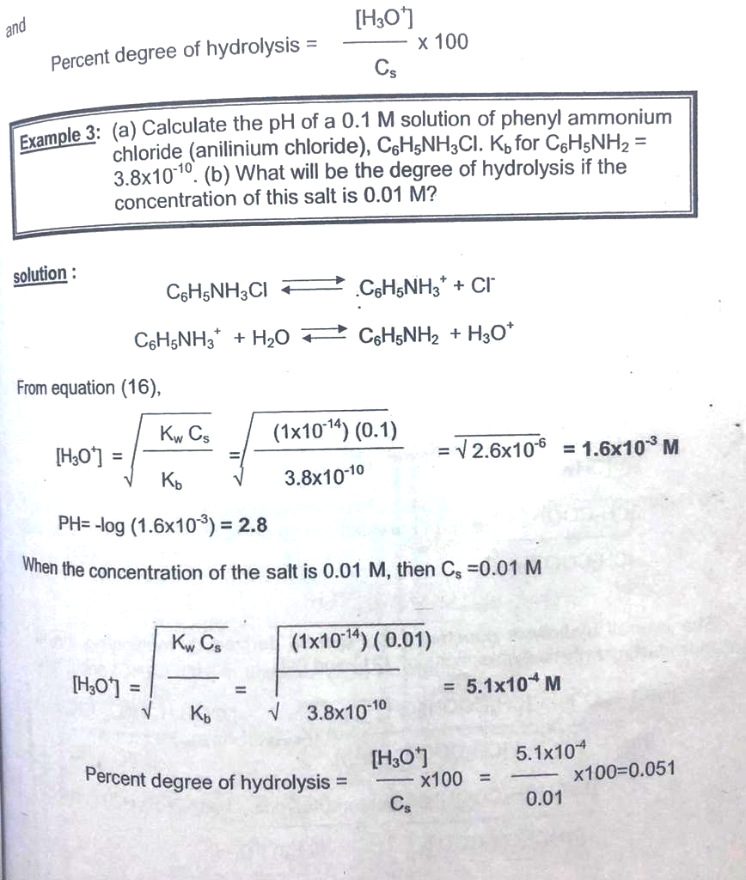

Slide 73
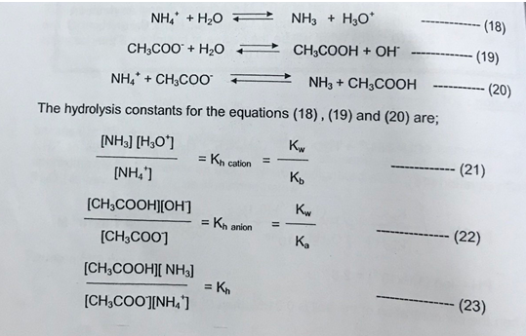
Hydrolysis of Salts Weak Acid and Weak Bases
The cations of this type of salt are acidic acid while anions are basic. Thus both ions undergo reactions.
When ammonium acetate is dissolved in water, the NH₄⁺ ion and CH₃COO⁻ ion will react with water.
The overall hydrolysis constant (K_{h}) can be dissolved by multiplying the two individual hydrolysis expressions of 21 and 22
Multiplying both sides by 1/K_{w} to get the equation 24

Slide 74
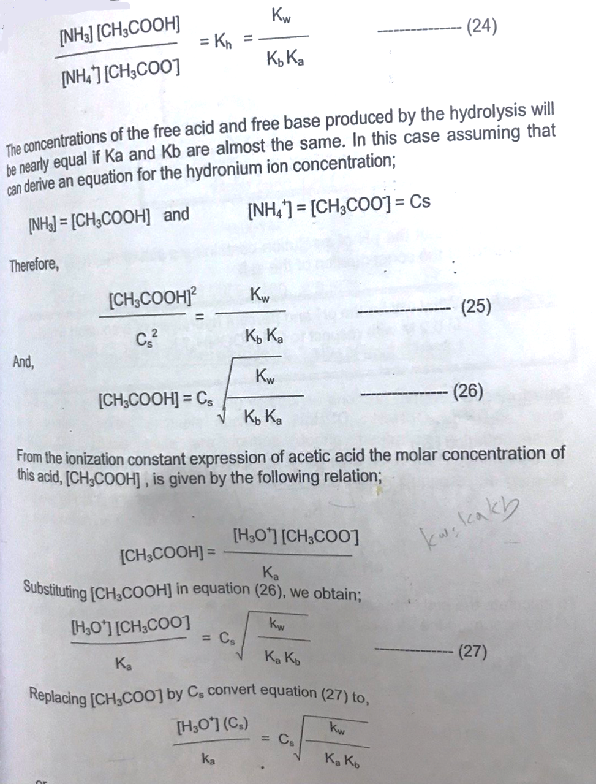

Slide 75
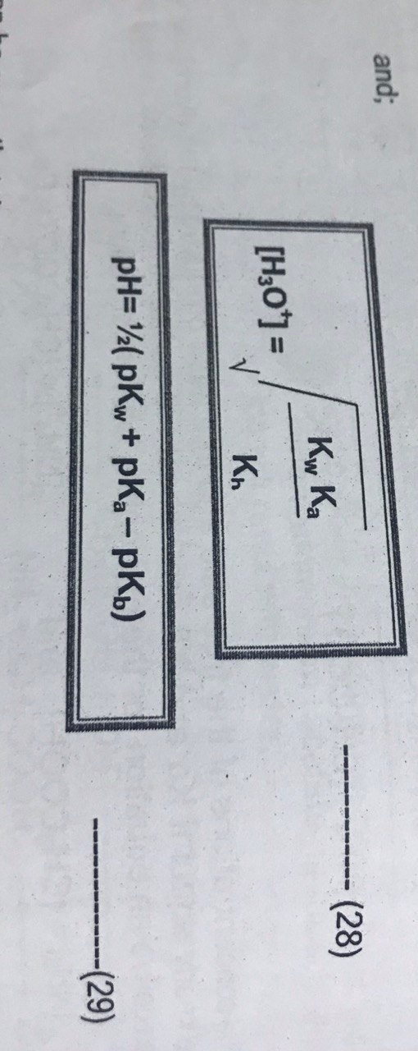
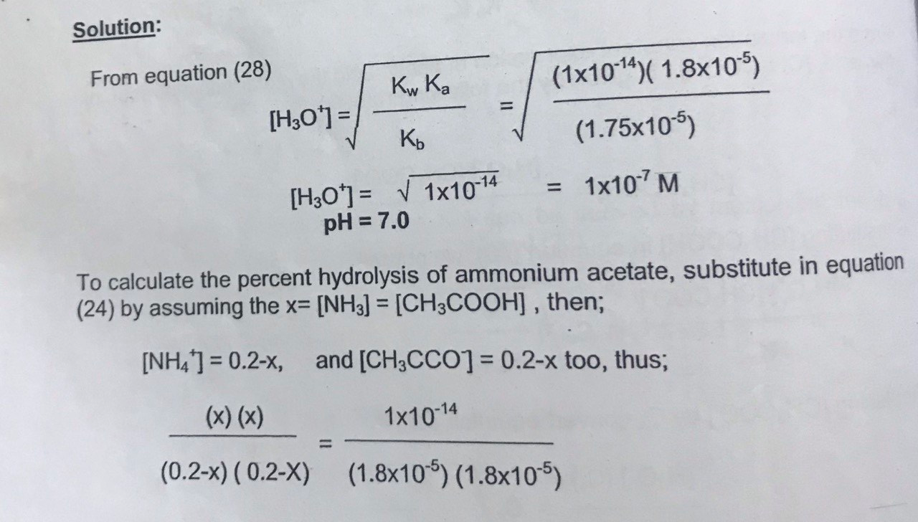
Calculation of the hydronium ion concertation.
Calculation of pH of the salt solution
It can be seen that the pH of a solution containing a salt of this type in water is independent of the concertation of the salt
Example: - What will be the pH and percent hydrolysis of a solution that is 0.2 M concerning CH₃COONH₄?
K_{a} (CH₃CCOOH) = 1.8 X10⁻⁵, and K_{b}(NH₄) =1.75x10⁻⁵
(1.75$×$ 10⁻⁵ )

Slide 76
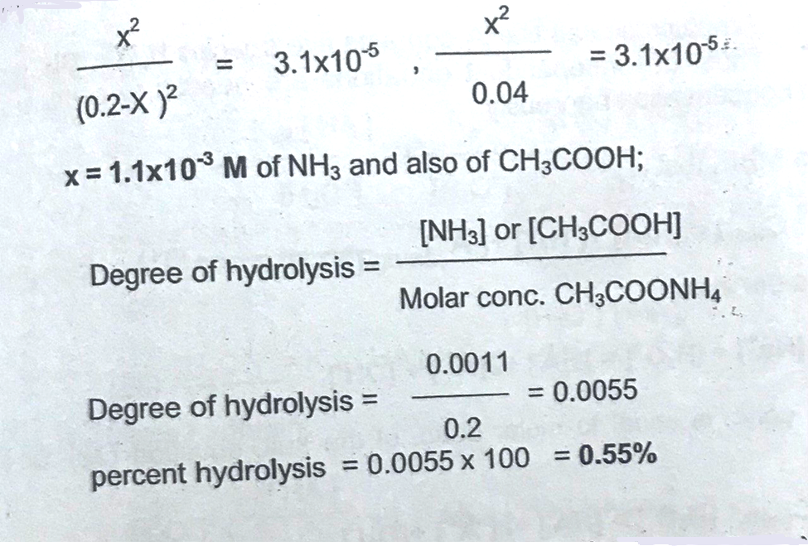

Slide 78
Checking Comprehension
1-Calculate pH of a sodium acetate solution at concentration of 0.01 M (pK_{a} of sodium acetate is 4.8)
Solution:
pH= ½ (pK_{w}+pK_{a}+log $Cs$)= ½(14+4.8+log 0.01)= ½(18.8-2)= 8.4
2-Calculate pH of ammonium chloride solution at concentration of 0.1 M (pK_{b} of ammonia is 4.75)
Solution:
pH= ½ (pK_{w}+pK_{b}-l og $Cs$)= ½(14+4.75+log 0.1)= ½(9.25+1)= 5.12
3- Calculate pH of ammonium acetate solution at concentrations of 0.1 M and 0.01 M(pK_{a} =4.8 pK_{b} =4.75)
Solution:
pH= ½ (pK_{w}+ pK_{a} - pK_{b})= ½(14+4.8- 4.75)= ½(14.05)= 7.03

Slide 79
Reaction of Amphiprotic Salt (acid salts)
Amphiprotic or acid salts are strong electrolyte and can behave as both acids and bases. Typical examples such as: NaHCO₃, NaHSO₄, KH₂CO_{4 ,} and KHC₈H₄O₄.
These salts are formed during neutralization titration of polyfunctional acid bases.
The pH of salt solutions is determined by two equilibria between for example HCO₃⁻ and water suppose the general formula of the salt is NaH. The solution is acidic because of
Where K_{a1}and K_{a2} are the acid dissociation constant for H₂A and K_{b2} is the basic dissociation constant for HA⁻ .if K_{b2} is greater than K_{a1} the solution, the solution is basic: otherwise, it is acidic.
A solution of the amphiprotic salt NaHA contains five species H₃O⁺, OH⁻,H₃A ,HA⁻, and A⁻² .
The five indented equations are needed to compute the hydronium ion concertation rigorously

