Slide 1
Assay of phenol
2022-2023

Slide 2
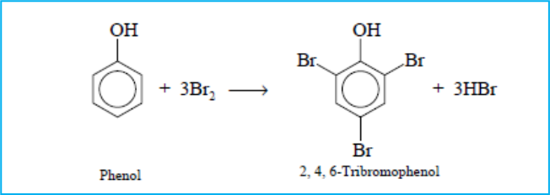
Phenol assay depends on the principle of reaction between phenol(brown) and bromine water to give tribromophenol (white ppt)

Slide 3
A back titration is done which is a titration method where the concentration of an analyte is determined by reacting it with a known amount of excess reagent. The remaining excess reagent is then titrated with another, second reagent.

Slide 4
Assay of phenol
Br2 solution, ( Koppeschaar’s solution ), is produced by mixing potassium bromate, KBrO3, (1º std. soln. ) with an excess of potassium bromide, KBr, in acidified solutions.

Slide 5
Assay of phenol
Using bromometric method which is a general method for all phenolic compounds for example, phenol.
Phenols are assayed by using an excess of a standard solution of bromine (composed of KBr and KBrO3)
The bromine is liberated after the addition of conc. HCl and the determination the excess unreacted bromine using potassium iodide (KI) and standard solution of sodium thiosulfate (Na₂S₂O₃)

Slide 6
Assay of phenol
First phenol reacts with bromine to form a white ppt. of 2,4,6-tribromophenol.

Slide 7
Assay of phenol

Slide 8
Assay of phenol
After the addition of KI, 5-10 ml of chloroform is added to dissolve the ppt. of tribromophenol which would otherwise interfere with clear observation of the end point, especially in the assay of old colored phenol.
A blank determination is always performed simultaneously to account for the losses caused by the bromine as well as iodine vapors due to the interaction of excess bromine on potassium iodide.

Slide 9
Assay of phenol
Calculation of chemical factor:
2 mole of Na₂S₂O₃ = 1mole of I₂ = 1 mole of Br₂
So 6 mole of Na₂S₂O₃ = 3mole of I₂ = 3 mole of Br₂= 1 mole of phenol
6 eq. wt. of Na₂S₂O₃ = 6 eq. wt. I₂ = 6 eq. wt. of Br₂=1 eq. wt. of phenol
6 × 1000 ml of 1 N Br₂ = 94.11 gm of phenol
6000 ml of 0.1 N Br₂ = 9.411 gm of phenol
1 ml of 0.1 N Br₂ = 9.411/6000 = 0.001569 gm phenol.

Slide 10
Assay of phenol
Procedure:
By bulb pipette withdraw 25 ml exactly of unknown and placed in iodine flask (500ml stoppered flask)
Add 50ml of standard o.1 N Br₂ solution from burette on the side to the iodine flask.
Add 5ml conc. HCl and stopper immediately.
Shake for 15 minute then allow standing in dark place for 15 minute.
Add 5ml KI solution (20%) ,stopper and shake well.
Remove the stopper; wash it and the sides of the flask by D.W.
Add 5ml chloroform and shake to dissolve the ppt. then titrate with 0.1 N Na₂S₂O₃ with shaking till pale yellow, then add starch mucilage (1ml) blue continuo titrate till discharge of blue color (colorless).

Slide 11
Assay of phenol
V1 =ml utilized by I₂ with Na₂S₂O₃ which represent excess of Br₂ .
This volume should be corrected to 0.1 N
N₁. V₁ = N₂.V₂
= 0.1 ×V₂
50 ml is the volume of total bromine solution of 0.1N or it is corrected.
50 – V₂ = V₃ ml of Na₂S₂O₃ which represent volume of Br₂ reacted with phenol
V₃ × chemical factor = gm phenol/25 ml
0.001519

