Slide 1
Advanced pharmaceutical analysis
Using instruments

Slide 2
Instrumental analysis
The use of spectrophotometer for the analysis of compounds which is divided into qualitative (what are they?) and quantitative (how much is there?),i.e. concentration or quantity.

Slide 3
Introduction
Atoms and molecules show the ability for absorption of energy in the form of electromagnetic radiation.
The type and quantity of the absorbed energy depends on
The chemical structure of these molecules.
The quantity of the absorbed energy depends on the number of the molecules absorbing this radiation.

Slide 4
Electromagnetic radiation
Electromagnetic radiation: is a term applied to the energy diffused in the form of waves.
Electromagnetic spectrum: is composed of wide range of radiation frequencies. It is possible to divide the spectrum into the following regions according to the wave length, energy, frequency, and the nature of interaction between the molecules and radiation (ionization, excitation, or vibration).

Slide 5
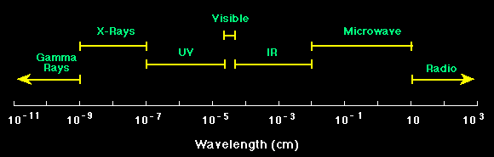
Electromagnetic spectrum

Slide 6
Electromagnetic spectrum
Cosmic rays (highest energy, highest frequency, and shortest wave length)
ᴽ- rays
X-rays
UV-rays
Visible rays
IR-rays
Micro waves
Radio waves (lowest energy, lowest frequency, and longest wave length)

Slide 7

Definitions
Wavelength is defined as the distance between adjacent peaks (or troughs), and may be designated in meters, centimeters or nanometers (10⁻⁹ meters).
(1mμ= 10A= 10⁻⁷ cm).(1 meter=10000000000A)
Frequency is the number of wave cycles that travel past a fixed point per unit of time, and is usually given in cycles per second, or hertz (Hz).

Slide 8
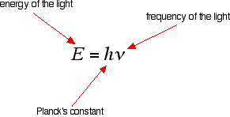
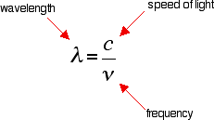
Definitions
The greater the frequency, the greater the energy is.
The higher the frequency, the lower the wavelength is.

Slide 9
UV-Visible Spectroscopy
It involves absorption within UV region 200-400 nm (for colorless solutions) and visible region 400-800 nm (for colored solutions).

Slide 10
The principle
For absorption to occur within this region of spectrum the compounds should be conjugated systems or aromatic compounds while saturated hydrocarbons show no absorption in this region so they can be used as solvents e.g. cyclohexane, n- hexane.
Some inorganic species are colored and show absorption within the visible region e.g. chromic nitrate.
Absorption spectra in the ultraviolet and visible regions are due to energy transitions of both bonding and nonbonding outer electrons of the molecule.

Slide 11
The principle
An electron is excited from a full orbital (low energy ground state orbital) into an empty anti-bonding orbital (high energy excited state orbital). Each jump takes energy from the light, and a big jump obviously needs more energy than a small one. Each wavelength of light has a particular energy associated with it.

Slide 12
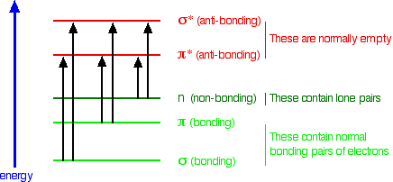
The principle

Slide 13
The principle
Electrons in σ bonds (a single covalent bond) are tightly bound and radiation of high energy (short wave length) is needed to excite them.
Certain atoms like N, O, and halogens have non bonding electrons (lone pair) that are less tightly bound than the previous and can be excited at a lower energy (longer wave length) radiation.
Electrons in double or triple bonds (π electrons) are easy to be excited (loosely bound) and in compounds that contain series of alternating double bonds (conjugated systems), the π electrons are delocalized due to resonance and require less energy for excitation (longer wave length).

Slide 14
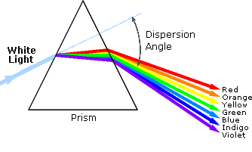
Visible light
White light is a combination of lights of different wavelengths in the visible spectrum. Passing white light through a prism splits it up into the several colors of light observed in the visible spectrum between 400 nm and 780 nm.

Slide 15
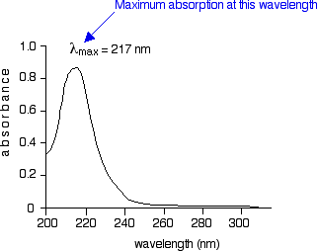
Absorption spectrum
It is a spectrum of absorbance versus wave length or transmittance versus wave length.
An example of simple UV-visible absorption spectrum for buta-1,3-diene is shown below. Absorbance (on the vertical axis) is just a measure of the amount of light absorbed. The higher the value, the more of a particular wavelength is being absorbed.

Slide 16
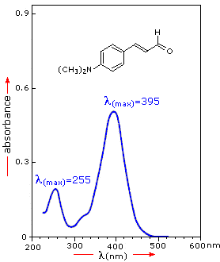
Definitions
Lambda max (ʎ max): is the wave length at which maximum absorption occurs (%T is minimum).
While ʎ min is the wave length at which minimum absorption occurs (%T is maximum).
Some compounds show more than one ʎ max.

Slide 17
Instrument parts
Light source: deuterium lamp (UV light), or tungsten lamp (visible).
Monochromator: allow the passage of light in certain selected wave length and neglecting the other unwanted wave lengths (using wave control knob).
Sample compartment: accommodate the sample (inside the cuvette) to be exposed to the monochromatic light.
Detector: responsible for converting light signals (transmitted) to electrical signals.
Microprocessor: translate the electrical signals to digital signals.
Displayer: display the digital signals on screen (A or %T).

Slide 18
Definitions
Cuvette: either quartz (UV) or glass (visible).
The use of scratched or contaminated cuvettes should be avoided since they reflect and/or absorb radiation that will give you inaccurate measurements. Also, bubbles, turbidity, fingerprints, should be avoided since they will diminish the accuracy of readings. The cuvettes commonly used for accurate work have an optical path length of 1 cm and require 2.5 to 3 ml of sample for all accurate reading.
Blank: the medium in which the substance being measured is located may itself absorb light of certain wave length so in order to measure the absorbance due to only a particular species in solution, zeroing is needed, in which the blank is added in the light path and the light control knob is rotated until read 100%T (A=0).

Slide 19
Operating procedure:
Open the spectrometer and allow standing for 20 minutes (warming).
Set the wavelength dial on the spectrophotometer to the lambda required. With the sample chamber is occupied with a block(black or opaque cell), this means no transmission(as in case of setting the instrument).
Place your reference blank into the sample compartment until reads 100% T (A=0).
The sample is added now and the A or %T is recorded.
Whenever a change in wave length is made the 0A and 100%T must then be reset since the amount of compensation varies with the wave length.

Slide 20
The purposes
Qualitative
Determine the absorption spectrum of unknown compounds (qualitative analysis).
Determine the λ_{max} of a compound.
Quantitative
3. Determine the concentration of a compound in solution using Beer-Lambert ́s Law .

Slide 21
Determination of the absorption spectrum of 0.02M chromic nitrate solution Cr (NO₃)₃ (qualitative analysis)
By gradual scanning along wide range of wave lengths then reading A and %T
Plot your data on graph paper (plot absorbance (A) on the y-axis as a function of wavelength (λ) on the x-axis).
Plot %T on the y-axis as a function of wavelength (λ) on the x-axis.
Establish the λ_{max} and the λ _{min} of the sample.

Slide 22
Wave length | Absorbance(A) | Transmittance %

